Slide 1

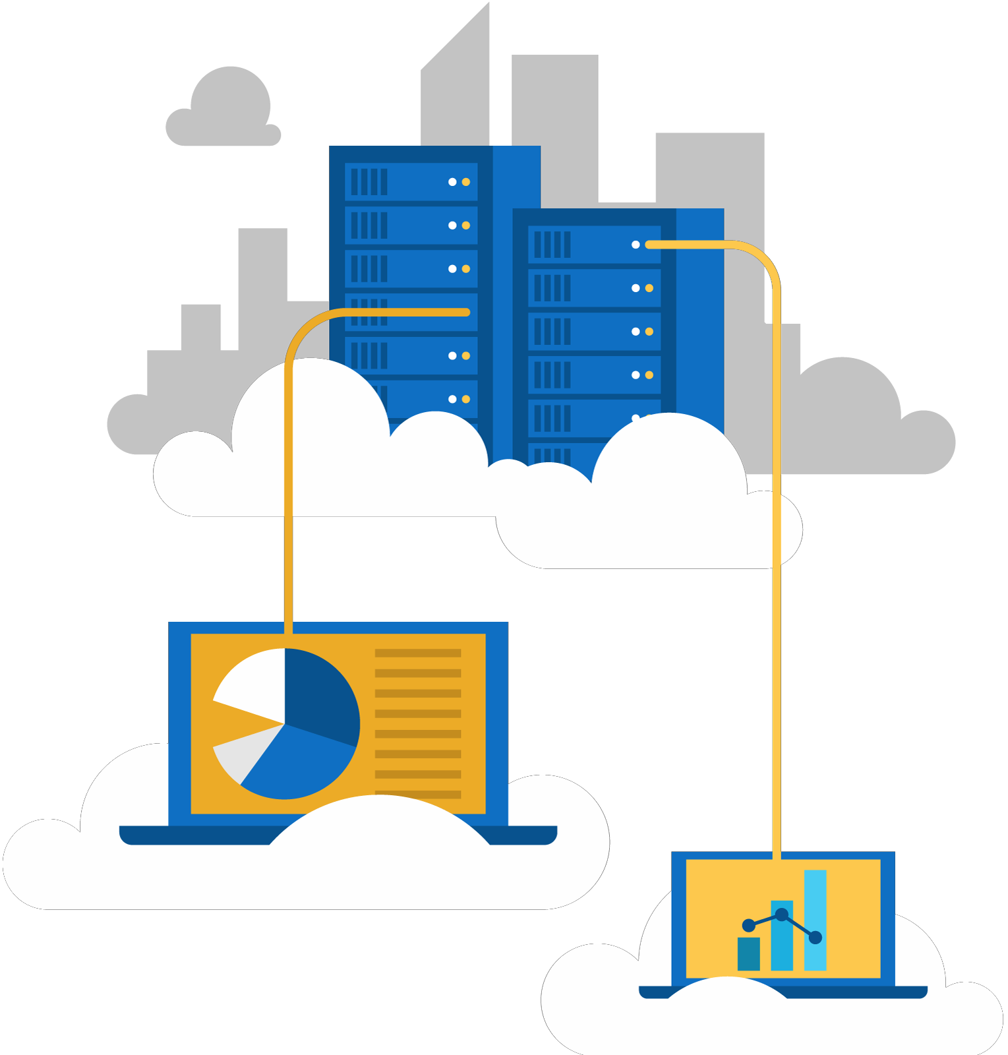




Jordan Radkov
Cloud Solution Architect

Slide 2

Design a Business Continuity Strategy (15- 20%)

Slide 3
Series Agenda
1 | Determine Workload Requirements (10-15%)
2 | Design for Identity and Security (20-25%)
3 | Design a Data Platform Solution (15-20%)
4 | Design a Business Continuity Strategy (15-20%)
5 | Design for Deployment, Migration, and Integration (10-15%)
6 | Design an Infrastructure Strategy (15-20%)

Slide 4
Series Agenda
1 | Determine Workload Requirements (10-15%)
2 | Design for Identity and Security (20-25%)
3 | Design a Data Platform Solution (15-20%)
4 | Design a Business Continuity Strategy (15-20%)
5 | Design for Deployment, Migration, and Integration (10-15%)
6 | Design an Infrastructure Strategy (15-20%)

Slide 5

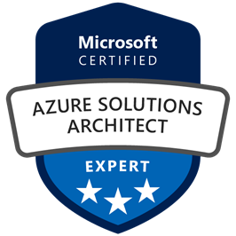
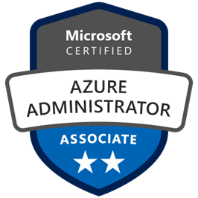
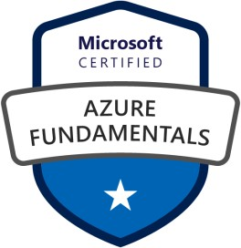



Jordan Radkov
Cloud Solution Architect based in the Munich
10+years in the industry in infrastructure administration , automation and now cloud
Constant learner - Ancora Imparo

Slide 6
Objectives
Design a Site Recovery Strategy
May include but not limited to: Design a recovery solution; design a site recovery replication policy; design for site recovery capacity and for storage replication; design site failover and failback (planned/unplanned); design the site recovery network; recommend recovery objectives (e.g., Azure, on-prem, hybrid, Recovery Time Objective (RTO), Recovery Level Objective (RLO), Recovery Point Objective (RPO)); identify resources that require site recovery; identify supported and unsupported workloads; recommend a geographical distribution strategy
Design for High Availability
May include but not limited to: Design for application redundancy, autoscaling, data center and fault domain redundancy, and network redundancy; identify resources that require high availability; identify storage types for high availability

Slide 7
Objectives (cont.)
Design a disaster recovery strategy for individual workloads
May include but not limited to: Design failover/failback scenario(s); document recovery requirements;
identify resources that require backup; recommend a geographic availability strategy
Design a Data Archiving Strategy
May include but not limited to: Recommend storage types and methodology for data archiving; identify requirements for data archiving and business compliance requirements for data archiving; identify SLA(s) for data archiving

Slide 8
Design a Site Recovery Strategy

Slide 9



Azure Site Recovery
One solution for multiple infrastructures
Replication
Replication
Hyper-V
Hyper-V Hyper-V to Hyper-V
(on-premises)
Microsoft Azure
Hyper-V
Hyper-V to Microsoft Azure
Replication
Replication
Replication
SAN
SAN
VMware/Physical VMware
VMware or Physical to VMware (on-premises)
Microsoft
Azure
Hyper-V
Hyper-V Hyper-V to Hyper-V
(on-premises)
VMware
VMware or Physical to Microsoft Azure
Protect important applications by coordinating the replication and recovery of private clouds across sites.
Protect your applications to your own second site, a hoster’s site, or even use Microsoft Azure as your disaster recovery
site

Slide 10




























Site to Azure
Setting | Details
Replication policy name | Policy name.
Recovery point retention | By default, Site Recovery keeps recovery points for 24 hours. You can configure a value between 1 and 72 hours.
App-consistent snapshot frequency | By default, Site Recovery takes an app-consistent snapshot every 4 hours. You can configure any value between 1 and 12 hours. An app-consistent snapshot is a point-in-time snapshot of the application data inside the VM. Volume Shadow Copy Service (VSS) ensures that app on the VM are in a consistent state when the snapshot is taken.
Replication group | If your application needs multi-VM consistency across VMs, you can create a replication group for those VMs. By default, the selected VMs are not part of any replication group.
Windows
Any OS
Linux

Slide 11
Source | Target | Availability | Supported Guest OS Types
Hyper-V 2012 R2 | Azure | Available | All Guest OS types supported by Azure
Hyper-V 2008 R2 SP1 and 2012 | Azure | Available | Windows* and Linux*
VMware vSphere 5.1, 5.5, 6.0 and Physical Servers | Azure | Available | Windows* and Linux*
Amazon Web Services (Windows AMIs) | Azure | Available | Windows Server 2008 R2 SP1+ (HVM only)
Amazon Web Services (Linux AMIs) | Azure | Available | RHEL 6.7 HVM
Hyper-V 2012 | Hyper-V 2012R2 | Available | All Guest OS types supported by Hyper-V
VMware vSphere 5.1, 5.5, 6.0 | Hyper-V 2012R2 | Available via Microsoft Services Global Delivery | Windows Server 2008 R2 SP1+

Slide 12



Config & Process Server
Microsoft Azure Site Recovery
https 443, 9443
https 443
Azure Storage
Microsoft Azure
Source: VMware & Physical Servers
On Premises Datacenter
Config & Process Server – Used for Caching, Compression, Encryption & Management
Mobility Service – Captures all data writes from memory

Slide 13
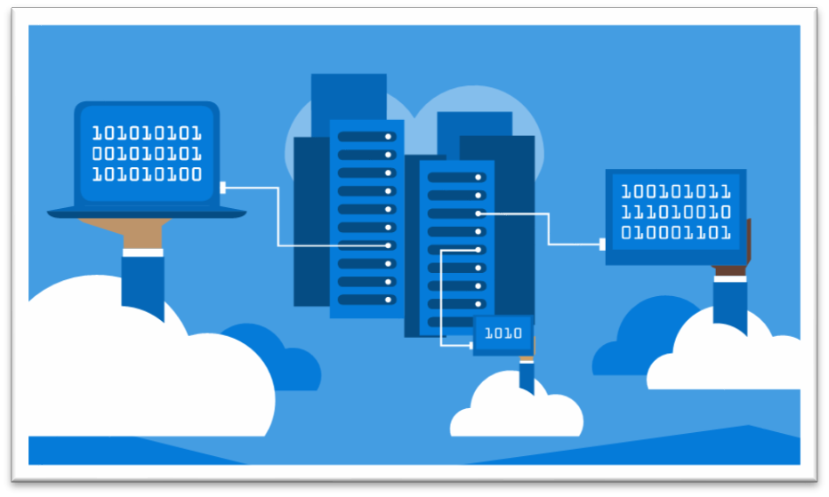
Capacity Planning
Network bandwidth
Initial replication
Delta replication and peaks
Storage
Replication
Workload IOPS during failovers
Test failover (Replication and
Workload IOPS simultaneously)
Standard or premium storage
Storage account naming
convention
Compute capacity
Test failover to ensure necessary capacity
Capacity considerations
Component | Details
Replication | Maximum daily change rate: A protected machine can use only one process server. A single process server can handle a daily change rate up to 2 TB. So, 2 TB is the maximum daily data change rate that’s supported for a protected machine. Maximum throughput: A replicated machine can belong to one storage account in Azure. A standard Azure Storage account can handle a maximum of 20,000 requests per second. We recommend that you limit the number of input/output operations per second (IOPS) across a source machine to 20,000. For example, if you have a source machine that has five disks and each disk generates 120 IOPS (8 K in size) on the source machine, the source machine is within the Azure per-disk IOPS limit of 500. (The number of storage accounts required is equal to the total source machine IOPS divided by 20,000.)
Configuration server | The configuration server must be able to handle the daily change rate capacity across all workloads running on protected machines. The configuration machine must have sufficient bandwidth to continuously replicate data to Azure Storage. A best practice is to place the configuration server on the same network and LAN segment as the machines that you want to protect. You can place the configuration server on a different network, but machines that you want to protect should have layer 3 network visibility. Size recommendations for the configuration server are summarized in the table in the following section.
Process server | The first process server is installed by default on the configuration server. You can deploy additional process servers to scale your environment. The process server receives replication data from protected machines. The process server optimizes data by using caching, compression, and encryption. Then, the process server sends the data to Azure. The process server machine must have sufficient resources to perform these tasks. The process server uses a disk-based cache. Use a separate cache disk of 600 GB or more to handle data changes that are stored if a network bottleneck or outage occurs.

Slide 14
Firewall Rules
All ASR scenarios require access to following URLs
*.hypervrecoverymanager.windowsazure.com
*.accesscontrol.windows.net
*.backup.windowsazure.com
*.blob.core.windows.net
*.store.core.windows.net
All communication happens on https (443)
IP address based firewall rules can be created by opening up Azure Datacenter IP Ranges for the region of recovery services vault and for WUS
IP range can change therefore it is not recommended to use IP based firewall rules
VMware Network Interfaces, and IP addressing Failover
NSG Rules

Slide 15
Create and customize recovery plans
Recovery time objective (RTO) is the maximum acceptable time that an application can be unavailable after an incident. If your RTO is 90 minutes, you must be able to restore the application to a running state within 90 minutes from the start of a disaster. If you have a very low RTO, you might keep a second regional deployment continually running an active/passive configuration on standby, to protect against a regional outage.
In some cases you might deploy an active/active configuration to achieve even lower RTO.
Recovery point objective (RPO) is the maximum duration of data loss that is acceptable during a disaster.
For example, if you store data in a single database, with no replication to other databases, and perform hourly backups, you could lose up to an hour of data.
Mean time to recover (MTTR) is the average time that it takes to restore a component after a failure. MTTR is an empirical fact about a component. Based on the MTTR of each component, you can estimate the MTTR of an entire application. Building applications from multiple components with low MTTR values results in an application with a low overall MTTR — one that recovers quickly from failures.
Mean time between failures (MTBF) is the runtime that a component can reasonably expect to last between outages. This metric can help you to calculate how frequently a service will become unavailable.
An unreliable component has a low MTBF, resulting in a low SLA number for that component.
However, a low MTBF can be mitigated by deploying multiple instances of the component and implementing failover between them.

Slide 16
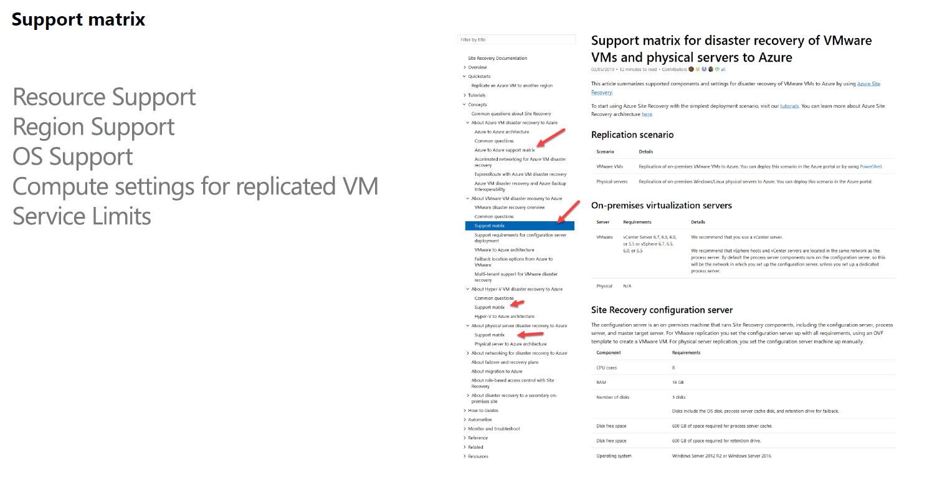

Slide 17
Design for High Availability

Slide 18



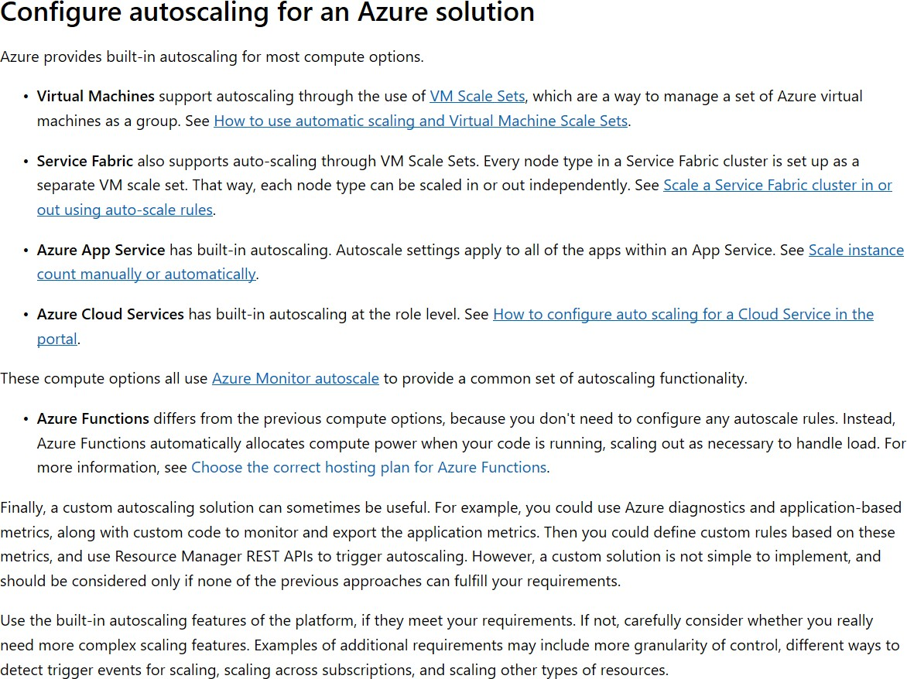
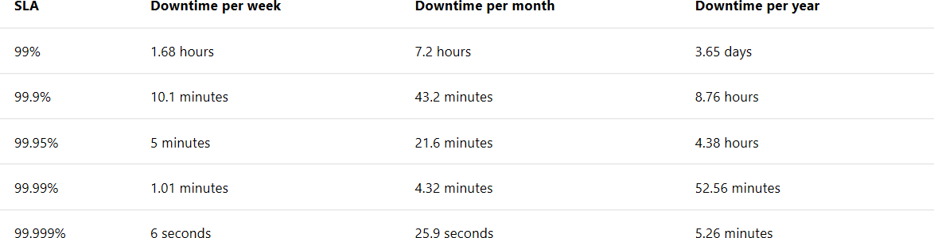
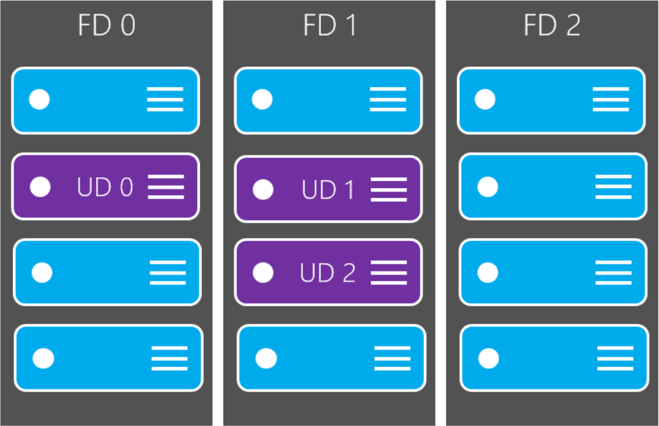
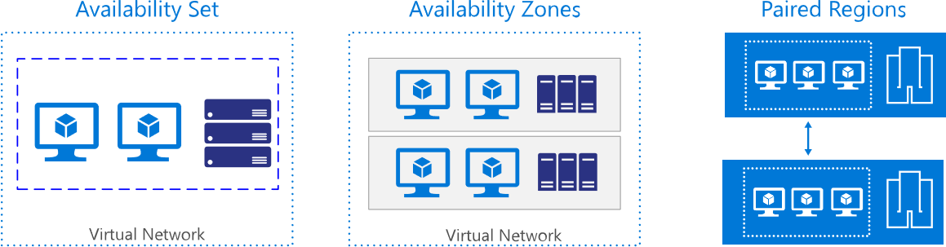

Slide 19





Slide 20
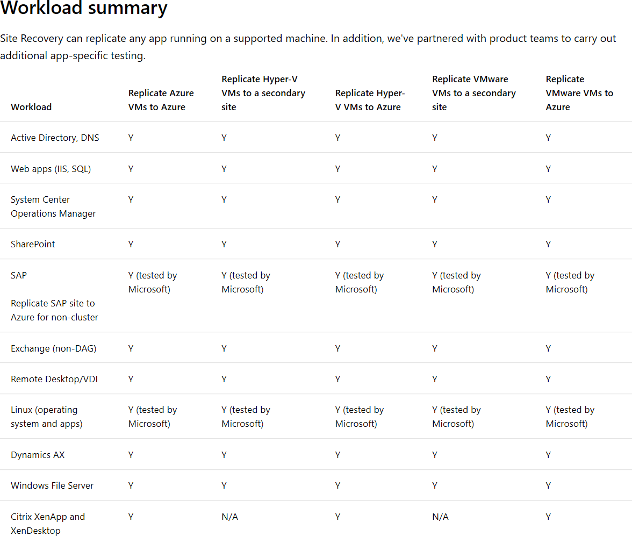

Slide 21




Azure Site
Recovery
DB Tier
IaaS VM
SQL Availability Group
App Tier
Web Tier
Active
Directory
ASR Replication
Azure Storage
AD & ASR Replication
IaaS VM
Primary Site
Azure

Slide 22


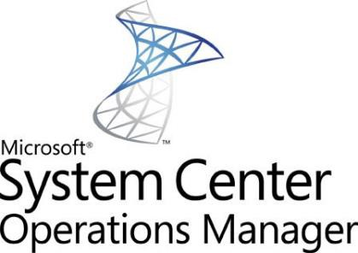





Active Directory | IIS | RDS/VDI | File Server
additional license charge for DR of 1st party workloads

Slide 23



Slide 24











Azure Backup Service
Data plane
No infrastructure
Enterprise scale
Extensible
Backup extension
Recovery Point Management
Data Pruning
Storage
Management
Data Packing
Backup extension
Authentication
Policy Management
Monitoring & Reporting
Central management
Access Control
Management plane

Slide 25
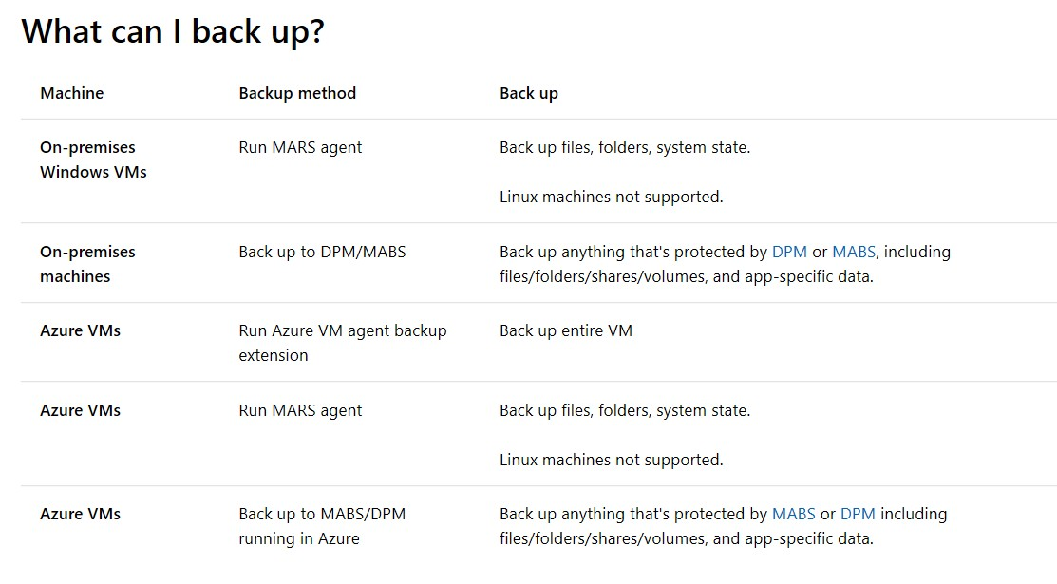

Slide 26








No infrastructure
Inspect before restore
Consistent
Azure Backup Service
Recovery Services Management
iSCSI Initiator
iSCSI Target
iSCSI connection
Azure VM
Data plane
VHD
snapshots
iSCSI Target
iSCSI
Connection
iSCSI Initiator
VHD
snapshots
On-premises server
Azure Backup Agent

Slide 27





10 TB
10 TB
Azure Import Service
Recovery Services Vault
Ship
Backup data
Azure Backup
agent
30 – 40% reduction in size
Save network bandwidth and time

Slide 28

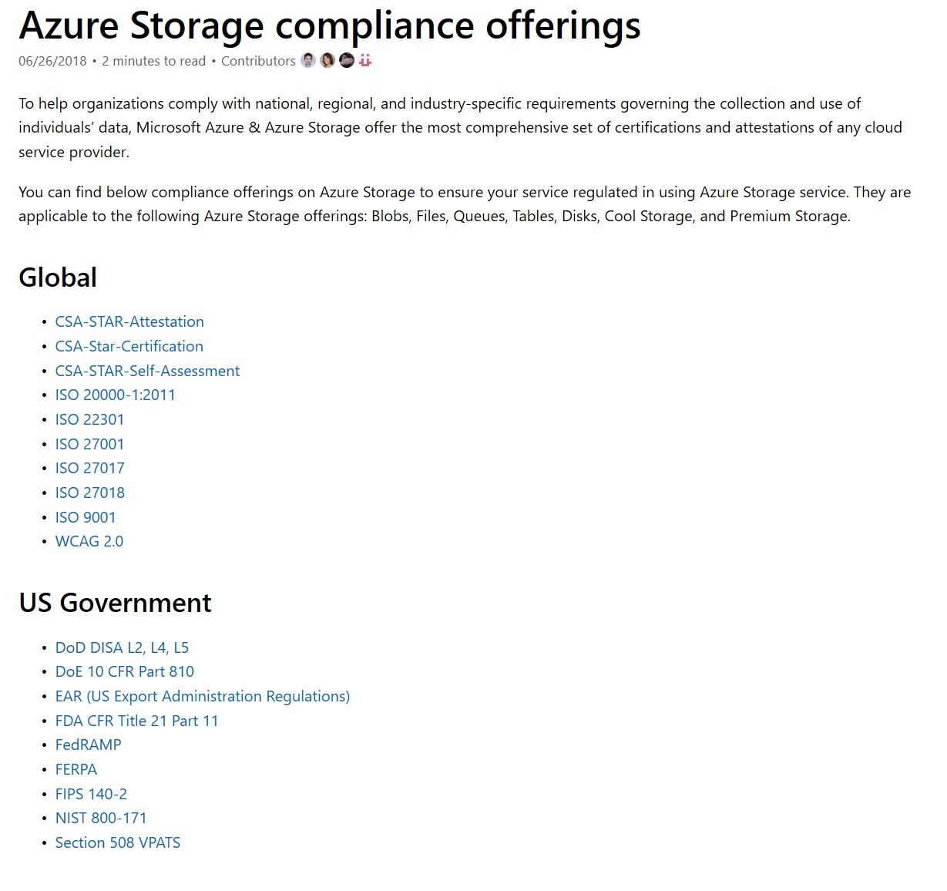

Slide 29

Questions?

