Slide 1
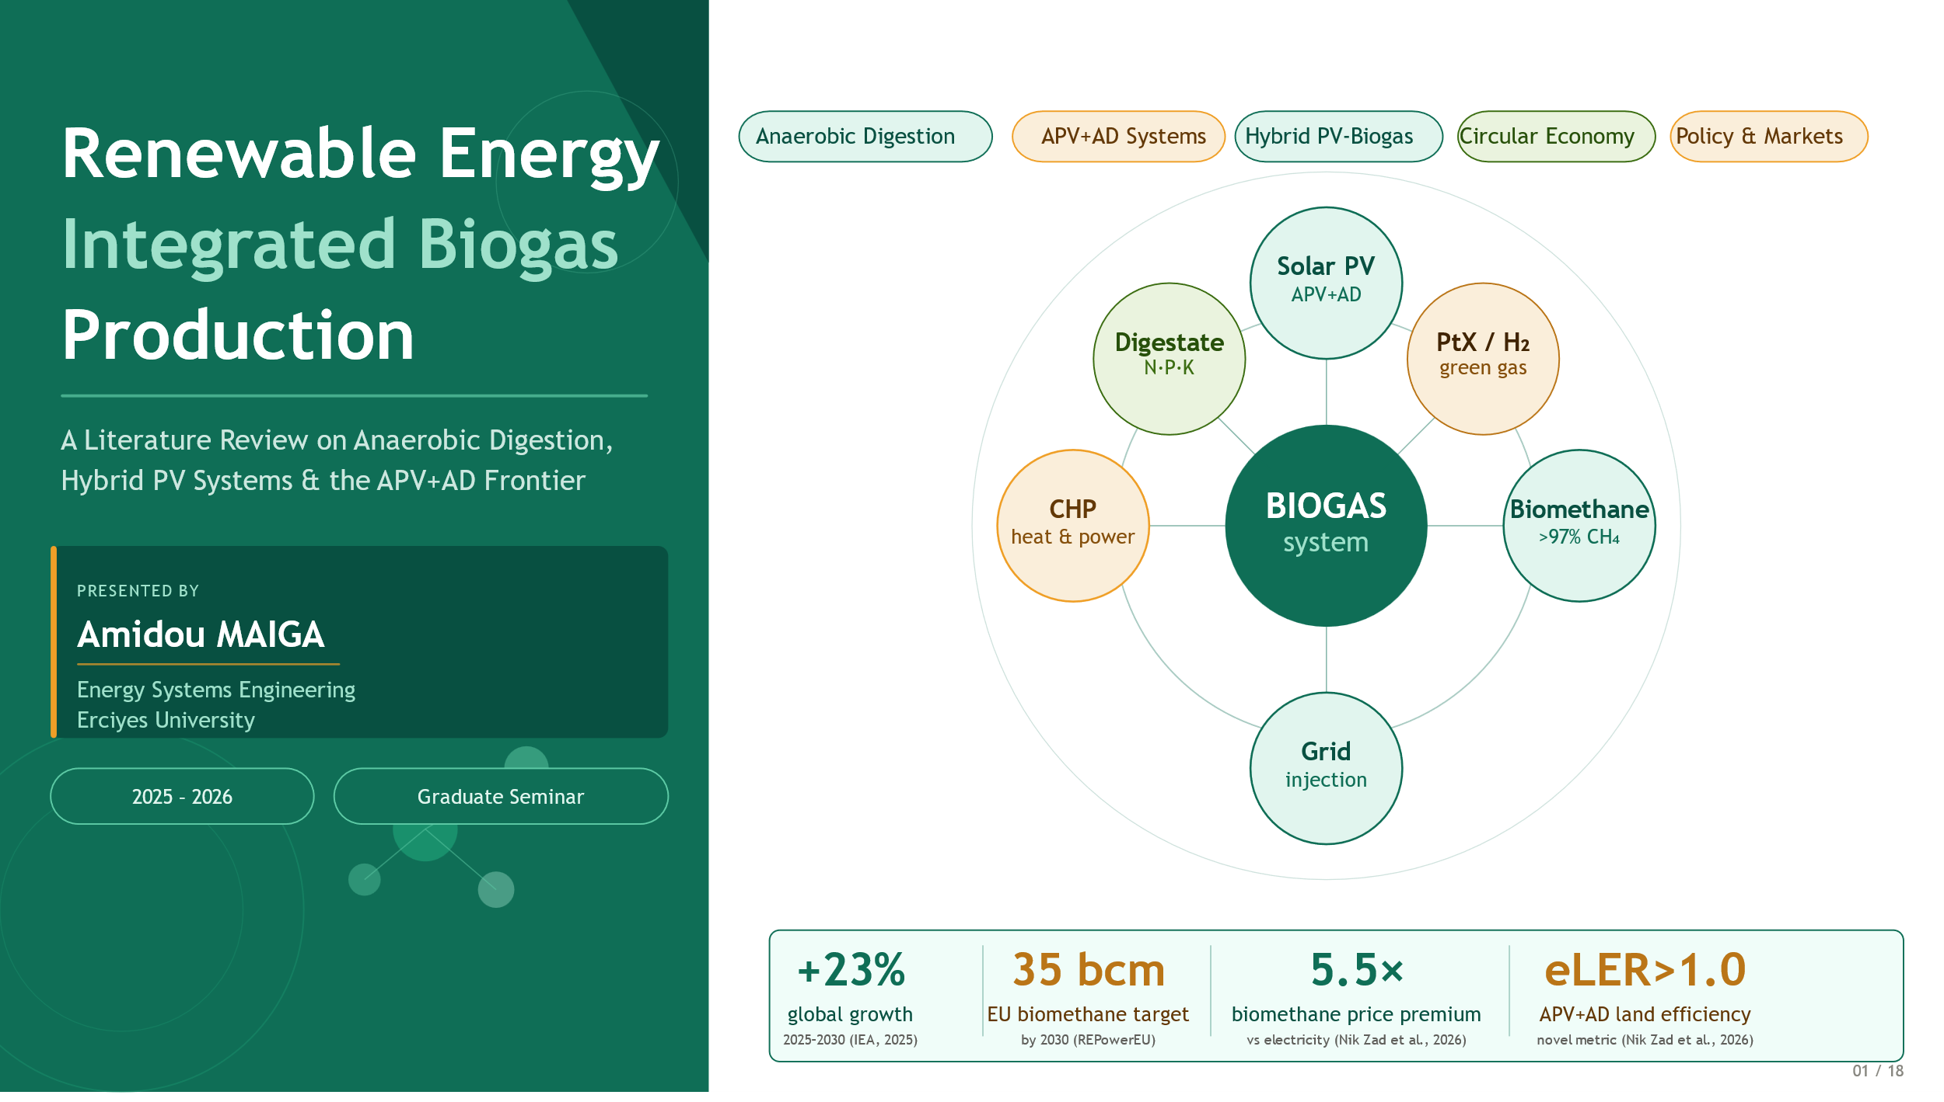
Notes:
Good morning. My name is Amidou MAIGA, graduate student in Energy Systems Engineering at Erciyes University. Today I present a literature review on Renewable Energy Integrated Biogas Production. The four numbers at the bottom of this slide tell the story at a glance: global production growing 23 percent by 2030, a 35 billion cubic meter EU target, a 5.5 times price premium for biomethane over electricity, and an eLER greater than one confirming that agrivoltaic-AD systems use land more efficiently than any single-purpose alternative. My central argument is simple: biogas is not just another renewable fuel — it is a systems technology.

Slide 2
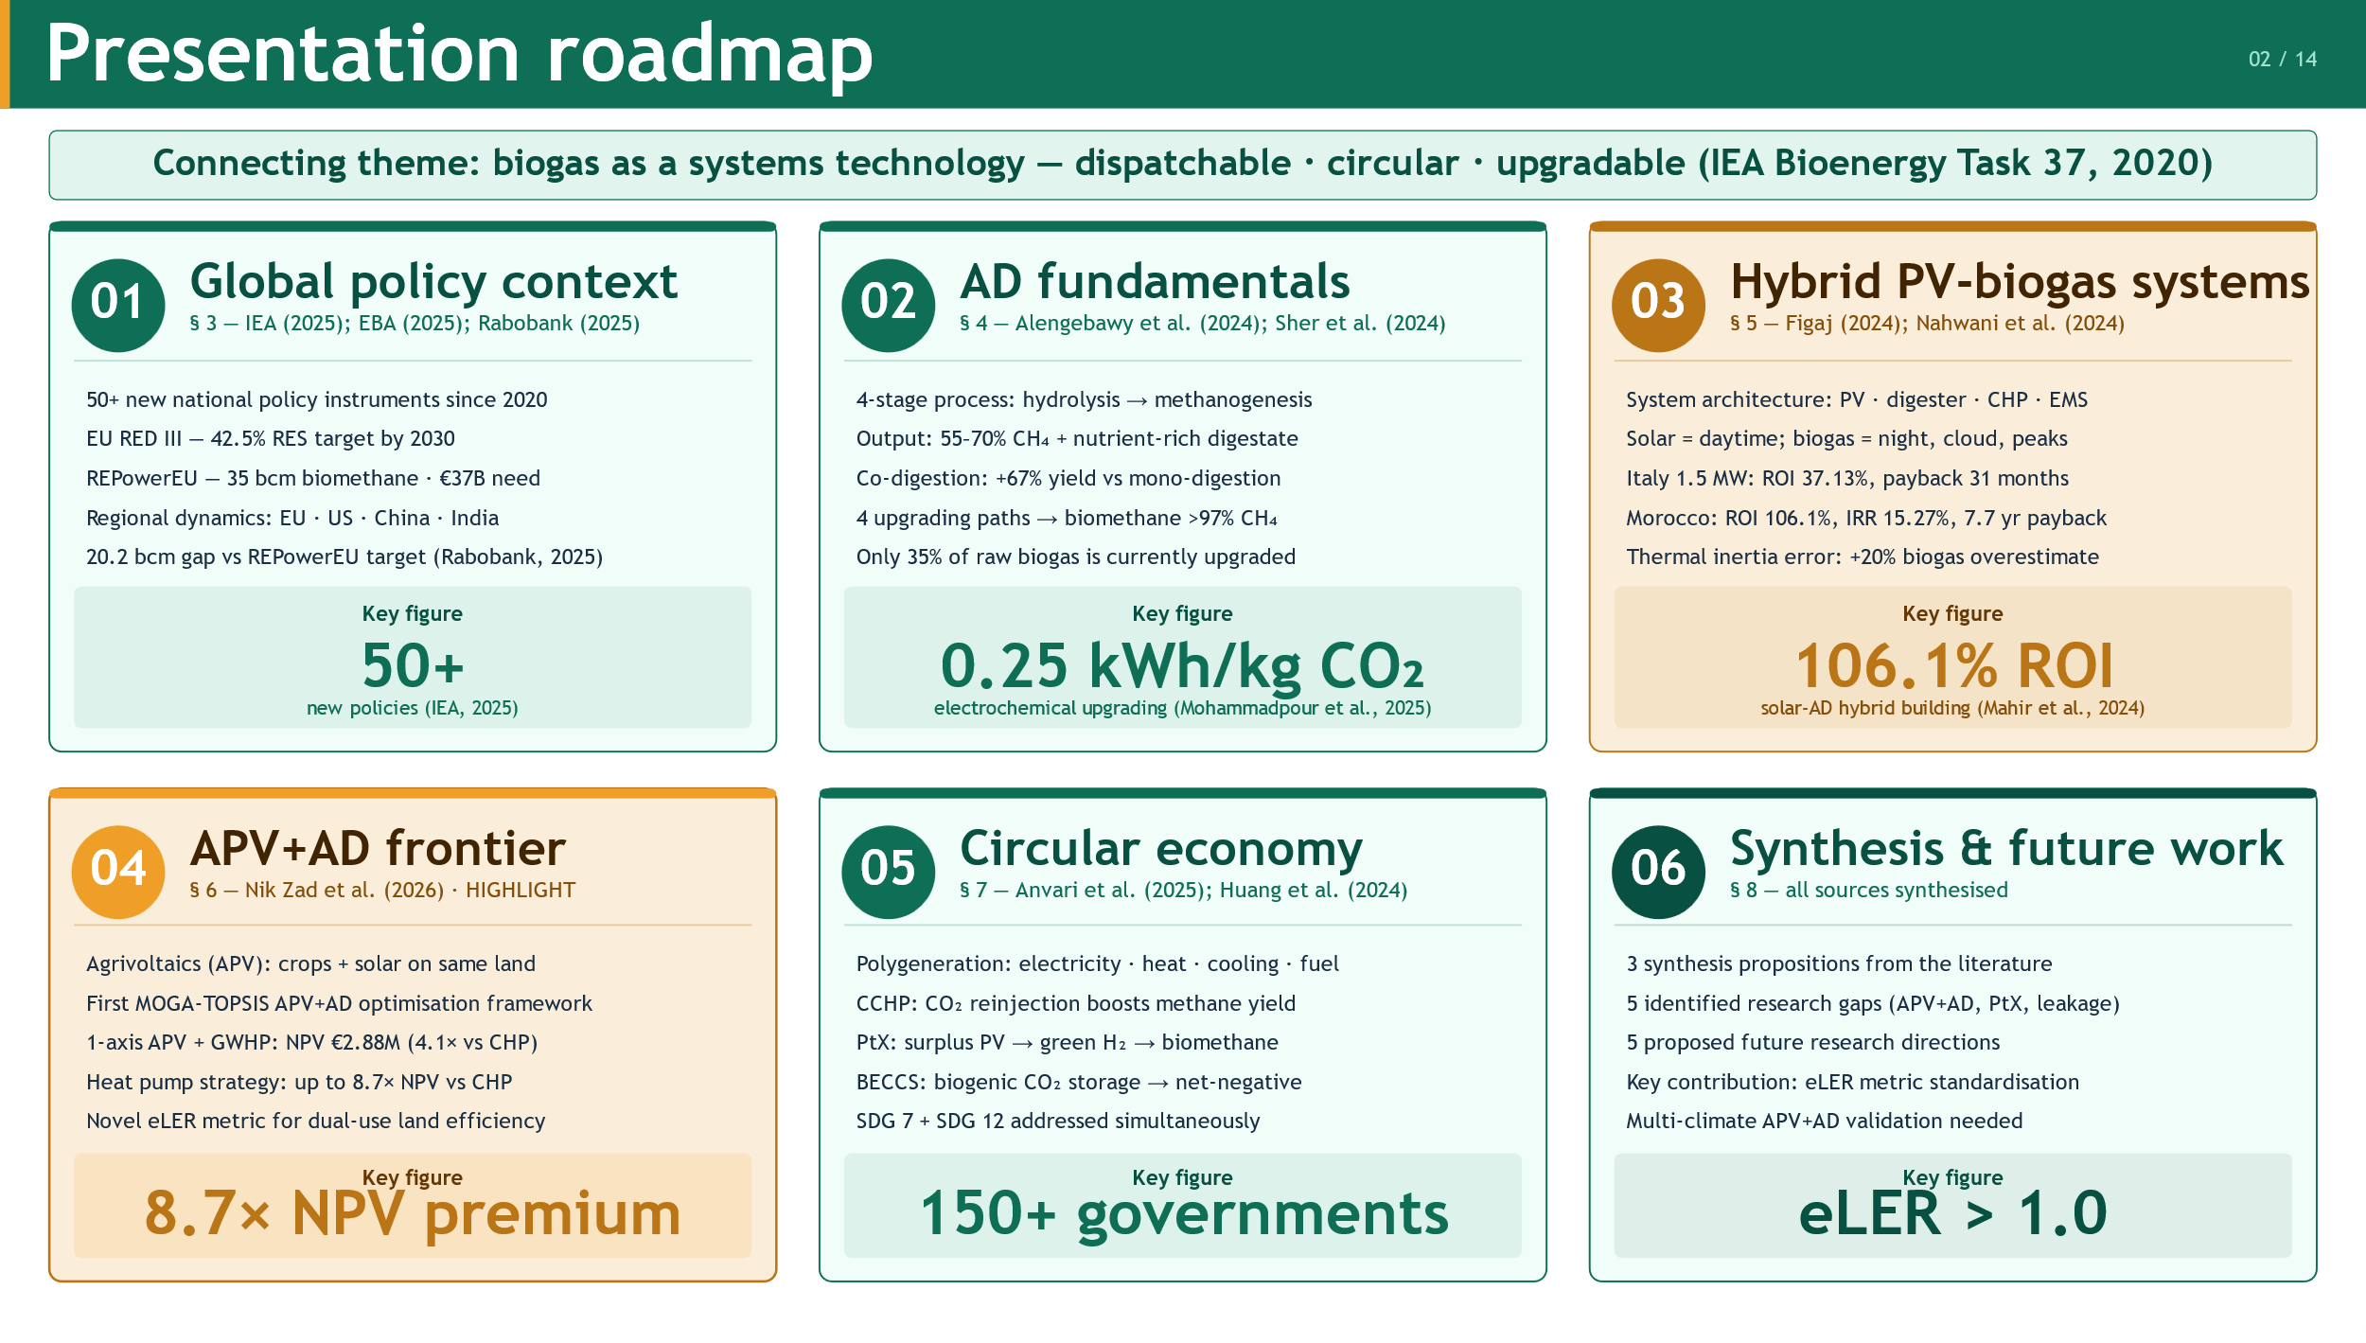
Notes:
The presentation covers six sections. We start with global policy, then move through AD fundamentals, hybrid PV-biogas systems, and the APV+AD frontier — which is the highlight of this review. We then address the circular economy and Power-to-X pathways, before closing with a synthesis of research gaps and five proposed future directions. The connecting thread throughout is one idea: biogas as systems technology — dispatchable, circular, and upgradable

Slide 3
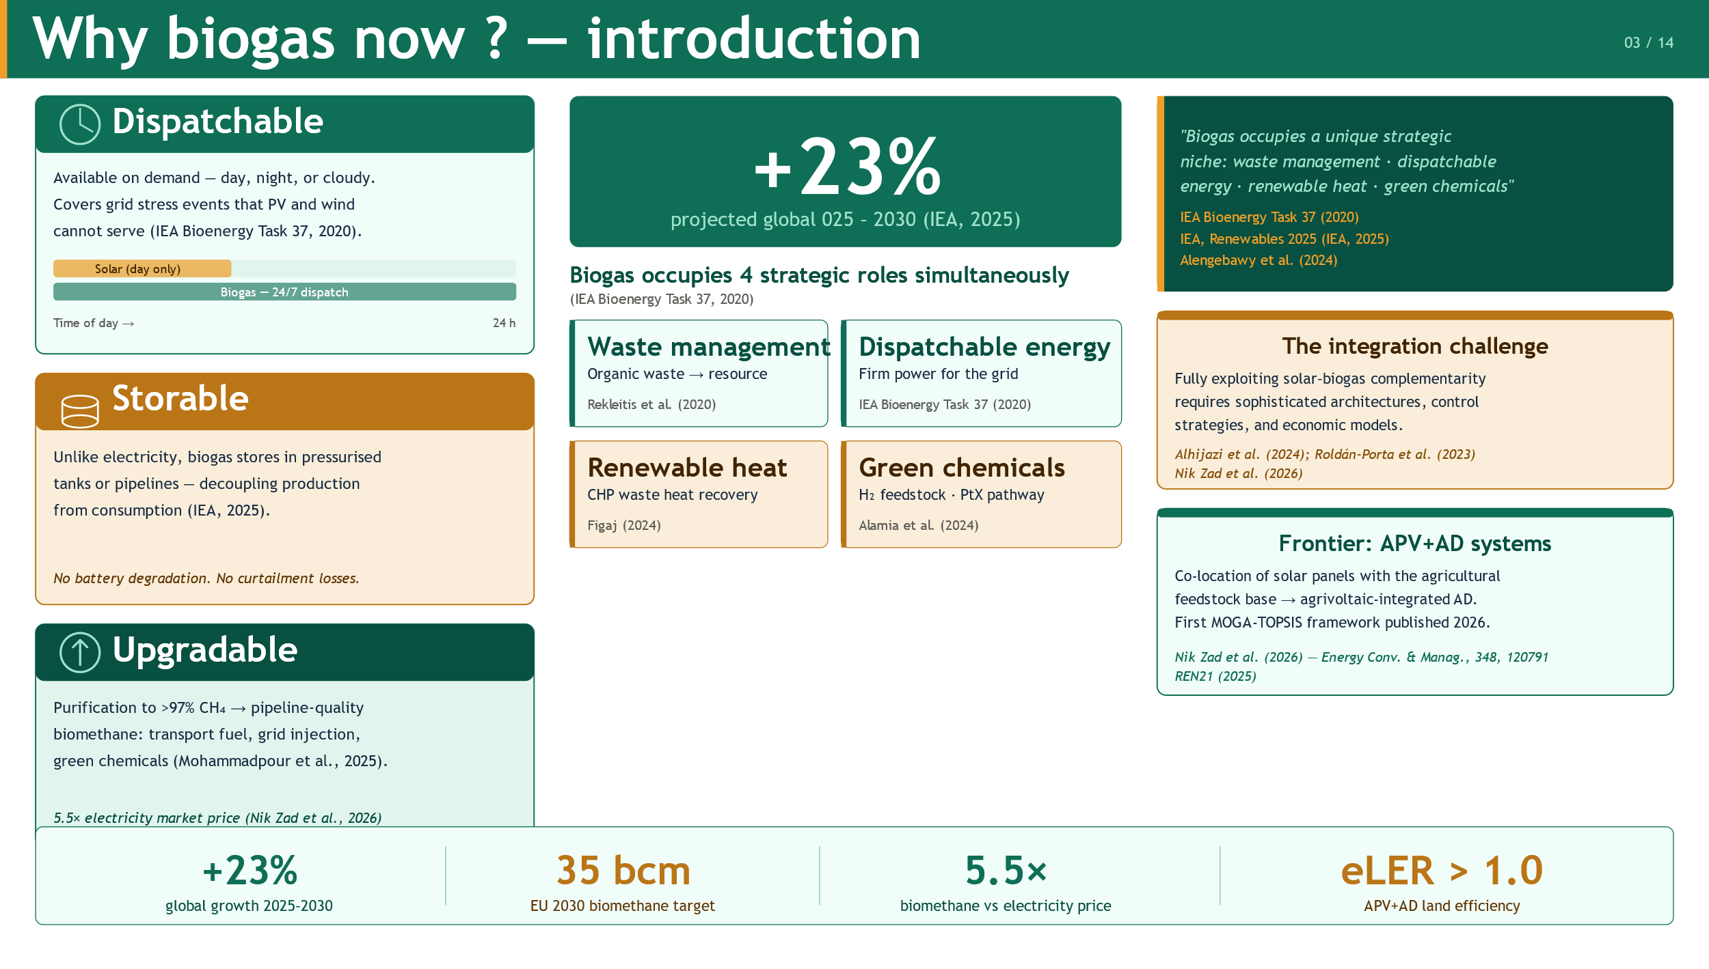
Notes:
Three properties make biogas uniquely valuable in the energy transition. It is dispatchable — available on demand, day or night. It is storable — chemical energy held in tanks without degradation. And it is upgradable — purified to pipeline-quality biomethane worth 5.5 times the electricity price. The IEA projects a 23 percent production increase by 2030. No other renewable technology simultaneously handles waste management, firm power delivery, renewable heat, and green chemical feedstock production. That combination is why biogas is attracting accelerating policy and investment across four continents.

Slide 4
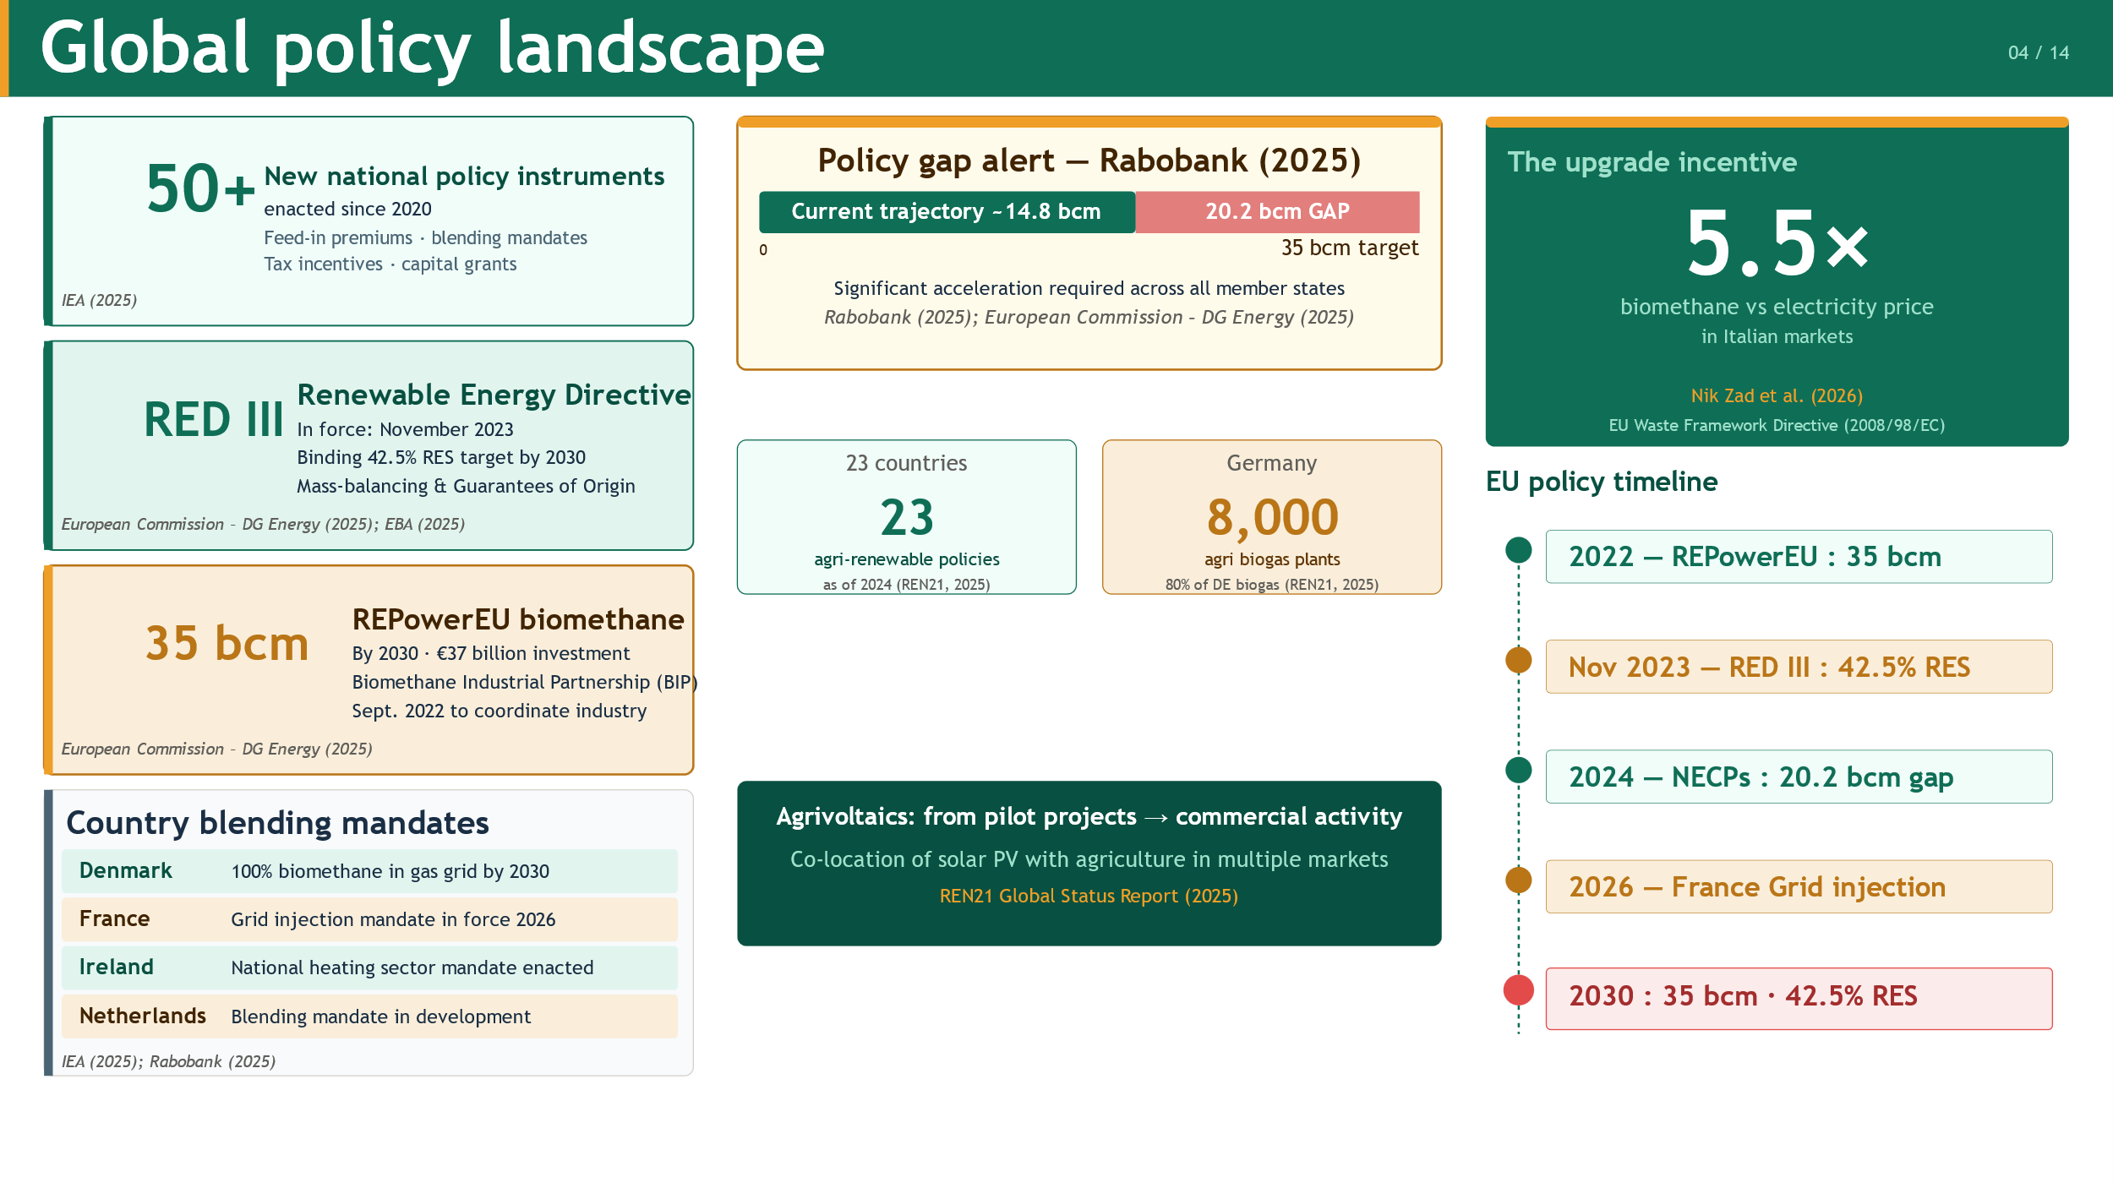
Notes:
The policy environment has intensified dramatically since 2020. The IEA documents over 50 new national instruments — feed-in premiums, blending mandates, capital grants. In Europe, RED III sets a binding 42.5 percent renewables target by 2030, and REPowerEU sets a 35 billion cubic meter biomethane goal requiring 37 billion euros of investment. Denmark aims for 100 percent biomethane in its gas grid. France mandates grid injection from 2026. However, a 2025 Rabobank analysis identifies a critical 20.2 billion cubic meter gap between national plans and the REPowerEU target. The political will exists — but the acceleration needed is substantial.
________________________________________

Slide 5
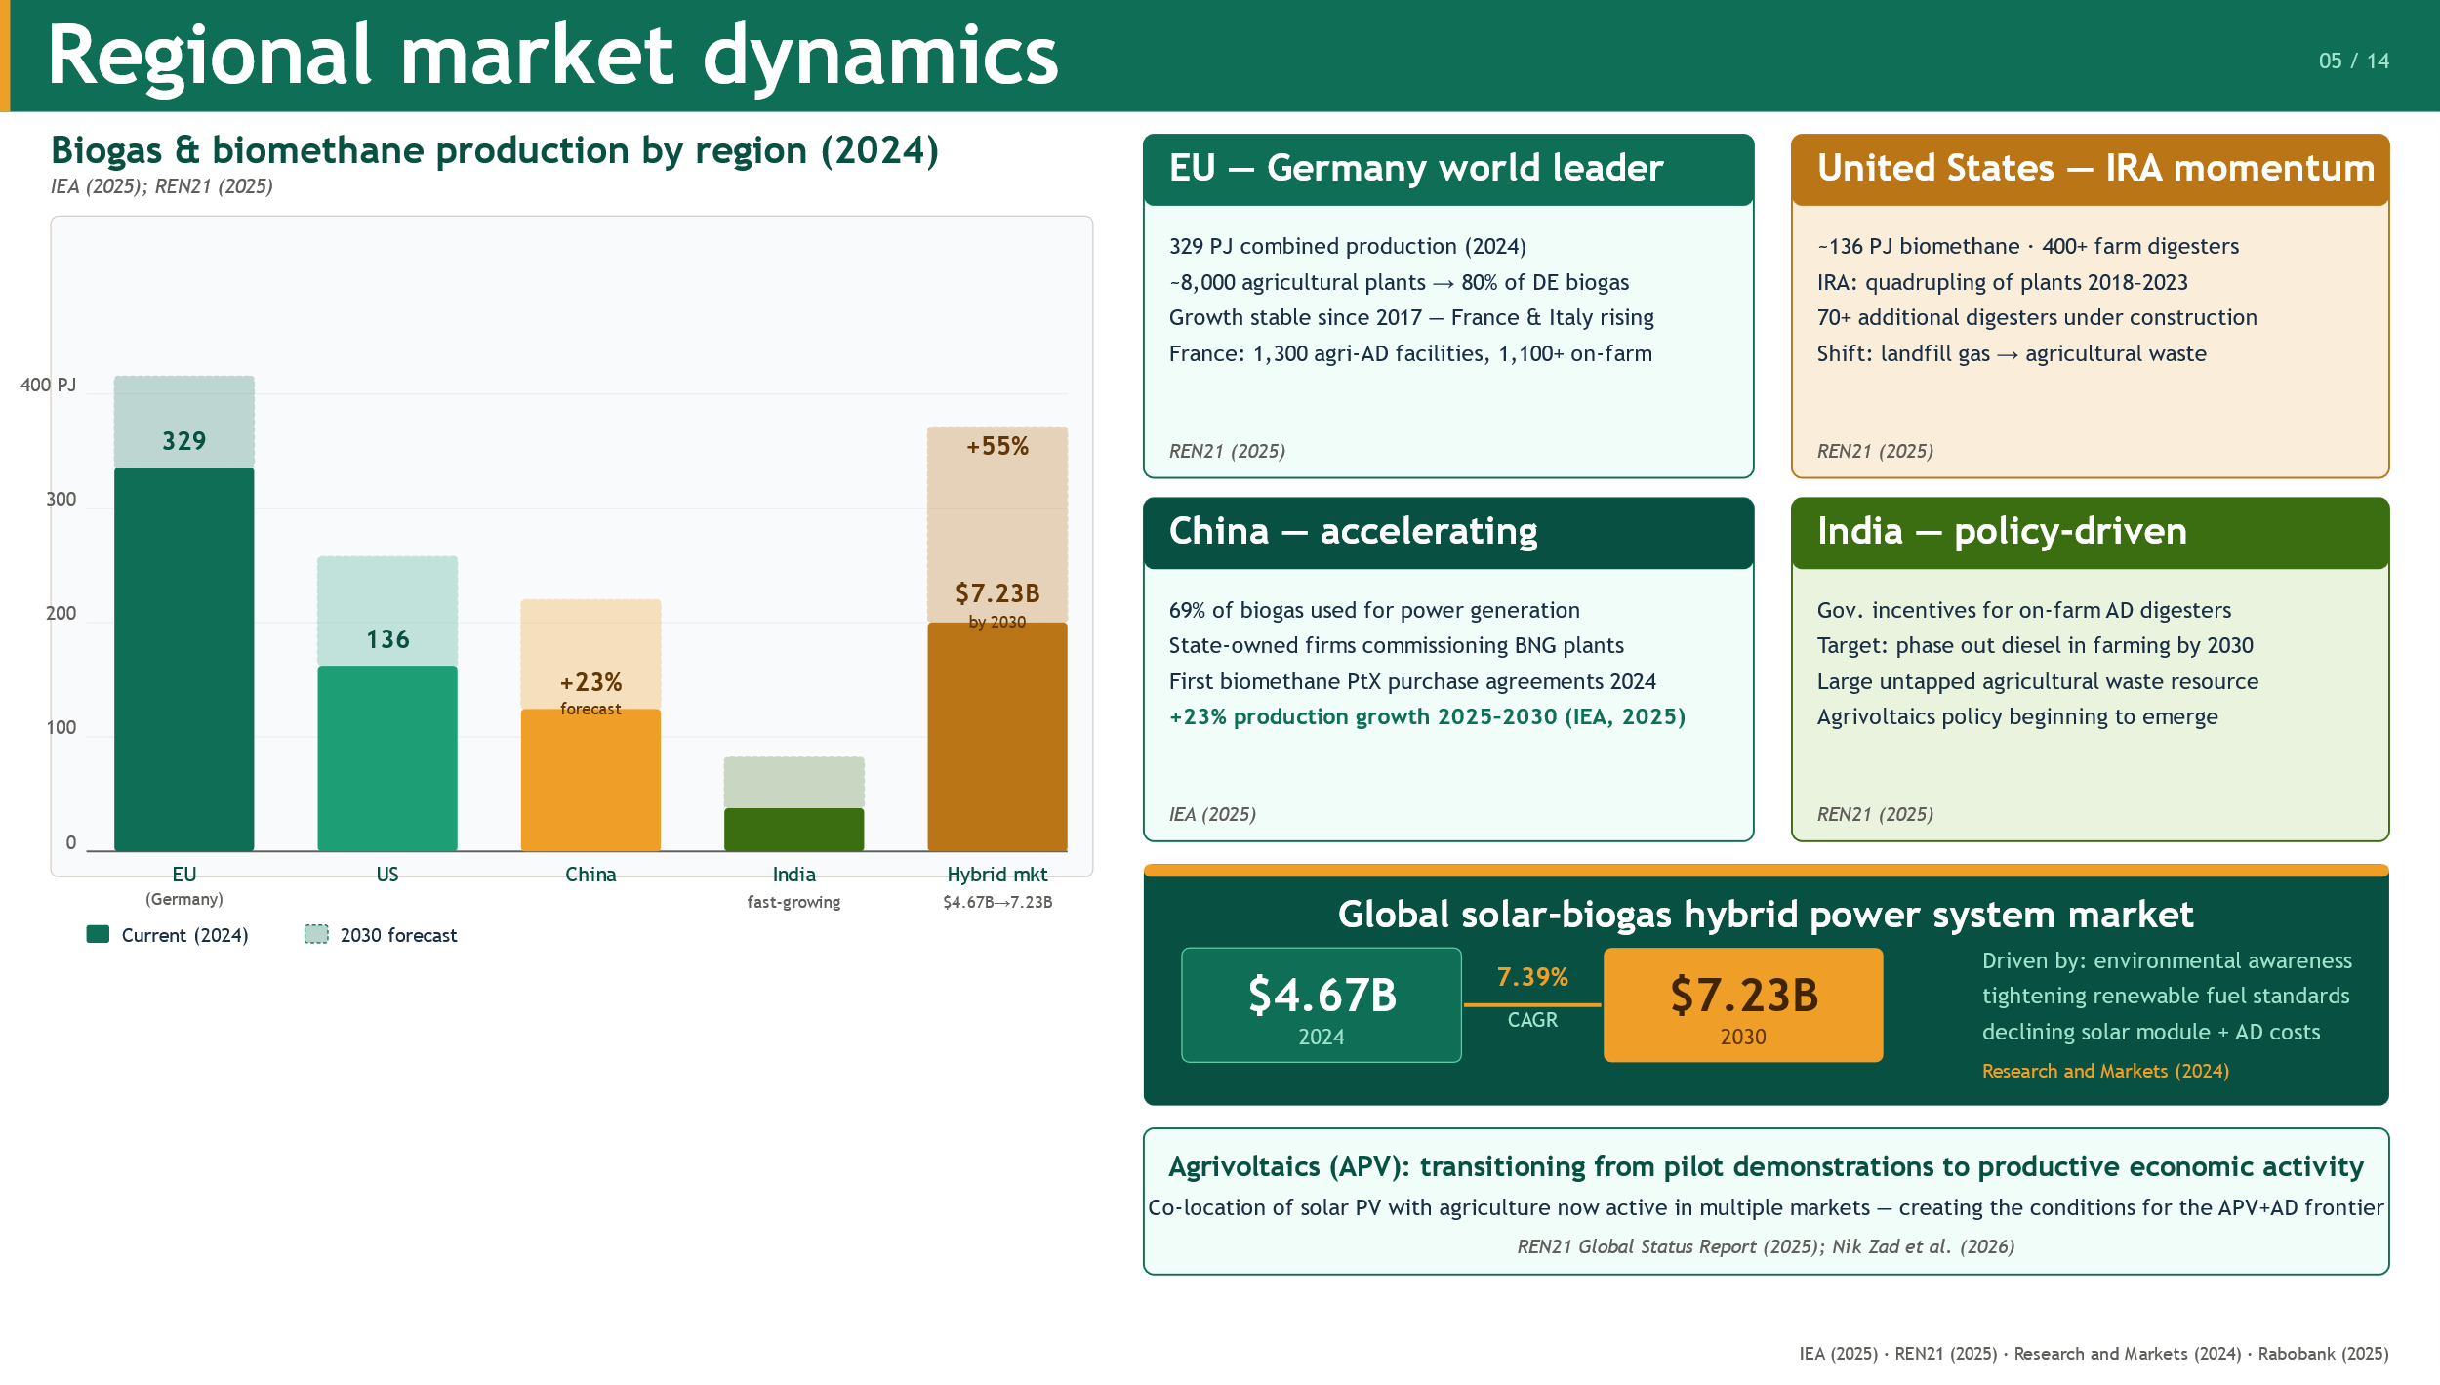
Notes:
Germany leads with 329 petajoules of production, backed by 8,000 agricultural plants. The US quadrupled plant numbers between 2018 and 2023 through IRA incentives, with over 400 farm digesters now operating. China signed its first biomethane purchase agreements involving PtX in 2024 and is forecast to grow 23 percent by 2030. India is deploying on-farm digesters to replace diesel in agriculture. At the global level, the solar-biogas hybrid market is growing from 4.67 billion to 7.23 billion dollars by 2030 at a 7.39 percent annual rate. The upgrade trend is clear across all markets: operators are shifting from combustion to biomethane grid injection, driven by those 5.5 times price premium.

Slide 6
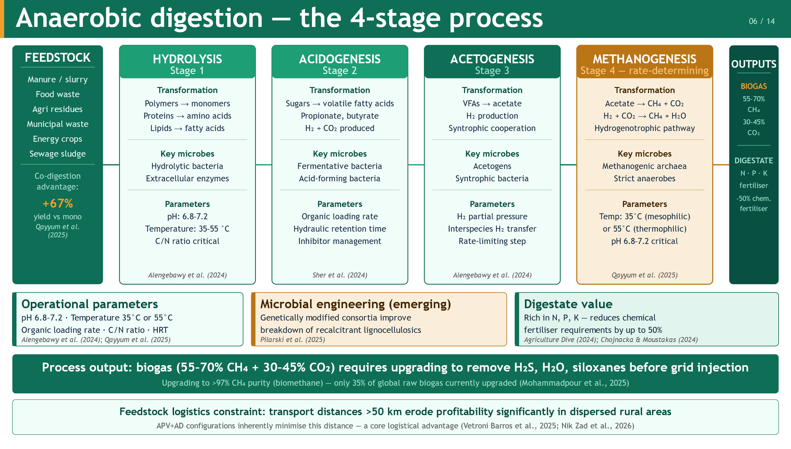
Notes:
Anaerobic digestion proceeds through four sequential biological stages. Hydrolysis breaks complex polymers into monomers. Acidogenesis converts those monomers into volatile fatty acids and hydrogen. Acetogenesis transforms fatty acids into acetate — this is typically the rate-limiting step. And methanogenesis — performed by sensitive methanogenic archaea — converts acetate and hydrogen into methane, yielding raw biogas of 55 to 70 percent CH₄. The entire process is sensitive to pH between 6.8 and 7.2, temperature at either 35 or 55 degrees, organic loading rate, and hydraulic retention time. The solid effluent — digestate — is rich in nitrogen, phosphorus, and potassium, and can replace up to 50 percent of chemical fertilizer needs.

Slide 7
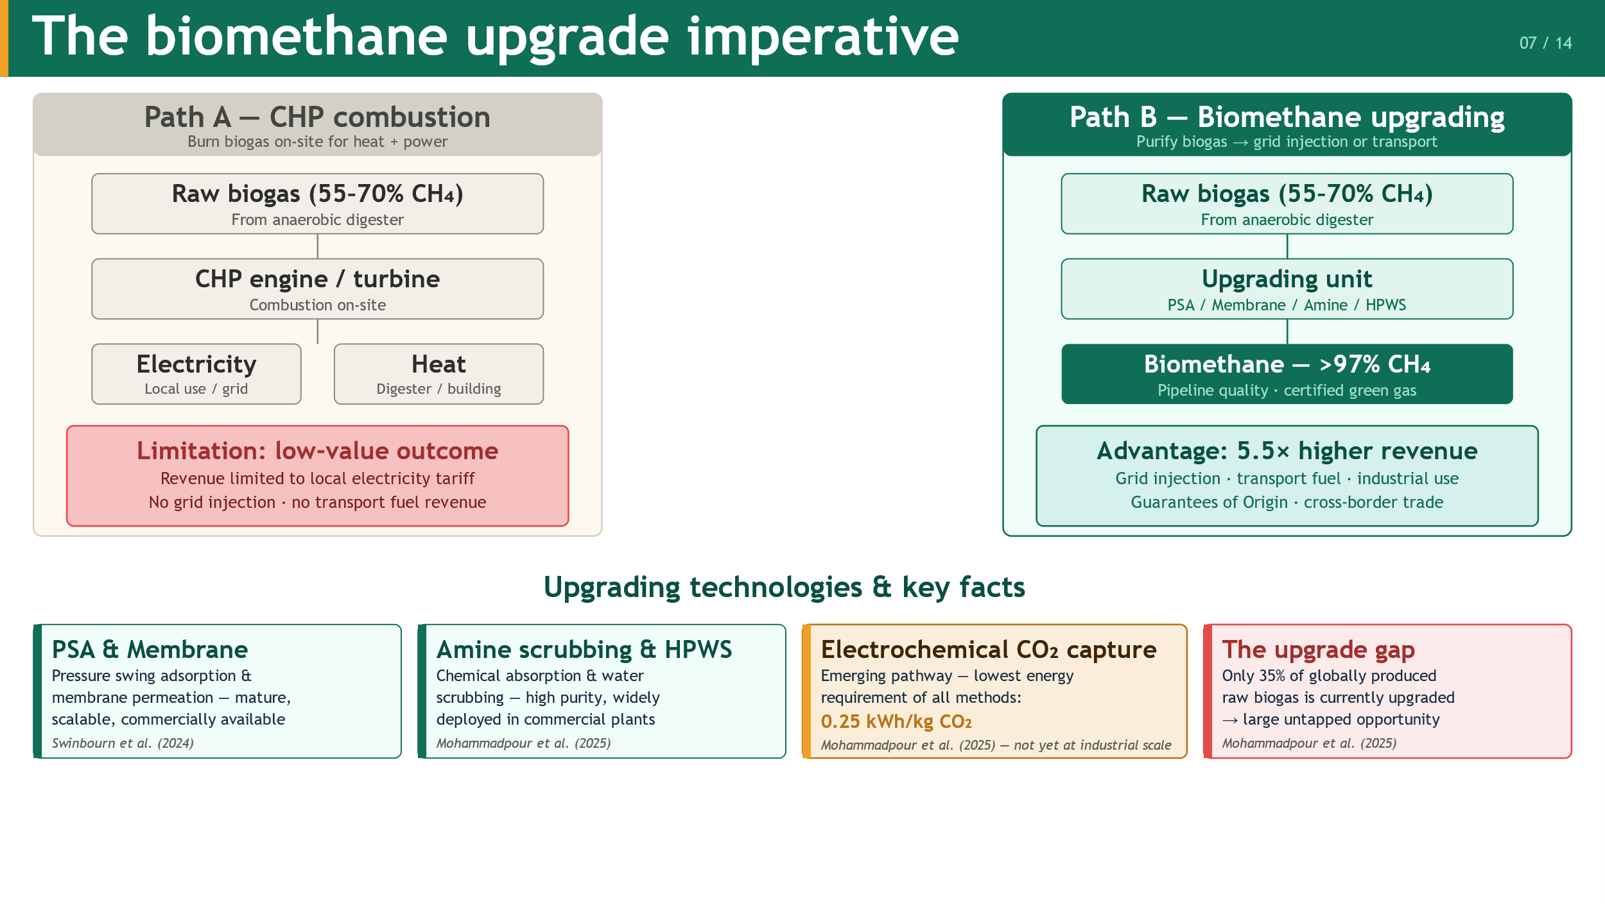
Notes:
When a biogas plant decides what to do with its gas, there are two paths. Path A burns it in a CHP engine for local electricity and heat — convenient, but low-value. Path B purifies it to greater than 97 percent methane and injects it into the grid — commanding 5.5 times the electricity price in Italian markets. Four upgrading technologies are commercially mature today: pressure swing adsorption, membrane permeation, amine scrubbing, and water scrubbing. An emerging fifth — electrochemical CO₂ capture at just 0.25 kilowatt-hours per kilogram — is the most energy-efficient of all, but has not yet reached industrial scale. Critically, only 35 percent of global raw biogas is currently upgraded. That gap represents the largest untapped economic opportunity in the entire sector.

Slide 8
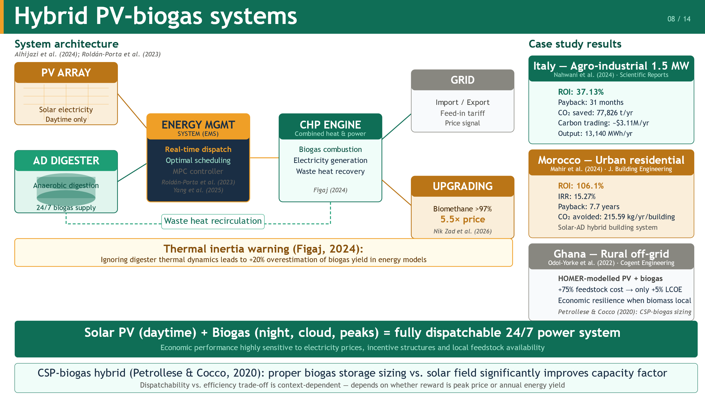
Notes:
The complementarity between solar and biogas is intuitive: PV covers daylight hours; biogas covers nights and cloudy periods. A canonical hybrid system integrates five components — PV array, digester, CHP engine, energy management system, and grid connection. One important technical warning from Figaj in 2024: ignoring the digester's thermal inertia in energy models leads to a 20 percent overestimation of biogas yield. On economics, three case studies stand out. In Italy, a 1.5-megawatt agro-industrial plant achieved a 37.13 percent annual ROI with a 31-month payback. In Morocco, a solar-AD hybrid building system achieved 106.1 percent ROI with a 7.7-year payback. In Ghana, a rural off-grid HOMER model showed that a 75 percent feedstock cost increase raised LCOE by only 5 percent — demonstrating the economic resilience of locally-sourced hybrid systems.

Slide 9
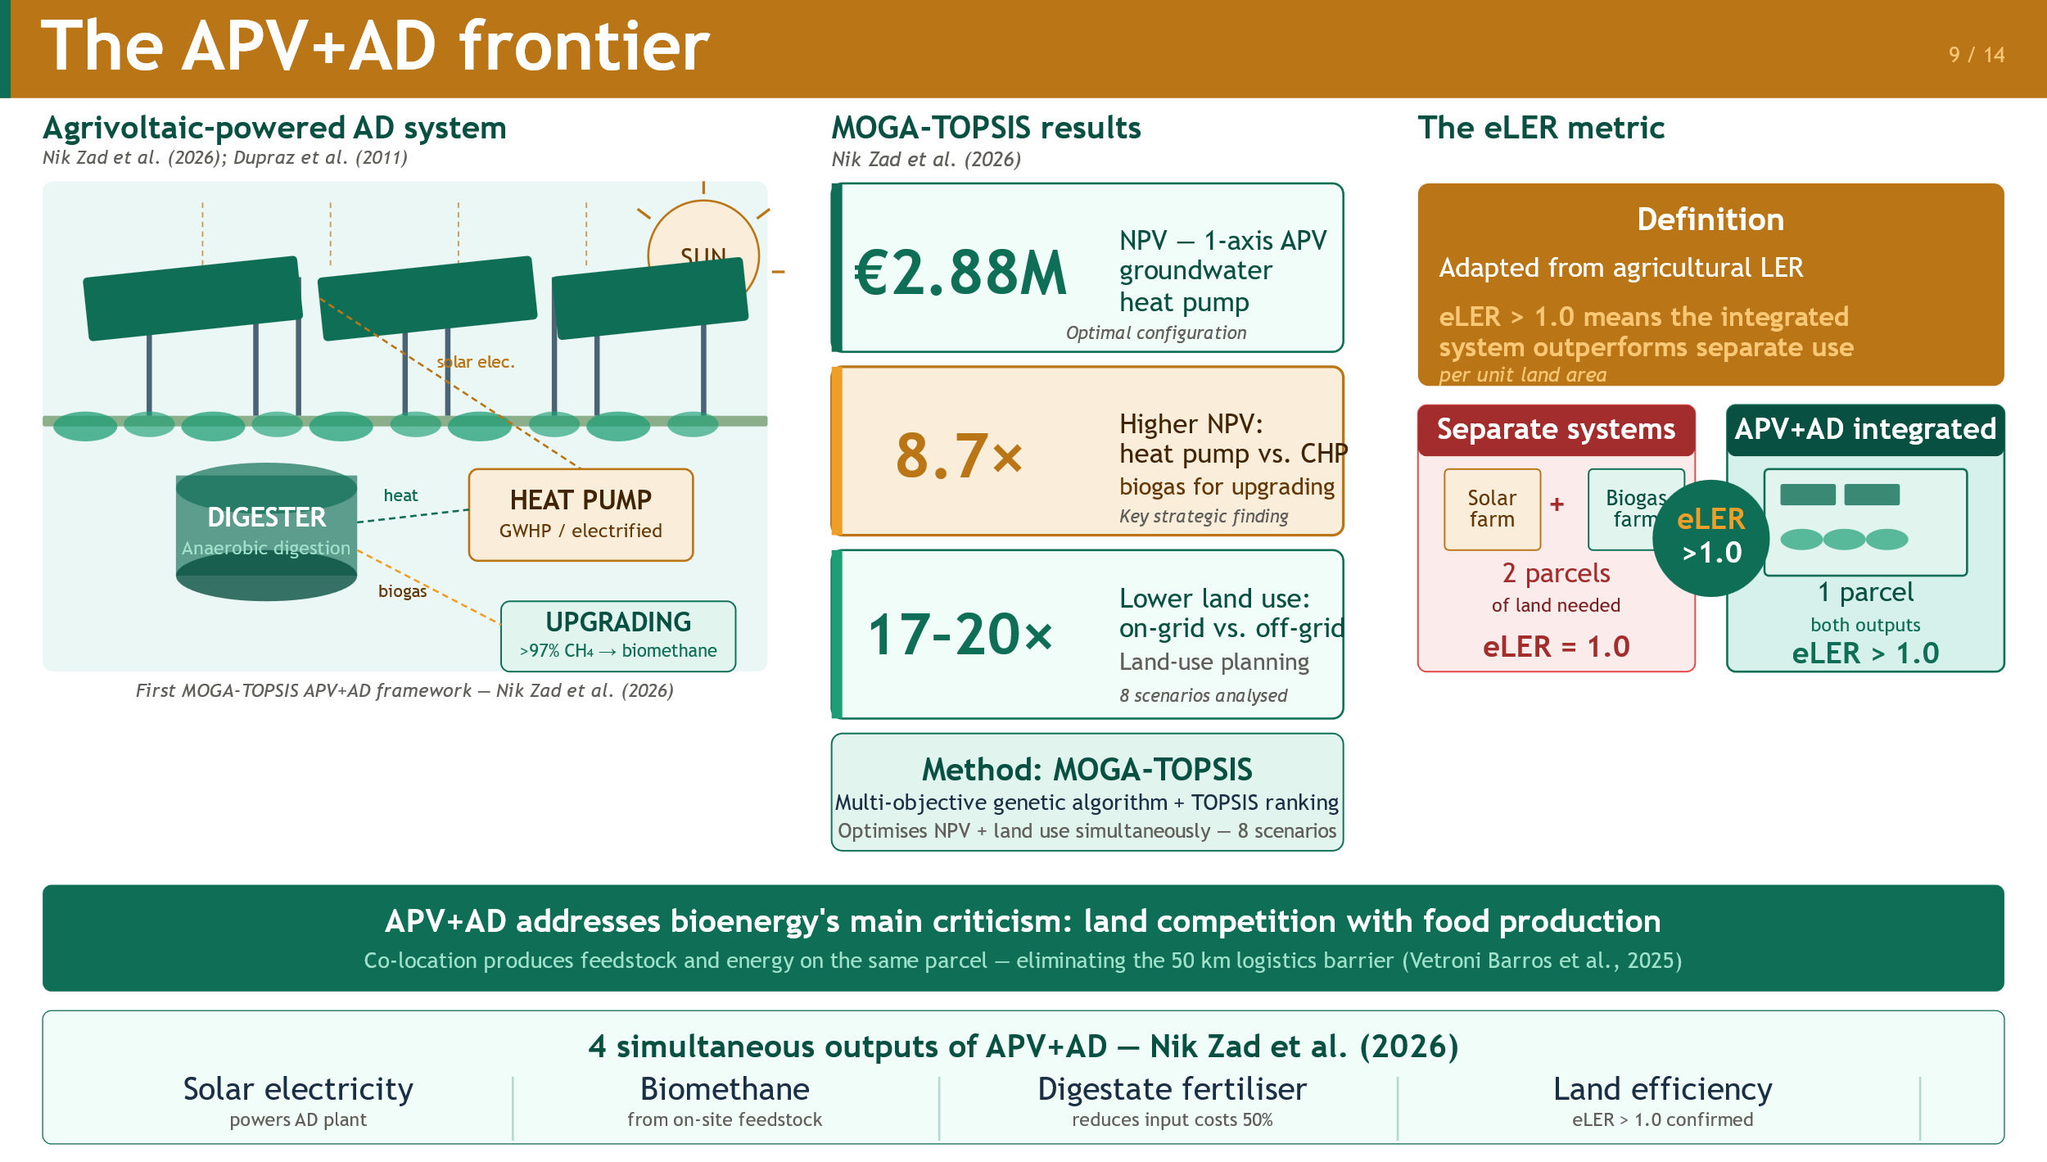
Notes:
Agrivoltaics — mounting solar panels above or between crops — has been developing since Dupraz et al. in 2011 and is now transitioning to commercial activity according to REN21 2025. The APV+AD configuration pairs agrivoltaics with an on-site AD plant, creating four simultaneous outputs: solar electricity powering the AD equipment, biomethane from on-site feedstock, digestate fertilizer cutting input costs by 50 percent, and confirmed land efficiency with eLER greater than one. A landmark 2026 study by Nik Zad et al. in Energy Conversion and Management — the first MOGA-TOPSIS optimization framework for this configuration — found that the optimal on-grid design with one-axis tracking and a groundwater heat pump achieves a net present value of 2.88 million euros, 4.1 times the CHP baseline, with 17 to 20 times lower land occupation than off-grid alternatives.

Slide 10
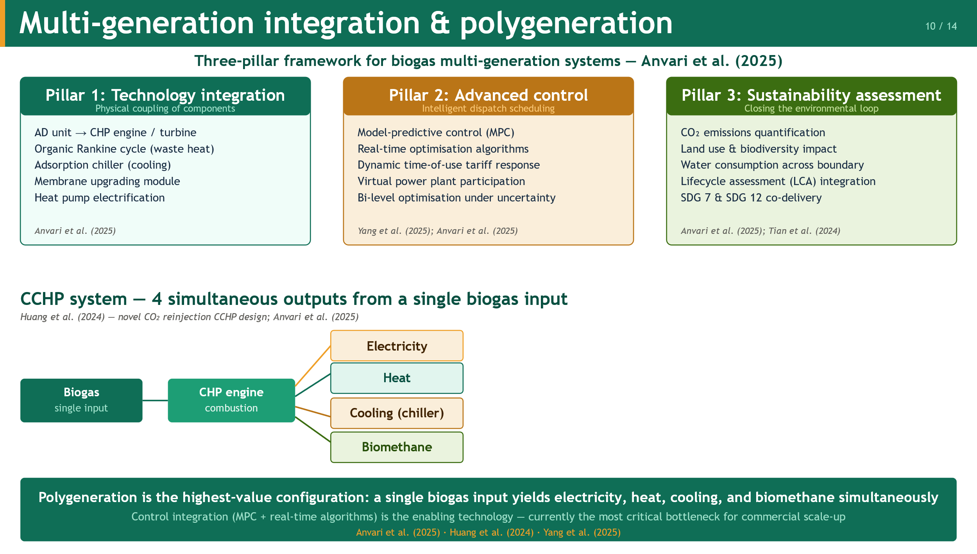
Notes:
Polygeneration elevates biogas from a fuel to the hub of a multi-output energy system. Anvari et al. in 2025 organize the field around three pillars: technology integration — coupling AD with CHP, organic Rankine cycles, adsorption chillers, and heat pumps; advanced control — model-predictive algorithms and real-time dispatch scheduling; and sustainability assessment — quantifying CO₂, land, water, and biodiversity across the full system boundary. The most innovative example is Huang et al.'s 2024 CCHP design, which recycles CO₂-rich exhaust back into the digester to boost methane yield. Four gaps remain in this domain: standardized sustainability metrics, real-time dispatch algorithms, virtual power plant integration, and long-term feedstock security modelling.

Slide 11
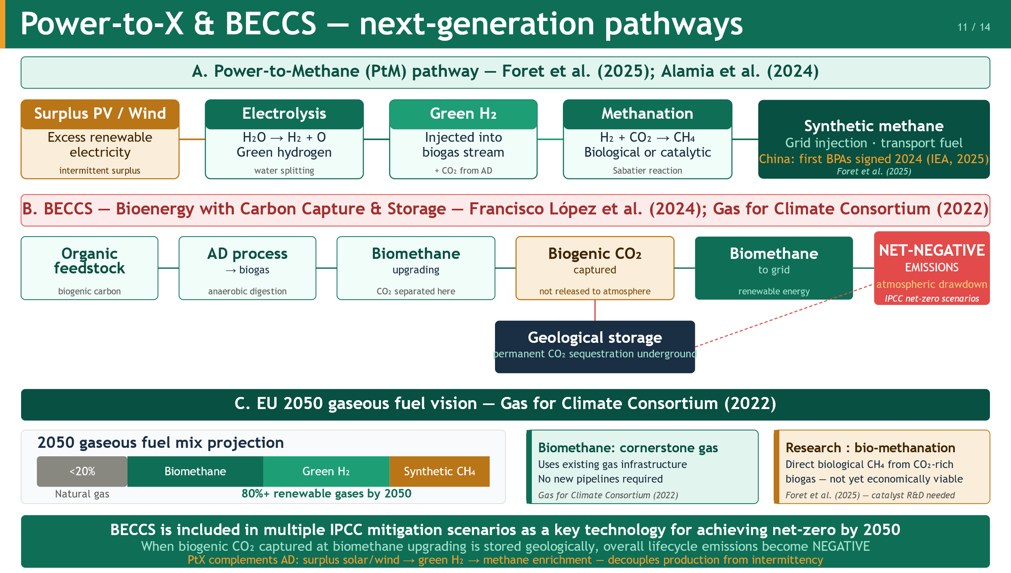
Notes:
Two emerging pathways extend biogas well beyond its current role. Power-to-Methane converts surplus renewable electricity — via electrolysis to green hydrogen — which is then injected into the biogas stream and converted to synthetic methane through biological or catalytic methanation. This stores intermittent renewable energy as chemical energy in existing gas pipelines. China signed its first PtX biomethane purchase agreements in 2024. BECCS goes further: when the biogenic CO₂ separated during biomethane upgrading is captured and stored geologically rather than vented, the system's lifecycle emissions become negative — not just neutral, but carbon-removing. This pathway is included in multiple IPCC net-zero 2050 scenarios. The EU's long-term strategy projects natural gas falling below 20 percent of the gaseous fuel mix by 2050, with biomethane, green hydrogen, and synthetic methane filling the remainder.

Slide 12
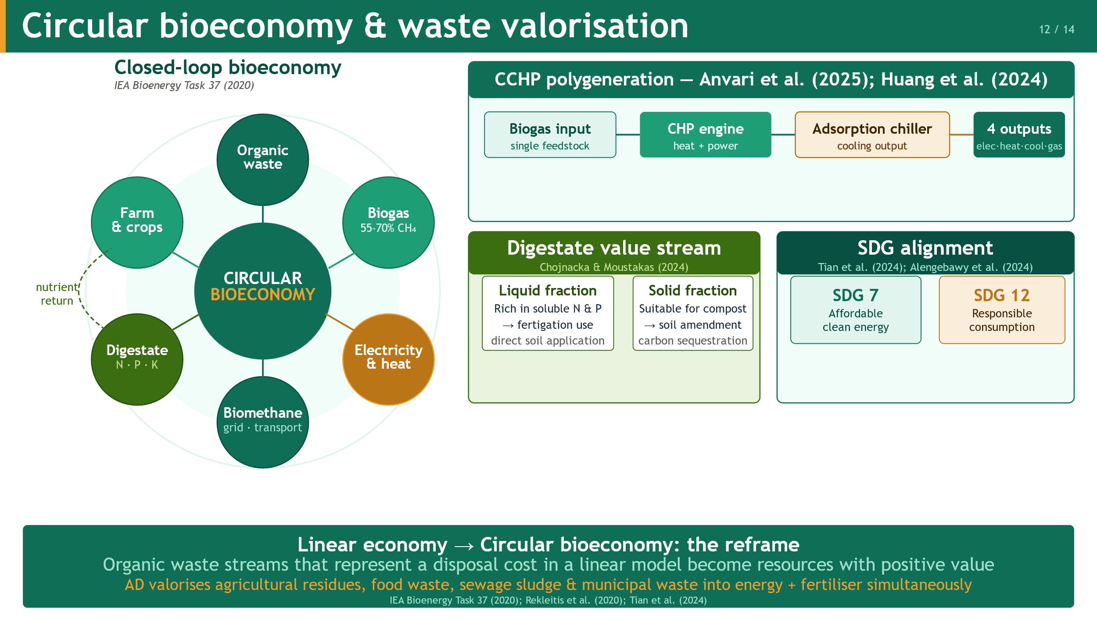
Notes:
Circular economy thinking reframes organic waste — a disposal cost in a linear model — as a resource with positive value. Anaerobic digestion is the central technology enabling that reframe: it simultaneously converts waste streams into energy and fertilizer. The most advanced polygeneration configuration is the CCHP system, in which a biogas CHP unit drives an adsorption chiller for cooling. A 2024 study by Huang et al. adds an innovative twist: recycling CO₂-rich exhaust back into the digester boosts methane yield through hydrogenotrophic methanogenesis — a circular internal loop that turns combustion waste into biological production input. Digestate provides a second value stream: the liquid fraction feeds crop directly through fertigation, the solid fraction composts into soil amendment. And the system simultaneously addresses two UN SDGs — SDG 7 clean energy and SDG 12 responsible consumption — within the same physical plant.

Slide 13
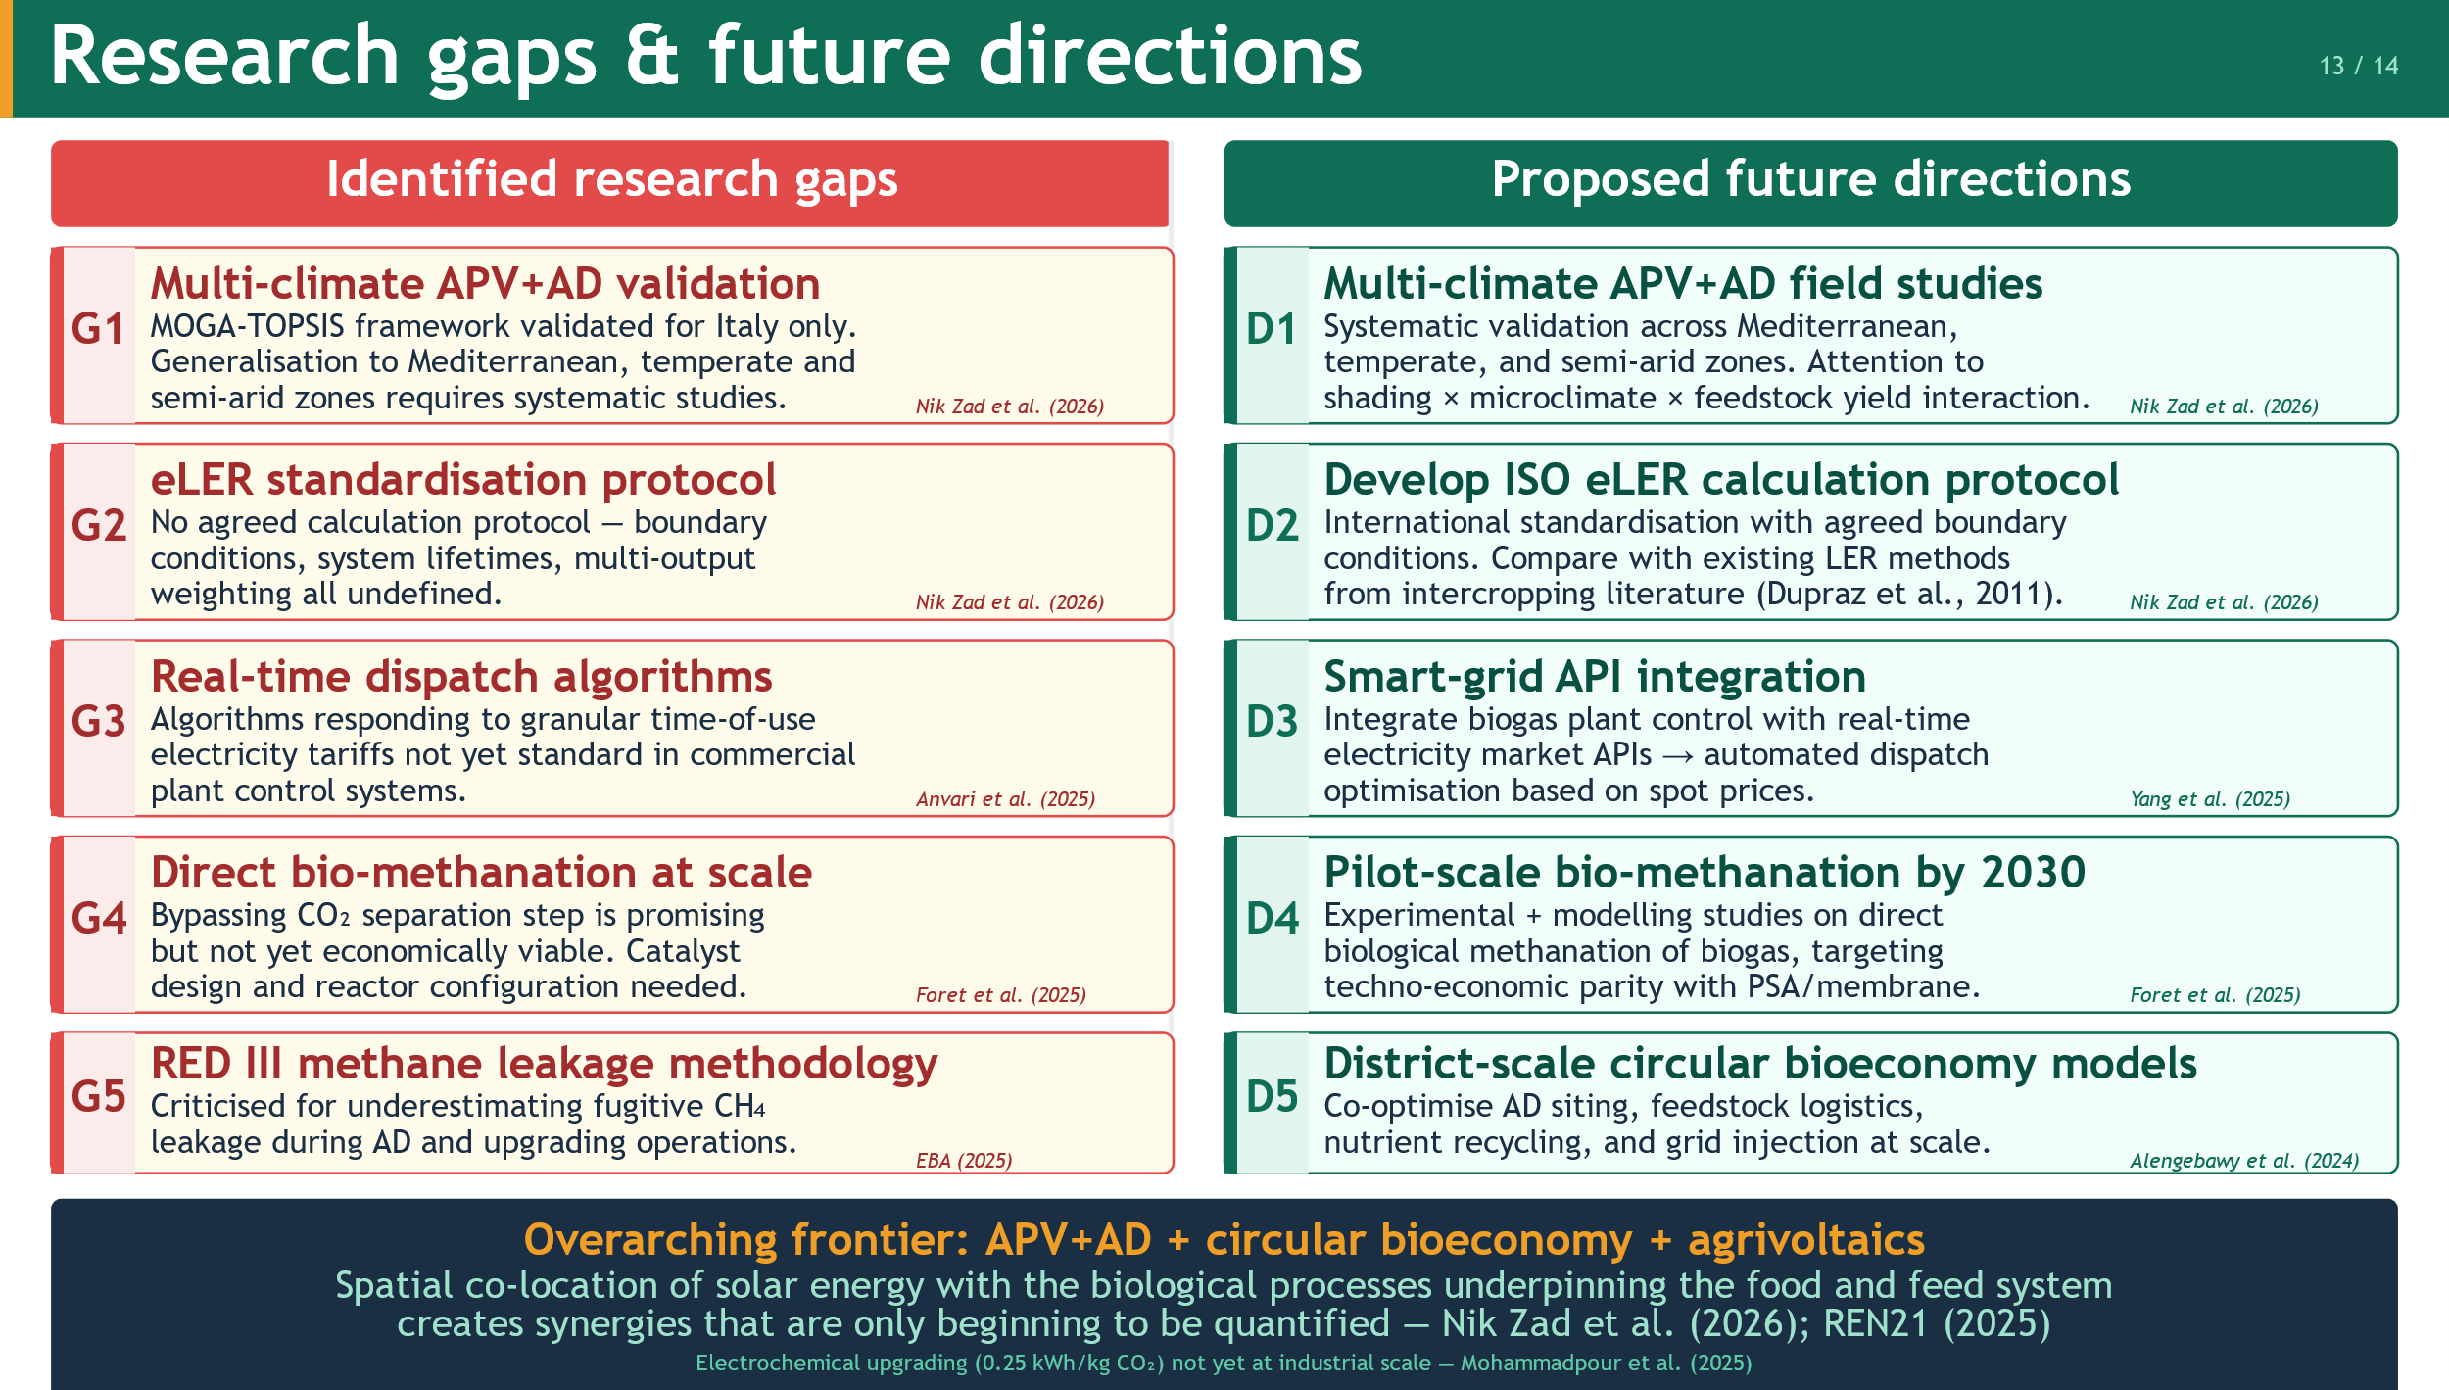
Notes:
Five critical gaps emerge from this review. First, the APV+AD framework has only been validated for Italian conditions — generalization to other climates is urgently needed. Second, the eLER metric has no standardized calculation protocol, limiting its use as a policy tool. Third, real-time biogas dispatch algorithms that respond to dynamic electricity tariffs are not yet commercially standard. Fourth, direct biological methanation — bypassing the CO₂ separation step — is promising but not yet economically viable at scale. Fifth, RED III's environmental assessment methodology has been criticized for underestimating fugitive methane leakage during AD and upgrading operations. Each gap maps directly to a proposed future direction: multi-climate field studies, an ISO eLER protocol, smart-grid API integration, pilot-scale bio-methanation by 2030, and improved lifecycle methane accounting.

Slide 14
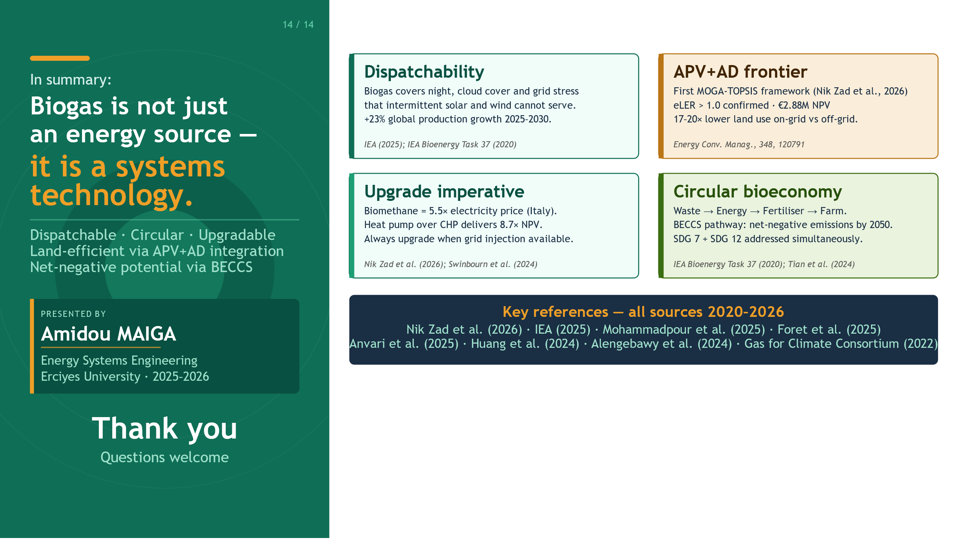
Notes:
To close. This review confirms three things. Biogas is the dispatchable backbone that net-zero energy systems cannot function without. Biomethane upgrading — at 5.5 times the electricity price — is the economically strong incitive strategy for grid injection. And APV+AD integration, confirmed by eLER greater than one, resolves the land-food-energy trilemma that has historically been bioenergy's greatest vulnerability. The APV+AD framework of Nik Zad et al. is a methodological milestone, the eLER metric is a genuine conceptual innovation, and the five research directions identified here chart a clear path for the next five years. The intersection of agrivoltaics, anaerobic digestion, and circular bioeconomy thinking is one of the most promising frontiers in applied renewable energy research today. Thank you very much for your attention — I am happy to take your questions.

