Slide 1
SEMINAR PRESENTATION
Integrated Agrivoltaic–Anaerobic Digestion
Optimization Across Four Climate Zones
A Novel Extended Land Equivalent Ratio Framework
for Food-Energy-Water Nexus Assessment
Sites: Konya (Türkiye) · Almería (Spain) · Ouagadougou (Burkina Faso) · Freiburg (Germany)
Amidou MAIGA | Erciyes University
Prof. Dr. Gamze GENÇ

Slide 2
1
Methodology
Framework Design, Models & Optimization

Slide 3
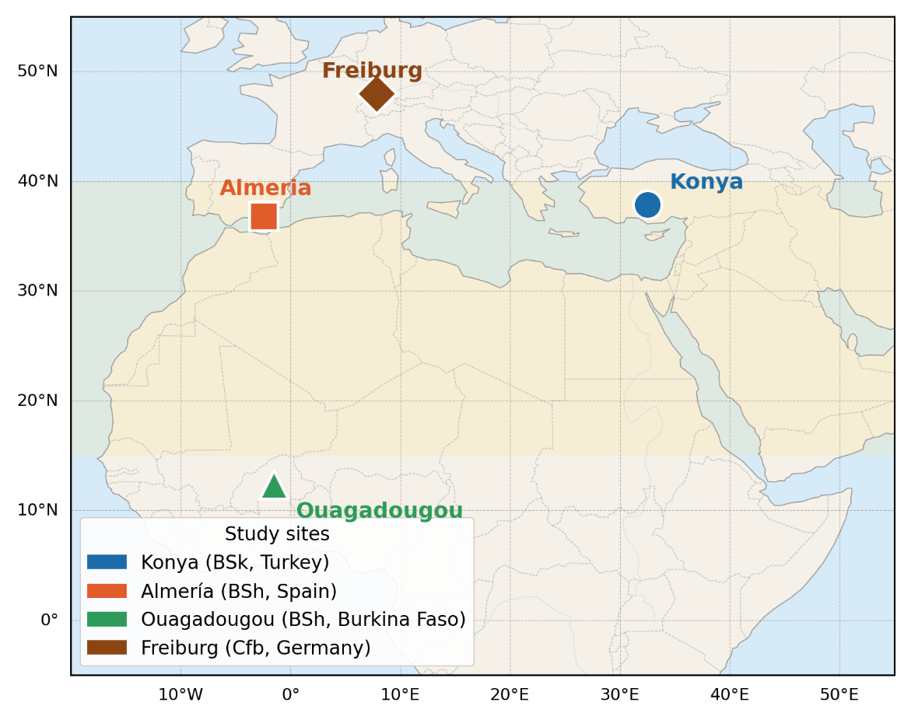
METHODOLOGY
Study Sites
Konya (Turkey)
Almería (Spain)
Ouagadougou (Burkina Faso)
Freiburg (Germany)

Slide 4

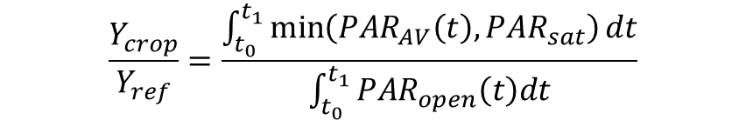

METHODOLOGY
PV Model & Crop Yield Equations
Cell Temperature — Faiman (2008) (Eq. 9)
Crop Yield Ratio — PAR Integral (Eq. 11)
$$T_{cell\left(t\right)}= T_{amb\left(t\right)}+\frac{G_{eff\left(t\right)}}{\left(U_{0}+ U_{1}× u\left(t\right)\right)}$$
$$\frac{Y_{crop}}{Y_{ref}}=\frac{\int_{t_{0}}^{t_{1}}{\min\left(PAR_{AV}\left(t\right),PAR_{sat}\right)dt}}{\int_{t_{0}}^{t_{1}}{PAR_{open}\left(t\right)dt}}$$
U₀ = 25 W/m²·K | U₁ = 6.84 W·s/m³·K (wind-dependent convective cooling)
PAR_sat (tomato) = 174 W/m² vs. lettuce = 76 W/m²
PV Power Output (Eq. 10)
$$P_{PV\left(t\right)}= P_{STC}× N × \left(1−η_{loss}\right)×\left[1 + β_{p}\left(T_{cell\left(t\right)}− 25\right)\right]×\frac{G_{eff\left(t\right)}}{1000}$$
P_STC = 550 Wp (Jinko Tiger Neo bifacial) βp = −0.0035 K⁻¹ η_loss = 0.12

Slide 5


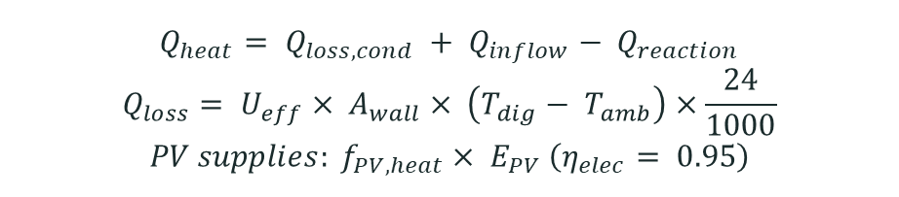
METHODOLOGY
Anaerobic Digestion & Arrhenius Correction
Arrhenius BMP Temperature Correction (Eq. 2)
$${BMP}_{T} = {BMP}_{ref} × exp⁡( θ × (T − T_{ref} )$$
$$θ = 0.069 °C^{−1} T_{ref}= 37°C$$
Digester Heat Balance (Eq. 18)
$$Q_{heat}= Q_{loss,cond} + Q_{inflow}− Q_{reaction}$$
$$Q_{loss}= U_{eff}× A_{wall}× \left(T_{dig}− T_{amb}\right)×\frac{24}{1000}$$
$$PV supplies: f_{PV,heat}× E_{PV} \left(η_{elec}= 0.95\right)$$
Energy Self-sufficiency Ratio (ESR)
$$ESR =\frac{\left(E_{PV}+ E_{biogas}\right)}{Q_{heat}} ≫ 1$$

Slide 6
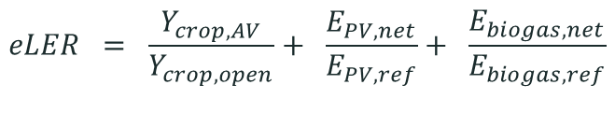
METHODOLOGY
The eLER Metric — Central Contribution
The eLER extends the classical two-component LER to include net biogas energy as a third land-use output:
$$eLER = \frac{Y_{crop, AV}}{Y_{crop,open}}+ \frac{E_{PV,net}}{E_{PV,ref}}+ \frac{E_{biogas,net}}{E_{biogas,ref}}$$
Study | Location | Crop | LER | System type
Dupraz et al. (2011) | France | Durum wheat | 1.35 | Fixed-tilt, modelled
Mohammedi et al. (2023) | Italy | Tomato | 1.42 | Fixed-tilt, exp.
Riaz et al. (2022) | USA (AZ) | Tomato | 1.94 ★ | Bifacial, optimized
Mazzeo et al. (2025) | Italy | Lettuce | 1.85 | Open-field, optimized

Slide 7
METHODOLOGY
Integrated Modelling Framework
Six coupled sub-models simultaneously optimized over six design variables:
PVGIS-SARAH3
Climate Data
Solar Geometry
& Shading
Bifacial PV
Model
Crop Yield
(PAR integral)
ET Reduction
(Penman-M.)
AD Biogas
+ Heat Balance
Hourly TMY
Eq. 6
Eq. 10
Eq. 11
Eq. 14
Eq. 18
Differential Evolution Optimizer → Maximize eLER

Slide 8
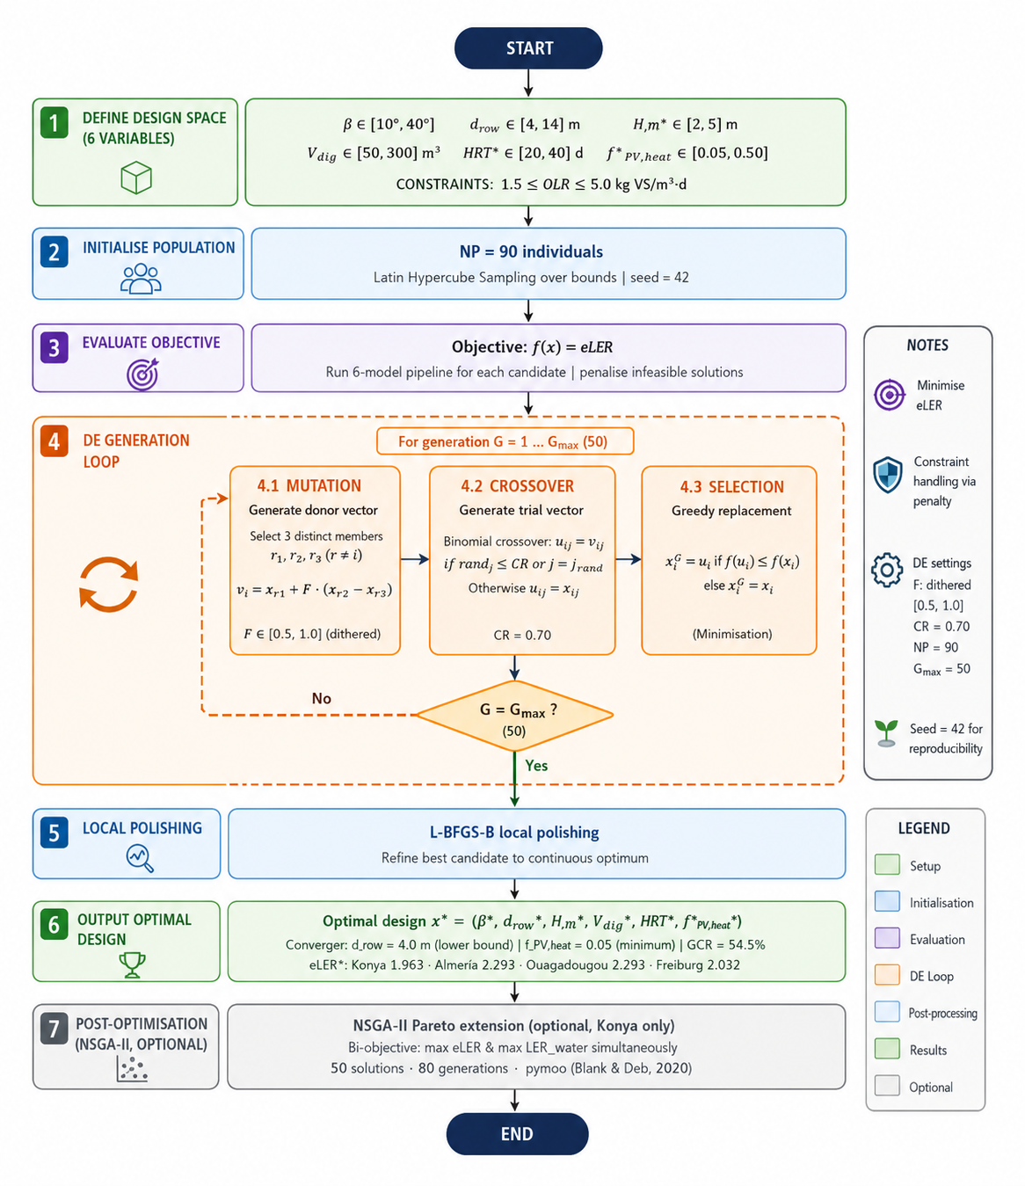
METHODOLOGY
Optimization Design & AD Scenarios : Differential Evolution Optimizer

Slide 9
METHODOLOGY
Optimization Design & AD Scenarios
Table 7: AD Valorization Scenarios (S0–S5)
Scenario | Description | Key change
S0 | Baseline — mono-digestion | BMP_mult = 1.00
S1 | Co-digestion (+30% manure) | +15% BMP
S2 | Sub-optimal CH₄ capture | η_cap = 0.85
S3 | LPG displacement (on-site) | p_biogas = $0.18/kWh
S4 | Digestate N-P-K credit | N credit $1.20/kg
S5 | Biomethane grid injection ★ | 5.5× electricity price
★ S5 motivated by Nik Zad et al. (2026): biomethane = 5.5× electricity market price (Italian / EEG 2023)
* Open-field German yield (DLG, 2023); residue input = 24 t/ha vs. 48 t/ha at semi-arid sites — propagated through all economic & eLER calculations

Slide 10
02
Data Inputs
PVGIS-SARAH3 Climate Data · Seasonal Profiles

Slide 11
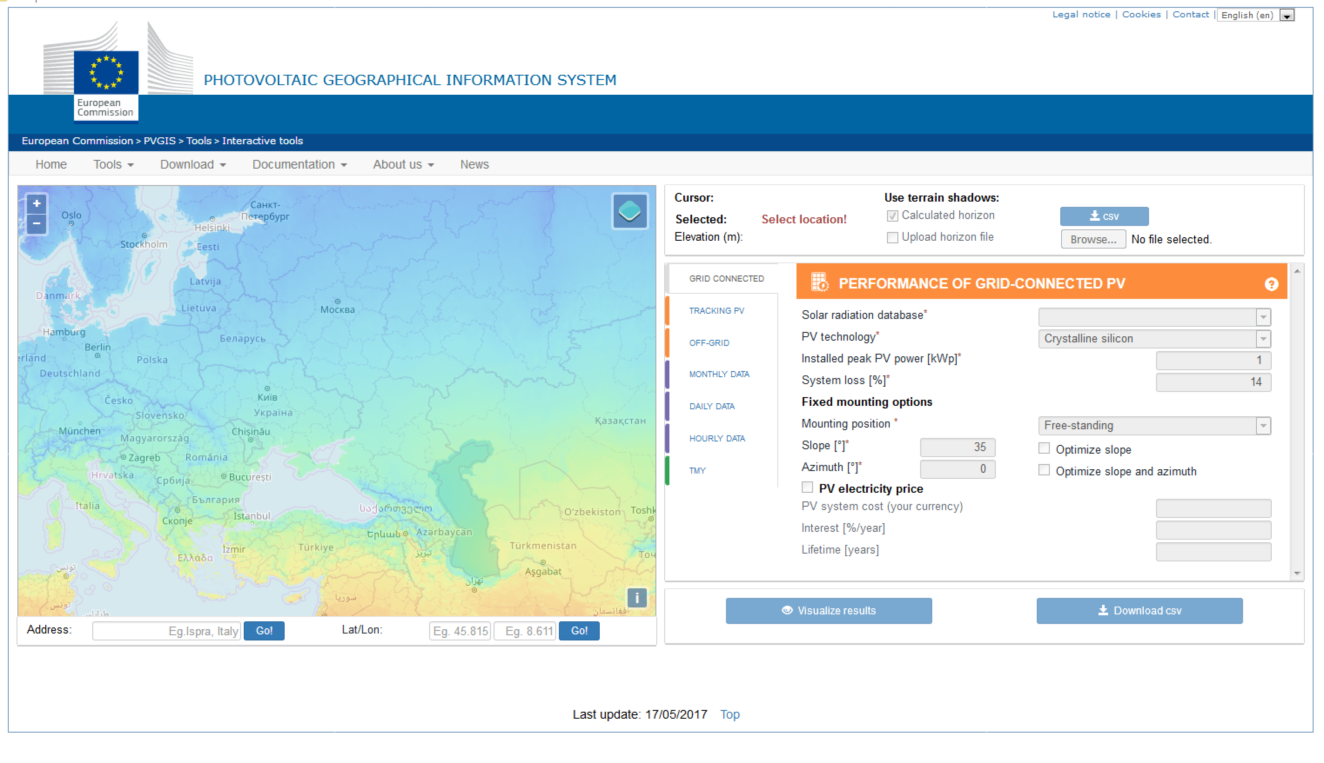
METHODOLOGY
PVGIS TYPICAL METEROLOGICAL YEAR (TMY) – SARAH3
Date & time (UTC)
T2m [°C] - Dry bulb (air) temperature.
RH [%] - Relative Humidity.
G(h) [W/m2] - Global horizontal irradiance.
Gb(n) [W/m2] - Direct (beam) irradiance.
Gd(h) [W/m2] - Diffuse horizontal irradiance
IR(h) [W/m2] - Infrared radiation downwards.
WS10m [m/s] - Windspeed.
WD10m [°] - Wind direction.
SP [Pa] - Surface (air) pressure.
https://re.jrc.ec.europa.eu/pvg_tools/en/#TMY

Slide 12
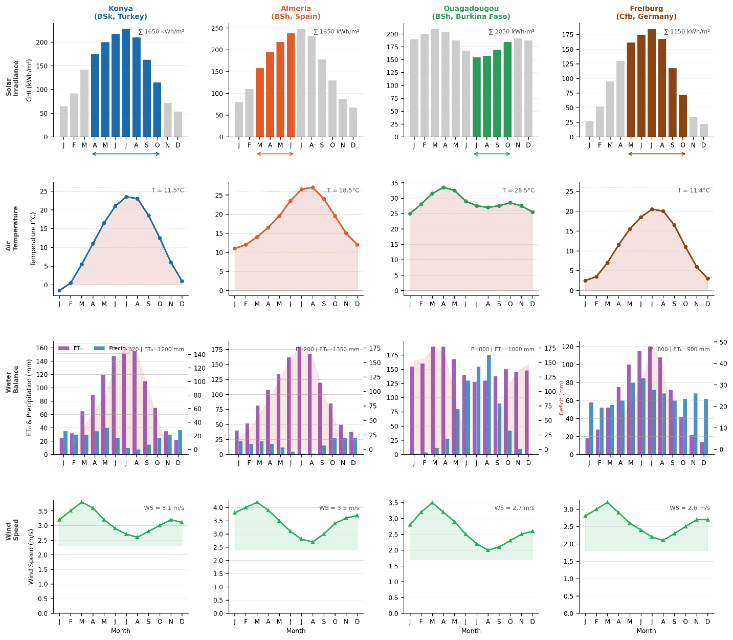
DATA INPUTS
Climate Data & Seasonal Profiles
PVGIS-SARAH3 Typical Meteorological Year (TMY) hourly data — mean bias error < ±5% for monthly GHI (Huld et al., 2012; Urraca et al., 2017). DNI and DHI extracted directly (not decomposed from GHI).

Slide 13
METHODOLOGY
Study Sites & Climate Zones
Table 4: Geographical & climatic characteristics (PVGIS-SARAH3 TMY)
Parameter | Konya (BSk) | Almería (BSh) | Ouagadougou (BSh) | Freiburg (Cfb)
Latitude | 37.87°N | 36.83°N | 12.37°N | 47.99°N
Köppen climate | BSk cold semi-arid | BSh hot semi-arid | BSh tropical semi-arid | Cfb oceanic temp.
Mean annual GHI (kWh/m²) | 1,650 | 1,850 | 2,050 | ~1,150
Mean annual T (°C) | 11.5 | 18.5 | 28.5 | ~11.4
Summer Tmax (°C) | 38 | 35 | 41 | ~35
Winter Tmin (°C) | −10 | +5 | +15 | ~−12
Annual ET₀ (mm) | 1,200 | 1,350 | 1,800 | ~900
Annual Precip. (mm) | 320 | 200 | 800 | ~800

Slide 14
03
Results
Optimization · eLER · Energy · Water · Scenarios

Slide 15
RESULTS
Optimal Design Parameters
Table 9: Optimal design variables and primary performance metrics — all four sites
Parameter | Konya (BSk) | Almería (BSh) | Ouagadougou (BSh) | Freiburg (Cfb)
Tilt angle β (°) | 33.3 | 19.3 | 26.0 | 15.9
Row spacing d_row (m) | 4.00 | 4.00 | 4.00 | 4.00
Module height Hm (m) | 2.02 | 3.03 | 2.48 | 2.69
Digester volume V_dig (m³) | 64 | 80 | 114 | 53
HRT design (days) | 29.1 | 21.8 | 22.8 | 20.8
PV heating fraction f_PV,heat | 0.050 | 0.050 | 0.050 | 0.050
GCR (%) | 54.5 | 54.5 | 54.5 | 54.5
OLR (kg VS/m³·d) | 4.35 | 4.67 | 3.13 | 3.70
Key finding: Optimizer converges to d_row = 4.0 m (lower bound) and f_PV,heat = 0.05 (minimum) at ALL four sites → GCR = 54.5% everywhere. Boundary convergence indicates eLER-maximizing solution lies at the edge of the feasible domain.

Slide 16
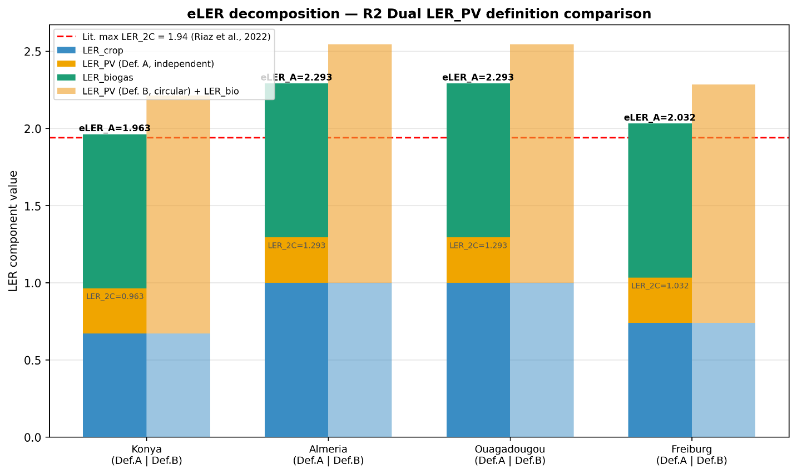
RESULTS
eLER Decomposition — Main Result

Slide 17
RESULTS
eLER Decomposition — Main Result
Table 10: eLER decomposition, all four sites (Scenario S0, Baseline)
Metric | Konya (BSk) | Almería (BSh) | Ouagadougou (BSh) | Freiburg (Cfb)
LER_crop | 0.670 | 1.000 ✦ | 1.000 ✦ | 0.739
LER_PV (Def. A — independent) | 0.293 | 0.293 | 0.293 | 0.293
LER_PV (Def. B — circular = GCR) | 0.545 | 0.545 | 0.545 | 0.545
LER_biogas | 1.000 | 1.000 | 1.000 | 1.000
eLER_global (Def. A) | 1.963 | 2.293 | 2.293 | 2.032
LER_2C = LER_crop + LER_PV(A) | 0.963 | 1.293 | 1.293 | 1.032
Lit. max LER_2C (Riaz et al. 2022) | 1.94 ★ | 1.94 ★ | 1.94 ★ | 1.94 ★
✦ Penalty-free PV: LER_crop = 1.000 at Almería & Ouagadougou — high solar elevation → near-zero shading during growing season

Slide 18
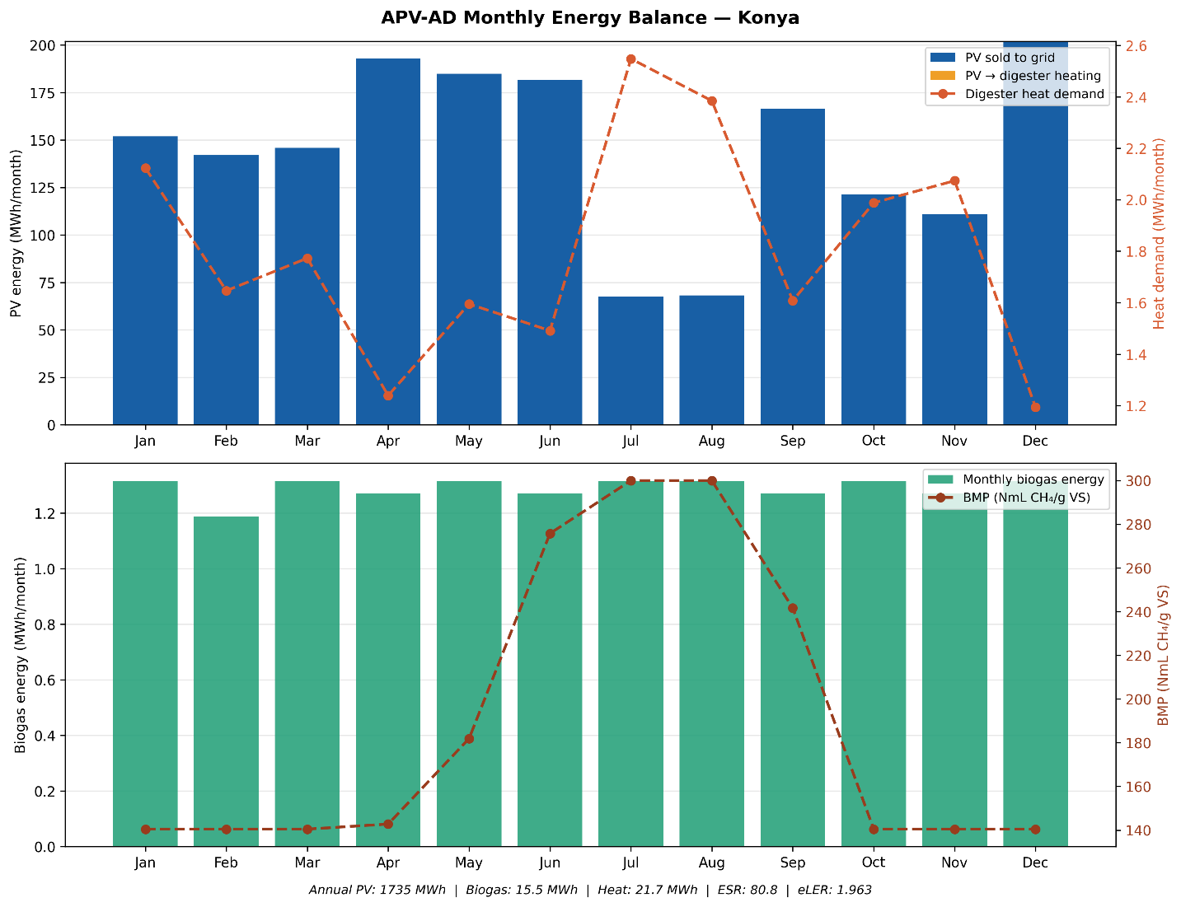
RESULTS
Annual Energy Performance & Thermal Balance : Konya

Slide 19
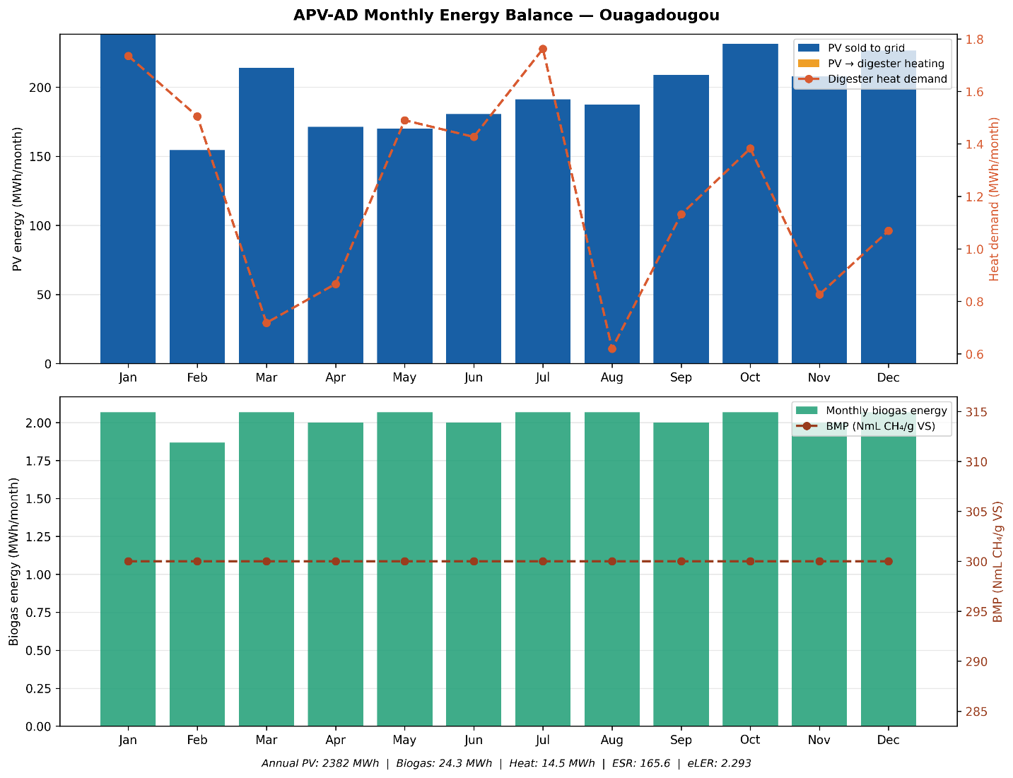
RESULTS
Annual Energy Performance & Thermal Balance : Ouagadougou

Slide 20
RESULTS
Annual Energy Performance & Thermal Balance
Table 11: Annual energy performance — all four sites
Parameter | Konya | Almería | Ouagadougou | Freiburg
PV total (MWh/ha·yr) | 1,735 | 2,227 | 2,382 | 1,560
PV sold to grid (MWh/ha·yr) | 1,649 | 2,116 | 2,263 | 1,482
Annual biogas total (MWh/ha) | 15.5 | 17.8 | 24.3 | 6.0
Annual heat demand (MWh/ha) | 21.7 | 23.3 | 14.5 | 20.5
Biogas used for heating | 0.0 | 0.0 | 0.0 | 0.0
ESR | 80.8 | 96.2 | 165.6 | 76.3
BMP annual avg (NmL CH₄/gVS) | 190.7 | 218.8 | 300.0 | 148.8

Slide 21
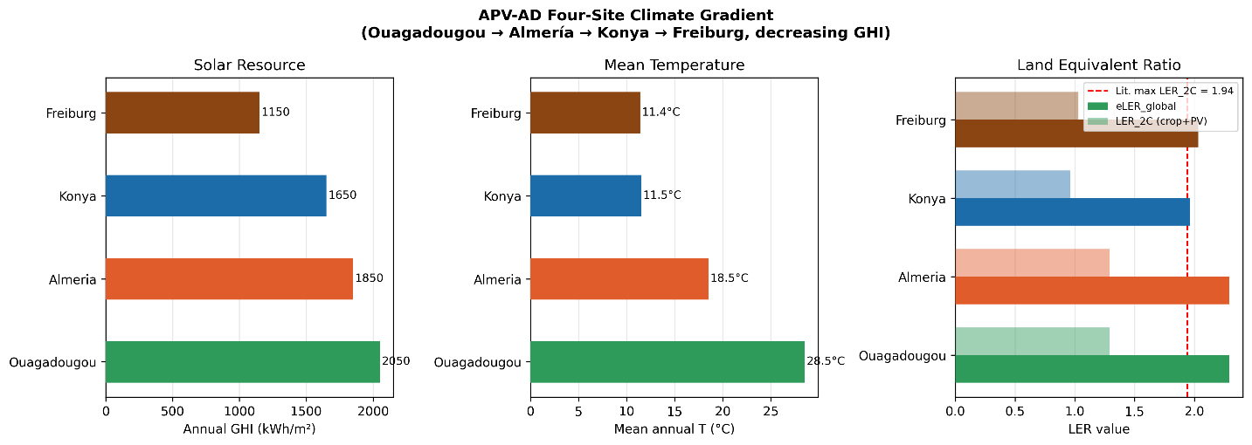
RESULTS
Climate Gradient: Counter-Intuitive eLER Ordering
GHI gradient: Ouagadougou > Almería > Konya > Freiburg
eLER gradient: Almería = Ouagadougou > Freiburg > Konya ← does NOT follow GHI !

Slide 22
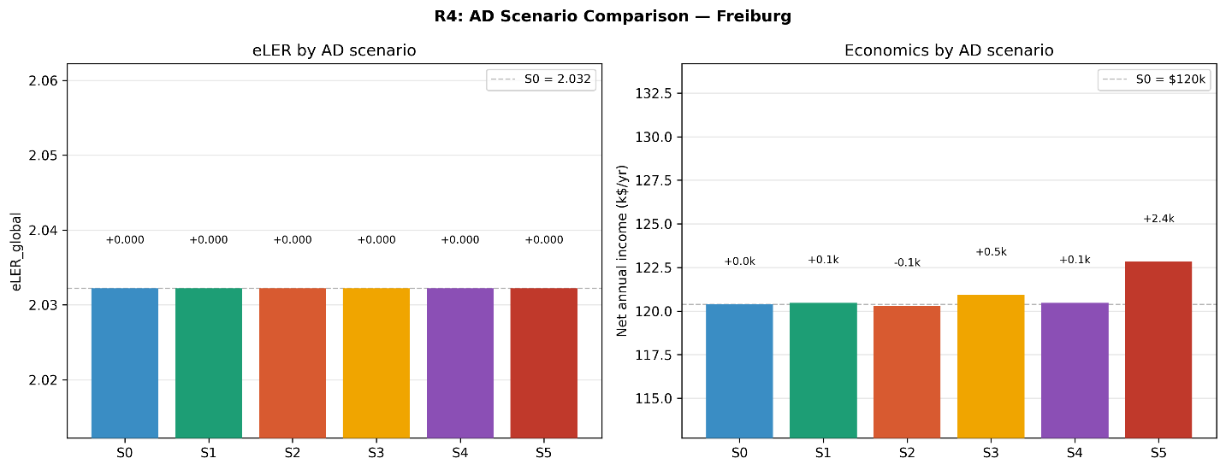
RESULTS
AD Scenario Economics (S0–S5)
eLER is invariant across all scenarios (ΔeLER = 0.000 for S0–S5) — structural result. Economic differentiation only.
Net annual income by scenario — summary (k$/yr):

Slide 23
RESULTS
AD Scenario Economics (S0–S5)
eLER is invariant across all scenarios (ΔeLER = 0.000 for S0–S5) — structural result. Economic differentiation only.
Net annual income by scenario — summary (k$/yr):
Scenario | Konya | Almería | Ouagadougou | Freiburg
S0 Baseline | $91k | $195k | $267k | $120k
S1 Co-digestion | $91k | $196k | $267k | $120k
S3 LPG displacement | — | — | +$2.4k | —
S5 Biomethane ★ | +$3.9k | +$7.2k | +$14.1k | +$2.4k
Payback period (yr) | 9.4 yr | 4.5 yr | 3.3 yr | 7.1 yr
★ S5 increments over S0 Baseline. S5 adds $14.1k (+5.3%) at Ouagadougou (highest biogas volume). Freiburg S5 limited by 6.0 MWh/yr biogas. Note: figures are revenue minus OpEx — not full NPV/IRR.

Slide 24
04
Limitations & Future Research
Scope, Uncertainty, and Open Questions

Slide 25
LIMITATIONS & FUTURE RESEARCH
Limitations
L1
Crop yield model uncertainty
L4
Biomethane S5 — no upgrading CAPEX
L2
ET model scope
L5
Economic analysis — no full NPV/IRR
L3
Digestate–soil feedback (Gap G6)
L6
Single-crop analysis

Slide 26
LIMITATIONS & FUTURE RESEARCH
Suggestions for Future Research
F1
Multi-crop validation
F4
Field validation — Freiburg / Baden-Württemberg
F2
eLER standardization — alternative LER_biogas
F5
Digestate-to-soil nutrient feedback (Gap G6)
F3
Full NPV/IRR + LCOE with CAPEX breakdown
F6
eLER confidence intervals

Slide 27
Key Conclusions
eLER exceeds the published 1.94 benchmark at ALL four climate zones (1.963–2.293).
1
eLER is non-monotone with solar resource
2
Penalty-free PV confirmed at Mediterranean & tropical sites
3
Thermal self-sufficiency confirmed at all sites (ESR = 76–166).
4
Biomethane S5 is the dominant economic scenario everywhere (+$2.4–14.1k/yr).
5

Slide 28
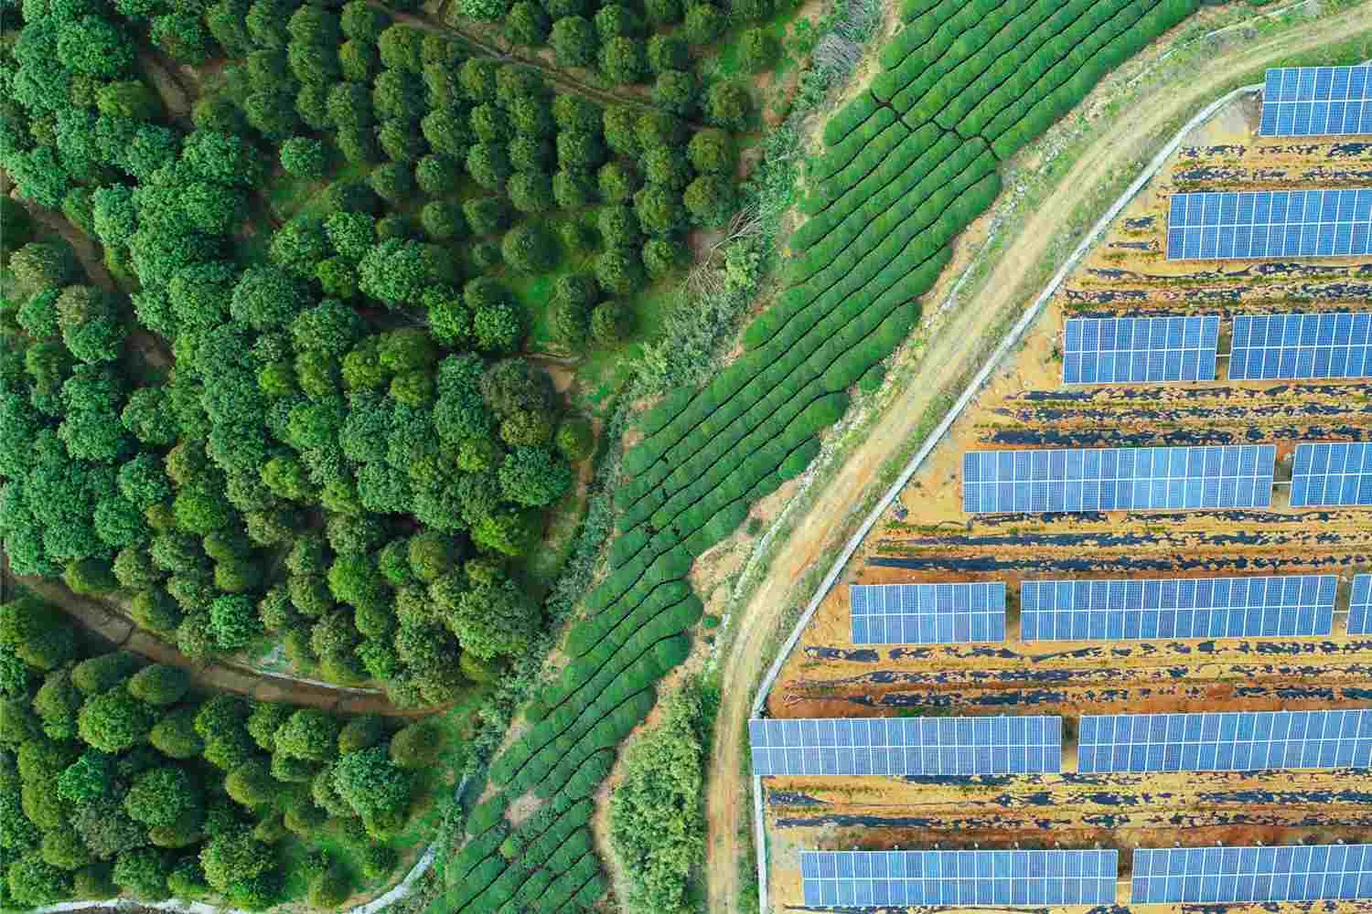
Thank You !

