Slide 1

Dmytro Brazhnyk
Resume attachments

Slide 2
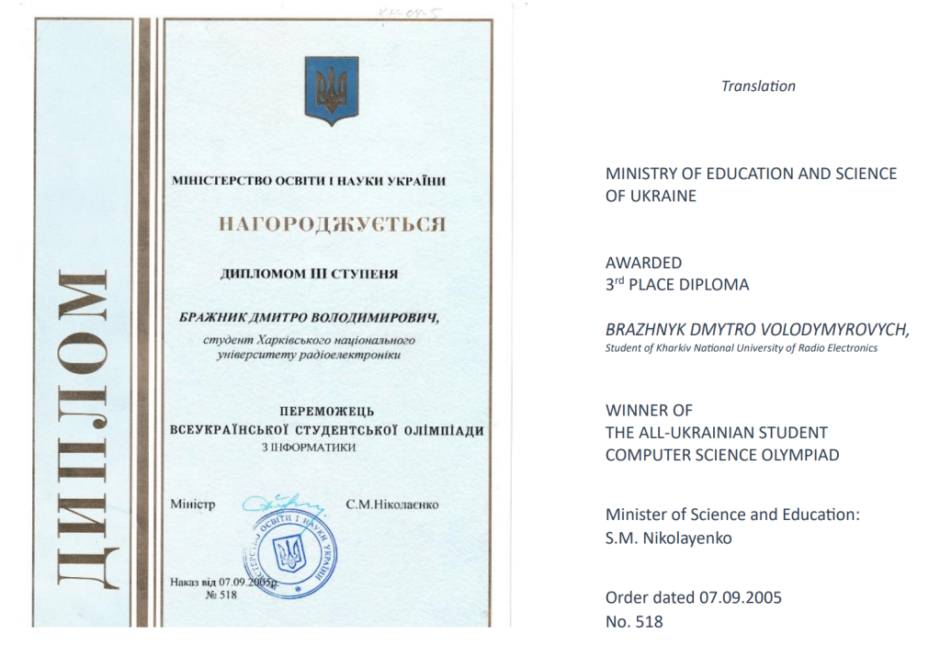
0.18% explained
Let's take as an example, one of my award that I've secured in country-wide computer science algorithms student contest in 2005.

Slide 3
0.18% explained
Let's take next numbers.
There are 20 millions of peoples working in IT world wide, while world population is 6 billions of people
I've taken 3rd place in student competition, and considered that it is in national wide competition, and this competition made every years, so with average life expectancy 80 years, so there are 80 * 3 living nominee of all years in my country
Ukraine population is about 40 million people for that moment
80*3 / (40 million * ( 20 million of IT world wide / 6 billion global population)) = 0.18%
In essence, within a company of 50,000 employees, only 90 individuals showcase comparable or superior talents. (50 000 * 0.18%/100% = 90

Slide 4

0.18% explained
Humble as it may be, it's a challenge to come across someone with my skill set in computer science and its neighboring disciplines.
It is not just a luck, I've proved my exceptional skills many times:
https://dmytrobrazhnyk.wordpress.com/awards/

Slide 5
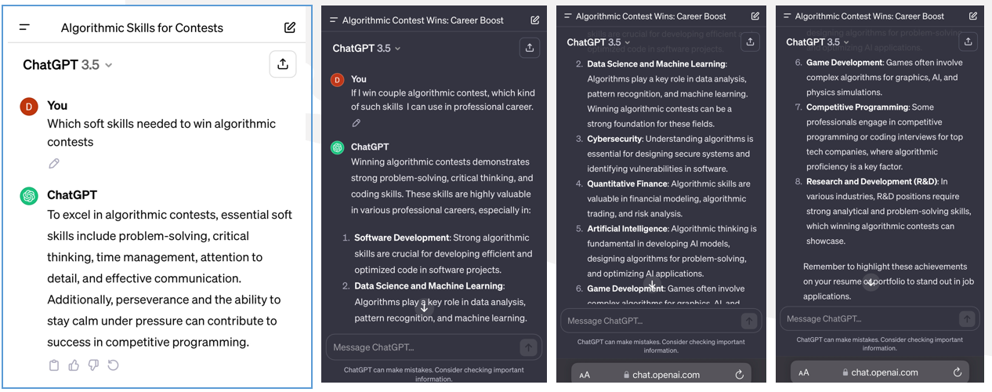
Chat GPT analysis
I’ve also was curious, what would Chat GPT tell me about my awards.
Does it have any connections does it have to professional career?

Slide 6
Chat GPT: Soft-skills analysis
Everything what Chat GPT tells is very true, like
Problem-solving, critical thinking, time management, attentions to details, effective communication, perseverance and ability to work under stress.
Everything the same I can tell about myself.
However, all persons, I worked with before, recognize my problem-solving, critical thinking and analytical skill as something exception, as well as my professional attitude.

Slide 7

Chat GPT: professional career analysis
Software Development – it might be obvious, that everything software engineers are doing at work, is just coding algorithm, maybe not such complex as in contest but still.
Data Science and Machine Learning – AI is new field, to master an AI an get market leadership, you need to be little bit more advance in computer science. Contest proved my ability to think creatively. To secure contest: logical thinking, strong scientifical intuition and imagination is required.

Slide 8

Chat GPT: professional career analysis
Cyber Security – it might not be obvious, how it connected to algorithm, however critical-think, to understand how system behave on its boundaries needed for cybersecurity and during algorithmic contest to secure all test cases. I am strongly ethical person by the way, will never use any of my knowledge for evil.
Game Development - it was my hobby all the time, even though I pursue career of enterprise development, I’ve entered IT industry just of couriosity to game development, and still if I have a spare time I love to learn about some matemathics and hardware acceleration capability related to computer graphics nowday.

Slide 9
About
If you curious about me, how I’ve maned to apply my talents in my professional career and before, you can check on this page, with some less formal description.
https://dmytrobrazhnyk.wordpress.com/about-me/

