Slide 1
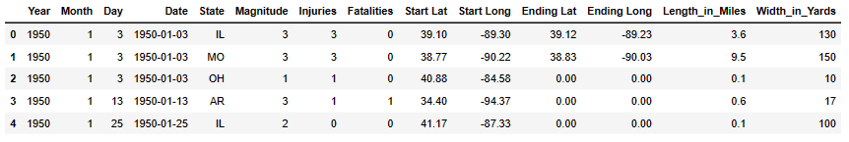

US Tornado Dataset 1950-2021
Prepare and Transform the data
Check Type of Data
Find and remove missing/null Data
Check for duplicates
Check for outliers
Deleting rows
Remove any columns that offer no value
Train and Scale the data

Slide 2

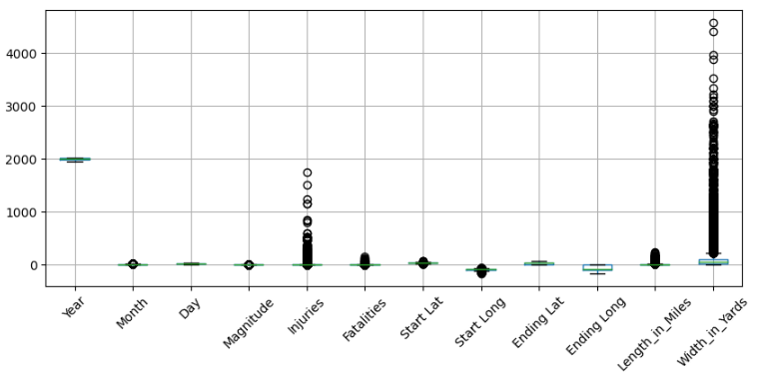
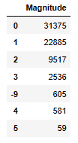
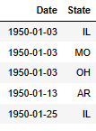
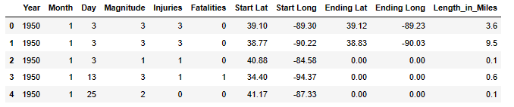


Outliers
Inaccurate Values
Redundant columns
Dataset after Transforming phase

Slide 3

MACHINE LEARNING MODELS
Can Injuries be predicted with the current dataset?
RANDOM FOREST REGRESSOR
Not enough data to accurately run a neural network machine learning model
MULTIPLE LINEAR REGRESSION
Ran and was the best model.
Accuracy = 55%
DECISION TREE REGRESSOR
Accuracy = 47%

