Slide 1
Python-SQL-Project
Objective
The primary goal of this project was to bridge the gap between raw data storage and strategic decision-making. By integrating SQL for data extraction and Python for advanced analytics, I developed a comprehensive pipeline to uncover trends and patterns within
complex datasets.
Key Components of My Work
Data Orchestration: Managed large-scale datasets using SQL to perform complex joins, aggregations, and subqueries.
Advanced Analytics: Leveraged Python (Pandas/NumPy) to clean, manipulate, and perform statistical analysis on the extracted data.
Visual Intelligence: Created dynamic Data Visualizations (using Matplotlib/Seaborn) to translate technical findings into intuitive, easy-to-understand charts

Slide 2
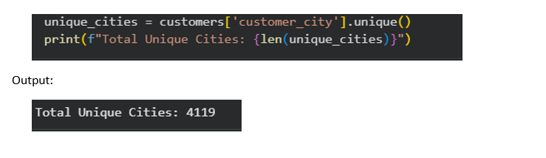
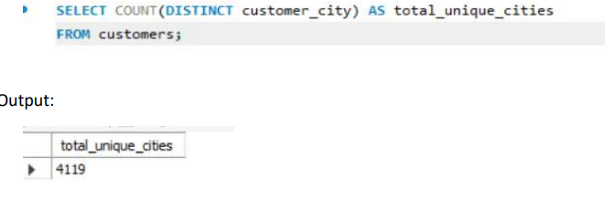
Q1. List all unique cities where customers are located.
Basic Level Question
Python code
SQL code

Slide 3
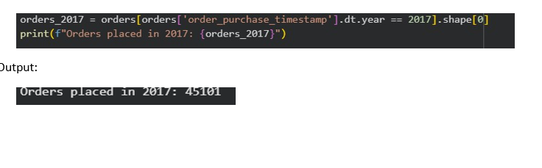
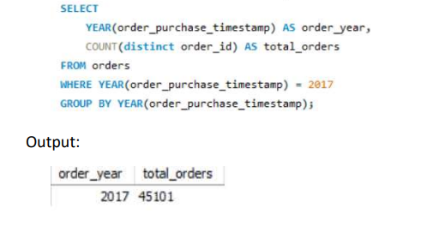
Q2. Count the number of orders placed in 2017
Python code
SQL code

Slide 4
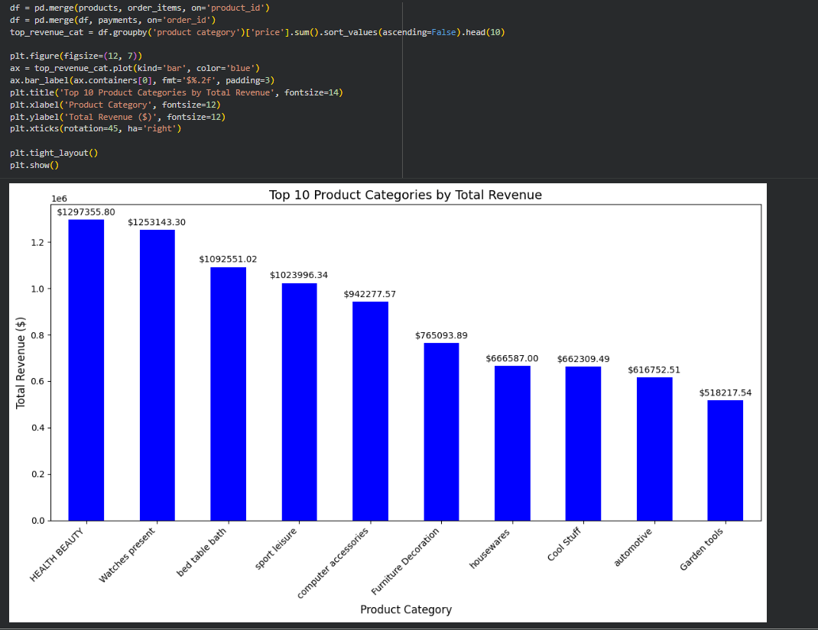
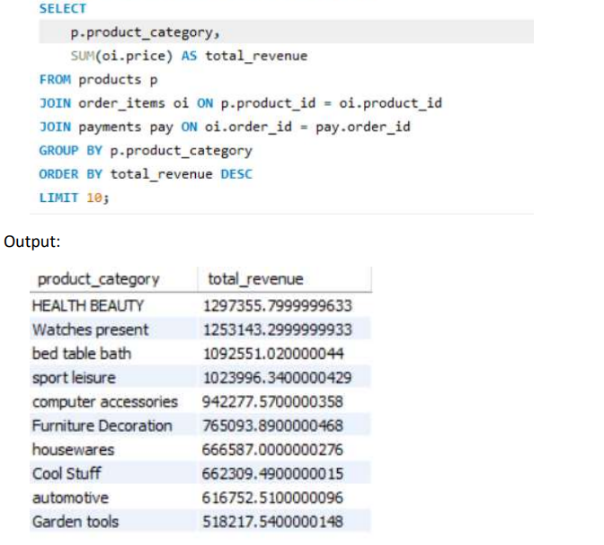
Q3. Find the total sales per category
Python code
SQL code

Slide 5
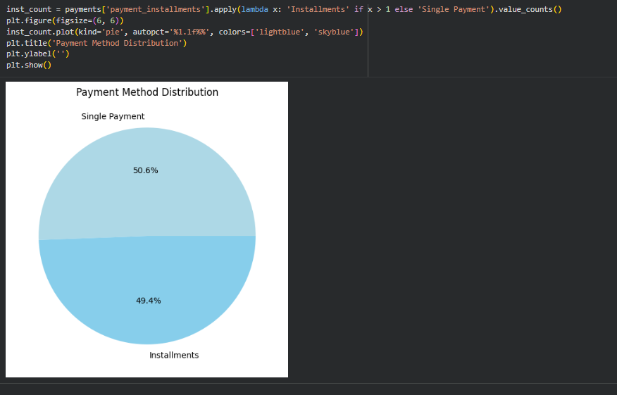
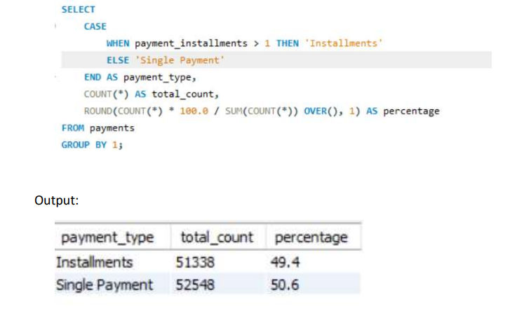
Q4. Calculate the percentage of orders that were paid in more than one installment.
Python code
SQL code

Slide 6
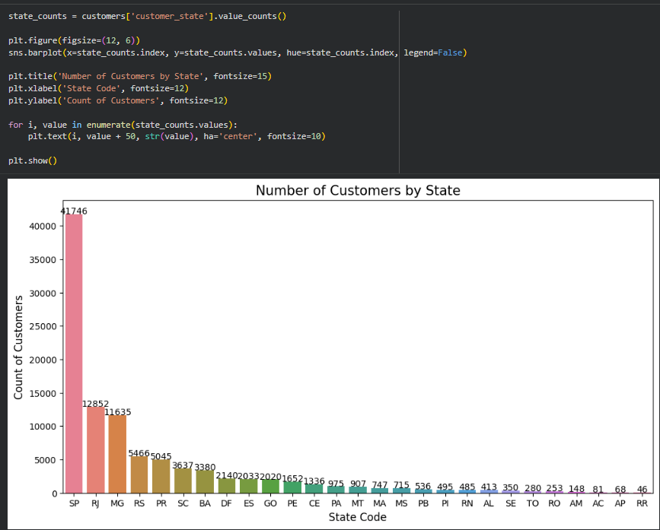
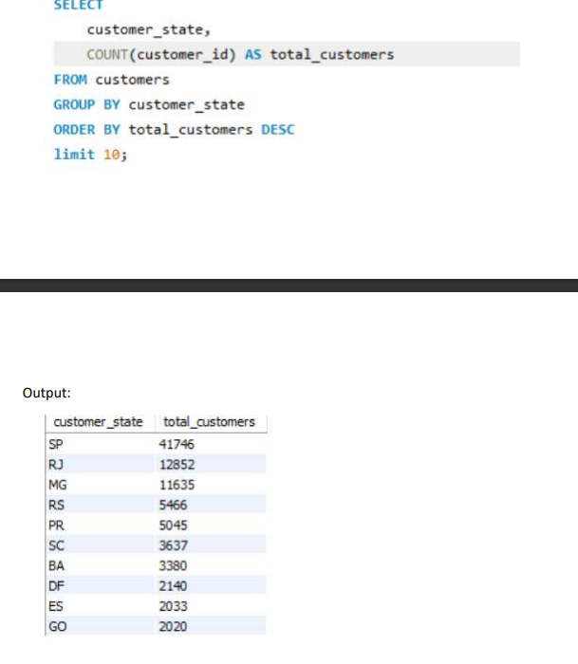
Q5. Count the number of customers from each state.
Python code
SQL code

Slide 7
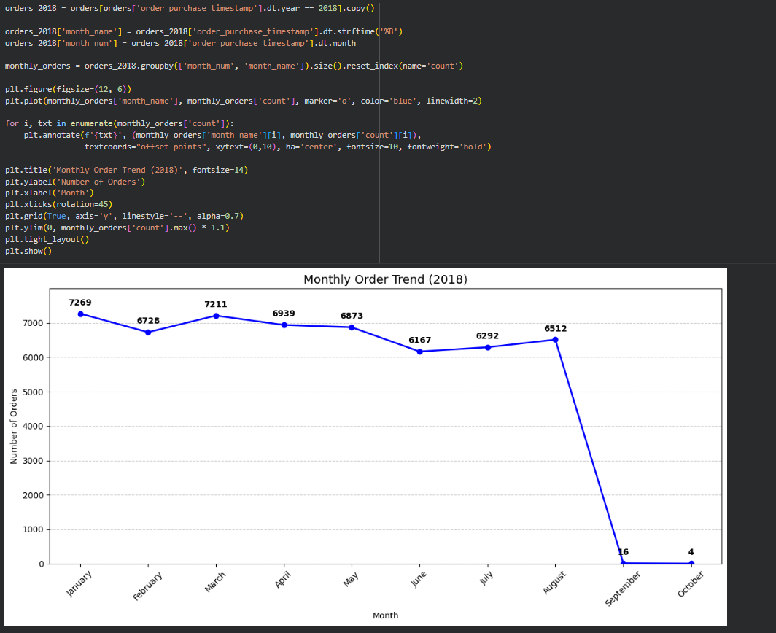
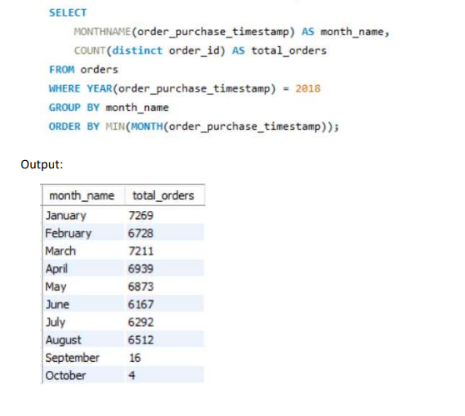
Q1. Calculate the number of orders per month in 2018.
Immediate Level Question
Python code
SQL code

Slide 8
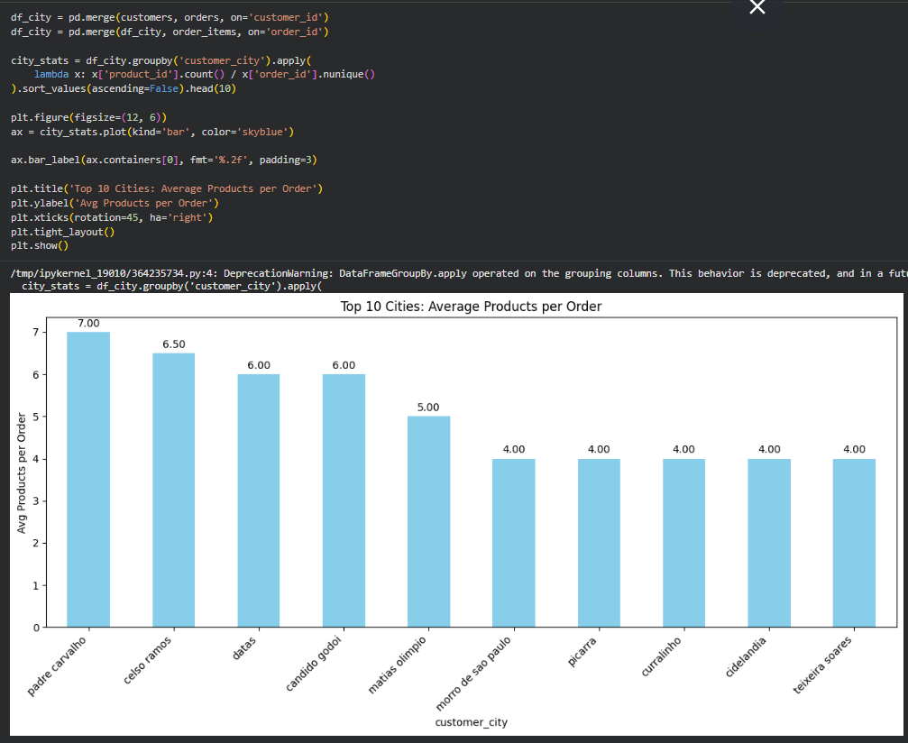
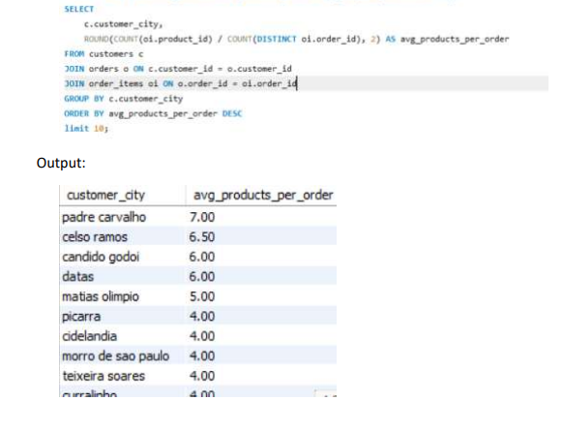
Q2. Find the average number of products per order, grouped by customer city.
Python code
SQL code

Slide 9
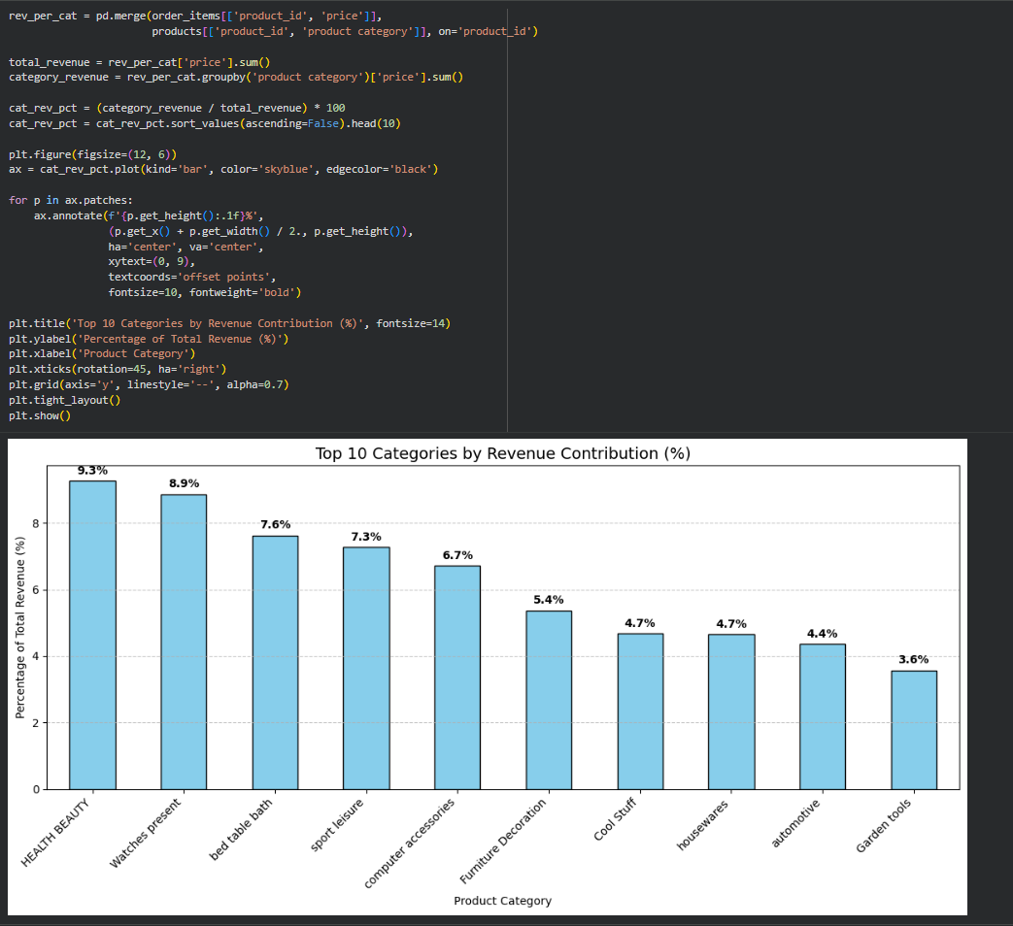
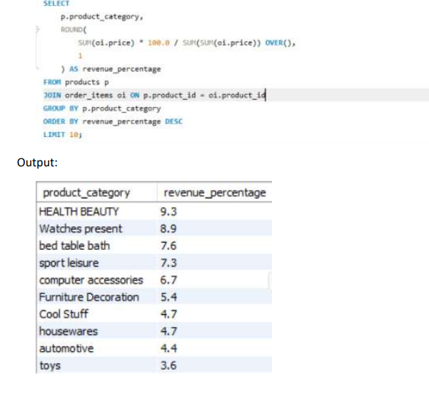
Q3. Calculate the percentage of total revenue contributed by each product category.
Python code
SQL code

Slide 10
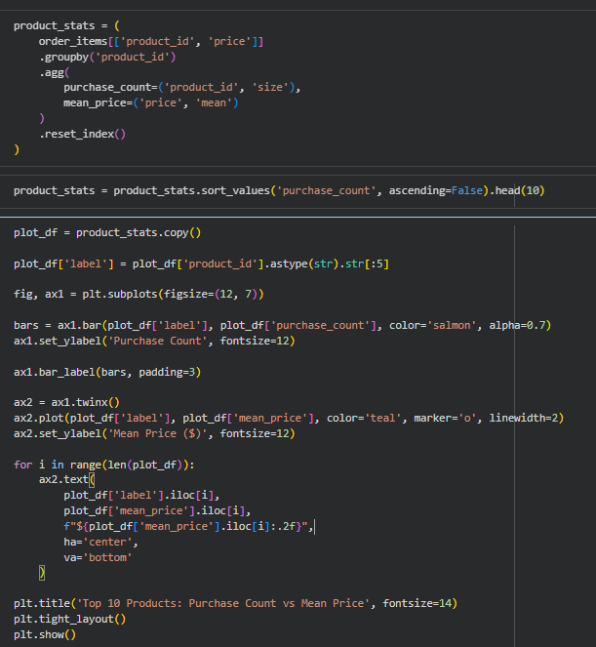
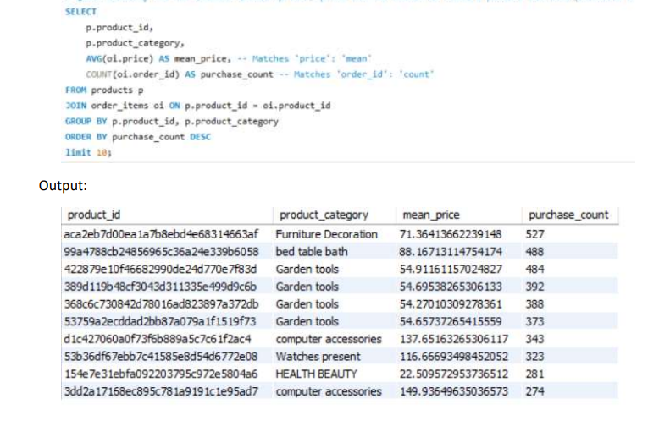
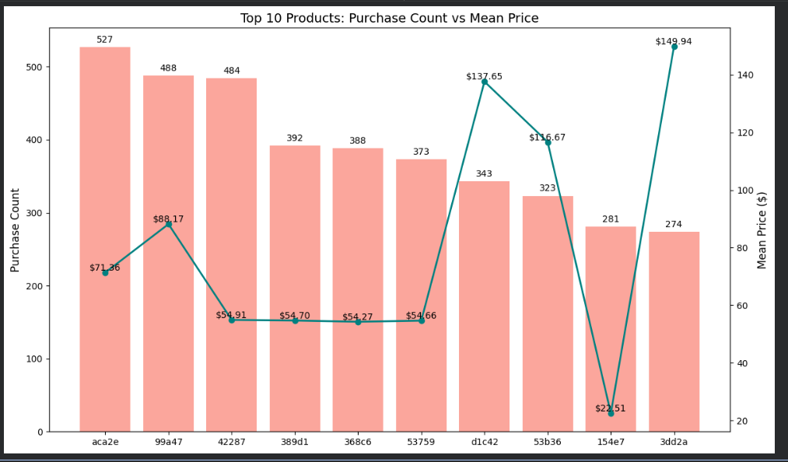
Q4. Identify the correlation between product price and the number of times a product has been purchased.
Python code
SQL code

Slide 11
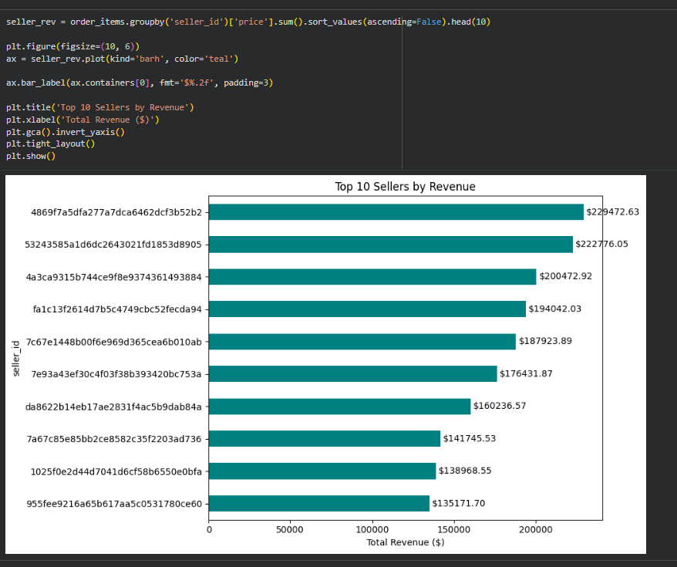
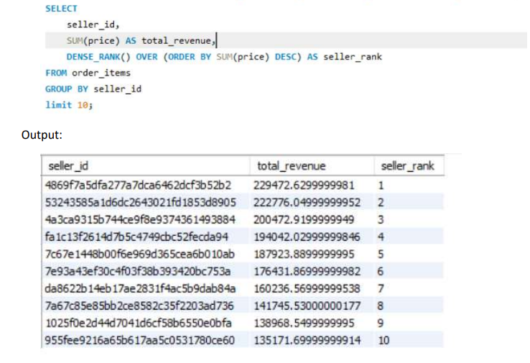
Q5. Calculate the total revenue generated by each seller, and rank them by revenue.
Python code
SQL code

Slide 12
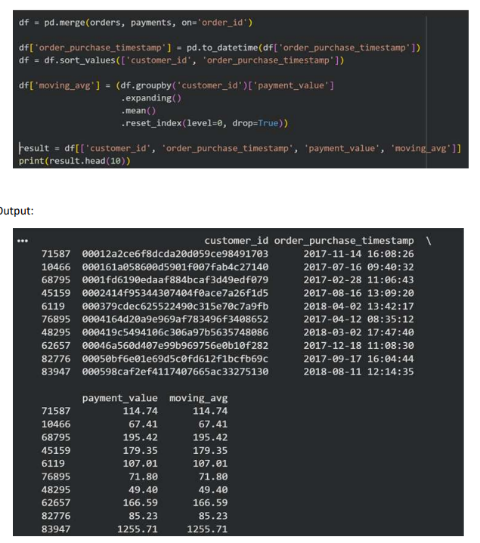
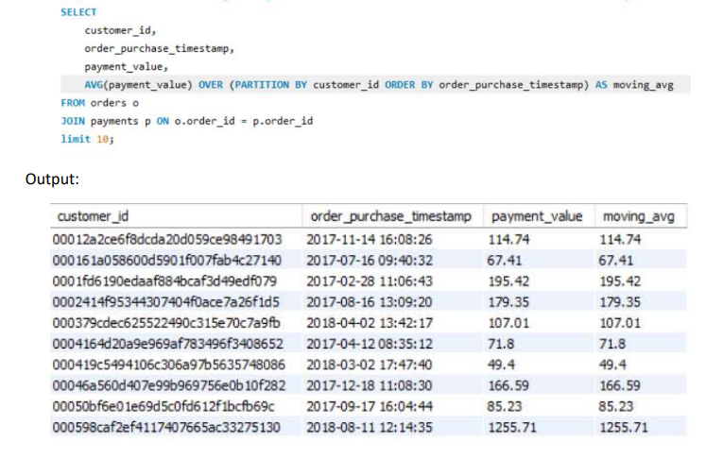
Q1. Calculate the moving average of order values for each customer over their order history.
Advanced Level Questions
Python code
SQL code

Slide 13
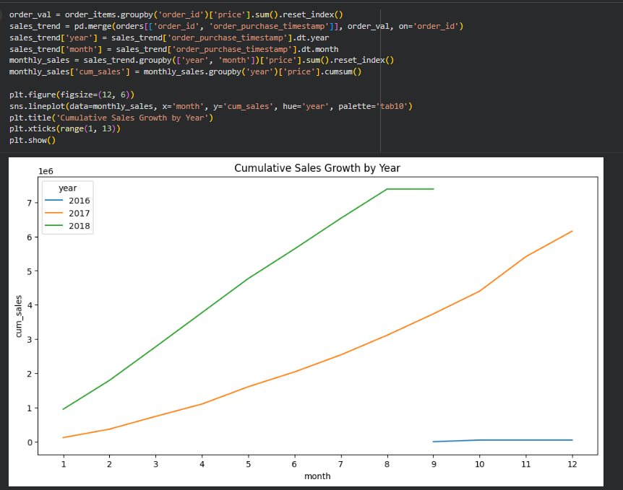
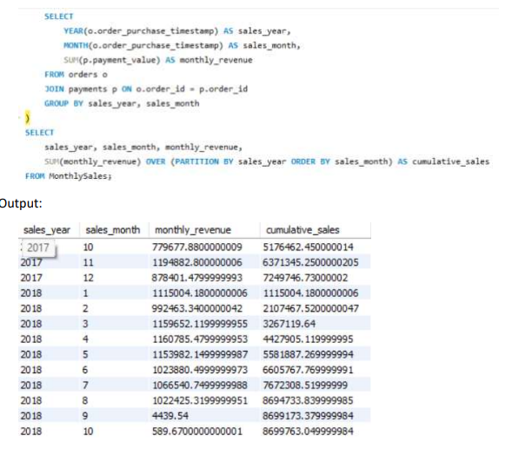
Q2. Calculate the cumulative sales per month for each year.
Python code
SQL code

Slide 14
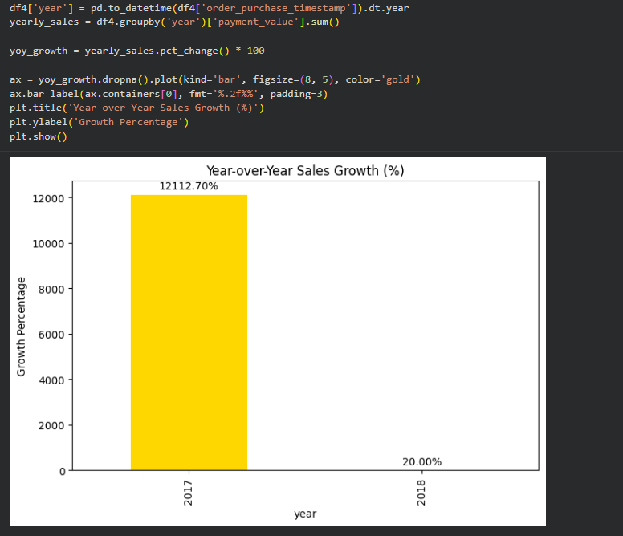
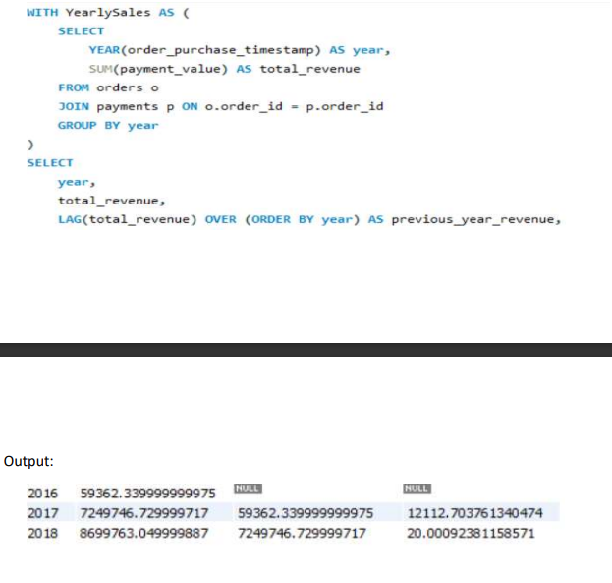
Q3. Calculate the year-over-year growth rate of total sales.
Python code
SQL code

Slide 15
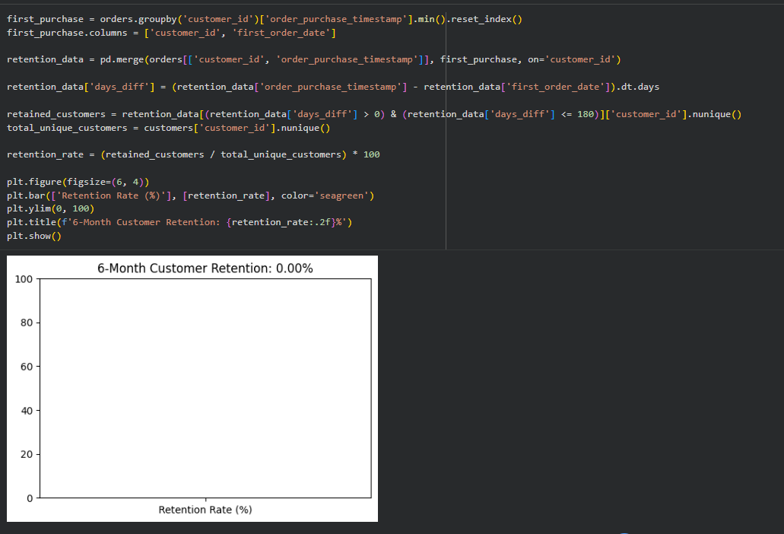
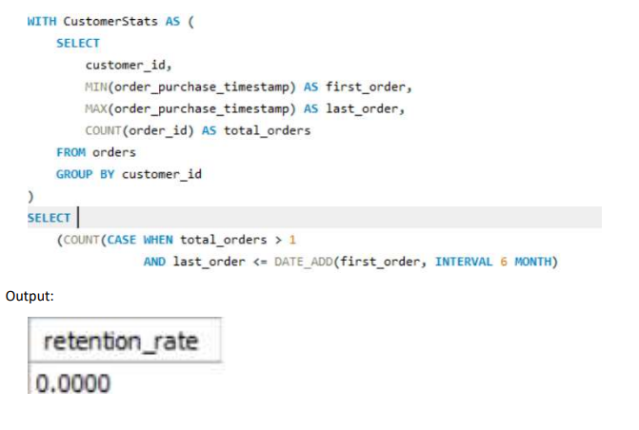
Q4. Calculate the retention rate of customers, defined as the percentage of customers who make another purchase within 6 months of their first purchase.
Python code
SQL code

Slide 16
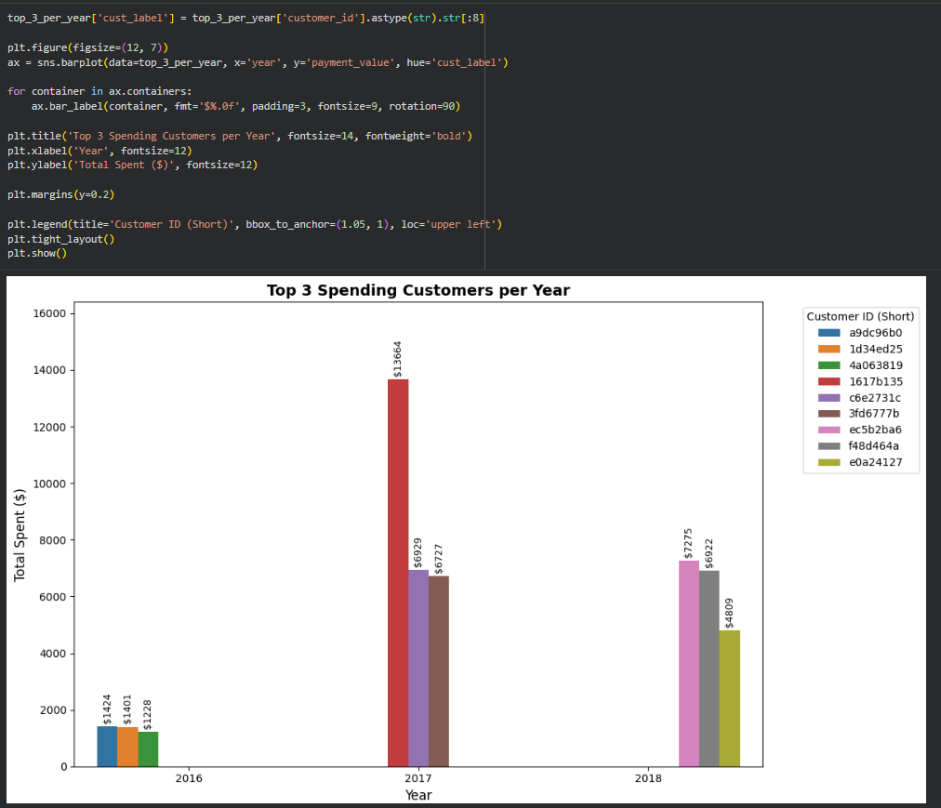
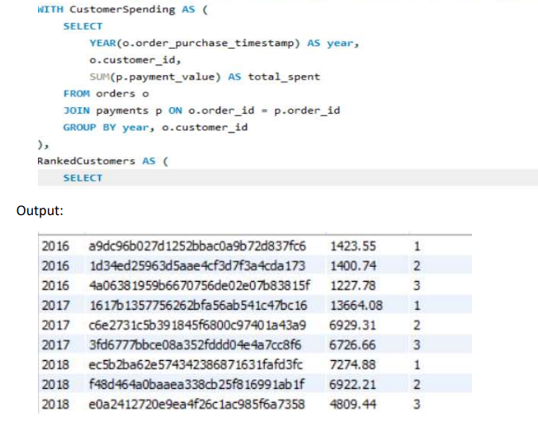
Q5. Identify the top 3 customers who spent the most money in each year.
Python code
SQL code

Slide 17
Thank You
enwelumchiamaka@gmail.com

