Slide 1
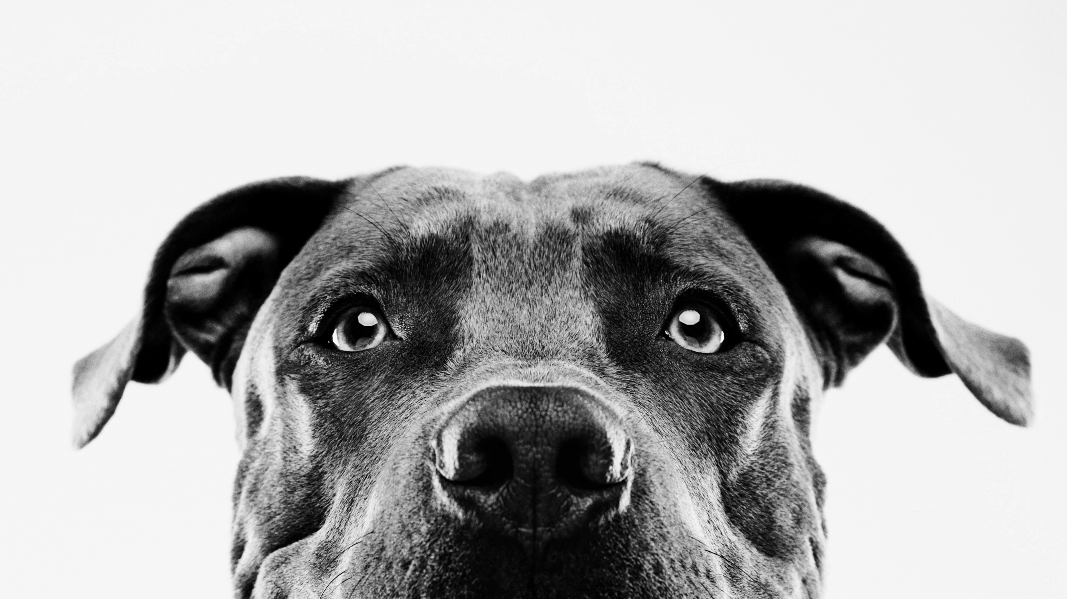
Pawmark
Code explanation

Slide 2
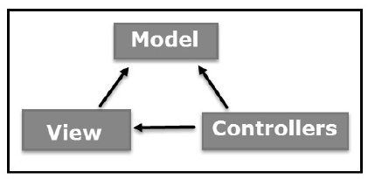
Web code
Pawmark web was implemented using MVC architectural pattern.
The Model-View-Controller (MVC) is an architectural pattern that separates an application into three main logical components: the model, the view, and the controller. Each of these components are built to handle specific development aspects of an application. MVC is one of the most frequently used industry-standard web development framework to create scalable and extensible projects. source:MVC Framework - Introduction (tutorialspoint.com)
MVC Components
Following are the components of MVC −

Slide 3
Model
The Model component corresponds to all the data-related logic that the user works with. This can represent either the data that is being transferred between the View and Controller components or any other business logic-related data. For example, a Customer object will retrieve the customer information from the database, manipulate it and update it data back to the database or use it to render data.
Actual code used in pawmark web:
class Customer(models.Model):
id = models.CharField(max_length=ID_LENGTH, primary_key=True, default=id_gen)
firstname = models.CharField(max_length=50, blank=True, null=True)
middlename = models.CharField(max_length=50, blank=True, null=True)
lastname = models.CharField(max_length=50, blank=True, null=True)
mobile = models.CharField(max_length=15, blank=True, null=True)
email = models.EmailField(max_length=254, unique=True, blank=False, null=False)
picture = models.ImageField(upload_to='images/', blank=True, null=True, default='')
This is one of the model code used, this is responsible for the customer(mobile app user) data definitions

Slide 4
VIEW
The View component is used for all the UI logic of the application. For example, the Customer view will include all the UI components such as text boxes, dropdowns, etc. that the final user interacts with.
<div id="contacts">
<ul class="ul-no-style">
{% for contact in contacts %}
<li class="contact">
<a href="/chat/{{request.user.id}}-{{ contact.id }}" class="chat-entry">
<div class="wrap">
<span class="contact-status online"></span>
<img src="{{ contact.get_photo_url }}" alt="" />
<div class="meta">
<p class="name">{{ contact }}</p></p>
<p class="preview">{{ contact.last_message }}</p>
</div>
</div>
</a>
</li>
{% endfor %}
</ul>
</div>
This code snippet is responsible for rendering the contact list in pawmark chat, since we are using Django, aside from
html syntax, we also have codes that contains brackets{%%} which is syntax provided by Django template

Slide 5
controller
Controllers act as an interface between Model and View components to process all the business logic and incoming requests, manipulate data using the Model component and interact with the Views to render the final output. For example, the Customer controller will handle all the interactions and inputs from the Customer View and update the database using the Customer Model. The same controller will be used to view the Customer data.
def chat(request, message_gc_id):
if request.user is None or request.user.is_authenticated is False:
return redirect('admin:index')
template = loader.get_template('pages/chat.html')
all_customers = Customer.objects.all()
receiver = None
receiver_id = ''
try:
receiver_id = message_gc_id.split('-')[1]
receiver = Customer.objects.filter(id=receiver_id).first()
except Exception:
pass
pets = get_my_pets(receiver)
context = {
"pets": pets,
"receiver": receiver,
"contacts": all_customers,
"message_gc_id": message_gc_id
}
if request.method == 'POST':
send_message(request=request, receiver_id=receiver_id)
return HttpResponse(template.render(context, request))
This is code is one example of a controller, it is responsible fetching/ saving data in the database which returns an object/(model) and also providing the needed data for the view(UI) to be rendered

Slide 6

Login / authentication
As a veterinarian, he/she can login in the web app
By default, there will be one admin user already registered, this is done internally by the developer using the built-in Django command : python manage.py createsuperuser
This will give user to access the web app using the default credential : username : admin@email.com password: admin@email.com
This user can now add other veterinarian accounts using the web app itself

Slide 7
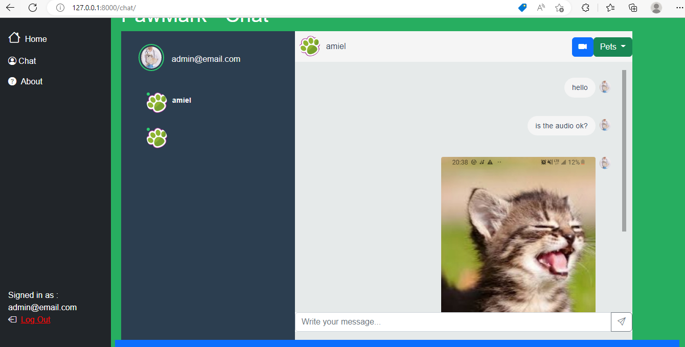
Web - Chat page
Click this button for video call
Clicking this button will expand this pet owner’ pet
Logged in Veterinarian user email and profile pic
Your chat will go on the right side, on the other hand receipient’s chat will go on the left side
Pawmark chat is realtime, that means when a reply has been sent from the mobile app, it will automatically be seen without the need of reloading the page
Available pet owners will be displayed in here
Image attachments can be clicked to zoom it
In here, you can type in your chat message
This button will send your message

Slide 8

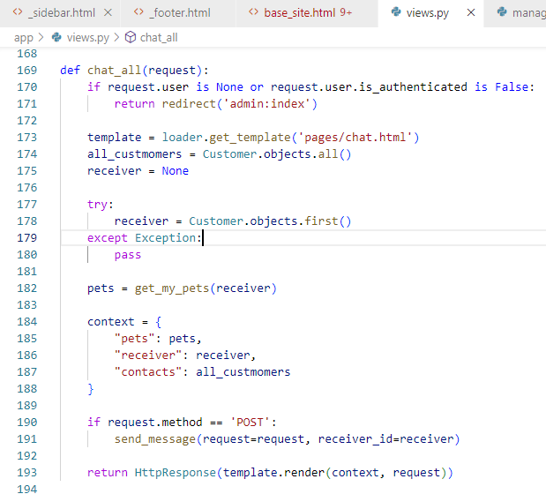
Web – chat, how it works?
By default when we navigate to this address:
This code will run on server side, this will fetch all the customers data from the database.
By default, it will select the first customer, so that will be the default user to chat with…
This code will also fetch all this user’s pets data, so that it will be rendered in the UI later.

Slide 9
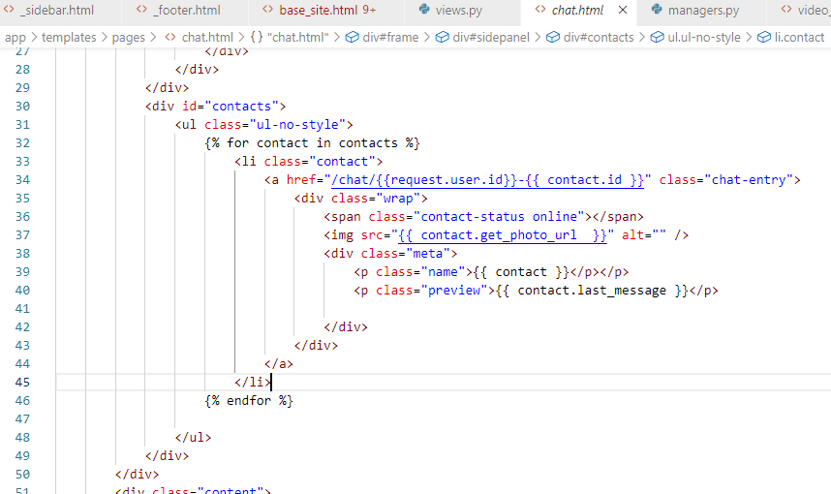
Web – chat, how it works?
After the server gave the needed data, this code will now render it

Slide 10
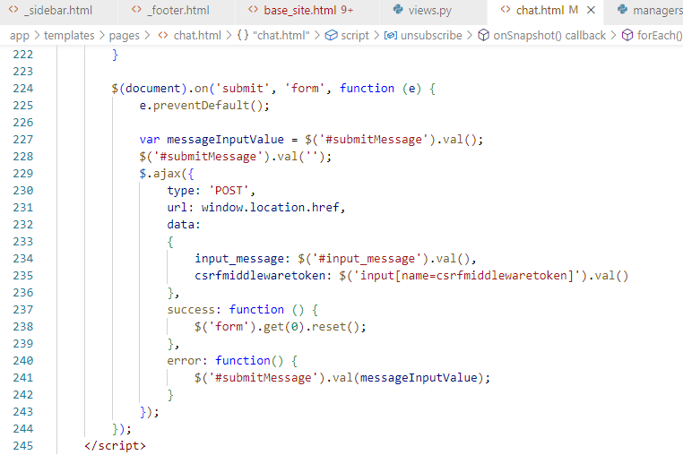
Web – chat, how it works?
This code is responsible for sending a request to the server (python) so that we can send a new chat message.

Slide 11
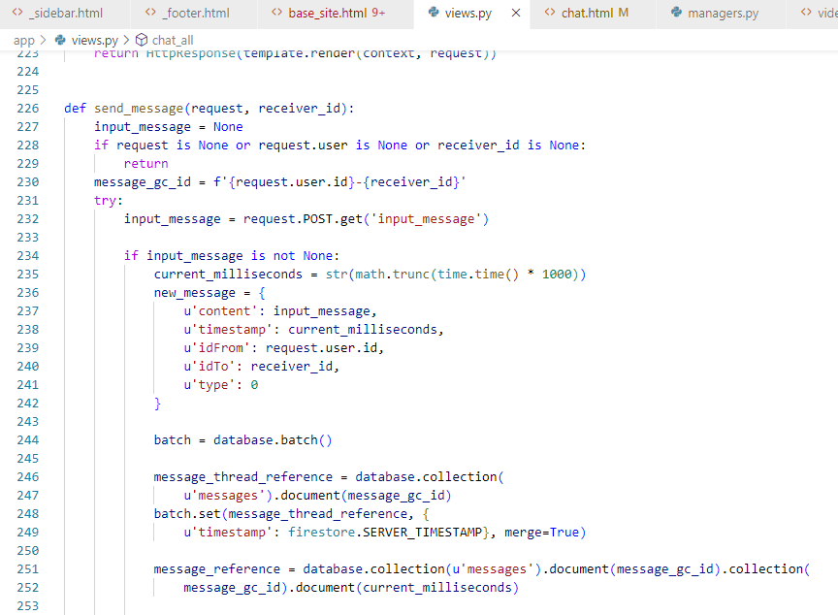
Web – chat, how it works?
This is the server code that will receive that request, in return it will save the new chat data in Firebase database.

Slide 12
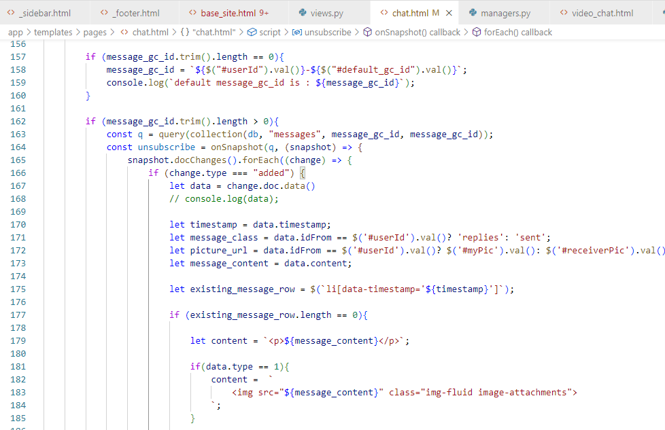
Web – chat, how it works?
We used this code to receive messages from Firebase, this is a listener so that we could add dynamic web elements(new chat messages/images)

Slide 13
Web – chat, how it works?
Please Note: We used different database for managing users/pet related data’s, from the actual chat message datas, since we are all using free versions of services. We used pythonanywhere .com to host our web app, and as a database used by users. For the chat message database, we used Firebase since it’s a NoSQL type of database, its more suitable for this chat purpose. By doing this, we can minimize the traffic or at least separate it.

