Slide 1
Data Lake &
Data Warehouse

Slide 2
What is a data lake?
A data lake is a centralized repository that allows you to store all your structured and unstructured data at any scale. You can store your data as-is, without having to first structure the data, and run different types of analytics—from dashboards and visualizations to big data processing, real-time analytics, and machine learning to guide better decisions.

Slide 3

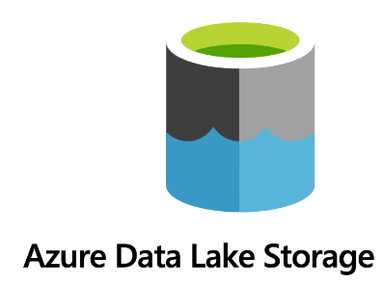

Slide 4
What is a data warehouse?
A data warehouse is a central repository designed for storing and analyzing large amounts of data, particularly for business intelligence and analytics purposes. It consolidates data from various sources, making it accessible for reporting, analysis, and decision-making.

Slide 5




Slide 6
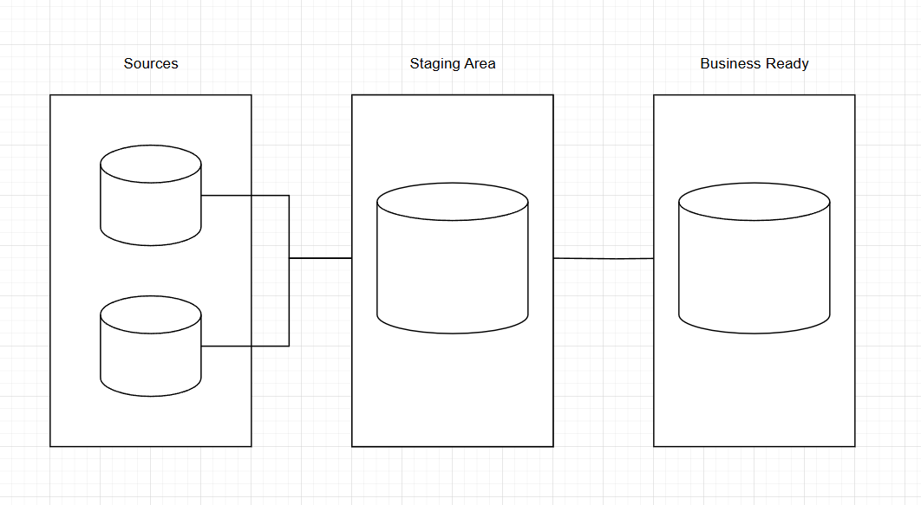
Data warehouse act

Slide 7
“
“Don't worry about failures, worry about the chances you miss when you don’t even try.”

