Slide 1
CSS
Cascading Style Sheets (CSS) is used to format the layout of a webpage.
With CSS, you can control the color, font, the size of text, the spacing between elements, how elements are positioned and laid out, what background images or background colors are to be used, different displays for different devices and screen sizes, and much more!

Slide 2
Inline - by using the style attribute inside HTML elements
<h1 style="color:blue;">A Blue Heading</h1>
<p style="color:red;">A red paragraph.</p>
Internal - by using a <style> element in the <head> section
<head>
<style>
body {background-color: powderblue;}
h1 {color: blue;}
p {color: red;}
</style>
</head>

Slide 3
External CSS
An external style sheet is used to define the style for many HTML pages.
To use an external style sheet, add a link to it in the <head> section of each HTML page:
<head>
<link rel="stylesheet" href="styles.css">
</head>

Slide 4
Flexbox (short for Flexible Box Layout)
is a powerful layout tool in CSS that helps you align and distribute space among items in a container—even when their size is unknown or dynamic. It's especially useful for building responsive layouts.
<div class="flex-container">
<div>Item 1</div>
<div>Item 2</div>
<div>Item 3</div>
</div>
.flex-container {
display: flex;
}

Slide 5
Common Flexbox Properties
Property | Description | Example
display: flex | Enables flexbox | display: flex;
flex-direction | Sets the direction of items | row, column, row-reverse, column-reverse
justify-content | Aligns items on main axis | flex-start, center, flex-end, space-between, space-around, space-evenly
align-items | Aligns items on cross axis | stretch, center, flex-start, flex-end, baseline
flex-wrap | Allows items to wrap | nowrap, wrap, wrap-reverse

Slide 6
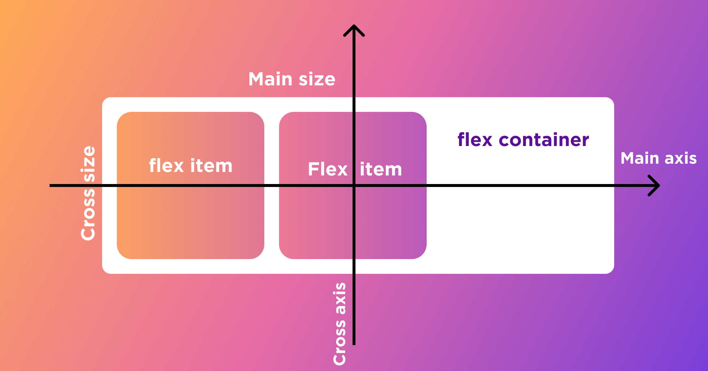
Common Flexbox Properties

