Slide 1
CI/CD

Slide 2
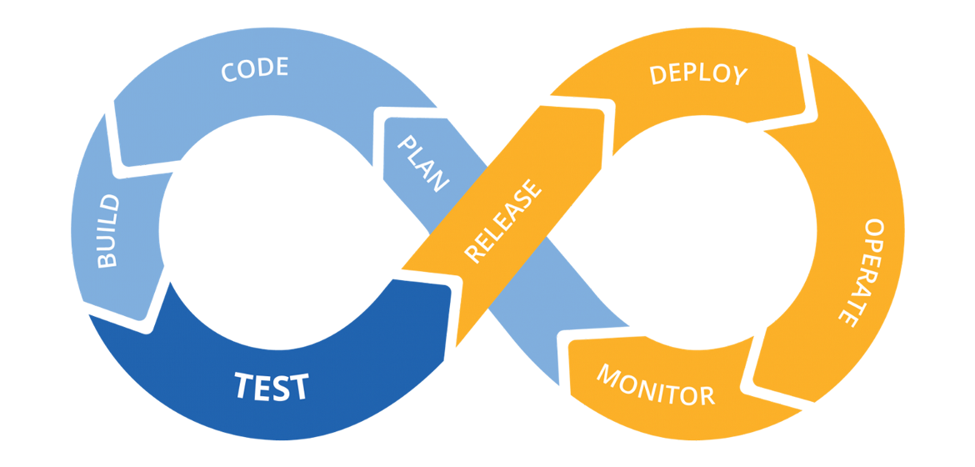
CI And CD is the practice of automating the integration of code changes from multiple developers into a single codebase. It is a software development practice where the developers commit their work frequently to the central code repository (Github or Stash). Then there are automated tools that build the newly committed code and do a code review, etc as required upon integration.

Slide 3
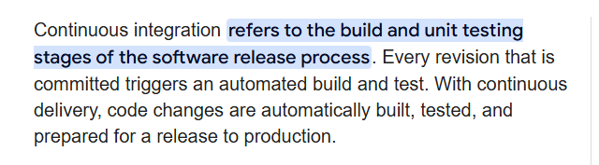
Continuous Integration

Slide 4
Continuous Delivery
This goes one step further by automating the deployment process, so the code that passes the tests in CI is automatically ready to be released to production. Continuous Delivery ensures that new features or updates can be released at any time with minimal manual intervention, but the actual release to production might still require human approval.

Slide 5
Continuous Deployment
This is the most advanced level of automation, where every change that passes the tests is automatically deployed to production, without any human intervention. This requires highly automated testing and monitoring to ensure the software remains stable after each deployment.

Slide 6


Slide 7
Git is a distributed version control system that allows multiple developers to work on the same project without overwriting each other’s changes. It tracks changes in the source code, making it easier to collaborate, manage different versions of a project, and maintain a history of changes.

Slide 8
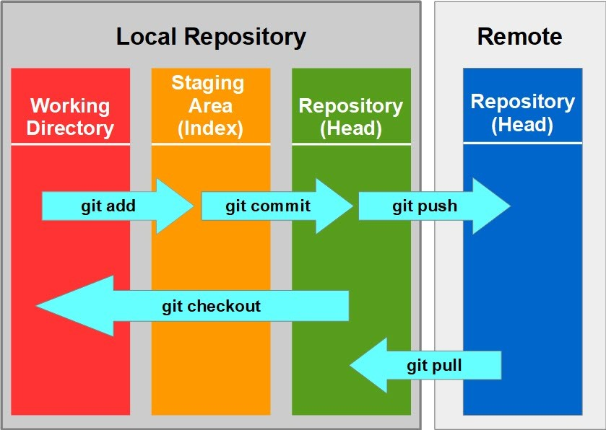
Code Locations

Slide 9
Git Commands
git clone
Copies an existing Git repository to your local machine.
git status
Shows the current status of your working directory (what files have been modified, added, or are untracked).
git add
Stages changes (adds modified files) to be committed.
git commit
Stages changes (adds modified files) to be committed.

Slide 10
Git Commands
git push
Uploads local commits to a remote repository (like GitHub or GitLab).
git pull
Fetches changes from a remote repository and merges them with your local branch.
git branch
Lists, creates, or deletes branches.
git checkout
Switches to a different branch or restores files.
git merge
Merges changes from one branch into the current branch.

Slide 11
  “
  Go Go Go
— Rufa Mae Quinto

