Slide 1
Application Programming Interface (API)

Slide 2
What is an API?
APIs are mechanisms that enable two software components to communicate with each other using a set of definitions and protocols. For example, the weather bureau’s software system contains daily weather data. The weather app on your phone “talks” to this system via APIs and shows you daily weather updates on your phone.
  https://aws.amazon.com/what-is/api/

Slide 3
How do APIs work?
API architecture is usually explained in terms of client and server. The application sending the request is called the client, and the application sending the response is called the server. So in the weather example, the bureau’s weather database is the server, and the mobile app is the client.
  https://aws.amazon.com/what-is/api/

Slide 4
There are four different ways that APIs can work depending on when and why they were created.
SOAP APIs
These APIs use Simple Object Access Protocol. Client and server exchange messages using XML. This is a less flexible API that was more popular in the past.
RPC APIs
These APIs are called Remote Procedure Calls. The client completes a function (or procedure) on the server, and the server sends the output back to the client.
Websocket APIs
Websocket API is another modern web API development that uses JSON objects to pass data. A WebSocket API supports two-way communication between client apps and the server. The server can send callback messages to connected clients, making it more efficient than REST API.
REST APIs
These are the most popular and flexible APIs found on the web today. The client sends requests to the server as data. The server uses this client input to start internal functions and returns output data back to the client.
  https://aws.amazon.com/what-is/api/

Slide 5
What are REST APIs?
REST stands for Representational State Transfer. REST defines a set of functions like GET, PUT, DELETE, etc. that clients can use to access server data. Clients and servers exchange data using HTTP.
The main feature of REST API is statelessness. Statelessness means that servers do not save client data between requests. Client requests to the server are similar to URLs you type in your browser to visit a website. The response from the server is plain data, without the typical graphical rendering of a web page.
  https://aws.amazon.com/what-is/api/

Slide 6

What is Postman?
Postman is an all-in-one API platform for building and working with APIs. It takes the pain out of every stage of the API lifecycle—from designing and testing to delivery and monitoring. Built for teams, Postman makes it easy to collaborate, stay organized, and build secure, reliable APIs faster.
  https://www.postman.com/product/what-is-postman/

Slide 7
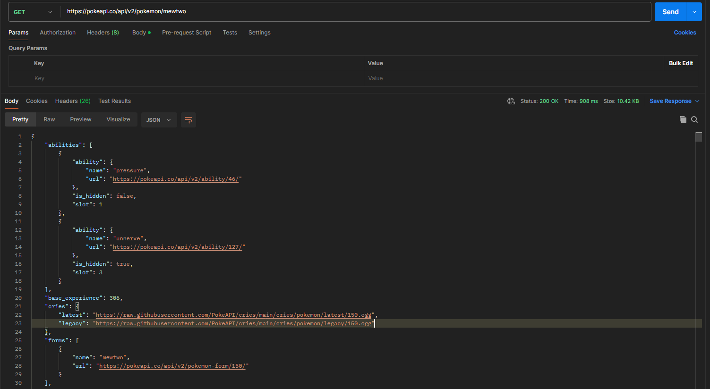
https://pokeapi.co/

Slide 8
Parts of API
1. Resources (Endpoints / URIs)
The main entities the API exposes, identified by URLs (Uniform Resource Locators). Each resource represents an object or data type (e.g., /users, /orders, /products).
Example:
GET /api/users/123
This might return the user with ID 123.

Slide 9
2. HTTP Methods (Verbs)
These specify the type of operation to perform on the resource.
Method | Meaning | Example
GET | Retrieve data | GET /users
POST | Create a new resource | POST /users
PUT | Update/replace an existing resource | PUT /users/123
DELETE | Remove a resource | DELETE /users/123

Slide 10
3. Headers
Used to send metadata about the request or response.
Common headers:
Content-Type: specifies the data format (e.g., application/json)
Authorization: carries credentials (e.g., API key or token)
Accept: tells the server what format the client expects in response

Slide 11
4. Body (Payload)
Carries data sent with POST, PUT, or PATCH requests.
Typically formatted as JSON.
Example:
{
"name": "Alice",
"email": "alice@example.com"
}

Slide 12
5. Response
The data the server sends back.
Contains:
Status code (e.g., 200 OK, 404 Not Found, 500 Internal Server Error)
Headers (metadata)
Body (the actual data, often JSON)
Example response:
{
"id": 123,
"name": "Alice",
"email": "alice@example.com"
}

Slide 13
6. Status Codes
These indicate the result of the request.
Code | Meaning
200 | OK (Successful request)
201 | Created
204 | No Content
400 | Bad Request
401 | Unauthorized
404 | Not Found
500 | Internal Server Error

Slide 14

FastAPI framework, high performance, easy to learn, fast to code, ready for production
FastAPI is a modern, fast (high-performance), web framework for building APIs with Python based on standard Python type hints
  https://fastapi.tiangolo.com/

Slide 15
Installation and Setup of FastAPI
To get started with FastAPI:
1. Install Python 3: Make sure Python 3.7 or above is installed.
2. Install FastAPI: Use pip to install the FastAPI library
pip install fastapi
3. Install Uvicorn (ASGI server): Uvicorn is a lightweight server used to run FastAPI apps
pip install uvicorn
  https://fastapi.tiangolo.com/

Slide 16
First Steps
from fastapi import FastAPI
app = FastAPI()
@app.get("/")
async def root():
return {"message": "Hello World"}
#saved as test.py
------------------------------------------------------------------------------------------------
uvicorn filename:fastapi variable --reload
uvicorn test:app --reload
  https://fastapi.tiangolo.com/

Slide 17
On start up
BEFORE
@app.on_event("startup")
def on_startup():
create_db_and_tables()
NEW
from contextlib import asynccontextmanager
@asynccontextmanager
async def lifespan(app: FastAPI):
create_db_and_tables()
yield
app = FastAPI(lifespan=lifespan)
  https://fastapi.tiangolo.com/

Slide 18
Path Parameters
from fastapi import FastAPI
from models import Employee
app = FastAPI()
@app.get("/employee/{id}")
async def read_employee(id):
with Session(engine) as session:
emp = session.get(Employee, id)
return {"message": emp}
  https://fastapi.tiangolo.com/

Slide 19
Request Body
from fastapi import FastAPI
from models import Employee
app = FastAPI()
@app.post("/ employee")
async def root(employee : Employee):
with Session(engine) as session:
session.add(employee)
session.commit()
session.refresh(employee)
return miming
  https://fastapi.tiangolo.com/

