Slide 1
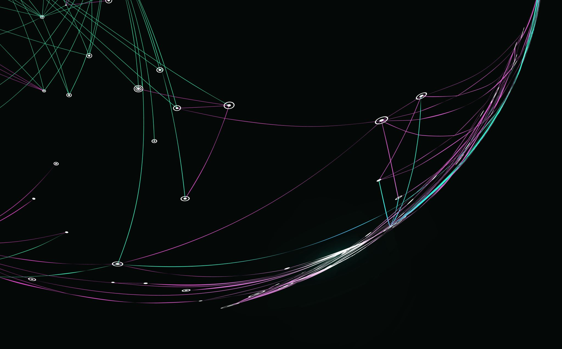
Osim Seder
After Passover

Slide 2
General Progress
https://garineiudi.org.il
The project is operational.
Key Functionalities:
- Registration
- Login
- Data manipulation (Add, Edit, Remove)
- Data viewing
- Responsive UI
- Cross Platform

Slide 3


Proof Of Concept

Slide 4
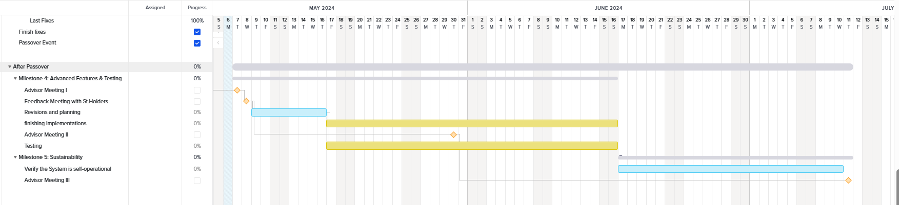
Gantt

Slide 5
Survey plan
Survey Overview: Please provide detailed feedback to help us improve. Rate user satisfaction from 1 (bad) to 5 (very good).
Survey Categories:
Registration
Login
Student Interaction
Staff Interaction
House Management
Group Management
Task Management
Overall User Interface (UI)
Survey Questions for Each Category:
Was it easy to use the page?
How intuitive were the interactions?
How would you rate the response time?
How clear was the information presented?
Open Text Field: Please provide general notes and ideas on how to improve each category.

