Slide 1
Osim Seder
Proof of Concept

Slide 2
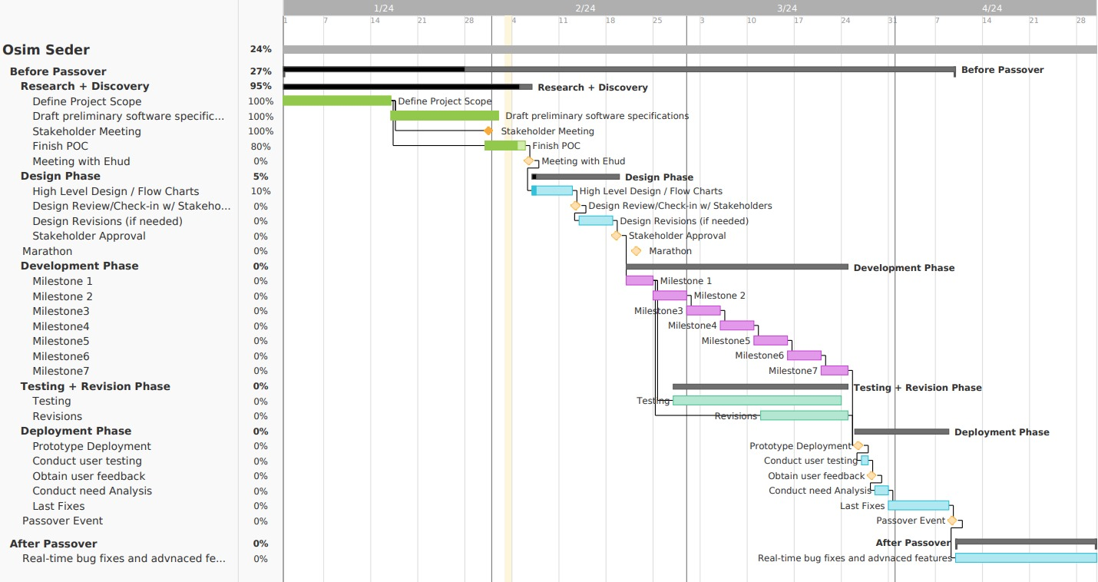
Gantt - advanced display

Slide 3
Risks and Challenges
Making a working application by Passover.
Acquiring a database and a server and making sure the server will not crash.
Verify the web app's compatibility across different web browsers and different resolutions (i.e. cellphones).
The customer has multiple opinions – therefore there has been many changes.
Implementing robust security measures to safeguard user data and system integrity.
Log libraries will be used in the code for logging every system and user activity.
Backup the system for recovery in case of optional disasters.

Slide 4
Costs
PostgreSQL Database – from 30$ a month (including automatic failover)
Web Server – from 4$ a month (with SSL Certification)
Google Maps API – around 6$ per 1000 requests

Slide 5
Security points
All passwords will be stored after encryption (using bcrypt).
No personal data will be stored for any user (except for disabilities that affect the work itself).
HTTPS will be used for web requests and sanitize user inputs to prevent SQL and other script injections.
Different staff roles will have access to different information (based on location and relevancy).
Implement account lockout after a certain number of failed login attempts.
To prevent CSRF and other attacks - Use secure token-based authentication for user sessions. Implement token expiration and refresh mechanisms.
To prevent web-based attack like DDoS, we will include security headers.

Slide 6
testing
For frontend, unit testing, database tests we’ll use Jest
For Code Quality and Coverage tests we’ll use Istanbul (part of Jest)
For End-to-End Testing we’ll use Playwright

Slide 7
Work distribution
Amiel – Fullstack
Feliks – Backend (NodeJS)
Ari – Frontend (react)
Yoav – Testing and Flow-observer

Slide 8
Mock

