Slide 1
Lane Changing Application with Discrete Time State Space LTI Bicycle Model and MPC Controller
Advisor: Asst. Prof. Claudia Fernanda YAŞAR
19015036 – Hasan Kaan TUNA

Slide 2
Table of Contents
What Happens During Lane Change?
How the Block Diagram Look Like?
Plant
The Bicycle Model
MPC
The Control Input
Discretization of Continuous LTI Model
The Cost Function
Controller Parameters and Constraints
Results

Slide 3
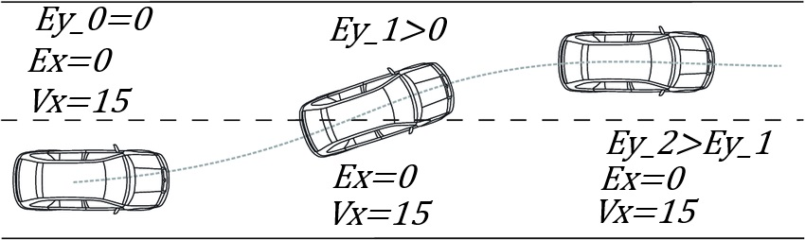
What Happens During Lane Change?

Slide 4
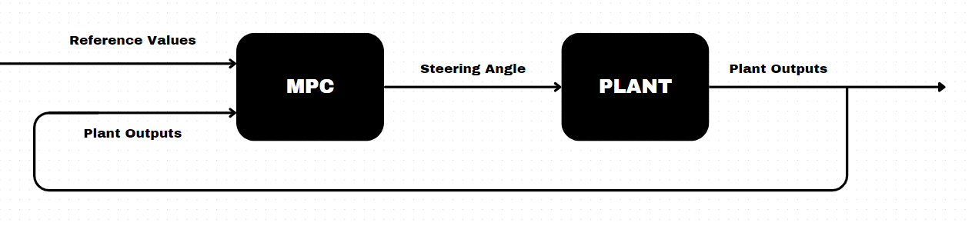
How The Block Diagram Look Like

Slide 5
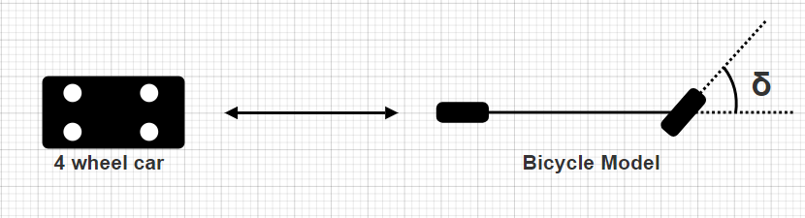
Plant: The Bicycle Model
Useful for understanding the lateral dynamics of a vehicle.
The bicycle model is a relatively simple.
Allows for the development of effective control strategies.

Slide 6
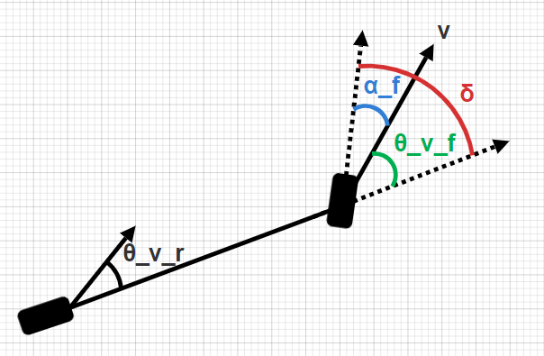
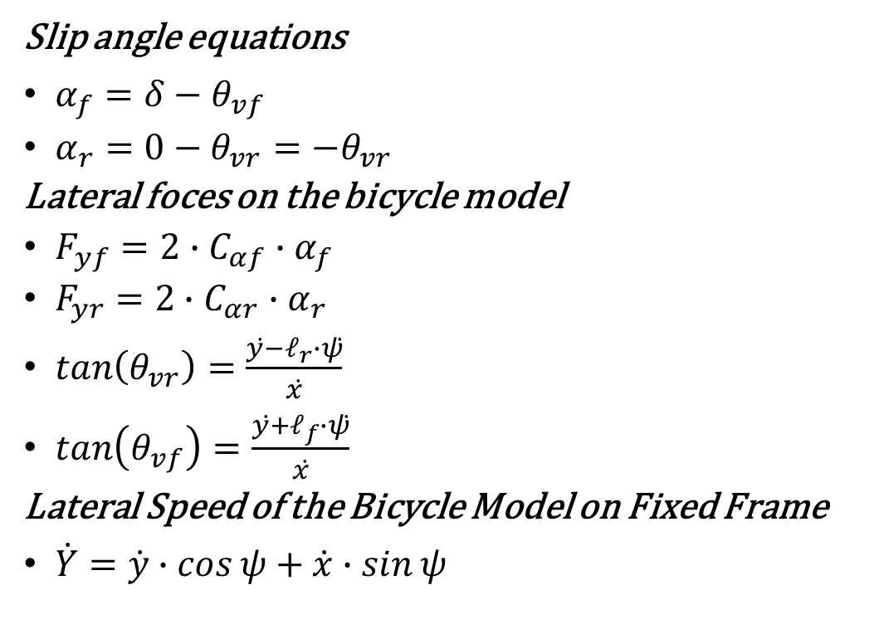
Plant: The Bicycle Model
Slip angle equations
$α_{f}=δ−θ_{vf}$
$α_{r}=0−θ_{vr}=−θ_{vr}$
Lateral foces on the bicycle model
$F_{yf}=2∙C_{αf}∙α_{f}$
$F_{yr}=2∙C_{αr}∙α_{r}$
$\tan\left(θ_{vr}\right)=\frac{ẏ−𝓁_{r}∙ψ̇}{ẋ}$
$\tan\left(θ_{vf}\right)=\frac{ẏ+𝓁_{f}∙ψ̇}{ẋ}$
Lateral Speed of the Bicycle Model on Fixed Frame
$\dot{Y}=\dot{y}∙\cos{ψ}+\dot{x}∙\sin{ψ}$

Slide 7
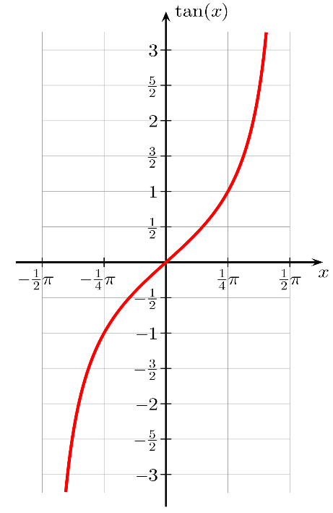
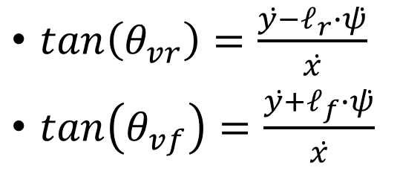
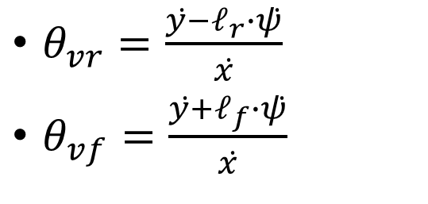
Plant: Linearization of the Bicycle Model
$\tan\left(θ_{vr}\right)=\frac{ẏ−𝓁_{r}∙ψ̇}{ẋ}$
$\tan\left(θ_{vf}\right)=\frac{ẏ+𝓁_{f}∙ψ̇}{ẋ}$
$θ_{vr}=\frac{ẏ−𝓁_{r}∙ψ̇}{ẋ}$
$θ_{vf}=\frac{ẏ+𝓁_{f}∙ψ̇}{ẋ}$

Slide 8
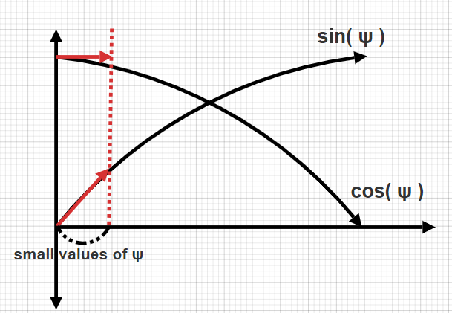
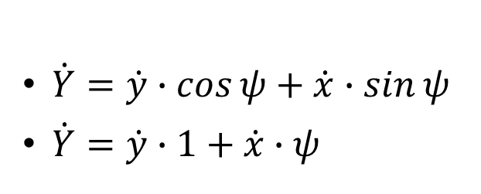
Plant: Linearization of the Bicycle Model
$\dot{Y}=\dot{y}∙\cos{ψ}+\dot{x}∙\sin{ψ}$
$\dot{Y}=\dot{y}∙1+\dot{x}∙ψ$

Slide 9
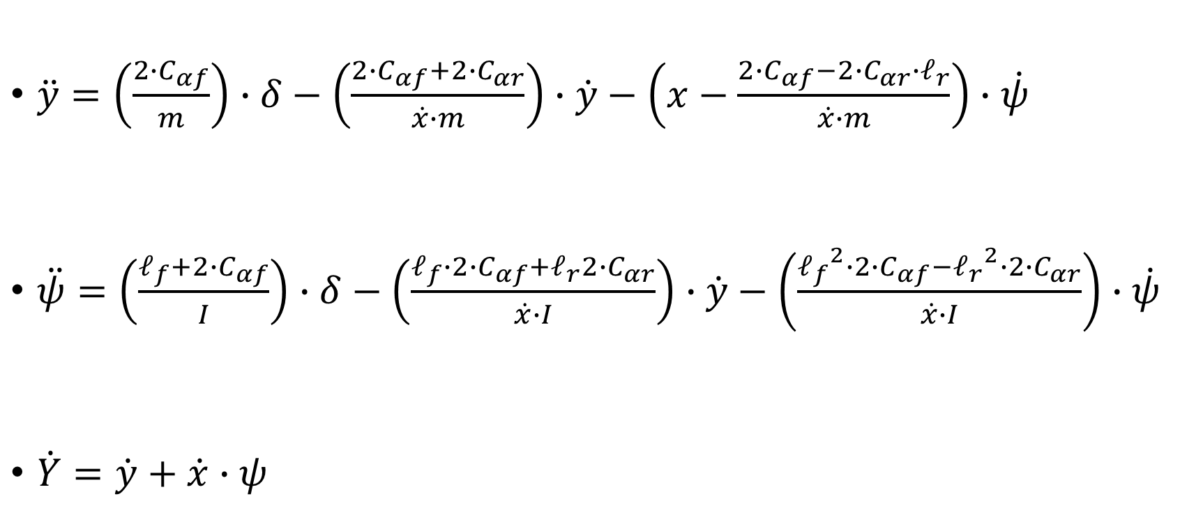
Plant: The Bicycle Model
$\ddot{y}=\left(\frac{2∙C_{αf}}{m}\right)∙δ−\left(\frac{2∙C_{αf}+2∙C_{αr}}{\dot{x}∙m}\right)∙\dot{y}−\left(x−\frac{2∙C_{αf}−2∙C_{αr}∙𝓁_{r}}{\dot{x}∙m}\right)∙\dot{ψ}$
$\ddot{ψ}=\left(\frac{𝓁_{f}+2∙C_{αf}}{I}\right)∙δ−\left(\frac{𝓁_{f}∙2∙C_{αf}+𝓁_{r}2∙C_{αr}}{\dot{x}∙I}\right)∙\dot{y}−\left(\frac{{𝓁_{f}}^{2}∙2∙C_{αf}−{𝓁_{r}}^{2}∙2∙C_{αr}}{\dot{x}∙I}\right)∙\dot{ψ}$
$\dot{Y}=\dot{y}+\dot{x}∙ψ$

Slide 10
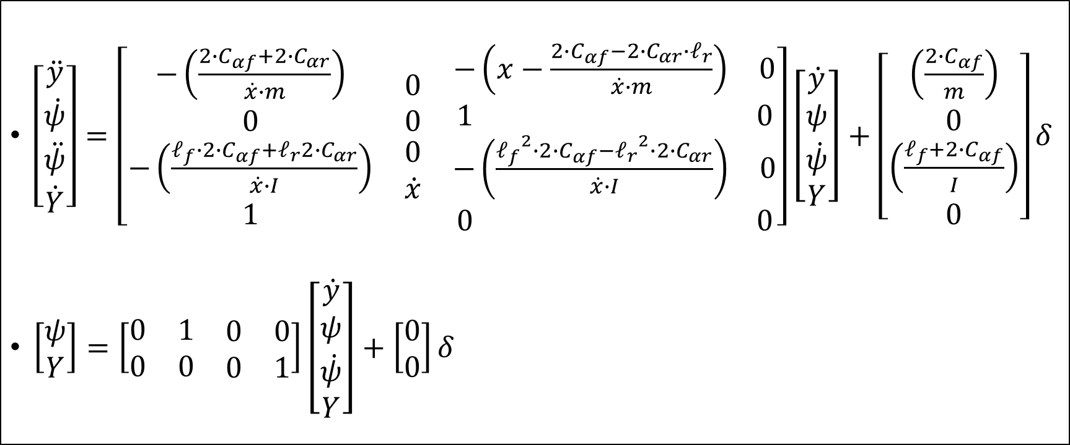
Plant: The Bicycle Model
$\left[\begin{matrix}\ddot{y} \\ \begin{matrix}\dot{ψ} \\ \ddot{ψ} \\ \dot{Y}\end{matrix}\end{matrix}\right]=\left[\begin{matrix}\begin{matrix}−\left(\frac{2∙C_{αf}+2∙C_{αr}}{\dot{x}∙m}\right) \\ 0 \\ \begin{matrix}−\left(\frac{𝓁_{f}∙2∙C_{αf}+𝓁_{r}2∙C_{αr}}{\dot{x}∙I}\right) \\ 1\end{matrix}\end{matrix} & \begin{matrix}0 \\ 0 \\ \begin{matrix}0 \\ \dot{x}\end{matrix}\end{matrix} & \begin{matrix}\begin{matrix}−\left(x−\frac{2∙C_{αf}−2∙C_{αr}∙𝓁_{r}}{\dot{x}∙m}\right) & 0\end{matrix} \\ \begin{matrix}1 & 0\end{matrix} \\ \begin{matrix}\begin{matrix}−\left(\frac{{𝓁_{f}}^{2}∙2∙C_{αf}−{𝓁_{r}}^{2}∙2∙C_{αr}}{\dot{x}∙I}\right) & 0\end{matrix} \\ \begin{matrix}0 & 0\end{matrix}\end{matrix}\end{matrix}\end{matrix}\right]\left[\begin{matrix}\dot{y} \\ \begin{matrix}ψ \\ \dot{ψ} \\ Y\end{matrix}\end{matrix}\right]+\left[\begin{matrix}\begin{matrix}\left(\frac{2∙C_{αf}}{m}\right) \\ 0 \\ \left(\frac{𝓁_{f}+2∙C_{αf}}{I}\right)\end{matrix} \\ 0\end{matrix}\right]δ$
$\left[\begin{matrix}ψ \\ Y\end{matrix}\right]=\left[\begin{matrix}0 & 1 & \begin{matrix}0 & 0\end{matrix} \\ 0 & 0 & \begin{matrix}0 & 1\end{matrix}\end{matrix}\right]\left[\begin{matrix}\dot{y} \\ \begin{matrix}ψ \\ \dot{ψ} \\ Y\end{matrix}\end{matrix}\right]+\left[\begin{matrix}0 \\ 0\end{matrix}\right]δ$

Slide 11
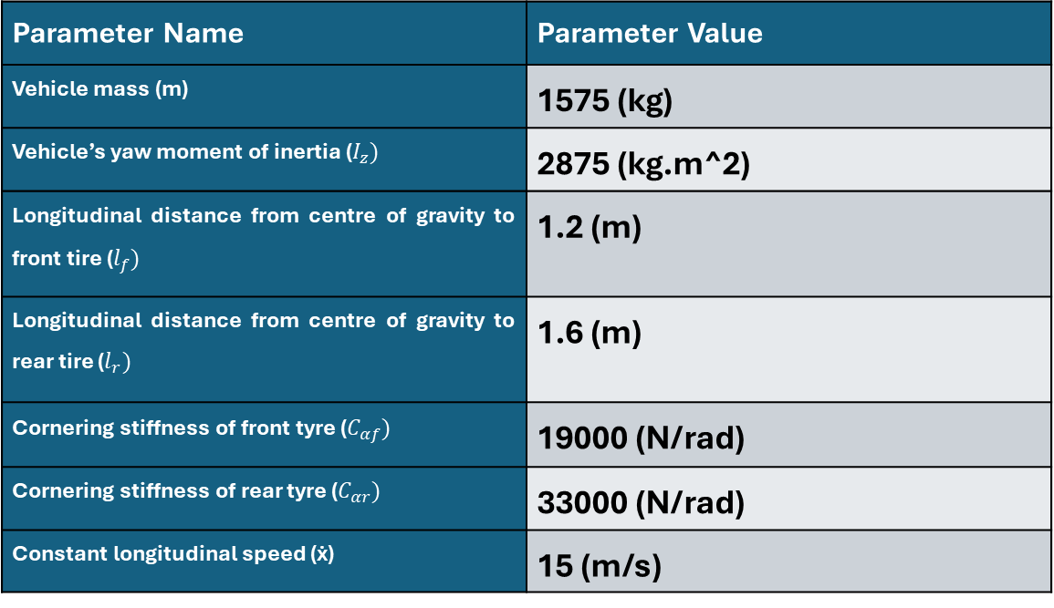
Plant: The Bicycle Model
Parameter Name | Parameter Value
Vehicle mass (m) | 1575 (kg)
Vehicle’s yaw moment of inertia ($I_{z})$ | 2875 (kg.m^2)
Longitudinal distance from centre of gravity to front tire ($l_{f})$ | 1.2 (m)
Longitudinal distance from centre of gravity to rear tire ($l_{r})$ | 1.6 (m)
Cornering stiffness of front tyre ($C_{αf})$ | 19000 (N/rad)
Cornering stiffness of rear tyre ($C_{αr})$ | 33000 (N/rad)
Constant longitudinal speed (ẋ) | 15 (m/s)

Slide 12
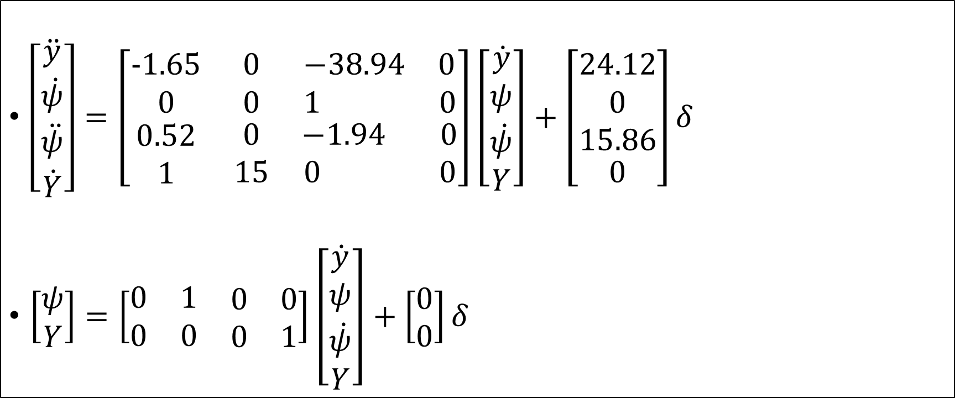
Plant: The Bicycle Model
$\left[\begin{matrix}\ddot{y} \\ \begin{matrix}\dot{ψ} \\ \ddot{ψ} \\ \dot{Y}\end{matrix}\end{matrix}\right]=\left[\begin{matrix}\begin{matrix}−1.65 \\ 0 \\ \begin{matrix}0.52 \\ 1\end{matrix}\end{matrix} & \begin{matrix}0 \\ 0 \\ \begin{matrix}0 \\ 15\end{matrix}\end{matrix} & \begin{matrix}\begin{matrix}−38.94 & 0\end{matrix} \\ \begin{matrix}1 & 0\end{matrix} \\ \begin{matrix}\begin{matrix}−1.94 & 0\end{matrix} \\ \begin{matrix}0 & 0\end{matrix}\end{matrix}\end{matrix}\end{matrix}\right]\left[\begin{matrix}\dot{y} \\ \begin{matrix}ψ \\ \dot{ψ} \\ Y\end{matrix}\end{matrix}\right]+\left[\begin{matrix}\begin{matrix}24.12 \\ 0 \\ 15.86\end{matrix} \\ 0\end{matrix}\right]δ$
$\left[\begin{matrix}ψ \\ Y\end{matrix}\right]=\left[\begin{matrix}0 & 1 & \begin{matrix}0 & 0\end{matrix} \\ 0 & 0 & \begin{matrix}0 & 1\end{matrix}\end{matrix}\right]\left[\begin{matrix}\dot{y} \\ \begin{matrix}ψ \\ \dot{ψ} \\ Y\end{matrix}\end{matrix}\right]+\left[\begin{matrix}0 \\ 0\end{matrix}\right]δ$

Slide 13
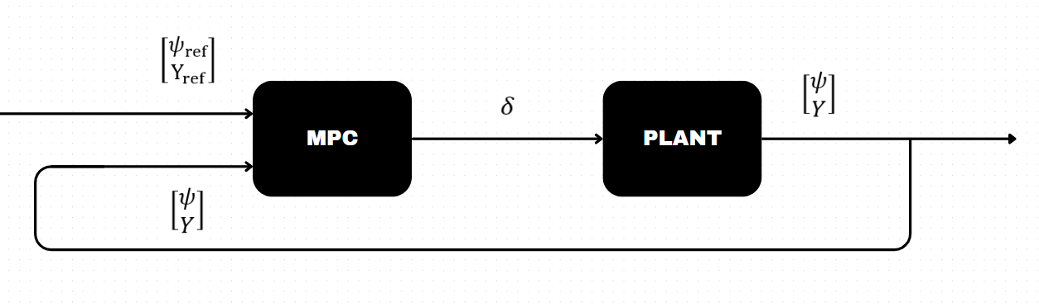
How The Updated Block Diagram Look Like

Slide 14
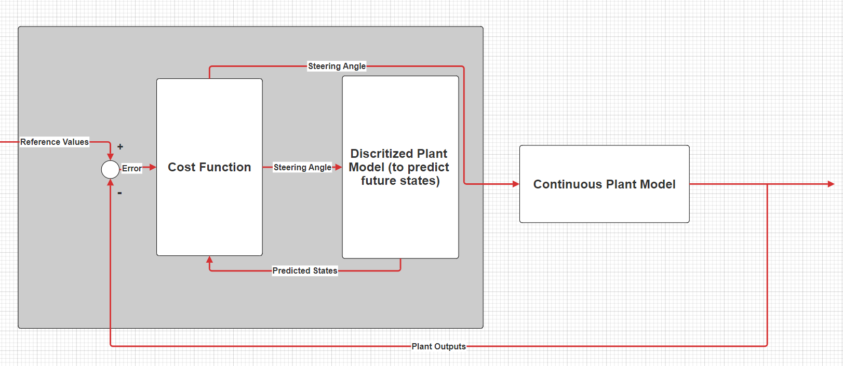
Model Predictive Controller

Slide 15
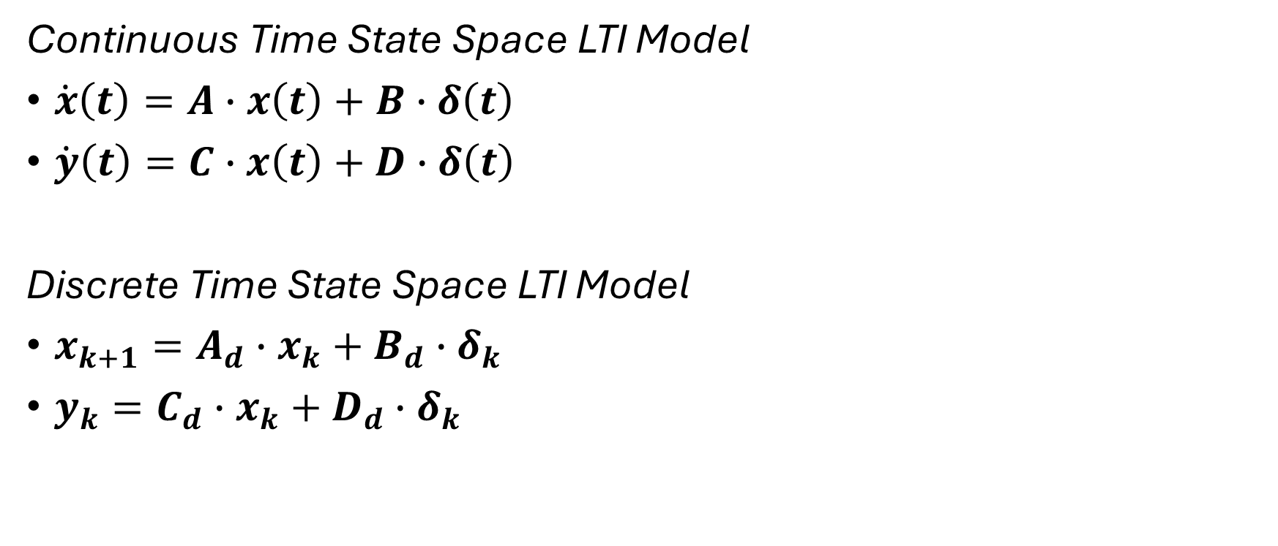
MPC: Discretization of LTI Model
Continuous Time State Space LTI Model
$\dot{x}\left(t\right)=A∙x\left(t\right)+B∙δ\left(t\right)$
$\dot{y}\left(t\right)=C∙x\left(t\right)+D∙δ\left(t\right)$
Discrete Time State Space LTI Model
$x_{k+1}=A_{d}∙x_{k}+B_{d}∙δ_{k}$
$y_{k}=C_{d}∙x_{k}+D_{d}∙δ_{k}$

Slide 16
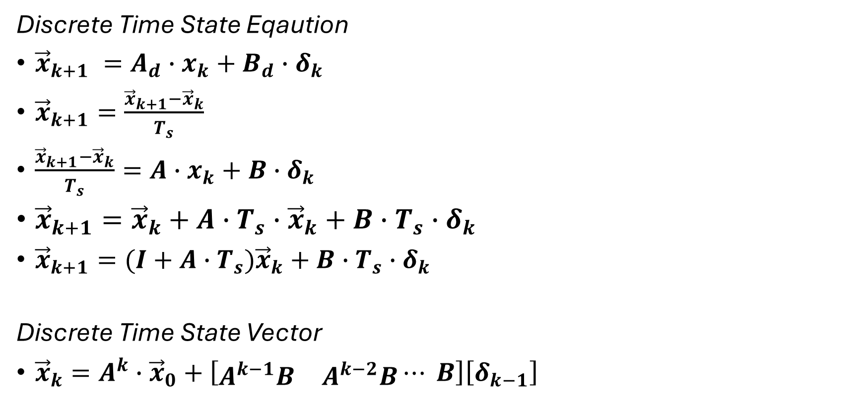
MPC: Discretization of LTI Model
Discrete Time State Eqaution
${\vec{x}}_{k+1} =A_{d}∙x_{k}+B_{d}∙δ_{k}$
${\vec{x}}_{k+1}=\frac{{\vec{x}}_{k+1}−{\vec{x}}_{k}}{T_{s}}$
$\frac{{\vec{x}}_{k+1}−{\vec{x}}_{k}}{T_{s}}=A∙x_{k}+B∙δ_{k}$
${\vec{x}}_{k+1}={\vec{x}}_{k}+A∙T_{s}∙{\vec{x}}_{k}+B∙{T_{s}∙δ}_{k}$
${\vec{x}}_{k+1}=(I+A∙T_{s}){\vec{x}}_{k}+B∙{T_{s}∙δ}_{k}$
Discrete Time State Vector
${\vec{x}}_{k}=A^{k}∙{\vec{x}}_{0}+\left[\begin{matrix}A^{k−1}B & A^{k−2}B\end{matrix}⋯ B\right]\left[δ_{k−1}\right]$

Slide 17
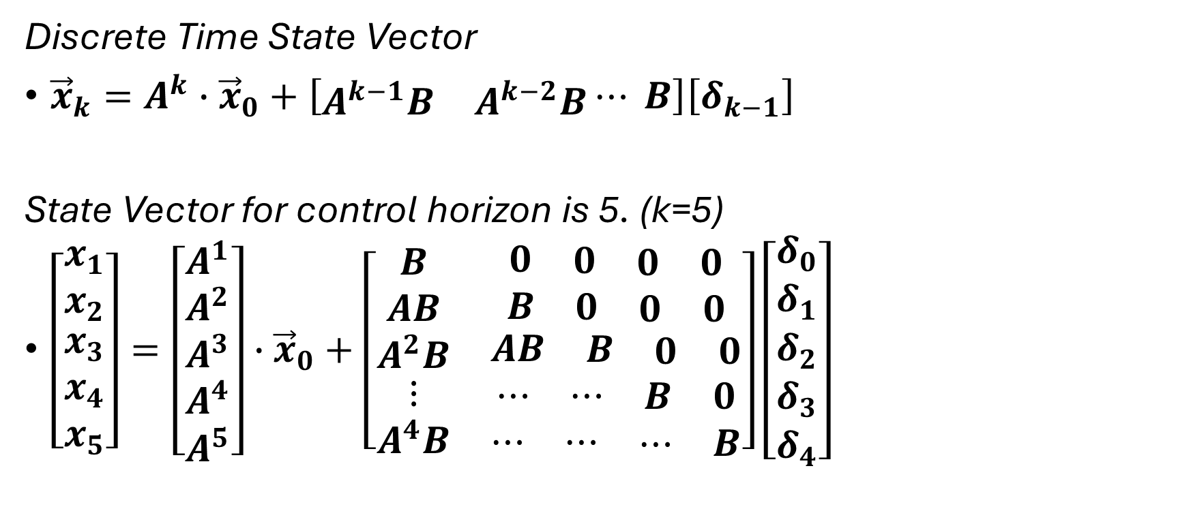
MPC: Discretization of LTI Model
Discrete Time State Vector
${\vec{x}}_{k}=A^{k}∙{\vec{x}}_{0}+\left[\begin{matrix}A^{k−1}B & A^{k−2}B\end{matrix}⋯ B\right]\left[δ_{k−1}\right]$
State Vector for control horizon is 5. (k=5)
$\left[\begin{matrix}x_{1} \\ x_{2} \\ \begin{matrix}x_{3} \\ x_{4} \\ x_{5}\end{matrix}\end{matrix}\right]=\left[\begin{matrix}A^{1} \\ A^{2} \\ \begin{matrix}A^{3} \\ A^{4} \\ A^{5}\end{matrix}\end{matrix}\right]∙{\vec{x}}_{0}+\left[\begin{matrix}\begin{matrix}B \\ AB \\ \begin{matrix}A^{2}B \\ \begin{matrix}⋮ \\ A^{4}B\end{matrix}\end{matrix}\end{matrix} & \begin{matrix}\begin{matrix}0 & \begin{matrix}0 & \begin{matrix}0 & 0\end{matrix}\end{matrix}\end{matrix} \\ \begin{matrix}B & \begin{matrix}0 & \begin{matrix}0 & 0\end{matrix}\end{matrix}\end{matrix} \\ \begin{matrix}\begin{matrix}AB & \begin{matrix}B & \begin{matrix}0 & 0\end{matrix}\end{matrix}\end{matrix} \\ \begin{matrix}⋯ & \begin{matrix}⋯ & \begin{matrix}B & 0\end{matrix}\end{matrix}\end{matrix} \\ \begin{matrix}⋯ & \begin{matrix}⋯ & \begin{matrix}⋯ & B\end{matrix}\end{matrix}\end{matrix}\end{matrix}\end{matrix}\end{matrix}\right]\left[\begin{matrix}δ_{0} \\ δ_{1} \\ \begin{matrix}δ_{2} \\ δ_{3} \\ δ_{4}\end{matrix}\end{matrix}\right]$

Slide 18
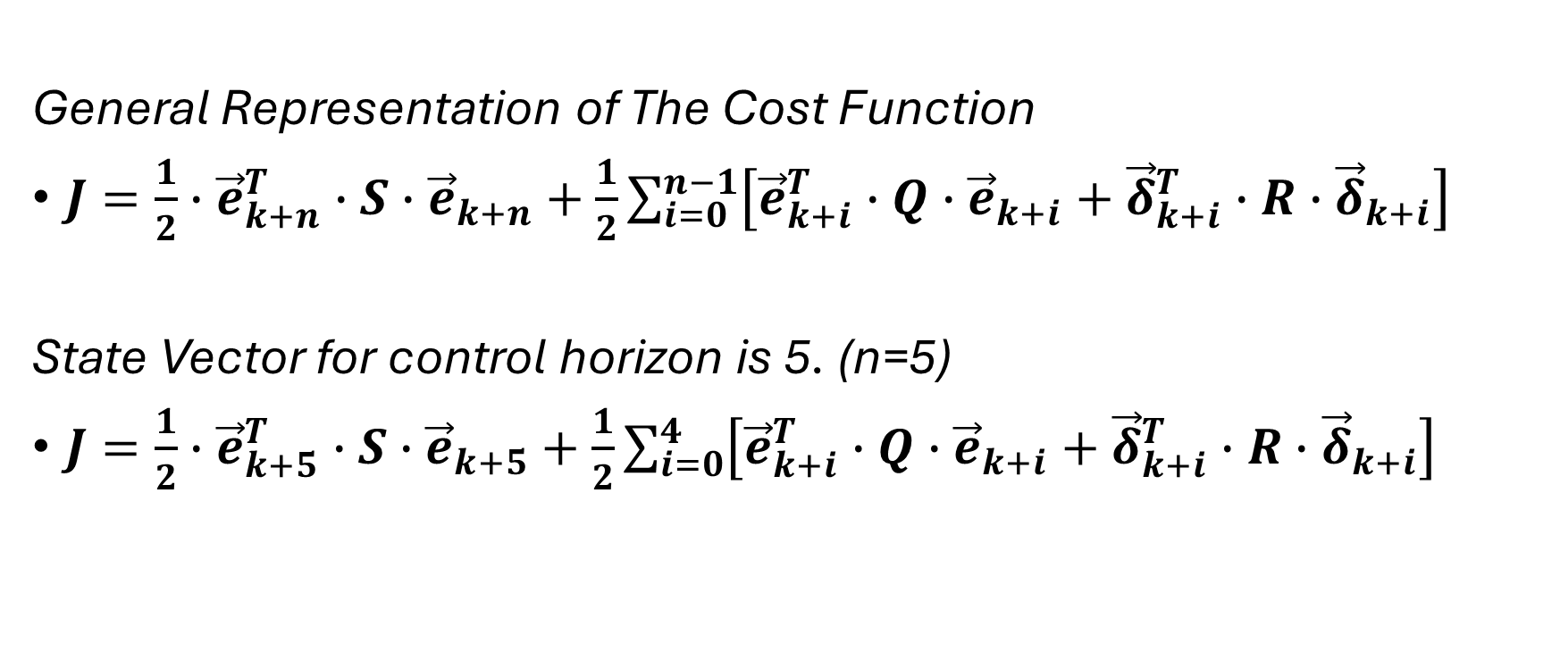
MPC: The Cost Function
General Representation of The Cost Function
$J=\frac{1}{2}∙{\vec{e}}_{k+n}^{T}∙S∙{\vec{e}}_{k+n}+\frac{1}{2}\sum_{i=0}^{n−1}{\left[{\vec{e}}_{k+i}^{T}∙Q∙{\vec{e}}_{k+i}+{\vec{δ}}_{k+i}^{T}∙R∙{\vec{δ}}_{k+i}\right]}$
State Vector for control horizon is 5. (n=5)
$J=\frac{1}{2}∙{\vec{e}}_{k+5}^{T}∙S∙{\vec{e}}_{k+5}+\frac{1}{2}\sum_{i=0}^{4}{\left[{\vec{e}}_{k+i}^{T}∙Q∙{\vec{e}}_{k+i}+{\vec{δ}}_{k+i}^{T}∙R∙{\vec{δ}}_{k+i}\right]}$

Slide 19
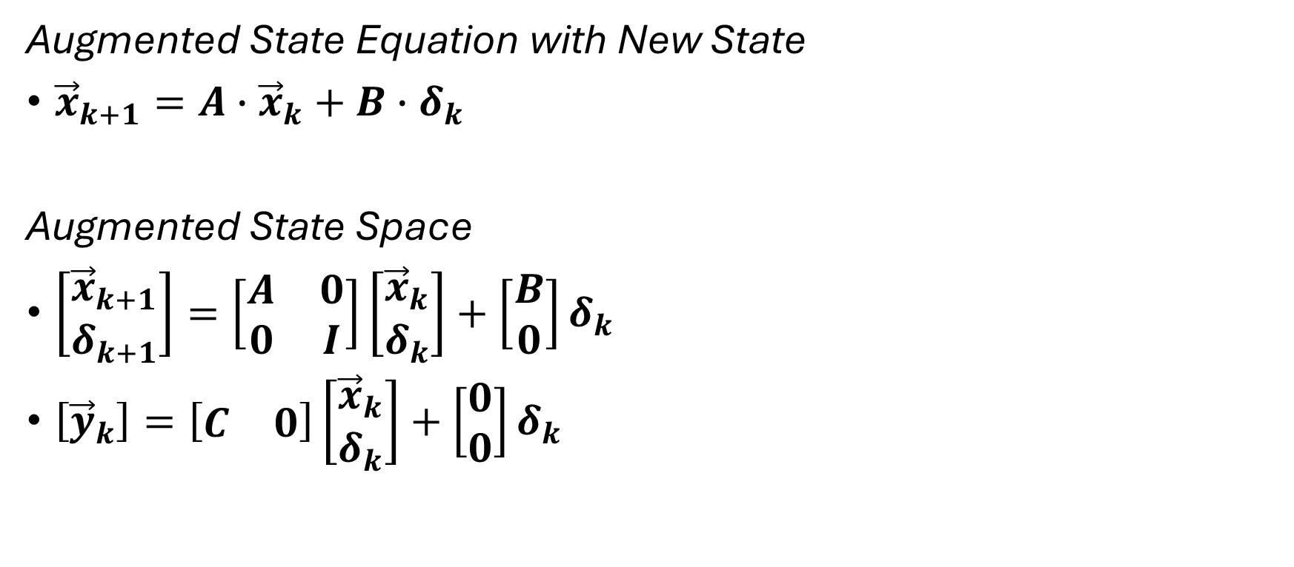
MPC: The Cost Function, Augmented SS
Augmented State Equation with New State
${\vec{x}}_{k+1}=A∙{\vec{x}}_{k}+B∙δ_{k}$
Augmented State Space
$\left[\begin{matrix}{\vec{x}}_{k+1} \\ δ_{k+1}\end{matrix}\right]=\left[\begin{matrix}A & 0 \\ 0 & I\end{matrix}\right]\left[\begin{matrix}{\vec{x}}_{k} \\ δ_{k}\end{matrix}\right]+\left[\begin{matrix}B \\ 0\end{matrix}\right]δ_{k}$
$\left[{\vec{y}}_{k}\right]=\left[\begin{matrix}C & 0\end{matrix}\right]\left[\begin{matrix}{\vec{x}}_{k} \\ δ_{k}\end{matrix}\right]+\left[\begin{matrix}0 \\ 0\end{matrix}\right]δ_{k}$

Slide 20
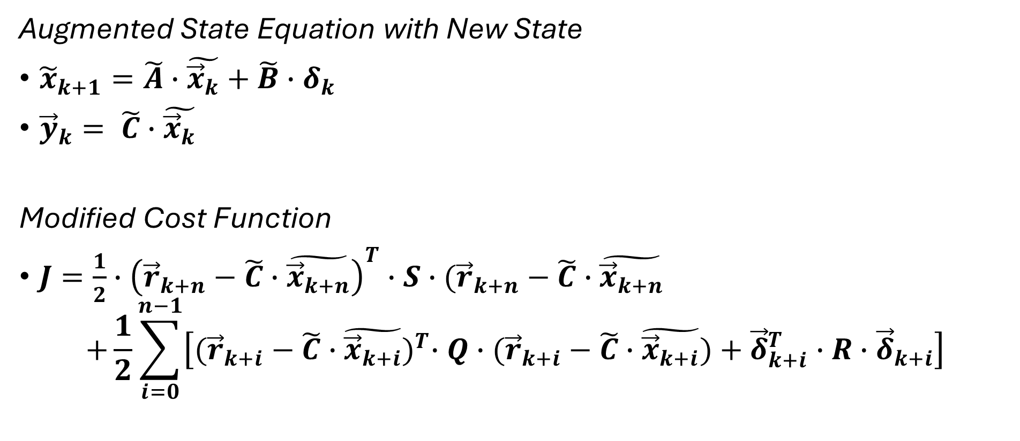
MPC: The Cost Function, Augmented SS
Augmented State Equation with New State
${\tilde{x}}_{k+1}=\tilde{A}∙\tilde{{\vec{x}}_{k}}+\tilde{B}∙δ_{k}$
${\vec{y}}_{k}= \tilde{C}∙\tilde{{\vec{x}}_{k}}$
Modified Cost Function
$J=\frac{1}{2}∙{\left({\vec{r}}_{k+n}−\tilde{C}∙\tilde{{\vec{x}}_{k+n}}\right)}^{T}∙S∙({\vec{r}}_{k+n}−\tilde{C}∙\tilde{{\vec{x}}_{k+n}}$
$$+\frac{1}{2}\sum_{i=0}^{n−1}{\left[{({\vec{r}}_{k+i}−\tilde{C}∙\tilde{{\vec{x}}_{k+i}})}^{T}∙Q∙({\vec{r}}_{k+i}−\tilde{C}∙\tilde{{\vec{x}}_{k+i}})+{\vec{δ}}_{k+i}^{T}∙R∙{\vec{δ}}_{k+i}\right]}$$

Slide 21
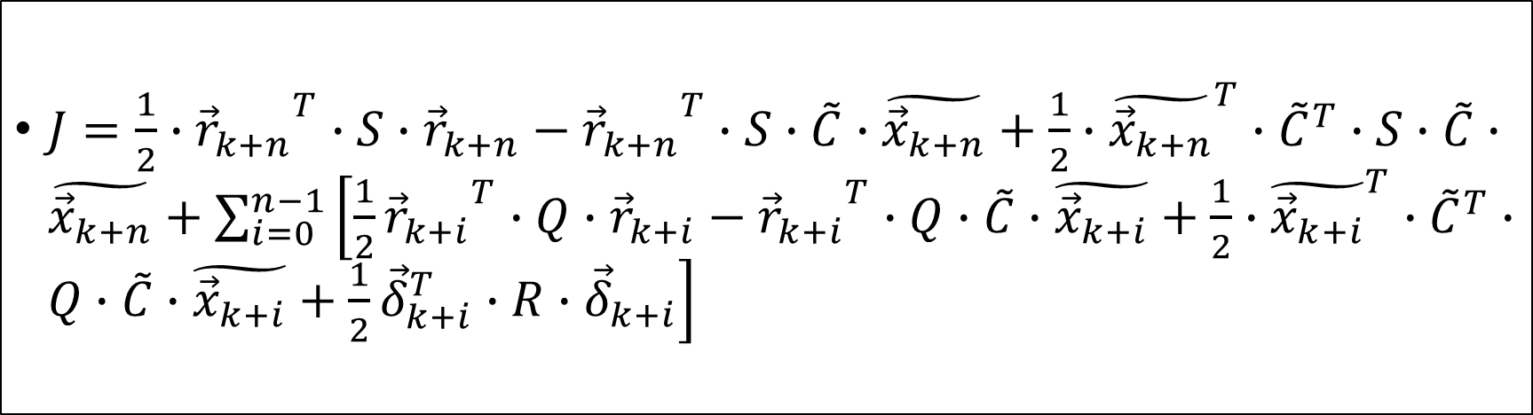
MPC: The Cost Function
$J=\frac{1}{2}∙{{\vec{r}}_{k+n}}^{T}∙S∙{\vec{r}}_{k+n}−{{\vec{r}}_{k+n}}^{T}∙S∙\tilde{C}∙\tilde{{\vec{x}}_{k+n}}+\frac{1}{2}∙{\tilde{{\vec{x}}_{k+n}}}^{T}∙{\tilde{C}}^{T}∙S∙\tilde{C}∙\tilde{{\vec{x}}_{k+n}}+\sum_{i=0}^{n−1}{\left[\frac{1}{2}{{\vec{r}}_{k+i}}^{T}∙Q∙{\vec{r}}_{k+i}−{{\vec{r}}_{k+i}}^{T}∙Q∙\tilde{C}∙\tilde{{\vec{x}}_{k+i}}+\frac{1}{2}∙{\tilde{{\vec{x}}_{k+i}}}^{T}∙{\tilde{C}}^{T}∙Q∙\tilde{C}∙\tilde{{\vec{x}}_{k+i}}+\frac{1}{2}{\vec{δ}}_{k+i}^{T}∙R∙{\vec{δ}}_{k+i}\right]}$

Slide 22
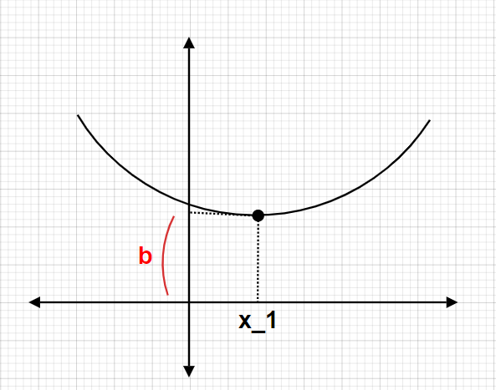

MPC: The Cost Function
$a{(x−x_{1})}^{2}+b$

Slide 23
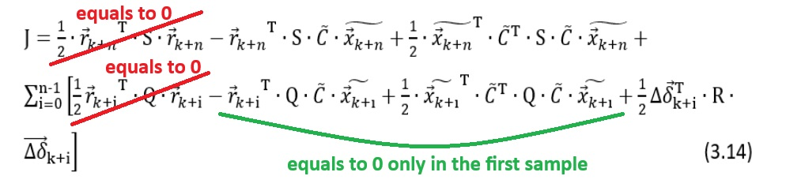
MPC: The Cost Function

Slide 24
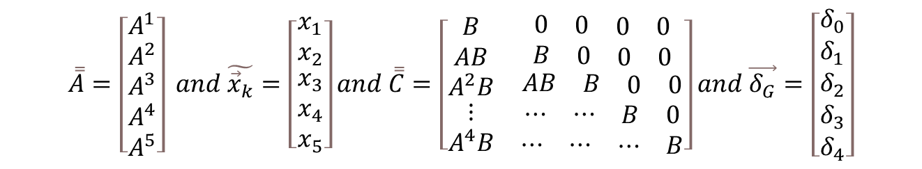
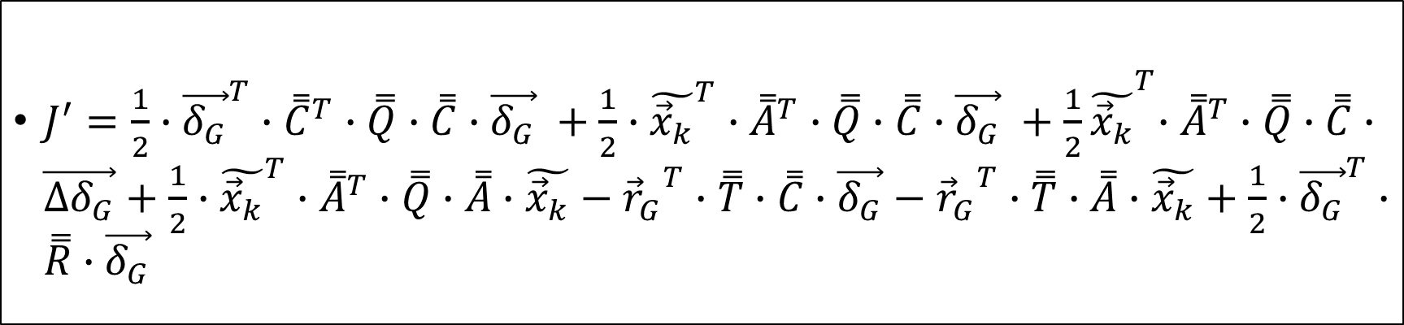
MPC: The Cost Function
$J^{′}=\frac{1}{2}{∙{\vec{δ_{G}}}^{T}∙{\overset{̿}{C}}^{T}∙\overset{̿}{Q}∙\overset{̿}{C}∙\vec{δ_{G}} +\frac{1}{2}∙{\tilde{{\vec{x}}_{k}}}^{T}∙{\overset{̿}{A}}^{T}∙\overset{̿}{Q}∙\overset{̿}{C}∙\vec{δ_{G}} +\frac{1}{2}\tilde{{\vec{x}}_{k}}}^{T}∙{\overset{̿}{A}}^{T}∙\overset{̿}{Q}∙\overset{̿}{C}∙\vec{∆δ_{G}}+\frac{1}{2}∙{\tilde{{\vec{x}}_{k}}}^{T}∙{\overset{̿}{A}}^{T}∙\overset{̿}{Q}∙\overset{̿}{A}∙\tilde{{\vec{x}}_{k}}−{{\vec{r}}_{G}}^{T}∙\overset{̿}{T}∙\overset{̿}{C}∙\vec{δ_{G}}−{{\vec{r}}_{G}}^{T}∙\overset{̿}{T}∙\overset{̿}{A}∙\tilde{{\vec{x}}_{k}}+\frac{1}{2}∙{\vec{δ_{G}}}^{T}∙\overset{̿}{R}∙\vec{δ_{G}}$
$$\overset{̿}{A}=\left[\begin{matrix}A^{1} \\ A^{2} \\ \begin{matrix}A^{3} \\ A^{4} \\ A^{5}\end{matrix}\end{matrix}\right] and \tilde{{\vec{x}}_{k}}=\left[\begin{matrix}x_{1} \\ x_{2} \\ \begin{matrix}x_{3} \\ x_{4} \\ x_{5}\end{matrix}\end{matrix}\right]and \overset{̿}{C}=\left[\begin{matrix}\begin{matrix}B \\ AB \\ \begin{matrix}A^{2}B \\ \begin{matrix}⋮ \\ A^{4}B\end{matrix}\end{matrix}\end{matrix} & \begin{matrix}\begin{matrix}0 & \begin{matrix}0 & \begin{matrix}0 & 0\end{matrix}\end{matrix}\end{matrix} \\ \begin{matrix}B & \begin{matrix}0 & \begin{matrix}0 & 0\end{matrix}\end{matrix}\end{matrix} \\ \begin{matrix}\begin{matrix}AB & \begin{matrix}B & \begin{matrix}0 & 0\end{matrix}\end{matrix}\end{matrix} \\ \begin{matrix}⋯ & \begin{matrix}⋯ & \begin{matrix}B & 0\end{matrix}\end{matrix}\end{matrix} \\ \begin{matrix}⋯ & \begin{matrix}⋯ & \begin{matrix}⋯ & B\end{matrix}\end{matrix}\end{matrix}\end{matrix}\end{matrix}\end{matrix}\right]and \vec{δ_{G}}=\left[\begin{matrix}δ_{0} \\ δ_{1} \\ \begin{matrix}δ_{2} \\ δ_{3} \\ δ_{4}\end{matrix}\end{matrix}\right]$$

Slide 25
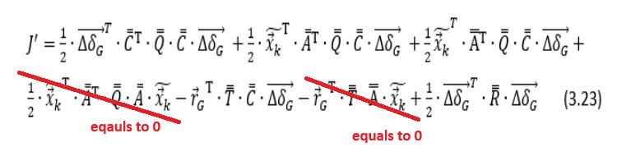
MPC: The Cost Function

Slide 26
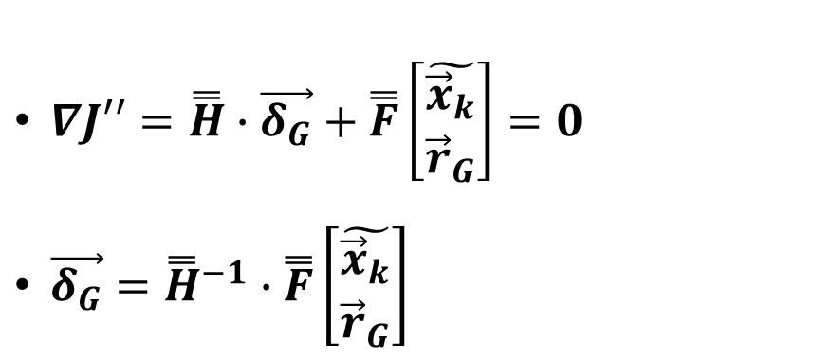
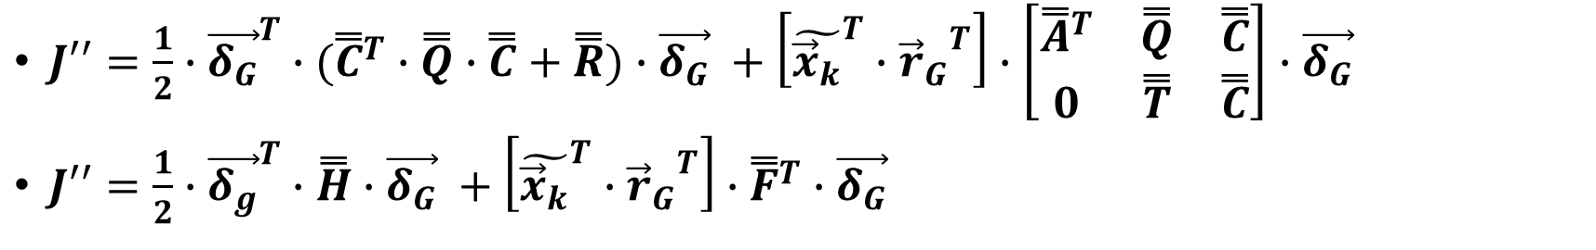
MPC: The Cost Function
$J′′=\frac{1}{2}∙{\vec{δ_{G}}}^{T}∙({\overset{̿}{C}}^{T}∙\overset{̿}{Q}∙\overset{̿}{C}+\overset{̿}{R})∙\vec{δ_{G}} +\left[{\tilde{{\vec{x}}_{k}}}^{T}∙{{\vec{r}}_{G}}^{T}\right]∙\left[\begin{matrix}{\overset{̿}{A}}^{T} & \overset{̿}{Q} & \overset{̿}{C} \\ 0 & \overset{̿}{T} & \overset{̿}{C}\end{matrix}\right]∙\vec{δ_{G}}$
$J′′=\frac{1}{2}∙{\vec{δ_{g}}}^{T}∙\overset{̿}{H}∙\vec{δ_{G}} +\left[{\tilde{{\vec{x}}_{k}}}^{T}∙{{\vec{r}}_{G}}^{T}\right]∙{\overset{̿}{F}}^{T}∙\vec{δ_{G}}$
$∇J′′=\overset{̿}{H}∙\vec{δ_{G}}+\overset{̿}{F}\left[\begin{matrix}\tilde{{\vec{x}}_{k}} \\ {\vec{r}}_{G}\end{matrix}\right]=0$
$\vec{δ_{G}}={\overset{̿}{H}}^{−1}∙\overset{̿}{F}\left[\begin{matrix}\tilde{{\vec{x}}_{k}} \\ {\vec{r}}_{G}\end{matrix}\right]$

Slide 27
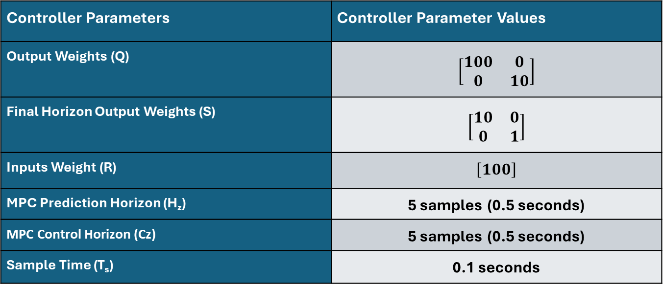
Controller Parameters and Constraints
Controller Parameters | Controller Parameter Values
Output Weights (Q) | $$\left[\begin{matrix}100 & 0 \\ 0 & 10\end{matrix}\right]$$
Final Horizon Output Weights (S) | $$\left[\begin{matrix}10 & 0 \\ 0 & 1\end{matrix}\right]$$
Inputs Weight (R) | $$\left[100\right]$$
MPC Prediction Horizon (H_{z}) | 5 samples (0.5 seconds)
MPC Control Horizon (Cz) | 5 samples (0.5 seconds)
Sample Time (T_{s}) | 0.1 seconds

Slide 28
Controller Parameters and Constraints
CONSTRAINTS TABLE
I/O | Constraint Name | Min Value | Max Value | Min Rate | Max Rate
I | Steering Angle (rads) | 0,52 | 0,52 | -0,17 | 0,17
O | Lateral Displacement (meters) | -10 | 10 | - | -
O | Yaw Angle (rads) | -0,4 | 0,4 | - | -

Slide 29
Results
The results could have caused confusion because they involved a comparison with another well-known reliable controller. Therefore, they were removed.

Slide 30
Thank you

