Slide 1
Introduction to Moveit
Will Mandil

Slide 2
Workshop plan
Installation and Basics.
Wave at the World.
Move Group start up and basic class
Reading robot states .
Simple Trajectory planning and movement.
Cartesian Path planning and execution. (If we have time)
Full code and package can be found at:
https://github.com/WillMandil001/moveit_workshop

Slide 3
Installation
To install, follow the instructions found here:
Melodic:
http://docs.ros.org/en/melodic/api/moveit_tutorials/html/doc/getting_started/getting_started.html
Kinetic:
http://docs.ros.org/en/kinetic/api/moveit_tutorials/html/doc/getting_started/getting_started.html
Should finish with catkin workspace called “ws_moveit” with two packages built in the src called panda_moveit_config and moveit_tutorials.

Slide 4

Moveit Basics
Two key practical aspects to Moveit:
Moveit setup assistant - this is the program used to configure a urdf file (physical description of a robot) for use with MoveIt. It generate a ros package to launch moveit, a simulated version of the robot and in the cases of real robots, the controllers for drivers. (BUILD THE ROBOT)
Move Group - Python and C++ interface for MoveIt allowing you to create motion paths etc. (MOVE THE ROBOT)

Slide 5
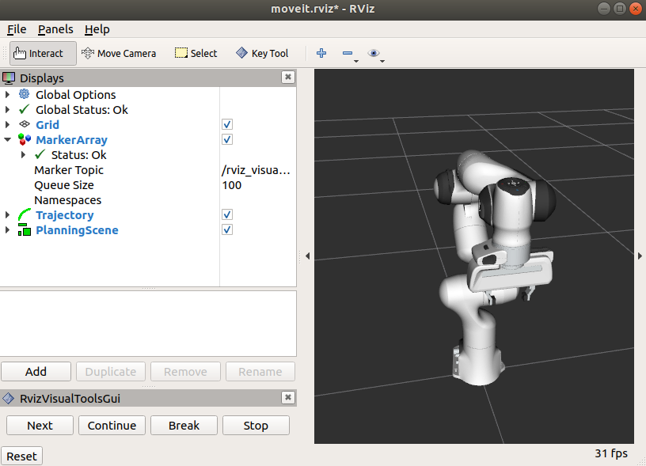
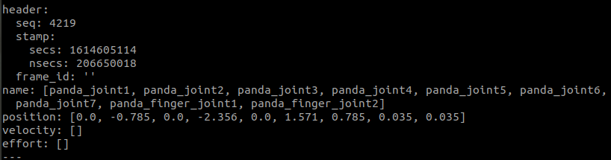
2. Start up and Wave at the World
The following sequence will ensure the install is correct and will introduce robot movements without any code.
Run : roslaunch panda_moveit_config demo.launch
Simulated version of the real robot visualised in RVIZ.
2. rostopic echo /joint_states

Slide 6
2. Start up and Wave at the World
Add the MotionPlanning display to Rviz. Which will allow us to animate solution paths within this planning scene.

Slide 7
2. Start up and Wave at the World
Change the Planning Group from “hand” to “panda_arm_hand” under MotionPlanning/Planned Request/
To see the planned path we will create enable the loop animation under: MotionPlanning/Planned Path/

Slide 8
2. Start up and Wave at the World
Use the marker to drag the robot to a goal location.
Use the motion planning window (bottom left) to plan and execute a motion from start state to goal state.

Slide 9
3. Move Group - Start up
We will create our own package and simple script to perform a variety of useful motions for the robot.
/ws_moveit/src$ catkin_create_package moveit_workshop std_msgs rospy roscpp
Create a python file in new moveit_workshop/src
Don’t forget to source and chmod +x the python file

Slide 10
3. Move Group - import packages:
To use the python moveit interface we will import the “moveit_commander” which provides us to the classes: “MoveGroupCommander”, “PlanningSceneInterface” and “RobotCommander”. We will also import a few ros messages required.
#!/usr/bin/env python
# Author: Acorn Pooley, Mike Lautman
import sys
import copy
import rospy
import moveit_commander
import moveit_msgs.msg
import geometry_msgs.msg
from geometry_msgs.msg import PoseStamped
from math import pi
from std_msgs.msg import String
from moveit_commander.conversions import pose_to_list

Slide 11
3. Move Group - Create robot class:
Let’s create a Franka Robot class that will contain all the relevant objects required.
class FrankaRobot(object):
def __init__(self):
super(FrankaRobot, self).__init__()
moveit_commander.roscpp_initialize(sys.argv)
rospy.init_node('FrankaRobotWorkshop', anonymous=True)
self.robot = moveit_commander.RobotCommander()
self.scene = moveit_commander.PlanningSceneInterface()
self.move_group = moveit_commander.MoveGroupCommander("panda_arm")
self.display_trajectory_publisher = rospy.Publisher('/move_group/display_planned_path',
moveit_msgs.msg.DisplayTrajectory,
queue_size=20)
self.planning_frame = self.move_group.get_planning_frame()
self.eef_link = self.move_group.get_end_effector_link()
self.group_names = self.robot.get_group_names()
if __name__ == '__main__':
robot = FrankaRobot()

Slide 12
3. Move Group - Robot Class Information:
self.robot = moveit_commander.RobotCommander() -- This provides the class with information such as the robot’s kinematic model and the robots current joint states
self.scene = moveit_commander.PlanningSceneInterface() -- This provides the class with a remote interface for getting, setting and updating the robots internal understanding of the robots surrounding environment.
self.move_group = moveit_commander.MoveGroupCommander(“panda_arm”) -- This object is an interface for the planning group (set of robot joints), for this workshop we will only work with the robots arm joints and ignore the robots end effector joints (fingers).

Slide 13
4. Reading Robot States:
Let’s create two functions within the robot class that read the robots position, one in joint space, the other in task space (position and orientation of end effector):
For joint space you will need the function:
self.robot.get_current_state()
self.group.get_current_joint_values()
For task space (position = [x,y,z], orientation = [x,y,z,w]): self.move_group.get_current_pose()
Solutions on next slide
Either is good

Slide 14
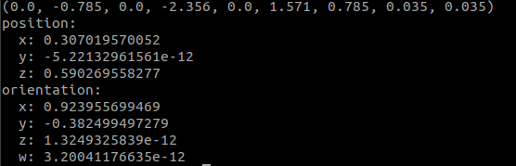
4. Reading Robot States - Solutions
def get_robot_joint_state(self):
robot_joint_state = self.robot.get_current_state().joint_state.position
print(robot_joint_state)
def get_robot_task_state(self):
robot_ee_pose = self.move_group.get_current_pose().pose
print(robot_ee_pose)
Can check joint states with rostopic echo /joint_states

Slide 15
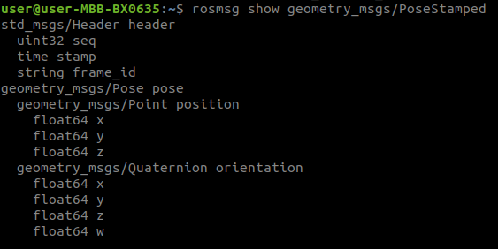
5. Moving the robot
As with the reading, we can also move the robot by giving a set of joint positions or an end effector pose:
For joint space motion you will need the function: move_group.go(joint_goal, wait=True) “joint_goal” should be a set of joint states in radians of length 7 (robot has 7 joints)
For task space motion you will need the function:
target = self.move_group.set_pose_target(pose)
self.move_group.go(target)
“Pose” will need to be the ROS geometry.msg “PoseStamped” this can be used as shown below, we need to set the base frame for the pose (used by tf tree to calculate the kinematics), for us this is “/panda_link0”:
pose = PoseStamped()
pose.header.frame_id = '/panda_link0'
Solutions on next slide
Use this to help work out how to populate the message.

Slide 16
5. Moving the robot - Solutions
def go_to_joint_state(self):
joint_goal = [0, -pi/4, 0, -pi/2, 0, pi/3, 0]
self.move_group.go(joint_goal, wait=True)
self.move_group.stop() # ensures there are no residual movements
def go_to_task_state(self):
p = PoseStamped()
p.header.frame_id = '/panda_link0'
p.pose.position.x = 0.45
p.pose.position.y = -0.25
p.pose.position.z = 0.45
p.pose.orientation.x = 1
p.pose.orientation.y = 0
p.pose.orientation.z = 0
p.pose.orientation.w = 0
target = self.move_group.set_pose_target(p)
self.move_group.go(target)
You can combine the read states and move to joint states to create closed loop control or motions relative to current state not global state

Slide 17
6. Creating a cartesian trajectory
You can plan a Cartesian path directly by specifying a list of waypoints for the end-effector to go through.
waypoints = []
wpose = move_group.get_current_pose().pose
wpose.position.z -= scale * 0.1 # First move up (z)
wpose.position.y += scale * 0.2 # and sideways (y)
waypoints.append(copy.deepcopy(wpose))
wpose.position.x += scale * 0.1 # Second move forward/backwards in (x)
waypoints.append(copy.deepcopy(wpose))
wpose.position.y -= scale * 0.1 # Third move sideways (y)
waypoints.append(copy.deepcopy(wpose))
(plan, fraction) = move_group.compute_cartesian_path(waypoints, # waypoints to follow
0.01, # eef_step
0.0)

Slide 18
6. Display and Execute a Cartesian trajectory
To have Rviz display the planned trajectory we can publish a trajectory with the message DisplayTrajectory() which we give the start state of the robot and the trajectory plan:
display_trajectory = moveit_msgs.msg.DisplayTrajectory()
display_trajectory.trajectory_start = self.robot.get_current_state()
display_trajectory.trajectory.append(plan)
self.display_trajectory_publisher.publish(display_trajectory)
Finally we can Execute this computed plan with:
raw_input(“press enter to execute”)
move_group.execute(plan, wait=True)

Slide 19
End of Workshop

