Slide 1


Baby Shark to Barracuda: Analyzing Children’s Music Listening Behavior
Lawrence Spear, Ashlee Milton, Garrett Allen, Amifa Raj, Michael Green, Michael D. Ekstrand, and Maria Soledad Pera.

Slide 2
Goal
Novelty
Why Children?
Analyze online music listening behavior to identify trends in children’s music preference at different stage of their lives
Going beyond artist-genre
Observe user characteristics
Novelty
Diversity
Mainstreamness
Observe music traits
Loudness
Energy
Valence (more)
Segment children user by education level
Children are different from adults
Music preferences develop over time
Children relevant recommendations

Slide 3
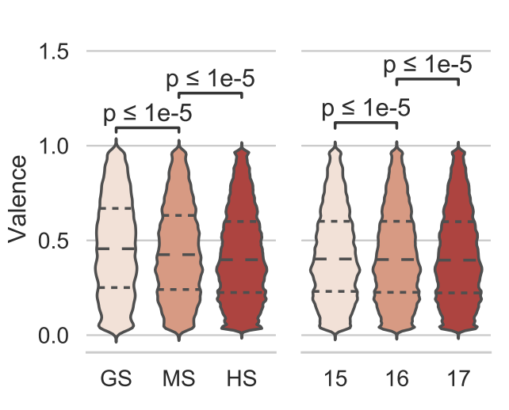
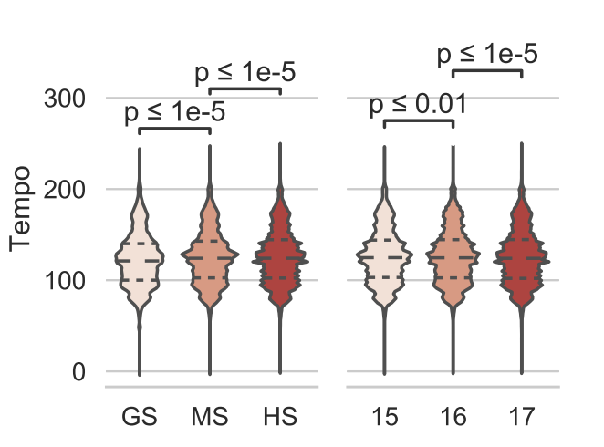
Exploration
Findings
K-Music
LastFM 1B (User listening events)
Spotify API (Audio features)
Grade level analysis
GS (6-11)
MS (12-14)
HS (15-17)
Further analyzed HS by age
Considered broad range of genre ((e.g., alternative rock and soul)
One size doesn't fit all for children
Preference of valence and tempo significantly differ over education level
Future studies needed

Slide 4
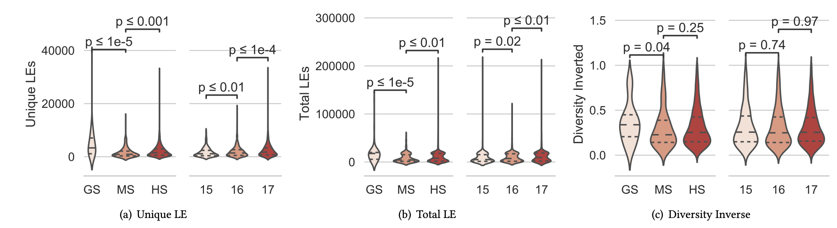
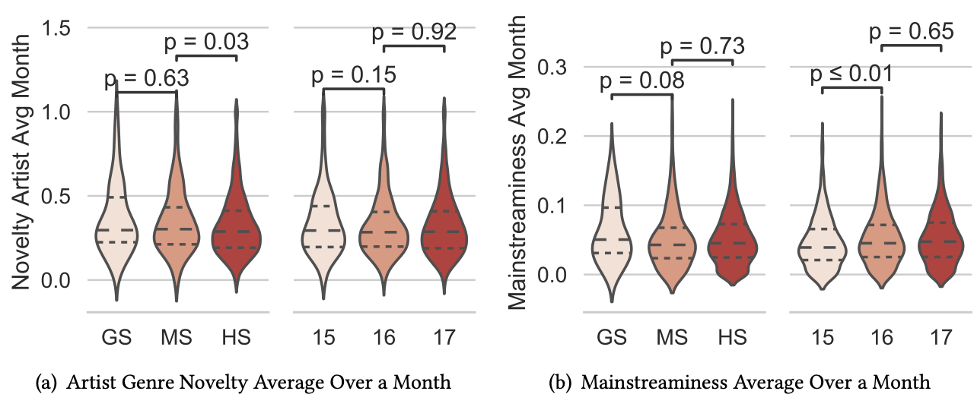
User Characteristics

Slide 5

Thanks!

