Slide 1
Bill’s Automated Home System
Arduino, Linux and Android system for wireless control of home lighting and ceiling fans.

Slide 2
WirelessSmarthomeSystem
Will useXbeetypeZigbeemodules for wireless communications, in a Mesh configuration.
Arduino prototyping boards for “wall switch” controls and target receivers. Arduinos will beZigbeerouter endpoints.
Linux based central “server” andZigbeeCoordinator. CoordinatesZigbeenetwork, logs activity,, controls away/vacation events, provides control and status capability via internet.
Android smartphone control. (I don’t’ have an AppleiDevice, but that could be some future addition)

Slide 3
Zigbeewireless
Mesh topology.
Central “Coordinator” running Linux, connected to anXbeecoordinator module
Using routers (as endpoints) in the Wireless topology helps to extend communication range if there are radio obstacles in some parts of the home, or if certain locations are at a long enough distance for weak signal at low broadcast power levels. Run by home AC mains, so no real worries about power consumption to require true endpoints.
Arduino controls useXbeerouter node
Arduino target receivers useXbeerouter node
UseXbeemodules in API messaging mode
Encryption for Security –Xbee’sAPS mode or Arduino AES software library

Slide 4
Controls
LCD touchscreen “wall switch” – 2.4inch model is inexpensive for Arduino. Depending on code size, either Uno or Due microcontroller.
LCD touchscreen server/coordinator. Logging and controls also accessible via internet/WiFiAndroid device. Programming/controls access via SSH to PC. Either an AMD Gizmo (I want to use it for something) or Raspberry Pi would make a decent central coordinator.
AndroidGeofence(GPS location of family smartphones)
Android manual control App
Android NFC tags by front door as option togeofence

Slide 5
Controllable Targets
Light fixtures - Dimmable fixture – using aTriacbased circuit
Ceiling Fan - Single-Phase AC Induction Motor – also useTriacbased circuit
On/Off for simple light fixtures, outlet dongles, small appliances, etc.
For dim/speed control, detect a zero-crossing of the AC Line waveform, and then pulse theTriacfor some percentage of the AC line waveform. Adjust the amount of the AC Waveform time theTriacis on to control dim/speed.

Slide 6
LCD Touchscreen Controls
Select Room
Select Target (light, fan, desk lampetc)
Darker/slower
Lighter/faster
Store (in target?) current setting as favorite (toeeprom, flash orSD)
Go to favorite level/speed (from whatever current state)
Communicate to selected target
Communicate to server for logging
Receive from Server for other controls (smartphone or server panel) to update local target state changed by another control.
Full on or off (also available in a simpler button or toggle switch control dedicated to a particular target set)

Slide 7
Control Message viaZigbee
Command,Acknowledge,Confirm,Completed. (master,slave)
Network ID (not same as plaintextZigbeeID)
16bit node ID (not same as plaintextZigbeeID)
Node type (touchscreen control, toggle control, dimmable light, fan, server,etc)
command (on, off, dimmer, brighter, slower, faster, status update, store favorite, ask favorite, ask current, No-OP, Update ID,ConfigNode, Add Node,etc)
current dim/speed level
a security handshake code
16bit Old ID, 16bit new ID (for an ID update)
Add node command includes new node ID, it’s type, current state, room location, so that controls will know about it
Add room location includes room ID
All message content encrypted, don’t use any non-encryptedZigbeeframing info in determining what to (or not)

Slide 8
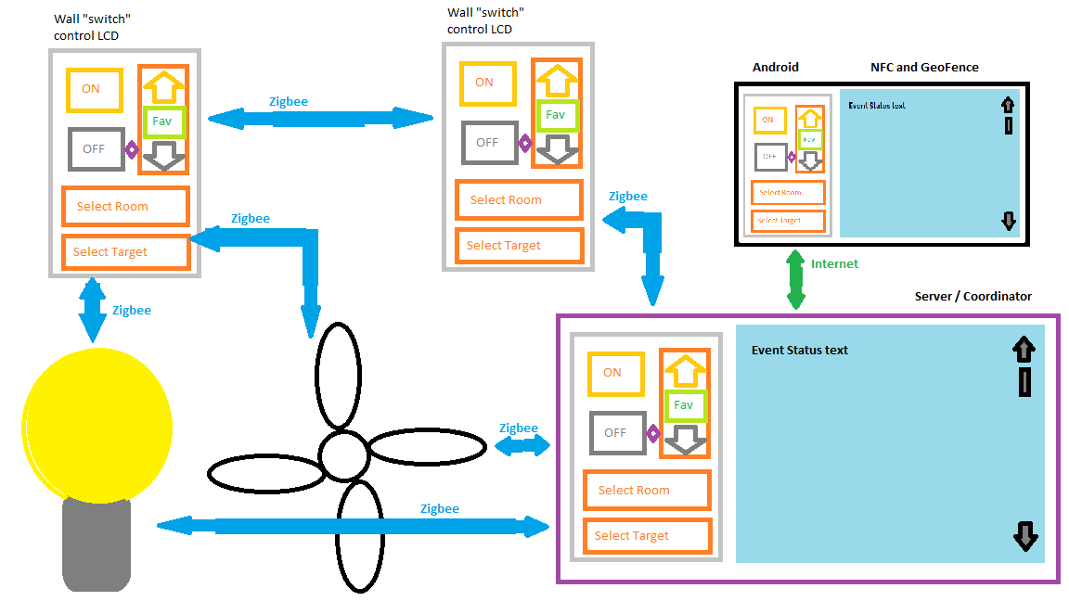
System Block Diagram (added after PDR submitted for presentation)

Slide 9
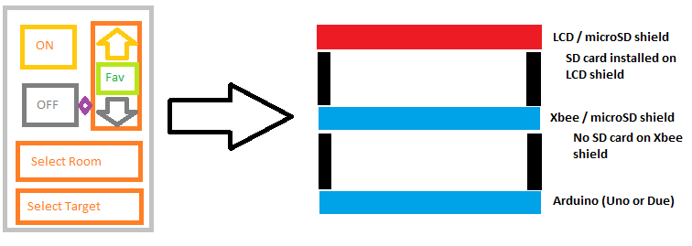
Wall “switch” LCD touch control is an Arduino board, Xbee shield and LCD/microSD shield. (added after PDR submitted for presentation)

Slide 10
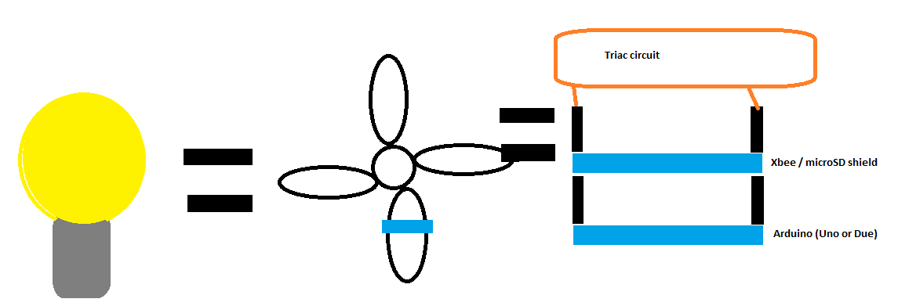
Targets to control are an Arduino Uno, Xbee/microSD shield, and a Triac AC control circuit. (added after PDR submitted for presentation)

Slide 11
Tentative Schedule part 1 (added after PDR submitted for presentation)

Slide 12
Tentative Schedule part 2 (added after PDR submitted for presentation)

Slide 13
Risks

Slide 14


