Slide 1
Case Study 02 August 17th 2019
Joe Chung
Notes:
Greetings(Hello my name is), (thank you for the opportunity to present to you today) obeisances, ect (This is a presentation of finding on the beer and brewery data provided to us. Let’s jump right in)

Slide 2

Build predictive model to identify high-potential turnover employees
Build predictive model to estimate income
Improve workforce planning
* The analysis is conducted on existing employee data.
Analysis Objective
Notes:
The objective of this analysis is to build robust models to identify high-potential employees and reducing voluntary employee turnover. And eventually help making business decision on workforce planning

Slide 3
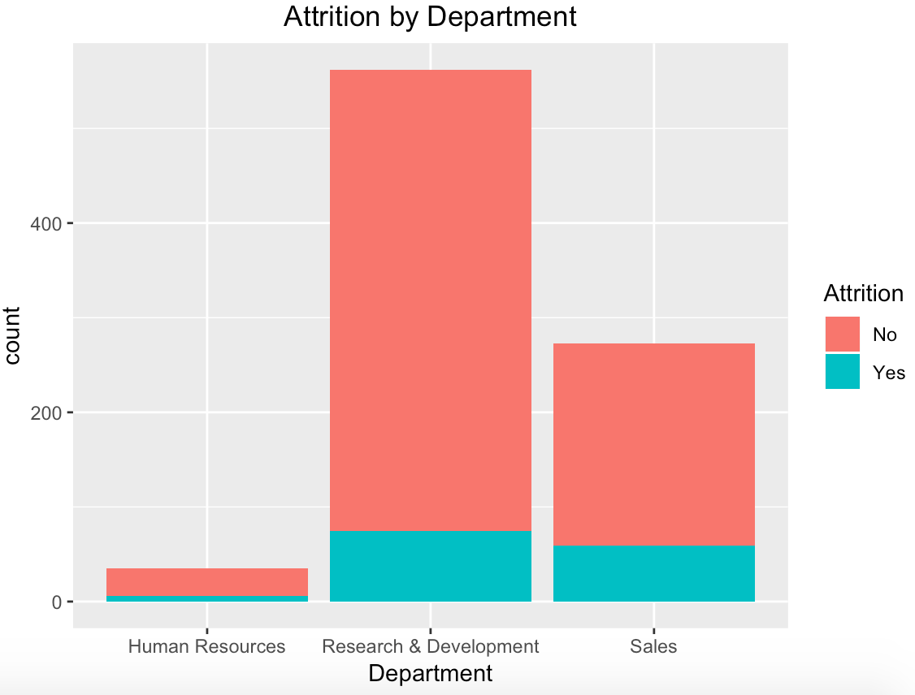
Preliminary Discovery
Department with Higher Attrition
Research & Development
Sales
Notes:
The objective of this analysis is to build robust models to identify high-potential employees and reducing voluntary employee turnover. And eventually help making business decision on workforce planning

Slide 4
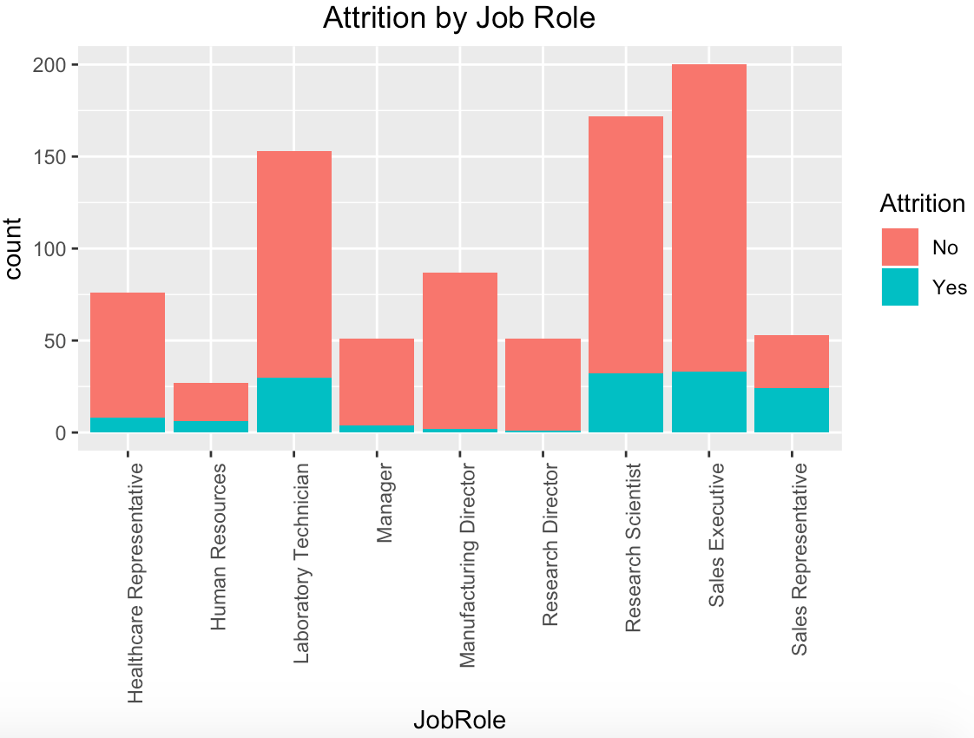
Preliminary Discovery
Job Roles with Higher Attrition
Laboratory Technician
Research Scientist
Sales Executive
Sales Representative
Notes:
The objective of this analysis is to build robust models to identify high-potential employees and reducing voluntary employee turnover. And eventually help making business decision on workforce planning

Slide 5

Predicting Attrition

Slide 6
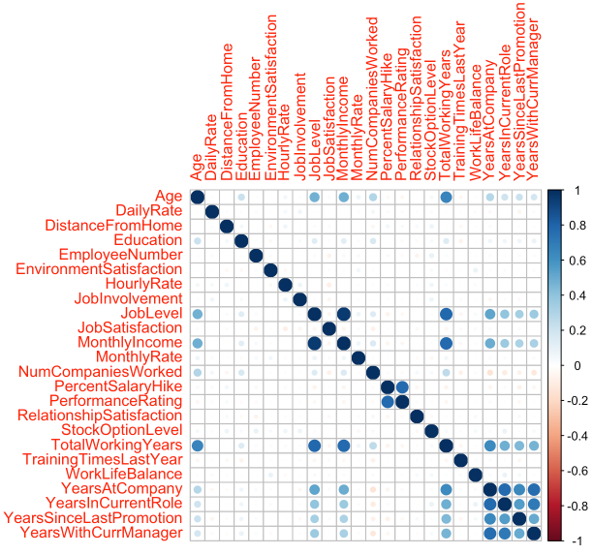
Correlation Between Numeric Variables
Highly Correlated Variables
Job Level /Monthly Income
Performance Rating /Relationship Satisfaction
Age /Total Working Years
Years At Company /Years In Current Role /Years Since Last Promotion /Years With Curr Manager
Notes:
The dataset that we are using to run the analysis contain 870 employees and 36 attribute. To build a predictive model, first we need to eliminate some of the redundant attribute by removing highly correlated variables.

Slide 7
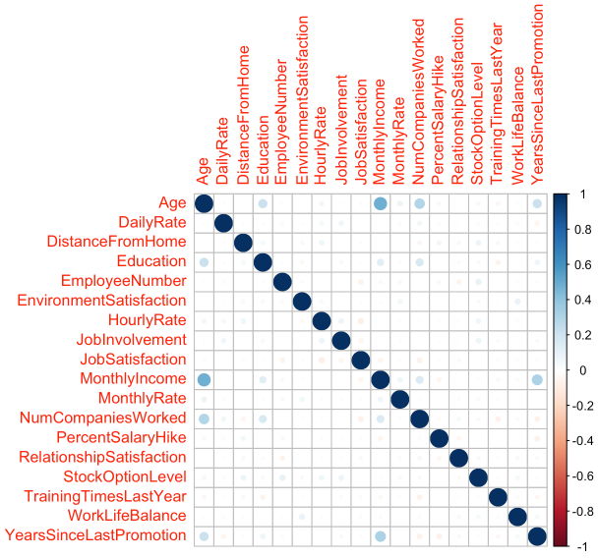
Correlation Between Numeric Variables
After cleaning redundant variables
Job Level
Performance Rating
Total Working Years
Years At Company
Years In Current Role
Years With Curr Manager
Notes:
After eliminating highly correlated columns, job levels, performance rating, and other variables. The graph looks much better.

Slide 8
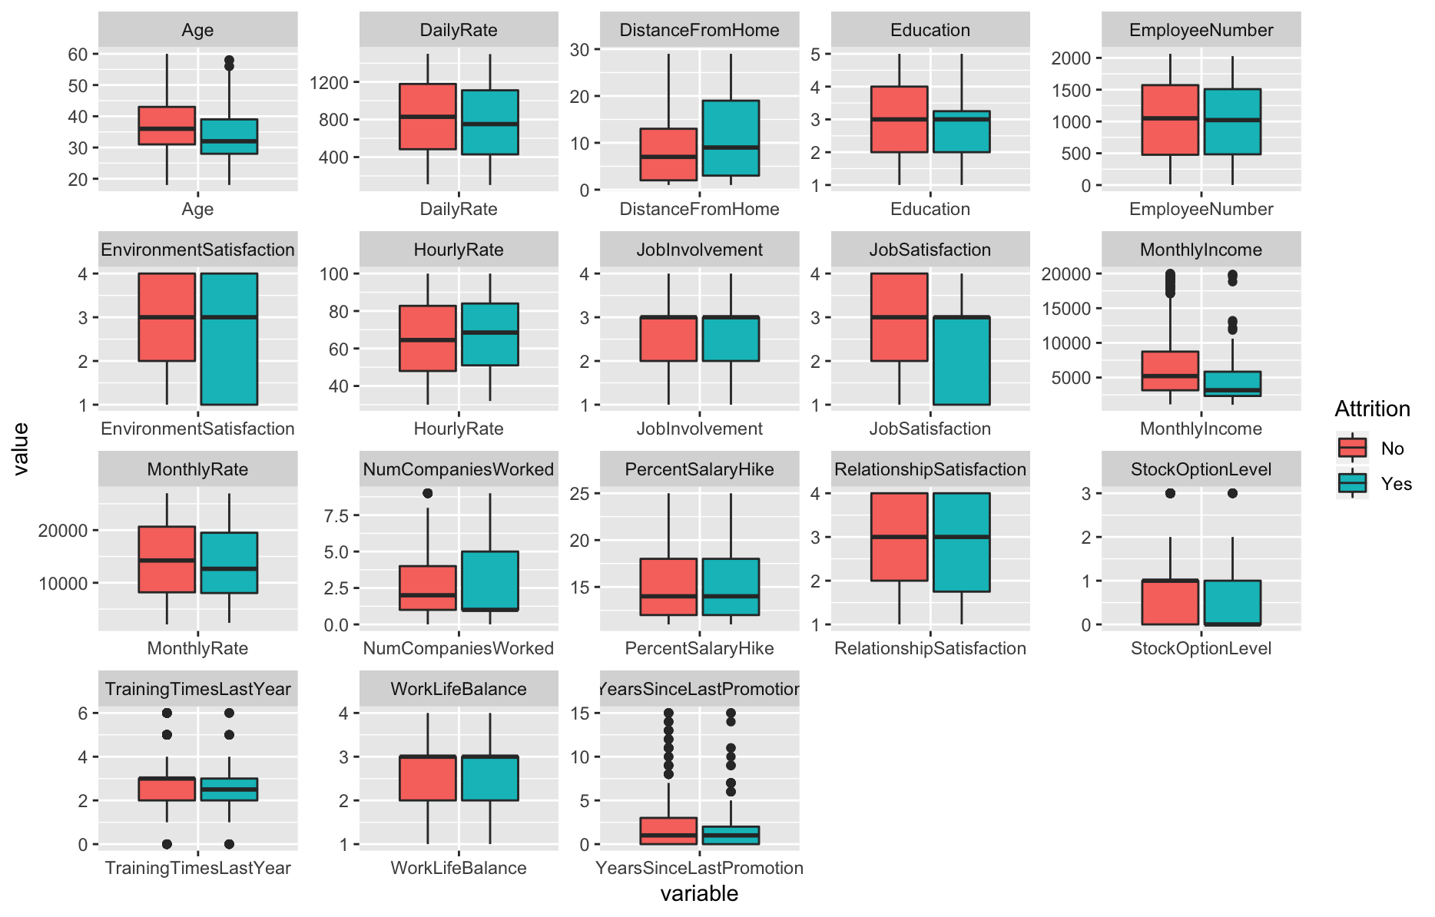
Visualize Attrition and explanatory variables
Variables that correlate with Attrition
Age
Distance From Home
Education
Job Satisfaction
Monthly Income
Years Companies Worked
Notes:
Here are the boxplot to visualize the relationship between Attrition and the explanatory variables. We can see the age, Distance from home,education, job satisfaction, monthly income, years of companies worked. Have associate relationship with the Attrition. The organization should look more deep into how to decrease Attrition, for example, provide more benefits for the employees that live far from workplace, provide more education assistant, etc.

Slide 9

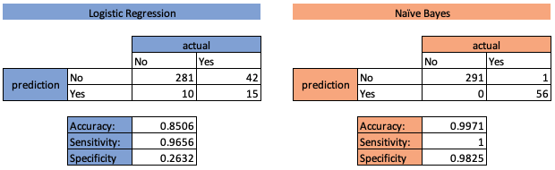
Predicting Attrition
Data are split to 60% training set and 40% test set.
Confusion Matrix of the 40% test set
Naive Bayes Algorithm performs better
Notes:
To predict Attrition, I ran 2 different models. The models are train with 60% of the random sample. And the Confusion Matrix is run on the 40% of the test set. The Naive Bayes Algorithm performs better, the accuracy is 99.7% with high sensitivity and specificity. The predictive result can be found in our github site. In the next slide, we are going to look into the monthly income, which is a hugh factor of the attrition.

Slide 10
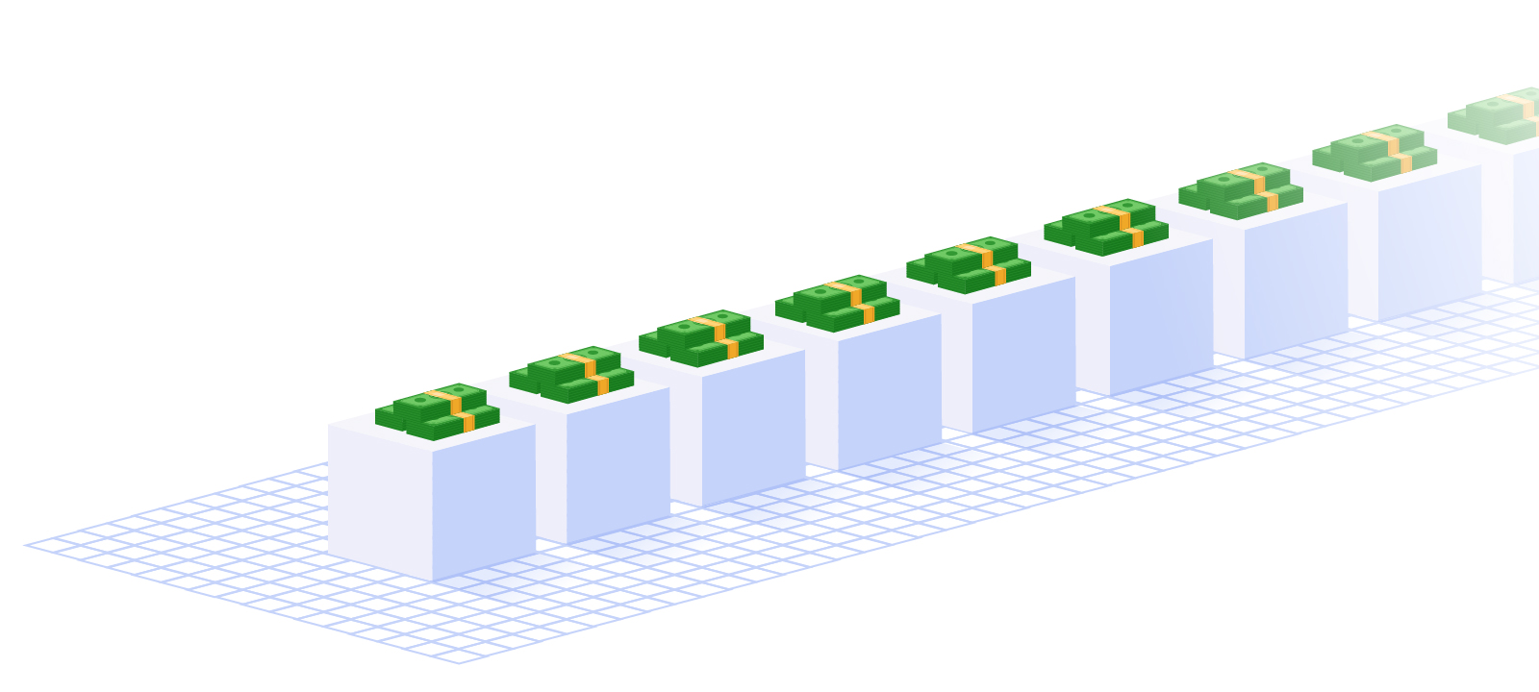
Predicting Monthly Income

Slide 11

Multiple Regression Model
Explanatory variables selection methods
Stepwise
Forward
Backward
Forward selection method selects more variable and produce a better RMSE
Multiple Regression Model
 | Adjusted R-squared | RMSE
Stepwise | 0.918 | 1327.915
Forward | 0.9168 | 1315.878
Backward | 0.918 | 1327.878
Notes:
To predict monthly income, we use the multiple regression model. And we run the stepwise, forward and backward selection methods and compare their root mean square error. The forward selection method produce a better RMSE.

Slide 12
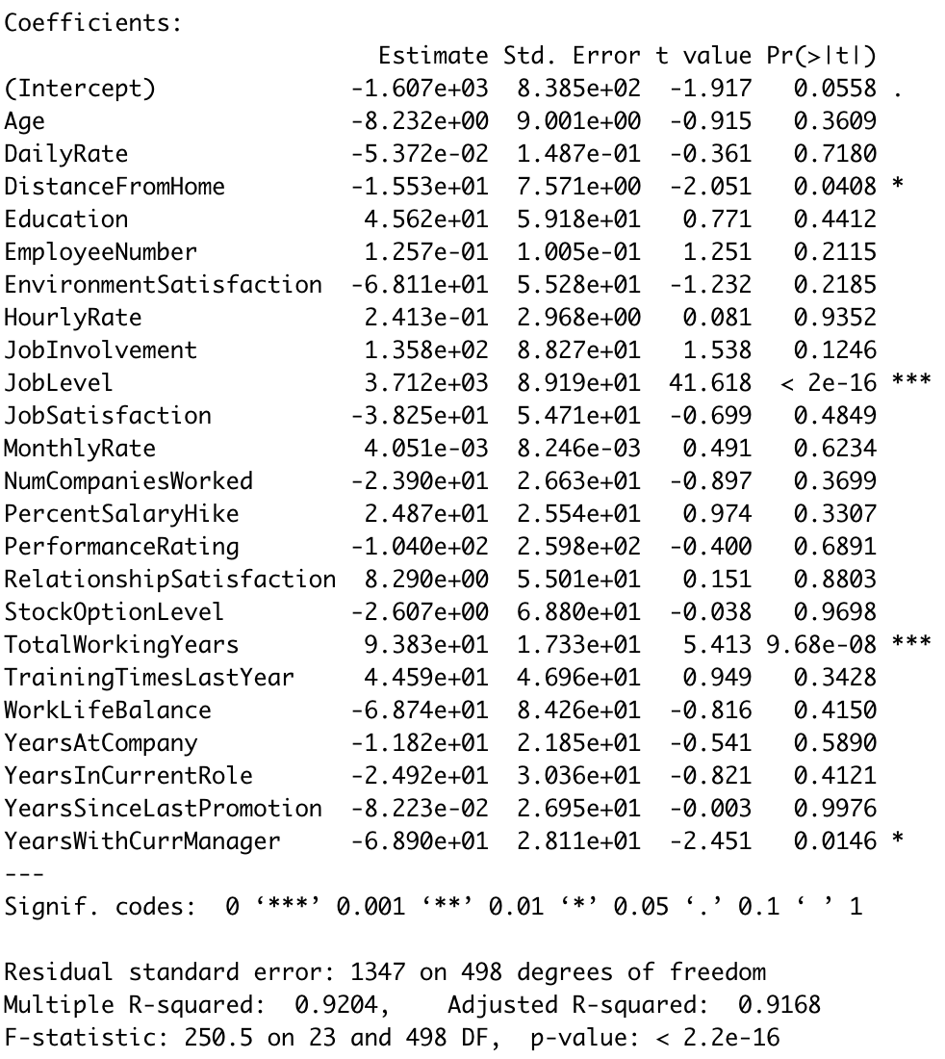
Forward Selection Variables
91.68% of the variance in the data can be explained by the predictor variables.
Notes:
Here are the explanatory variable we use to train our regression model. 91.68% of the variance in the data can be explained by the predictor variables.

Slide 13

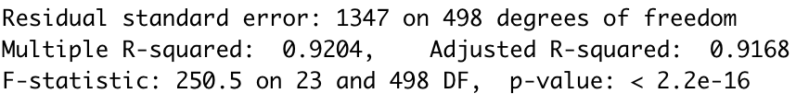
Regression Statistics
As the significance value is less than p=0.001, we can say that the regression model significantly predicts Monthly Income. F(23,498) = 250.5

Slide 14

Conclusions
Data suggests that the attrition rate of Sales Department and technical job roles are higher..
The Attrition is highly correlated with “Distance From Home”, “Job Satisfaction”, “Monthly Income” and employees’ Attrition.
Our Attrition predictive model using Naive Bayes Algorithm achieve 99.7% accuracy rate
Our Monthly Income regression model significantly predicts income.
Notes:
Thank you for the opportunity to present to you today. Additional questions about the material can be directed to myself or my partner at github.com/amigotomodachiami.significantly predicts Monthly Income

Slide 15

Documentation and Sources
Video Presentations
Chung
Youtube
Project Repository
Github

