Slide 1



SMART INDIA HACKATHON 2026
Problem Statement ID - SIH26133
Problem Statement Title- Accessibility and Quality of Public Healthcare Services, particularly in rural and underserved areas
Theme- Medtech/ Biotech/ Healthtech
PS Category- Software
Team Number- 68
Team Name- Team Alpha

Slide 2
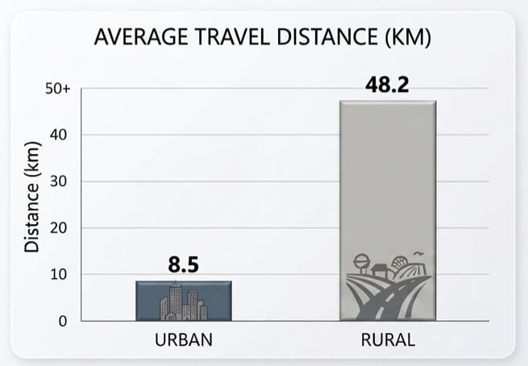
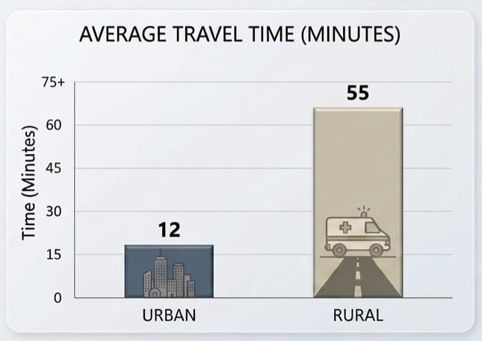
MAKE HEALTHCARE ACCESSIBLE ANYTIME AND ANYWHERE
TEAM ALPHA
Proposed Solution
Innovation and Uniqueness
Rural Health Checkup
Vital Check : BP, Sugar, Temperature, Pulse
Local Language Support
Digital Prescription
Accessible and Easy to Use
Simple Digital Health Record
Personalized Prescription Support
Local Language + Health Data
Rural-First Healthcare Model
How It Addresses the Problem
Healthcare at Village Level
Quick Health Assessment
Less Travel to Hospitals
Easy Access to Prescription
Early Health Risk Detection

Slide 3
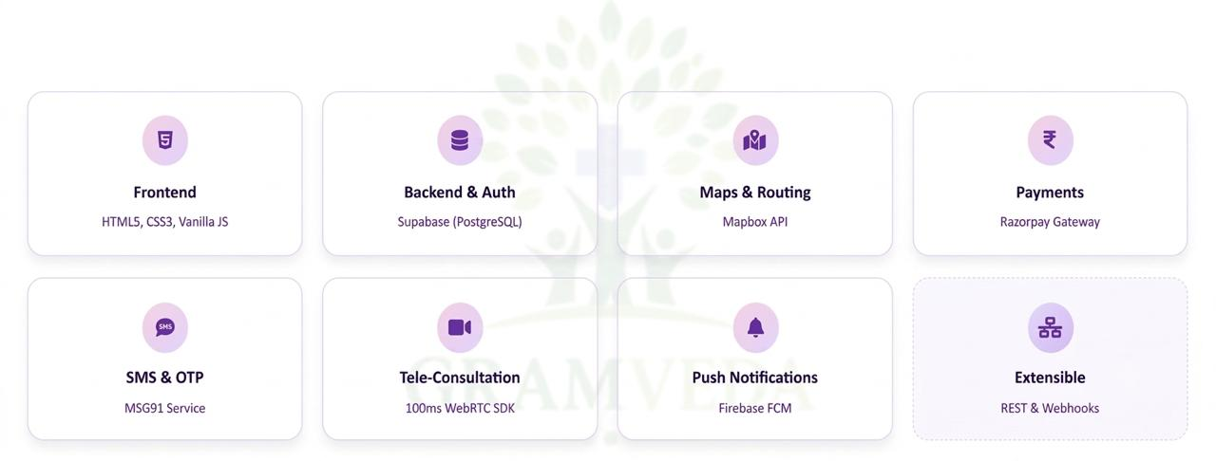
TECHNICAL APPROACH
TEAM ALPHA

Slide 4
FEASIBILITY AND VIABILITY
TEAM ALPHA
Analysis of Feasibility of the Idea
Uses existing resources: Connects available doctors, pharmacies, clinics and diagnostic centres instead of creating new infrastructure.
User-friendly: Designed with a simple interface so that even users with limited digital literacy can access healthcare services.
Potential Challenges & Risks
Poor internet connectivity in remote villages.
Availability of doctors may be limited in remote areas.
Strategies for Upcoming Challenges
Low-network solution: Design lightweight pages/app features that work with limited connectivity.
Doctor network: Partner with local doctors and hospitals and maintain scheduled consultation slots.

Slide 5
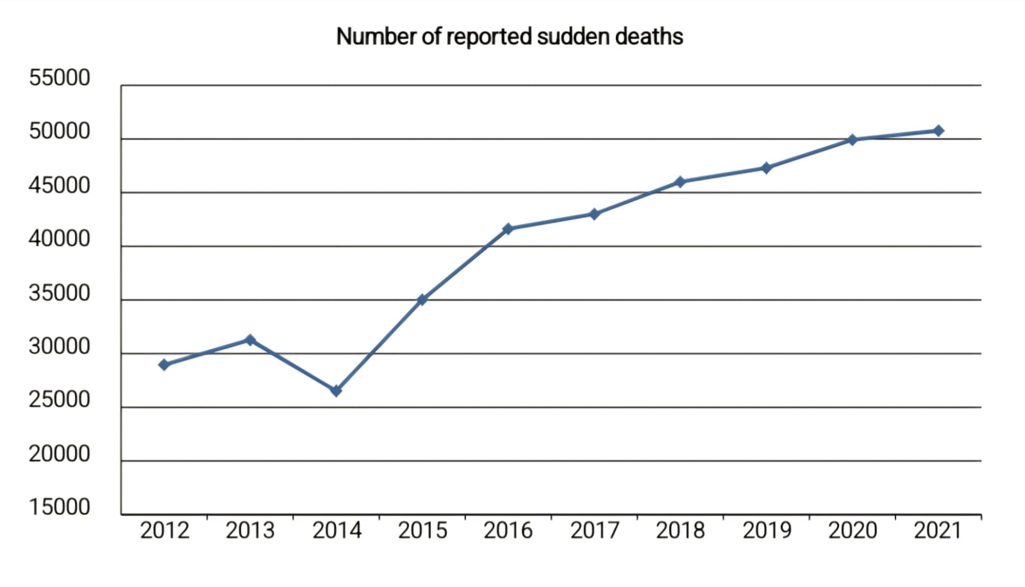
IMPACT AND BENEFITS
TEAM ALPHA
Social : Democratizes quality healthcare access, drastically reducing the mortality rate gap between urban and rural citizens.
Economic : Lowers out-of-pocket medical expenditure by up to 60%.
Environmental : Significantly minimizes carbon footprints.
Early Intervention : Catches chronic condition risks months before they become fatal emergencies.
Zero Income Disruption : Saves daily wage laborers from losing a day’s pay to travel to distant city hospitals for basic consultations.

Slide 6
RESEARCH AND REFERENCES
TEAM ALPHA
National Health Mission (NHM) India Reports : Used data on rural doctor shortages and operational primary health centers (PHCs).
World Health Organization (WHO) Telemedicine Frameworks : Adhered to standard guidelines for mobile health (mHealth) and remote clinical assessments.
Ayushman Bharat Digital Mission (ABDM)
IEEE Research Papers

