Slide 1


Hangouts in 30 minutes with Socket.io
Speaker:
Aleksandar Mihajlovski
Notes:
Hello everyone! First of all I have to say that it’s a great honor to me being here on such an eminent conference where I have the chance to speak about my research and presentation named…

Slide 2

Aleksandar Mihajlovski
Front end developer at Polar Cape Consulting, working mainly with JavaScript frameworks for developing either web or hybrid mobile applications.
Follow me at:
Twitter: https://twitter.com/mihajlovskia
LinkedIn: https://www.linkedin.com/in/amihajlovski
GitHub: https://github.com/amihajlovski
Notes:
Hello everyone. My name is Aleksandar Mihajlovski. I’m coming from Skopje, Republic of Macedonia. I’m front-end developer working for Polar Cape, Swedish company based in Macedonia, where I’m developing hybrid mobile applications. But, today I’ll talk about something different from what I’m doing at work, I’ll talk about how to create simple streaming application and why would you need that.

Slide 3
What is live streaming?
Live streaming refers to content delivered live over the Internet, requires a form of source media (e.g. a video camera, an audio interface, screen capture software), an encoder to digitize the content, a media publisher, and a content delivery network to distribute and deliver the content.
Notes:
So first, we all know what live streaming is. Live streaming means connecting two or more people to connect and communicate between each other or in short, to share their audio and video in real-time.

Slide 4

Why to use it?
Conversations
Competitions
Teaching lessons
Notes:
The main focus why we need this kind of applications is for conversations, to connect with people, but also to create competitions or some language teaching lessons or programming lessons.

Slide 5
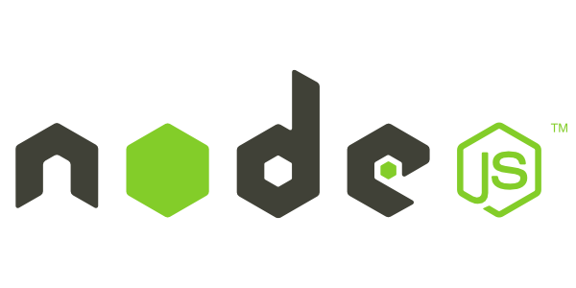

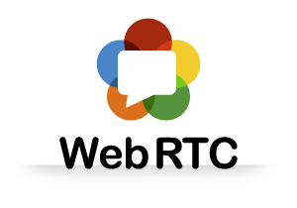
How to implement?
Notes:
There are many ways to implement this kind of applications. In my application I’ve used Node.js server, socket.io for web sockets and webRTC library getting user meria like audio and video.

Slide 6
Node.js uses an event-driven, non-blocking I/O model, which makes it lightweight.
In simple words Node.js is “server-side JavaScript”
In not-so-simple words Node.js is a high-performance network applications framework, well optimized for high concurrent environments.
Notes:
NodeJS is non-blocking event driven server. Runs only one process or in short only on one port. On that port the server listens for every request but also for socket connections or emitted messages too. Someone also call this framework server-side javascript or front-end server.

Slide 7
WebSockets is an advanced technology that makes it possible to open an interactive communication session between the user's browser and a server
Socket.io is a framework that creates a persistent, real time, connection between server and client.
Works on every platform, browser, device.
Mainly used for
Instant messaging and chat
Binary streaming (image/video/audio)

Slide 8
WebRTC offers real time communication natively from a web browser.
WebRTC is a media engine with JavaScript API.
MediaStream
RTCPeerConnection
RTCDataChannel
Notes:
supports browser-to-browser applications for voice calling, video chat, and P2P file sharing without the need of either internal or external plugins.

Slide 9
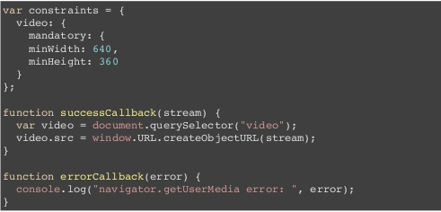
MediaStream
Acquiring audio and video from the browser
navigator.webkitGetUserMedia
navigator.mozGetUserMedia

Slide 10
RTCPeerConnection
Peer to peer communication
Connection state (connecting, new, connected, disconnected, failed, closed)
Signaling state (stable, closed..)
Security type (reliable / unreliable)
Bandwidth management

Slide 11
RTCDataChannel
Flow control (size of data)
Congestion control (latency detection)
Binary type (Blob or ArrayBuffer)
Direct messages

Slide 12
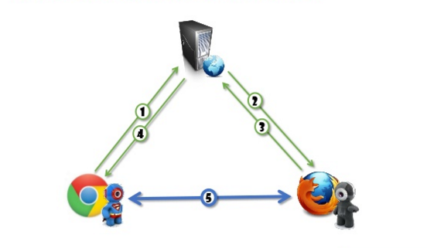
Architectures
Triangle

Slide 13
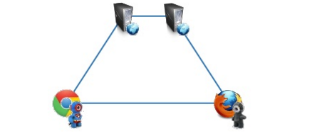
Architectures
Trapezoid

Slide 14
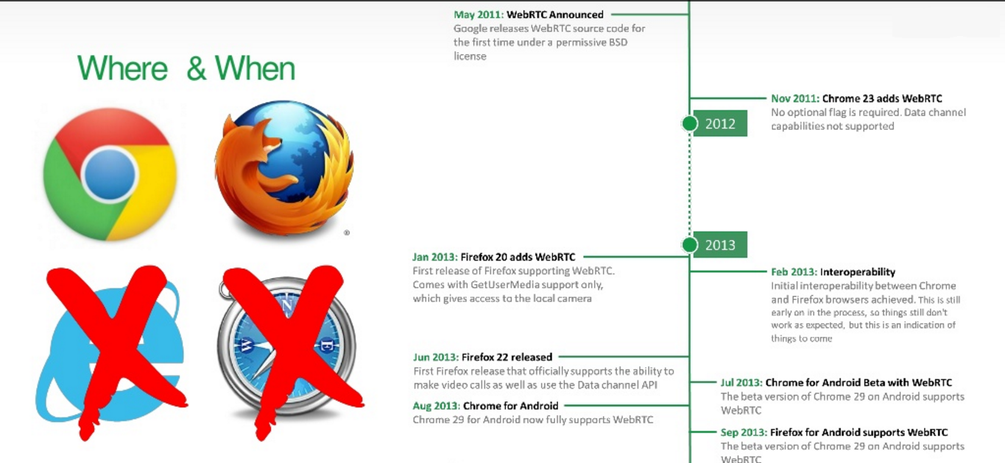
Compatibility

Slide 15
Limitations
Live streaming with WebRTC only runs under HTTPS
For testing purposes specific IP address / port should be allowed in the browser

Slide 16
Demo

Slide 17
Conclusion
Help in communicating only with specific people.
Upgrade
Chatting / Multiple clients
Similar implementation with:
Meeting.js, PeerJS, SimpleWebRTC…
Java Spring + Sock.js (client)

Slide 18

Questions?

Slide 19
Discussion
How to implement live streaming application with more than two clients?
Notes:
All peers are directly connected with broadcaster. They're not connected with each other. Broadcaster can see/talk with all of them; they can only talk/listen only the broadcaster.

