Slide 1


Hangouts in 30 minutes with Socket.io
Speaker:
Aleksandar Mihajlovski

Slide 2

Aleksandar Mihajlovski
Front end developer at Polar Cape Consulting, working mainly with JavaScript frameworks for developing either web or hybrid mobile applications.
Follow me at:
Twitter: https://twitter.com/mihajlovskia
LinkedIn: https://www.linkedin.com/in/amihajlovski
GitHub: https://github.com/amihajlovski

Slide 3
What is live streaming?
Live streaming refers to content delivered live over the Internet, requires a form of source media (e.g. a video camera, an audio interface, screen capture software), an encoder to digitize the content, a media publisher, and a content delivery network to distribute and deliver the content.

Slide 4
Why to use it?
Conversations
Competitions
Teaching lessons

Slide 5
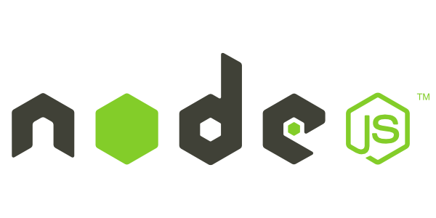

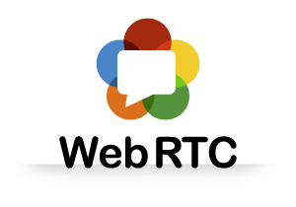
How to implement?
Notes:
NodeJS event driven non blocking excellent with websockets
Socket io web socket technology
Web RTC features: media stream (navigator), peer2peer

Slide 6
Node.js uses an event-driven, non-blocking I/O model, which makes it lightweight.
In simple words Node.js is “server-side JavaScript”
In not-so-simple words Node.js is a high-performance network applications framework, well optimized for high concurrent environments.

Slide 7
Socket.io is a framework that creates a persistent, real time, connection between server and client.
Works on every platform, browser, device.
Mainly used for
Instant messaging and chat
Binary streaming (image/video/audio)

Slide 8
WebRTC offers real time communication natively from a web browser.
WebRTC is a media engine with JavaScript API.
MediaStream
RTCPeerConnection
RTCDataChannel

Slide 9
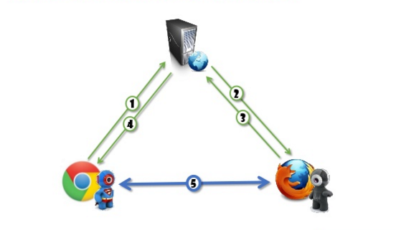
Architectures
Triangle

Slide 10
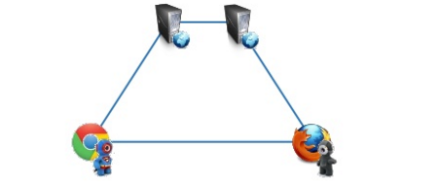
Architectures
Trapezoid

Slide 11
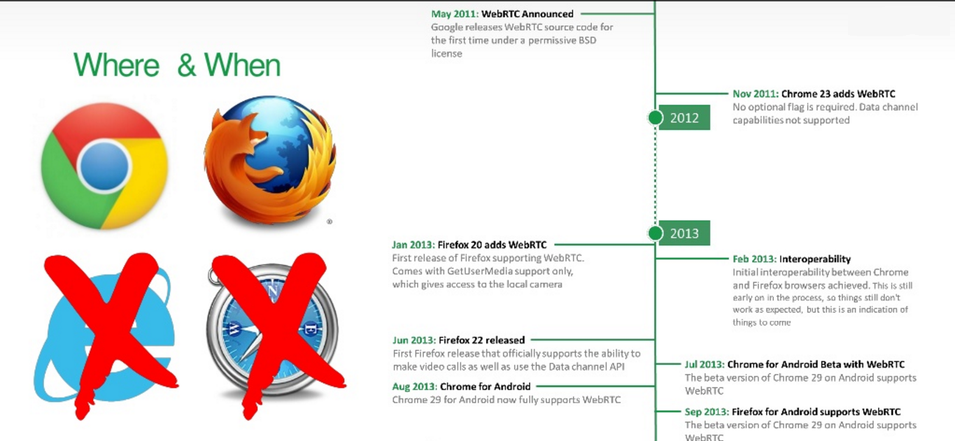
Compatibility

Slide 12
Demo

Slide 13

Questions?

Slide 14
Discussion
How to implement live streaming application with more than two clients?

