Slide 1
Chapter One:
An Introduction to Programming and
Visual Basic

Slide 2
Learning Objectives
Understand the importance of information systems in organizations.
Discuss the role of computer programs and programming in information systems.
List and discuss the six computer operations.
Describe the difference between modern Windows-based computer languages and older procedural languages.
Discuss the difference between compiled and interpreted languages.
List and discuss the steps in the object-oriented, event-driven programming process.

Slide 3
Data and Information
Data are raw facts
Examples of data include transactions, dates, amounts, etc.
Information are data that have been processed into a usable form
Information includes tables, documents, charts, etc.
Goal of computer applications is to process data into information

Slide 4
Six Basic Computer Operations
1. A computer can receive (input) data
2. A computer can store data in memory
3. A computer can perform arithmetic and manipulate text strings
4. A computer can compare the contents of two memory locations and select one of two alternatives
5. A computer can repeat a group of operations
6. A computer can output information (processed data)
We will use pseudocode statements to demonstrate these six operations.

Slide 5
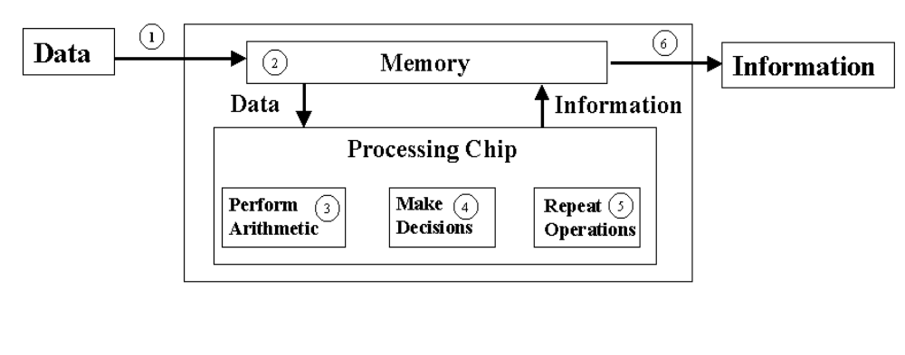
Computer Operations

Slide 6
Programs and Programming
A program is a very specific set of rules that tell the computer which switches should be "ON" or "OFF".
The process of creating a program is called programming.
The computer only knows what it is told through programs, so they must be accurate and very specific.

Slide 7
What is Programming?
Deciding if there is a task to be accomplished or problem to be solved using a computer, e.g., is there a need for a program?
Determining the nature of the task or problem, e.g., what must the program do?
Developing a plan that will accomplish the task or solve the problem, e.g., generating the step-by-step process that the program will follow (algorithm).
Converting the plan into a computer language program
Testing the program to ensure it accomplishes task or solves problem defined earlier.
Implementing the program to accomplish the task or solve the problem.

Slide 8
Types of Computer Languages
Procedural: Monolithic programs that run from start to finish with no intervention from user other than input
Basic, QBasic, QuickBasic
COBOL
FORTRAN
C
Object Oriented/Event Driven (OOED): Programs that use objects which respond to events; use small segments to code for each object
Visual Basic
Visual C++

Slide 9
Levels of Computer Languages
Low Level: at the level of the computer, i.e., in binary (0-1) format Computer can only execute a binary form of a program
Intermediate Level: close to the computer but uses English words or mnemonics, e.g., Assembler, that is converted directly into binary
High Level: at the level of the programmer using English words and clearly defined syntax; must be converted or translated into binary for computer to implement it, e.g., Visual Basic
Need a software program to handle the conversion of high-level into binary

Slide 10
Translating from High-level Language to Binary
Interpreted: each statement translated as it is executed--slow but easy to use
Compiled: entire program is converted to binary--executes faster, but more difficult to use (.exe files are compiled programs)
VB is interpreted during creation and testing but can then be compiled into an .exe file

Slide 11
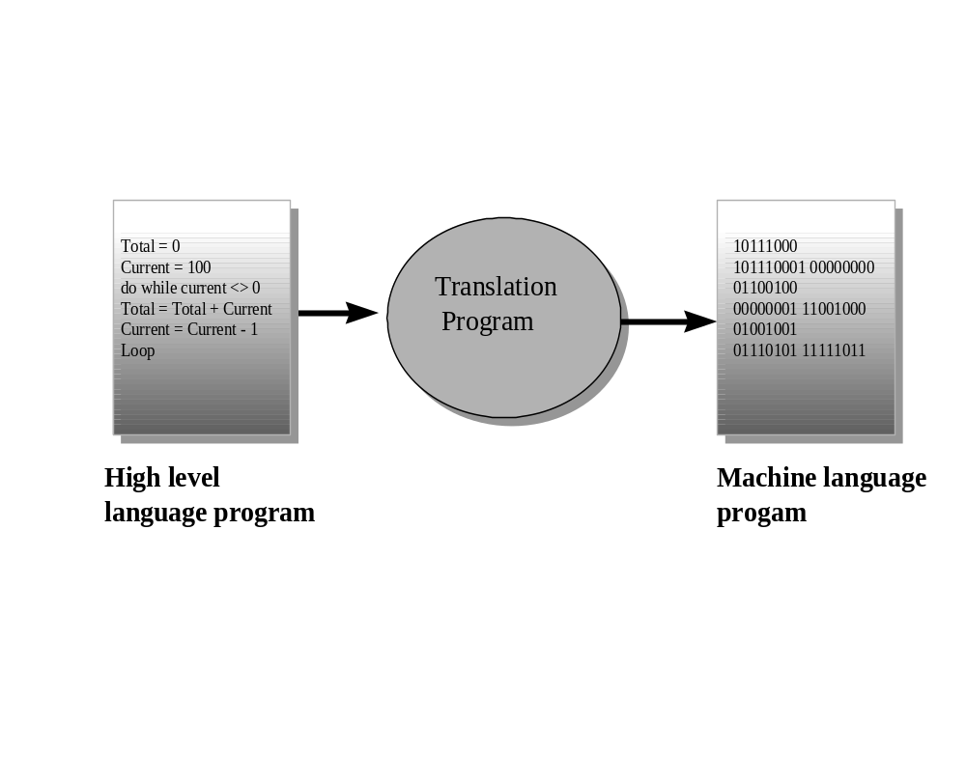

Slide 12
Object-Oriented Event-driven Programming (OOED)
OOED uses objects, or self contained modules that combine data and program code which pass strictly defined messages to one another.
OOED is easier to work with, because it is more intuitive than traditional programming methods.
Visual Basic is an OOED language.
Users can combine the objects with relative ease to create new systems or extend existing ones.
Properties of objects are attributes associated with an object.
Methods of objects are those activities that the object can carry out.
Objects respond to events.

Slide 13
OOED Programming Process
A six step process for writing an OOED computer program:
1. Define problem.
2. Create interface
3. Develop logic for action objects
4. Write and test code for action objects
5. Test overall project
6. Document project in writing
No matter how well a program is written, the objective
is not achieved if the program solves the wrong problem.

Slide 14
Step One: Define Problem
Before you can create a computer application to solve a problem, you must first clearly define it.
This may involve a study of the problem to understand the inputs and outputs.
Must identify the data to be input to the program and the results to be output from it.
Sketching an interface is a good way to understand the problem and to communicate your understanding to other people.
Denote input and output objects as well as action objects--those for which code (instructions) are needed.

Slide 15
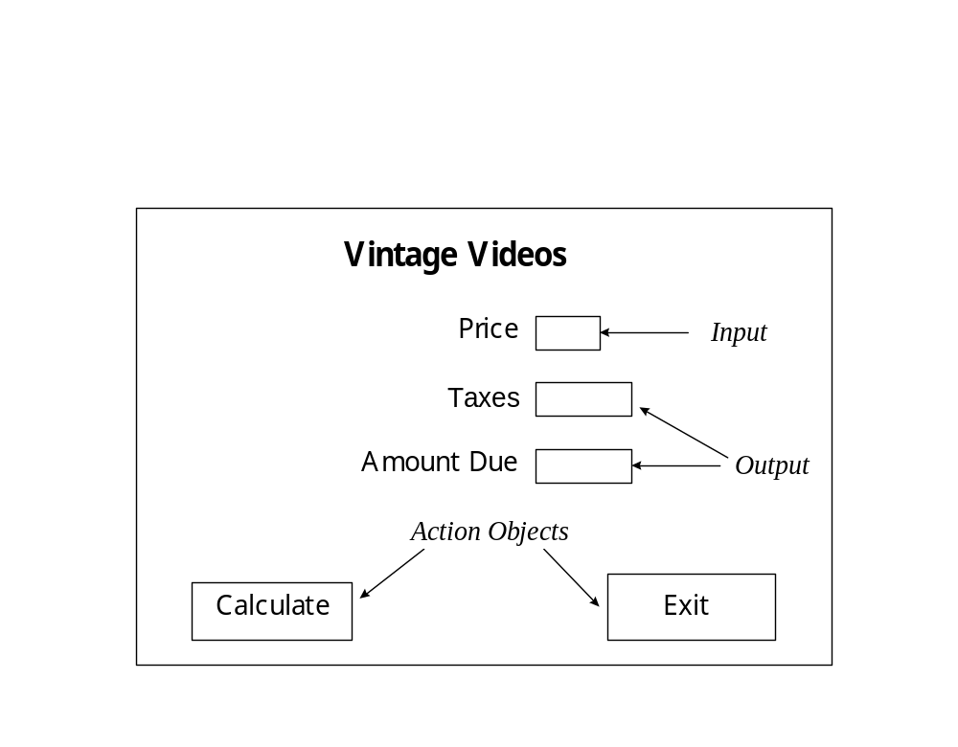
Sketch of Vintage Video Interface

Slide 16
Step Two: Create Interface
Once you have defined problem and sketched interface, you are ready to create interface.
Doing this with VB is quite easy--select objects and place them on VB form following sketch.
For Vintage Video, only need three objects:
  buttons for action
  textboxes for input and output
  labels for descriptors

Slide 17
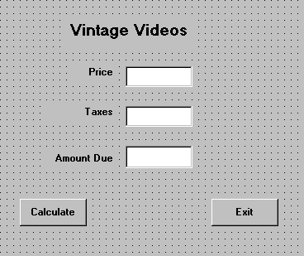
Vintage Video Interface

Slide 18
Step Three: Develop Logic for Action Objects
Need to think about what each action object should do in response to an event
This is the logic for each object
Use Input/Processing/Output (IPO) Tables and Pseudocode to develop the logic
IPO Tables show the inputs, outputs, and the processing to convert inputs into outputs

Slide 19
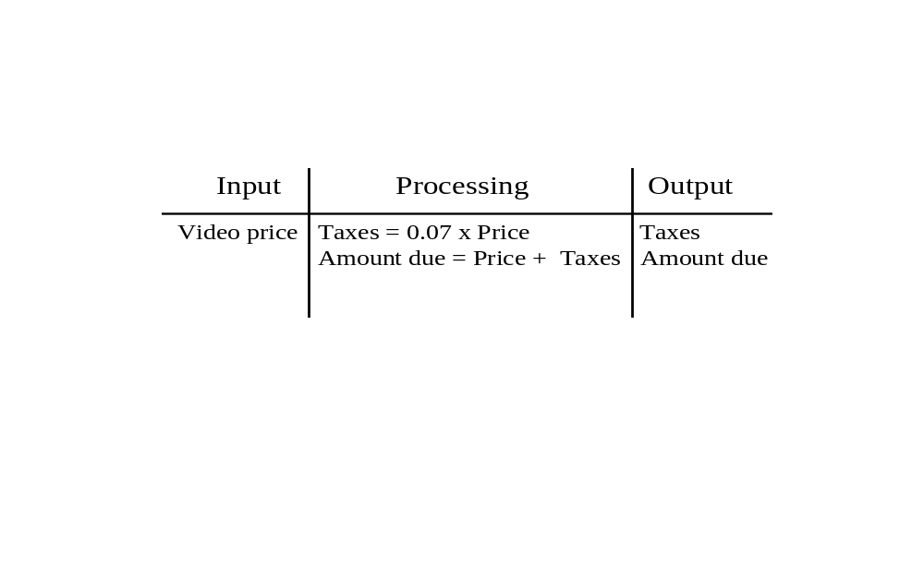
IPO Table for Calculate Button

Slide 20
Using Pseudocode
An important part of the developing the logic for action objects is generating corresponding pseudocode.
Pseudocode involves actually writing a program in English rather than in a computer language.
When the actual computer program is written, the pseudocode is translated into computer language.
A pseudocode program is useful for two reasons:
  The programmer may use it to structure the algorithm's logic in writing.
  It provides a relatively direct link between the algorithm and the computer program

Slide 21
Pseudocode for Calculate Button
Begin procedure
Input Video Price
Taxes = 0.07 x Video Price
Amount Due = Video Price + Taxes
Output Taxes and Amount Due
End procedure

Slide 22
Step Four: Write and Test Code of Action Objects
Once you learn the vocabulary and syntax of a language, you should be able to convert the logic embodied in the pseudocode into a computer language. In our case, we use VB.
You need to test each code for each action object as they are created.
Once the object code is written, the programmer must test and correct it. This stage is referred to as debugging, since it involves removing "bugs".
Use test data for which you know the correct answer to test the object code.

Slide 23
VB Code for Calculate Button
Private Sub cmdCalc_Click()
‘ This object calculates the Taxes and Amount
‘ Due given the Video Price
Dim curPrice as Currency, curTaxes as Currency
Dim curAmountDue as Currency
curPrice = Val(txtVideoPrice.Text )
curTaxes = 0.07* curPrice
curAmountDue = curPrice + curTaxes
txtTaxes.Text = Str(curTaxes)
txtAmountDue.Text = Str(curAmountDue)
End Sub

Slide 24
Step Five: Test Overall Project
Even with extensive testing, some bugs can often be found in most commercial software.
With computer software, each program instruction must be absolutely correct. Otherwise, the whole program might fail.
BE SURE to test your program in the actual environment and on the actual data on which it will be used (just ask IBM at the Olympics).

Slide 25
Step Six: Document Project in Writing
Documentation includes the pictorial and written descriptions of the software. It contains internal descriptions of programming commands and external descriptions and instructions.
Documentation is necessary since, sooner or later, the program will need to be maintained (correct bugs, add new features, handle problems not thought of previously, etc. This is NOT possible without documentation.
Written documentation includes books, manuals, and pamphlets that give instructions on software use and discuss the objectives and logic of the software.

