Slide 1
Visual Basic 6
Basics of Visual Basic 6 Programming
Design and develop Information Systems with the help of Visual Basic as front-end and MS Access as backend.

Slide 2
What is Visual Basic?
It is an “Event Driven Programming Language”
The "Visual" part refers to the method used to create the graphical user interface (GUI). Rather than writing numerous lines of code to describe the appearance and location of interface elements, you simply add prebuilt objects into place on screen. If you've ever used a drawing program such as Paint, you already have most of the skills necessary to create an effective user interface.
The "Basic" part refers to the BASIC (Beginners All-Purpose Symbolic Instruction Code) Visual Basic has evolved from the original BASIC language and now contains several hundred statements, functions, and keywords, many of which relate directly to the Windows GUI. Beginners can create useful applications by learning just a few of the keywords, yet the power of the language allows professionals to accomplish anything that can be accomplished using any other Windows programming language

Slide 3
Why Visual Basic??
Data access features allow you to create databases, front-end applications, and scalable server-side components for most popular database formats, including Microsoft SQL Server and other enterprise-level databases.
ActiveX™ technologies allow you to use the functionality provided by other applications, such as Microsoft Word word processor, Microsoft Excel spreadsheet, and other Windows applications. You can even automate applications and objects created using the Professional or Enterprise editions of Visual Basic.
Internet capabilities make it easy to provide access to documents and applications across the Internet or intranet from within your application, or to create Internet server applications.
Your finished application is a true .exe file that uses a Visual Basic Virtual Machine that you can freely distribute.

Slide 4
Interpreting and Compiling
The traditional application development process :
writing
compiling
testing code
Visual Basic uses an interactive approach to development, blurring the distinction between the three steps.
Visual Basic interprets your code as you enter it, catching and highlighting most syntax or spelling errors on the fly. It's almost like having an expert watching over your shoulder as you enter your code.
In addition to catching errors on the fly, Visual Basic also partially compiles the code as it is entered. When you are ready to run and test your application, there is only a brief delay to finish compiling.
Compilation also possible to generate faster applications

Slide 5
Key Concepts
windows, events and messages.
Think of a window as simply a rectangular region with its own boundaries.
Explorer window
document window within your word processing program,
dialog box ,Icons, text boxes, option buttons and menu bars are all windows
OS manages all of these many windows by assigning each one a unique id number (window handle or hWnd). The system continually monitors each of these windows for signs of activity or events. Events can occur through user actions such as a mouse click or a key press, through programmatic control, or even as a result of another window's actions.
Each time an event occurs, it causes a message to be sent to the operating system. The system processes the message and broadcasts it to the other windows. Each window can then take the appropriate action based on its own instructions for dealing with that particular message (for example, repainting itself when it has been uncovered by another window).
Visual Basic insulates you from having to deal with all of the low-level message handling.

Slide 6
Event Driven Programming
In traditional or "procedural" applications, the application itself controls which portions of code execute and in what sequence. Execution starts with the first line of code and follows a predefined path through the application, calling procedures as needed.
In an event-driven application, the code doesn't follow a predetermined path — it executes different code sections in response to events. Events can be triggered by the user's actions, by messages from the system or other applications, or even from the application itself. The sequence of these events determines the sequence in which the code executes, thus the path through the application's code differs each time the program runs.
Your code can also trigger events during execution. For example, programmatically changing the text in a text box cause the text box's Change event to occur. This would cause the code (if any) contained in the Change event to execute. If you assumed that this event would only be triggered by user interaction, you might see unexpected results. It is for this reason that it is important to understand the event-driven model and keep it in mind when designing your application.

Slide 7
DEMO

Slide 8
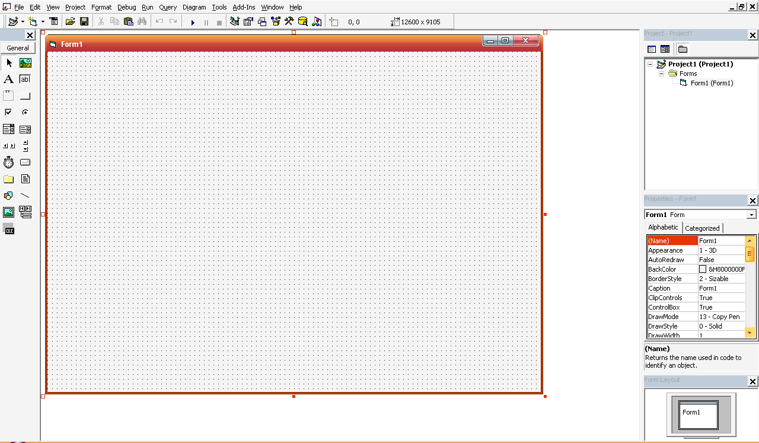
Visual Basic Environment
Toolbar
Menu Bar
Project
Explorer
Toolbox
Form
Properties
Window
Form Designer
Form Layout
Window

Slide 9
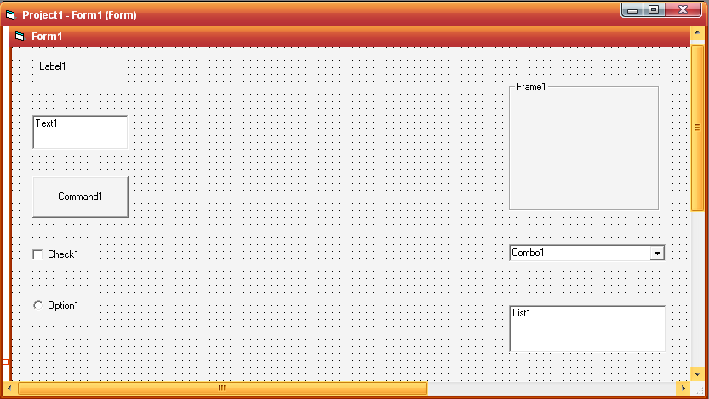
Controls
Label
Frame
Text Box
Command Button
Check Box
Combo
Box
Option Button
List
Box

Slide 10
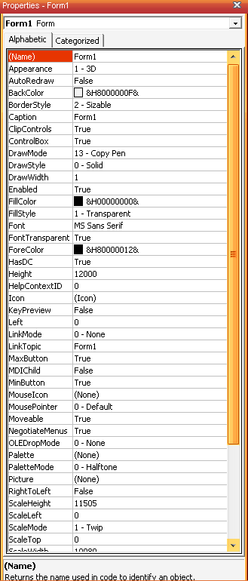
Control Properties
The most common and important object properties are :-
Name
Caption
Left
Top
Height
Width
Enabled
Visible

Slide 11
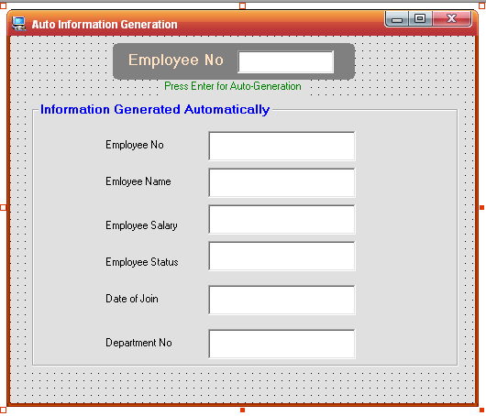
Forms
Caption
Control Box
Close
Icon
Maximize
Minimize
Design Grid
Frame
Labels
Text Boxes

Slide 12
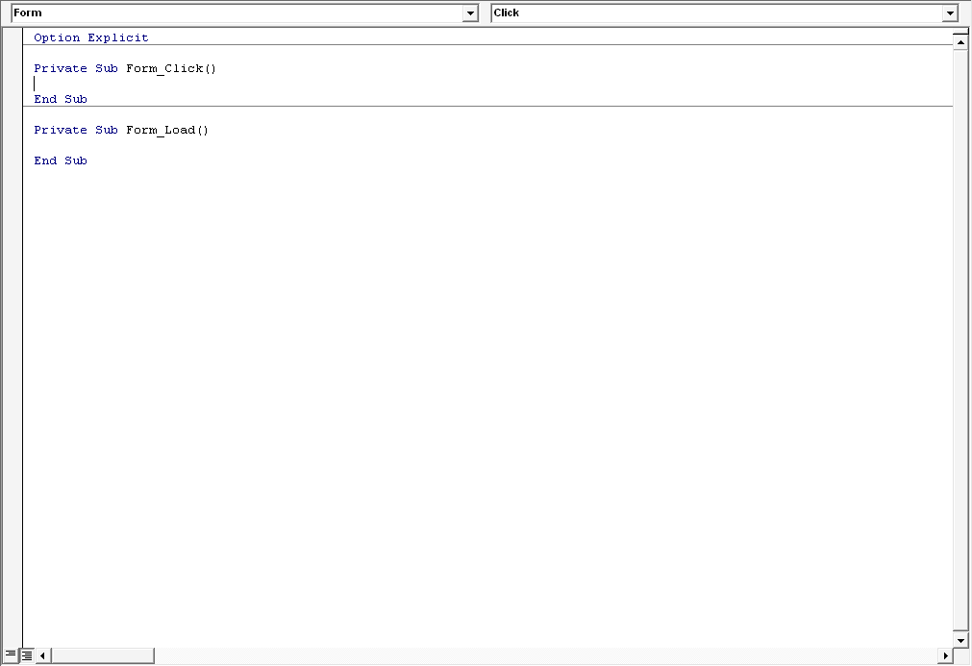
The Visual Basic Editor

Slide 13
DEMO

Slide 14
Language Basics
Data Types and Variables
Writing Statements
Math Operations
Control Statements
Functions

Slide 15
Data Types
A Data Type is a set of values ,together with a set of operations on those values having certain properties.
Built in Type
User Defined Types

Slide 16
Built in Type
Type | Stores | Memory(byte) | Range
Integer | Whole Number | 2 | -32,768 to +32,767
Long | Whole Number | 4 | +/- 2 billions
Single | Decimal | 4 | +/- 1E45 to 3E-38
Double | Decimal | 8 | +/- 5E324 to 1.8E308
Currency |  | 8 | +/- 9E14
String | Text | 1/char | <= 65400 char
Byte | Whole Number | 1 | 0-255
Boolean | Logical | 2 | True/False
Date | Date & Time | 8 | 1/1/100 to 12/31/9999
Object | Instance of Classes | 4 | N/A
Variant | Any of above | 16 + 1/char | N/A

Slide 17
Variables
Variables are used to store information in Computer’s memory while programs are running. Three Components that define a variable:
The Variable’s Name
The Type of information being stored
The actual information itself

Slide 18
Naming Variable
Syntax:
Dim Var_name As Datatype
Example:
Dim X As Integer
Dim S_Name As String
Dim Sname As String * 25
Rules:
The name must be start with a letter not number or other character.
The remainder of name can contain numbers, letters and/or underscore character. Space ,Punctuation are not allowed.
Name should be unique within variable scope.
The name can be no longer than 255 character.
No reserve words.

Slide 19
Constants
Constants are values which remains unchanged.
Ex.
Const MeterToFeet = 3.3
Public const ProgTitle = “My Application Name”
Public const ProgVersion = “3.1”

Slide 20
User Defined Types
In addition to Built in Types we can also create User Defined Data Types as follows :-
Ex.
Private Type Point
x As Integer
y As Integer
End Type
USES:
Private Sub Command1_Click()
Dim MyPoint As Point
MyPoint.x = 3
MyPoint.y = 5
End Sub

Slide 21
Writing Statements
Statement Type | Example
Assign a value to a variable | sName= “Ankit”
Call a Predefined Function | MsgBox (“Good Morning”)
Call your own function | A=fun(“hello”)
Assign Object Property | Command1.visible = True
Make decisions | If height > 1000 then MoveOn

Slide 22
Using Assignment Statements
Assignments statements are used to assign values to a variable.
Assignment Statements | Type of Expression
S1 = 25 | Numeric Literal
Str1 = “John” | String literal
AvgScore = TotScore / n | Mathematical Expression
Sname = “Mrs. “ & “ Tina” | String Expression
Cname = Ucases$(“ Chris”) | Return value of function

Slide 23
Math Operations
Operation | Operator | Uses
Addition | + | Res=num1+ num2
Subtraction | - | Res=num1-num2
Multiplication | * | Res=num1*num2
Division | / | Res=num1/num2
Integer division | \ | Res=num1\ num2
Modulus | mod | Res=num1 mod num2
Exponent | ^ | Res=num1+^num2

Slide 24
Strings
Strings can be defined as array of characters.
Strings Functions
Ucase and Lcase
InStr and InStrRev
Left and Right
Mid
Ltrim, Rtrim and Trim
Len
Chr and Asc
Str ,CStr and Val
StrReverse

Slide 25
Examples
1. string1 = “himansu” & “ shekhar”
output : himansu shekhar
Ucase(“Hello”)
output: HELLO
Lcase(“HeLLo”)
Output: hello
Pos = InStr(“hi”, “sahoo himansu”) //return 6
Pos = InStrRev(“a”, “Nauman”) //return 5
Left(“Hello”, 3) //Hel
Right(“Hello”,2) //lo
Ltrim(“ Hello”) //Hello
Trim(“ Hello “) //Hello
Len(“Himansu”) //return 7
Chr(65) , Asc(‘A’) //return A, 65
Str(num), Val(string1)
StrReverse(“Hello”) //olleH

Slide 26
Decision Making
Using If Statements:
Syntax:
If <condition> Then command
Example:
If cSal > cMaxSale Then msgbox(“Greater”)
Syntax:
If condition Then
………
Else
………
End If
Example:
If Deposit > 0 Then
total = total + Deposit
End If

Slide 27
Decision Making
Using Multiple If Statements:
Syntax:
If condition Then
………
ElseIf condition Then
………
Else
………..
End If
Example:
If Bsal > 12000 Then
tSal = 2.5 * Bsal
ElseIf Bsal > 10000 Then
tSal = 2* Bsal
Else
tSal = 1.8 * Bsal
End If

Slide 28
Decision Making
Select Case Examples
Syntax:
avgNum = total / n
Select Case Round(avgNum)
Case Is = 100
grade = “EX”
Case 80 To 99
grade = “A”
………
End Select

Slide 29
Control Statements
For Loop
Ex:
sum = 0
For i = 1 To 10
sum = sum + i
Next i
Do While Loop
Ex:
sum = 0
i = 1
Do
sum = sum + i
i = i + 1
Loop While i <= 10

Slide 30
Control Statements
Until Loop
Ex:
sum = 0
i = 1
Do Until i > 10
sum = sum + i
i = i + 1
Loop

Slide 31
Functions
Built in Functions
User Defined Functions
Sub Procedures

Slide 32
Built in Functions
These are the functions that are the provided with the Visual Basic Package. Some Examples are:
Abs(num)
Left(string, n)
Val(Text1.Text)
Combo1.AddItem
Combo1.Clear
Date

Slide 33
User Defined Functions
Visual Basic allows to create user defined functions.
User defined functions that are created by the users for specific operations.
Ex 1:
Public Function Fun()
msgBox(“Hello”)
End Function
Ex 2:
Public Function AddNum(num1 As Integer, num2 As Integer) As Integer
AddNum = num1 + num2
End Function

Slide 34
Procedures
Procedures can be defined in either of two ways.
Public procedures
Private procedure
These two keywords ( Public and Private ) determines which other programs or procedures have access to your procedures.
Procedures are by default Private.

Slide 35
Procedure
Examples:
Sub CalRect(nWidth As Integer, nHeight As Integer, nArea As Integer, nPerimeter As Integer)
If nWidth <= 0 Or nHeight <= 0 Then
Exit Sub
End If
nArea = nWidth * nHeight
nPerimeter = 2 * ( nWidth + nHeight )
End Sub

Slide 36
Events
Visual Basic forms and controls are objects which expose their own properties, methods and
events. Properties can be thought of as an object's attributes, methods as its actions, and events as its responses.
The common events related to several controls are as follows:-
Change – The user modifies the text in a text box or combo box.
Click- The user clicks an object with the primary mouse button( usually the left button).
Dblclick- The user double-clicks an object with the primary mouse button.
DragDrop- The user drags a control to another location.
DragOver- An object is dragged over a control.
GotFocus – An object receives a focus.
KeyDown- A key is pressed while an object has the focus.
KeyPress- A key is pressed and released while an object has the focus.
KeyUp- A key is released while an object has the focus.
MouseDown- A mouse button is pressed while the mouse pointer is over an object.
MouseMove- A mouse cursor is moved over an object.
MouseUp- A mouse button is released while the mouse pointer is over an object.

Slide 37
DEMO

Slide 38
Database connectivity
This part explains what is a database and how can it be connected to our vb application.

Slide 39
Database
A database is a structured collection of meaningful information stored over a period of time in machine-readable form for subsequent retrieval.
Tables(Tuples or relations) are used to represent collections of objects or events in the real world.
A row in a table represents a record consisting of values relative to an entity by its attribute field.
A column ,also known as field represents an attribute of the entity.
A primary key is defined as a field or a group of fields which uniquely defines a single row or record in a table.

Slide 40
Ways to connect
DAO(Data Access Objects)
RDO(Remote Data Objects)
ADODC(ActiveX Data Objects Data Control)

Slide 41
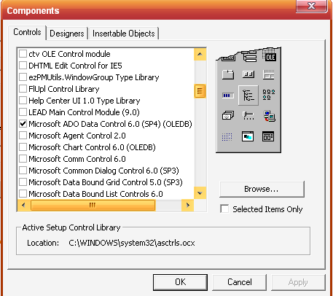
ADODC
The most recent method of data access that Microsoft has introduced.
As compared to RDO and DAO ,ADODC provides several options to access data.
To start using ADODC ,we have to add its control using the components options in the project menu.

Slide 42
How to connect
Create a database using MS Access.
Create a ADODC control in your form.
In the connection string property of the ADODC control ,select the use connection string option and click on build button.
In the provider list select the Microsoft Jet OLE DB provider.
In the connection tab specify the path of the existing database.
In the record source tab ,in the command type list select adCmdTable.
Select the table name from the list of tables now available.
Press OK.

Slide 43
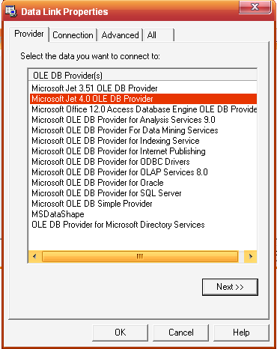
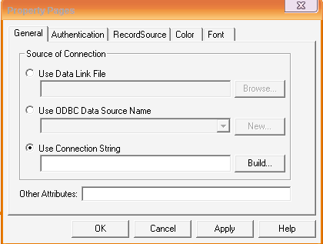
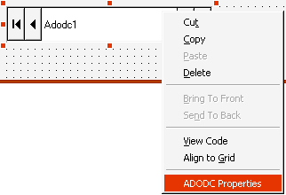
Preview

Slide 44
Basic Database commands
Adodc1.recordset.BOF
Adodc1.recordset.EOF
Adodc1.recordset.MoveFirst
Adodc1.recordset.MoveLast
Adodc1.recordset.MoveNext
Adodc1.recordset.MovePrevious
Adodc1.recordset.Update

Slide 45

Thank You
Presented by :-
Himansu Shekhar Sahoo
Manish Sethi
Narender Singh Thakur
Pratik Barasia

