Slide 1
Burrows-Wheeler Transformation with
FM Index
Aleksandar Mijatović 3144/19
Petar Radivojević 3155/19

Slide 2
Content
Algorithms overview
Test results
Optimization discussion
Conclusion

Slide 3
Burrows-Wheeler Transformation
Algorithm for input string transformation that reorganizes characters in such way that result of transformation is more suitable for compression
Compression suitability is achieved by bringing similar characters into runs in output string
Reversible, which means that original sequence can be restored without need to store additional data except index of first original character
Widely used in genomics for long strings with high character repetition

Slide 4
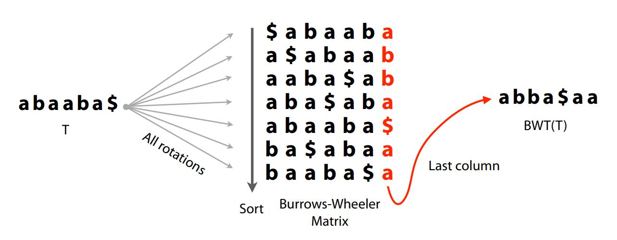
Burrows-Wheeler Transformation
How does it work?
Form matrix that consists of all rotations made from input string
Lexicographically sort all rows
Take last column as result

Slide 5
FM-Index
Data structure used for efficient search of substring locations, as well as number of occurrences, inside compressed string
Combines Burrows-Wheeler Transformation with few auxiliary data structures
Used in genomics for searching extremely long DNA sequences to find occurrences of particular genes

Slide 6
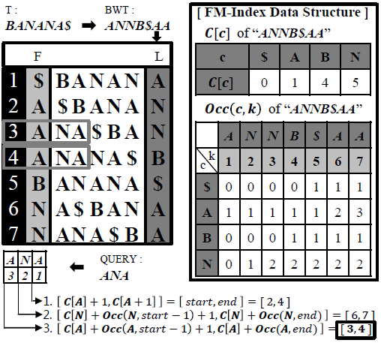
FM-Index
How does it work?
Relies on BW matrix to read:
Transformed text (Last column)
Number of occurrences for each character (First column)
Requires a lot of memory for calculations
Optimizations
Info about offset (Suffix Array)
Info about ranks and occurrences (Tally Matrix)
Introduce steps so that we calculate every i-th offset in SA and every i-th occurrence in TM

Slide 7
Test results
Algorithms tested:
Standard (Non-optimized) algorithm
Optimized algorithm with different SA & TM combinations:
Suffix Array values: 4, 16, 64, 256
Tally Matrix values: 8, 32, 128, 512
Test data sets:
Coffea Arabica, Chromosome 1c with patterns: ATGCATG, TCTCTCTA, TTCACTACTCTCA
Mus Pahari, Chromosome X with patterns: ATGATG, CTCTCTA, TCACTACTCTCA
Octopus Vulgaris, Chromosome LG28 with patterns: TAACGAACTA, ACACACA, GACGGA

Slide 8
Non Optimized algorithm:
BW Transformation: 285s
FM(P1): 0.195ms - 16 matches;
FM(P2): 27.299ms - 57559 matches;
FM(P3): 7.617ms - 2803 matches;
Test results – Octopus Vulgaris
Optimized algorithm:

Slide 9
Non Optimized algorithm:
Memory: 7.09GB
Test results – Octopus Vulgaris
Optimized algorithm:

Slide 10
Non Optimized algorithm:
BW Transformation: 760s
FM(P1): 5.423ms - 6529 matches;
FM(P2): 1.005ms - 1262 matches;
FM(P3): 0.101ms - 0 matches;
Test results – Coffea Arabica
Optimized algorithm:

Slide 11
Non Optimized algorithm:
Memory: 18.6GB
Test results – Coffea Arabica
Optimized algorithm:

Slide 12
Non Optimized algorithm:
BW Transformation: 2883s
FM(P1): 68.654ms - 43200 matches;
FM(P2): 22.177ms - 10237 matches;
FM(P3): 0.576ms - 8 matches;
Test results – Mus Pehari
Optimized algorithm:

Slide 13
Non Optimized algorithm:
Memory: 183GB
Test results – Mus Pehari
Optimized algorithm:

Slide 14
Conclusion
Successfully implemented index search using Burrows-Wheeler transformation and FM-Index
Algorithm performance shows why it has such wide area of application
Non-optimized algorithm:
Quick to find offsets of matches
Slow scanning for preceding characters
More memory required to store ranks
Optimized algorithm:
Faster scanning of preceding characters
Calculates offsets even quicker
Less memory consumptions using checkpointing

