Slide 1
Trees II

Slide 2
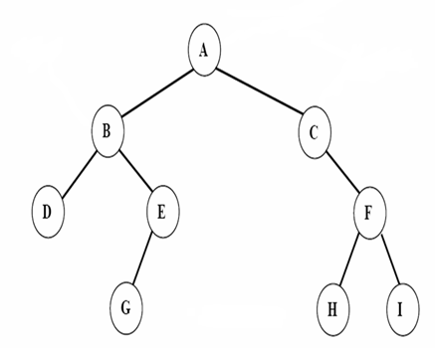
Tree Traversal
Preorder
Inorder
Postorder

Slide 3
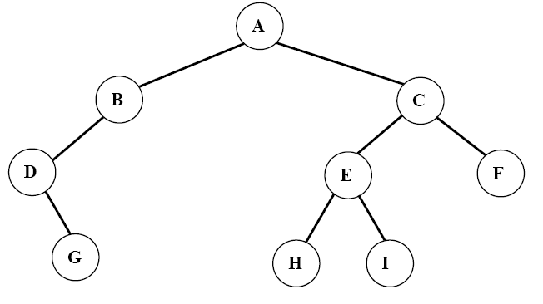
Breadth-first (level order) Traversal

Slide 4
Breadth-first (level order) Traversal

Slide 5
Breadth-first (level order) Traversal

Slide 6
Breadth-first (level order) Traversal

Slide 7
Breadth-first (level order) Traversal

Slide 8
Breadth-first (level order) Traversal

Slide 9
Breadth-first (level order) Traversal

Slide 10
Breadth-first (level order) Traversal

Slide 11
Breadth-first (level order) Traversal

Slide 12
Breadth-first (level order) Traversal

Slide 13
Breadth-first (level order) Traversal
ptr

Slide 14
void level_order(Tree ptr)
/* level order tree traversal */
{
int front= 0, rear=-1;
PtrToNode Queue[MAX_QUEUE_SIZE];
if (!ptr) return; /* empty tree */
Queue[++rear]=ptr;
for (;;) {
ptr = Queue[front++];
if (ptr) {
printf(“%d”, ptr->data);
if (ptr->left)
Queue[++rear]=ptr->left;
if (ptr->right)
Queue[++rear]=ptr->right;
}
else break;
}
}

Slide 15
Threaded Binary Trees
Too many null pointers in current representation of binary trees
Replace these null pointers with some useful “threads”.
T
a ⋀
n: number of nodes number of non-null links: n-1 total links: 2n null links: 2n-(n-1)=n+1
b
⋀ c ⋀
d
⋀ e
⋀ f ⋀
⋀ g ⋀

Slide 16
Rule 1: If PtrToNode->Left is null, replace it with a pointer to the inorder predecessor of the node
T
⋀ ⋀
T
a ⋀
Rule 2: If PtrToNode->Right is null, replace it with a pointer to the inorder successor of the node.
b
⋀ c ⋀
d
⋀ e
⋀ f ⋀
Rule 3: There must not be any loose threads. Therefore a threaded binary tree must have a head node of which the left child points to the first node.
⋀ g ⋀
Solid lines represent links
Dashed lines represent threads

Slide 17
typedef struct ThreadedTreeNode *PtrTo ThreadedNode;
typedef struct PtrToThreadedNode ThreadedTree;
typedef struct ThreadedTreeNode {
int LeftThread; /* if it is TRUE, then Left */
ThreadedTree Left; /* is a thread, not a child ptr. */
ElementType Element;
int RightThread; /* if it is TRUE, then Right */
ThreadedTree Right; /* is a thread, not a child ptr. */
}
LeftThread Left data Right RightThread
The node structure of threaded BT
0：Left is a link
LeftThread=
1：Left is a thread
0：Rchild is a link
RightThread=
1：Rchild is a thread

Slide 18
〖Example〗 Given the syntax tree of an expression (infix)
A + B ∗ C / D
head node
+
F
F
A
/
∗
D
F
+
F
B
C
T
A
T
F
/
F
F
∗
F
T
D
T
T
B
T
T
C
T
Solid lines represent links
Dashed lines represent threads

Slide 19


主观题
10分
Draw out the inorder threaded binary tree of the following binary tree:
正常使用主观题需2.0以上版本雨课堂
作答

Slide 20
Inorder Traverse Threaded BT
Find the first node:
The left most node in the tree. From the head node, following the Left link untill a node with Leftthread=1 is reached
T
H
A
B
C
p=T;
while (p->LeftThread==0 ) p=p->Left;
D
E
F
G
H
I

Slide 21
Inorder Traverse Threaded BT
Find the next node
All the Right links of nodes with RightThread=1 are threads, point to the successor of the node
For nodes with RightThread=0, the successor is the left most node in the right subtree of the node(i.e. search following the Left link of the right subtree untill the node with leftthread=1 reached)
T
H
A
B
C
if (p->RightThread==1) p=p->Right ;
/* find the successor with right thread*/
else /* otherwise the left most node of the
right subtree is the successor*/
{ p=p->Right ;
while (p->LeftThread==0 ) p=p->Left;
}
D
E
F
G
H
I

Slide 22
Find the first node
p=T;
while (p->LeftThread==0 ) p=p->Left;
Find the successor nodes
if (p->RightThread==1) p=p->Right ;
/* find the successor with right thread*/
else /* otherwise the left most node of the
right subtree is the successor*/
{ p=p->Right ;
while (p->LeftThread==0 ) p=p->Left;
}

Slide 23
Traverse Inorder Threaded BT
void inorder_Thread_bt(ThreadTree T)
{ PtrToThreadedNode p ;
if (T!=NULL)
{ p=T;
while (p->LeftThread==0 )
p=p->Left; /* find the left most node */
while (p!=T)
{ visit(p->data) ;
if (p->RightThread==1)
p=p->Right ; /* find the successor
with right thread */
else /* otherwise the
left most node of the right subtree is
the successor*/
{ p=p->Right ;
while (p->LeftThread==0 ) p=p->Left;
}
}
}
}
T
F
F
F
+
F
T
A
T
F
/
F
F
∗
F
T
D
T
T
B
T
T
C
T

Slide 24
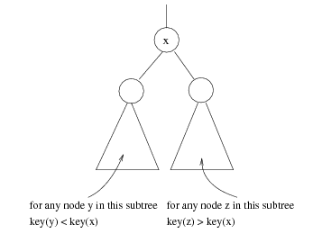
Binary Search Tree （二叉排序树）
A binary search tree may be empty. If it is not empty, suppose every node has a key which is an integer, and the keys are distinct.
For EVERY node X
All the keys in its left subtree are smaller
than the key value in X
All the keys in its right subtree are larger than
the key value in X

Slide 25
30
60
20
5
40
70
15
25
2
65
80
12
21
26

Slide 26
ADT of BST
Objects: A finite ordered list with zero or more elements.
Operations:
☞ SearchTree MakeEmpty( SearchTree T );
☞ PtrToNode Search( int X, SearchTree T );
☞ PtrToNode FindMin( SearchTree T );
☞ PtrToNode FindMax( SearchTree T );
☞ SearchTree Insert( int X, SearchTree T );
☞ SearchTree Delete( int X, SearchTree T );
☞ int Retrieve( Position P );

Slide 27
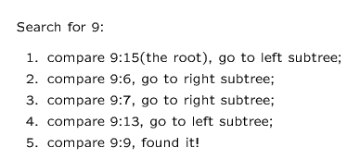
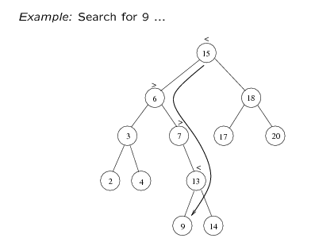
Searching BST

Slide 28
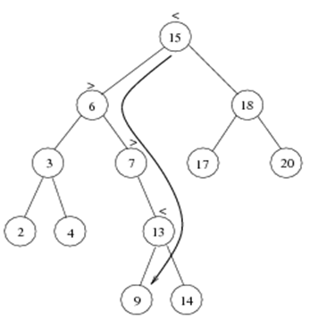
PtrToNode Search( int X, SearchTree T )
{
if ( T == NULL )
return NULL; /* not found in an empty tree */
if ( X < T->Data ) /* if smaller than root */
return Search( X, T->Left ); /* search left subtree */
else
if ( X > T->Data ) /* if larger than root */
return Search( X, T->Right ); /* search right subtree */
else /* if X == root */
return T; /* found */
}
T( N ) = S ( N ) =
O( h ) where h is the depth of X

Slide 29
PtrToNode Iter_Find( int X, SearchTree T )
{
/* iterative version of Find */
while ( T ) {
if ( X == T->Data )
return T ; /* found */
if ( X < T->Data )
T = T->Left ; /*move down along left path */
else
T = T-> Right ; /* move down along right path */
} /* end while-loop */
return NULL ; /* not found */
}

Slide 30
Find Min/ Find Max
Goal: return the node containing the smallest (largest) key in the tree
Algorithm: Start at the root and go left (right) as long as there is a left (right) child. The stopping point is the smallest (largest) element

Slide 31

主观题
答案解析
10分
答案解析
Fill the blank to make the program completed:
PtrToNode FindMax( SearchTree T )
{
if ( T != NULL )
while ( )
T = T->Right;
return T
}
T->Right != NULL
正常使用主观题需2.0以上版本雨课堂
作答
可为此题添加文本、图片、公式等解析，且需将内容全部放在本区域内。正常使用需3.0以上版本

Slide 32
主观题
答案解析
10分
答案解析
PtrToNode FindMax( SearchTree T )
{
if ( T == NULL )
return NULL;
else
if ( )
return T;
else
return FindMax( T->Right );
}
T->Right==NULL
正常使用主观题需2.0以上版本雨课堂
作答
可为此题添加文本、图片、公式等解析，且需将内容全部放在本区域内。正常使用需3.0以上版本

Slide 33
PtrToNode FindMax( SearchTree T )
{
if ( T != NULL )
while ( T->Right != NULL )
T = T->Right; /* keep moving to find right most */
return T; /* return NULL or the right most */
}
T( N ) = O ( h )
PtrToNode FindMax( SearchTree T )
{
if ( T == NULL )
return NULL; /* not found in an empty tree */
else
if ( T->Right == NULL ) return T; /* found right most */
else return FindMax( T->Right ); /* keep moving to left */
}
T( N ) = O ( h )

Slide 34
Insertion
Insert 80
30
① check if 80 is already in the tree
5
40
② 80 > 40, so it must be the right child of 40
2
25
35
80
This is the last node
we encounter
when search for the key.
It will be the parent
of the new node.
Insert 35
① check if 35 is already in the tree
② 35 < 40, so it must be the left child of 40
Insert 25
① check if 25 is already in the tree
② 25 > 5, so it must be the right child of 5

Slide 35
Proceed down the tree as you do with a search.
If X is found, do nothing.
Otherwise, insert X at the last spot on the path traversed.

Slide 36
单选题
1分
The inorder traversal sequence of a BST is a sorted sequence.
A
True
B
False
提交

Slide 37
单选题
1分
While inserting a new node into a BST, it will
always be inserted as a leaf node.
A
True
B
False
提交

Slide 38
SearchTree Insert( ElementType X, SearchTree T )
{
if ( T == NULL ) { /* Create and return a one-node tree */
T = (TreeNode *)malloc( sizeof( struct TreeNode ) );
if ( T == NULL )
FatalError( "Out of space!!!" );
else {
T->Data = X;
T->Left = T->Right = NULL; }
} /* End creating a one-node tree */
else /* If there is a tree */
if ( X < T->Data)
T->Left = Insert( X, T->Left );
else
if ( X > T->Data )
T->Right = Insert( X, T->Right );
/* Else X is in the tree already; we'll do nothing */
return T; /* Do not forget this line!! */
}
T( N ) = O ( h )

Slide 39
Deletion
There should be no gap after deletion.
The property of search tree should be maintained.
20
15
25
12
18
26

Slide 40
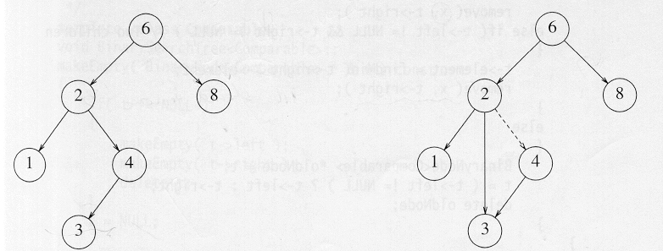
Different Cases
Case 1: the node is a leaf
Delete it immediately by reset its parent link to NULL
Case 2: the node has one child
Adjust the link from the parent to bypass that node

Slide 41
Deletion Case 3
Note: These kinds of nodes
have degree at most 1.
Case 3: the node has 2 children
Replace the key of that node with the smallest one in its right subtree (or the largest one in its left subtree)
Delete that replacing node from the subtree
Time complexity = O(height of the tree)
〖Example〗 Delete 60
40
20
60
Solution 1: reset left subtree.
55
10
30
50
70
Solution 2: reset right subtree.
45
55
52
52
8/22

Slide 42
SearchTree Delete( ElementType X, SearchTree T )
{ Position TmpCell;
if ( T == NULL ) Error( "Element not found" );
else if ( X < T->Data ) /* Go left */
T->Left = Delete( X, T->Left );
else if ( X > T->Data ) /* Go right */
T->Right = Delete( X, T->Right );
else /* Found element to be deleted */
if ( T->Left && T->Right ) { /* Two children */
/* Replace with smallest in right subtree */
TmpCell = FindMin( T->Right );
T->Data = TmpCell->Data;
T->Right = Delete( T->Data, T->Right ); } /* End if */
else { /* One or zero child */
TmpCell = T;
if ( T->Left == NULL ) /* Also handles 0 child */
T = T->Right;
else if ( T->Right == NULL ) T = T->Left;
free( TmpCell ); } /* End else 1 or 0 child */
return T;
}
40
T1
20
60
10
30
50
70
45
55
52
T( N ) = O ( h ) where h is the height of the tree

Slide 43
Operations:
☞ PtrToNode Search( int X, SearchTree T );
☞ PtrToNode FindMin( SearchTree T );
☞ PtrToNode FindMax( SearchTree T );
☞ SearchTree Insert( int X, SearchTree T );
☞ SearchTree Delete( int X, SearchTree T );
The time complexity of all these operations are:
T( N ) = O ( h ) , where h is the height of the BST

Slide 44
Question: Insert n elements into an original empty binary search tree. How high can this tree be?
Answer: The height depends on the order of insertion.
〖Example〗 Given elements 1, 2, 3, 4, 5, 6, 7. Insert them into an originally empty BST one by one in the orders:
4, 2, 1, 3, 6, 5, 7 and 1, 2, 3, 4, 5, 6, 7
1
4
2
2
6
h = 6
3
1
3
5
7
4
h = 2
5
6
7
In the best case: height of the tree= ?
In the worst case: height of the tree= ?

