Slide 1
Chapt.7 Sorting (III)

Slide 2
Stable sort algorithms
A stable sort: the relative orders of equal elements are kept
This may matter when you are sorting data according to some characteristic
Example: sorting students by test scores
Ann
98
Ann
98
Bob
90
Joe
98
Dan
75
Bob
90
Joe
98
Sam
90
Pat
86
Pat
86
Sam
90
Zoe
86
Zoe
86
Dan
75
original array
stably sorted

Slide 3
Unstable sort algorithms
An unstable sort may or may not keep equal elements in the same order
Stability is usually not important, but sometimes it matters
Ann
98
Joe
98
Bob
90
Ann
98
Dan
75
Bob
90
Joe
98
Sam
90
Pat
86
Zoe
86
Sam
90
Pat
86
Zoe
86
Dan
75
original array
unstably sorted

Slide 4
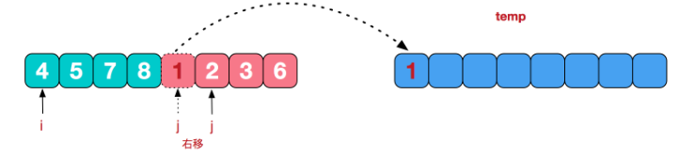
Stability of merging
Stability of mergesort depends on the merge method
Merging is the only place where elements get moved
What if we encounter equal elements when merging?
If we always choose the element from the left subarray, mergesort is stable

Slide 5
Summary: comparison based sorting methods
Sorting method | Time complexity |  | Stability | Space complexity
 | Worst case | Avarage case
Insertion sort | O(n²) | O(n²) | Y | O(1)
Shell sort |  |  | N | O(1)
Bubble sort | O(n²) | O(n²) | Y | O(1)
Heap sort | O(nlogn) | O(nlogn) | N | O(1)
Merge sort | O(nlogn) | O(nlogn) | Y | O(N)
Quick sort | O(n²) | O(nlogn) | N | O(logn)

Slide 6
Time complexity of Sorting
Several sorting algorithms have been discussed and the best ones, so far:
Heap sort and Merge sort: O( n log n )
Quick sort (best one in practice): O( n log n ) on average, O( n² ) worst case
It can be proven that any comparison-based sorting algorithm will need to carry out at least O( n log n ) operations on avarage and worst case

Slide 7
§9 A General Lower Bound for Sorting
【Theorem】Any algorithm that sorts by comparisons only requires at least Ω( N log N ) comparisons on avarage and worst case.
Proof:
K₀ ≤ K₁
T
F
K₁ ≤ K₂
K₀ ≤ K₂
T
F
T
F
stop
[0,1,2]
K₀ ≤ K₂
stop
[1,0,2]
K₁ ≤ K₂
T
F
T
F
stop
[0,2,1]
stop
[2,0,1]
stop
[1,2,0]
stop
[2,1,0]
Decision tree (决策树)
for insertion sort on {K₀, K₁, K₂}

Slide 8
When sorting N distinct elements, there are different possible results.
N !
K₀ ≤ K₁
T
F
Thus any decision tree must have at least N ! leaves.
K₁ ≤ K₂
K₀ ≤ K₂
T
F
T
F
stop
[0,1,2]
K₀ ≤ K₂
stop
[1,0,2]
K₁ ≤ K₂
If the height of the tree is k,
then N ! ≤ 2^{k} (2^{k} is the # of leaves in a full binary tree of height k)
T
F
T
F
stop
[0,2,1]
stop
[2,0,1]
stop
[1,2,0]
stop
[2,1,0]
Decision tree for insertion sort on K₀, K₁, and K₂
⇒ k ≥ log(N !)
Since N ! ≥ (N/2)^{N/2} and log₂ N ! ≥ (N/2)log₂(N/2) = Θ ( N log₂ N )
Therefore T(N) = O(k) ≥ O(N log₂ N) .

Slide 9
Time complexity of Sorting
Can we do better than O( n log n )?
Non-comparison sorts: bucket（桶排序） and radix sort（基数排序）

Slide 10
Bucket Sort
Restriction on the problem:
Suppose the values in the list to be sorted can repeat but the values range in a limit (e.g., values are digits from 0 to 9)

Slide 11
Bucket sort
Idea: suppose the values are in the range 0..m-1; start with m empty buckets numbered 0 to m-1, scan the list and place element i in the i^{th} bucket, and then output the buckets in order
No comparisons will be necessary

Slide 12
Example
4 | 2 | 1 | 2 | 0 | 3 | 2 | 1 | 4 | 0 | 2 | 3 | 0
0 1 2 3 4
0 00
1 1
2 2 22
3 3
4 4
0 | 0 | 0 | 1 | 1 | 2 | 2 | 2 | 2 | 3 | 3 | 4 | 4

Slide 13
Values versus entries
If we were sorting values: each bucket is just a counter that we increase counter[i] by one whenever a value i is encountered
If we were sorting entries according to keys, then each bucket is a queue
Entries are enqueued into a matching bucket
Entries will be dequeued back into the array after the scan

Slide 14
Time complexity
Bucket initialization:
From array to buckets:
From buckets to array:
Even though this stage is a nested loop, notice that all we do is dequeue from each bucket until they are all empty –> n dequeue operations in all
Strictly speaking, time complexity is O(m+n)
Since m will likely be small compared to n, Bucket sort is O( n )
O( m )
O( n )
O( n )

Slide 15
Sorting integers
Can we perform bucket sort on any array of (non-negative) integers?
Yes, but note that the number of buckets will depend on the maximum integer value
If you are sorting 10 integers and the maximum value is 999999
You will need 1 million buckets!
Time complexity is not really O( n ) because m is much > than n. Actual time complexity is O( m )
Can we do better?
What if M >> N ?

Slide 16
Radix sort
Digit-by-digit sort
every integer can be represented by at most k digits
d₀d₁d₂…d_{k-1} where d_{i} are digits in base r
d₀: Most Significant Digit
d_{k-1}: Least Significant Digit

Slide 17
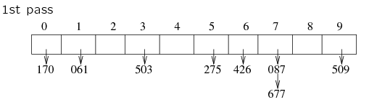
Radix Sort
Example: 275, 087, 426, 061, 509, 170, 677, 503
Least-significant-digit-first
275, 087, 426, 061, 509, 170, 677, 503
Combine the pockets to form the new set of numbers, keeping their relative order :
170 | 061 | 503 | 275 | 426 | 087 | 677 | 509

Slide 18
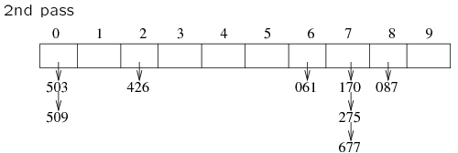
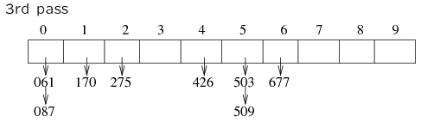
170 | 061 | 503 | 275 | 426 | 087 | 677 | 509
503 | 509 | 426 | 061 | 170 | 275 | 677 | 087
061 | 087 | 170 | 275 | 426 | 503 | 509 | 677

Slide 19
Radix Sort
Algorithm
sort by the least significant digit first (bucket sort)
=> Numbers with the same digit go to the same pocket
reorder all the numbers: the numbers in pocket 0 precede the numbers in pocket 1, which precede the numbers in pocket 2, and so on
sort by the next least significant digit
continue this process until the numbers have been sorted on all k digits

Slide 20
Radix Sort
Does it work?
Radix sort works as long as the bucket sort stages are stable sorts
Suppose there are two elements whose first digit is the same; for example, 52 & 58
If 52 occurs before 58 in the array prior to the sorting stage, 52 should occur before 58 in the resulting array
This way, the work carried out in the previous bucket sort stages is preserved

Slide 21
〖Example〗
What if we sort according to the Most Significant Digit first?
Input: 64, 8, 216, 512, 27, 729, 0, 1, 343, 125
Sort according to the Least Significant Digit first.
Bucket
0
1
2
3
4
5
6
7
8
9
Pass 1
0
1
512
343
64
125
216
27
8
729
0
512
125
343
64
Pass 2
1
216
27
8
729
0
125
216
343
512
729
1
Pass 3
8
27
64
Output: 0, 1, 8, 27, 64, 125, 216, 343, 512, 729

Slide 22
Radix Sort
Running time
K passes over the numbers (i.e. k bucket sorts, with range being 0..r)
each pass takes O(N+r)
total: O(Nk+rk)
k and r are constants: O(N)
Increasing the base r decreases the number of passes k

Slide 23
Example
Sorting a sequence of 4-bit binary integers
1001
0010
1001
1001
0001
0010
1110
1101
0001
0010
1101
1001
0001
0010
1001
0001
1101
0010
1101
1101
1110
0001
1110
1110
1110

Slide 24
Suppose that the record R_{i} has r keys.
K_{i} ^{j} : the j+1-th key of record R_{i}
K_{i} ⁰ : the most significant key of record R_{i}
K_{i} ^{r−1} : the least significant key of record R_{i}
A list of records R₀, ..., R_{n−1} is lexically sorted with respect to the keys K ⁰, K ¹, ..., K ^{r−1} iff
That is, K_{i} ⁰ = K_{i+1} ⁰, ... , K_{i} ^{l} = K_{i+1} ^{l}, K_{i} ^{l+1} < K_{i+1} ^{l+1} for some l < r − 1.
〖Example〗 A deck of cards sorted on 2 keys
club
diamond
heart
spades
K ⁰ [Suit]
♣ < ♦ < ♥ < ♠
K ¹ [Face value]
2 < 3 < 4 < 5 < 6 < 7 < 8 < 9 < 10 < J < Q < K < A
Sorting result :
2♣ ... A♣ 2♦ ... A♦ 2♥ ... A♥ 2♠ ... A♠

Slide 25
☞ MSD ( Most Significant Digit ) Sort
① Sort on K ⁰: for example, create 4 buckets for the suits
3
♣
♣
♣
5
♦
♦♦
♦
♦♦
4
♥
♥♥
A
♠
♠
♣
♥♥
3
♣
5
♦
4
♥
A
♠
② Sort each bucket independently (using any sorting technique)
♠
♥
♦
♣

Slide 26
LSD ( Least Significant Digit ) Sort
① Sort on K ¹: for example, create 13 buckets for the face values
2
♣
♣
3
♣
♣
♣
4
♥
♥♥
5
♦
♦♦
♦
♦♦
...
A
♠
♠
♣
♣
♥♥
2
♣
3
♣
4
♥
5
♦
A
♠
② Reform them into a single pile
A
♠
♠
③ Create 4 buckets and resort
3
♣
♣
♣
A
♠
2
♣
♣
♣
3
♣
♣
2
♣

Slide 27
External Sort
Consider the problem if sorting a large file, stored on disk or tape, containing a large number of records.
If the file is very large then it will be impossible to read all of the records into memory at once, and so the internal sorting techniques will not work.

Slide 28
The principal goal of external sorting:
Minimize the times of disk accessing operations

Slide 29
Simple Approaches to External Sorting
We could sort a file of records as follows:
Partition the file into two files, say F1 and F2
Take the first record from each file and write them in sorted order to a new file, say M1.
Repeat the process with the record from each file but write to a second file, say M2.
Repeat until F1 and F2 have been done. M1 and M2 consist of odered pairs of records.

Slide 30
Repeat step2-4, but merge pairs of records instead of single records, producing sorted runs of length 4
Continue, building longer and longer runs.

Slide 31
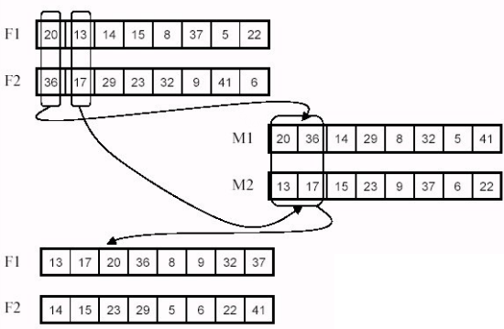
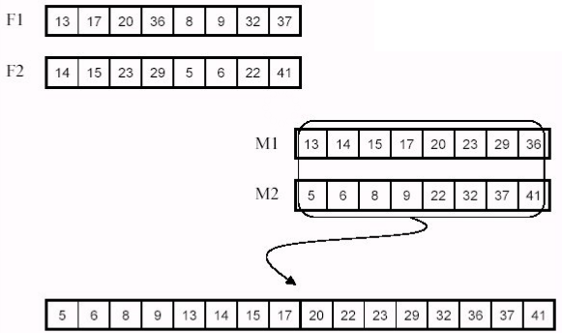
Example
How many times is the entire file read here?

Slide 32
Reducing the number of passes
Assume a file of n records, the simple merge sort requires logn passes to read/write each record.
Reducing the number of passes can reduce the amount of the time for reading/writing records, and can also improve performance.

Slide 33
Reducing the number of passes
There are two approaches to reduce the number of merge passes:
Break the file into large initial runs
Merge the runs by multi-way

Slide 34
Building long initial runs
How can we efficiently build long runs to which we may efficiently apply the merging algorithm?
One solution: read as much of the records as possible into memory at once, then sort them and write to a new file. Repeat the process until the entire file has been read. This will build runs whose length corresponds to the amount of memory we can allot to hold records.

Slide 35
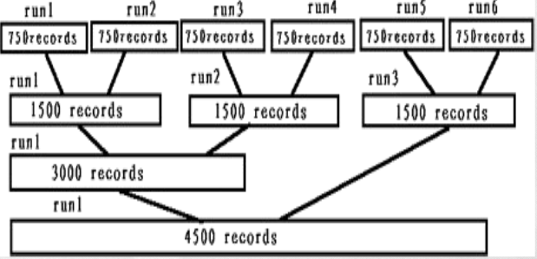
example
File–- 4500 records(A1,…,A4500)
Run – 750 records
Internally sort three blocks at a time(i.e. 750 records) to obtain 6 runs

Slide 36
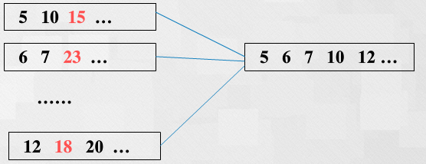
Multi-way merging
The number of passes can be reduced if we merge runs at a time. Multi-way is similar to two-way merging.

Slide 37

Assume n records, m runs.
k-way merging: need log_{k}m passes
In each pass, k-way merge requires:
n(k-1) comparisons
Total comparisons: n(k-1)log_{k}m

