Slide 1

§4 Network Flow Problems
〖Example〗 Consider the following network of pipes:
source
Note: Total coming in (v)
≡ Total going out (v)
where v ∉ { s, t }
s
s
3
2
3
2
1
a
1
a
b
b
3
2
3
2
c
4
d
Determine the maximum amount of flow that can pass from s to t.
c
4
d
2
3
2
1
t
t
sink

Slide 2
1. A Simple Algorithm
s
s
s
3
2
3
2
0
0
0
1
1
a
b
a
b
a
b
0
0
3
2
3
2
0
0
c
4
d
c
d
c
4
d
0
0
2
3
2
3
1
t
t
t
G
Flow G_{f}
Residual G_{r}
Step 1: Find any path s → t in G_{r} ;
Step 4: If (there is a path s → t in G_{r} )
Goto Step 1;
Else
End.
Step 2: Take the minimum edge on this path as the amount of flow and add to G_{f} ;
augmenting path
Step 3: Update G_{r} and remove the 0 flow edges;

Slide 3
s
s
3
2
a
1
b
a
b
3
2
c
4
d
c
d
2
3
t
t
G
Residual G_{r}

Slide 4
2. A Solution – allow the algorithm to undo its decisions
For each edge ( v, w ) with flow f_{v, w} in G_{f} , add an edge ( w, v ) with flow f_{v, w} in G_{r} .
s
s
s
3
2
3
2
3
2
1
3
2
a
b
a
b
a
1
2
b
2
2
3
4
1
3
2
2
1
3
2
3
3
2
c
4
d
c
d
1
c
d
3
2
3
2
3
2
3
t
t
2
t
G
Flow G_{f}
Residual G_{r}
〖Proposition〗 If the edge capabilities are rational numbers, this algorithm always terminate with a maximum flow.
Note: The algorithm works for G with cycles as well.

Slide 5
3. Analysis ( If the capacities are all integers )
☞ An augmenting path can be found by an unweighted shortest path algorithm.
T = O( ) where f is the maximum flow.
f · |E|
s
1 000 000
1 000 000
a
1
b
1 000 000
t
1 000 000
☞ Always choose the augmenting path that allows the largest increase in flow.
/* modify Dijkstra’s algorithm */
T = T_{augmentation} * T_{find a path}
= O( |E| log cap_{max} ) * O( |E| log |V| )
= O( |E|² log |V| ) if cap_{max} is a small integer.

Slide 6
☞ Always choose the augmenting path that has the least number of edges.
T = T_{augmentation} * T_{find a path}
= O( |E| ) * O( |E| · |V| )
/* unweighted shortest path algorithm */
= O( |E|² |V| )

Slide 7
Application of DFS

Slide 8
Connected components of undirected graphs (I)
Back edges
::= (u, v) ∉ tree
and (u, v) ∈Graph
DFS ( 0 )
0
0
1
1
3
4
2
2
3
4
void DFS ( Vertex V ) /* this is only a template */
{ visited[ V ] = true; /* mark this vertex to avoid cycles */
for ( each W adjacent to V )
if ( !visited[ W ] )
DFS( W );
}

Slide 9
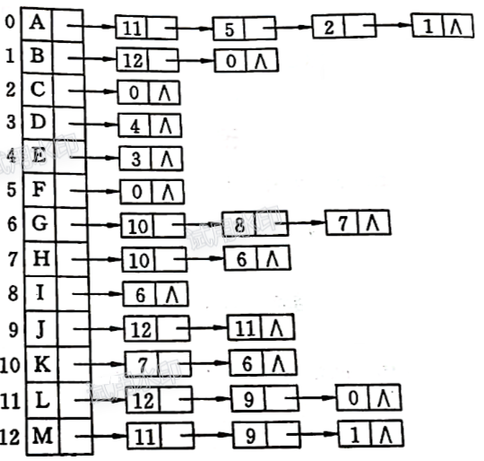
Connected components of undirected graphs (II)
If the graph is not connected, processing all nodes requires several calls to Dfs, and each generates a tree. This entire collection is a depth-first spanning forest.
A L M J B F C D E G K H I

Slide 10
Biconnectivity
Biconnected undirected graph: there are no vertices whose removal disconnects the rest of the graph.
0
0
8
9
1
7
1
3
4
2
3
5
2
4
6
Articulation (关节，枢纽）points

Slide 11
 v is an articulation point if G’ = DeleteVertex( G, v ) has at least 2 connected components.


 G is a biconnected graph if G is connected and has no articulation points.
Biconnected
graph
Articulation
point

 A biconnected component is a maximal biconnected subgraph.
〖Example〗


a
j
i
a
j
i
b
h
h
Note: No edges can be shared by two or more biconnected components. Hence E(G) is partitioned by the biconnected components of G.
b
h
b
h
c
d
f
c
c
d
f
f
e
g
e
g
Connected graph
Biconnected components

Slide 12
Finding the articulation points of a connected undirected G
➢ Use depth first search to obtain a spanning tree of G
DFS ( d )
Depth first spanning tree
0
preorder
number Num(v)
a
9
j
i
8
Note: If u is an ancestor of v, then Num( u ) < Num( v ).
4
d
3
b
h
e
1
5
f
7
2
0
5
c
d
f
c
2
6
g
e
g
b
3
7
h
1
6
a
4
8
i
j
9
➢ Find the articulation points in G
 The root is an articulation point iff it has at least 2 children
 Any other vertex u is an articulation point iff u has at least 1 child, and there is NO path from its child to its ancestor in the tree.

Slide 13
Low(v): the lowest-numbered vertex which is reachable from v by taking zero or more tree edges (can including one back edge)
0
/0
d
e
1
/0
5
/5
f
Low can be computed efficiently by performing a postorder traversal of the DFS spanning tree.
c
/0
/5
2
6
g
b
3
/0
7
/5
h
a
4
/4
8
/8
i
j
/9
9
Therefore, u is an articulation point iff
(1) u is the root and has at least 2 children; or
(2) u is not the root, and has at least 1 child such that Low( child ) ≥ Num( u ).

Slide 14
Strongly Connected Component
A directed graph is strongly connected if there is a directed path from v_{i} to v_{j} and also from v_{j} to v_{i}.
A strongly connected component is a maximal subgraph that is strongly connected.

Slide 15
strongly connected component
(maximal strongly connected subgraph)
0
0
2
1
1
2
G

Slide 16
1
4
6
3
2
5
strongly connected component
(maximal strongly connected subgraph)
1
4
6
3
2
5

Slide 17
Strong Connectivity
The sequence of steps required to find the strong components in a digraph are given below:
Perform the DFS traversal(s) on the given graph G to produce a set of DFS spanning trees called a DFS spanning forest.
All vertices of the graph G are numbered with the help of post-order traversal of DSF spanning forests
6
B
H
G
3
A
B
G
10
C
F
J
2
D
C
F
H
9
A
4
5
I
D
1
E
8
J
I
7
E

Slide 18
Strong Connectivity
3. Obtain the reverse graph G_{r} of G by reversing the edges of G in G_{r}.
Perform the DFS traversal on graph G_{r} starting at the vertex which is numbered highest and mark the vertex as ‘visited’.
If one traversal procedure does not visit all the vertices of G1, perform another DFS traversal starting at the vertex with the highest number among all the remaining vertices.
6
3
B
10
G
H
B
D
E
A
G
Study the proof of the algorithm on P.333 by yourself
C
I
A
2
D
F
H
9
4
5
C
J
1
E
8
J
I
7
F
G_{r}

Slide 19
Another example:
a
a
6
b
c
b
3
c
5
d
2
f
e
f
d
4
e
1
(a) Digraph G
(b) After steps 1 and 2
a
a
b
b
c
d
d
e
e
f
c
f
(c) After step 3
(d) After steps 4 and 5

Slide 20
Euler Circuits
Draw each line exactly once without lifting your pen from the paper – Euler tour problem
Draw each line exactly once without lifting your pen from the paper, AND finish at the starting point – Euler circuit problem
〖Proposition〗 An Euler circuit is possible only if the graph is connected and each vertex has an even degree.
〖Proposition〗 An Euler tour is possible if there are exactly two vertices having odd degree. One must start at one of the odd-degree vertices.

Slide 21
DFS
1
2
3
4
5
6
7
8
9
10
11
12
Note:
The path should be maintained as a linked list.
For each adjacency list, maintain a pointer to the last edge scanned.
T = O( |E| + |V| )

