Slide 1
Review

Slide 2
Chapter 2 Analysis
The big-O notation
Running time analysis of a program segment

Slide 3
Gig-O Notation
Big-O, “bounded above by”: T(n) = O(f(n))
Compare their relative rates of growth.
The growth rate of T(n) is less than or equal to that of f(n)

Slide 4
Useful Rules
Rule of sums
If T₁(n)=O(f(n)) and T₂(n)=O(g(n)), then
T₁(n)+T₂(n)=O(max(f(n),g(n)))
Rule of products
If T₁(n)=O(f(n)) and T₂(n)=O(g(n)), then
T₁(n)*T₂(n)=O(f(n)*g(n))
For any constant k, we have log^{k}n=O(n).
This tells us that logarithms grow very slowly.

Slide 5
General Rules of Time Analysis
simple statements (read, write, assign)
The running time is constant O(1)
simple operations (+ - * / == > >= < <= )
The running time is constant O(1)
sequence of simple statements/operations
the runtime is dominated by the most expensive operation

Slide 6
for, do, while loops
The running time is at most the running time of the statements inside the for loop (including tests) times the number of iterations.

Slide 7
NESTED FOR LOOPS:
The total running time of a statement inside a group of nested loops is the running time of the statements multiplied by the product of the sizes of all the for loops.

Slide 8
IF / ELSE:
For the fragment
if ( Condition ) O(1)
S1; T₁(n)
else S2; T₂(n)
the running time is never more than the running time of the test plus the larger of the running time of S1 and S2.
T(n)=O(max(T₁(n),T₂(n))
Method calls
A calls B
B calls C
etc.
A sequence of operations when call sequences are flattened
T(n) = max(T_{A}(n), T_{B}(n), T_{C}(n))

Slide 9
For each of the following six program fragments give an analysis of the running time (Big-Oh will do).
void fun(int n){
int i=1;
while (i<=n)
i=i*2;
}
(2) int y=5;
while ((y-1)*(y-1)<n)
y=y+1;
(3) int i=0, sum=0;
while (sum<n) sum+=++i;
(4) int fact (int n) {
if (n<=1) return 1;
return n*fact(n-1);
}
(5) sum = 0;
for( i=0; i<n; i++ )
for( j=0; j<i*i; j++ )
for( k=0; k<j; k++)
sum++;
(6) sum = 0;
for( i=1; i<n; i++ )
for( j=1; j<i*i; j++ )
if( j%i == 0 )
for( k=0; k<j; k++ )
sum++;
Answer:
(I) The running time is O( logN ).
(II) The running time is O( N ^{1/2} ).
(III) The running time is O( N ^{1/2} ).
(IV) The running time is O( N ).
(V) The running time is O( N ⁵ ).
(VI) The running time is O( N ⁴ ).

Slide 10
Ch.3 List, Stack and Queue
List
Sequencial list
#define MAXLEN 100
typedef struct
{
ElemType data[MAXLEN];
int Length;
}SeqList;
Linked list (with or without header node)
Singly linked list
Singly circular linked list (main advantage is that starting from any node the whole list can be traversed)
Doubly linked list

Slide 11

单选题
1分
In the following descriptions of list, which one is wrong?
A
Sequential list must occupy continuous memory locations
B
Sequential list is convenient for insertion and deletion
C
Linked list do not necessary occupy continuous memory locations
D
Linked list is convenient for insertion and deletion
提交

Slide 12
单选题
1分
For linked list, the time complexity of visiting the i^{th} element is_______
A
O(i)
B
O(1)
C
O(n)
D
O(i-1)
提交

Slide 13
单选题
1分
Suppose the most common operations on a list are inserting a new node into the end of the list and deleting the first node of the list, how to implement the list such that most computational time can be saved?
A
singly linked list
B
singly circular linked list with only head pointer
C
doubly linked list
D
singly circular linked list with only tail pointer
提交

Slide 14
单选题
1分
Suppose the most common operations on a list are accessing the i^{th} element and accessing the predecessor of the i^{th} element, , how to implement the list such that most computational time can be saved?
A
Singly linked list
B
Sequential list
C
Doubly linked list
D
Singly circular list
提交

Slide 15
单选题
1分
Suppose L is a singly linked list with header node, the judging condition of whether L is empty is
A
L->next==NULL
B
L==NULL
C
L!=NULL
D
L->next==L
提交

Slide 16

单选题
5分
Find element x in the singly linked list L with header node:
position find(element_type x, LIST L)
{ position p;
p=_________
while( )
p=p->next;
return p;
}
L->next; (p!=NULL) && (p->data!=x)
A
L->next; (p->next!=NULL) && (p->next->data!=x)
B
L; (p!=NULL) && (p->data!=x)
C
L; (p->next!=NULL) && (p->next->data=!x)
D
提交

Slide 17
Insertion and deletion operations on a singly linked list
Insertion and deletion operations on a doubly linked list

Slide 18
Stack
First in Last out
Operations are only performed at one end (call the top)
Array implementation
Linked list implementation
Basic operations:
IsEmpty
Push
Pop
Top

Slide 19
Applications of Stack
Balancing symbols
Infix expression to postfix expression conversion

Slide 20
单选题
1分
The postfix expression of the following expression A*(B+C)/(D-E+F) is
A
A*B+C/D-E+F
B
AB*C+D/E-F+
C
ABC+*DE-F+/
D
ABCDEF*+/-+
提交

Slide 21
Queue
First in First out
Insertion is done at one end (called the rear), whereas deletion is performed at the other end (called the front)
Basic operations
Enqueue
Dequeue

Slide 22
Queue
Array implementation
Linked list implementation
How to tell whether a circular queue is empty and full
the space pointed by front is always empty
the queue is empty: rear=front
the queue is full: (rear+1)mod n=front
Number of elements in the circular queue:
(n+rear-front) mod n
( n is the size of the circular queue)

Slide 23
Ch.4 Tree
Binary trees
Traversal of binary trees
Implementation of binary trees
Threaded binary tree
Binary search tree
AVL trees
B trees (concept)

Slide 24
Binary Trees
Definition and terminologies
Degree, height, depth, level
For an empty tree the height=-1. For a tree with only the root node, the height=0.
Full binary tree, complete binary tree
Numbers:
The maximum number of nodes on level l of a binary tree is 2^{l} , l>=0.
The maximum number of nodes in a binary tree of depth k is 2^{k+1}-1, k>=0.
The minimal number of nodes in a complete binary tree of depth k is 2^{k}
For any nonempty binary tree, if n₀ is the number of leaf nodes and n₂ the number of nodes of degree 2, then n₀=n₂+1
For any binary tree with n node, there are n+1 null pointers.

Slide 25
单选题
1分
Suppose a complete binary tree has 5 nodes on its 4th level (the root node is on the level 0), how many leaves are there in the tree.
A
11
B
5
C
10
D
13
提交

Slide 26
单选题
1分
答案解析
Suppose a binary tree has 50 node, the minimal height of the tree should be____
suppose the height of the tree is k, we have
2^(k+1)-1>=50>=2^k
solve the ineuqality, we have k=5.
A
3
B
4
C
5
D
6
提交
可为此题添加文本、图片、公式等解析，且需将内容全部放在本区域内。

Slide 27
单选题
1分
The height of a binary tree with 2000 nodes is ( ), suppose the height of an empty tree is -1.
A
10
B
11
C
Between 11 to 2000
D
Between 10 to 1999
提交

Slide 28
Implementation of Binary Trees
Array representation
Linked list representation

Slide 29
Array Representation
Using an array (linear representation)
The nodes of the tree are stored sequentially in the array level by level, for each level ,from left to right according to the following rules:

Slide 30
The root node is at location indexed with 1.
For any node with index i, 1<=i<=n, we have:
left_child(i) is at 2i , if 2i<=n.
If 2i>n, then i has no left child.
right_child(i) is at 2i+1 , if 2i +1 <=n.
If 2i +1 >n, then i has no right child.
parent(i) is at , if i!=1.
If i=1, i is at the root and has no parent.
i/2

Slide 31
单选题
1分
答案解析
Given a complete binary tree with 2000 nodes, there are totally _______degree 2 nodes on the tree.
A complete binary can have at most 1 one-degree node. If total number of node is even, there is 1 one-degree node. If total number of node is odd, there is no one-degree node.
A
500
B
1000
C
1001
D
999
提交
可为此题添加文本、图片、公式等解析，且需将内容全部放在本区域内。

Slide 32
Linked List Representation
typedef struct TreeNode *PtrToNode;
typedef struct PtrToNode Tree;
typedef struct TreeNode
{
ElemType data;
PtrToNode left, right;
};
data
left
data
right
left
right

Slide 33
Binary Tree Traversals（遍历）
Traverse the tree: visit each node exactly once
Preorder traversal
Inorder traversal
Postorder traversal
Levelorder traversal

Slide 34
Preorder Traversal (recursive version)
void preorder(Tree ptr)
/* preorder tree traversal */
{
if (ptr) {
printf(“%d”, ptr->data);
preorder(ptr->left);
predorder(ptr->right);
}
}

Slide 35
Inorder Traversal (recursive version)
void inorder(Tree ptr)
/* inorder tree traversal */
{
if (ptr) {
inorder(ptr->left);
printf(“%d”, ptr->data);
indorder(ptr->right);
}
}

Slide 36
Postorder Traversal (recursive version)
void postorder(Tree ptr)
/* postorder tree traversal */
{
if (ptr) {
postorder(ptr->left);
postdorder(ptr->right);
printf(“%d”, ptr->data);
}
}

Slide 37
Level order Traversal
void level_order(Tree ptr)
{int front= 0, rear=-1;
PtrToNode Queue[MAX_QUEUE_SIZE];
if (!ptr) return; /* empty tree */
Queue[++rear]=ptr;
for (;rear!=front-1;) {
ptr = Queue[front++];
if (ptr) {
printf(“%d”, ptr->data);
if (ptr->left)
Queue[++rear]=ptr->left;
if (ptr->right)
Queue[++rear]=ptr->right;
else break;
}
}

Slide 38
单选题
1分
Suppose the preorder traversal of a binary tree is ABDEC and the inorder traversal is BDEAC, then the binary tree is ____
A
A complete binary but not a full binary tree
B
Not a complete binary tree
C
A full binary tree
D
Can not determine
提交

Slide 39
Threaded Binary Trees
Too many null pointers in current representation of binary trees
Replace these null pointers with some useful “threads”.
T
a ⋀
n: number of nodes number of non-null links: n-1 total links: 2n null links: 2n-(n-1)=n+1
b
⋀ c ⋀
d
⋀ e
⋀ f ⋀
⋀ g ⋀

Slide 40
LeftThread Left data Right RightThread
The node structure of threaded BT
0：Left is a link
LeftThread=
1：Left is a thread
0：Rchild is a link
RightThread=
1：Rchild is a thread

Slide 41
Binary Search Tree
Definition of a BST
Operations:
Search
Find Min
Find Max
Insertion
Deletion

Slide 42
Find Min/ Find Max
Goal: return the node containing the smallest (largest) key in the tree
Algorithm: Start at the root and go left (right) as long as there is a left (right) child. The stopping point is the smallest (largest) element

Slide 43
Insertion in a BST
Proceed down the tree as you do with a search.
If X is found, do nothing.
Otherwise, insert X at the last spot on the path traversed.

Slide 44
Deletion from a BST
Case 1: the node is a leaf
Delete it immediately by reset its parent link to NULL
Case 2: the node has one child
Adjust the link from the parent to bypass that node
Case 3: the node has 2 children
Replace the key of that node with the smallest one in its right subtree (or the largest one in its left subtree)
Delete that replacing node from the subtree

Slide 45
AVL tree
A height balanced binary search tree
Balance Factor: The balance factor of a node is defined as BF( node ) = h_{L} − h_{R} . In an AVL tree, BF( node ) = −1, 0, or 1.
5
7
5
2
8
2
8
2
8
1
4
7
1
4
1
4
7
3
3
3
5

Slide 46
Insertion in a AVL tree
Single rotation
Double rotation

Slide 47
B-Tree
Definition of B-Tree

Slide 48
Ch.5 Heap
Min heap & max heap
Structure property & value property
A min heap is a key sequence {k1, k2,…,kn}, which satisfies the following properties:
Ki<=K2i (i=1,…,n/2-1)
Ki<=k2i+1
Operations
Insertion
Delete_Min
Generate a heap

Slide 49
Basic Heap Operations
☞ insertion
➢ Sketch of the idea:
10
The only possible position
for a new node
since a heap must be
a complete binary tree.
[1]
9
[2]
12
[3]
20
17
9
10
15
18
21
17
20
[4]
[5]
[6]
Case 1 : new_item = 21
20
<
21
Percolate (渗透）up
Case 2 : new_item = 17
20
>
17
10
<
17
Case 3 : new_item = 9
20
>
9
10
>
9

Slide 50
☞ DeleteMin
➢ Sketch of the idea:
The node which must be
removed to keep a
complete binary tree.
10
① move 18 up to the root
18
[1]
12
[2]
12
15
18
[3]
20
② find the smaller child of 18
<
12
18
15
<
18
18
15
18
[4]
[5]
Percolate down
Time complexity：
best case:T (N) = O ( 1 )
worst case:T (N) = O ( log N )

Slide 51
☞ BuildHeap ( H )
0 1 2 3 4 5 6 7 8 9 10 11 12 13 14 15
150 80 40 30 10 70 110 100 20 90 60 50 120 140 130
150
PercolateDown (7)
10
PercolateDown (6)
80
PercolateDown (5)
10
150
20
40
PercolateDown (4)
30
20
150
30
10
80
60
70
50
110
PercolateDown (3)
PercolateDown (2)
100
20
PercolateDown (1)
30
150
90
60
80
50
70
120
140
130
T (N) = O(N)

Slide 52
单选题
1分
Where is the minimal element in a max heap?
A
Saved in the Left most leaf
B
Saved in the right most leaf
C
Saved in a leaf
D
Cannot determine
提交

Slide 53
主观题
10分
(a) Given the array [5, 3, 17, 10, 84, 19, 6, 22, 9], build a max heap.
(b) Give the resulting heap after delete the max element from the above heap.
(c) Insert a new key 37 into the resulting heap of (b).
正常使用主观题需2.0以上版本雨课堂
作答

Slide 54
Ch. 6 Hashing
Hashing function
Hash(x)= x mod TableSize
TableSize should be a prime number.
Collision resolution
Separate chaining: λ≈1
Open addressing:
Linear probing (cause primary cluster)
position(x)=Hash(x)+i; i=0,1,2,…
Quadratic probing (cause secondary cluster): λ≈0.5
position(x)=Hash(x)+i²; i=0,1,2,…
Double hashing
position (x)=Hash(x)+i*Hash2(x) ; i=0,1,2,…
Hash2(x)=R-(x mod R),
where R is a prime smaller that TableSize

Slide 55
Ch.9 Graph
Definition and terminologies
Graph representations
Adjacency list
Adjacency matrix
Graph traversal
Topological search
Depth first search
Breadth first search
Shortest path
Minimum spanning tree
Biconnected graph

Slide 56
Definition and terminologies
Directed graph, undirected graph, weighted graph
Complete graph
Degree, path, subgraph, simple graph, acyclic graph, directed acyclic graph
Connected, strongly connected, connected component…

Slide 57
Adjacency matrix
Undirected graph
Symmetric
Degree?
Directed graph
Normally not symmetric
Indegree?
Outdegree?
Degree?

Slide 58
0
1
4
3
2
8
2
3
3
5
2
4
0
1
1

Slide 59
Adjacency List (I)
Undirected graph
0
1
2
3
4
v₀
v₁
v₂
v₃ ⋀
v₁
v₀
v₂ ⋀
v₃
v₀
v₂
v₀
v₁
v₃
v₄ ⋀
v₄
v₃
v₀
v₂
v₄ ⋀
v₁
v₂
v₄
v₂
v₃ ⋀
┇ ┇
MAX_VEX-1

Slide 60
Adjacency List (II)
0
1
2
3
4
v₁ 2
v₂
v₄ ⋀
v₄
v₂ 0 ⋀
v₁
v₃ 3
v₁
v₂
v₅
v₅ ⋀
v₄ 1
v₃ ⋀
v₂
v₃
v₅ 1
v₄ ⋀
(a)
┇ ┇ ┇
MAX_VEX-1
0
1
2
3
4
v₁ 1
v₃ ⋀
(b) Adjacency list, out-degree
v₂ 2
v₁
v₃ ⋀
v₃ 1
v₄ ⋀
v₄ 2
v₁
v₅ ⋀
v₅ 1
v₃ ⋀
┇ ┇ ┇
MAX_VEX-1
(c) Inverse adjacency list，in-degree

Slide 61
Graph traversal
Topological sequence
Topological sequence is not unique
Only exist for acyclic digraphs
Depth first search
Breadth first search

Slide 62
Topological Ordering
STEPS:
Counting the number of edges that lead to each vertex (the in-degree of each vertex);
All vertices with in-degree 0 are inqueue;
If the queue is empty, goto 7);
Remove the first vertex N from queue and output it;
The in-degrees of all the neighbors of N is decremented by 1. Inqueue vertices whose in degrees become to 0;
Goto 3);
If all vertices have been output, the printed order is topological ordering. Otherwise, the graph include cycles.

Slide 63
Topological Ordering
void topsort(ALGraph *G, Queue *Q)
{ int indegree[G->Vexnum()]; //store the indgree of each vertex
Node *p;
for (i = 0; i < G->Vexnum; i++) indegree[i] = 0;
for (i = 0; i < G->Vexnum; i++)
{p=G->AdjList(i)->LINK;
for (j = p.data; p!=NULL; p=p->LINK)
indegree[j]++;
}
for (i = 0; i < G->Vexnum; i++)
if (indegree[i] == 0 ) Q->enqueue(i);
// see next page …..
Counting the indegree of each vertex.
Place vertices with indegree 0 on the queue.

Slide 64
Topological Ordering
while (isEmpty(Q)!= 0 ){
v = Q.dequeue();
Printout(v);
p=G->AdjList(v)->LINK;
for (w = p.data; p!=NULL; p=p->LINK){
indegree[w]--;
if (indegree[w]==0)
Q.enqueue(w);
}
}
}

Slide 65
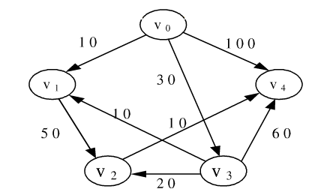
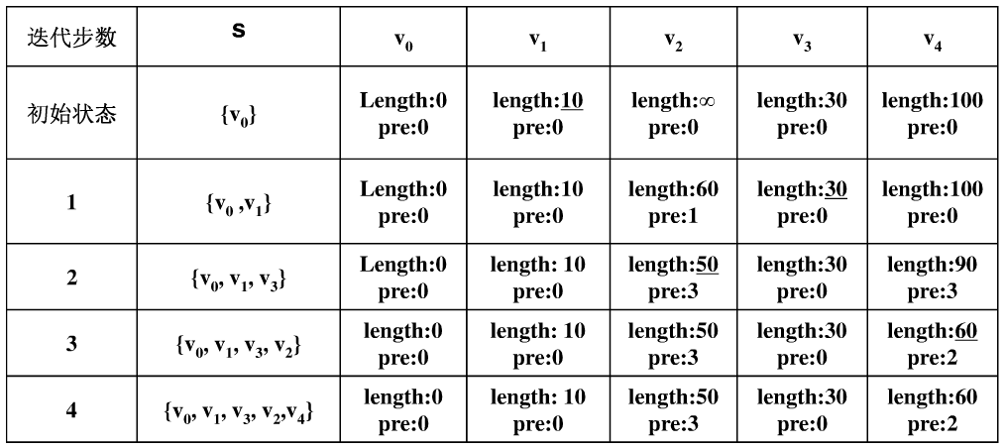
Dijkstra’s Algorithm

Slide 66
Minimum Spanning Tree
Definition of spanning tree
Defined for connected graph (with n nodes)
Spanning trees contain n nodes and n-1 edges
Spanning trees are not unique
Minimum spanning tree
Computation of MST
Prim’s algorithm
Kruskal’s algorithm

Slide 67
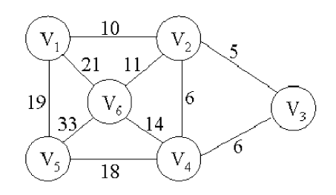
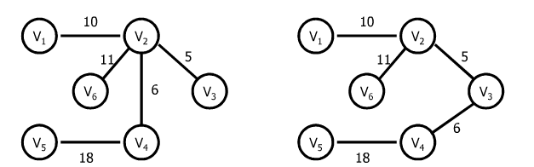
Prim’s algorithm

Slide 68
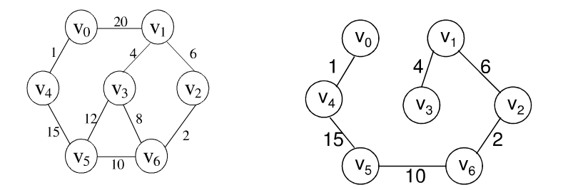
Kruskal’s algorithm

Slide 69
Prim’s algorithm is more efficient for dense graphs
Kruskal’s algorithm is more efficient for sparse graphs

Slide 70
Ch.6 Sorting
Insertion sort
Shell sort
Bubble sort
If compare from front to back, the largest element is put at the last position
If compare from back to front, the smallest element is put at the first position
Heap sort
Quick sort
Merge sort
Radix sort

Slide 71
Summary: comparison based sorting methods
Sorting method | Time complexity |  |  | Stability | Space complexity | Number of passes
 | Worst case | Best case | Avarage case
Insertion sort | O(n²) | O(n) | O(n²) | Y | O(1) | n-1
Shell sort |  |  |  | N | O)1)
Bubble sort | O(n²) | O(n) | O(n²) | Y | O(1) | 1~n-1
Heap sort | O(nlogn) | O(nlogn) | O(nlogn) | N | O(1) | n-1
Merge sort | O(nlogn) | O(nlogn) | O(nlogn) | Y | O(N) | logn
Quick sort | O(n²) | O(nlogn) | O(nlogn) | N | O(logn)
Radix sort (not comparison based) | O(k(N+r)) | O(k(N+r)) | O(k(N+r)) | Y | O(n) | k

Slide 72
Suppose the element sequence ( 8, 9, 10, 4, 5, 6, 20, 1, 2) is the result of the first 2 passes sorting, the sorting method can be ___________?
A. Bubble sort B. insertion sort
C. quick sort D. heap sort

Slide 73
Sort the sequence ( 18, 7, 20, 4, 5, 27, 2, 1, 6) by (1)quick sort with median-of-three partitioning/(2)bubble sort/(3)heap sort, the result of the first pass is ___________?

Slide 74
Among the following sorting methods:
quick sort B. insertion sort C. merge sort D. bubble sort
E. heap sort F. shell sort
The methods of which the number of passes is independent of the initial status: B C E F
The unstable methods are: A E F
If the initial sequence is basically ordered (only the first k elements are not sorted, k<<n), the most efficient sorting method is B
The average time complexity of which methods is O(nlogn) A, C, E
The average time complexity of which methods is O(n*n) B D
The methods cannot guarantee that each pass of sorting can place at least one element at its final position: B C F

Slide 75
单选题
2分
The minimal number of nodes in a complete binary tree of depth k, k>=0, is .
A
2^{k}
B
2^{k}+1
C
2^{k+1}
D
2^{k+1}+1
提交

Slide 76
单选题
2分
The time complexity of the following program segments is .
int x=1;
while ((x-4)*(x-4)<N)
x++;
A
O( logN )
B
O( N ^{1/2} )
C
O(N)
D
O( N ² )
提交

Slide 77
填空题
0分
Sorting the array of elements (20, 15, 36, 18, 21, 14, 40, 17) with quick sort method, if 17 is used as the pivot the result of the first pass sorting is .
此题未设置答案，请点击右侧设置按钮
作答

Slide 78
单选题
2分
Where is the minimal element in a binary search tree?
A
Saved in the left most leaf
B
Saved in the root
C
Saved in the right most leaf
D
Cannot determine
提交

Slide 79
单选题
2分
Given a binary tree implemented with array representation, if the node saved in the location with index i, then its parent is saved in the location with index ______.
A
2i
B
floor( i/2)-1
C
floor(i/2)
D
2i+1
提交

Slide 80
单选题
2分
答案解析
Among the following sorting methods, which CAN guarantee that each pass of sorting can place at least one element at its final position? _______
selection sort, bubble sort, quick sort
A
shell sort
B
merge sort
C
insertion sort
D
heap sort
提交
可为此题添加文本、图片、公式等解析，且需将内容全部放在本区域内。

Slide 81
单选题
2分
In a graph, the sum of the degrees of all the vertices is equal to times the number of edges in the graph.
A
1/2
B
1
C
2
D
4
提交

Slide 82
单选题
2分
Find element x in the singly linked list L with a header node:
position find(element_type x, LIST L)
{ position p;
p=___(1)______
while( (2) )
p=p->next;
return p;
}
A
(1) L; (2) (p!=NULL) && (p->data!=x)
B
(1) L; (2) (p->next!=NULL) &&
(p->next->data!=x)
C
(1) L->next; (2) (p!=NULL) && (p->data!=x)
D
(1) L->next; (2) (p->next!=NULL) && (p->next->data!=x)
提交

Slide 83
单选题
2分
In the adjacency list of a directed graph, the number of nodes in each vertex singly linked list is equal to of the vertex.
A
out_degree
B
in_degree
C
degree
D
nothing

Slide 84
单选题
2分
In an undirected graph, if the length of the path between two vertices is k, then the number of vertices on the path is .
A
k-1
B
k
C
k+1
D
2k
提交

Slide 85
单选题
2分
If we want to find out the 10 smallest from 10000 elements, the best way is to use .
A
Insertion sort
B
merge sort
C
heap sort
D
quick sort
提交

Slide 86
单选题
2分
Among the following sequences, is not a min-heap.
A
1, 3, 5, 9, 7, 12
B
1, 5, 3, 7, 9, 12
C
1, 5, 3, 9, 7, 12
D
1, 5, 9, 3, 7, 12
提交

Slide 87
单选题
2分
Sort n elements with bubble sort, in the best case the time complexity is .
A
O(1)
B
O(log₂n)
C
O(n²)
D
O(n)
提交

Slide 88
填空题
2分
2. Suppose a complete binary has 3000 nodes, the height of the tree is [填空1] .
正常使用填空题需3.0以上版本雨课堂
作答

Slide 89
填空题
2分
3. To sort a sequence of n keys using insertion sort method, [填空1] passes are needed.
正常使用填空题需3.0以上版本雨课堂
作答

Slide 90
填空题
2分
4. Given the array [34, 3, 10, 27, 6, 22, 9], suppose a max heap is built in linear time. The max heap is [填空1] .
正常使用填空题需3.0以上版本雨课堂
作答

Slide 91
填空题
2分
5. To realize BFS of a graph, a [填空1] is used to implement the algorithm.
正常使用填空题需3.0以上版本雨课堂
作答

Slide 92
填空题
2分
6. An undirected complete graph with n nodes has [填空1] edges.
正常使用填空题需3.0以上版本雨课堂
作答

Slide 93
填空题
2分
7. Given an undirected graph with n nodes and e edges, there are totally [填空1] (how many) 0's in the adjacency matrix of this graph.
正常使用填空题需3.0以上版本雨课堂
作答

Slide 94
填空题
2分
8. For any node in a threaded binary tree, if RightThread=1, then in the Right field is a [填空1] .
正常使用填空题需3.0以上版本雨课堂
作答

Slide 95
填空题
2分
9. For linked list, the time complexity of visiting the i^{th} element is [填空1] .
正常使用填空题需3.0以上版本雨课堂
作答

Slide 96
主观题
15分
True or False (10 questions，1.5 points for each question，totally 15 points)
Sequential list must occupy continuous memory locations. ( )
Suppose T1(N)=O(f(N)) and T2(N)=O(f(N)), then T1(N)/T2(N)=O(1). ( )
A queue is a first in last out linear data structure. ( )
If an undirected graph has n vertices and more than n-1 edges, then the
graph is connected. ( )
5. A new record can always be inserted into a hash table by using quadratic
probing as long as there are empty locations. ( )
6. Bubble sort is stable. ( )
7. The minimum spinning tree of a connected graph is unique. ( )
In a sorted array with 100 elements, the maximum search time for successful
binary search is 8. ( )
If the sequence to be sorted is basically in order, using bubble sort is more
time efficient than quick sort. ( )
10. The DFS of a graph is a recursive procedure. ( )
正常使用主观题需2.0以上版本雨课堂
作答

Slide 97
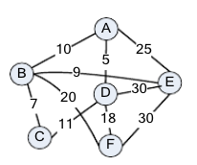
主观题
7分
Given the undirected graph shown in the fig.1, try to find the shortest path from the vertex A to all other vertices with Dijkstra algorithm. Describe the procedure with a table and list the shortest paths.
Fig. 1 an undirected graph
正常使用主观题需2.0以上版本雨课堂
作答

Slide 98
主观题
7分
2. For the graph shown in the Fig. 1,
(1) draw out the adjacency matrix and the adjacency list of it.(4 points)
(2) find the minimum spinning tree with the prim’s algorithm. (3 points)
正常使用主观题需2.0以上版本雨课堂
作答

Slide 99
主观题
7分
3. Suppose a linear table to be hashed is (32， 75， 29， 63， 46， 94， 24， 46， 18， 70), and the length of the hash table is 13, if the hash function is chosen as hash(x)=x % 13 and the separate chaining(linear probing/secondary probing) method is used to handle collisions, try to draw the hash table.
正常使用主观题需2.0以上版本雨课堂
作答

Slide 100
主观题
7分
4. Given a key sequence (142, 534, 253, 64, 450, 87, 572, 434),
(a) show radix sort processes of the sequence.
(b) show heap sort processes of the sequence.
(c) show quick sort processes of the sequence, suppose always use the last element as the pivot and cutoff=2.
正常使用主观题需2.0以上版本雨课堂
作答

Slide 101
主观题
7分
5. Given the sequence (32, 11, 54, 16, 79, 15, 20, 57), starting from an empty tree and insert the keys into the tree one by one
(a) show the resulting binary search tree .
(b) show the resulting AVL tree.
正常使用主观题需2.0以上版本雨课堂
作答

