Slide 1
Data Structure Using C
Dr. YAN LI
Room 411, Nanhai Building
yanlics@qq.com

Slide 2
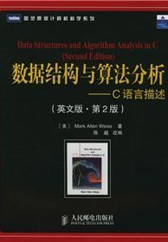
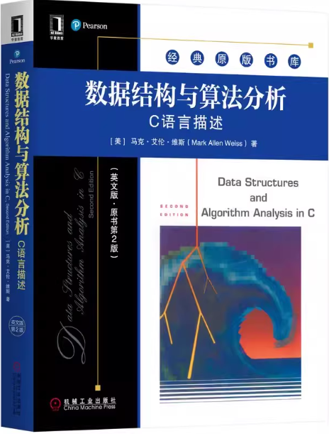
Textbook
Textbook :
Data Structures and
Algorithm Analysis in C,
Second Edition
by Mark Allen Weiss
But I will use material from other books, so the ultimate source should be my lectures.

Slide 3
Score distribution
Regular Grade: 40%
Attendance
Homework
Mid-term exam
Study attitude
Final exam: 60%

Slide 4
What is Data
Data
The set of symbols which can be recognized, stored and processed by the computer.
Is the carrier of information.
Examples
Integer \ real. (processed by digital processing programs)
Source program.( processed by compiler)
Images. (processed by image processing programs)
Students in our class room
Notes:
例如,200402班为一个学生数据,而其中的“张三”是一个数据元素)。

Slide 5
Basic Concepts about Data
Data object：A data object (or entity) is an abstract representation of a real-world thing about which data is collected. For example, "information of all students in our classroom" is a data object that contains all student-related data elements; similarly, "information of all books in a library" is a data object, and each specific book record (data element) belongs to this collection.
Data element：A data element (or data attribute) is a specific one of a data object. It is the basic unit of data, also called an "element" or "record," used to describe a specific object (such as a student or a book). For example, in a student information table, an entire record like "Student ID: 2024001, Name: Zhang San, Age: 20" is a data element.
Data item：A data item is the smallest, indivisible unit that constitutes a data element, used to describe one aspect of a data element's attributes. Following the example above, "Student ID: 2024001", "Name: Zhang San" , and "Age: 20" are each data items, which together form the "student" data element.

Slide 6
What Is a Data Structure?
Data Structure
organization of data
=
+
its associated operations

Slide 7
These operations are fundamental to all data structures :
Operation | Description | Example Scenario
Insertion | Add a new data element to the structure (at a specified position). | Add "apple" to a list of fruits.
Deletion | Remove an existing data element from the structure (by value or position). | Delete the 3rd element in an array.
Traversal (Iteration) | Visit every data element exactly once (to read or process data). | Print all elements in a tree.
Search | Find the position or existence of a target element (by value or key). | Check if "John" is in a hash table.
Update | Modify the value of an existing data element (by position or key). | Change "age: 25" to "age: 26" in a dict.
Sorting | Rearrange elements in a specified order (ascending/descending). | Sort a list of numbers from smallest to largest.
Merging | Combine two or more structures of the same type into one. | Merge two sorted lists into one sorted list.

Slide 8
“Clever” ways to organize data in order to enable efficient operations
What do we mean by ‘clever’?
What do we mean by ‘efficient’?
Time efficient
Memory efficient
Notes:
clever – range from techniques with which you are already familiar – eg, representing simple lists – to ones that are more complex, such as hash tables or self-balancing trees. Elegant, mathematically deep, non obvious.
making the different meanings of “efficient” precise is much of the work of this course!

Slide 9
Why So Many Data Structures?
Ideal data structure:
elegant, fast, memory efficient
Generates tensions:
time vs. space
one operation’s performance vs. another’s
generality vs. simplicity
The study of data structures is the study of tradeoffs. That’s why we have so many of them!

Slide 10
Why do we need to learn data structures?
The way in which the data is organized affects the performance of a program for different tasks.
A general understanding of the data structure is important in developing efficient algorithms in all phases of advanced data processing and computer science.

Slide 11



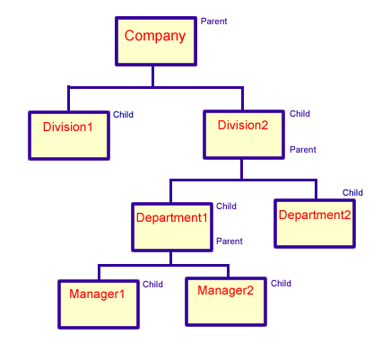
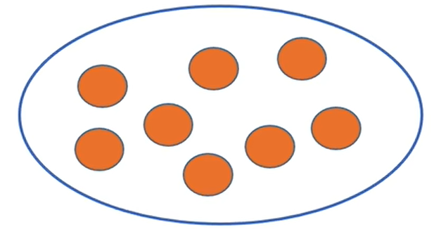
Class Overview
Introduction of the basic data structures used in computer software
Linear data structures:
Array
Stack
Queue
Nonlinear data structures:
佛山
广州
惠州
中山
东莞
珠海
深圳
Tree
Graph
Set

Slide 12
Class Overview
Introduction of the basic data structures used in computer software
fundamental data structures
logical structure & storage structure
time-space complexity analysis
their implementations
Introduction of implementations and analysis of sorting and searching algorithms.

Slide 13
Recursion（递归）
Definition of a Recursion
Simple Examples of Recursion
Conditions for Recursion to Work
How Recursion Works Internally
Tower of Hanoi
Binary Search

Slide 14
Definition of Recursion
A function is said to be recursive if it is defined in terms of iteself
Recursion is a programming technique that enables the solution to certain problems to be expressed in terms of solutions to smaller instances of the problem itself.

Slide 15
Problem: calculate x^{y} (y>=0)
The solution to the problem can be expressed in terms of
solutions to smaller instances of itself as:
x^{y} = 1, if y=0
x^{(y-1)} *x , if y>0
A function to calculate x^{y} (y>=0) can be expressed
recursively as:
int power(int x, int y){
if (y==0) return 1;
retrun power(x,y-1)*x; // recursion
}
Solution directly defined for base case
Recursive calls must always make progress toward the base case.
Usually made with smaller or simpler instances of the problem

Slide 16
Conditions for Valid Recursion
For recursive functions to work, the following two conditions must be met:
There must be a base case where the input value or size is
the smallest possible, and
in which case the processing is non-recursive.
The input (parameters) of every recursive call must be smaller in value or size than the input of the original function

Slide 17
Illustration of the Conditions
long power(int x, int y){
if (y==0) return 1; // base case. Input value y is the minimum.
return x*power(x,y-1); // recursion. Input value of recursive call
//is y-1<y
}

Slide 18
Example 1
int f(unsigned int N)
{
if(N==0)
return 0;
else
return f(N/3+1)+N-1;
}
A nonterminating recursive program

Slide 19
Example 2: Investment Accounts
Suppose you invest in an account $x every year, and that the account grows at an interest rate of 8%.
Write a function S(n) that computes how much money you have in your account at the end of year n.
Notes:
Three things to consider:1. what is the scale of the problem
2. what is the base case
3. how to make recursive involking i.e. how to express the problem in terms of smaller instances of the problem

Slide 20

主观题
10分
Indicate the base case of the recursive procedure.
Write a function S(n) that computes how much money you have in your account at the end of year n.
正常使用主观题需2.0以上版本雨课堂
作答

Slide 21
Investment Example (contd.)
The math:
S(n) = S(n-1) + interest of past year + new deposit $x
S(n)=S(n-1)+0.08*S(n-1)+x
S(n)=1.08*S(n-1) + x
Note that S(0)=x (the first deposit when opening the acct)
//The recursive code:
//Precondition: n is a non-negative integer
//Postcondition: returns S(0)=x; S(n) = 1.08*S(n-1) + x
double S(int n, double x){
if (n==0) return x;
return 1.08*S(n-1,x)+x;
}

Slide 22
Example 3: Finding the Minimum in an Array
Question: the input is a double array x[ ], find the minimum element
in the array.
// Precondition:start and end are nonnegative integer indexes
// marking the portion of x[ ] over which to find the minimum.
// end >= start; i.e. find minimum from x[start] to x[end]
// Postcondition: returns the smallest value in x[start. .end ].
// Recursion principle: if you we have the minimum of the 1st
// half of x and the minimum of the 2nd half of x, then the
// global minimum is the smaller of those two minimums

Slide 23
The Minimum Example (Contd.)
double min(double x[ ], int start, int end){
assert(end >= start && start >=0);
if (end == start) // one number to minimize over
return x[start];
int mid=(start+end)/2; // mid-point index
double min1=min(x, start, mid); // 1st recursive call
double min2=min(x, mid+1, end); // 2nd recursive call
if (min1 <= min2)
return min1;
else
return min2;
}

Slide 24
Illustration of the Conditions
double min(double x[ ], int start, int end){
assert(end >= start && start >=0);
if (end == start) // Base case. Input size is minimum = 1.
return x[start]; // No recursion
int mid=(start+end)/2; // mid-point index
double min1=min(x, start, mid); // 1st recursive call
double min2=min(x, mid+1, end); // 2nd recursive call
// In both recursive calls, the input size is half the original, and so less.
if (min1 <= min2)
return min1;
else
return min2;
}

Slide 25
Design rule: Assume all the recursive calls work
When coding, do not concern yourself how recursion is unfolding during execution
Rather, think of yourself as a boss, and treat each recursive call as an order to one of your trusted subordinates to do something.
As a boss, you need not worry how the subordinates do their work. Instead, take the outcome of their work
Finally, take the outcome of the subordinate’s work, and use it to compute by yourself the final result.

Slide 26
Illustration of Recursive Thinking
double min(double x[ ], int start, int end){
assert(end >= start && start >=0);
if (end == start) // Basis step.
return x[start]; // The boss does the basis step
int mid=(start+end)/2; // mid-point index
double min1=min(x, start, mid); // subordinate produces min1
double min2=min(x, mid+1, end); // subordinate produces min2
// The two recursive calls are the work of “subordinates”. Don’t
// worry how the subordinates do their work.
if (min1 <= min2)
return min1;
else
return min2;
}
// You, the boss, take the
// outcome min1 and min2
// from subordinates, and use
// them to get the final result.

Slide 27
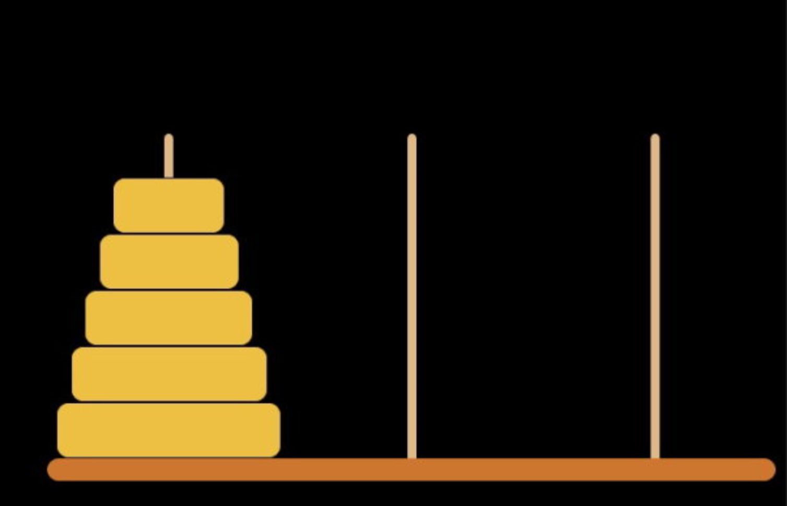
Towers Of Hanoi/Brahma

Slide 28
Towers Of Hanoi/Brahma
n
6
5
4
3
2
1
A
B
C
N disks to be moved from tower A to tower C
Cannot place big disk on top of a smaller one
Notes:
Could use animation of towers of hanoi from animations page on Web site.
Also known as Towers of Brahma.
According to legend, on the day of creation Buddhist monks began the task of moving disks from tower A to tower C. When they get done, the world will come to an end.

Slide 29
N=1
1
A
B
C

Slide 30
N=1
1
A
B
C

Slide 31
N=2
2
1
A
B
C

Slide 32
N=2
1
2
A
B
C

Slide 33
N=2
2
1
A
B
C

Slide 34
N=2
3 movements
2
1
A
B
C

Slide 35
N=3
3
2
1
A
B
C

Slide 36
N=3
2
1
3
A
B
C

Slide 37
N=3
1
2
3
A
B
C

Slide 38
N=3
3
1
2
A
B
C

Slide 39
N=3
3
2
1
A
B
C

Slide 40
N=3
3
2
1
A
B
C

Slide 41
N=3
2
3
1
A
B
C

Slide 42
N=3
7 movements
3
2
1
A
B
C

Slide 43
Recursive Solution
n-1
1
A
B
C
n > 1 disks to be moved from A to C using B
move top n-1 disks from A to B using C

Slide 44
Recursive Solution
1
A
B
C
move disk 1 from A to C using B

Slide 45
Recursive Solution
1
A
B
C
move top n-1 disks from B to C using A

Slide 46
Recursive Solution
1
A
B
C
Hanoi(n) = 1 when n = 1
Hanoi(n,A,B,C) =
Hanoi(n-1,A,C,B)+Hanoi(1,A,B,C)+Hanoi(n-1,B,A,C), n>1

Slide 47
Towers Of Hanoi/Brahma
H(n) = 2*H(n-1)+1
H(64) = 2⁶⁴-1 moves
Performing 1 move/second, would take about 585 billion years to complete.
Notes:
At the rate of a billion moves/second it would take 570 years to complete the task of moving 64 disks. Of course, the Buddhist monks engaged in this activity are moving far fewer disks/second. At the rate of (say) 1 disk a minute (the disks are, after all, rather heavy), the monks will take about 3.4 * 10¹³ years. So there is quite a while to go before the world comes to an end.

Slide 48
Binary Search
Input:
A sorted array X[ ] of size n
A value b to be searched for in X[ ]
Output:
If b is found, the index k where X[k]=b is returned
If b is not found, return -1
Definition: An X[ ] is said to be sorted if:
X[0] ≤ X[1] ≤ X[2] ≤ … ≤ X[n-1]

Slide 49
Binary Search: Method
The method is recursive:
Compare b with the middle value X[mid]
If b = X[mid], return mid
If b < X[mid], then b can only be in the left half of X[left..mid], because X[ ] is sorted. So call the function recursively on the left half.
If b > X[mid], then b can only be in the right half of X[mid+1..right], because X[ ] is sorted. So call the function recursively on the right half.

Slide 50
Illustration of Binary search
X[12]:
Search for b=12
mid = (0+11)/2 = 5. Compare b with X[5]: 12<20.
So search in left half X[0..5]
mid = (0+5)/2 = 2. Compare b with X[2]: 12 > 7.
So search right half X[3..5]
mid = (3+5)/2 = 4.Compare b with X[4]: 12<15.
So search left half X[3..4]
mid = (3+4)/2 = 3.Compare b with X[3]: b=X[3]=12.
Return 3.
1
5
7
12
15
20
25
27
35
40
47
60
0
1
2
3
4
5
6
7
8
9
10
11
1
5
7
12
15
20
25
27
35
40
47
60
0
1
2
3
4
5
6
7
8
9
10
11
1
5
7
12
15
20
25
27
35
40
47
60
0
1
2
3
4
5
6
7
8
9
10
11

Slide 51
The Recursive Code of Binary Search
int binarySearch(double b, double X[], int left, int right)
{
if (left == right)
if (b==X[left]) return left;
else return -1;
int mid = (left+right)/2;
if (b==X[mid]) return mid;
if (b < X[mid]) return binarySearch (b, X, left, mid);
if (b > X[mid]) return binarySearch(b, X, mid+1, right);
}

