Slide 1
Software Engineering
Course Introduction
Dr. 何明昕 HE Mingxin, MX, Max
Send your email to c.max@yeah.net with
a subject like: SE-id-Andy: On What …
Download from c.program@yeah.net
/文件中心/网盘/SoftwareEngineering26S

Slide 2
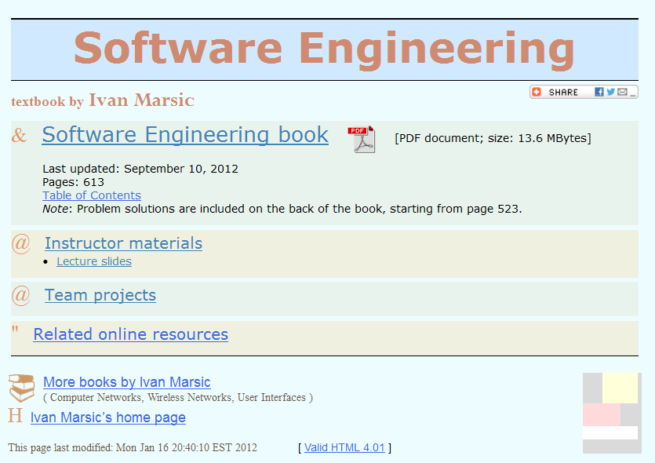
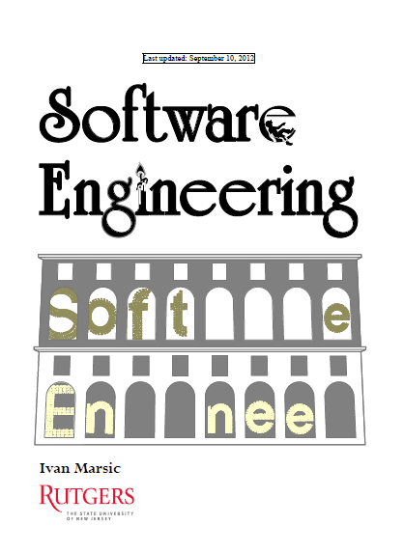
Textbook
http://eceweb1.rutgers.edu/~marsic/books/SE/

Slide 3
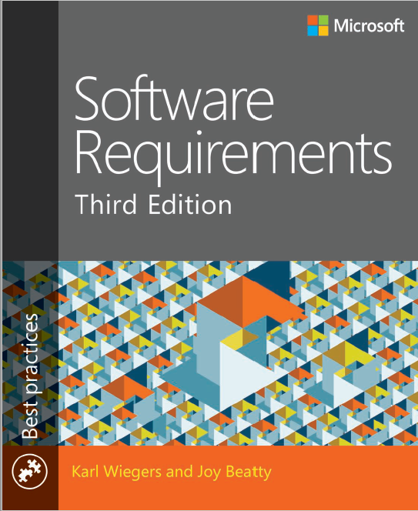
Reference Textbook
Karl Wiegers and Joy Beatty.
Software
Requirements,
Third Edition
Microsoft, 2013

Slide 4
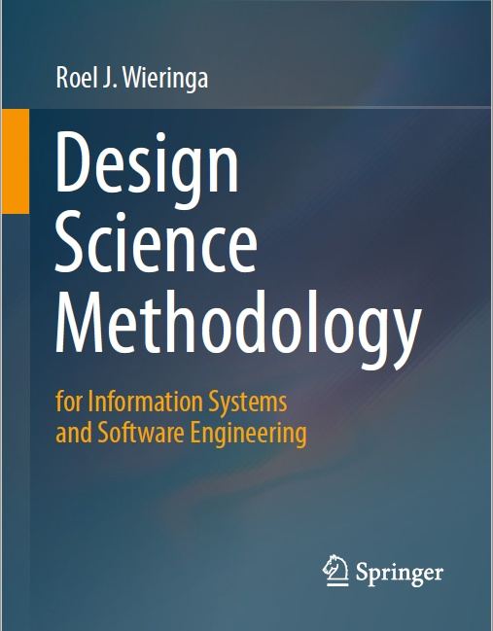
Reference Textbook
R.J. Wieringa:
Design Science Methodology
for Information Systems and Software Engineering.
Springer, 2014

Slide 5
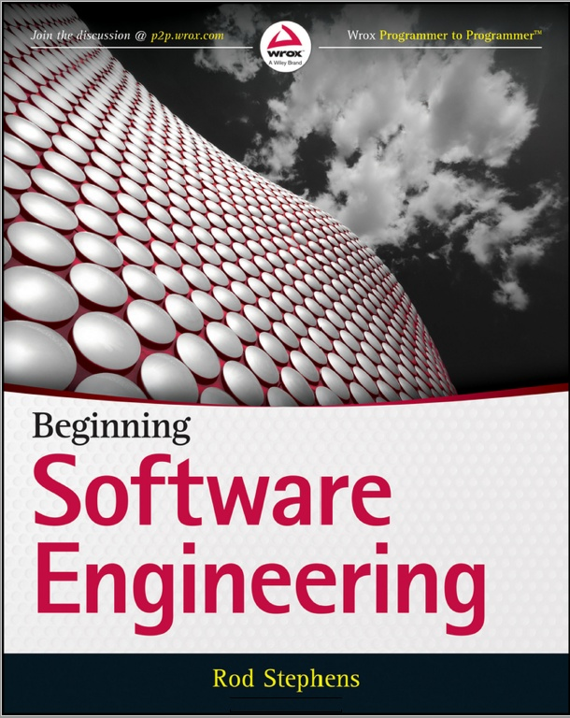
Reference Textbook
Rod Stephens.
Beginning Software Engineering,
John Wiley & Sons, 2015

Slide 6
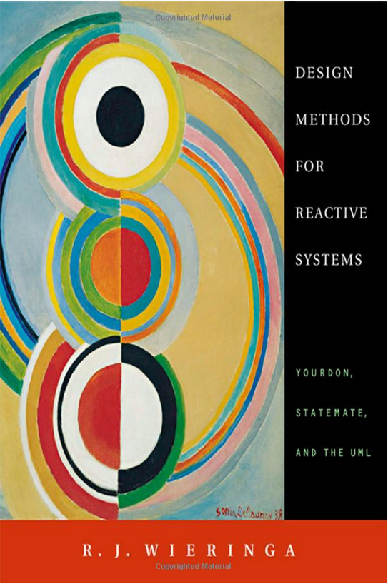
Reference Textbook
R.J. Wieringa:
Design Methods for Reactive Systems
Yourdon, Statemate, and the UML
Elsevier Science (USA), 2003
Morgan Kaufmann Publishers

Slide 7
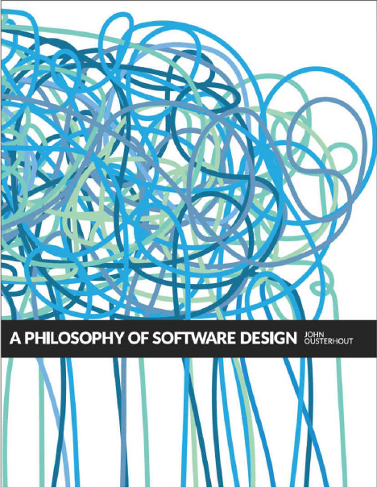
Reference Textbook
John Ousterhout.
A Philosophy of Software Design
Springer, 2014

Slide 8
Reference
Ivar Jacobson, Pan-Wei Ng, et la.
The Essence of Software Engineering: The SEMAT Kernel. Communications of the ACM, 2012.12

Slide 9
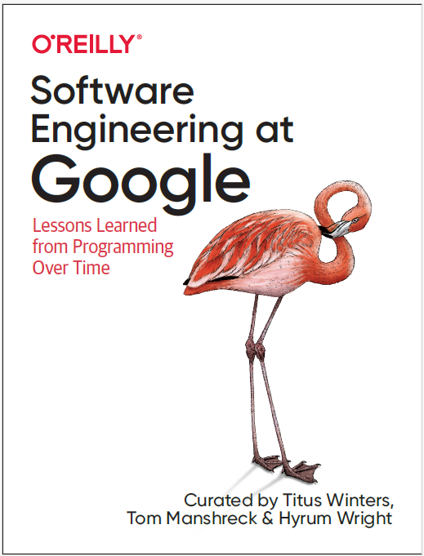
Reference
Titus Winters, Tom Manshreck, and Hyrum Wright
Software Engineering at Google, Lessons Learned from Programming Over Time
O’Reilly, 2020

Slide 10
Course Description
The key objective of this course is to learn modular design of software and documenting the design using symbolic representations, i.e., UML diagrams. The course will cover software life-cycle models and different phases of the software development process.
Object-oriented techniques are key to the course. Since the ultimate result of software engineering is a working software package, the course will put a great emphasis on developing a demonstrable software package. However, this is not a programming course.

Slide 11
Course Description (cont.)
The key characteristic is having project works: individual work (Programming in OS), teams of two to three students work on developing complex software systems over a course of one semester.

Slide 12
Who is this course for?
An introductory Foundations of Software Engineering and Practical Training on Software Engineering through Team Projects.
Prepare to Design Solutions (Problem-Solving) for real world pragmatic problems
Prerequisites: solid programming skills, algorithms and data structures
Credit: 3 credits

Slide 13
Grading
Exercise Homework and Class Participation: 15%
Project: 25%
Project reports (2 Projects, 4 version of reports): 25 + 10
Exam: 60% (Closed-book, from projects, Lectures & Exercises)

Slide 14
Syllabus at a Glance (ch1~ch5 only, +...)
Topic 0 (3hrs): Design Science Methodology
Topic 1 (3hrs): Software Lifecycle
Topic 2 (3hrs): Requirements Engineering and Use Cases
Topic 3 (2hrs): Software Architecture
Topic 4 (4 hrs): Object-Oriented Analysis
Topic 5 (4 hrs): Object-Oriented Design
Topic 6 (2 hrs): Test-Driven Implementation
Topic 7 (3 hrs): System Specification
Topic 8 (6 hrs): Problem Frames & Software Measurement
Topic 9 (6 hrs): Design Patterns

Slide 15
Writing, writing, writing…
Good Engineers must be good writers.
This course is a W (writing) course. You will be writing a lot in this class, perhaps more than in any other college course (☺).
Homework and Project assignments will ask you to write and to rewrite. The project will involve even more extensive writing, subject to a four-step revision cycle: draft requirements - specification with architecture - first rewrite - second rewrite.
In addition to project-related documents you will be writing weekly progress reports and the final project write-up.
Your homework assignments and project documents will be graded not only on the subject matter, but also on correctness and writing (expression) qualities.
The exam will include drawing UML models and writing essays.

Slide 16
Writing, writing, writing…
3 key points:
Understanding
Expressing
What Really Matter?

Slide 17
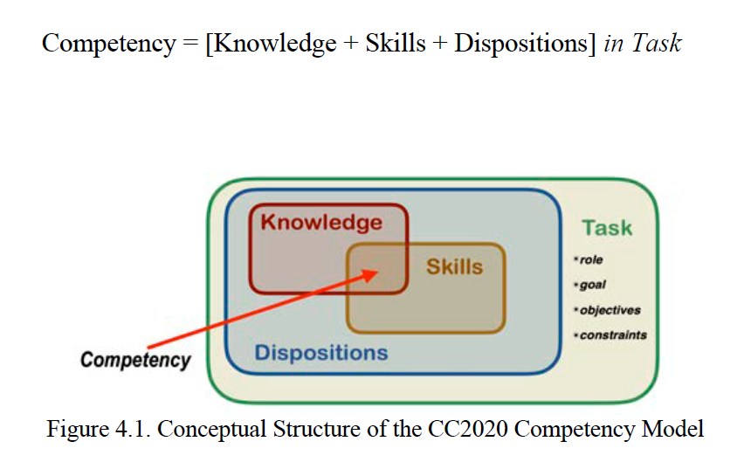
From Knowledge-based Computing Education
To Competency-based Computing Education

Slide 18
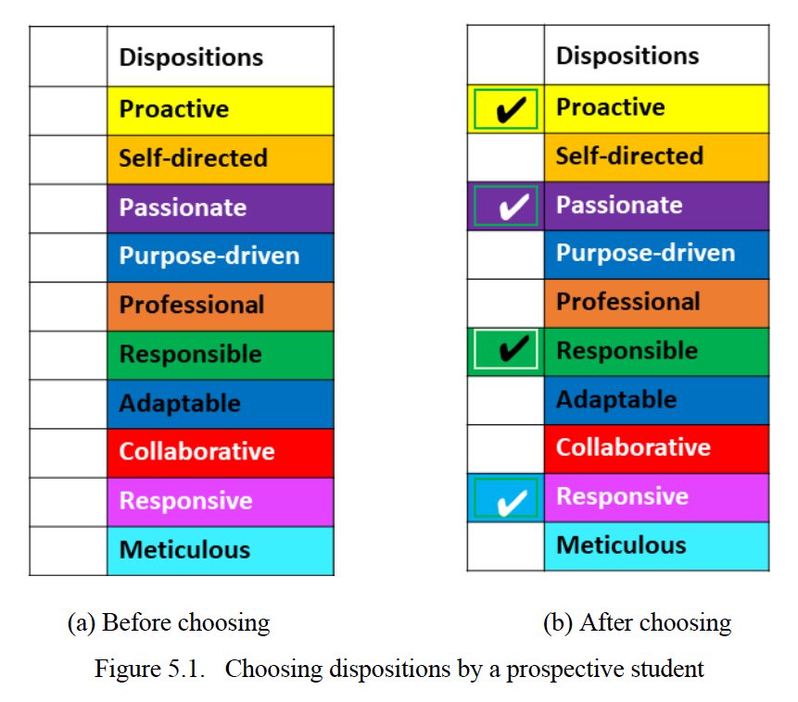

Slide 19
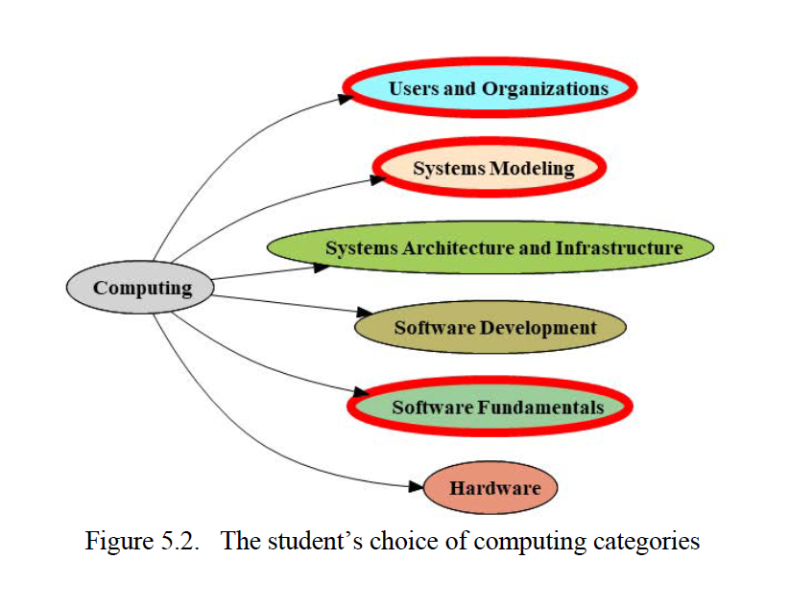

Slide 20
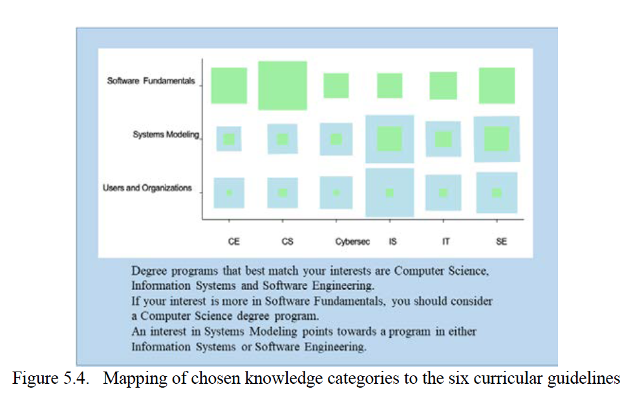

Slide 21
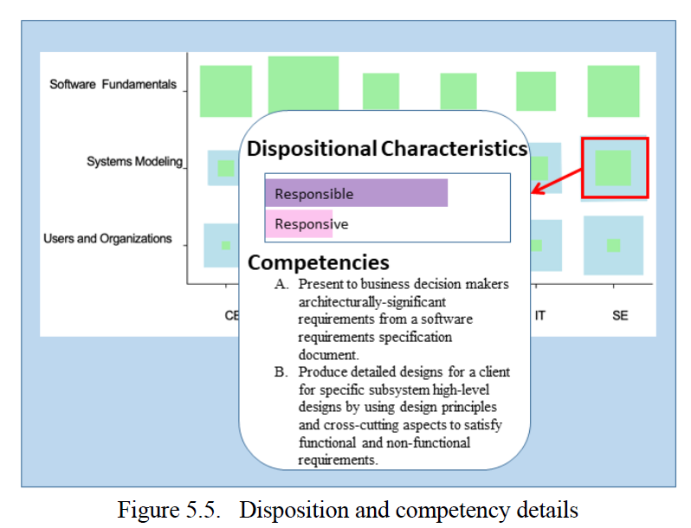

Slide 22
Three Dimensions of most CST Courses
Most of Courses on CST is organized by a combination of elements from the following 3 dimensions:
THEORY related: Maths, Concepts, Models, Algorithms, Principles, Mechanisms, Methods, … Need to understand Abstract Things
SYSTEM and TOOLS related: HW, Network, OS, PLs, IDEs, DBMS, Clients, Servers, Virtual Machines, Containers in Cloud, … Need to understand, set and use them properly
DESIGN related: According to Requirements (Problems), need to use Theory and Tools to shape/implement/test Solutions!
Put them all together!!!

Slide 23
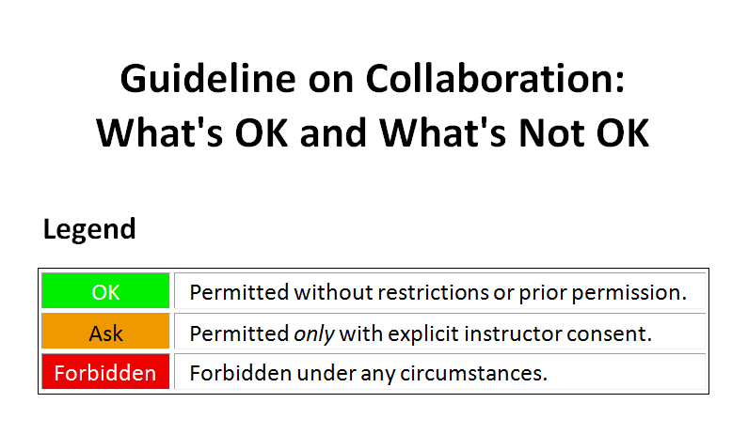

Slide 24
