Slide 1
Intro to SE : Complexity
何明昕 HE Mingxin, Max
Send your email to c.max@yeah.net with
a subject like: SE-id-Andy: On What …
Download from c.program@yeah.net
/文件中心/网盘/SoftwareEngineering26S

Slide 2
Exercise 01: Review & Preview (in 2 weeks)
Read 1.1-1.2 and preview 1.3-1.4 of TextBook.
Read ch1 of “Beginning Software Engineering”
Read “Essence of Software Engineering”
Preview ch1 of “Design Science Methodology for IS & SE”
Preview ch1 of “A Philosophy of Software Design”
Send an email in a week to c.max@yeah.net with a subject like:
SE-nnnn-Adam: Register for SE Course,
simply describe your experience on SE and your expectation for the course.

Slide 3
Introduction: Software is Complex
Complex (错综复杂的) ≠ complicated (复杂难懂的)
Complex = composed of many simple parts related to one another
Complicated = not well understood, or explained

Slide 4
Software Engineering is
Complex and Complicated
软件规模增长带来要素数量增长，熵增长必然导致混乱（热力学第三定律）
准确定义需求很难（用户通常不知道要什么，只知道不要什么），需求蔓延是软件项目失败的首要原因
不同的设计可以实现同样的功能(系统结构/行为/功能的关系），判断一个设计是否是好的设计很难（Conway’s law: 软件的结构倾向于与开发团队的组织架构具相似性)

Slide 5
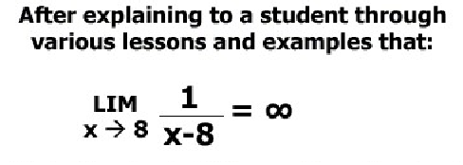
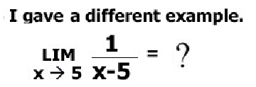
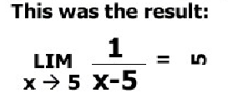

Slide 6




Slide 7
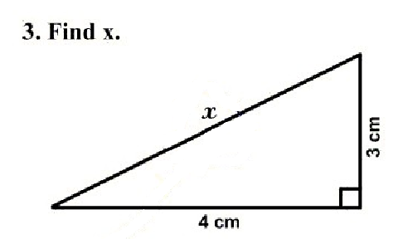
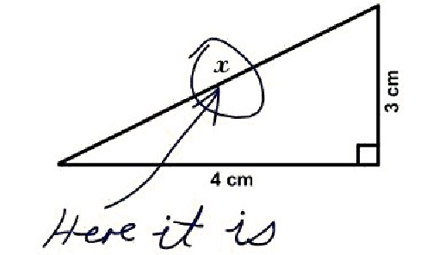
2 Key points:
What does it mean?
What really matters?

Slide 8
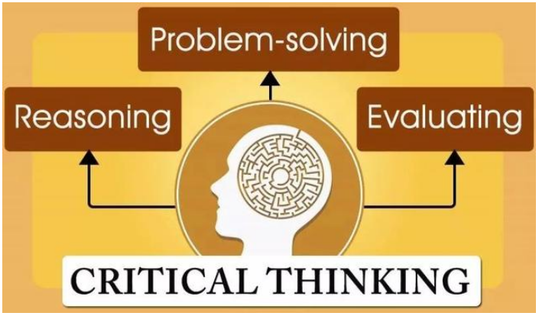
Critical thinking is
a mental process involving the evaluation of arguments or statements to determine whether they are valid, accurate, or logical.
It involves the ability to think analytically, identify and assess arguments, draw conclusions, and make decisions.
Critical thinking is essential in many areas, such as problem-solving, decision-making, creativity, and research.
批判性思维
审辨性思考
关键性思考
建设性思考
Critical Observing:
建设性观察
系统化认知问题 与
构建解决方案的能力

Slide 9
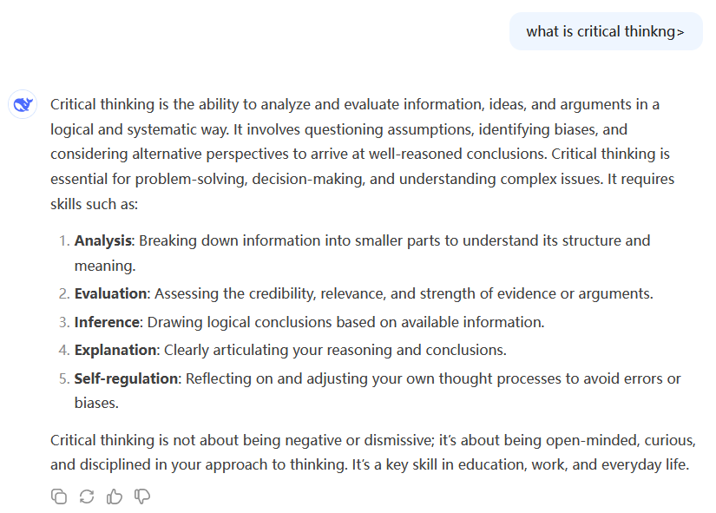

Slide 10
Complexity Example: Scheduling Fence Construction Tasks
Setting posts
[ 3 time units ]
Cutting wood
[ 2 time units ]
Nailing
[ 2 time units for unpainted;
3 time units otherwise ]
Painting
[ 5 time units for uncut wood;
4 time units otherwise ]
Setting posts < Nailing, Painting
Cutting < Nailing
…shortest possible completion time = ?
[ ⇒ “simple” problem, but hard to solve without a pen and paper ]
Notes:
SOURCE: Goodaire & Parmenter, Discrete Mathematics with Graph Theory, Third Edition, Pearson Prentice Hall, 2006. [ Section 11.5, p. 361 ]

Slide 11
More Complexity
We know that
Today is Wendesday, March 11.
What day will be on July 1?
( To answer, we need to bring the day names and the day numbers into coordination, and for that we may need again a pen and paper. )

Slide 12
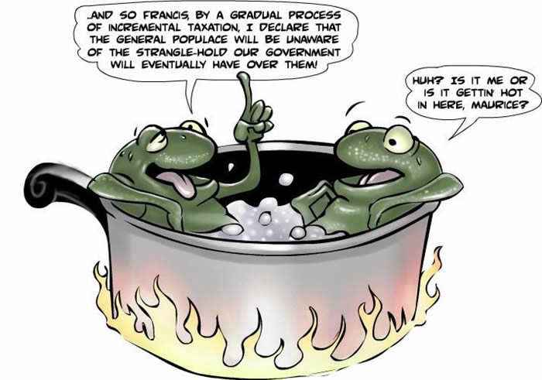
The Frog in Boiling Water
Small problems tolerate complacency(自满)—lack of immediate penalty leads to inaction
Negative feedback accumulates subtly and by the time it becomes painful, the problem is too big to address
Frog in gradually heated water analogy:
The problem with little things is that none of them is big enough to scare you into action, but they keep creeping up and by the time you get alarmed the problem is too difficult to handle
Consequently, “design smells(设计怪味)” accumulate, “technical debt (技术债务)” grows, and the result is “software rot(软件腐烂)”
https://en.wikipedia.org/wiki/Design_smell
https://en.wikipedia.org/wiki/Technical_debt
https://en.wikipedia.org/wiki/Software_rot
Notes:
https://en.wikipedia.org/wiki/Boiling_frog
http://tealandco.com/the-frog-in-boiling-water-the-myth-and-the-metaphor/
https://www.theatlantic.com/technology/archive/2006/09/the-boiled-frog-myth-stop-the-lying-now/7446/
https://medium.com/psychology-secrets-for-marketing/the-boiling-frog-4ef1d66c9b35

Slide 13
The Role of Software Engg. (1)
A bridge from customer needs to programming implementation
Customer
Software Engineering
Programmer
First Law of Software Engineering
Software engineer is willing to learn the problem domain
(problem cannot be solved without understanding it first)
Notes:
"You cannot solve it, unless you understand it."

Slide 14
The Role of Software Engg. (2)

Slide 15
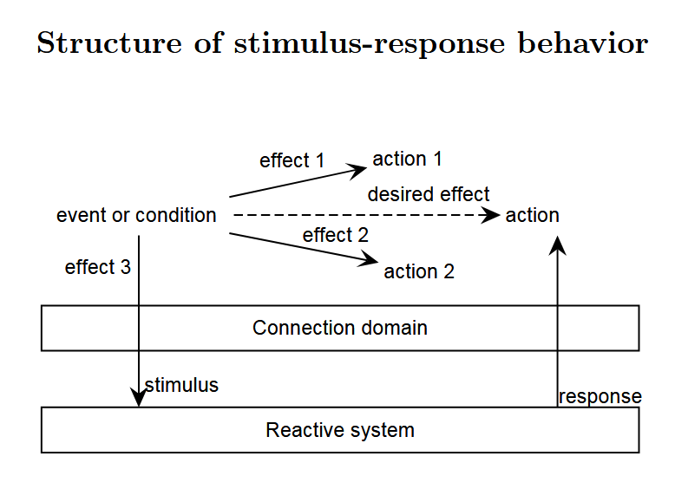

Slide 16
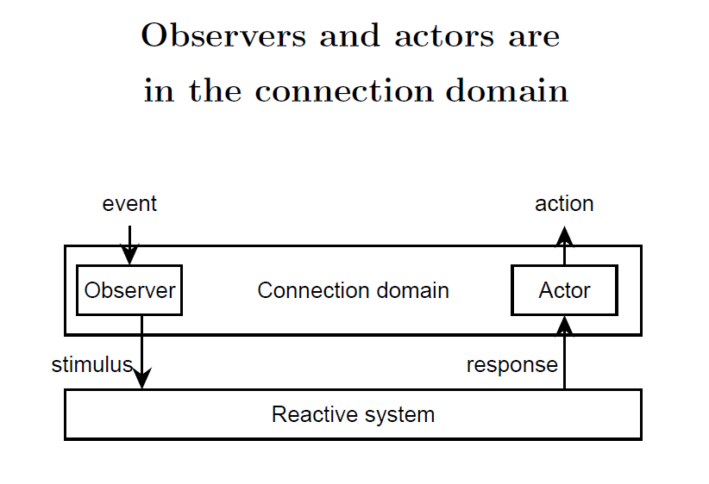

Slide 17
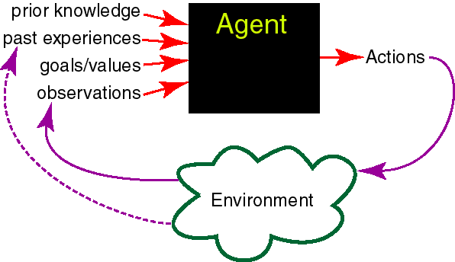
Intelligent Agents in the World
Knowledge Representation
Machine Learning
abilities
Reasoning +
Decision Theory
Natural Language
Generation
+
Robotics
Human Computer
/Robot
Interaction
Natural Language
Understanding
+
Computer Vision
Speech Recognition
+
Physiological Sensing
Mining of Interaction Logs

Slide 18

Research methodology accross the disciplines
• Do these disciplines have the same methodology?
– Technical science? Build cool stuff; test it; iterate
– Social science? Observe people, interpret what they do or say; or select a sample, do a lot of statistics; iterate.
– Physical science? Build instruments, create phenomena, analyze data, create theories; iterate.
– Mathematics? Read, think, write, think; iterate.
© R.J. Wieringa

Slide 19

Wieringa’s Approach on Design Science
• All research in all disciplines is problem‐solving
Design science is the design and investigation of artifacts in context
• The problems in design science research are design problems
– Goal is to design something useful
– Research method is the design cycle
• The problems in empirical research are knowledge questions
– Goal is to acquire theoretical knowledge
– Research method is the empirical cycle
• Wieringa, R.J. (2014) Design science methodology for information
systems and software engineering. Springer Verlag

Slide 20
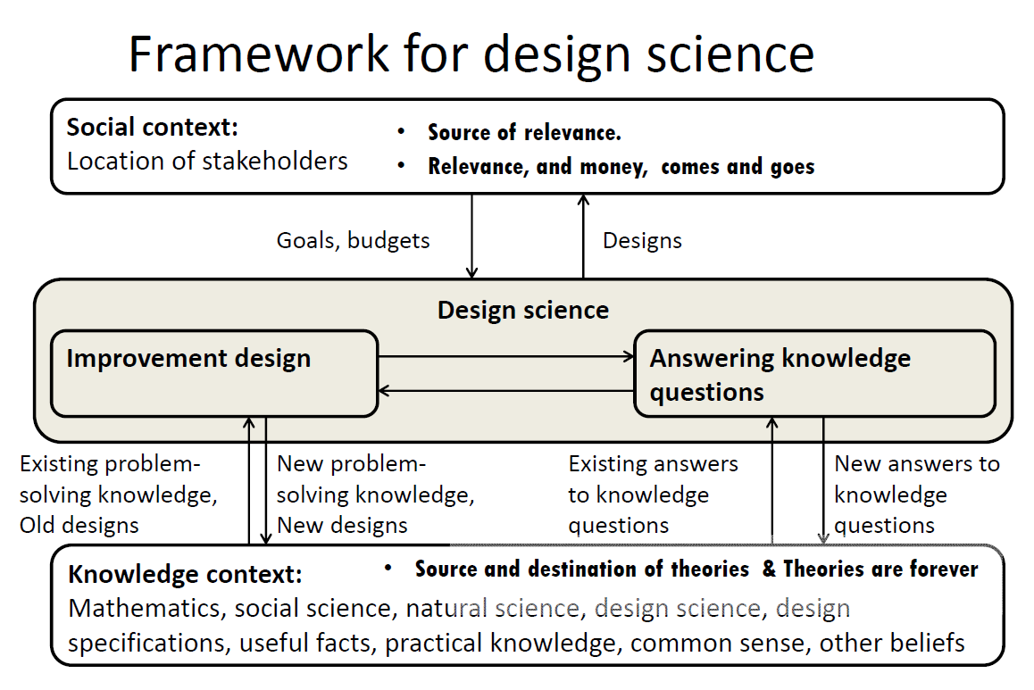
© R.J. Wieringa

Slide 21
Example: ATM Machine
Understanding the money-machine problem:

Slide 22
Problem-solving Strategy
Divide-and-conquer:
Identify logical parts of the system that each solves a part of the problem
Easiest done with the help of a domain expert who already knows the steps in the process (“how it is currently done”)
Result: A Model of the Problem Domain (or “domain model”)

Slide 23
How ATM Machine Might Work
Domain model created with help of domain expert

Slide 24
Cartoon Strip: How ATM Machine Works

Slide 25
Software Engineering Blueprints
Specifying software problems and solutions is like cartoon strip writing
Unfortunately, most of us are not artists, so we will use something less exciting: UML symbols
However …

Slide 26
Second Law of Software Engineering
Software should be written for people first
( Computers run software, but hardware quickly becomes outdated )
Useful + good software lives long
To nurture software, people must be able to understand it

Slide 27
Software Development Methods
Method = work strategy
The Feynman Problem-Solving Algorithm: (i) Write down the problem (ii) think very hard, and (iii) write down the answer.
Waterfall
Unidirectional, finish this step before moving to the next
Iterative + Incremental
Develop increment of functionality, repeat in a feedback loop
Agile
User feedback essential; feedback loops on several levels of granularity

Slide 28
Waterfall Method
Unidirectional, no way back finish this step before moving to the next

Slide 29
UML – Language of Symbols
UML = Unified Modeling Language
Online information:
http://www.uml.org

Slide 30
Understanding the Problem Domain
System to be developed
Actors
Agents external to the system
Concepts/ Objects
Agents working inside the system
Use Cases
Scenarios for using the system

Slide 31
How Much Diagramming?
Use informal, ad-hoc, hand-drawn, scruffy diagrams during early stages and within the development team
Hand-drawing forces economizing and leads to low emotional investment
Economizing focuses on the essential, most important considerations
Prioritize substance over the form
Not being invested facilitates critique and suggested modifications
Always take snapshot to preserve records for future
Use standardized, neat, computer-generated diagrams when consensus reached and designs have “stabilized”
Standards like UML facilitate communication with broad range of stakeholders
But, invest effort to make neat and polished diagrams only when there is an agreement about the design, so this effort is worth doing
Invest in the form, only when the substance is worth such an investment

Slide 32
ATM: Gallery of Players
Actors
(Easy to identify because they are visible!)

Slide 33
Gallery of Workers + Things
Concepts
(Hard to identify because they are invisible/imaginary!)

Slide 34
Use Case: Withdraw Cash

Slide 35
How ATM Machine Works (2)
Domain Model (2)
Alternative solution

Slide 36
How ATM Machine Works (3)
Domain Model (3)
Alternative solution
Which solution is the best or even feasible?

Slide 37
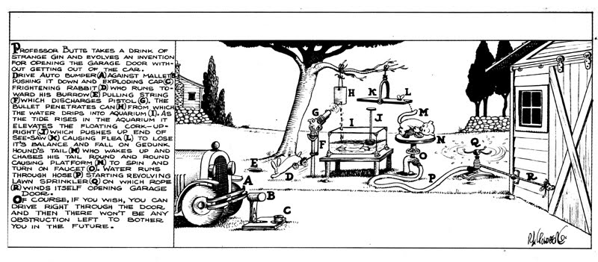
Rube Goldberg Design
Garage door opener

Slide 38
Actual Design

Slide 39
Feasibility & Quality of Designs
Judging feasibility or quality of a design requires great deal of domain knowledge (and commonsense knowledge!)

Slide 40
Software Measurement
What to measure?
Project (developer’s work), for budgeting and scheduling
Product, for quality assessment

Slide 41
Formal hedge pruning

Slide 42
Sizing the Problem (1)
Step 1: Divide the problem into small & similar parts
Step 2:
Estimate relative sizes of all parts
Size(  ) = 4
Size(  ) = 7
Size(  ) = 10
Size(  ) = 3
Size(  ) = 4
Size( □ ) = 2
Size(  ) = 4
Size(  ) = 7

Slide 43
Sizing the Problem (2)
Step 3: Estimate the size of the total work
Total size = Σ points-for-section i (i = 1..N)
Step 4: Estimate speed of work (velocity)
Step 5: Estimate the work duration
Travel duration =
Path size
Travel velocity

Slide 44
Sizing the Problem (3)
Advantages:
Velocity estimate may need to be adjusted (based on observed progress)
However, the total duration can be computed quickly (provided that the relative size estimates of parts are accurate – easier to achieve if the parts are small and similar-size)

Slide 45
Exponential Cost of Estimation
100%
Estimation accuracy
Estimation cost
Improving accuracy of estimation beyond a certain point requires huge cost and effort (known as the law of diminishing returns)
In the beginning of the curve, a modest effort investment yields huge gains in accuracy

Slide 46
Estimation Error Over Time
Estimation
error
Waterfall Method
Requirements
Design
Implementation
Start
Completion
Time
Waterfall method cone of uncertainty starts high and gradually converges to zero as the project approaches completion.
Notes:
Barry Boehm, Software Engineering Economics, Prentice-Hall, 1991.

Slide 47
Estimation Error Over Time
Agile method cone of uncertainty starts high and in leaps converges to zero as the project approaches completion.

Slide 48
Agile Project Effort Estimation

Slide 49
Measuring Quality of Work

Slide 50
Concept Maps
Useful tool for problem domain description
SENTENCE: “My friend is coding a new program”
translated into propositions
Proposition | Concept | Relation | Concept
1. | I | have | friend
2. | friend | engages in | coding
3. | coding | constructs a | program
4. | program | is | new
Search the Web for Concept Maps

Slide 51
Estimation Error Over Time
Estimation
error
Requirements
Design
Implementation
Start
Completion
Time
The cone of uncertainty starts high and narrows down to zero as the project approaches completion.
Notes:
Barry Boehm, Software Engineering Economics, Prentice-Hall, 1991.

Slide 52
Agile Project Effort Estimation

Slide 53
Measuring Quality of Work

Slide 54
Concept Maps
Useful tool for problem domain description
SENTENCE: “My friend is coding a new program”
translated into propositions
Proposition | Concept | Relation | Concept
1. | I | have | friend
2. | friend | engages in | coding
3. | coding | constructs a | program
4. | program | is | new
Search the Web for Concept Maps

Slide 55
Case Study: Home Access Control
Objective: Design an electronic system for:
Home access control
Locks and lighting operation
Intrusion detection and warning

Slide 56
Case Study – More Details

Slide 57
Know Your Problem
Mortise Lock Parts

Slide 58
Concept Map for Home Access Control

Slide 59
States and Transition Rules
IF validKey AND holdOpenInterval THEN unlock
IF validKey THEN unlock
locked
unlocked
IF pushLockButton THEN lock
IF timeAfterUnlock ≥ max{ autoLockInterval, holdOpenInterval } THEN lock
… what seemed a simple problem, now is becoming complex

