Slide 1
Intro to Software Engineering
Elements and Qualities

Slide 2
Exercise 01: Review & Preview (in 2 weeks)
Read 1.1-1.2 and preview 1.3-1.4 of TextBook.
Read ch1 of “Beginning Software Engineering”
Read “Essence of Software Engineering”
Preview ch1 of “Design Science Methodology for IS & SE”
Preview ch1 of “A Philosophy of Software Design”
Send an email in a week to c.max@yeah.net with a subject like:
SE-nnnn-Adam: Register for SE Course,
simply describe your experience on SE and your expectation for the course.

Slide 3
What is Software Engineering? (SE, SWE)
SEers use a disciplined approach to the development of software-driven systems
SE ! = Programming; SE is a relatively new field of study that applies to all types of systems that are developed as usable products
There are many different jobs that SEers do
Software Engineering is a challenging career because of the inherent problems of software - as well as the rate of change in computing technologies, and the ever broadening range of applications

Slide 4
Sustainability for Software
This distinction is at the core of what we call sustainability for software.
Your project is sustainable if, for the expected life span of your software, you are capable of reacting to whatever valuable change comes along, for either technical or business reasons.
Importantly, we are looking only for capability—you might choose not to perform a given upgrade, either for lack of value or other priorities.
When you are fundamentally incapable of reacting to a change in underlying technology or product direction, you’re placing a high-risk bet on the hope that such a change never becomes critical.
For short-term projects, that might be a safe bet. Over multiple decades, it probably isn’t.

Slide 5
Multi-person development of multi-version programs
Another way to look at software engineering is to consider scale. How many people are involved? What part do they play in the development and maintenance over time?
A programming task is often an act of individual creation, but a software engineering task is a team effort.
An early attempt to define software engineering produced a good definition for this viewpoint: “The multi-person development of multi-version programs.”
This suggests the difference between software engineering and programming is one of both time and people.
Team collaboration presents new problems, but also provides more potential to produce valuable systems than any single programmer could.

Slide 6
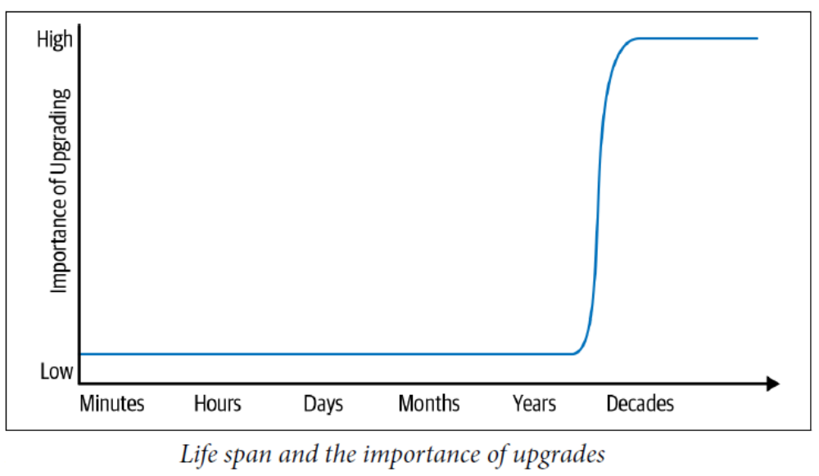
Compiler(Tools) Upgrade?

Slide 7
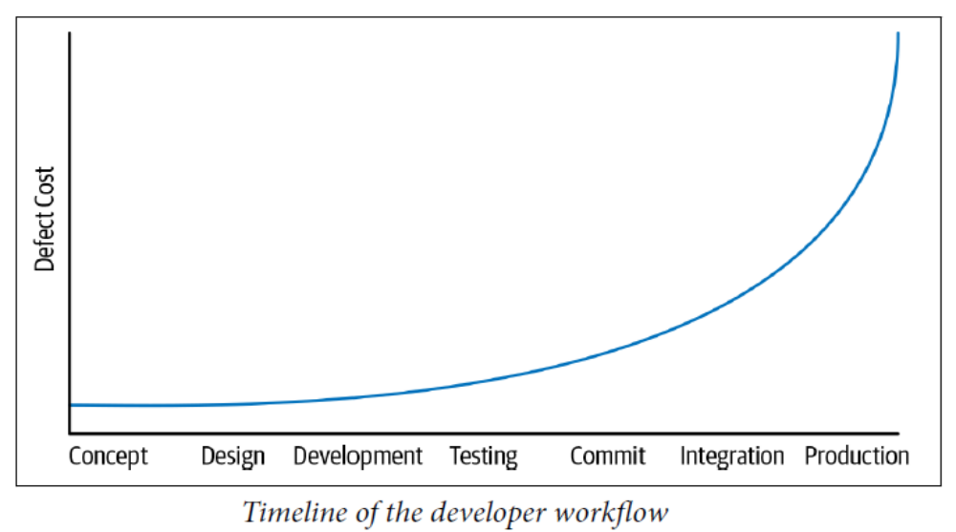
Shifting Left

Slide 8
Software engineering
Software engineering is an engineering discipline that is concerned with all aspects of software production from the early stages of system specification through to maintaining the system after it has gone into use.
Engineering discipline
  Using appropriate theories and methods to solve problems bearing in mind organizational and financial constraints.
All aspects of software production
  Not just technical process of development. Also project management and the development of tools, methods etc. to support software production.

Slide 9
Importance of software engineering
More and more, individuals and society rely on advanced software systems. We need to be able to produce reliable and trustworthy systems economically and quickly.
It is usually cheaper, in the long run, to use software engineering methods and techniques for software systems rather than just write the programs as if it was a personal programming project. For most types of system, the majority of costs are the costs of changing the software after it has gone into use.

Slide 10
4 Technical Aspects of Software
Software specification (规格描述), where customers and engineers define the software that is to be produced and the constraints on its operation.
Software development (开发), where the software is designed and programmed.
Software validation (验证), where the software is checked to ensure that it is what the customer requires. (narrowly also call Software verification)
Software evolution (演化) , where the software is modified to reflect changing customer and market requirements.
(+ Project Management – minor topic in this course)

Slide 11
Software is Complex
Different from traditional types of products:
malleable
    Intangible -- difficult to describe and evaluate
abstract
solves complex problems
interacts with other software and hardware
human intensive -- involves only trivial “manufacturing” process
consequently, often software is buggy

Slide 12
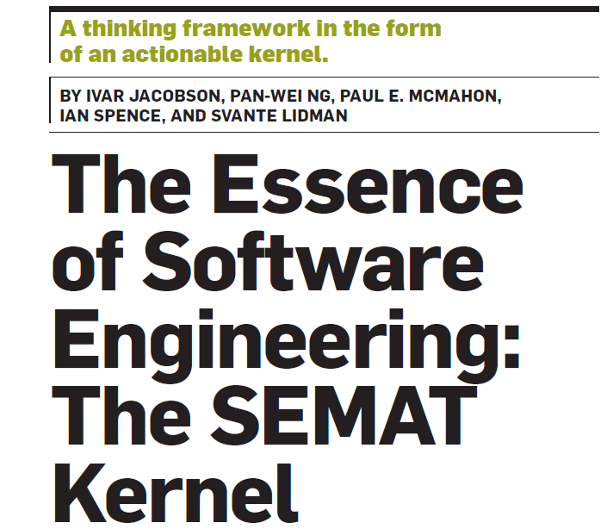

Slide 13
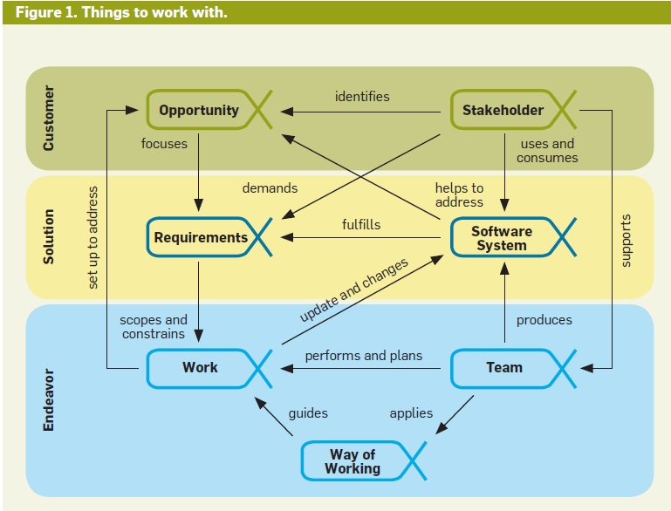

Slide 14
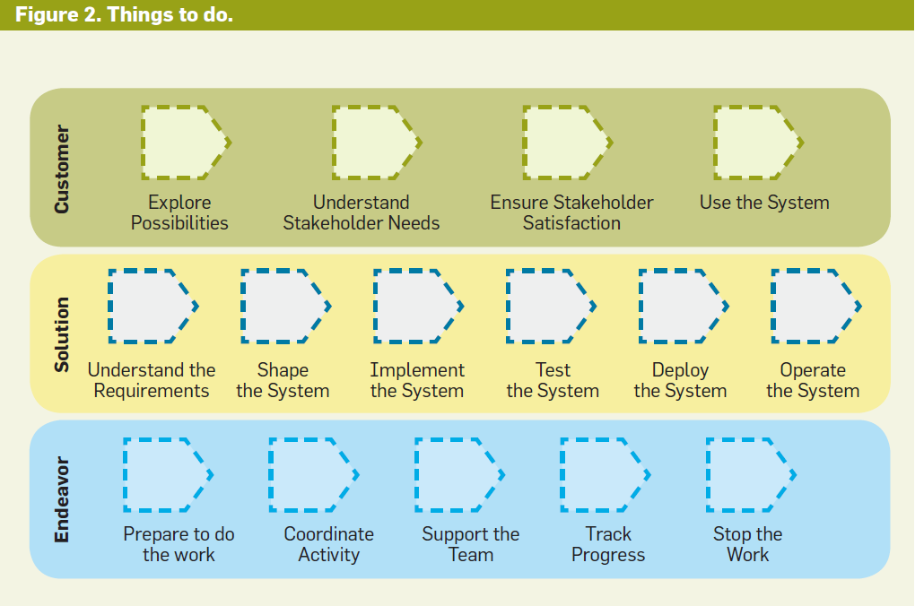

Slide 15
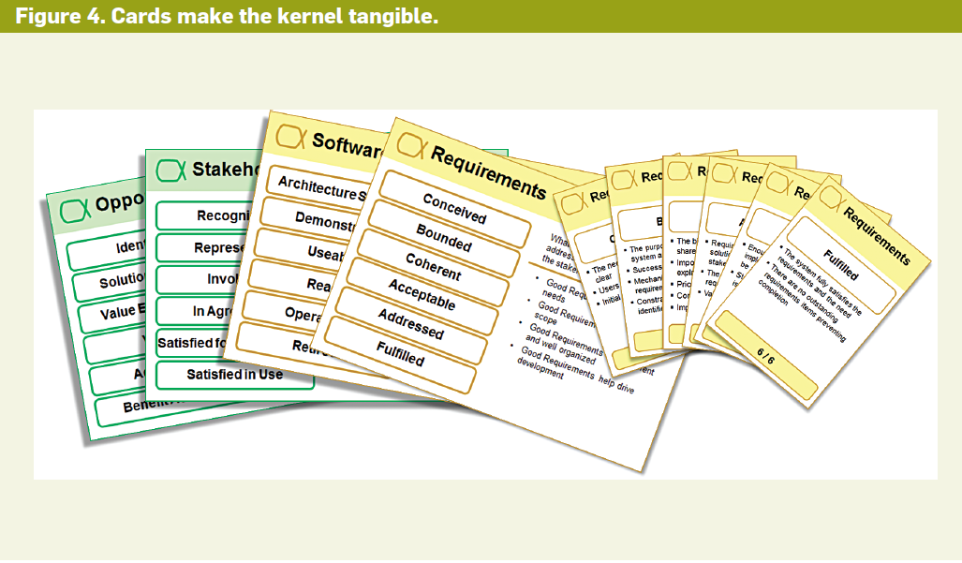

Slide 16
Key Points on Software
Software engineering (SE) is an intellectual activity and thus human-intensive
Software is built to meet a certain functional goal and satisfy certain qualities
Software processes also must meet certain qualities
Software qualities are sometimes referred to as “ilities”

Slide 17
Classification of sw qualities : "ilities"
Internal vs. external
  External→ visible to users
  Internal→ concern developers
Product vs. process
  Our goal is to develop software products
  The process is how we do it
Internal qualities affect external qualities
Process quality affects product quality

Slide 18
Correctness (正确性)
Software is correct if it satisfies the functional requirements specifications
  assuming that specification exists!
If specifications are formal, since programs are formal objects, correctness can be defined formally
  It can be proven as a theorem or disproved by counterexamples (testing)

Slide 19
The limits of correctness
It is an absolute (yes/no) quality
  there is no concept of “degree of correctness”
  there is no concept of severity of deviation
What if specifications are wrong?
  (e.g., they derive from incorrect requirements or errors in domain knowledge)

Slide 20
Reliability (可靠性)
Reliability
  informally, user can rely on it
  can be defined mathematically as “probability of absence of failures for a certain time period”
  if specs are correct, all correct software is reliable, but not vice-versa (in practice, however, specs can be incorrect …)

Slide 21
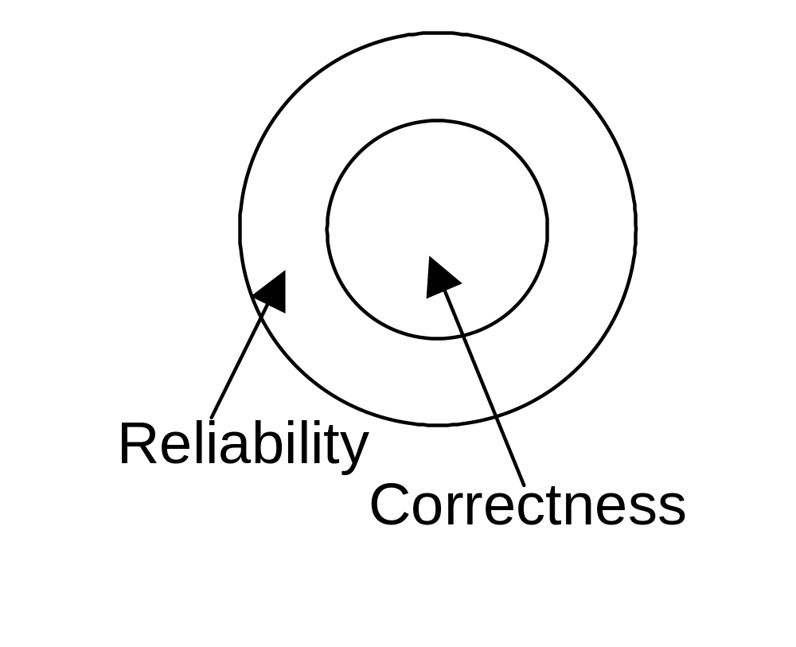
Idealized situation
Requirements are correct

Slide 22
Robustness (稳健性，鲁棒性)
Robustness
  software behaves “reasonably” even in unforeseen circumstances (e.g., incorrect input, hardware failure)

Slide 23
Performance (性能，效率)
Efficient use of resources
  memory, processing time, communication
Can be verified
    complexity analysis
    performance evaluation (on a model, via simulation)
Performance can affect scalability
    a solution that works on a small local network may not work on a large intranet

Slide 24
Usability (可用性)
Expected users find the system easy to use
Other term: user-friendliness
Rather subjective, difficult to evaluate
Affected mostly by user interface
  e.g., visual vs. textual
Better expression: Usage centric

Slide 25
Verifiability (可验证性)
How easy it is to verify properties
  mostly an internal quality
  can be external as well (e.g., security critical application)

Slide 26
Maintainability (可维护性)
Maintainability: ease of maintenance
Maintenance: changes after release
Maintenance costs exceed 60% of total cost of software
Three main categories of maintenance
  corrective: removing residual errors (20%)
  adaptive: adjusting to environment changes (20%)
  perfective: quality improvements (>50%)

Slide 27
Maintainability
Can be decomposed as
  Repairability
    ability to correct defects in reasonable time
  Evolvability
    ability to adapt sw to environment changes and to improve it in reasonable time

Slide 28
Reusability (重用性，复用性)
Existing product (or components) used (with minor modifications) to build another product
  (Similar to evolvability)
Also applies to process
Reuse of standard parts measure of maturity of the field

Slide 29
Portability (可移植性)
Software can run on different hw platforms or sw environments
Remains relevant as new platforms and environments are introduced (e.g. digital assistants)
Relevant when downloading software in a heterogeneous network environment

Slide 30
Understandability (可理解性)
Ease of understanding software
Program modification requires program understanding

Slide 31
Interoperability (互操作性)
Ability of a system to coexist and cooperate with other systems
  e.g., word processor and spreadsheet

Slide 32
Criteria for Good Programs (Software)
Run Effectively (Correctly) & Efficiently (Objectives 目的)
Easy to be Extended and Modified (Approaches 手段)
Easy to be Understood (Pre-conditions 前提)

Slide 33
Typical process qualities
Productivity
  denotes its efficiency and performance
Timeliness
  ability to deliver a product on time
Visibility
  all of its steps and current status are documented clearly

Slide 34
Timeliness: issues
Often the development process does not follow the evolution of user requirements
A mismatch occurs between user requirements and status of the product

Slide 35
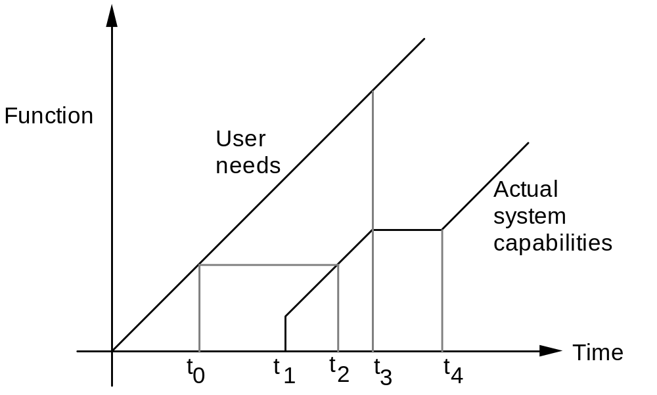
Timeliness: a visual description of the mismatch

Slide 36
Application-specific qualities
E.g., information systems
  Data integrity
  Security
  Data availability
  Transaction performance.

Slide 37
Quality measurement
Many qualities are subjective
No standard metrics defined for most qualities

