Slide 1

Designing Informing systems: What Research Tells Us
Alan R. Hevner
University of South Florida
ahevner@usf.edu
Revised by Max HE with Thanks

Slide 2
Outline
Designing Informing Systems
Design Science Research (DSR)
Concepts, Models, and Guidelines
Three Cycles of Design Activities
Positioning and Presenting DSR
The Knowledge Contribution Matrix
A Fitness/Utility Model of DSR

Slide 3
Informing Systems
Design Science is a creative research paradigm that informs multiple audiences:
Researchers: Design principles and mid-range design theories
Practitioners: Artifact (product and process) instantiations
Managers: Work and application system controls
Government: Economic and social welfare

Slide 4
Design Science Research
Sciences of the Artificial, 3rd Ed. – Simon 1996
A Problem Solving Paradigm
The Creation of Innovative Artifacts to Solve Real Problems
Design in Other Fields – Long Histories
Engineering, Architecture, Art
Role of Creativity in Design
DSR in Information Systems
A. Hevner, S. March, J. Park, and S. Ram, “Design Science Research in Information Systems,” Management Information Systems Quarterly, Vol. 28, No. 1, March 2004, pp. 75-105.
S. Gregor and D. Jones, “The Anatomy of a Design Theory,” Journal of the Association of Information Systems, (8:5), 2007, pp. 312-335.

Slide 5
Research in Information Systems
Information Systems (IS) are complex, artificial, and purposefully designed.
IS are composed of people, structures, technologies, and work systems.
Two Basic IS Research Paradigms
Behavioral Research – Goal is Truth
Design Research – Goal is Utility (and Truth!)

Slide 6
IS Research Cycle

Slide 7
Design Thinking
Design is an Artifact (Noun)
Constructs
Models
Methods
Instantiations
Design is a Process (Verb)
Build
Evaluate
Design is a Wicked Problem
Unstable Requirements and Constraints
Complex Interactions among Subcomponents of Problem and resulting Subcomponents of Solution
Inherent Flexibility to Change Artifacts and Processes
Dependence on Human Cognitive Abilities - Creativity
Dependence on Human Social Abilities - Teamwork

Slide 8
Environment
Relevance
IS Research
Rigor
Knowledge Base
People
Roles
Capabilities
Characteristics
Experience
Organizations
Strategies
Structure
Culture
Processes
Technology
Infrastructure
Applications
Communications Architecture
Development Capabilities
Foundations
Theories
Frameworks
Experimental Instruments
Constructs
Models
Methods
Instantiations
Methodologies
Experimentation
Data Analysis Techniques
Formalisms
Measures
Validation Criteria
Optimization
Develop / Build
Theories
Artifacts
Business Needs
Applicable Knowledge
Assess
Refine
Justify / Evaluate
Analytical
Case Study
Experimental
Field Study
Simulation
Application in
the Appropriate Environment
Additions to
the Knowledge Base

Slide 9
Design Research Guidelines
Guideline | Description
Guideline 1: Design as an Artifact | Design-science research must produce a viable artifact in the form of a construct, a model, a method, or an instantiation.
Guideline 2: Problem Relevance | The objective of design-science research is to develop technology-based solutions to important and relevant business problems.
Guideline 3: Design Evaluation | The utility, quality, and efficacy of a design artifact must be rigorously demonstrated via well-executed evaluation methods.
Guideline 4: Research Contributions | Effective design-science research must provide clear and verifiable contributions in the areas of the design artifact, design foundations, and/or design methodologies.
Guideline 5: Research Rigor | Design-science research relies upon the application of rigorous methods in both the construction and evaluation of the design artifact.
Guideline 6: Design as a Search Process | The search for an effective artifact requires utilizing available means to reach desired ends while satisfying laws in the problem environment.
Guideline 7: Communication of Research | Design-science research must be presented effectively both to technology-oriented as well as management-oriented audiences.

Slide 10
Three Cycles of DSR
Ref: A. Hevner, “A Three Cycle View of Design Science Research,” Scandinavian Journal of Information Systems, Vol. 19, No. 2, 2007, pp. 87-92.
Environment
Design Science
Knowledge Base
Application Domain
People
Organizational Systems
Technical Systems
Problems & Opportunities
Foundations
Scientific Theories & Methods
Build Design Artifacts & Processes
Experience & Expertise
Relevance Cycle
Requirements
Field Testing
Rigor Cycle
Grounding
Additions to KB
Design Cycle
Evaluate
Meta-Artifacts (Design Products & Design Processes)

Slide 11
The Relevance Cycle
The Application Domain initiates Design Research with:
Research requirements (e.g., opportunity, problem, potentiality)
Acceptance criteria for evaluation of design artifact in application domain
Field Testing of Research Results
Does the design artifact improve the environment?
How is the improvement measured?
Field testing methods might include Action Research or Controlled Experiments in actual environments.
Iterate Relevance Cycle as needed
Artifact has deficiencies in behaviors or qualities
Restatement of research requirements
Feedback into research from field testing evaluation

Slide 12
The Rigor Cycle
Design Research Knowledge Base
Design Theories
Engineering Methods
Experiences and Expertise
Existing Design Artifacts and Processes
Research Rigor is predicated on the researcher’s skilled selection and application of appropriate theories and methods for constructing and evaluating the artifact.
Additions to the Knowledge Base:
Extensions to theories and methods
New experiences and expertise
New artifacts and design processes

Slide 13
Design Cycle
Rapid iteration of Build and Evaluate activities
The hard work of design research (1% inspiration and 99% perspiration - Edison)
Build – Create and Refine artifact design as both product (noun) and process (verb)
Evaluation – Rigorous, scientific study of artifact in laboratory or controlled environment
Continue Design Cycle until:
Artifact ready for field test in Application Environment
New knowledge appropriate for inclusion in Knowledge Base

Slide 14
Useful Knowledge
Ω – Descriptive Knowledge
Λ – Prescriptive Knowledge
Artifacts
Constructs
Concepts
Symbols
Models
Representation
Semantics/Syntax
Methods
Algorithms
Techniques
Instantiations
Systems
Products/Processes
Design Theory
Phenomena (Natural, Artificial, Human)
Observations
Classification
Measurement
Cataloging
Sense-making
Natural Laws
Regularities
Principles
Patterns
Theories

Slide 15
The Artifact as Knowledge
 | Contribution type | Examples
More abstract, complete, and mature knowledge ↕ ↕ ↕ ↕ More specific, limited, and less mature knowledge | Level 3. Well-developed design theory about embedded phenomena | Design theories (mid-range and grand theories)
 | Level 2. Nascent design theory – knowledge as operational principles/architecture | Constructs, methods, models, design principles, technological rules.
 | Level 1. Situated implementation of artifact | Instantiations (software products or implemented methods)

Slide 16
Design Theory as Knowledge
Theory – set of statements of relationships among constructs that aims to describe, explain, enhance understanding, and, in some cases, allow predictions about the future (Gregor 2006)
Design Theory (Gregor and Jones 2007) – prescriptions for design and action
Behaviors of individual artifacts (Level 1) lead to empirical generalizations or technical rules
Extending the boundaries of abstract design artifacts (Level 2) grows nascent design theory
Middle-range design theory (Level 3) – understanding expands to partial theory (Goal of theory in applied fields – Merton 1968)
Grand design theory – transitions to descriptive theory

Slide 17
The DSR Process
Application Environment
Human Capabilities
Ω Knowledge
Knowledge Sources
Cognitive
Creativity
Reasoning
Analysis
Synthesis
Social
Teamwork
Collective Intelligence
- Research Opportunities and Problems
- Research Questions
Contribution to Ω Knowledge
Informing Ω Knowledge
Constructs
Models
Methods
Instantiations
Design Theory
Λ Knowledge

Slide 18
Knowledge Growth in DSR Cycles
Design Cycle 1
Design Cycle 2
Design Cycle n
Ω₁ Knowledge
Ω₂ Knowledge
Ω_{n} Knowledge
… …
… …
Λ₁ Knowledge
Λ₂ Knowledge
Λ_{n} Knowledge

Slide 19
DSR Knowledge Contribution Framework
A Guideline for Positioning DSR with respect to Knowledge Contribution
Two dimensions:
Maturity of Application Domain (Opportunities/ Problems)
Maturity of Solutions (Existing Artifacts)
Difficulties:
Subjectivity – where to draw the lines
Everything builds on something else, nothing entirely new

Slide 20
Improvement: Develop new solutions for known problems Research Opportunity
Invention: Invent new solutions for new problems Research Opportunity
Low
Solution Maturity
Routine Design: Apply known solutions to known problems
Exaptation: Extend known solutions to new problems (e.g. Adopt solutions from other fields) Research Opportunity
High
High
Low
Application Domain (Problem) Maturity

Slide 21
Invention Quadrant
An invention is a radical breakthrough; a departure from accepted ways of thinking and doing
DSR projects in which little understanding of the problem context exists and no effective artifacts are available as solutions
Research contributions are novel artifacts or inventions
Level 1 artifacts
The newness of artifact makes this research difficult to publish
Insufficiently grounded in theory
Design is incomplete and not fully evaluated
Understanding is insufficient to provide new contribution to theory via the design

Slide 22
Invention Exemplars
Agrawal, R., Imielinski, T. and Swami, A. (1993). “Mining Association Rules between Sets of Items in Large Databases”, Proceedings of the 1993 ACM SIGMOD Conference, Washington DC, May.
Aim: produce an algorithm that generates all significant association rules between items in the database
Practical importance: Allows organizations to find interesting relationships (e.g. shopping patterns)
Theoretical significance (newness): Shows (Sect 5) that no other work has done same thing
Description of new method: Shows requirements (Sect 1), new concepts (association rule, support, confidence), Formal Model (pseudocode) (Sects 2-3)
Proof: Experiments (Sect 4)
Scott-Morton (1967) – Decision Support Systems

Slide 23
Improvement Quadrant
An improvement is a better artifact solution in the form of more efficient and effective products, processes, services, technologies, or ideas
DSR projects in which the problem context is mature but there is a great need for more effective artifacts as solutions
Improvement DSR is judged by:
Clearly grounding, representing, and communicating the new artifact design
Convincing evaluation providing evidence of improvements over current solutions
All levels of artifact knowledge contribution can be made

Slide 24
Improvement Exemplars
Many DSR projects in IS are in the Improvement Quadrant, for example:
Better data mining algorithms for knowledge discovery (extending the initial ideas invented by Agrawal et al. (1993)); for example, (Fayyad et al. 1996; Zhang et al. 2004; Witten et al. 2011)
Improved recommendation systems for use in e-commerce; for example (Herlocker et al. 2004; Adomavicius and Tuzhilin 2005)
Better technologies and use strategies for saving energy in IT applications; for example (Donnellan et al. 2011; Watson and Boudreau 2011)
Improved routing algorithms for business supply chains; for example (van der Aalst and Hee 2004; Liu et al. 2005)

Slide 25
Exaptation Quadrant
An exaptation is the expropriation of an artifact in one field to solve problems in another field
DSR projects in which the problem context is not well understood but there exist mature artifacts in other fields that can be exapted as effective solutions
Exaptation DSR is judged by:
Clearly grounding, representing, and communicating the exapted artifact design
Convincing evaluation providing evidence of how well the new artifact solves the given problem
All levels of artifact knowledge contribution can be made

Slide 26
Exaptation Exemplars
Exaptation DSR is employed when new technologies provide opportunities to solve new and/or different IS problems; for example:
Codd’s exaptation of relational mathematics to the problem of database systems design leading to relational database concepts, models, methods, and instantiations (Codd, 1970; Codd, 1982)
Berners-Lee original concept of the World Wide Web was one of simply sharing research documents in a hypertext form among multiple computers. In short time, however, many individuals saw the potential of this rapidly expanding interconnection environment to exapt applications from old platforms to the WWW platforms. These new Internet applications were very different from previous versions adding many new artifacts to Λ knowledge
Research by Berndt et al. (2003) on the CATCH data warehouse for health care information. Well-known methods of data warehouse development (e.g. Inmon, 1992) were exapted to new and interesting areas of health care systems and decision-making applications

Slide 27
Routine Design Quadrant
Professional design or system building to be distinguished from DSR
However, evolving or best practices may be observed and documented in “extractive case study” work (Van Aken)
Study of best practices in routine design may lead to empirical generalization
Example – Davenport’s observation of BPR (Davenport & Short SMR 1990)

Slide 28
A Fitness-Utility Model for DSR
Rethinking the Dependent Variable in DSR
How can we make the results of DSR (e.g., artifacts, design theories) more sustainable ?
T.G. Gill and A. Hevner, “A Fitness-Utility Model for Design Science Research,” ACM Transactions on Management Information Systems, 2013.
DESRIST 2011 Herbert Simon Best Paper Award

Slide 29
The DSR Dependent Variable
Usefulness
Aligns with current MIS research paradigms
Well understood in academia and practice
Measurable with current instruments
Why look elsewhere?
Extend the search for DSR dependent variables
Explore ‘goodness’ ideas from other fields
Design Fitness (Biology)
Design Utility (Economics)
Goal is to complement and extend current DSR thinking

Slide 30
Design Fitness Landscape
In evolutionary biology, the term fitness landscape is used to describe a functional mapping between some abstract representation of an entity—such as a listing of attributes and traits or, even, as a DNA sequence—and its associated fitness that captures the entity’s ability to survive, reproduce, and evolve from generation to generation.
This concept can be generalized to design situations, whereby a design is represented as a collection of traits and its fitness represents the likelihood that all or some pieces of the design (which we informally refer to as design DNA) will continue to exist and evolve from generation to generation.

Slide 31
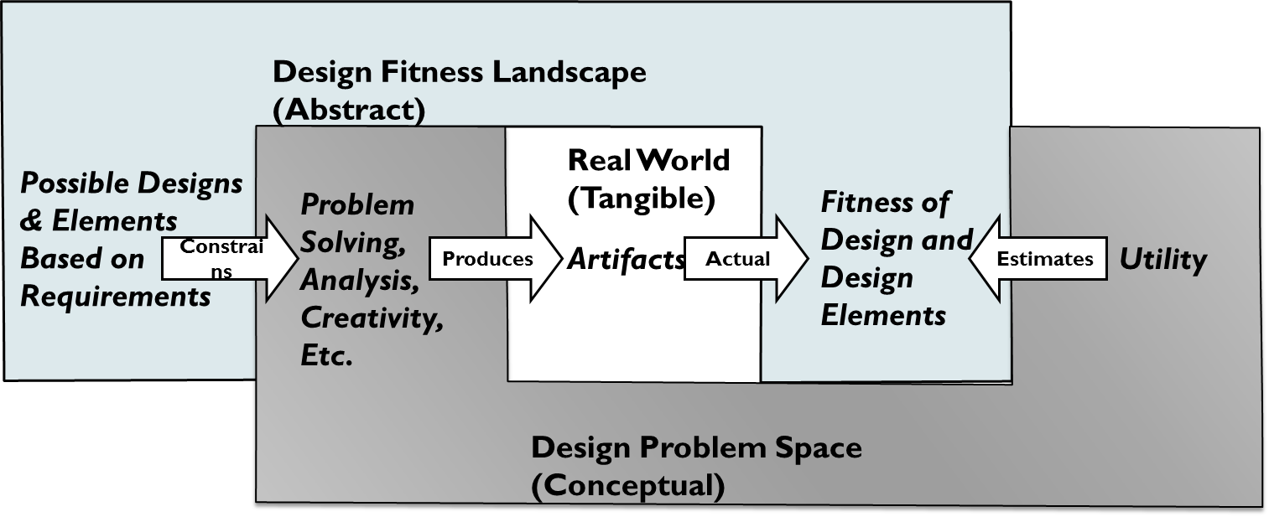
Design Process Elements

Slide 32
Design Fitness
Definition 1 – The fitness of an organism describes its ability to survive as a high level of capacity over time.
Definition 2 – The fitness of an organism describes its ability to replicate and evolve over successive generations.
Two definitions are not correlated
Empirical data refutes Malthus’ proposition
Focus on Design Fitness as Definition 2

Slide 33
Design Utility
IS Artifact Utility typically means Usefulness
Efficacy to perform task
Ease of Use, Ease of Learning
Cost-Benefit vis-à-vis other artifacts
Economic Utility involves a complex Utility Function used to rank alternatives in order to Maximize Utility
Utility = u(x1, x2, …, xN)
Utility Characteristics
Income and consumption
Expectations and goals
Social context
Utility Function will vary for different application contexts

Slide 34
Evolutionary Economics
Essentially, the human utility function is tuned to maximize evolutionary fitness on a fitness landscape
Higher fitness humans will crowd out lower fitness humans over time
Since fitness landscapes change over time, Evolutionary Stable Strategies (ESS) encourage traits that promote diversity and adaptation
While Human Evolution is slow, ICT Evolution is rapid, made more so by good DSR
What is a good design utility function to apply to a complex and evolving ICT fitness landscape?

Slide 35
Fitness-Utility Model applied to DSR
A design artifact has an associated fitness that designers estimate via design utility functions
Artifacts perform two roles in the design search process:
They provide evidence that a particular design candidate is feasible, has value, can be effectively represented, and can be built. This serves to help us better estimate the shape of the design fitness landscape
They provide a mechanism for communication between designers and for retaining information that might be imperfectly stored during the design process
Intentionality – Creative guidance that differentiates ICT design/evolution from human evolution
Search on the design space changes the design space by modifying the utility function of design fitness

Slide 36
Re-Framing DSR with Fitness-Utility
The goal of DSR is to impact the design space so as to ensure a continuous flow of high fitness design artifacts. This impact is accomplished in two ways: through the production of artifacts that demonstrate the feasibility of new designs and through improving the utility function that we use to assess the fitness of evaluation artifacts.

Slide 37
DSR Evaluation with Fitness-Utility
As opposed to just Usefulness, the evaluation would be based on a more extensive and detailed utility function that estimates the evolutionary fitness of the artifact
Utility Function Attributes:
Support the design’s ability to evolve incrementally;
Encourage experimentation by users and other designers; and
Are effective memes, meaning that they contain ideas of a form that propagate and replicate.

Slide 38
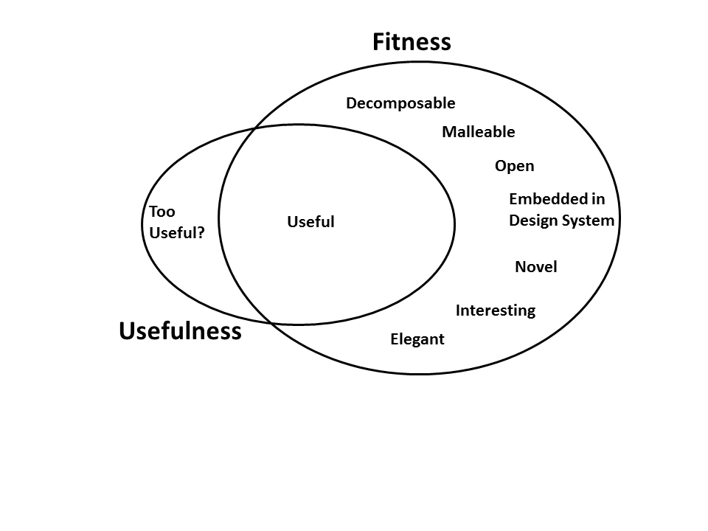
Fitness Characteristics
Questions:
How to measure the fitness characteristics?
How to select appropriate characteristics for application environment?
How to combine and weigh characteristics in utility function?
How to evolve utility function as environment changes?

Slide 39
Designs That are Too Useful?
Situations where a design artifact becomes so useful that it inhibits future design activity
The tendency of organizations to stick with designs that have proven useful is a well-documented phenomenon known as the Innovator’s Dilemma (Christensen, 1997)
Disk Drives
Printers
Mini-computers

Slide 40
Decomposable Designs
Systems evolve from nearly decomposable subsystems (Simon, 1996)
Decomposability supports:
Independence of modules
Information hiding
Maintenance and evolution of modules separately from whole system
Robustness
Exemplar – Open Source Software

Slide 41
Malleable Designs
The malleability of an artifact represents the degree to which it can be adapted by its users and respond to changing use/market environments
Types of malleability
Customization
Exaptation
Integration
Extension

Slide 42
Open Designs
Openness is the degree to which artifacts are open to inspection, modification, and reuse
Open designs—particularly when also imbued with decomposability and malleability—encourage further design evolution by making it easier both to see how an artifact is constructed and to modify existing components of the artifact
Exemplar – UNIX vs. LINUX

Slide 43
Embedded in a Design System
We would expect design artifacts that are the product of a sustainable design system environment to evolve more rapidly than artifacts that are produced in a context where design is an unusual activity
The particular purpose that such systems play is encouraging communication within and throughout the design process
A design system can also manifest itself as a community of users and designers, providing contributors with intrinsic motivation to contribute

Slide 44
Design Novelty
A design may be considered novel if it originates from an unexplored region of the design fitness landscape
While a particular novel design may be less individually fit than existing counterparts, where the landscape is dynamic the fitness of the population as whole benefits from having a sub-population of designers seeking novelty for its own sake, thereby ensuring design diversity

Slide 45
Interesting Designs
Designs are interesting when
An artifact may demonstrate unexpected emergent behaviors that are worthy of subsequent investigation and the creation of subsequent artifacts
An artifact may be constructed in an unexpected way that intrigues other designers or design researchers
The benefit of an interesting design is its propensity to diffuse—to be an effective meme

Slide 46
Design Elegance
The Form of an artifact describes aesthetic elements such as appearance that do not necessarily serve a useful purpose, yet nevertheless increase the user’s utility
Like quality, elegance is hard to define in a rigorous manner and yet characteristics that might be associated with it—such as compactness, simplicity, transparency of use, transparency of behavior, clarity of representation—can all lead to designs that invite surprise, delight, imitation, and enhancement

Slide 47
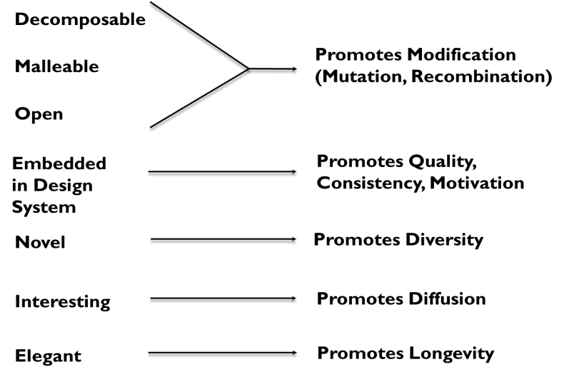
Fitness Characteristics and Outcomes

Slide 48
Pros of Fitness-Utility Model
Fitness-Utility Model complements current thinking
Researcher is an active participant in the design system
Alternative bases for evaluating DSR impact
Aligns better with dynamic design environments
Recognizes limitations of intended usefulness
Encourages collaboration between researchers and designers in IS and other fields

Slide 49
Cons of Fitness-Utility Model
Existing research standards do not reward design impacts based on new model – longitudinal studies needed to evaluate evolutionary impacts
Research is needed to understand how to evaluate design fitness
Rigor in Fitness-Utility research requires alternative (new?) research methods

Slide 50
Conclusions
The Fitness-Utility Model of DSR provides a new approach for viewing the building and evaluating of design artifacts
Design characteristics beyond usefulness are important in rapidly changing application environments
Future Research
Empirical studies evaluating utility functions in context and for general applications
Case studies of historical designs based on fitness-utility
Adapting Evolutionary Economics concepts to DSR

