Slide 1
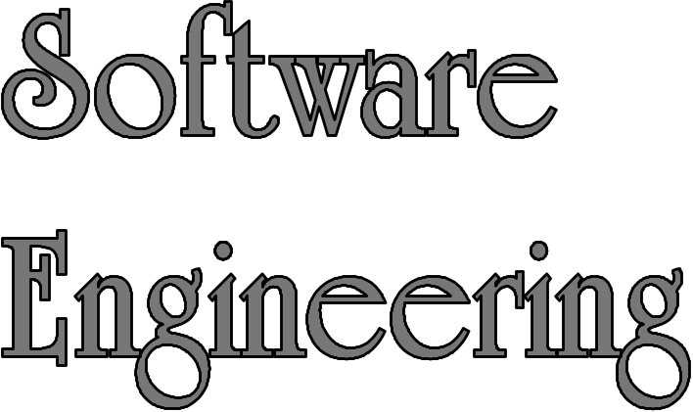
The Object Model
何明昕 HE Mingxin, Max
Send your email to c.max@yeah.net with
a subject like: SE-id-Andy: On What …
Download from c.program@yeah.net
/文件中心/网盘/SoftwareEngineering26S

Slide 2
Topics
Objects and Method Calls
Interfaces
UML Notations
Class/Object Relationships
Process/Algorithm-Oriented vs. Object Oriented Approaches
How To Design Well OO Systems?

Slide 3
Exercise 03: Review & Preview
Read 1.3,1.4, 2.1,2.2 and Preview 2.3, 2.4 of TextBook.
Preview Appendix G (p449-476) of TextBook
Keep Reading, continue to write work log (just reading jobs in this week) something like:
  Read 1.3, 1.4 of TextBook, Mar. 14, 8:00pm-9:20pm
  Read 2.1 of TextBook, Mar. 15, 9:30pm-10:30pm
  Read 2.2 of TextBook, …
  Preview Appendix G (p449-476) of TextBook, DATE, FROM-TO

Slide 4
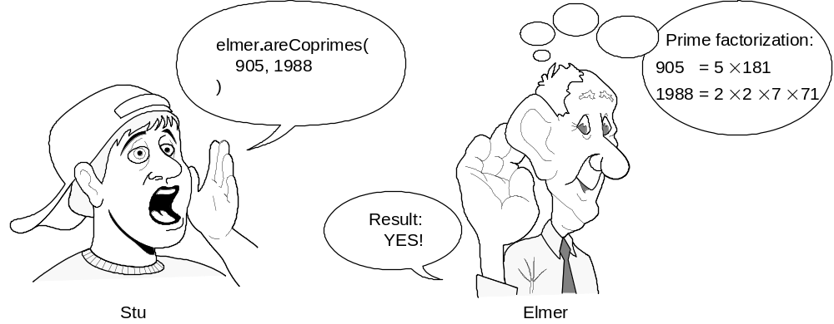
Objects, Calling & Answering Calls
Prime factorization of 905:
5×181 (2 distinct factors)
Prime factorization of 1988:
2×2×7×71 (4 factors, 3 distinct)
Two integers are said to be coprimes or relatively prime if they have no common factor other than 1 or, equivalently, if their greatest common divisor is 1.

Slide 5
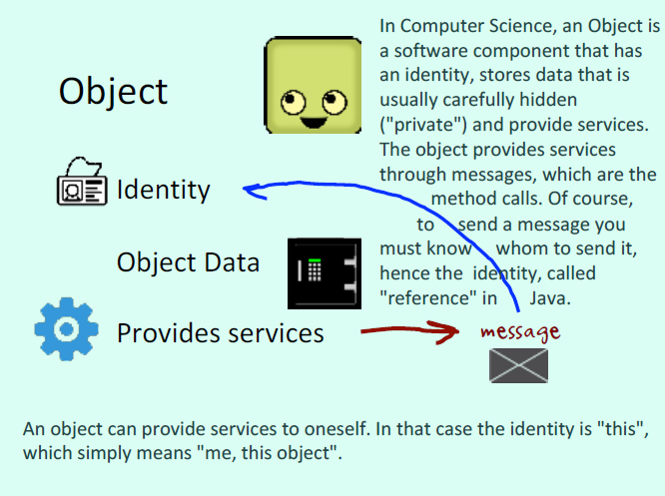

Slide 6
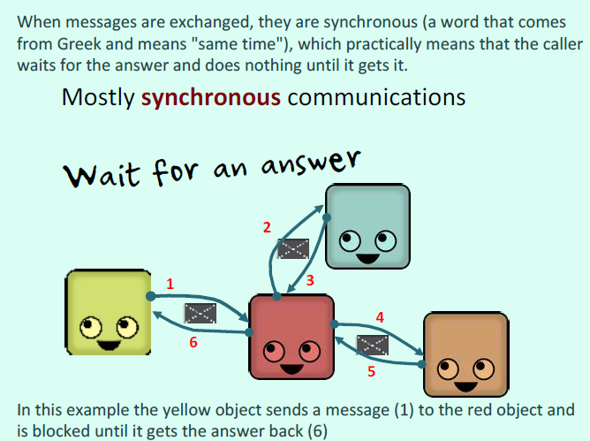

Slide 7
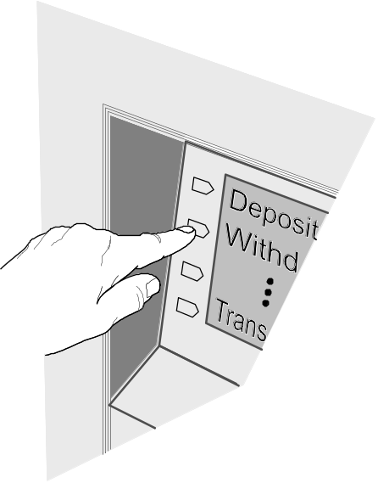
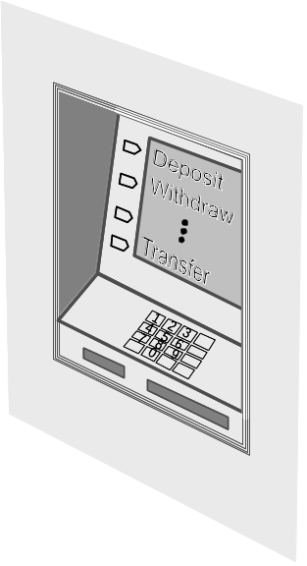
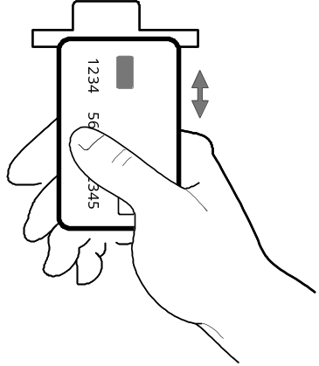
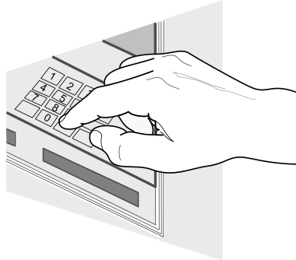
Objects Don’t Accept Arbitrary Calls
Acceptable calls are defined by object “methods”
(a.k.a. Operations, Procedures, Subroutines, Functions)
Object:
ATM machine
method-1:
Accept card
method-2:
Read code
method-3:
Take selection

Slide 8
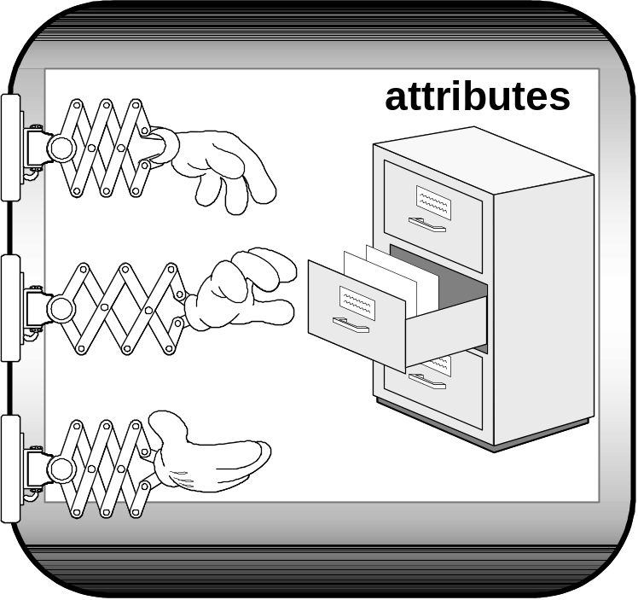
Object Interface
Interface defines method “signatures”
Method signature: name, parameters, parameter types, return type
Interface
method-1
Object hides its state (attributes). The attributes are accessible only through the interface.
method-2
method-3

Slide 9
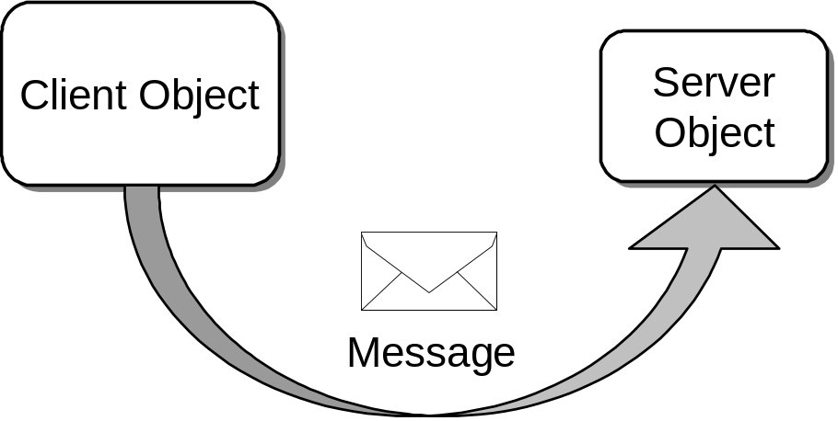
Clients, Servers, Messages
Objects send messages by calling methods
Client object: sends message and asks for service
Server object: provides service” and returns result

Slide 10
Interfaces
An interface is a set of functional properties (services) that a software object provides or requires.
Methods define the “services” the server object implementing the interface will offer
The methods (services) should be created and named based on the needs of client objects that will use the services
  “On-demand” Design — we “pull” interfaces and their implementations into existence from the needs of the client, rather than “pushing” out the features that we think a class should provide

Slide 11
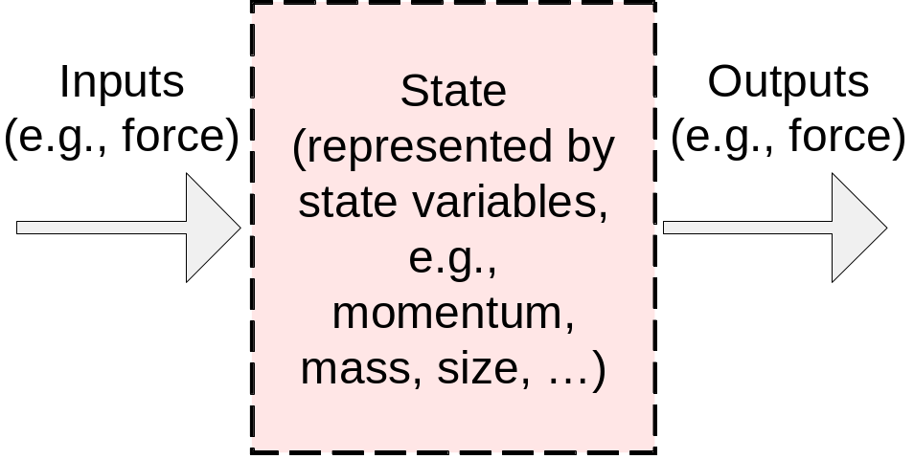
Objects are Modules
Software Module

Slide 12
Modules versus Objects
Modules are loose groupings of subprograms and data
“Promiscuous” access to data often results in misuse
Subprograms
(behavior)
Data
(state)
Software Module 1
Software Module 2
Software Module 3
Objects encapsulate data
Attributes
/data
(state)
Methods
(behavior)
Software Object 1
Software Object 2
Software Object 3

Slide 13
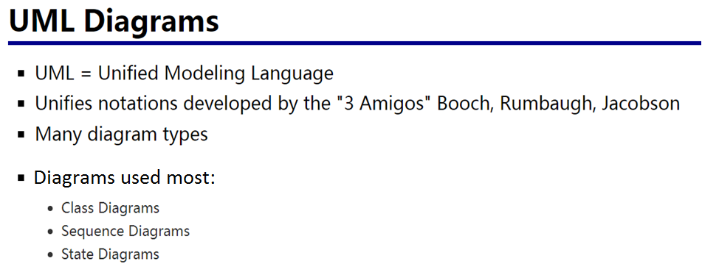
http://www.uml.org

Slide 14
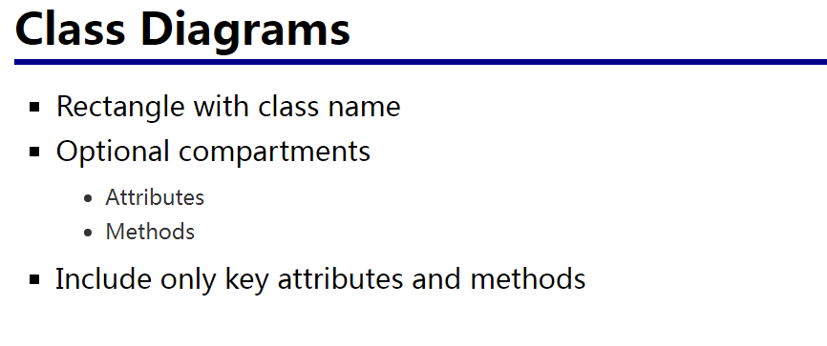

Slide 15
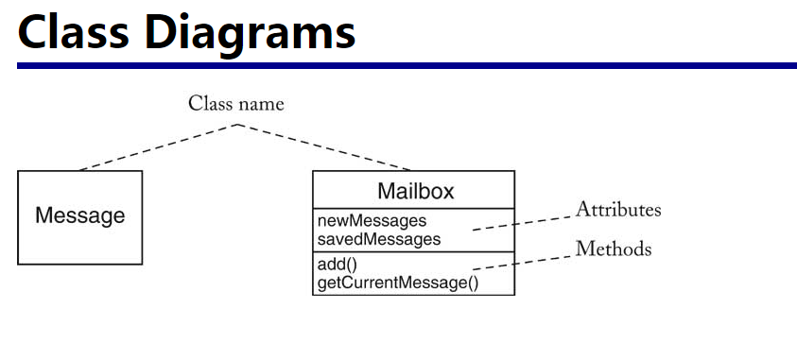

Slide 16
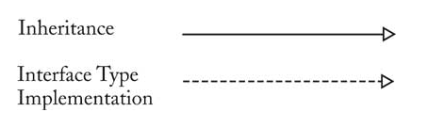
UML Notation for Classes
Software Interface Implementation
(traditional notation)
Software Class
«interface»
BaseInterface
+ operation()
Inheritance
relationship:
BaseInterface
is implemented
by two classes
ClassName
# attribute_1 : int
# attribute_2 : boolean
# attribute_3 : String
+ operation_1() : void
+ operation_2() : String
+ operation_3(arg1 : int)
Three compartments:
Classifier name
Attributes
Operations
Class1Implement
+ operation()
Class2Implement
+ operation()
Access Modifiers (Visibility):
+ public
# protected (package + sub-classes)
~ package
- private

Slide 17
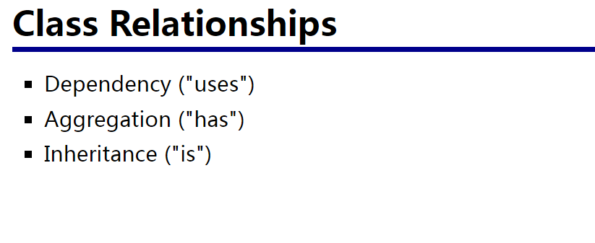

Slide 18
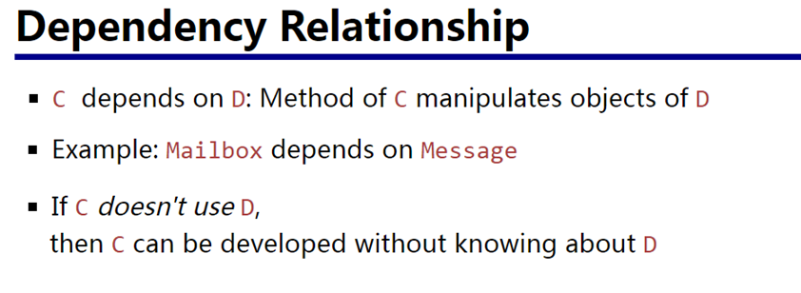

Slide 19
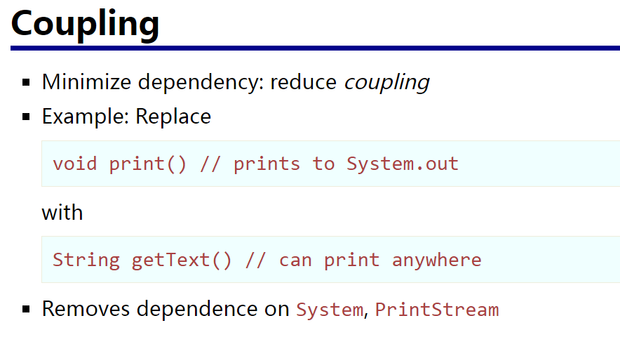

Slide 20
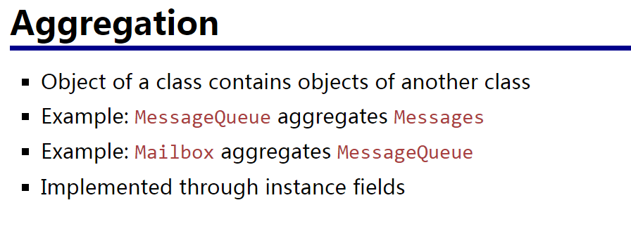

Slide 21
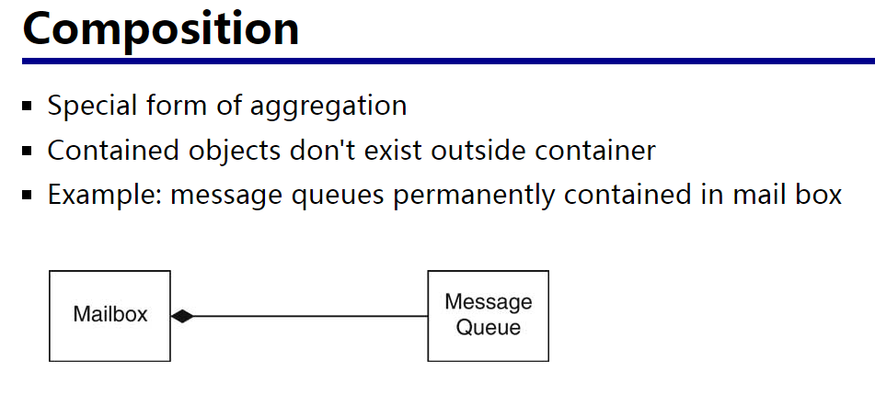

Slide 22
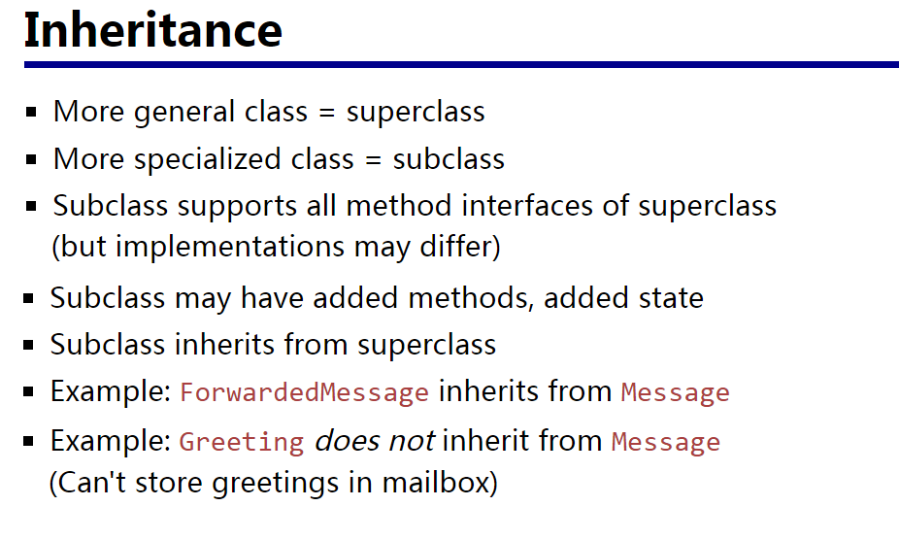
(Generalization/Specialization)

Slide 23
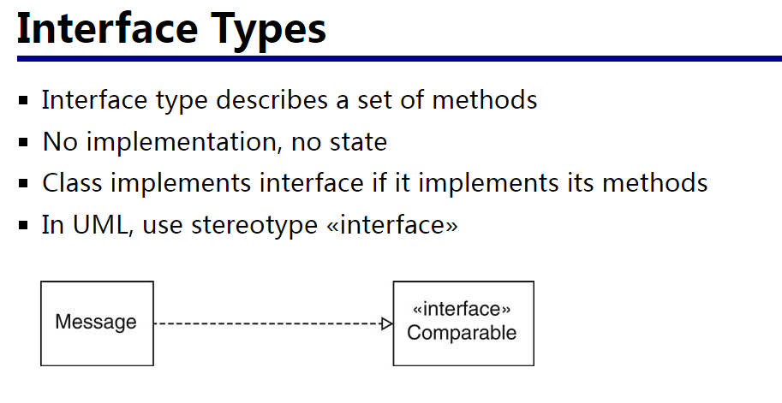

Slide 24
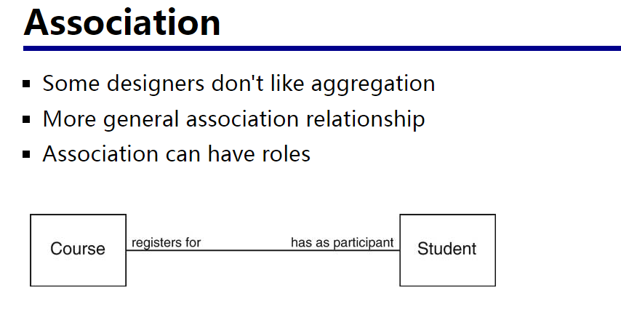

Slide 25
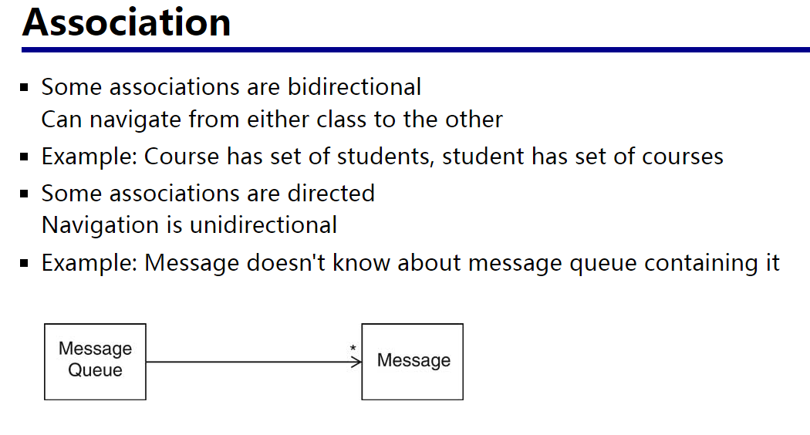

Slide 26
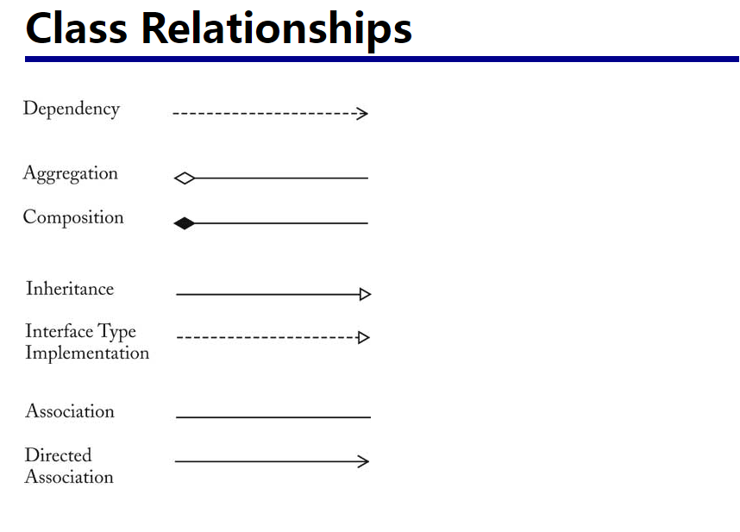
Instance field
extends in java
implements in java

Slide 27
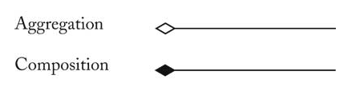
Object Relationships (1)
Aggregation/Composition (HasA):
Using instance variables that are references to other objects
Inheritance (IsA):
Inheriting common properties through class extension
Inheritance:
Aggregation/Composition:
Base Class A
+ operation()
Derived Class B
+ operation()
Base Class A
+ operation()
B acts as “front-end” for A and uses services of A
(i.e., B may implement the same interface as A)
Derived Class B
+ operation()

Slide 28
Object Relationships (2)
Both inheritance and composition extend (traditional recognition out of date) the base functionality provided by another object
INHERITANCE (IsA): Change in the “base” class propagates to the derived class and its client classes
  BUT, any code change has a risk of unintentional introducing of bugs.
AGGREGATION/COMPOSITION (HasA): More adaptive to change, because change in the “base” class is easily “contained” and hidden from the clients of the front-end class

Slide 29
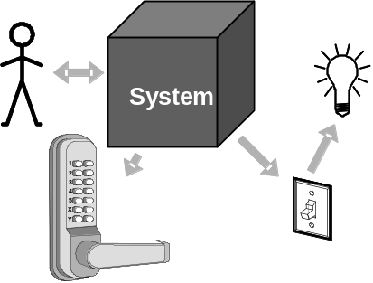
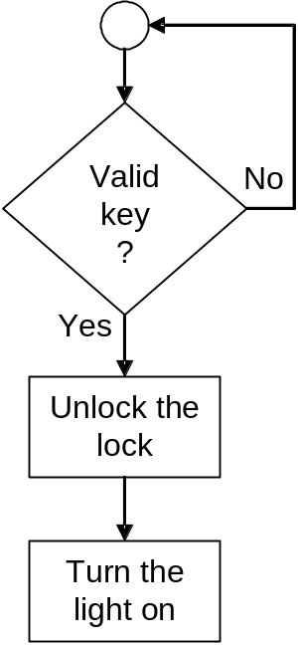
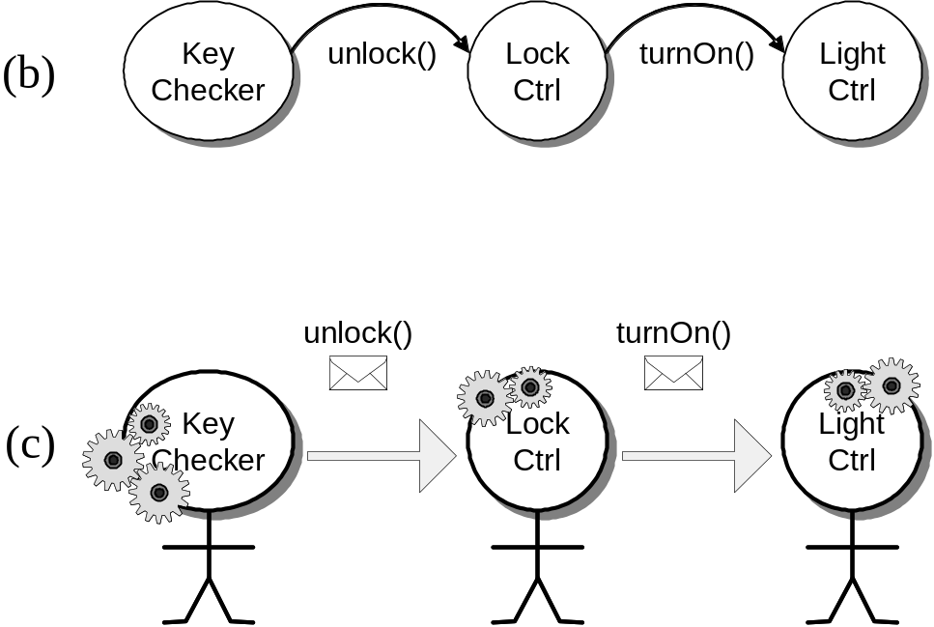
Object-Oriented versus
Process-Oriented Approaches
(a)
Process oriented
Object oriented

Slide 30
Object vs. Process-Oriented (1)
Process-oriented is more intuitive because it is person-centric
  thinking what to do next, which way to go
Object-oriented may be more confusing because of labor-division
  Thinking how to break-up the problem into tasks, assign responsibilities, and coordinate the work
  It’s a management problem…

Slide 31
Object vs. Process-Oriented (2)
Process-oriented does not scale to complex, large-size problems
  Individual-centric, but…
Large scale problems require organization of people instead of individuals working alone
Object-oriented is organization-centric
  But, hard to design well organizations…

Slide 32
How To Design Well OO Systems?
That’s the key topic of this course!
Decisive Methodological Factors:
  Traceability
  Testing
  Measurement
  Security
(Section 2.1.2)

Slide 33
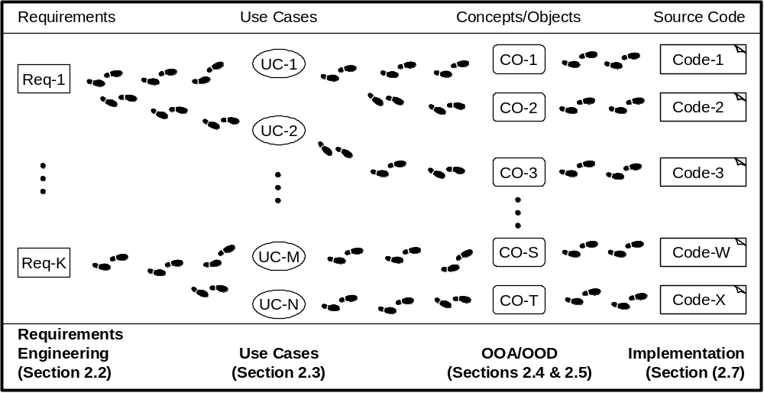
Traceability (1)
It should be possible to trace the evolution of the system, step-by-step, from individual requirements, through design objects, to code blocks.

Slide 34
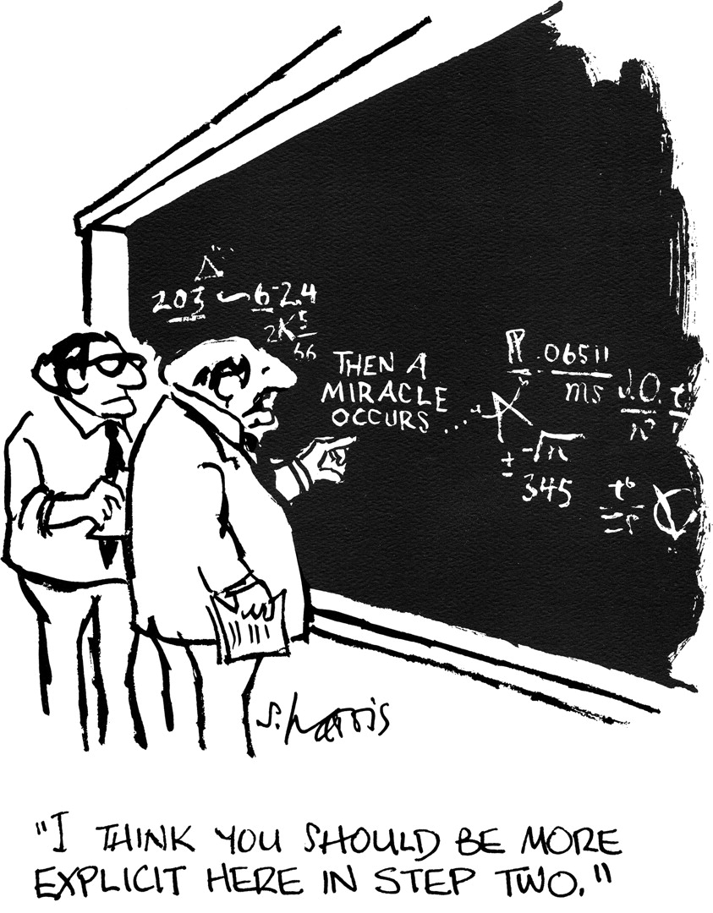
Traceability (2)
Avoid inexplicable leaps!
…where did this come from?!
“Deus ex machina”

Slide 35
Testing (1)
Test-Driven Development (TDD)
Every step in the development process must start with a plan of how to verify that the result meets a goal
The developer should not create a software artifact (a system requirement, a UML diagram, or source code) unless they know how it will be tested
But, testing is not enough…

Slide 36
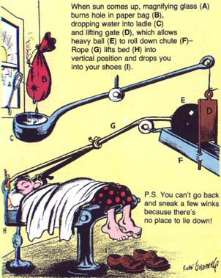
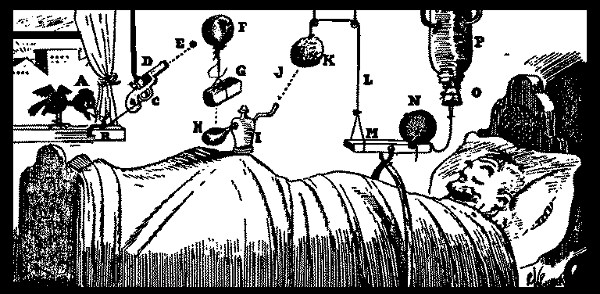
Testing (2)
A Rube Goldberg machine follows
Test-Driven Development (TDD)
—the test case is always described
…it’s fragile—works correctly for one scenario
Automatic alarm clock
Oversleeping cure

Slide 37
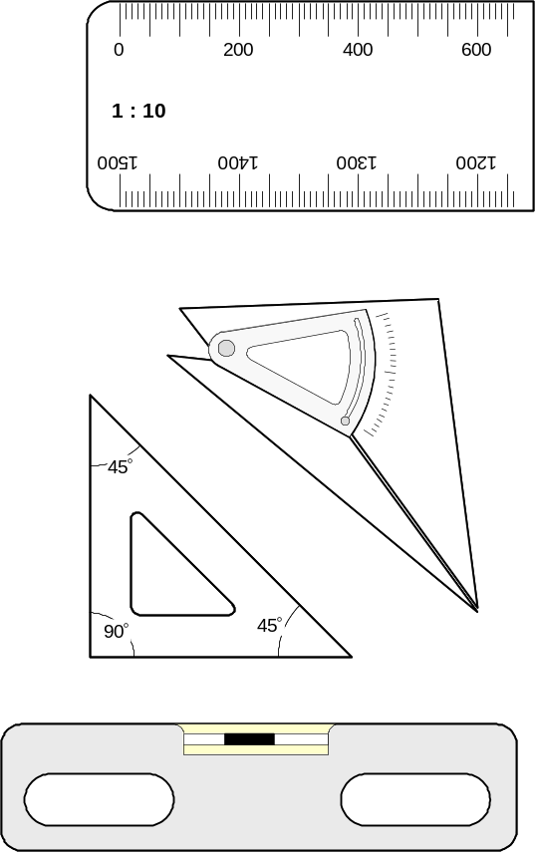
Measuring (1)
We need tools to monitor
the product quality
And tools to monitor the
developers productivity
But, measuring is not enough…

Slide 38
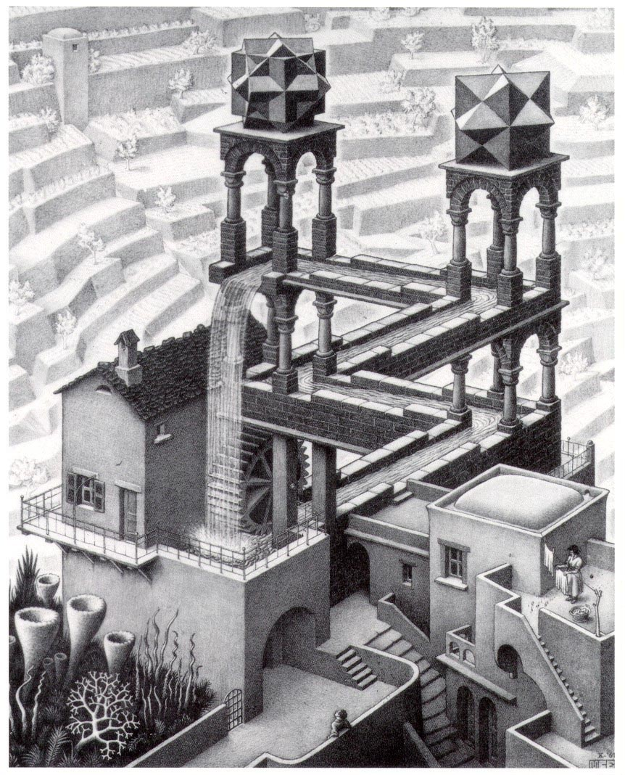
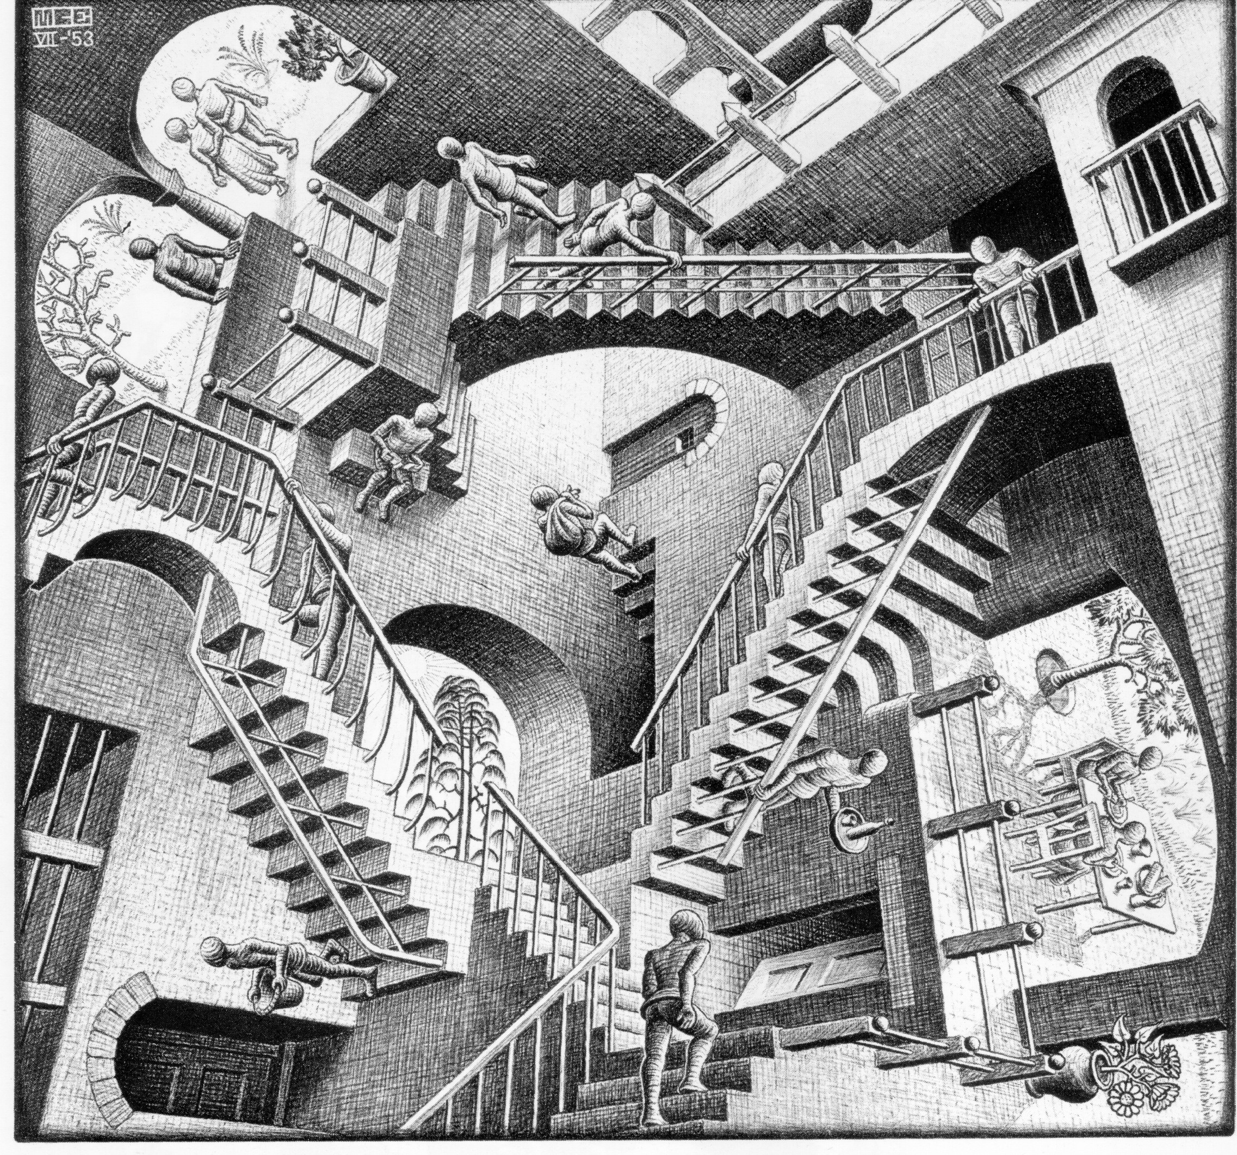
Measuring (2)
Maurits Escher designs, work under all scenarios (incorrectly)
—robust but impossible
Relativity
Waterfall

Slide 39
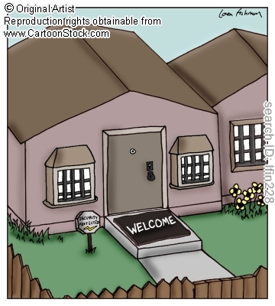
Security
Conflicting needs
of computer security…
Microsoft Security Development Lifecycle (SDL)
http://www.microsoft.com/security/sdl/

Slide 40
Elements of Computer Security
Secrecy
  Protecting against unauthorized data disclosure
  Ensuring data source authenticity
Integrity
  Preventing unauthorized data modification
  Man-in-the-middle exploit
    E-mail message intercepted; contents changed before forwarded to original destination
Necessity
  Preventing data delays or denials (removal)
  Delaying message or completely destroying it

Slide 41
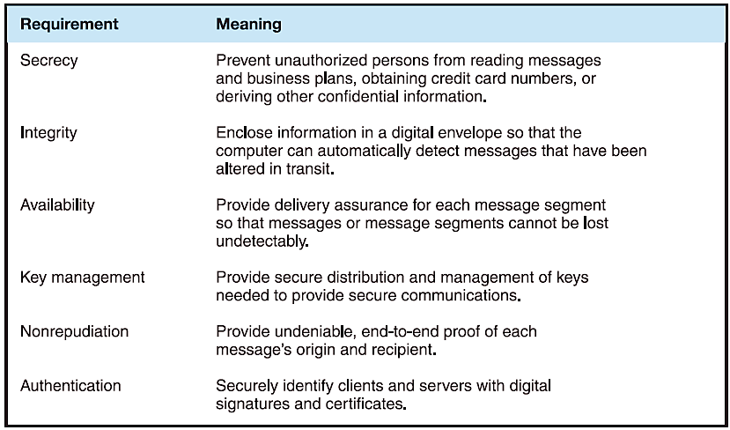
Requirements for secure electronic commerce

Slide 42
Security and Dependability of Sociotechnical Systems
Dependability properties
  The system attributes that lead to dependability.
Availability and reliability
  Systems should be available to deliver service and perform as expected.
Safety
  Systems should not behave in an unsafe way.
Security
  Systems should protect themselves and their data from external interference.

