Slide 1

Software Configuration Management
何明昕 HE Mingxin, Max
Send your email to c.max@yeah.net with
a subject like: SE-id-Andy: On What …
Download from c.program@yeah.net
/文件中心/网盘/SoftwareEngineering26S

Slide 2
Topics
Definitions
Working Scenarios
Revision Control Functions
  Git and GitHub

Slide 3
Why Software Config Mgmt?
Software configuration management (SCM) is the process of controlling the evolution of a software system
Simplifies sharing code and other documents
The ability to revert to an older version (“undo”)
Coherently integrate contributions from team members (“merge”)
Notify interested parties about new modifications (“reporting”)
Track software issues (e.g., bugs)
Create an auditing trail (“archiving”)
SCM system allows us to answer questions:
  When was this software module last changed?
  Who made changes in this line of code?
  What is the difference between the current version and last week’s?
  How many lines of code did we change in this release?
  Which files are changed most frequently?

Slide 4
Why Software Config Mgmt?
SCM simplifies collaboration and increases productivity
But it all can be done with
old-fashioned email, file system, etc.
  Naming convention?
  How to reconcile your version #1 with my version #1?

Slide 5
Definitions
A software configuration is a collection of work products (“artifacts”) created during a project lifetime
Software configuration item (SCI) is any piece of knowledge (a.k.a. “work product” or “artifact”) created by a person (developer or customer)
A snapshot of a software configuration or a configuration item represents the version of that item at a specific time
A commit (or “check-in”) refers to submitting a software configuration to the project database (“repository”)
A build is a version of a program code (part of a software configuration), and a process by which program code is converted into a stand-alone form that can be run on a computer (“executable code”)

Slide 6
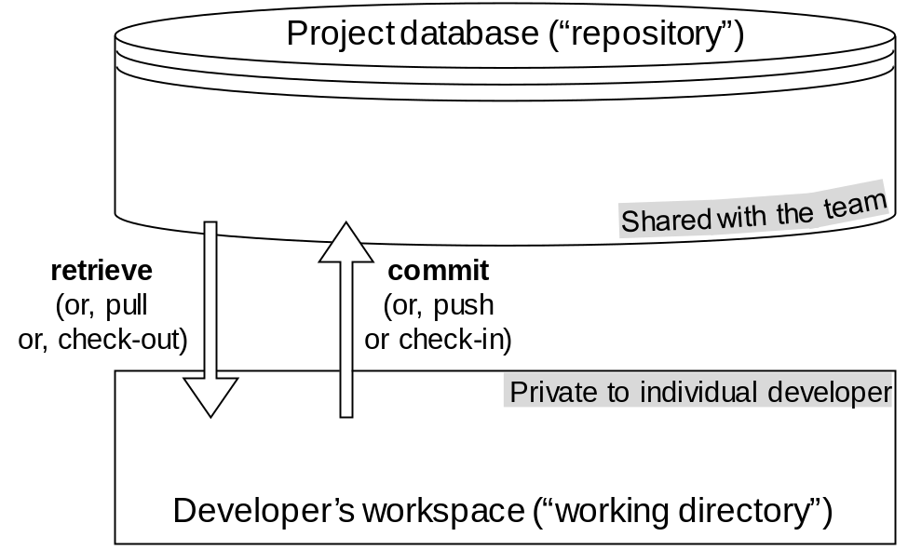
Repository vs. Workspace
Committed configurations
(at discrete times during project life)
Working copies
(piecewise continuous development)
Project database is usually on a remote server,
or “mirrored” on several servers
  This is the “team memory,” unlike individual workspaces that are private
SCM provides a set of tools to interact with project database

Slide 7
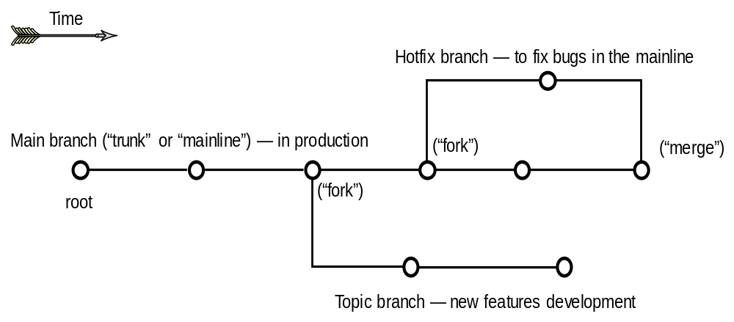
Version Graph and Branching
Each graph node (a “commit”) represents a “version” of the software configuration shared with the team
  The private workspace of one team member was publicized in the shared repository and becomes a part of “team memory”
Think of branches as separate folders, each with its own content and history
The project snapshot at the tip of a branch represents the latest version

Slide 8
Example Working Scenarios
Undoing mistakes in new work
Supporting multi-pronged product evolution
  Parallel versions coexist at times, but will eventually merge (single trunk—“Main”)
Developing product lines
  Coexisting parallel versions (same product for different markets) that will never merge (multiple trunks)
    but they still need synchronization so that versions for different markets are at the same “level”
Working with a small team of peers
  All developers can write to the project database
Working with a managed team
  Only configuration manager can write to the project database

Slide 9
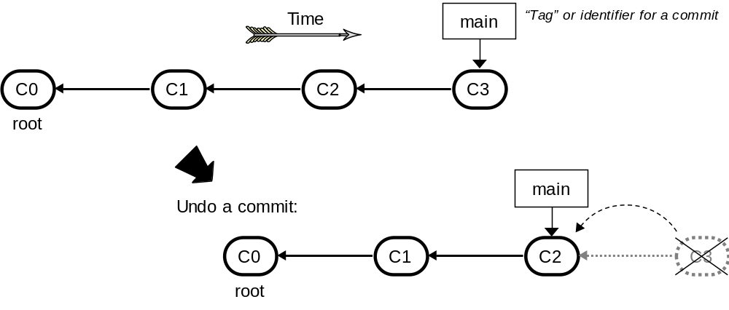
Undoing Commits
We can undo a commit; undo a merge; or undo a checkout
(See later how undo can be done without deleting the history)

Slide 10
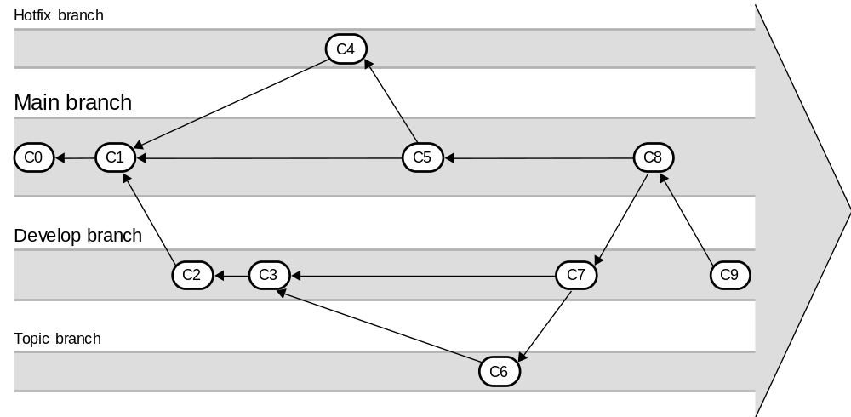
Multi-pronged Product Evolution
Parallel versions coexist at times, but will eventually merge
(to a single trunk—Main branch)

Slide 11
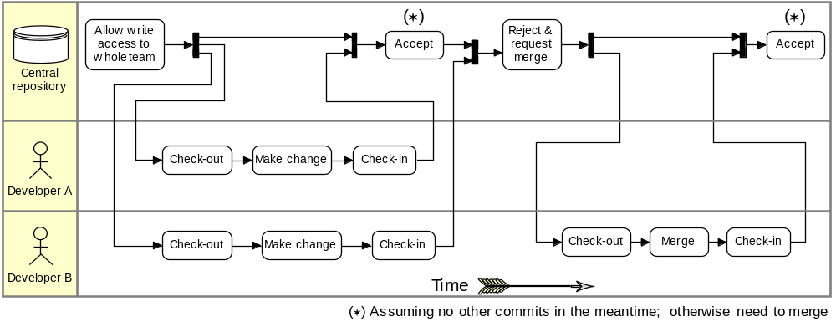
Working with Peers:
Centralized Workflow
Example scenario: Two developers clone from the hub and both make changes
The first developer to push his changes back up can do so with no problems
The second developer must merge in the first one’s work before pushing changes up, so as not to overwrite the first developer’s changes

Slide 12
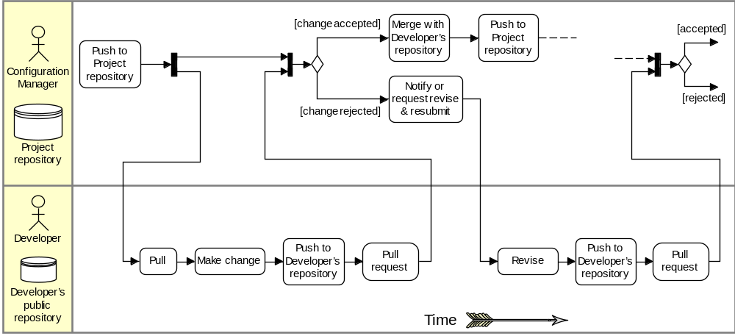
Working with a Managed Team
Example scenario:
1. The configuration manager pushes the current version to the central project repository
2. A contributor clones that repository and makes changes
3. The contributor pushes the changed version to his own public repository
4. The contributor notifies the configuration manager requesting to pull changes
5. The configuration manager adds the contributor’s repository as a remote and merges locally
6. The configuration manager pushes merged changes to the central project repository

Slide 13
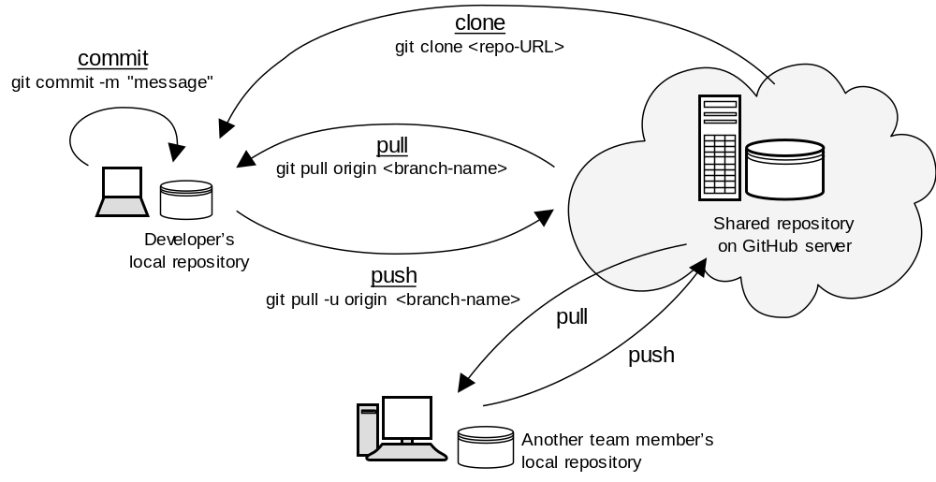
Git Commands Summary

Slide 14
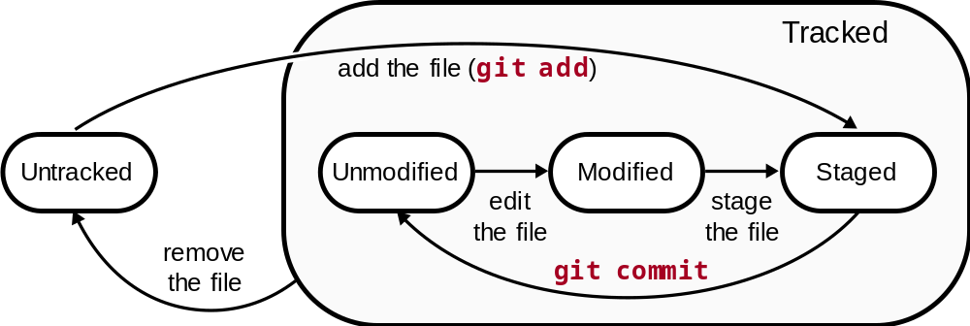
Git: States of
Software Configuration Items
“untracked” file is in
developer’s working directory
“tracked” file is in
developer’s local repository
git add is a multipurpose command (to begin tracking new files, to stage files, etc., e.g., marking merge-conflicted files as resolved
Using git add we signal to Git that we wish to “add this content to the next commit” (place it to the “staging area”)
Next time we execute git commit,
Git will “add this file to the project”

Slide 15
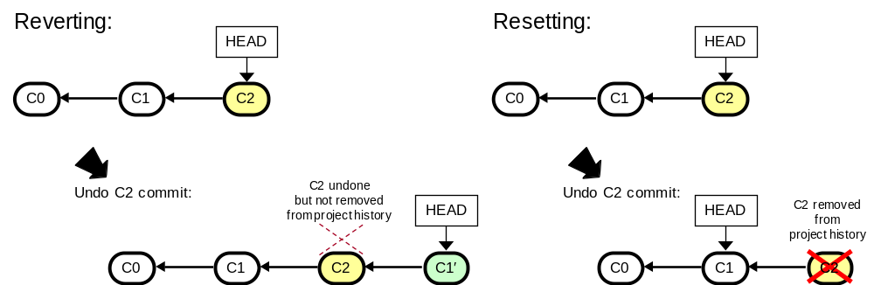
Undo: Reverting vs. Resetting
git revert undoes a committed snapshot C2 by undoing the changes and appending a new commit C1′ (instead of removing the commit C2 from the project history) ⬅ “safe”
  Historic record of abandoned versions exists
git reset works backwards from the current commit by removing all of the commits after the target commit ⬅ “unsafe”
  No historic record of abandoned versions

Slide 16
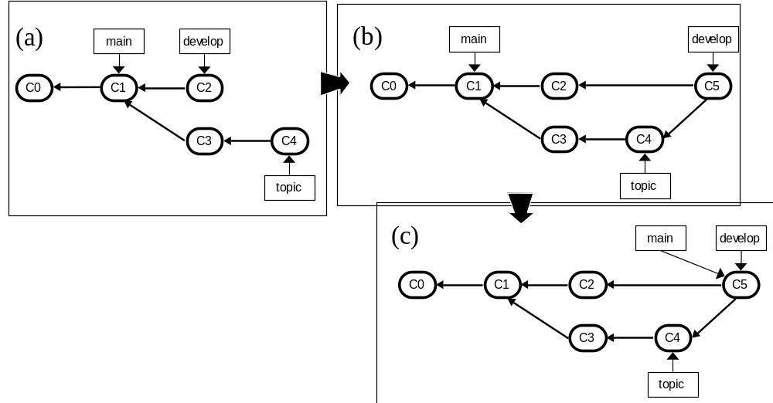
Merge on Large/Important Projects
(a) Before a topic branch merge
(b) After a topic branch merge
(c) After a project release (“main” tag is moved)

Slide 17
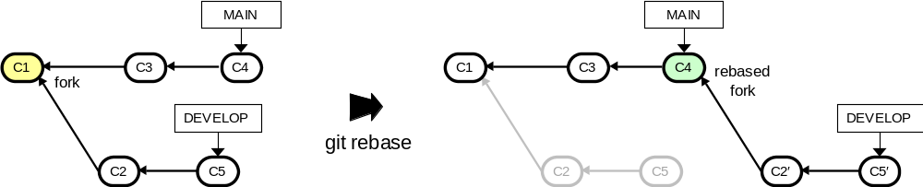
Rebasing Existing Branches
Rebasing = moving a branch to a different baseline commit
  Appears as if it forked off from a different version
  All commits in the branch are replayed on new base
replayed commits from the moved branch

