Slide 1
Introduction to Design Science
Erik Perjons (Revised by Max HE with Thanks)
Department of Computer and Systems Sciences (DSV), Stockholm University

Slide 2
What is Design Science?

Slide 3
Positioning design science
Natural Science
Social Science
Design Science
Empirical science - aims at describing and explaining the actual world in the present (as-is) or the past (has been)
Design science - aims at improve and change the world in the future (to-be) - by developing and introducing artefacts in practice

Slide 4
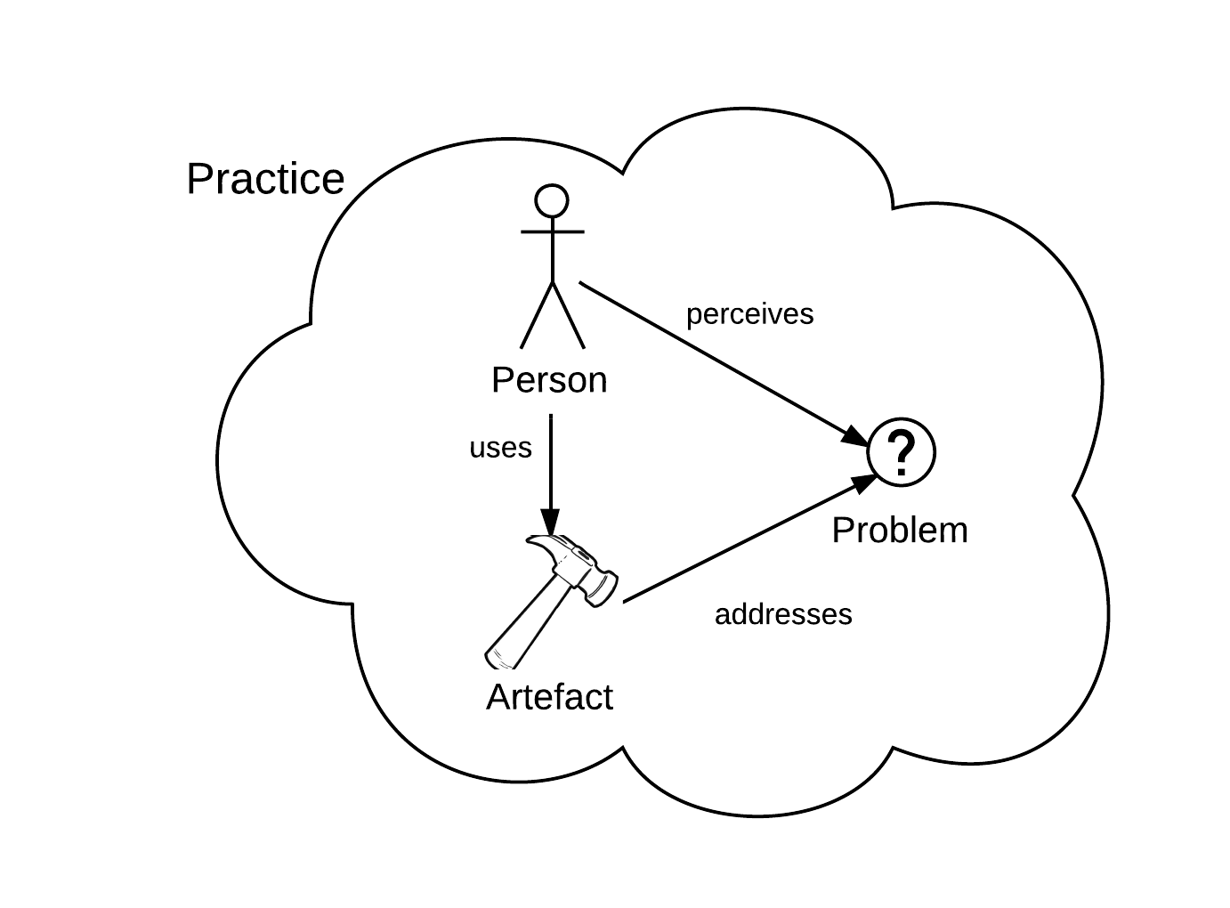
Defining design science
Design science is the scientific study and creation of artefacts as they are developed and used by people with the goal of solving practical problems of general interest

Slide 5
Defining artefact
An artefact is an object made by humans with the intention to be used to address a practical problem in a practice

Slide 6
Artefact types in information systems
IT system
Prototype of an IT system
Method
Model
Guidelines
Requirements
Algorithm
Notation
Metric
Pattern
Socio-Technical system
…

Slide 7
Artefact types in information systems
Usually, four types of artefacts are presented when introduce design science (March & Smith, 1995):
Construct (构想，观念) – is a term, notation, concept needed for formulate problems and their possible solutions
Model – is a representation of possible solution, that is, a model can be used for supporting construction of other artefact
Method – defined guidelines and processes of how to solve problems and achieve goals
Instantiation (实例) – is a working system that can be used in practice

Slide 8
Artefact and practice
An artefact is an object made by humans with the intention to be used to address a practical problem in a practice

Slide 9
Defining practice
A practice is a set of human activities performed regularly and seen as meaningfully related to each other by the people participating in them.

Slide 10
An example of a practice
The practice of dentists is an example a practice
Dentist are engaging in cleaning teeth, drilling teeth, taking X-rays, and many other activities.
To carry out the practice, dentists make use of artefacts, such as pliers, drills, X-ray machines, and other tools

Slide 11
What characterize design science?
The artefact developed in a design science project needs to be novel, something new and original, not previously developed

Slide 12
What characterize design science?
The artefact developed in a design science initiative needs to be novel, something new and original, not previously developed
The artefact is the solution that needs to be developed to address the problem

Slide 13
What characterize design science?
The artefact developed in a design science initiative needs to be novel, something new and original, not previously developed
The artefact is the solution that needs to be developed to address the problem
The artefact needs to be used in a practice

Slide 14
What characterize design science?
The problem needs to be a problem in a practice
The artefact developed in a design science initiative needs to be novel, something new and original, not previously developed
The artefact is the solution that needs to be developed to address the problem
The artefact needs to be used in a practice

Slide 15
What characterize design science?
The problem needs to be a problem in a practice
The artefact developed in a design science initiative needs to be novel, something new and original, not previously developed
The problem needs to be generic, that is, a solution not only for one organization
The artefact is the solution that needs to be developed to address the problem
The artefact needs to be used in a practice

Slide 16
Design science and Practice research
Design science is often seen as part of what is called practical research
Practice research is research that addresses problems in practices

Slide 17
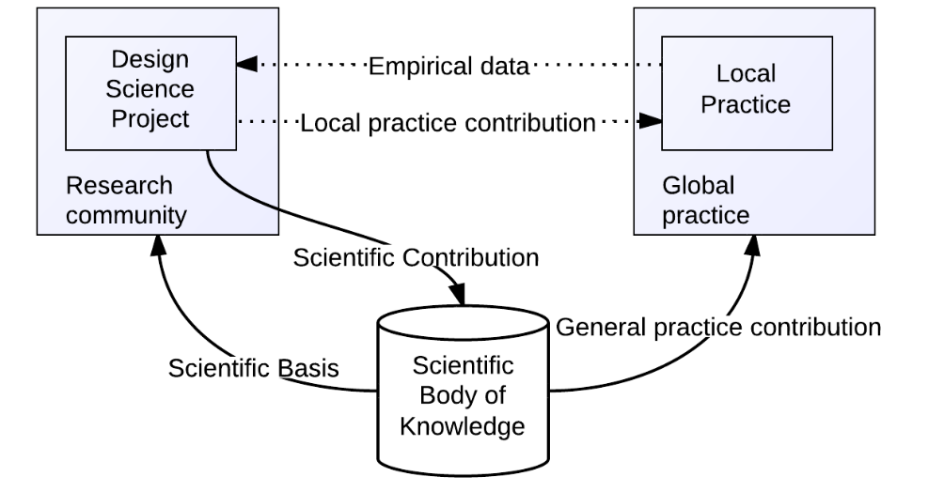
Design science and Practice research
Design Science
Project
[Inspired by Goldkuhl, 2012]

Slide 18
A Design Science Framework

Slide 19
A design science framework
Initial problem
Explicate
problem
Explicated problem
Define require-
ments on artefact
Requirements
Design and develop artefact
Artefact
Demon-
strate artefact
Demonstrated artefact
Evaluate artefact
Evaluated artefact
[Inspired by Peffer, et al, 2007]

Slide 20
A design science framework
Initial problem
Explicate
problem
Explicated problem
Define require-
ments on artefact
Requirements
Design and develop artefact
Artefact
Demon-
strate artefact
Demonstrated artefact
In this activity, the problem needs to be precisely formulated and justified by showing that it is significant for some practice
Evaluate artefact
Evaluated artefact

Slide 21
Explicate problem
Two categories of problems, and both need to be stated:
Practical problem – is an issue for practitioners in the practice that they want to be addressed
Knowledge problem – is often a knowledge gap in research
Example of practical problem:
The difficulty of finding and selecting appropriate best practices (BPs) in large collections of BPs impedes the use of BPs.
Example of knowledge problem:
There is a lack of knowledge/research of how to find and select appropriate best practices (BPs) in BP repositories.

Slide 22
A design science framework
Defining requirements can be seen as a transformation of the problem into demands on the proposed artefact.
Initial problem
Explicate
problem
Explicated problem
Define require-
ments on artefact
Requirements
Design and develop artefact
Artefact
Demon-
strate artefact
Demonstrated artefact
In this activity, the problem needs to be precisely formulated and justified by showing that it is significant for some practice
Evaluate artefact
Evaluated artefact

Slide 23
Define requirement
Two categories of requirements:
Features/Functions – for example, the artefact should support communcation between decision makers
Generic qualities – for example, the artefact should be should be easy to use for the users

Slide 24
Define requirements
Example of requirements in form of generic qualities:
Understandability: The artefact should be easy to comprehend for the users, since they need use it in an effective way
Efficient: The artefact should make it possible to carry out improvement of business processes in a time and resource efficient ways, since business process improvement is a cost and resource intensive endeavor, where cost may easily exceed the benefit
Completeness ….
Specify the generic quality for the artefact

Slide 25
Define requirements
Example of requirements in form of generic qualities:
Understandability: The artefact should be easy to comprehend for the users, since they need use it in an effective way
Efficient: The artefact should make it possible to carry out improvement of business processes in a time and resource efficient ways, since business process improvement is a cost and resource intensive endeavor, where cost may easily exceed the benefit
Completeness ….
Justify the generic quality for the artefact

Slide 26
A design science framework
Defining requirements can be seen as a transformation of the problem into demands on the proposed artefact.
Initial problem
Explicate
problem
Explicated problem
Define require-
ments on artefact
Requirements
Design and develop artefact
Artefact
Demon-
strate artefact
Demonstrated artefact
In this activity, the problem needs to be precisely formulated and justified by showing that it is significant for some practice
This activity creates an artefact that addresses the explicated problem and fulfils the defined requirements.
Evaluate artefact
Evaluated artefact

Slide 27
Design and devlop artefact
This part usually contains:
A description of the artefact and its components
A description of how the artefact was designed and developed

Slide 28
A design science framework
This activity uses the developed artefact in an illustrative or real-life case, sometimes called a “proof of concept”, thereby proving the feasibility of the artefact.
Defining requirements can be seen as a transformation of the problem into demands on the proposed artefact.
Initial problem
Explicate
problem
Explicated problem
Define require-
ments on artefact
Requirements
Design and develop artefact
Artefact
Demon-
strate artefact
Demonstrated artefact
In this activity, the problem needs to be precisely formulated and justified by showing that it is significant for some practice
This activity creates an artefact that addresses the explicated problem and fulfils the defined requirements.
Evaluate artefact
Evaluated artefact

Slide 29
A design science framework
This activity uses the developed artefact in an illustrative or real-life case, sometimes called a “proof of concept”, thereby proving the feasibility of the artefact.
Defining requirements can be seen as a transformation of the problem into demands on the proposed artefact.
Initial problem
Explicate
problem
Explicated problem
This activity determines how well the artefact fulfils the requirements and to what extent it can solve, or alleviate, the practical problem that motivated the research.
Define require-
ments on artefact
Requirements
Design and develop artefact
Artefact
Demon-
strate artefact
Demonstrated artefact
In this activity, the problem needs to be precisely formulated and justified by showing that it is significant for some practice
This activity creates an artefact that addresses the explicated problem and fulfils the defined requirements.
Evaluate artefact
Evaluated artefact

Slide 30
Evaluate artefact
Ex ante evaluation - means that the artefact is evaluated without being used or even being fully developed
For example, an ex ante evaluation of a new collaborative editor software (like Google docs) can be carried out by interviewing a number of experts on word processing and social software, based on a specification and early prototype of the editor.
Ex post evaluation - requires the artefact to be employed.
An ex post evaluation can be done by implementing the collaborative editor software in an organization and observing the use of it.
(Pries-Heje et al, 2008)

Slide 31
Evaluate artefact
Evaluate how the artefact fulfills each requirement, for example in form of strengths/benefits, weaknesses/drawbacks, and also suggested improvement
Evaluate how the artefact addresses the overall practical problems, for example in form of strengths/benefits, weaknesses/drawbacks and suggested improvement

Slide 32
Evaluate artefact: Informed argument
Informed argument - is an evaluation “method” presented in Hevner et al. (2004).
Informed argument - is a lightweight evaluation method where the researchers who developed an artefact discuss its benefits and drawbacks, and by this argumentation show that it does (or does not) fulfil the defined requirements.

Slide 33
A design science framework
Initial problem
Explicate
problem
Explicated problem
Define require-
ments on artefact
Requirements
Design and develop artefact
Artefact
Demon-
strate artefact
Demonstrated artefact
Evaluate artefact
Evaluated artefact

Slide 34
The design science framework
IMPORTANT: The design science framework supports presentations of the research methodology: it presents the result of each activity.
However, the design science framework is NOT a description of how the research has been carried out.

Slide 35
The design science framework
The actual design science research can be carried out in different ways, for example:
often a design science research project is carried out using several iterations of design and evaluation (as in agile software development methods). This is not explicitly showed in the framework. The framework just present the result of each activity when the research project has been finished
the developed artefact may solve another problem than the first expected, therefore the original problem statement (and probably also the requirements) need to be changed

Slide 36
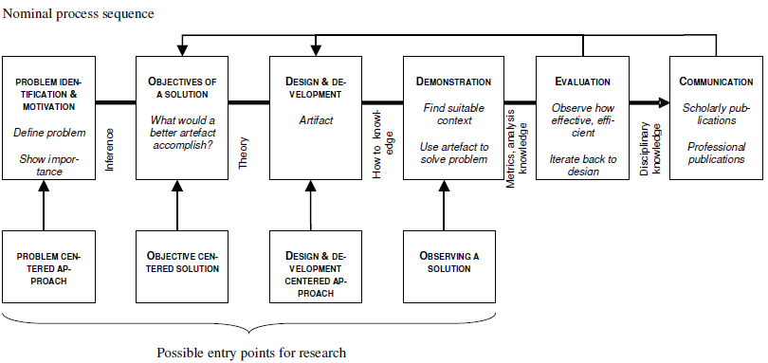
Peffer et al (2007)

Slide 37
Research strategies and methods
Initial problem
Explicate
problem
Explicated problem
Define require-
ments on artefact
Requirements
Design and develop artefact
Artefact
Demon-
strate artefact
Demonstrated artefact
Evaluate artefact
Evaluated artefact

Slide 38
Research methods
Case Study
Survey
Action research
Experiment
…
Research strategy
(Denscombe, 2014)
govern
Research Method
Questionnaire
Interview
Observation
…
Data collection method
Data analysis method
Content analysis
Discource analysis
…
Qualitative analysis method
Quantitative analysis method
Statistical methods
…

Slide 39
Research strategies and methods
Literature survey
Literature survey
Survey using expert interviews
Literature survey based on Grounded Theory
Case study using interviews
Survey using expert interviews
Quantitative analysis using descriptive statistics
Qualitative analysis using content analysis
Initial problem
Explicate
problem
Explicated problem
Define require-
ments on artefact
Requirements
Design and develop artefact
Artefact
Demon-
strate artefact
Demonstrated artefact
Evaluate artefact
Evaluated artefact

Slide 40
Research strategies and methods
Literature survey
Literature survey
Survey using expert interviews
Literature survey based on Grounded Theory
Case study using interviews
Survey using expert interviews
Quantitative analysis using descriptive statistics
Qualitative analysis using content analysis
Initial problem
Explicate
problem
Explicated problem
Define require-
ments on artefact
Requirements
Design and develop artefact
Artefact
Demon-
strate artefact
Demonstrated artefact
Evaluate artefact
Evaluated artefact
Knowledge base

Slide 41
Research strategies and methods
Literature survey
Literature survey
Survey using expert interviews
Literature survey based on Grounded Theory
Case study using interviews
Survey using expert interviews
Quantitative analysis using descriptive statistics
Qualitative analysis using content analysis
Initial problem
Explicate
problem
Explicated problem
Define require-
ments on artefact
Requirements
Design and develop artefact
Artefact
Demon-
strate artefact
Demonstrated artefact
Evaluate artefact
Evaluated artefact
Literature on Best Practices and on documentations on best practices
Literature on Best Practices and on documentations on best practices
Existing solutions for documenting best practices
Knowledge base

Slide 42
Knowledge base
Design Science
Project

Slide 43
Cases of Design Science
Many design science projects do not undertake all of the five activities of the method framework in depth.
Instead, they may focus on one or two of the activities, while the others are treated more lightly.
Typical cases of design science research:
Problem-focused Design Science Research
Requirements-focused Design Science Research
Requirements- and development-focused Design Science Research
Development- and evaluation-focused Design Science Research
Evaluation-focused Design Science Research

Slide 44
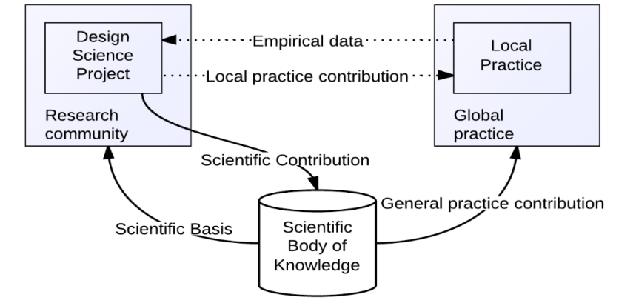
What is the science part of Design Science?
Design science needs to develop artefacts that are:
generic, in that they are solutions for generic problems
new, novel, original
based on the knowledge base/scientific body of knowledge
contributing to the knowledge base/scientific body of knowledge
well described, so it is possible to critically discuss and evalute the artefact using rigouros scientific strategies and methods
evaluated/tested
communicated to both researchers
and practitioners

Slide 45
Positioning Design Science

Slide 46
What is design science?
Which of the following statements are OK to use
Design science is a methodology
Design science is a research approach
Design science is a branch of science, such as natural, social and formal science
Design science is a paradigm, such as positivism and interpretivism
Design science is a research strategy, such as case study and survey

Slide 47
What is design science?
Which of the following statements are OK to use
Design science is a methodology
Design science is a research approach
Design science is a branch of science, such as natural, social and formal science
Design science is a paradigm, such as positivism and interpretivism
Design science is a research strategy, such as case study and survey
These statement are OK to use according to me

Slide 48
What is design science?
The core of design science is based of prescriptive knowledge:
Definitional knowledge - consists of concepts, constructs, terms, definitions, classifications
Descriptive knowledge - describes an existing or past reality
Explanatory knowledge - provides answers to questions of why
Predictive knowledge - offers black-box predictions, i.e. it predicts outcomes based on underlying factors but without explaining causal or other relationships between them.
Explanatory and predictive knowledge
Prescriptive knowledge
(Gregor, 2006)

Slide 49
Presciptive knowledge
Prescriptive knowledge consists of prescriptive models and methods that help solve practical problems
Prescriptive methods are guidelines and procedures that help people to work in systematic ways when solving problems.
Prescriptive models can be seen as blueprints for developing, for example, business processes or IT systems

Slide 50
Presciptive knowledge
Typical examples of prescriptive methods are systems and software development methods, such as the Rational Unified Process (RUP) (Kroll et al. 2003), or agile methods, such as XP and SCRUM (Cohn 2009).
Typical examples of prescriptive models are conceptual reference models, such as SCOR (Bolstorff and Rosenbaum 2007), or architectural models, such as OSI (Day and Zimmerman 1983).

Slide 51
Presciptive knowledge
Prescriptive models and methods can be viewed as comprising two parts.
The first part - is the model or method itself
The second part - is a statement about some desirable effect of using the model or method.
This statement (the second part) implies that if a prescriptive model or method is used in a certain practice, this will contribute to effects desired by some stakeholders.
In this sense, prescription can be seen as a special case of prediction.

Slide 52
Presciptive knowledge
Examples of prescriptive knowledge:
Apply sun lotion before sun bathing!
Develop your software system iteratively!

Slide 53
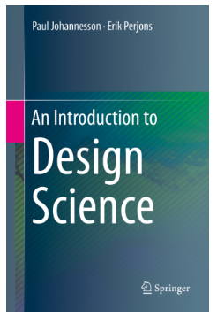
Book and presentations
Johannesson, P., & Perjons, E. (2014). An introduction to design science. Springer.
Presentation of the major chapters:
https://introtodesignscience.wordpress.com/

