Slide 1

Requirements Engineering
何明昕 HE Mingxin, Max
Send your email to c.max@yeah.net with
a subject like: SE-id-Andy: On What …
Download from c.program@yeah.net
/文件中心/网盘/SoftwareEngineering26S

Slide 2
Topics
The Essential Software Requirement
Requirements Development (majors)
Requirements Management (minors)
Main Requirements Engineering Components
Requirements and User Stories
Types of Requirements
Effort Estimation (Agile Methods)

Slide 3
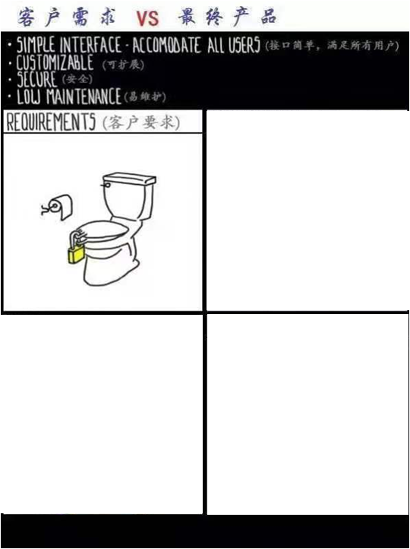
Requirements & Implementation

Slide 4
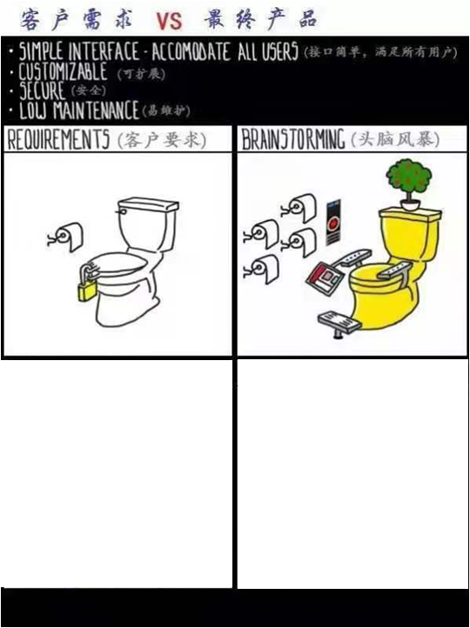
Requirements & Implementation

Slide 5
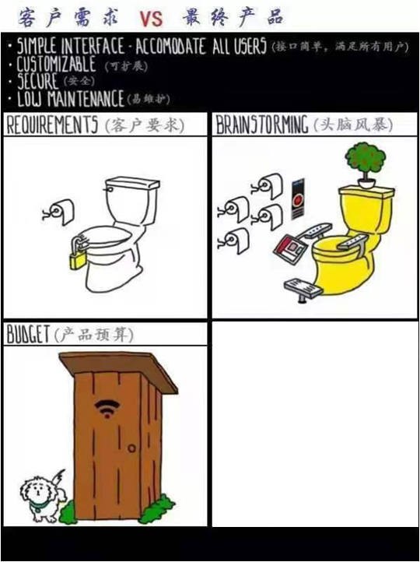
Requirements & Implementation

Slide 6
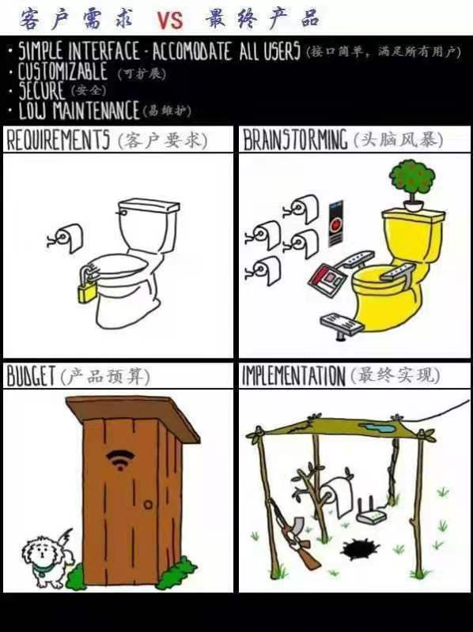
Requirements & Implementation

Slide 7
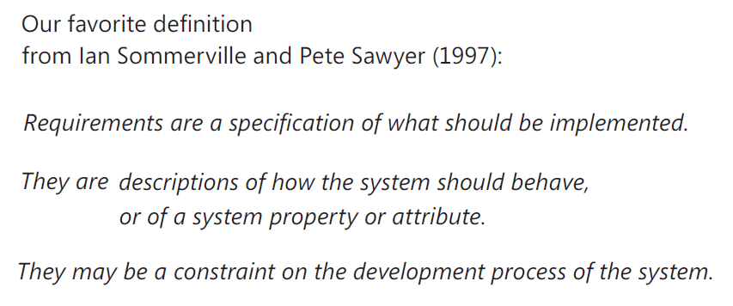
What are Requirements?

Slide 8
Software Requirements
A requirement specifies the business functions that the user will be able to perform using the system-to-be in different “situations” or “contexts”, and the kind of experience the user will have during this work
  Other concerns, such as how the system will manage the resources (computing, network, …), how the system will manage and protect user’s data, etc.
User requirements will often be high-level, vague and incomplete. They are more like high-level goals, or business goals, rather than software requirements needed by the developer
When trying to achieve a given high-level goal, we will need to consider what matters, what are the important parameters, so that we can derive the detailed technical requirements
Only based on deeper understanding of detailed issues, we can identify important "scenarios" or "situations" and identify what parameters should be considered in each situation
Then using these parameters, we decide what the system should do, or how to respond to this situation (i.e., inputs)

Slide 9
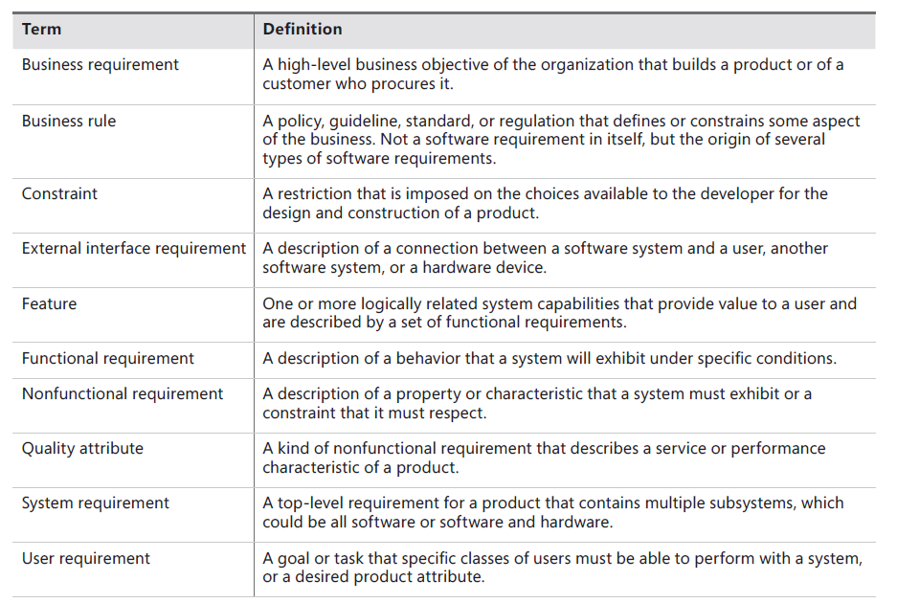

Slide 10
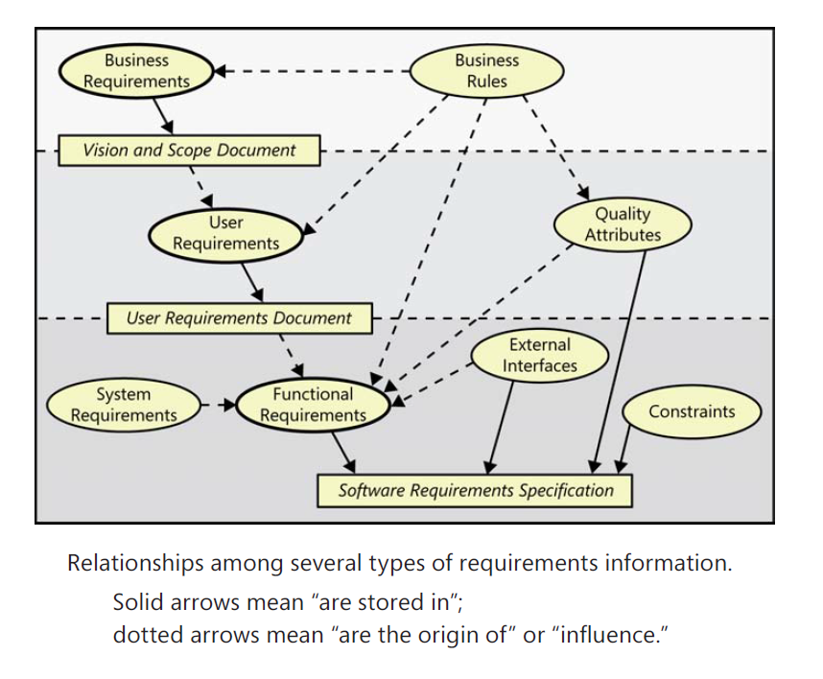

Slide 11
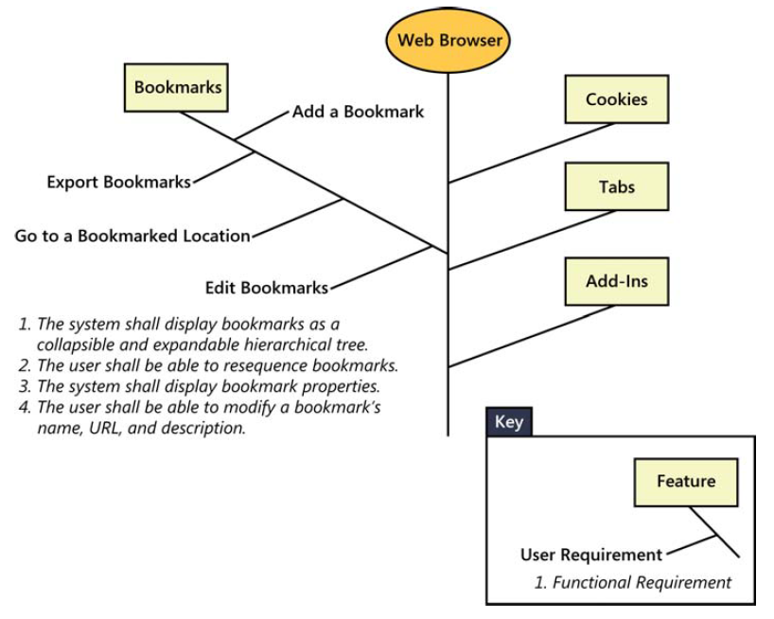
Relationships among features, user requirements, and
functional requirements.

Slide 12
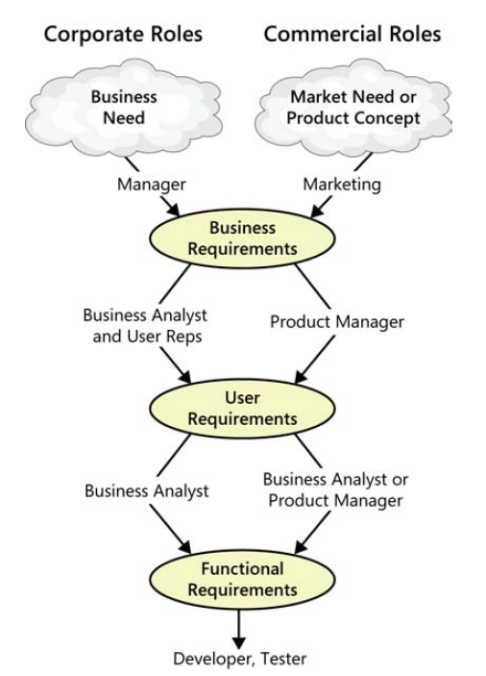
An example of how different stakeholders participate in requirements development.

Slide 13
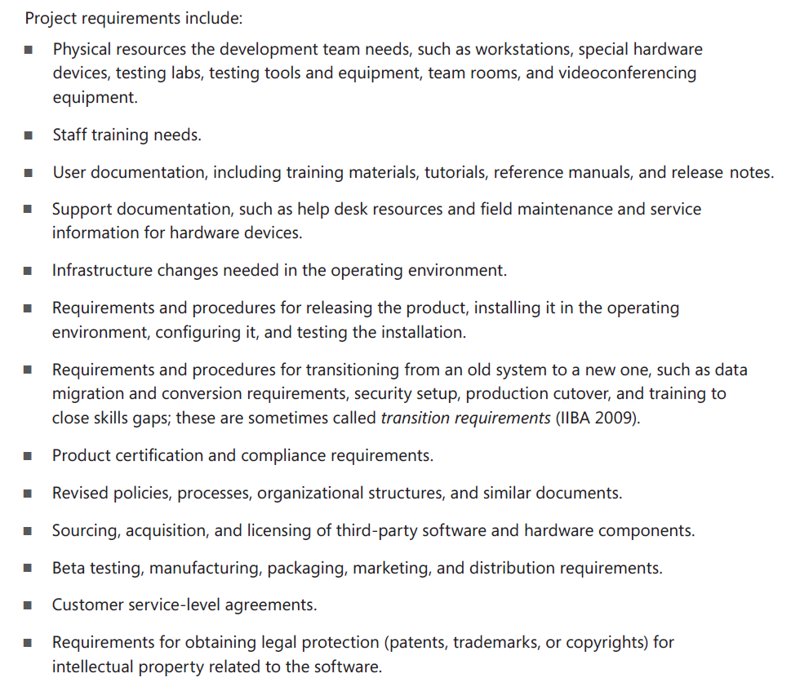
Product (majors) vs. project (minors) requirements

Slide 14
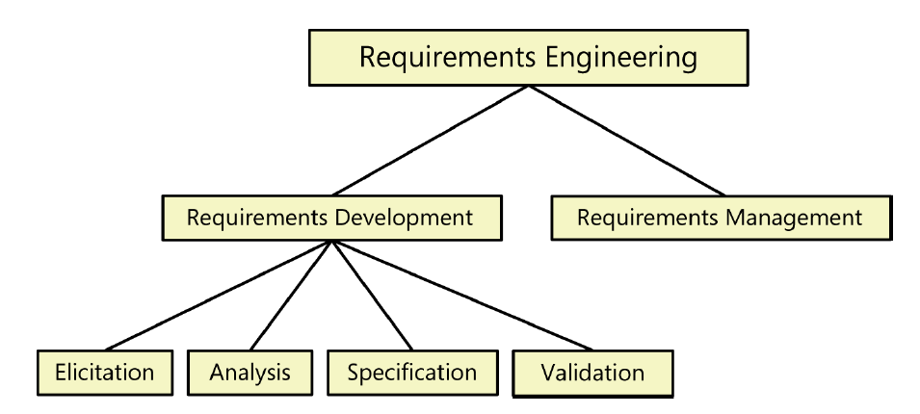

Slide 15
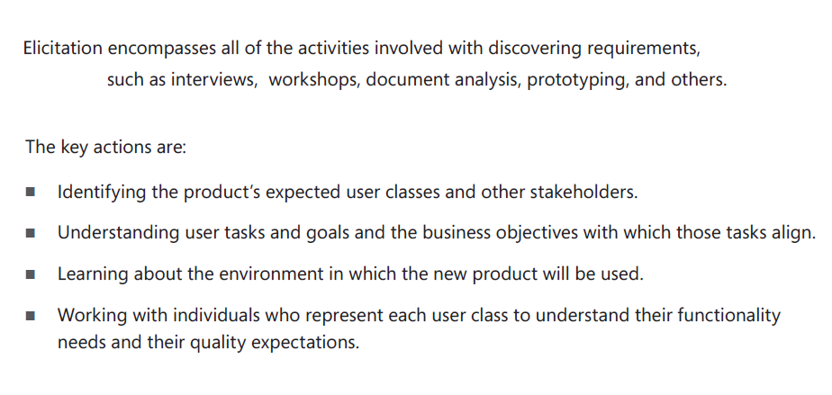
Requirements Elicitation

Slide 16
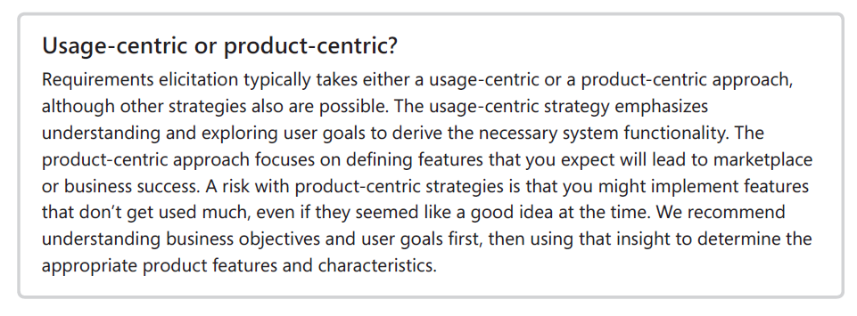

Slide 17
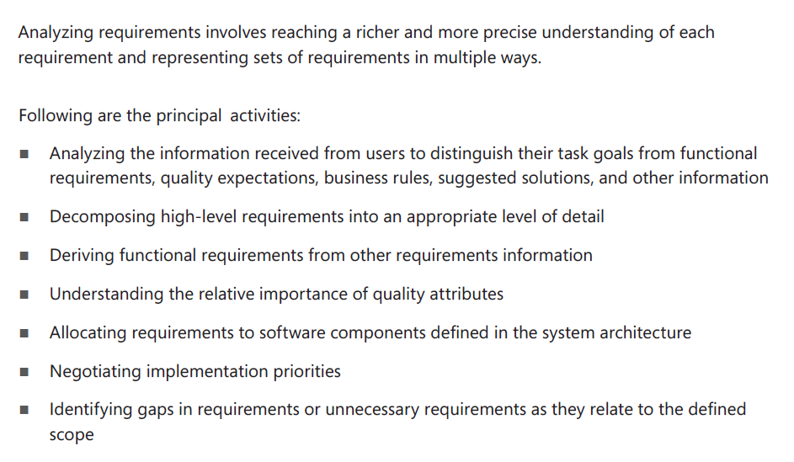
Requirements Analysis

Slide 18
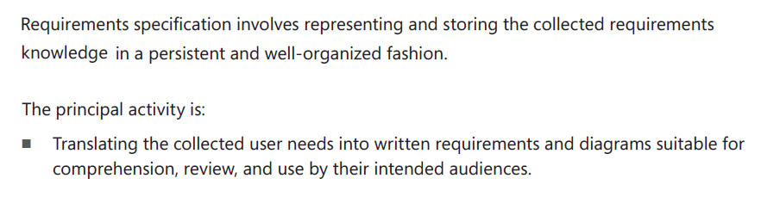
Requirements Specification

Slide 19
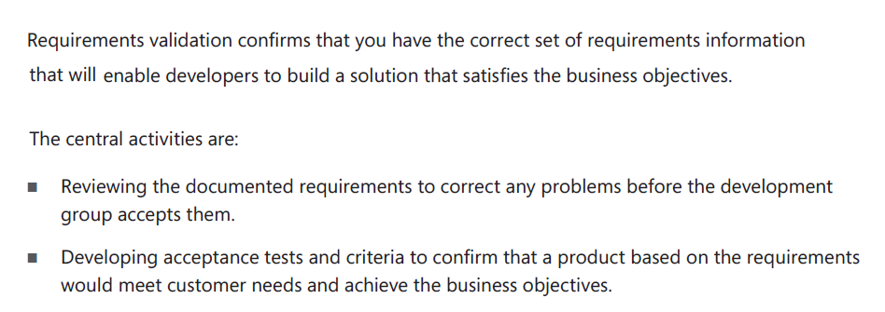
Requirements Validation

Slide 20
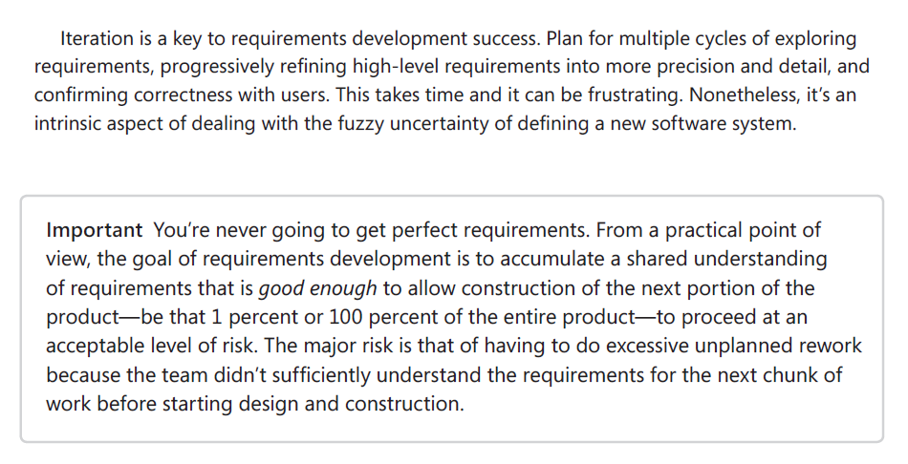
Iteration

Slide 21
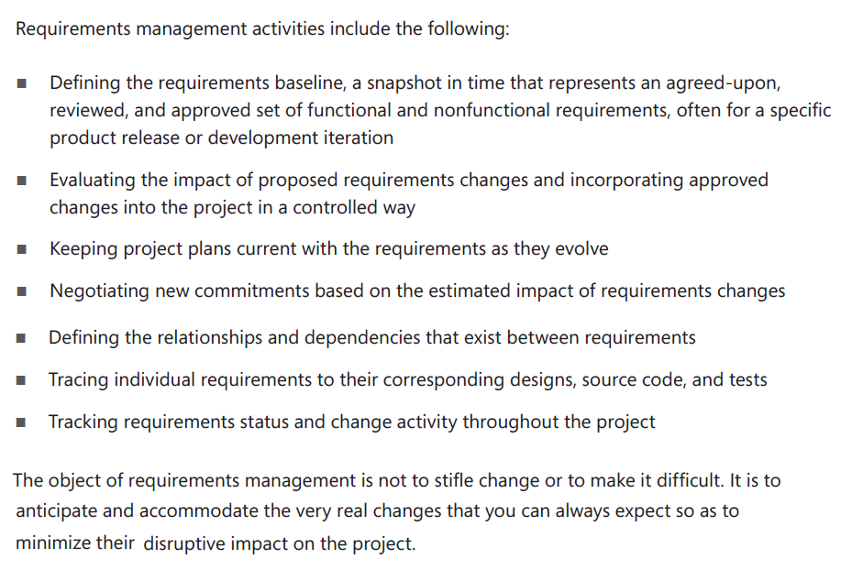
Requirements Management

Slide 22
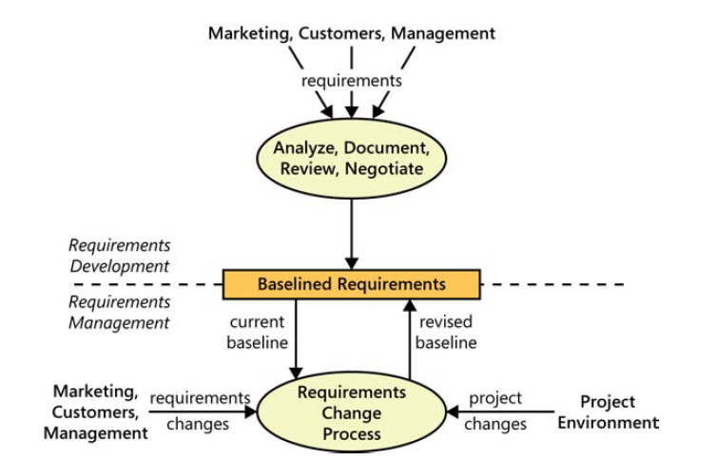
The boundary between requirements development
and requirements management

Slide 23
When bad requirements happen to good people
Insufficient user involvement
Inaccurate planning
Creeping user requirements
Ambiguous requirements
Gold plating
Overlooked stakeholders

Slide 24
Benefits from a high-quality requirements process
Fewer defects in requirements and in the delivered product.
Reduced development rework.
Faster development and delivery.
Fewer unnecessary and unused features.
Lower enhancement costs.
Fewer miscommunications.
Reduced scope creep.
Reduced project chaos.
Higher customer and team member satisfaction.
Products that do what they’re supposed to do.
Even if you can’t quantify all of these benefits, they are real.

Slide 25
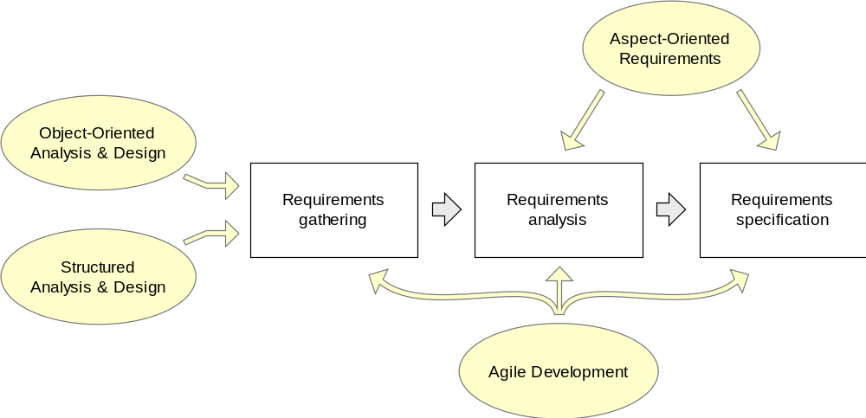
Simplified Requirements Process

Slide 26
Requirements Engineering Components
Requirements gathering
  (a.k.a. “requirements elicitation”) helps the customer to define what is required: what is to be accomplished, how the system will fit into the needs of the business, and how the system will be used on a day-to-day basis
Requirements analysis
  refining and modifying the gathered requirements
Requirements specification
  documenting the system requirements in a semiformal or formal manner to ensure clarity, consistency, and completeness

Slide 27
Practical Requirements Engineering
Test your idea in practice and use the result in further work, iterating through these creative and evaluative steps until a solution is reached
  No one can know all the constraints for a solution before they go through the solving experience
Define the criteria for measuring the success (“acceptance tests”)
Avoid random trial-and-error by relying on domain knowledge (from publications or customer expertise)

Slide 28
Requirements and Specification
Problem domain
Software (Solution) domain
Describes
problem
Requirements
Specifi
cation
Program
Customer
Specifies
Analyzes
Develops
We receive “customer problem statement,” not the requirements!
Software Engineer

Slide 29
Requirements Derivation
Detecting that a problem exists is different from defining the problem and its causes, and solution constraints.
Depending on the cause, the solution will be different.
Requirements are determined by:
Judgment about customer’s business goals and obstacles that currently are hindering their achievement
Conditions on solutions imposed by real-world constraints:
  Physical
  Social/Cultural
  Legal
  Financial
  …
Threats created by adversaries
➔ Requirements are not simply desires!
Requirements are desires adjusted to real-world constraints and threats

Slide 30
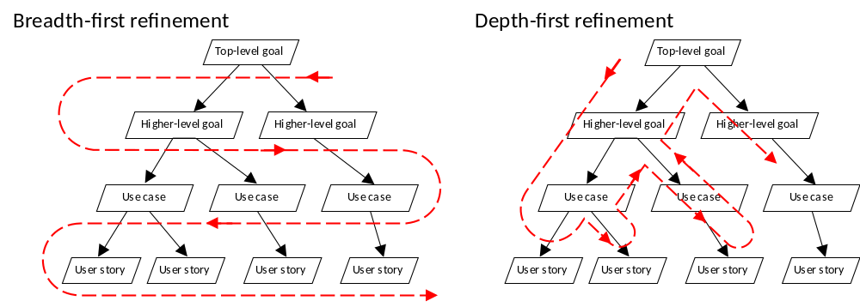
Decomposition of Business Goals

Slide 31
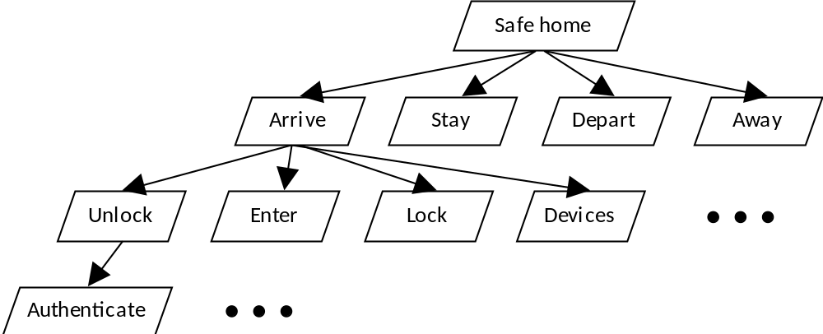
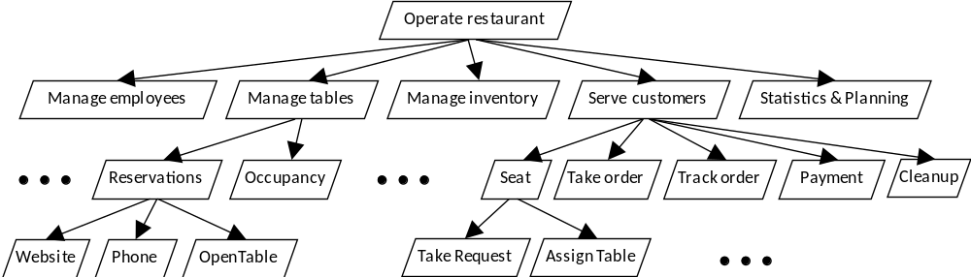
Examples: Safe Home Access
Restaurant Automation

Slide 32
Problem Analysis Examples
Traffic Monitoring:
  Problem: User is delayed to work and needs help
  Cause A: Traffic is unpredictable (predictably high if repeated delays?!)
  Cause B: User is unfamiliar with the route
  Cause C: User has a habit of starting late
Restaurant Automation:
  Problem: Restaurant is operating at a loss and customers are unhappy
  Cause A: Staff is encumbered with poor communication and clerical duties, resulting in inefficiencies
  Cause B: The menu does not match the likeliest customer’s taste
  Cause C: Staff is misbehaving with customers or mismanaging the food supplies
Health Monitoring:
  Problem: User is leading unhealthy lifestyle and experiencing health problems
  Cause A: User is trying to be active but unsure about sufficient level of activity
  Cause B: User is trying to be active but too busy with other duties
  Cause C: User cannot find affordable solutions for active lifestyle
  Cause D: User has poor sleep
  Cause E: User is aware of issues but not motivated to act

Slide 33
Problem Example: Safe Home Access
Problem detected:
inconvenient physical keys or unwanted intrusion
(plus: operating household devices and minimizing living expenses)
Analysis of the Causes:
  User forgets to lock the door or turn off the devices
  User loses the physical key
  Inability to track the history of accesses
  Inability to remotely operate the lock and devices
  Intruder gains access
System Requirements: based on the selected causes

Slide 34
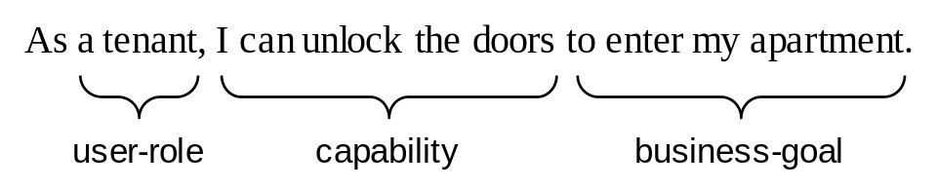
Requirements as User Stories
Preferred tool in agile methods.
Stated in terms of user’s goals and capabilities instead of system features
Written by the customer or user, not by the developer.
The development effort to implement a story is estimated immediately
Acceptance tests are written when the story is identified
Requirements identified only for the next iteration, not for the whole project

Slide 35
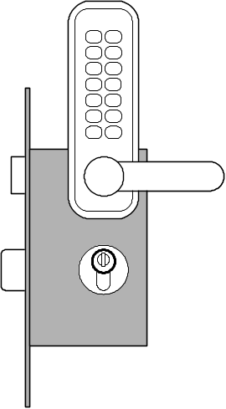
Example User Story Requirements
Safe Home Access
Identifier | User Story | Size
REQ-1 | As a user, I can be sure that the doors by default will be locked. | 4 points
REQ-2 | As a user, I will be able to unlock the doors using a valid key. | 7 points
REQ-3 | An intruder will not be able to unlock the doors by guessing a valid key; the system will block when it detects a “dictionary attack.” | 7 points
REQ-4 | As a user, I can be sure that the doors will be automatically locked at all times. | 6 pts
REQ-5 | The door keypad will be backlit when dark for visibility. | 3 pts
REQ-6 | Anyone will be able to lock the doors on demand. | 3 pts
REQ-7 | As a user, I will be able to manage additional user accounts. | 10 pts
REQ-8 | As a user, I will be able to view the history of accesses to my home. | 6 pts
REQ-9 | As a user, I will be able to configure the preferences for how my household devices will be activated on my arrival. | 6 pts
Note no priorities for user stories
  Story priority is given by its order of appearance on the to-do list
Estimated size points (last column) will be described later (also see Chapter 1)
Compare to IEEE-830 style requirements
  https://en.wikipedia.org/wiki/Software_requirements_specification

Slide 36
Example User Story Requirements
Restaurant Automation
Identifier | User Story | Size
REQ-1 | As a host, I can take a seating request including customer party information, place into the seating queue, and have a table assigned or waiting time estimated. | 10 points
REQ-2 | As a waiter, I can input customer’s order. | 5 points
REQ-3 | As a waiter, I can add special instructions to an order at the customer’s request. | 2 points
REQ-4 | As a waiter, I can notify the chef of the order without walking to the kitchen. | 2 pts
REQ-5 | As a waiter, I can view customer’s bill and enter their payment information. | 7 pts
REQ-6 | As a waiter, I will be notified when an order has been completed. | 2 pts
REQ-7 | As a chef, I can see the queue of orders waiting to be prepared. | 3 pts
REQ-8 | As a chef, I can mark orders as “In Preparation” and “Complete”. | 2 pts
REQ-9 | As a chef, I can modify the menu to make certain dishes available or unavailable if supplies are limited. | 6 pts
REQ-10 | As a chef, I can adjust and update the supply inventory to let the manager know of any lacking ingredients. | 7 pts
After requirements analysis:
Identifier | User Story | Size
REQ-2a | As a waiter, I can input orders at different times for customers at the same table. | 7 points
REQ-2b | As a waiter, I can input different courses at different times for the same customer. | 5 pts
REQ-2c | As a waiter, I can input side plates after the main course is served. | 2 pts

Slide 37
Requirements Analysis
Requirement REQ-3 states that intruders will not be able to succeed with a “dictionary attack,” but many details need to be considered and many parameters determined (“business policies”)
  What distinguishes user’s mistakes from “dictionary attacks”
    The number of allowed failed attempts, relative to a predefined threshold value
      The threshold shall be small, say three ⬅ business policy!
  How is the mechanical lock related to the “blocked” state?
    Can the user use the mechanical key when the system is “blocked”?
Requirement REQ-5 states that the keypad should be backlit when dark
  Is it cost-effective to detect darkness vs. keep it always lit?
Etc.
Requirements analysis should not be exhaustive,
but should neither be avoided.

Slide 38
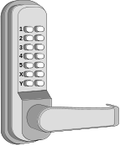
Problem Domain:
How Electronic Lock Works
We may need separate descriptions/models of door vs. lock.
Door state is what the user cares about; lock is one way of achieving it.
Computer
Lock
Voltage:
HIGH
Physical domain (lock) description; used in specification
LOW
lock armed
lock disarmed
lock armed
Semantic meaning defined by user’s goals; used in requirements
The behavior of the system-to-be determined not only by user’s actions
but also by the context (“situation”).
E.g., what in case of power failure?
  - By default armed
  - By default disarmed (e.g., fire exit)

Slide 39
Analyst’s Task: Three Descriptions
The requirement
The problem domain
The specification
What user wants:
When valid keycode entered & Unlock pressed, open the lock;
Automatically lock after a period of time.
How problem domain behaves:
What software-to-be will do (at interface):
If entered number matches one of stored numbers & Button-1 pressed, put HIGH voltage on Output-port-1;
Start a timer countdown;
When the timer expires,
put LOW voltage on Output-port-1.
Armed
Electromechanical lock
HIGH VOLTAGE /
LOW VOLTAGE /
Disarmed
Concern:
It is not obvious that this is the only or even “correct” solution to the requirement-posed problem.
Problem Frames tell us what each description should contain and how to verify the concern.

Slide 40
From Requirements to Business Policies
Explicit identification of business policies is important for two reasons:
Making the need for BP explicit allows involving other stakeholders, particularly the customer, in decision making about the BP solutions to adopt
Helps to anticipate potential future changes in the policies, so mechanisms can be implemented in the code that localize the future changes and allow quick substitution of implemented business policies
These issues too important to be left to the programmer to make ad-hoc decisions and hard-code them.

Slide 41
Requirements Analysis Activities
Not only refinement of customer requirements, but also feasibility and how realistic
Needs to identify the points where business policies need to be applied.
Explicit identification of business policies (BP) is important for two reasons:
  Making the need for BP explicit allows involving other stakeholders in decision about the solutions to adopt—Helps to involve others, particularly the customer, in decision making about each policy to adopt
  Helps to anticipate potential future changes in the policies, so mechanisms can be implemented in the code that localize the future changes and allow quick substitution of business policies

Slide 42
Types of Requirements
Functional Requirements
Non-functional requirements (or quality requirements)
  FURPS+
  Functionality (security), Usability, Reliability, Performance , Supportability
User interface requirements

Slide 43
FURPS+
Functional (features, capabilities, security)
Usability (human factors, help, documents)
Reliability (failures, recovery, predictable)
Performance (response, throughput, etc)
Supportability (maintainability, configuration)
+ ancillary and sub-factors (next slide)

Slide 44
Ancillary and sub-factors
Implementation (includes limitations)
Interface
Operations
Packaging
Legal Requirements

Slide 45
Functional Requirements
Detailed in the Use Case Model and in the System Features list of the Vision artifact. They are specified in detail in Operation Contracts where necessary.

Slide 46
Non-functional requirements
Often called the “-ilities” of a system; quality, reliability, usability, performance, etc.
The glossary, data dictionary and supplemental specifications describe many non-functional requirements.
In addition, architectural documents may have non-functional requirements.

Slide 47
Tools for Requirements Eng.
Tools, such as user stories and use cases,
used for:
  Determining what exactly the user needs (“requirements analysis”)
  Writing a description of what system will do (“requirements specification”)
Difficult to use the same tool for different tasks (analysis vs. specification)

Slide 48
Acceptance Tests
Each requirement describes for a given “situation” (i.e., system inputs), the output or behavior the system will produce
  The “output” represents the user’s need or business goal
An acceptance test specifies a set of scenarios for determining whether the (part of the) system meets the customer requirements
An acceptance test case specifies, for a given “situation” or “context” (defined by current system inputs), the output or behavior the system will produce in response
We cannot ever guarantee 100% coverage of all usage scenarios, but systematic approach can increase the expected degree of coverage
[See examples in Appendix G of the TextA]

Slide 49
Project Estimation using User Story Points
Similar to “hedge pruning points” in the first lecture
Points assigned to individual user stories
Total work size estimate:
  Total size = Σ points-for-story i (i = 1..N)
Velocity (= productivity) estimated from experience
Estimate the work duration
Project duration =
Path size
Travel velocity

Slide 50
Example User Stories
Identifier | User Story | Size
REQ-1 | As an authorized user, I will be able to keep the doors by default always locked. | 4 points
REQ-2 | As an authorized user, I will be able to unlock the doors using a valid key. | 7 points
REQ-3 | An intruder will not be able to unlock the doors by guessing a valid key; the system will block upon a “dictionary attack.” | 7 points
REQ-4 | The door will be automatically locked after being open for a defined period of time. | 6 pts
REQ-5 | As a user, I will have the door keypad backlit when dark for visibility. | 3 pts
REQ-6 | Anyone will be able to lock the doors on demand. | 2 pts
REQ-7 | As a landlord, I will be able at runtime to manage user authorization status. | 10 pts
REQ-8 | As an authorized user, I will be able to view the history of accesses and investigate “suspicious” accesses. | 6 pts
REQ-9 | As an authorized user, I will be able to configure the preferences for activation of household devices. | 6 pts

Slide 51
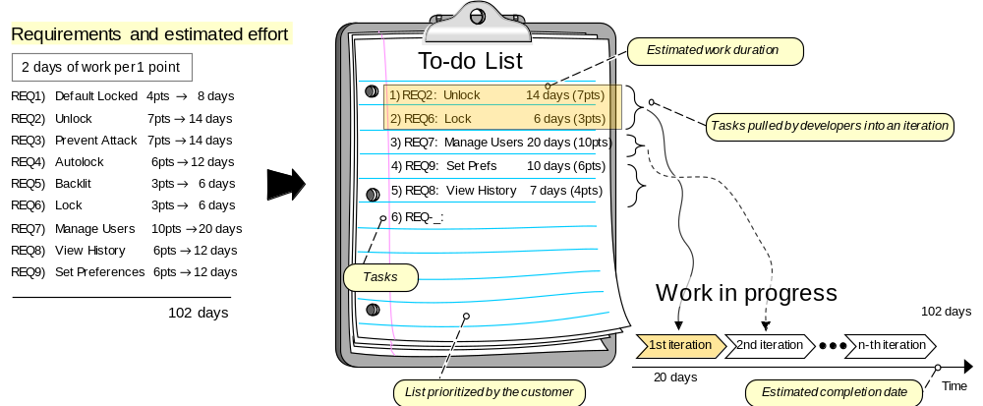
Agile Estimation of Project Effort
Instead of assigning priorities, the customer creates an ordered list of user stories ➔ TO-DO LIST
Developers simply remove the top list items and work on them in the next iteration ➔ IN-PROGRESS LIST

Slide 52
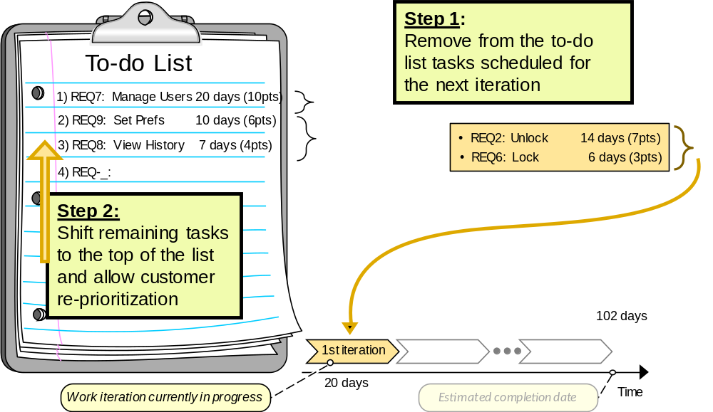
Tradeoff between Customer Flexibility and Developer Stability
Items pulled by developers into an iteration are not subject to further customer prioritization
Developers have a steady goal until the end of the current iteration
Customer has flexibility to change priorities in response to changing market forces
[ Read more in Section 1.4.1 of TextA ]

Slide 53
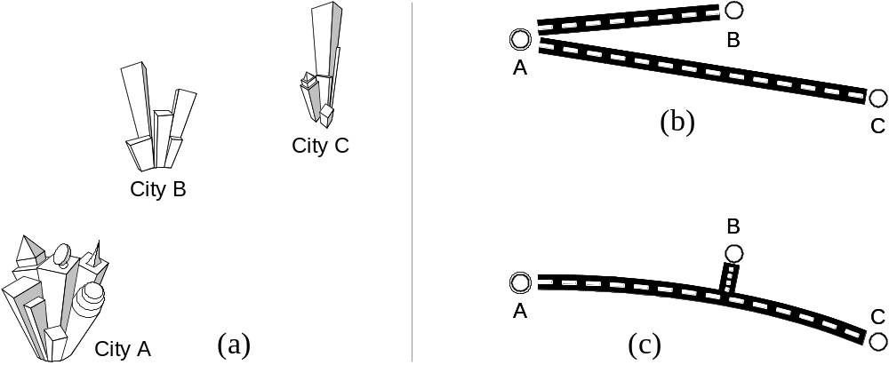
How To Combine the Part Sizes?
Costs are not always additive
But, solution (c) is not necessarily “cheaper” than (b) …

Slide 54
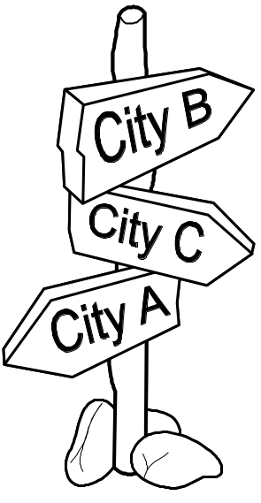
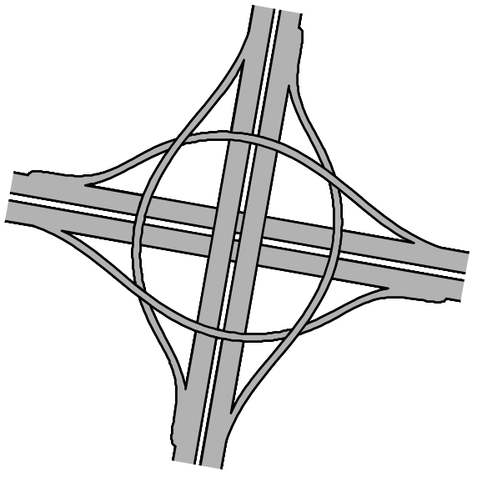
Additional Costs
Highway traffic-circle interchange
Traffic signs

