Slide 1
Software Engineering
WarmUp Programming Exercise
Dr. 何明昕, He Mingxin, Max
c.max @ yeah.net
Email Subject：SE-yourID-Name: TOPIC
Download c.program @ yeah.net
/文件中心/网盘/SoftwareEnginerring26S

Slide 2
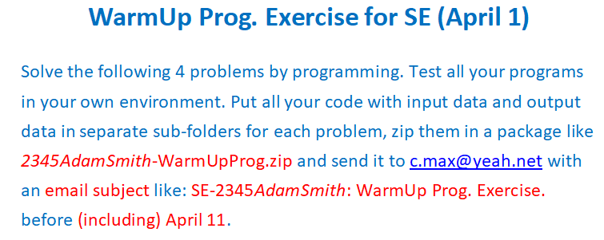
Exercise 04 (April 1)
1) Read 2.3, 2.4 of TextBook. (in 1-2 weeks)
2) Read Appendix G (p449-476) of TextBook (in 3-4 weeks)
( Continue to write work-log as before ☺ )

Slide 3
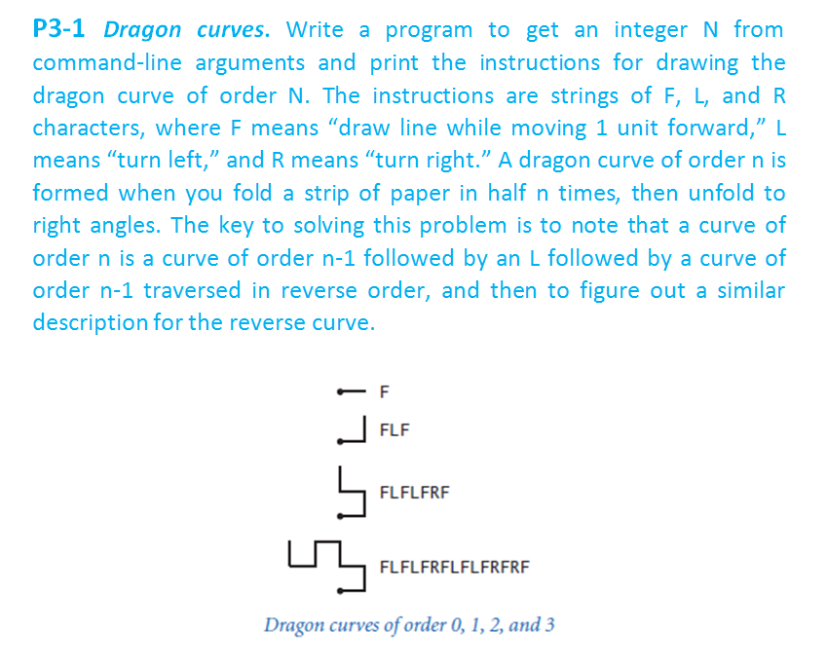

Slide 4
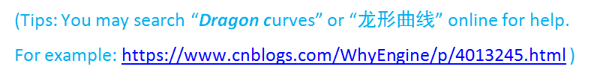
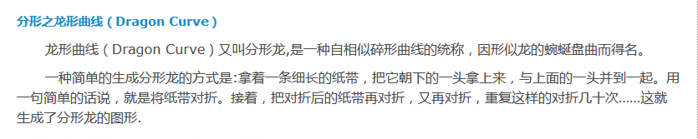
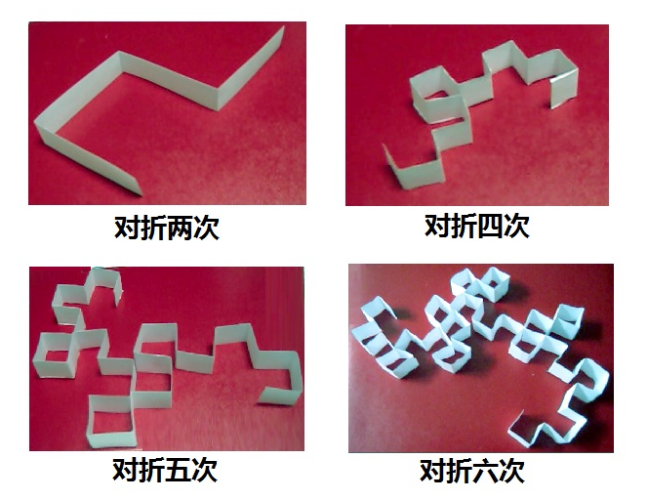

Slide 5
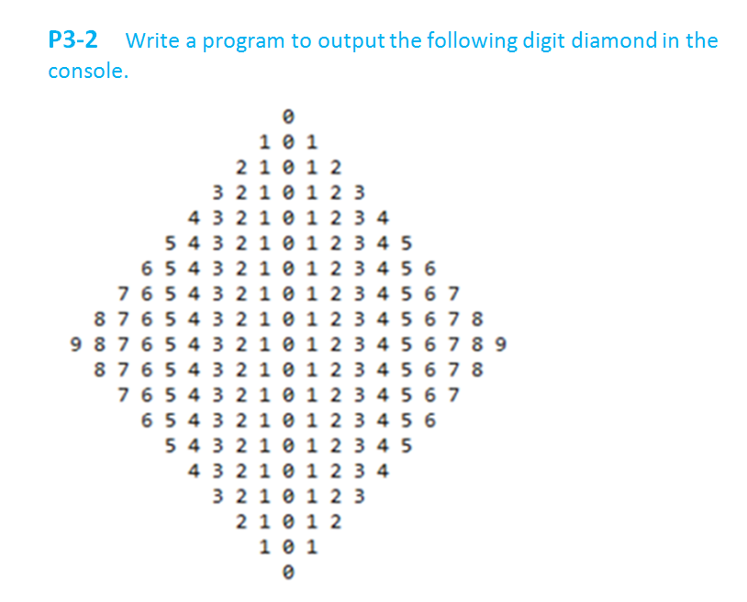

Slide 6
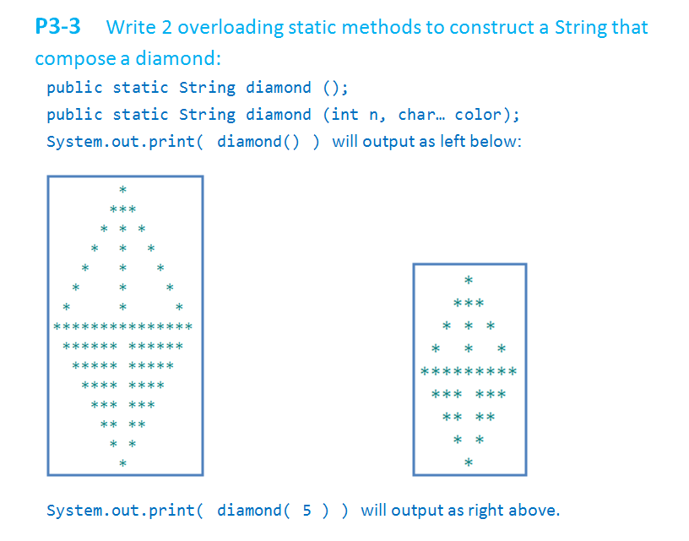

Slide 7
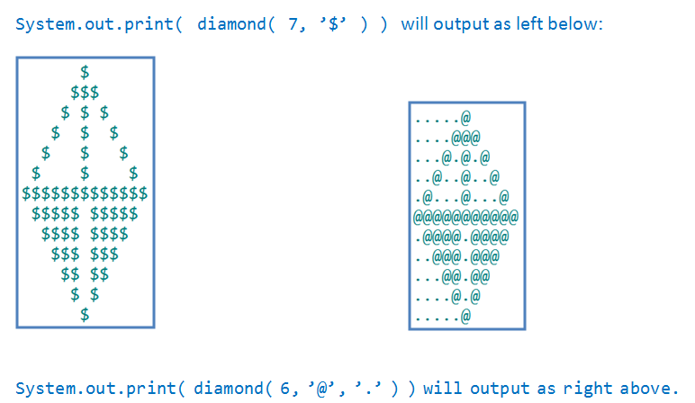
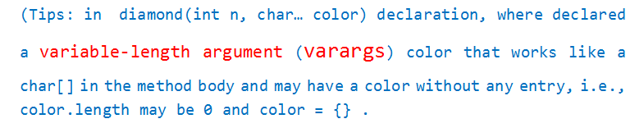

Slide 8
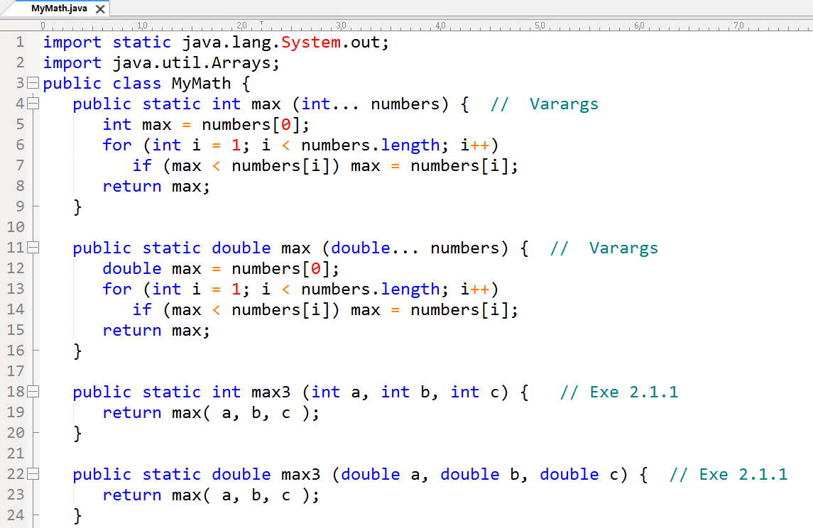

Slide 9
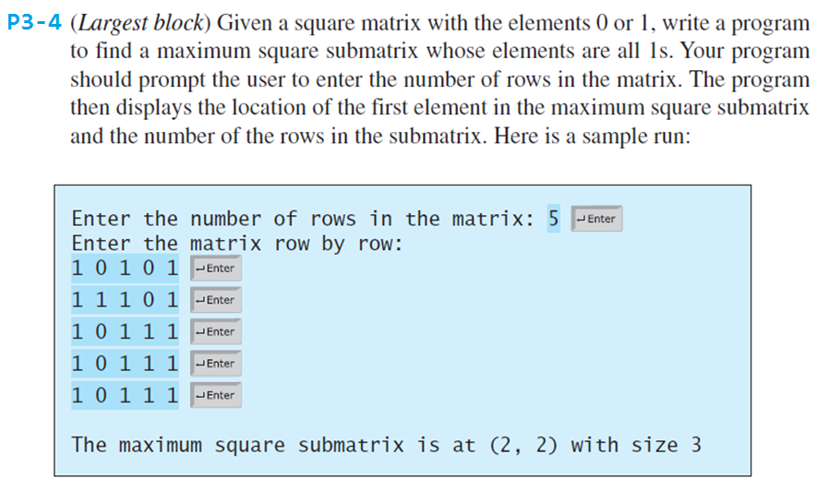

Slide 10
Tips:
If int[][] a = int[N][N] with elements 0 or 1,
let int[][] s = int[N][N], s[r][c] denotes the size of the maximum sub-matrix start from a[r][c] towards right-down direction.
Then we could compute s[r][c] in the following way (using pseudo-code):
s[N-1][N-1 .. 0] = a[N-1][N-1 .. 0] // last row
s[N-2 .. 0][N-1] = a[N-2 .. 0][N-1] // last column
for (r from N-2 down to 0)
for (c from N-2 down to 0)
s[r][c] = (a[r][c] == 0) ? 0 :
1 + min(s[r][c+1], s[r+1][c], s[r+1][c+1])

Slide 11
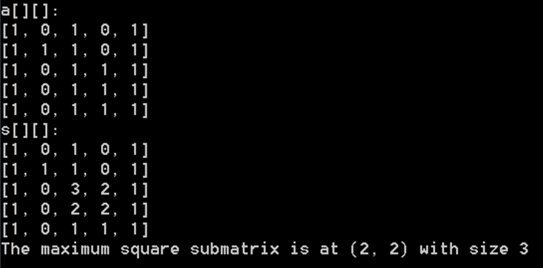
The Output may be changed to the following example.

Slide 12
Reactive Systems Use Cases Domain Models Sample Case Studies (self-learning in 3-4 weeks)
Next Up

