Slide 1
Solutions for WarmUp Prog.

Slide 2
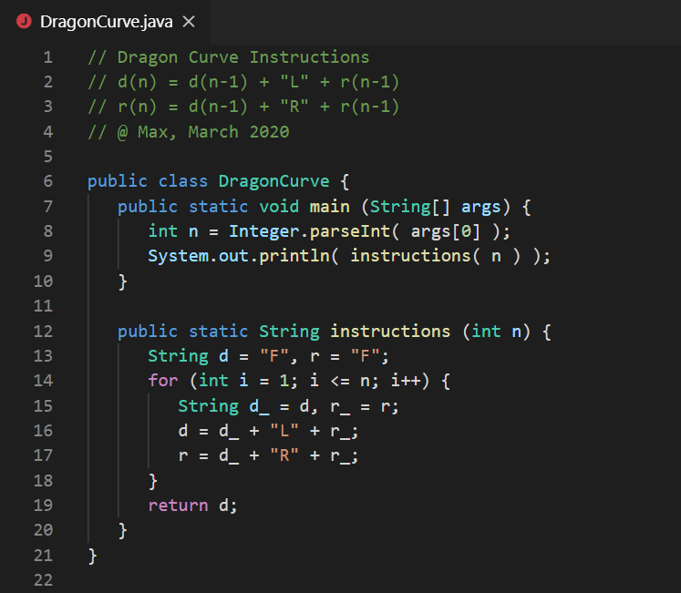

Slide 3
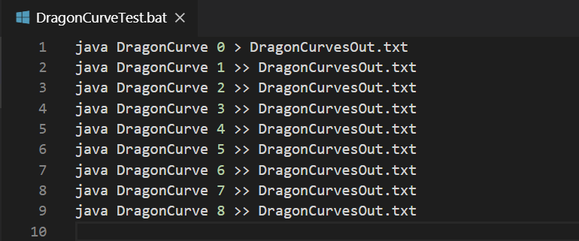
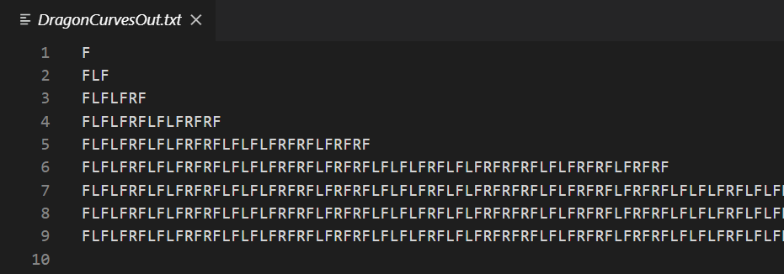

Slide 4
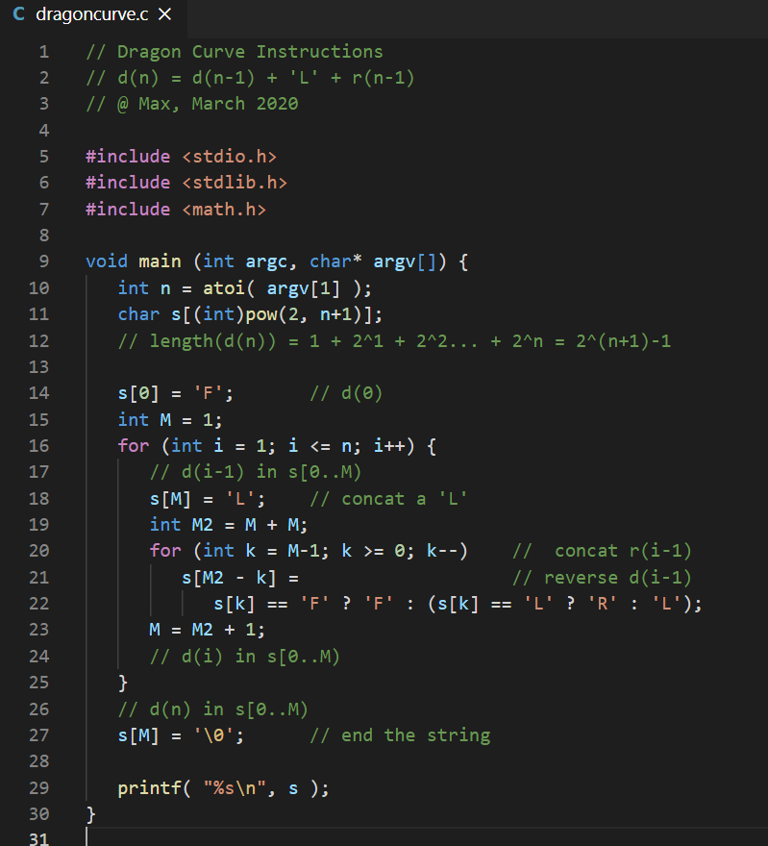

Slide 5
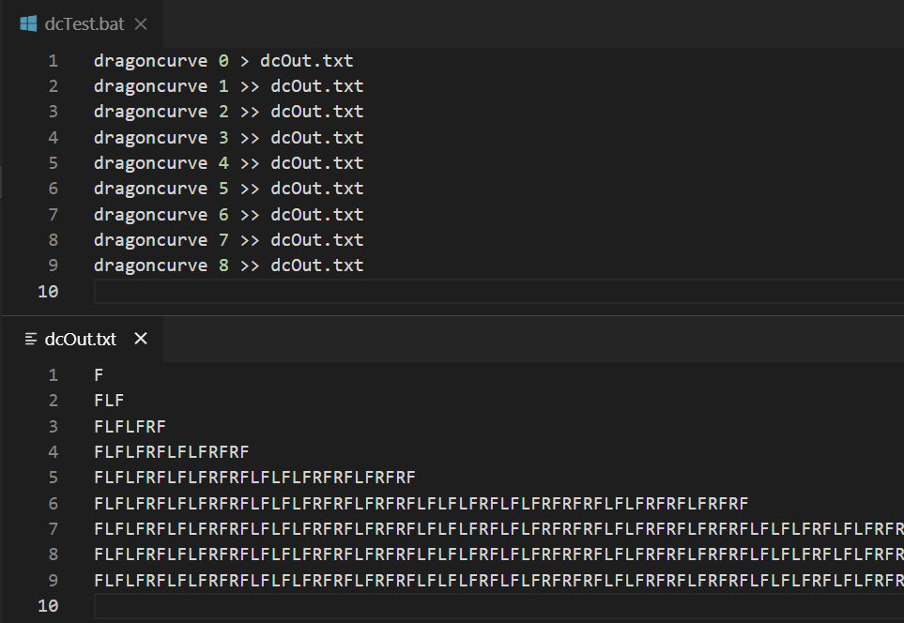

Slide 6
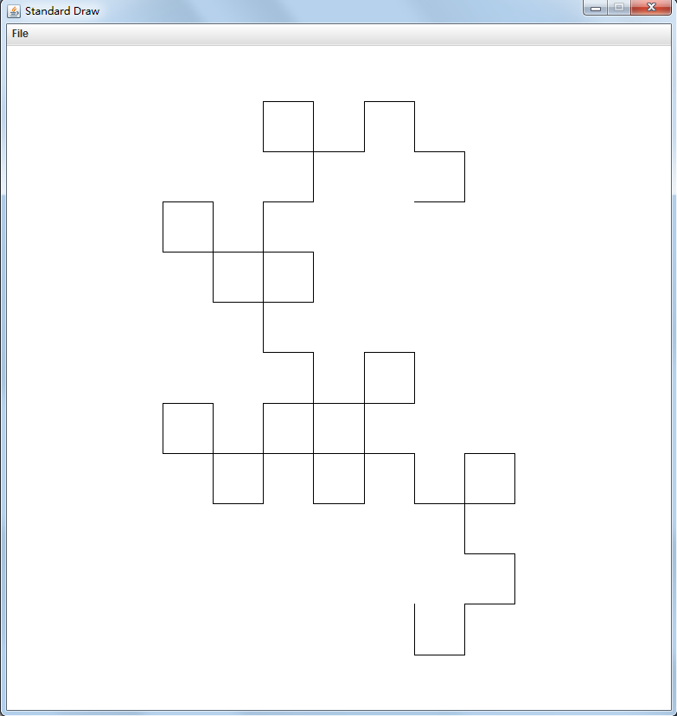
Dragon Curve
Level 6

Slide 7
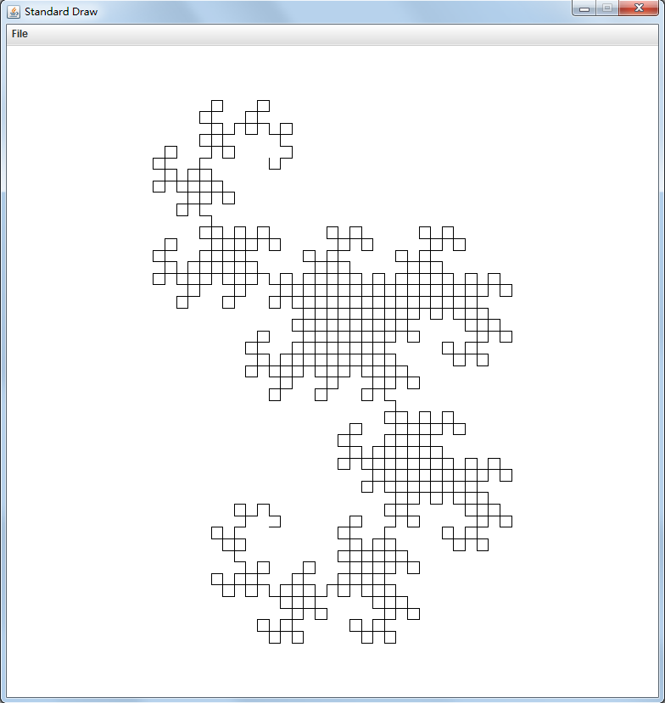
Dragon Curve
Level 10

Slide 8
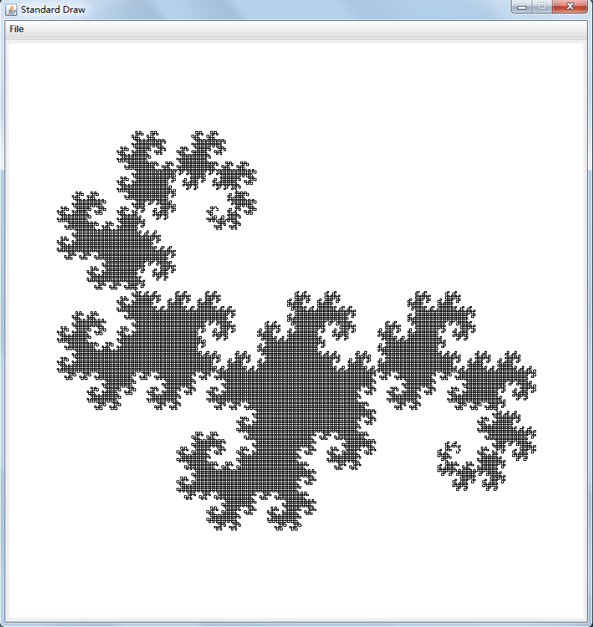
Dragon Curve
Level 15

Slide 9
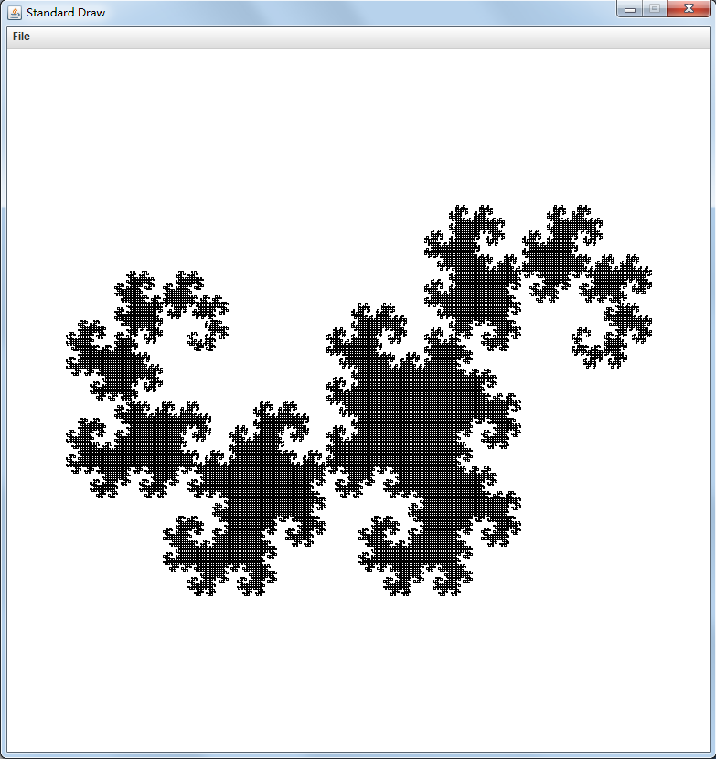
Dragon Curve
Level 16

Slide 10
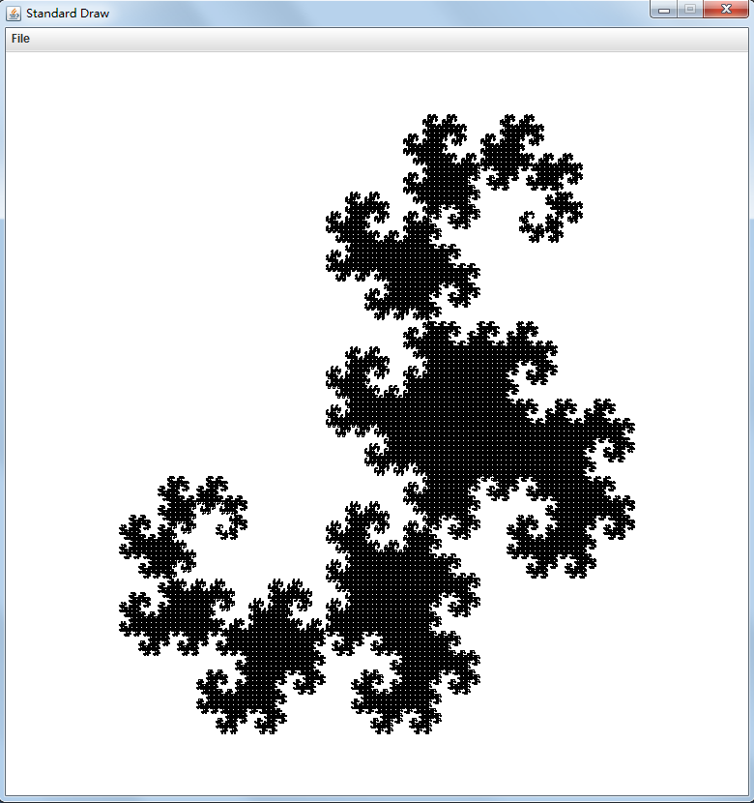
Dragon Curve
Level 17

Slide 11
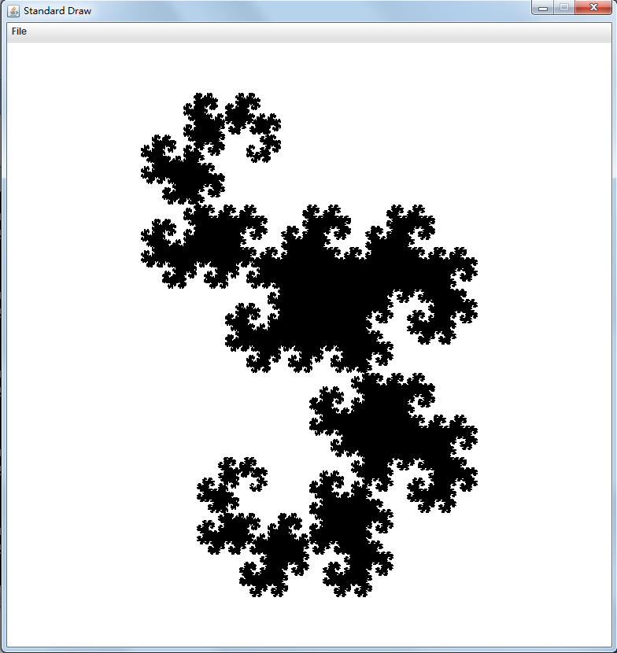
Dragon Curve
Level 18

Slide 12
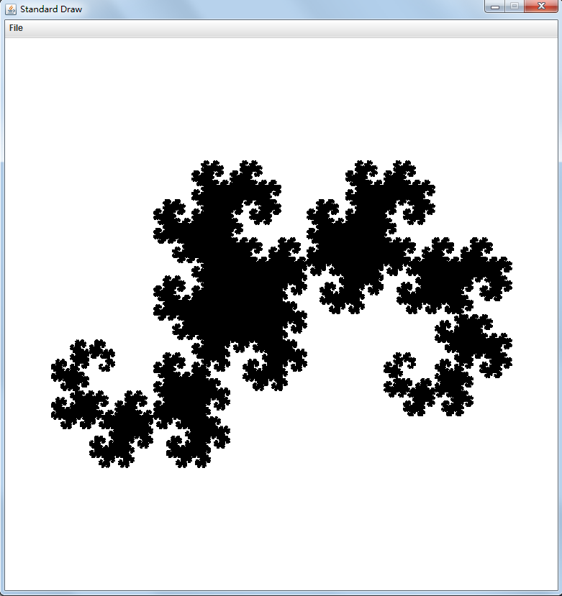
Dragon Curve
Level 20

Slide 13
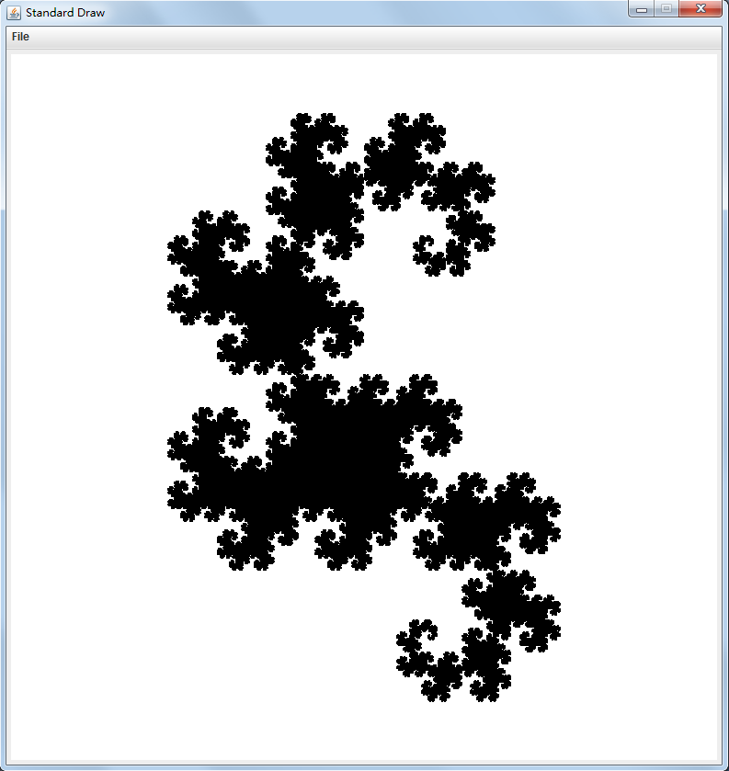
Dragon Curve
Level 22

Slide 14
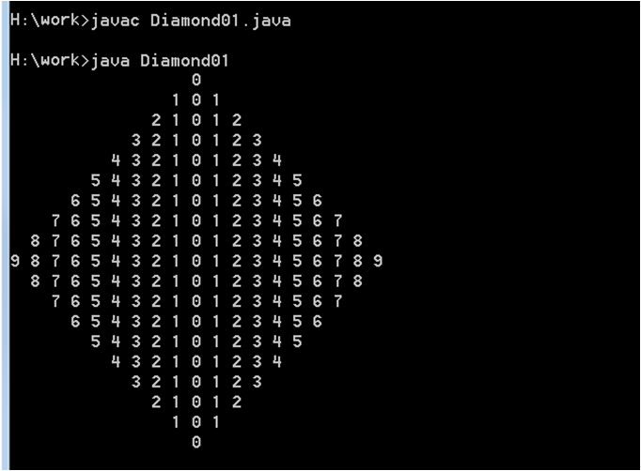
The easiest way:
KISS: Keep It Simple & Stupid

Slide 15
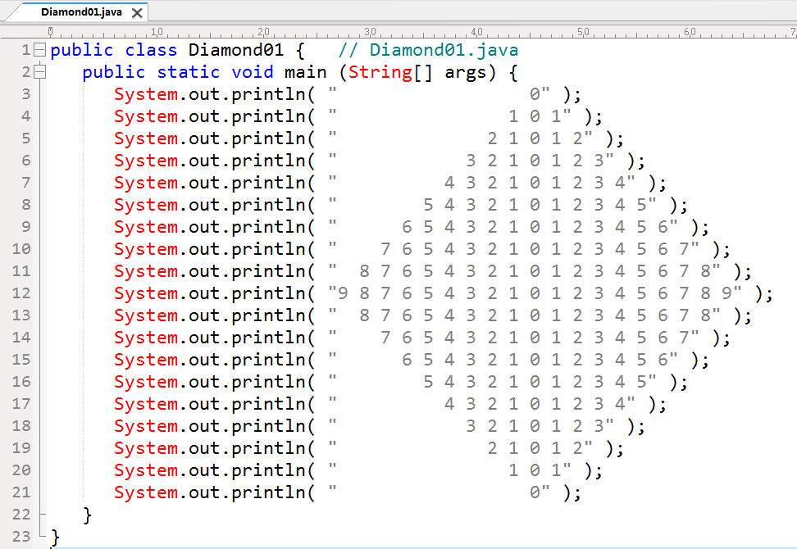
19 actions. Too much Duplication!

Slide 16
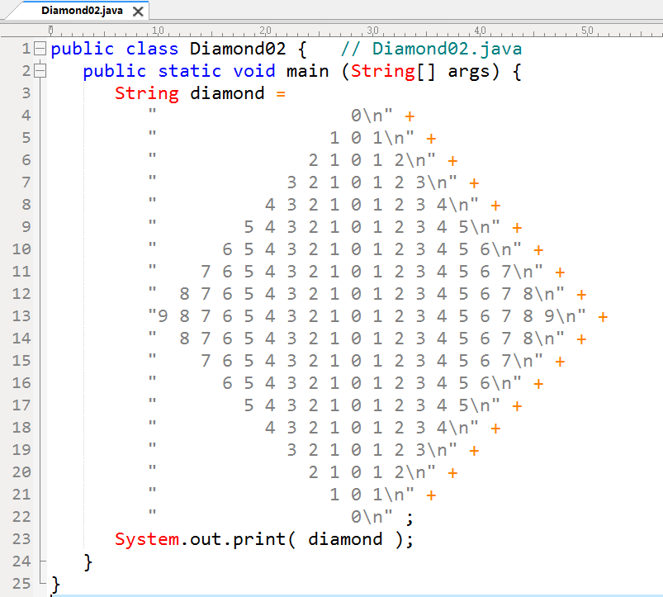
1 String
With
Structs.
1 action!
Works,
But
Not
Flexible!

Slide 17
The Patterns:
Each line : Blanks + mirrorDigits + newLine
Top Part [0 .. n] + Bottom Part [n-1 .. 0]
Beyond 0 .. 9
A .. Z : 10 .. 35
Conditional Operator ( ? : )
v = condition ? exp1 : exp2;
if (condition) v = exp1;
else v = exp2;

Slide 18
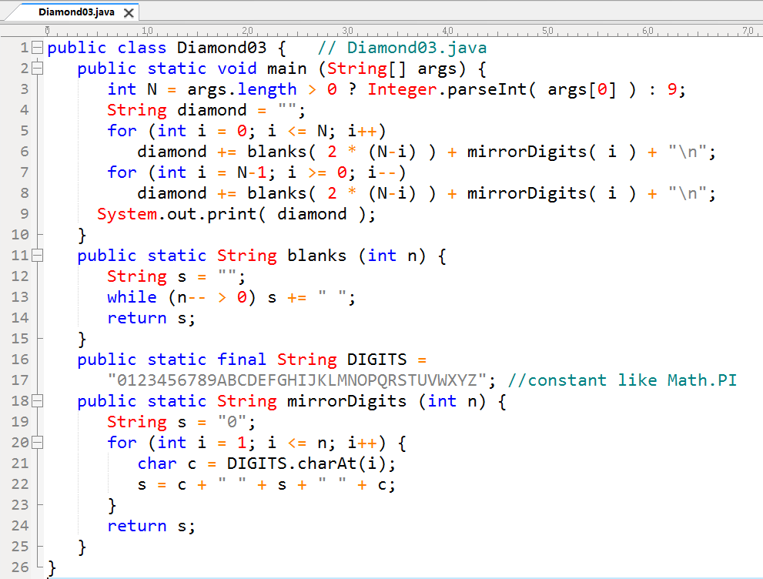

Slide 19
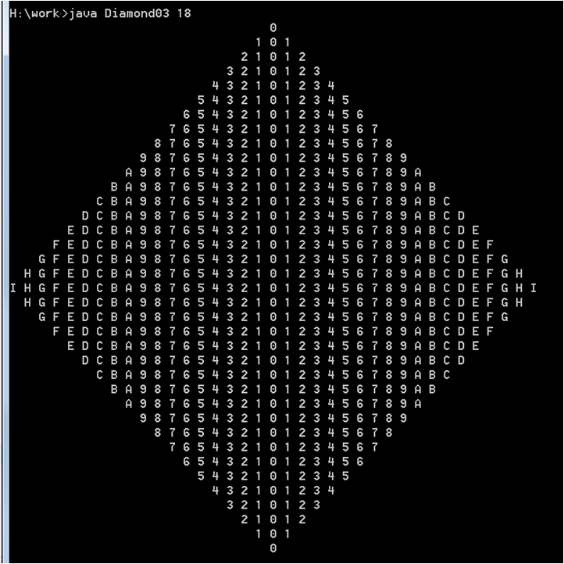

Slide 20
The Patterns:
Each line : Blanks + mirrorDigits + newLine
Top Part [0 .. n] + Bottom Part [n-1 .. 0]
Mapping:
Line: 0 .. 2n
In Top Part [0 .. n], i = line when line <= n;
In Bottom Part [n-1 .. 0], i = 2n – line when line > n.
i = line <= n ? line : 2*n - line;

Slide 21
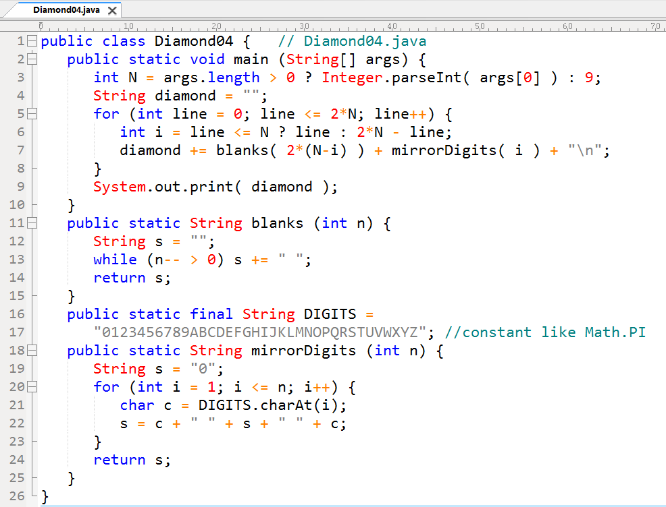

Slide 22
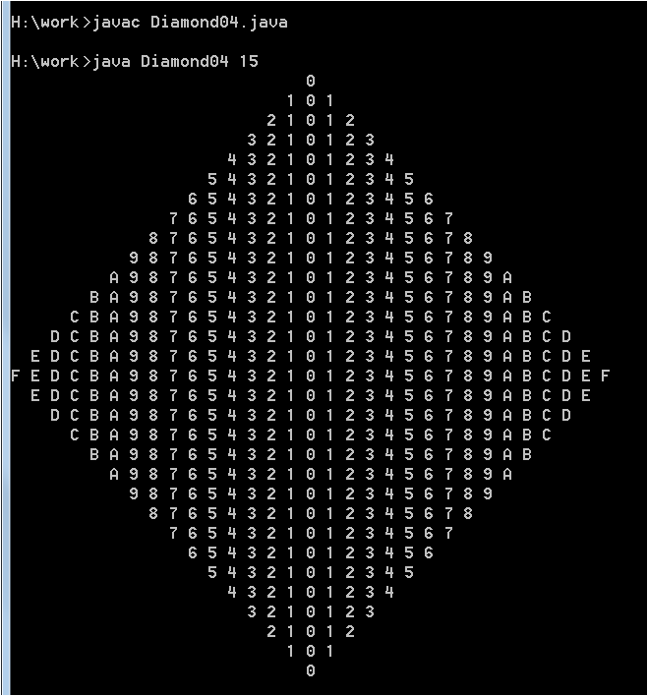

Slide 23
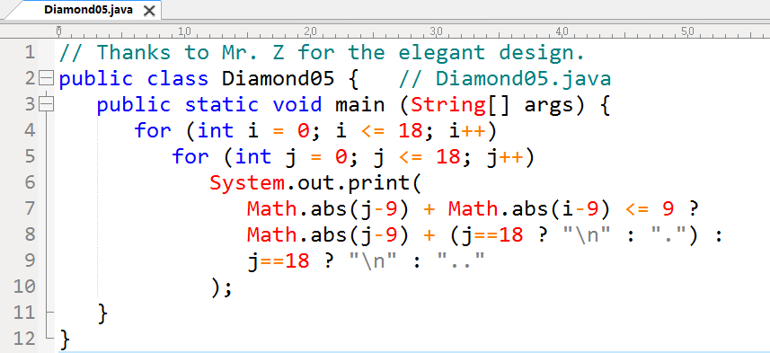

Slide 24
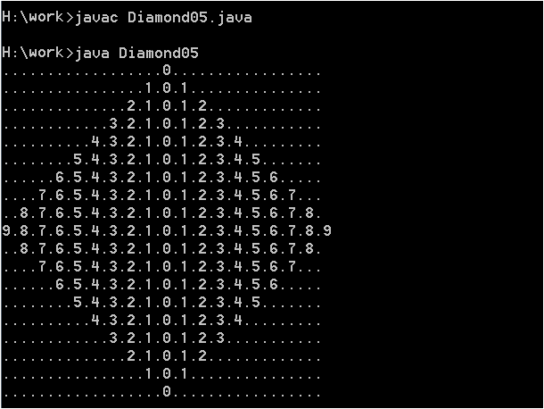

Slide 25
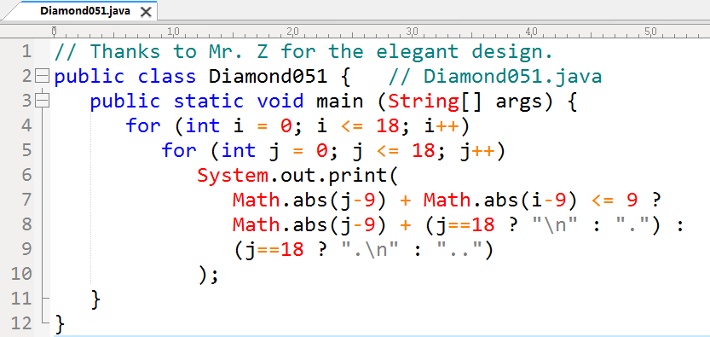

Slide 26
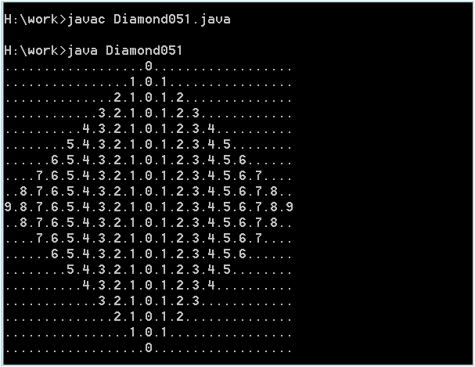

Slide 27
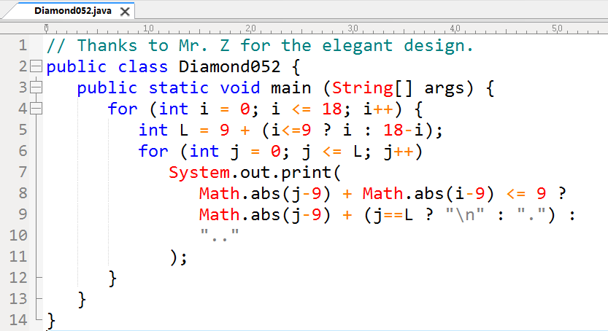

Slide 28
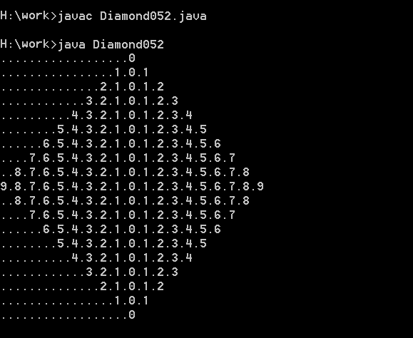

Slide 29
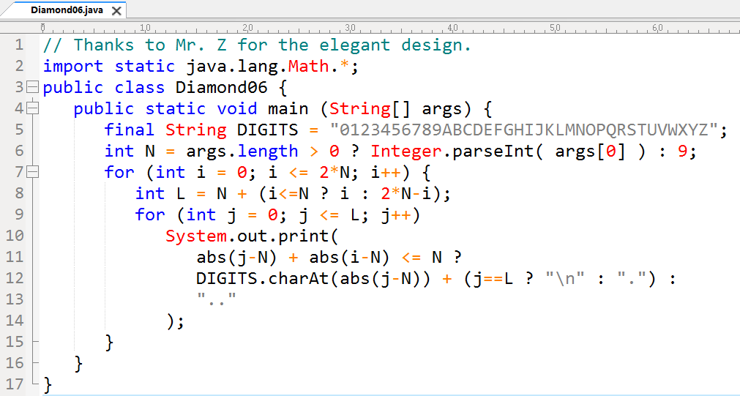

Slide 30
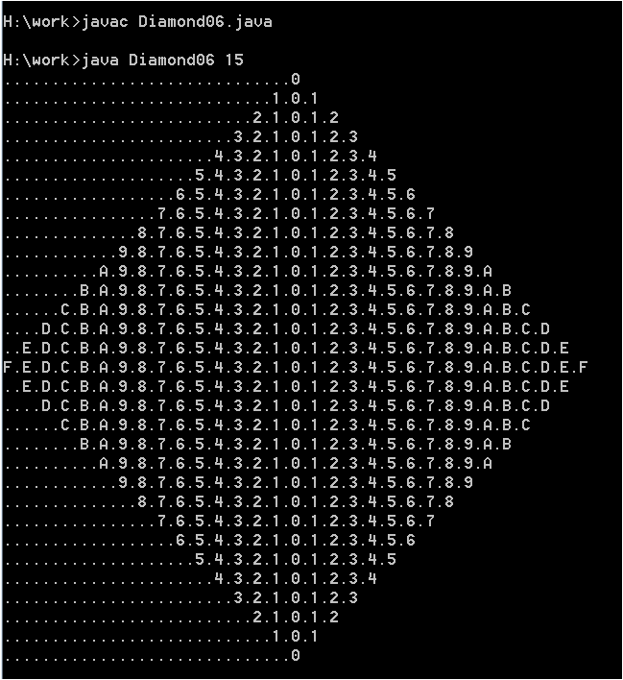

Slide 31
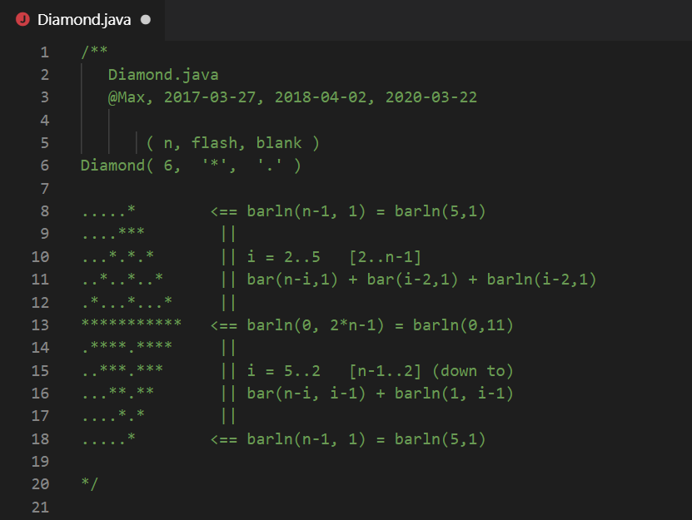

Slide 32
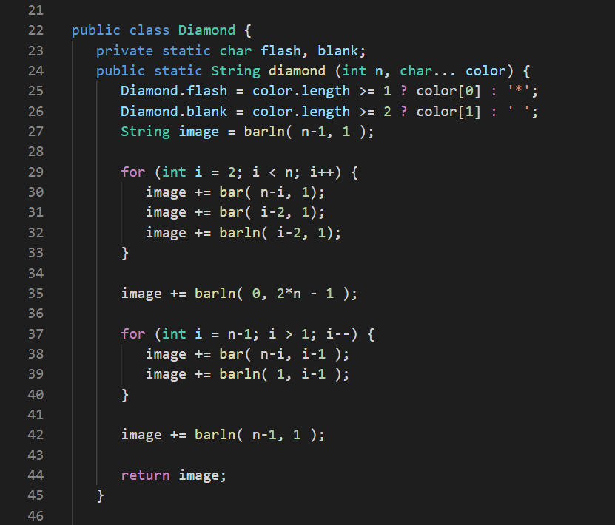

Slide 33
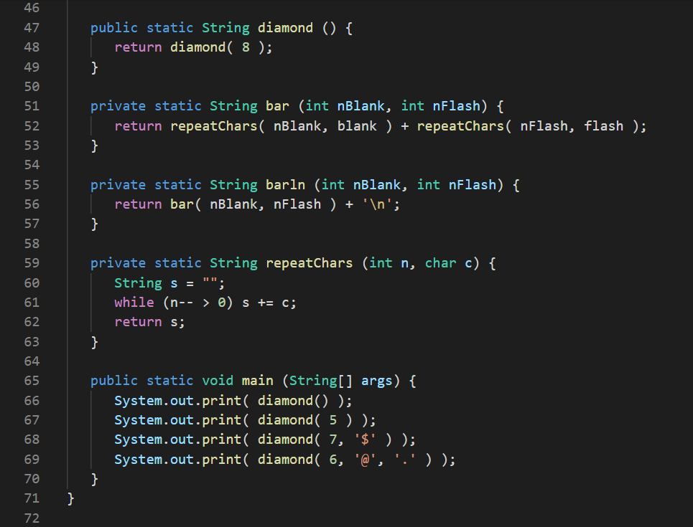

Slide 34
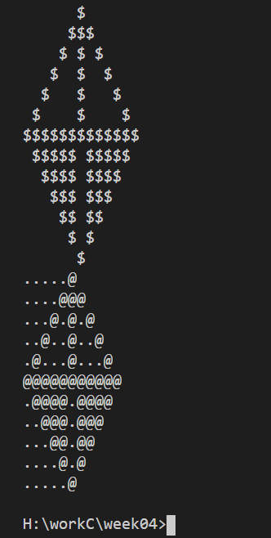
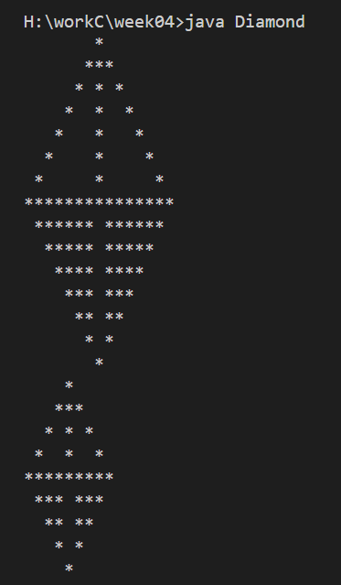

Slide 35
Tips:
If int[][] a = int[N][N] with elements 0 or 1,
let int[][] s = int[N][N], s[r][c] denotes the size of the maximum sub-matrix start from a[r][c] towards right-down direction.
Then we could compute s[r][c] in the following way (using pseudo-code):
s[N-1][N-1 .. 0] = a[N-1][N-1 .. 0] // last row
s[N-2 .. 0][N-1] = a[N-2 .. 0][N-1] // last column
for (r from N-2 down to 0)
for (c from N-2 down to 0)
s[r][c] = (a[r][c] == 0) ? 0 :
1 + min(s[r][c+1], s[r+1][c], s[r+1][c+1])

Slide 36
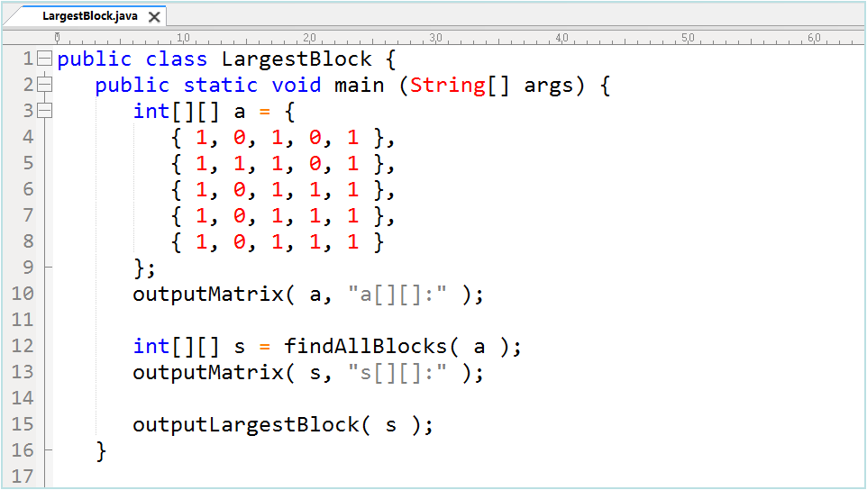

Slide 37
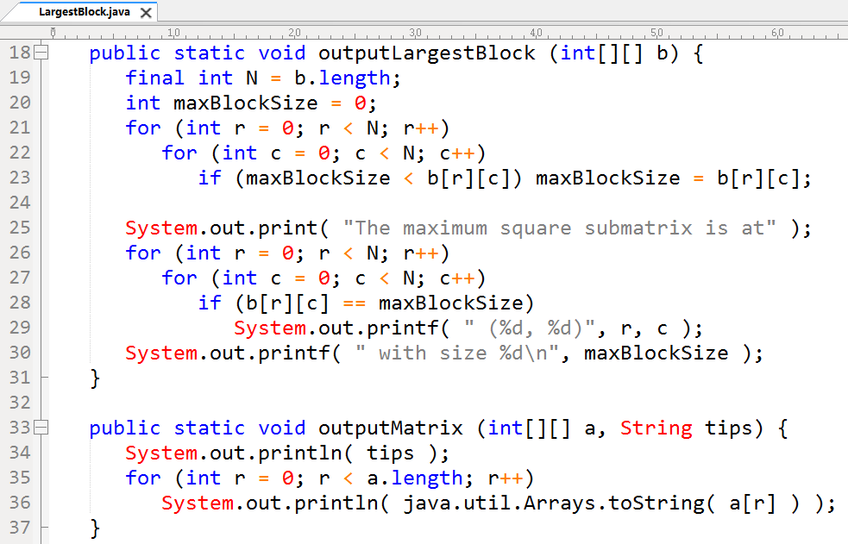

Slide 38
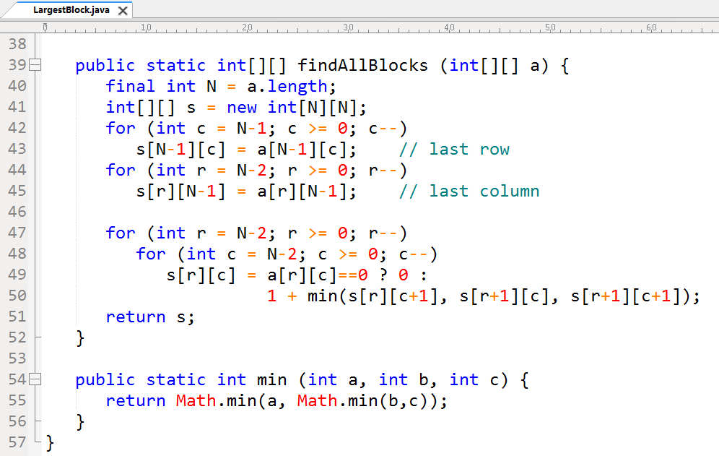

Slide 39
