Slide 1
Domain Analysis and Modeling
何明昕 HE Mingxin, Max
Send your email to c.max@yeah.net with
a subject like: SE-id-Andy: On What …
Download from c.program@yeah.net
/文件中心/网盘/SoftwareEngineering26S

Slide 2
Topics
Domain Analysis & Modeling Tools, from Use Cases to Domain Model
Identifying Concepts
Concept Attributes
Concept Associations
Contracts: Preconditions and Postconditions
Domain Modeling Beyond Use Cases

Slide 3
Domain Analysis & Modeling
Domain analysis and modeling identifies the system elements needed to solve the problem (i.e., meet the requirements)
Why? —The goal of domain modeling is to understand how system-to-be will work
Requirements analysis determined how users will interact with system-to-be (external behavior)
Domain modeling determines how elements of system-to-be interact (internal behavior) to produce the external behavior
How? —We do domain modeling based on sources:
Knowledge of how system-to-be is supposed to behave (from requirements analysis, e.g., use cases)
Studying the work domain (or, problem domain)
Knowledge base of software designs
Developer’s past experience with software design

Slide 4
Use Cases vs. Domain Model
In use case analysis, we consider the system as a “black box”
In domain analysis, we consider the system as a “transparent box”
(a)
(b)

Slide 5
What is Domain Modeling Example: ATM Machine
(b)
(a)

Slide 6
Building Domain Model from Use Cases
Step 1: Identifying the boundary concepts
Step 2: Identifying the internal concepts
Step 2: Identifying the internal concepts
Internal concepts “route” data between boundaries
Data format conversion
Data protection policies

Slide 7
Use Case 1: Unlock
Use Case UC-1: |  |  | Unlock
Related Requirements: |  |  | REQ1, REQ3, REQ4, and REQ5 stated in Table 2-1
Initiating Actor: |  |  | Any of: Tenant, Landlord
Actor’s Goal: |  |  | To disarm the lock and enter, and get space lighted up automatically.
Participating Actors: |  |  | LockDevice, LightSwitch, Timer
Preconditions: |  |  | • The set of valid keys stored in the system database is non-empty. • The system displays the menu of available functions; at the door keypad the menu choices are “Lock” and “Unlock.”
Postconditions: |  |  | The auto-lock timer has started countdown from autoLockInterval.
Flow of Events for Main Success Scenario:
→ | 1. | Tenant/Landlord arrives at the door and selects the menu item “Unlock”
 | 2. | include::AuthenticateUser (UC-7)
← | 3. | System (a) signals to the Tenant/Landlord the lock status, e.g., “disarmed,” (b) signals to LockDevice to disarm the lock, and (c) signals to LightSwitch to turn the light on
← | 4. | System signals to the Timer to start the auto-lock timer countdown
→ | 5. | Tenant/Landlord opens the door, enters the home [and shuts the door and locks]

Slide 8
Extracting the Responsibilities
Responsibility Description | Type | Concept Name
Coordinate actions of all concepts associated with a use case, a logical grouping of use cases, or the entire system and delegate the work to other concepts. | D | Controller
Container for user’s authentication data, such as pass-code, timestamp, door identification, etc. | K | Key
Verify whether or not the key-code entered by the user is valid. | D | KeyChecker
Container for the collection of valid keys associated with doors and users. | K | KeyStorage
Operate the lock device to armed/disarmed positions. | D | LockOperator
Operate the light switch to turn the light on/off. | D | LightOperator
Operate the alarm bell to signal possible break-ins. | D | AlarmOperator
Block the input to deny more attempts if too many unsuccessful attempts. | D | Controller
Log all interactions with the system in persistent storage. | D | Logger

Slide 9
Domain Model (1)
Domain concepts for subsystem #1 of safe home access

Slide 10
Domain Model (2)
«entity»
Key
user code
access location
timestamp
Domain model for UC-1: Unlock
Associations: who needs to work together, not how they work together
Concept pair | Association description | Association name

Slide 11
Degrees of Domain Model Refinement
Simplest case: all household devices are conceptually the same—just an on/off switch to activate or deactivate
If each device will provide additional functionality, use different conceptual objects
The correct approach depends on the requirements

Slide 12
Domain Model (3)

Slide 13
Use Case 5: Inspect Access History
Use Case UC-5: |  |  | Inspect Access History
Related Requirements: |  |  | REQ8 and REQ9 stated in Table 2-1
Initiating Actor: |  |  | Any of: Tenant, Landlord
Actor’s Goal: |  |  | To examine the access history for a particular door.
Participating Actors: |  |  | Database, Landlord
Preconditions: |  |  | Tenant/Landlord is currently logged in the system and is shown a hyperlink “View Access History.”
Postconditions: |  |  | None.
Flow of Events for Main Success Scenario:
→ | 1. | Tenant/Landlord clicks the hyperlink “View Access History”
← | 2. | System prompts for the search criteria (e.g., time frame, door location, actor role, event type, etc.) or “Show all”
→ | 3. | Tenant/Landlord specifies the search criteria and submits
← | 4. | System prepares a database query that best matches the actor’s search criteria and retrieves the records from the Database
→ | 5. | Database returns the matching records
← | 6. | System (a) additionally filters the retrieved records to match the actor’s search criteria; (b) renders the remaining records for display; and (c) shows the result for Tenant/Landlord’s consideration
→ | 7. | Tenant/Landlord browses, selects “interesting” records (if any), and requests further investigation (with an accompanying complaint description)
← | 8. | System (a) displays only the selected records and confirms the request; (b) archives the request in the Database and assigns it a tracking number; (c) notifies Landlord about the request; and (d) informs Tenant/Landlord about the tracking number

Slide 14
Extracting the Responsibilities
Responsibility Description | Type | Concept Name
Rs1. Coordinate actions of concepts associated with this use case and delegate the work to other concepts. | D | Controller
Rs2. Form specifying the search parameters for database log retrieval (from UC-5, Step 2). | K | Search Request
Rs3. Render the retrieved records into an HTML document for sending to actor’s Web browser for display. | D | Page Maker
Rs4. HTML document that shows the actor the current context, what actions can be done, and outcomes of the previous actions. | K | Interface Page
Rs5. Prepare a database query that best matches the actor’s search criteria and retrieve the records from the database (from UC-5, Step 4). | D | Database Connection
Rs6. Filter the retrieved records to match the actor’s search criteria (from UC-5, Step 6). | D | Postprocessor
Rs7. List of “interesting” records for further investigation, complaint description, and the tracking number. | K | Investigation Request
Rs8. Archive the request in the database and assign it a tracking number (from UC-5, Step 8). | D | Archiver
Rs9. Notify Landlord about the request (from UC-5, Step 8). | D | Notifier

Slide 15
Extracting the Associations
Concept pair | Association description | Association name
Controller ↔ Page Maker | Controller passes requests to Page Maker and receives back pages prepared for displaying | conveys requests
Page Maker ↔ Database Connection | Database Connection passes the retrieved data to Page Maker to render them for display | provides data
Page Maker ↔ Interface Page | Page Maker prepares the Interface Page | prepares
Controller ↔ Database Connection | Controller passes search requests to Database Connection | conveys requests
Controller ↔ Archiver | Controller passes a list of “interesting” records and complaint description to Archiver, which assigns the tracking number and creates Investigation Request | conveys requests
Archiver ↔ Investigation Request | Archiver generates Investigation Request | generates
Archiver ↔ Database Connection | Archiver requests Database Connection to store investigation requests into the database | requests save
Archiver ↔ Notifier | Archiver requests Notifier to notify Landlord about investigation requests | requests notify

Slide 16
Extracting the Attributes
Concept | Attributes | Attribute Description
Search Request | user’s identity | Used to determine the actor’s credentials, which in turn specify what kind of data this actor is authorized to view.
 | search parameters | Time frame, actor role, door location, event type (unlock, lock, power failure, etc.).
Postprocessor | search parameters | Copied from search request; needed to Filter the retrieved records to match the actor’s search criteria.
Investigation Request | records list | List of “interesting” records selected for further investigation.
 | complaint description | Describes the actor’s suspicions about the selected access records.
 | tracking number | Allows tracking of the investigation status.
Archiver | current tracking number | Needed to assign a tracking number to complaints and requests.
Notifier | contact information | Contact information of the Landlord who accepts complaints and requests for further investigation.

Slide 17
Domain Model (4)
Domain model
for UC-5: Inspect Access History

Slide 18
Traceability Matrix (1)
Mapping: System requirements to Use cases
UC1: Unlock
UC2: Lock
UC3: AddUser
UC4: RemoveUser
UC5: InspectAccessHistory
UC6: SetDevicePrefs
UC7: AuthenticateUser
UC8: Login
REQ1: Keep door locked and auto-lock
REQ2: Lock when “LOCK” pressed
REQ3: Unlock when valid key provided
REQ4: Allow mistakes but prevent dictionary attacks
REQ5: Maintain a history log
REQ6: Adding/removing users at runtime
REQ7: Configuring the device activation preferences
REQ8: Inspecting the access history
REQ9: Filing inquiries

Slide 19
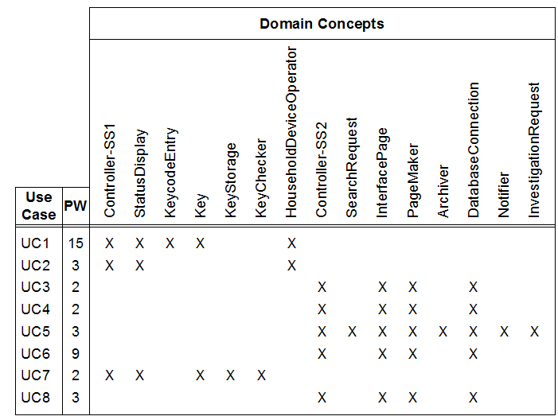
Traceability Matrix (2)
Mapping: Use cases to Domain model
UC1: Unlock
UC2: Lock
UC3: AddUser
UC4: RemoveUser
UC5: InspectAccessHistory
UC6: SetDevicePrefs
UC7: AuthenticateUser
UC8: Login

Slide 20
Contracts: Preconditions and Postconditions
Operation | Unlock
Preconditions | • set of valid keys known to the system is not empty
 | • numOfAttempts ≤ maxNumOfAttempts
 | • numOfAttempts = 0, for the first attempt of the current user
Postconditions | • numOfAttempts = 0, if the entered Key ∈ Valid keys
 | • current instance of the Key object is archived and destroyed
Operation | Lock
Preconditions | None (that is, none worth mentioning)
Postconditions | • lockStatus = “armed”, and
 | • lightStatus remains unchanged (see text for discussion)

Slide 21
Typical Problems with Domain Models
Unaware that requirements are not simply a wish list
Ignoring real-world constraints and problems
Physical I/O devices, networks, sensors, etc., are failure prone
Economic, legal, cultural, etc., constraints
Results in one requirement (or even use case!) being mapped to one concept/module that acts as a trivial input-to-output “connector”
Omitting input data for modules (if any) and output data for modules (if any) “things” for “worker” concepts
Unaware of dependencies between requirements (or use cases)
Unaware of incompatible data across concepts/modules
Different concepts/modules may receive or output different data formats

Slide 22
Why Domain Modeling?
To achieve N different things, we need N different tasks
Formulated by W.R. Ashby as the law of requisite variety
https://en.wikipedia.org/wiki/Variety_(cybernetics)
https://en.wikipedia.org/wiki/Good_regulator
It’s basically like ensuring that every row in the traceability matrix crosses at least one column (assuming the complete requirements)!
The problem for the beginners is that they do not know what needs to be achieved
Example: car steering problem—the beginner is not aware of differences between steering at low and high vehicle speeds
Experienced developers will at least know or guess some things that are common to many problems
such as: generic issues for networks or I/O devices
but the only way to know what is needed is to study the problem domain and get help from domain experts

Slide 23
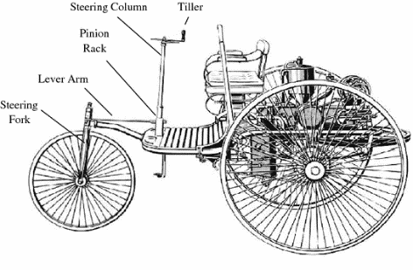
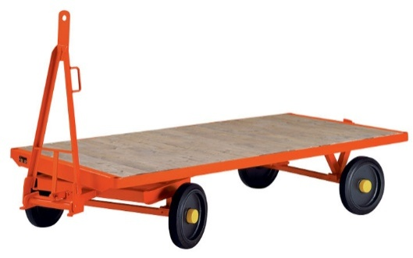
Example: Car Steering System
Requirement: As a driver, I will be able to steer the car left or right to follow the road.
“Software”: Steering system
Participating Actor: Front wheels
Initiating Actor: Driver + Steering wheel
Solution #1 is derived from the requirement: Simply connect the input (steering wheel) to the output (front axle / car wheels) ( 1 requirement ➔ 1 concept/module )
pivot
Works!? (called “turntable steering,” a design in which a rigid axle is turned around its center
and both front wheels turn around a common pivot)
Problem: At higher vehicle speeds, wheels on the inside and outside of a turn need to trace out circles of different radii.

Slide 24
Example: Car Steering System
Problem: wheels on the inside and outside of a turn need to trace out circles of different radii ➔
➔ Incompatible components—steering wheel moves rotationally, wheels need to turn linearly in lockstep.
“Ackermann steering” (simplified)
(Note how many new “concepts” we got!)
Agile approach:
But what better way to figure out that a solution is wrong than by trying to implement it!
Yes, if one has good acceptance tests …
… which are hard to create without a systematic and thorough domain analysis.
It gets more complicated— Another problem:
At high vehicle speeds, a tire needs a slip angle to transfer the lateral forces…

Slide 25
Domain Modeling: Looking from Inside Out
The developer should not engage in unconstrained construction of models of real world
Instead, identify only the concepts relevant for the problem at hand
Looking from inside out: What the computer needs to know about the world to solve the current problem
The resulting model should be as parsimonious as possible

Slide 26
Next Lecture: Design of Object Interactions

