Slide 1

Software Architecture
何明昕 HE Mingxin, Max
Send your email to c.max@yeah.net with
a subject like: SE345-Andy: On What …
Download from c.program@yeah.net
/文件中心/网盘/SoftwareEngineering26S

Slide 2
Topics
Software Architecture Definition
Architectural Decisions & Key Concerns
Architecture Styles
Documenting Architecture: Views
Problem Structure vs. Solution Structure

Slide 3
Hierarchical Organization of Software
Product line (or product family)
highest abstraction level
System or product
Subsystems/Modules
Packages
Classes/Objects
Methods
lowest level
Source code
Software is not one long list of program statements but it has structure
The above is a taxonomy of structural parts (abstraction hierarchy), but not representation of relationships between the parts and does not specify the function of each part
The hierarchy shows a taxonomy of the system parts, but not the procedure for decomposing the system into parts — how do we do it?
But first, why do we want to decompose systems?

Slide 4
Why We Want To
Decompose Systems
Tackle complexity by “divide-and-conquer”
See if some parts already exist & can be reused
Focus on creative parts and avoid “reinventing the wheel”
Support flexibility and future evolution by decoupling unrelated parts, so each can evolve separately (“separation of concerns”)
Create sustainable strategic advantage

Slide 5
Software Architecture Definition
Software Architecture =
a set of high-level decisions that determine the structure of the solution
(parts of system-to-be and their relationships)
  Principal decisions made throughout the development and evolution of a software system
  made early and affect large parts of the system (“design philosophy”) — such decisions are hard to modify later
Decisions to use well-known solutions that are proven to work for similar problems
Software Architecture is not a phase of development
  Does not refer to a specific product of a particular phase of the development process (labeled “high-level design” or “product design”)

Slide 6
Example Architectural Decisions
Example decisions:
Safe Home Access System
Subsystem for device control
Subsystem for administration
Subsystem for remote data access
Decision on system decomposition
On embedded computer
On office desktop
On user’s smartphone
(…and Web?)
Decision on mapping software-to-hardware
Decision on development platform or operating system
(Android vs. iOS, etc.)
Decision on how to fit the subsystems together (“architecture style”)
Such decisions are made early on,
perhaps while discussing the requirements with the customer
to decide which hardware devices will be used for user interaction and device control

Slide 7
Architectural Decisions
—A matter of scope
product line architecture decisions
product or system architecture decisions
systemic impact
Product line scope
Product/system A scope
Product B scope
Subsystem scope
local impact
Class scope
Given the current level of system scope, a decision is “architectural” if it can be made only by considering the present scope
  I.e. could not be made from a more narrowly-scoped, local perspective
  Architectural decisions should focus on high impact, high priority areas that are in strong alignment with the business strategy

Slide 8
Software Architecture
Key Concerns
(Principal decisions to be made)
System decomposition
  how do we break the system up into pieces?
    what functionality/processing or behavior/control to include?
  do we have all the necessary pieces?
  do the pieces fit together?
    how the pieces interact with each other and with the runtime environment
Cross-cutting concerns
  broad-scoped qualities or properties of the system
  tradeoffs among the qualities
Conceptual integrity
Software architecture provides a set of
well-known solutions that are proven to work for similar problems

Slide 9
Architectural Decisions Often Involve Compromise
The “best” design for a component considered in isolation may not be chosen when components considered together or within a broader context
  Depends on what criteria are used to decide the “goodness” of a design
  E.g., car components may be “best” for racing cars or “best” for luxury cars, but will not be best together
Additional considerations include business priorities, available resources, core competences, target customers, competitors’ moves, technology trends, existing investments, backward compatibility, …

Slide 10
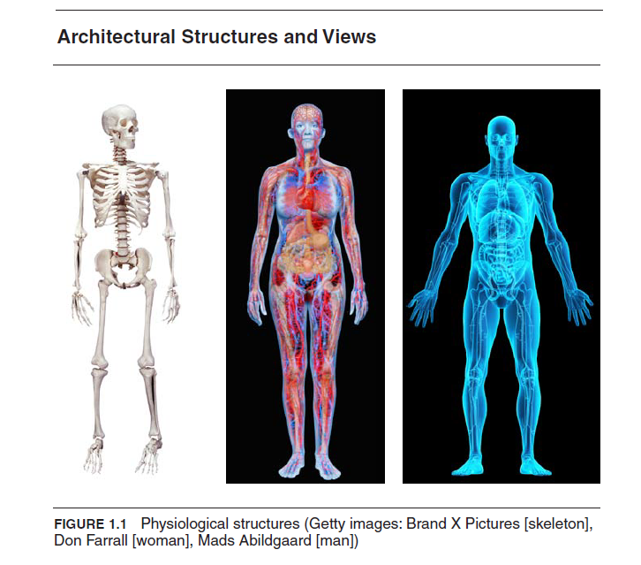

Slide 11
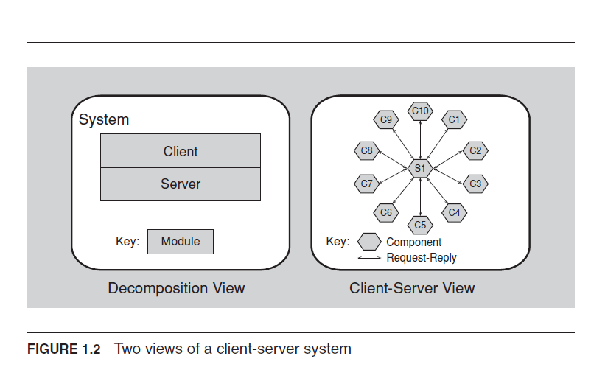

Slide 12
Module/Subsystem Views
Module Decomposition View
  Top-down refinement (e.g., simple “block diagram”)
Dependency View
  How parts relate to one another
Layered View
  Special case of dependency view
Class View
  “domain model” in OOA and “class diagram” in OOD

Slide 13
Component and Connector Views
Process View
  Defined sequence of activities?
  System represented as a series of communicating processes
Concurrency View
Shared Data View
  …
Client/Server View
  E.g., in Web browsing

Slide 14
Allocation Views
Deployment View
  Software-to-hardware assignment
Implementation View
  File/folder structure – “package diagram”
Work Assignment View
  Work distribution within the development team

Slide 15
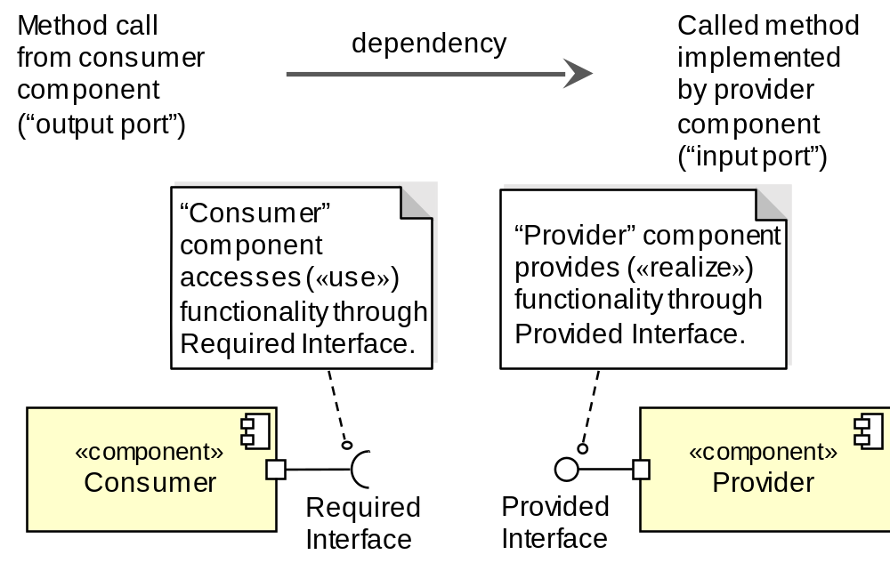
UML Notation for Software Components
A component has its behavior defined in terms of provided interfaces and required interfaces (potentially exposed via ports)

Slide 16
How to Fit Subsystems Together:
Some Well-Known Architecture Styles
World Wide Web architecture style:
REST (Representational State Transfer)
UNIX shell script architecture style:
Pipe-and-Filter
Client/Server
Central Repository (database)
Layered (or Multi-Tiered)
Peer-to-Peer
Microservices
Development platform (e.g., Web vs. mobile app, etc.) may dictate the architecture style or vice versa…

Slide 17
Real System is a Combination of Styles
Subsystem for device control
Central Repository
Architecture Style
Subsystem for remote data access
Valid keys
Access history
Tenant profiles
…
Subsystem for administration
Application server
Web server
Web browser
Tiered Architecture Style

Slide 18
Architecture Styles –
Constituent Parts
Components
  Processing elements that “do the work”
Connectors
  Enable communication among components
    Broadcast Bus, Middleware-enabled, implicit (events), explicit (procedure calls, ORBs, explicit communications bus) …
Interfaces
  Connection points on components and connectors
    define where data may flow in and out of the components/connectors
Configurations
  Arrangements of components and connectors that form an architecture

Slide 19
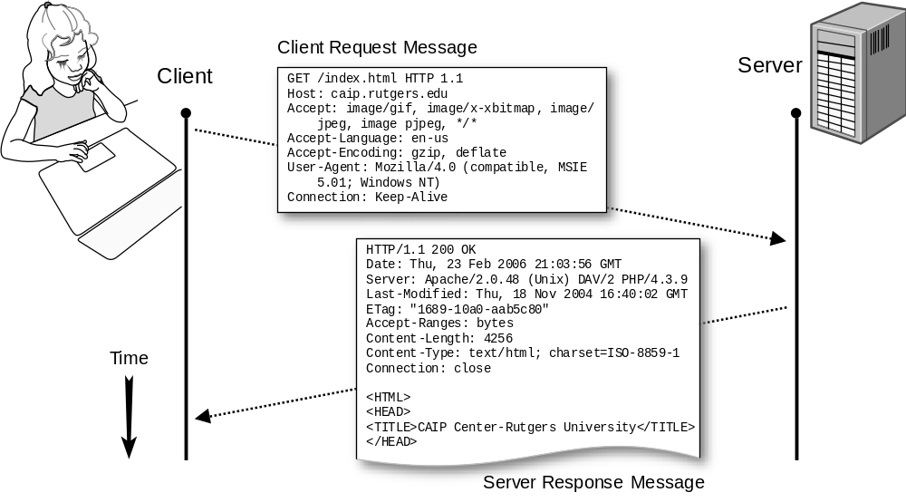
Connectors: HTTP Protocol
POST method requests the server to create a new resource
GET method requests the server to read a resource
PUT method requests the server to update a resource
DELETE method requests the server to delete a resource

Slide 20
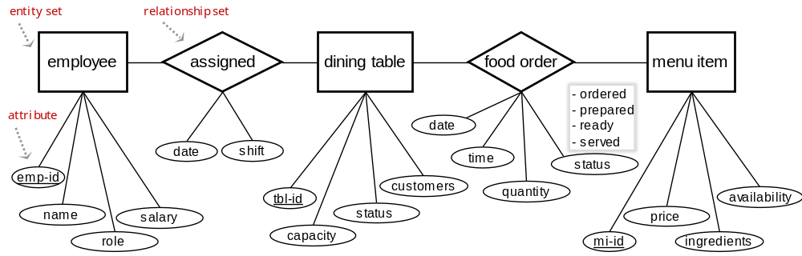
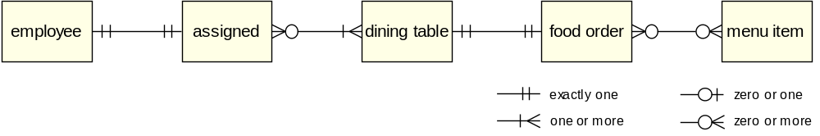
Shared Database Connector
— Data Model for Restaurant
Entity-relationship diagram of the data model:
Crow’s foot diagram of the same data model:
employee (identifier, name, role, salary, …)
assigned (date, working shift)
dining table (identifier, capacity, status, seated customers)
food order (time, item, quantity, total price, status)
menu item (identifier, price, ingredients, availability)
payment (time, date, amount, confirmation number)

Slide 21
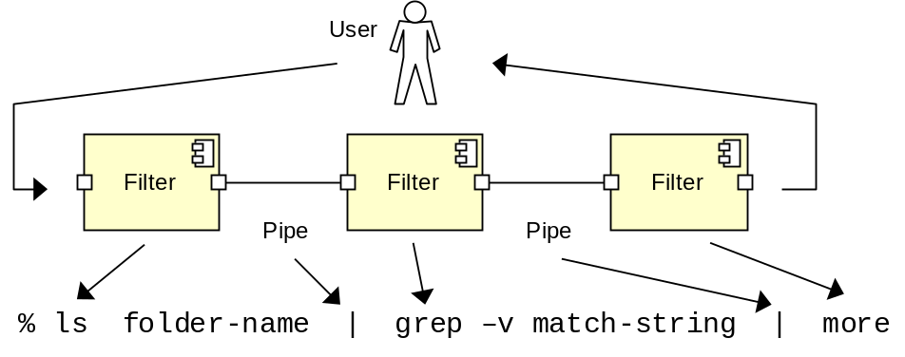
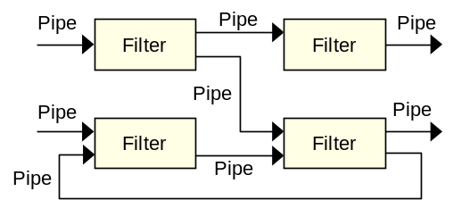
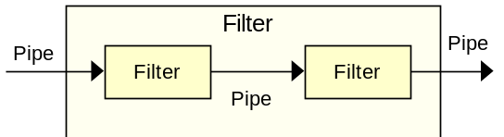
Architecture Style: Pipe-and-Filter
Components: Filters transform input into output
Connectors: Pipe data streams
Example: UNIX shell commands
More complex configurations:

Slide 22
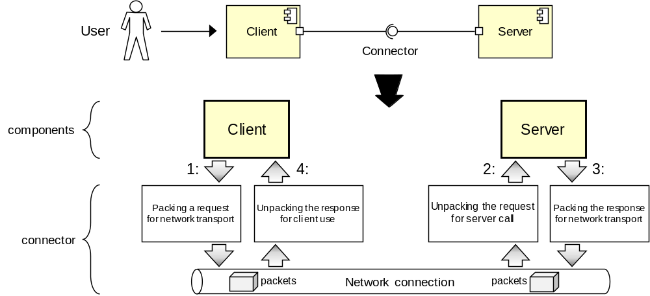
Architecture Style: Client/Server
A client is a triggering process; a server is a reactive process. Clients make requests that trigger reactions from servers.
A server component, offering a set of services, listens for requests upon those services. A server waits for requests to be made and then reacts to them.
A client component, desiring that a service be performed, sends a request at times of its choosing to the server via a connector.
The server either rejects or performs the request and sends a response back to the client

Slide 23
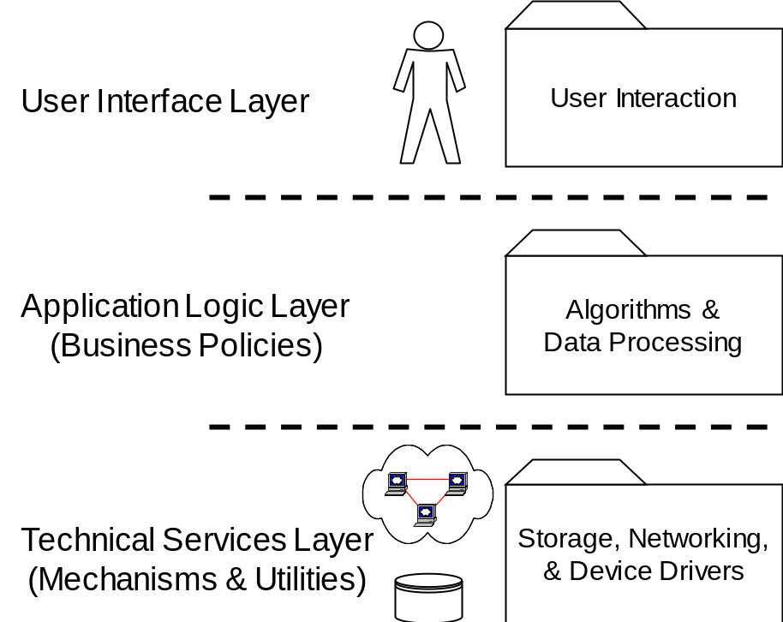
Architecture Style: Layered
a.k.a. Tiered Software Architecture
A layered system is organized hierarchically, each layer providing services to the layer above it and using services of the layer below it
Layered systems reduce coupling across multiple layers by hiding the inner layers from all except the adjacent outer layer, thus improving evolvability and reusability

Slide 24
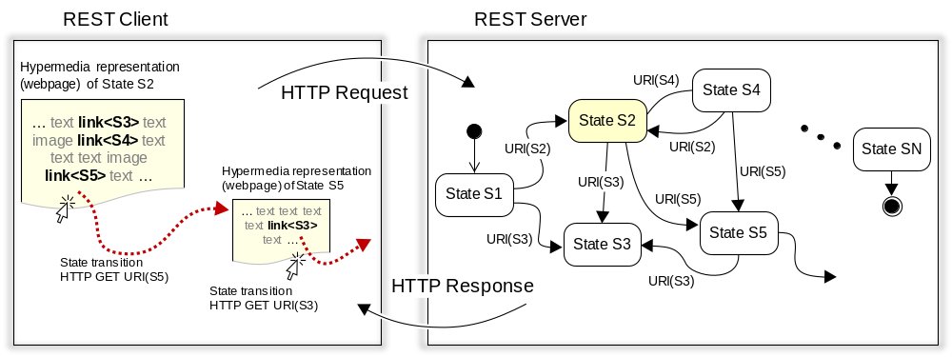
REST: Hypermedia as the Engine of Application State (HATEOAS)
REST: Representational state transfer
Conceptual model: hypermedia as the engine of application state (HATEOAS)

Slide 25
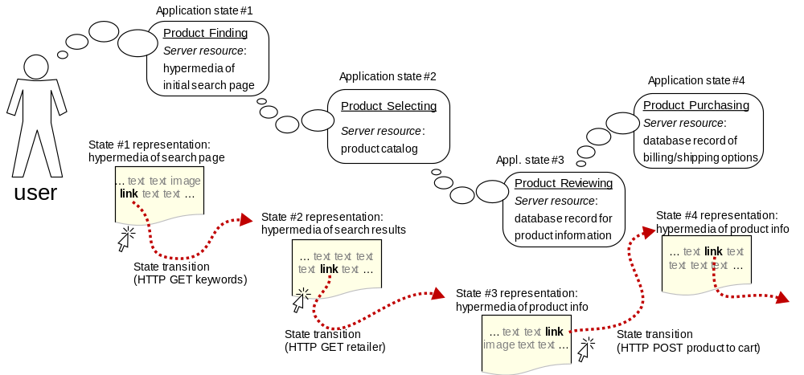
Hypermedia as the Engine of Application State
Web application:
A network of Web resources (a virtual state-machine), where the user by following the links requests the transfer of next resource (“state”).

Slide 26
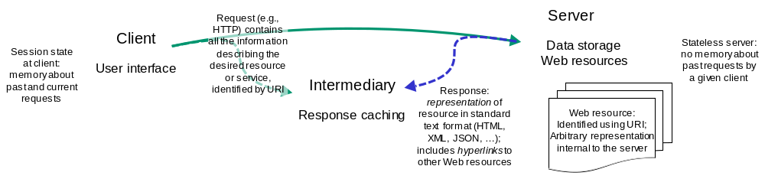
REST physical model

Slide 27
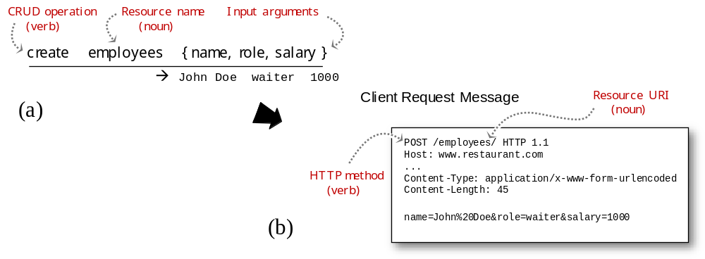
RESTful Resource Naming
(a) Conceptual representation of creating a new employee record
(b) HTTP request message carrying the content of the HTML form that was used to enter the employee data

Slide 28
REST, a resource-based architecture style
Client/server style that supports caching and replicated repositories
Uniform interface between components based on HTTP methods and URI-named resources, which is efficient for coarse-grain hypertext/hypermedia data transfer
Server dynamically communicates to clients the application logic in hypertext or in code-on-demand
Hypertext does not specify the operations allowed on a resource; it just contains embedded hyperlinks that determine all possible transitions from the current to the next application state
For every media type, the server has defined a default processing model; standard formats for message payload representation (HTML, XML, JSON, JPEG, …) ensure interoperability between different clients and servers
Stateless sessions—each request must carry all the information needed for its processing
Statelessness may cause network inefficiency, so requires caching to avoid redundant responses
A RESTful API looks like hypertext
    Every addressable unit of information carries an address or identifier, either explicitly (e.g., link and id attributes) or implicitly (e.g., derived from the media type definition and representation structure)
      Every media type defines a default processing model
      Hypertext doesn’t specify the operations allowed on a resource;
      it specifies which operation to use for each potential state transition

Slide 29
RESTful API Design versus
JSON-RPC APIs over HTTP
RESTful APIs | JSON-RPC APIs over HTTP
URIs for resource addresses | URIs for object addresses
Focus on navigable resources (nouns) | Focus on data-processing procedures (verbs)
HATEOAS, application logic runs on the server | Application logic runs on the client; the server manages the data using CRUD and application-specific RPCs
HTTP methods for resource CRUD actions, plus media-specific server-side controllers activated by the media type | HTTP methods for service actions, plus application-specific server-side procedures explicitly addressed with the verb as part of the request message URI
Message body can be any standard media format, as negotiated by clients and servers | Message body encoded as JSON objects
Code-on-demand | No code in response messages—only JSON objects
Caching and replication of resource content | Caching and replication not relevant for procedures

Slide 30
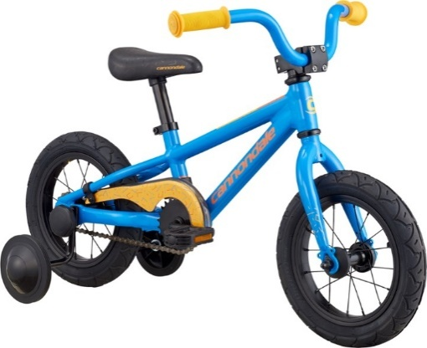
Example Request
Cannondale Trail 1 12 Kids' Bike:
  https://www.rei.com/product/145832/cannondale-trail-1-12-kids-bike?CAWELAID=120217890005260197&CAGPSPN=pla&CAAGID=15877514320&CATCI=aud-553371945779:pla-539113402242&cm_mmc=PLA_Google%7C404_1050512963%7C1458320001%7Cnone%7Ccb2b5bf7-95ae-43d8-a53c-6a16aaf4a0d0%7Caud-553371945779:pla-539113402242&lsft=cm_mmc:PLA_Google_LIA%7C404_1050512963%7C1458320001%7Cnone%7Ccb2b5bf7-95ae-43d8-a53c-6a16aaf4a0d0&kclid=cb2b5bf7-95ae-43d8-a53c-6a16aaf4a0d0&gclid=CjwKCAiAyrXiBRAjEiwATI95mcKyoLfTjKFAaCiElWKC3Vt51nTPk0Fxyt9rm8S0Y99Dikidu_DQrxoC2CwQAvD_BwE

Slide 31
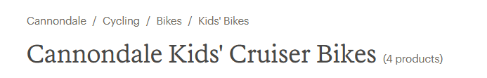
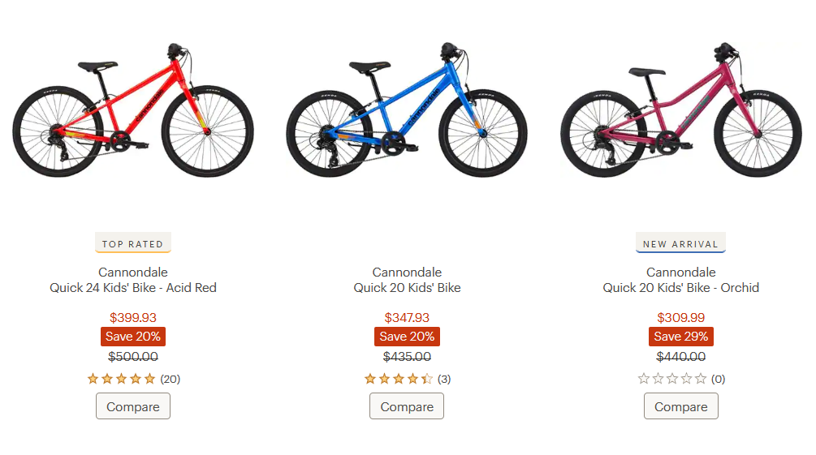

Slide 32
Architecture Style:
Model-View-Controller
Model: holds all the data, state and application logic. Oblivious to the View and Controller. Provides API to retrieve state and send notifications of state changes to “observer”
View: gives user a presentation of the Model.
Gets data directly from the Model
Controller: Takes user input and figures out what it means to the Model
display
View
5. I need your state (to display)
Model
4. I have changed
3. Change your display
1. The user did something
Controller
user
2. Change your state
input device

Slide 33
Model-View-Controller
User Interface
Model
Controller
Input
device
events
Event
Interpreter
Domain
model
action
Domain
Model
Visual feedback
of the altered
model
Model
Visualizer
Notification
about the
effects of the
action
User
View
26
31
14
Model: array of numbers [ 14, 26, 31 ]
➔ Different Views for the same Model:
14
31
versus
26

Slide 34
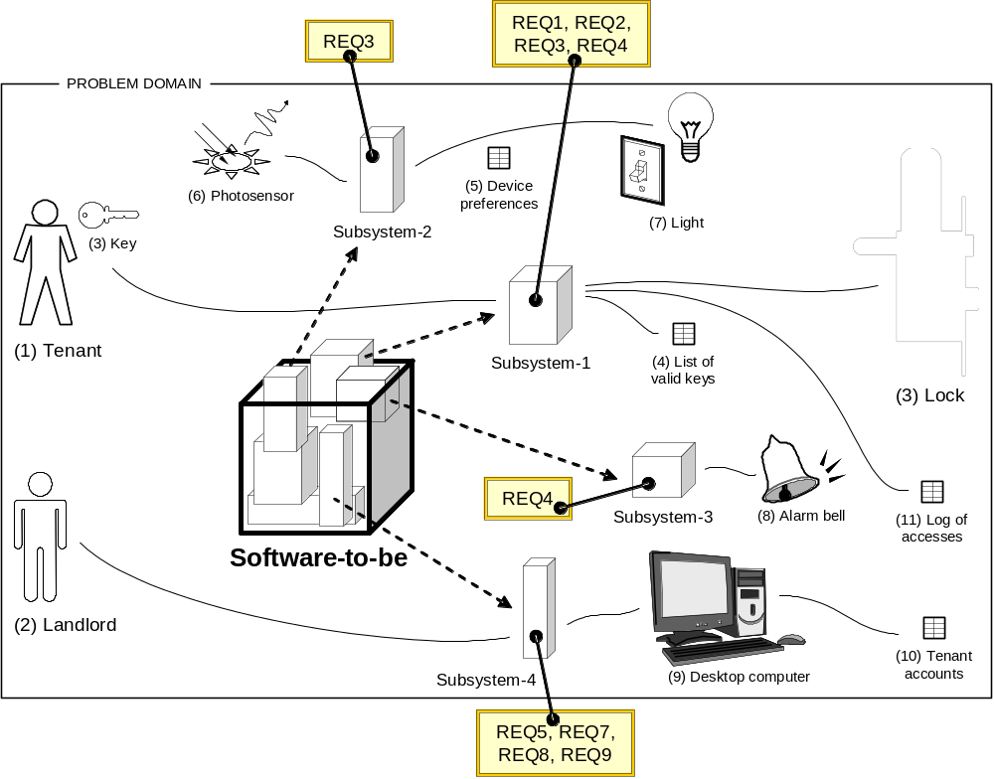
Problem Structure
Subsystems derived from the requirements (“bottom-up” approach or induction)

Slide 35
Typical Software Eng. Problems
1.a) System transforms input document to output document
1. User works with computer system
(problem domain is “virtual”, not physical)
REQ-1: Map input data to output data as said by given rules
IN doc
User
System
OUT doc
1.b) User edits information stored in a repository
User
System
Problem domain
REQ-2: Allow repository editing, where “repository” is a collection of data
User
System
Repository
2. Computer system controls the (physical) problem domain
(user not involved)
REQ-3: Autonomously control a physical object/device
User
System
Problem domain
3. Computer system intermediates between
the user and the problem domain
3.a) System observes the problem domain and displays information
REQ-5: Monitor and display information about an object
User
System
Problem domain
User
System
Problem domain
3.b) System controls the problem domain as commanded by the user
REQ-4: Interactively control a physical object/device
User
System
Problem domain

Slide 36
5-dimensional Problem Space
The five elementary problem types represent the coordinate system of the problem space
The “axis” projections represent the degree to which the whole problem contains a subproblem of this type
Each subproblem can be analyzed independently and eventually recombined into the whole problem
The structure of the solution should be selected to fit the problem structure
Software
problem
to solve
Simple editing
(“Simple workpieces”)
Data transformation
Autonomous control
(“Required behavior”)
Manual control
(“Commanded behavior”)
Information display

Slide 37
Software (i.e., Solution) Structure
REQ-1: Map input data to output data as said by given rules
SYSTEM
1.a) Transformation:
Feeding subsystem
Transformation subsystem
Receiving subsystem
REQ-2: Allow repository editing, where “repository” is a collection of data
SYSTEM
1.b) Simple editing:
Data editor
User
Data repository
REQ-3: Automatically control a physical object/device
SYSTEM
2. Required behavior:
Controlling subsystem
Controlled subsystem
REQ-5: Monitor and display information about an object
SYSTEM
3.a) Information display:
Monitoring subsystem
Monitored subsystem
Display
REQ-4: Interactively control a physical object/device
SYSTEM
3.b) Commanded behavior:
Controlling subsystem
Controlled subsystem
Operator

