Slide 1
Meaning Group(意群) Design on Clear & Clean Expression

Slide 2




Slide 3



Slide 4


Slide 5
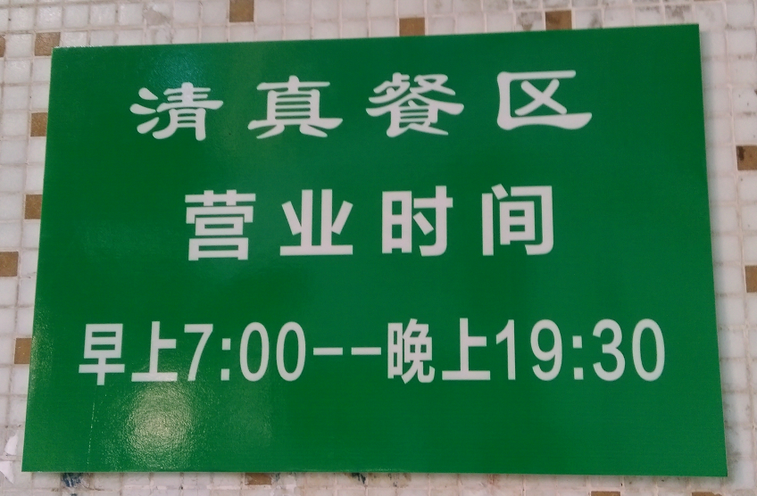

Slide 6
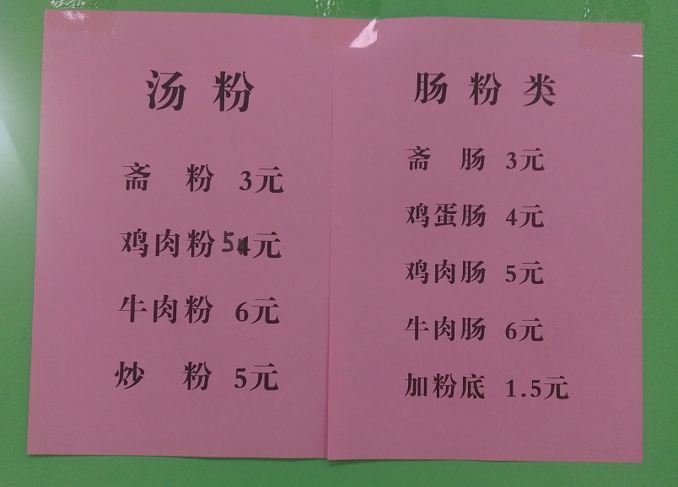

Slide 7
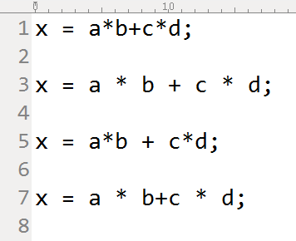
Crowded, Bad
Clear, Good
Creative, Best
Confused, Worse
代码/文字布局结构体现出计算的逻辑/意群结构
节省思维

Slide 8
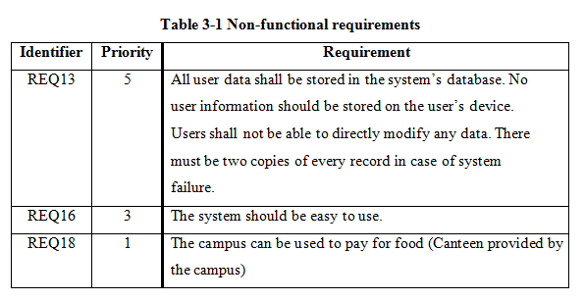

Slide 9
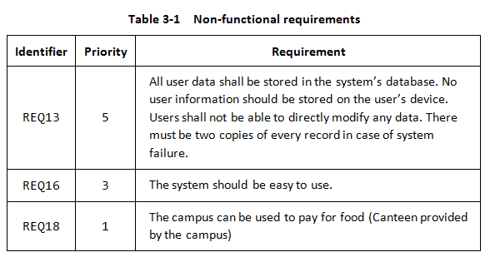
Reference: Layout of HTML Elements, Gap, Padding, Margin…
For text: Font Spacing, Line Spacing, Alignment Styles…

Slide 11
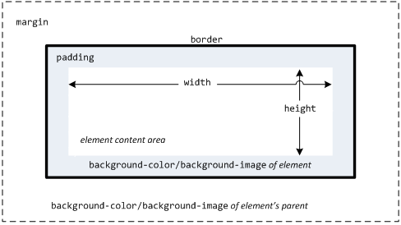
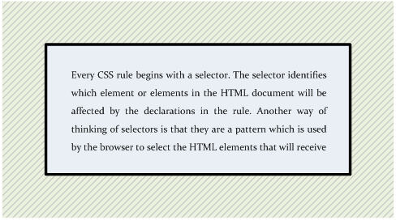
The HTML/CSS Box Model

Slide 12
源代码就是设计 -- Jack Reecves 1990
工程师为什么必须是好的作家。
工程过程的最终结果是文档。换句话说，工程师生产的是文档，不是实物。其他人根据这些文档去制造实物。
我就在困惑中提出了一个问题，“除了软件项目正常产生的所有文档以外，还有可以被认为是真正的工程文档的东西吗？”我给出的回答是，“是的，有这样的文档存在，并且只有一份——源代码。

Slide 13
意图向导的编程：“无需注释”
避免不必要的注释，正当的注释如下：
不完整的代码 (TODO: The tree should be balanced after the insertion);
有疑义代码需要复查 (CODE DEBT: The looping structure is a bit convoluted.);
重构无法使其足够清楚 (NEEDS WORK: I tried extract method, but it’s still awkward. Maybe refactoring to a Strategy would clean it up?);
使用了某种非同寻常的算法 (注明那里可以找到这种算法即可);
性能调整 (防止别人把有意的技巧性代码重构，一般只在性能成为瓶颈时进行);
类注释 (简单解释类的存在意义及用途)。

Slide 14
代码风格
Many people have been taught that a method should have only a single exit point (i.e., return statement). There is no valid reason for this, certainly not at the expense of clarity. In a method that should exit under multiple conditions, this leads to complex, nested conditional statements. A better, and much clearer, alternative is to use guard clauses to return under those conditions.
int fib (int i) {
int result;
if (i == 0) {
result = 0;
} else if (i <= 2) {
result = 1;
} else {
result = fib( i-1 ) + fib( i-2 );
}
return result;
}
It's correct, but very ugly and crowded. And the conditional isn't even deeply nested.

Slide 15
代码风格
Now let's refactor it to use guard clauses instead of the conditional:
int fib (int i) {
if (i == 0) return 0;
if (i <= 2) return 1;
return fib( i–1 ) + fib( i–2 );
}

Slide 16
代码风格
This is one case where I will drop the braces surrounding the body of an if: guard clauses that perform one very simple action, typically a return. The intent is revealed much more by using this format rather than the more canonical:
int fib (int i) {
if (i == 0) {
return 0;
}
if (i <= 2) {
return 1;
}
return fib( i–1 ) + fib( i–2 );
}

Slide 17
Kent Beck: Four Rules of Simple Design:
1) Passes the Tests
2) Reveals Intention
3) No Duplication
4) Fewest Elements

Slide 18
Program Elegantly:
Choose Appropriate Names, Formats & Styles
Reveal Intentions and Computing Structures Visually
Make Simple Things Simple
Write Readable/Understandable Code

