Slide 1
Class Rational

Slide 2
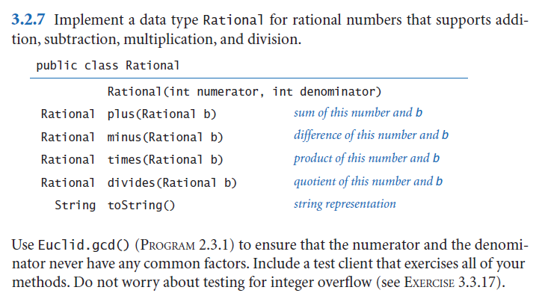
The output may be something like:
1|2 + 1|3 = 5|6
1_1|6 / 2|3 = 1_3|4

Slide 3
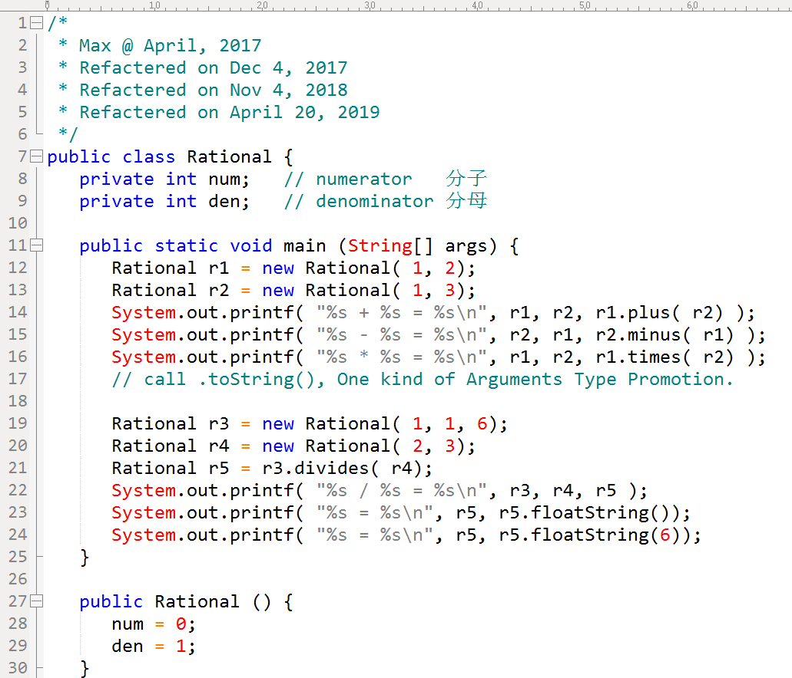

Slide 4
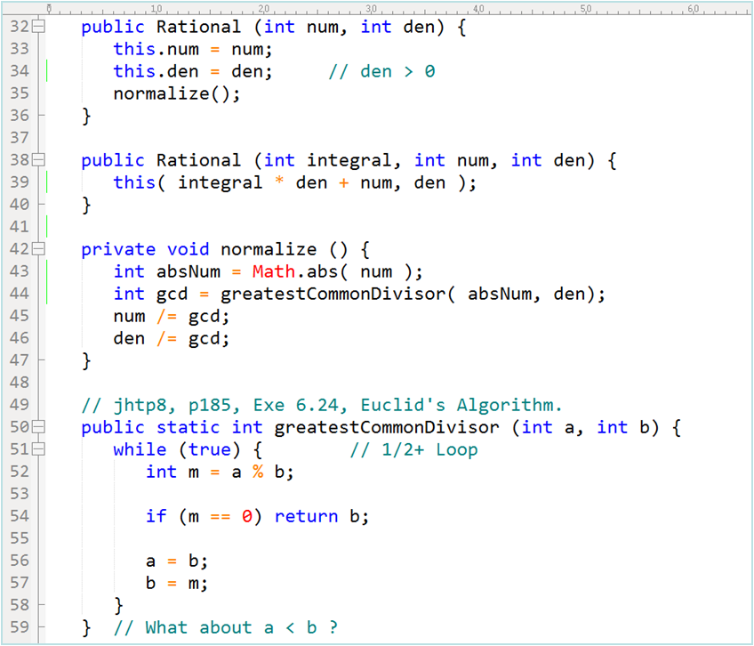

Slide 5
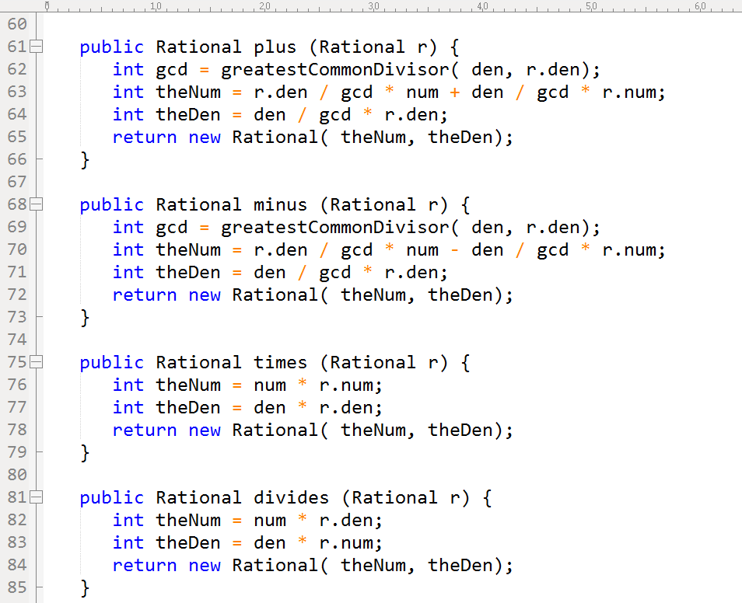

Slide 6
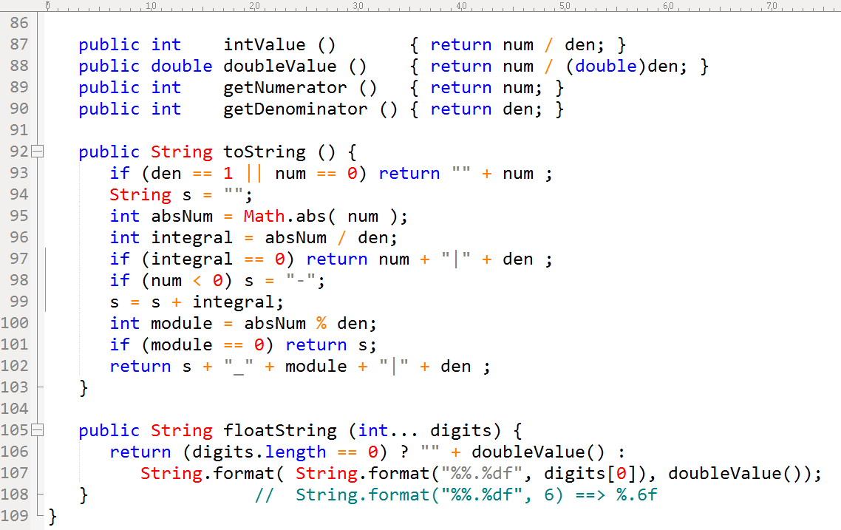

Slide 7
