Slide 1
Object Oriented Design - Basics
何明昕 HE Mingxin, Max
Send your email to c.max@yeah.net with
a subject like: SE345-Andy: On What …
Download from c.program@yeah.net
/文件中心/网盘/SoftwareEngineering26S

Slide 2
Topics
Gluing the Modules from Analysis Stage
Assigning responsibilities for actions of use-case plans to modules
Design Principles
Expert Doer
High Cohesion
Low Coupling
Business Policies
Class Diagram

Slide 3
System Sequence Diagrams
We already worked with interaction diagrams: System Sequence Diagrams
User
«initiating actor»
: System
Timer
«offstage actor»
select function(“unlock")
Time
prompt for the key
enter key
verify key
signal: valid key, lock open
open the lock,
turn on the light
start ("duration“)
System Sequence Diagrams represent interactions between the actors
(the system is also an “actor”)

Slide 4
Design: Object Interactions
Design
Sequence Diagram
System Sequence Diagram
System Sequence Diagrams represent interactions of external actors
Module Sequence Diagrams represent interactions of modules inside the system

Slide 5
Metaphor for Software Design: “Connecting the Dots” within the System Box
SYSTEM
We start System Sequence Diagrams (which show only actors and the system as a “black box”) to design the internal behavior using concept modules from the Domain Model and modify or introduce new modules, as needed to make the given system function work.

Slide 6
Types of Object Responsibilities
Knowing responsibility: Memorizing data values, collections, or references to other objects, represented as attributes
Doing responsibility: Performing computations, data processing, control of physical devices, etc., represented as methods
Delegation responsibility: Delegating subtasks to object’s dependencies, represented as sending messages (method invocation)

Slide 7
Example …
Delegation responsibilities identified for the system function “enter key”:
Responsibility Description
Send message to Key Checker to validate the key entered by the user.
Send message to a DeviceCtrl to disarm the lock device.
Send message to a DeviceCtrl to switch the light bulb on.
Send message to PhotoObserver to report whether daylight is sensed.
Send message to a DeviceCtrl to sound the alarm bell.

Slide 8
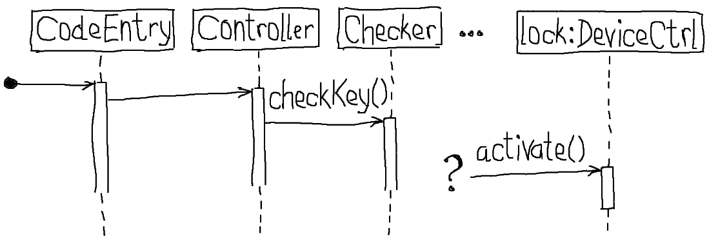
Assigning Responsibilities: Design Diagramming
(a) Hand-drawn during creation
(b) Computer-based UML specification of the design
Two purposes of design diagrams:
Communication tool, during the creative process ➔ use hand drawings and take an image by phone camera (don’t waste time on polishing something until you’re feel confident that you reached a good design)
Specification tool for documentation ➔ use UML design tools to produce presentable and professional-looking diagrams

Slide 9
Gluing the Modules (“Connecting the Dots”)
Starting Points:
Domain Model from UC-1 (concept modules):
Use Case UC-1: Unlock (plan of action):
1. User enters the key code
2. System verifies that the key is valid
3. System signals the key validity
4. System controls:
(a) LockDevice to disarm the lock
(b) LightSwitch to turn the light on

Slide 10
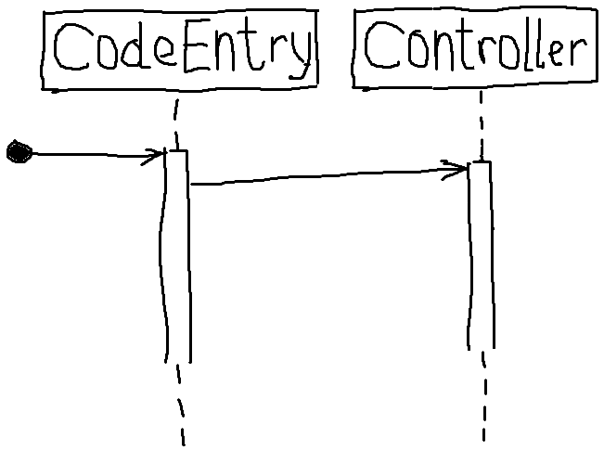
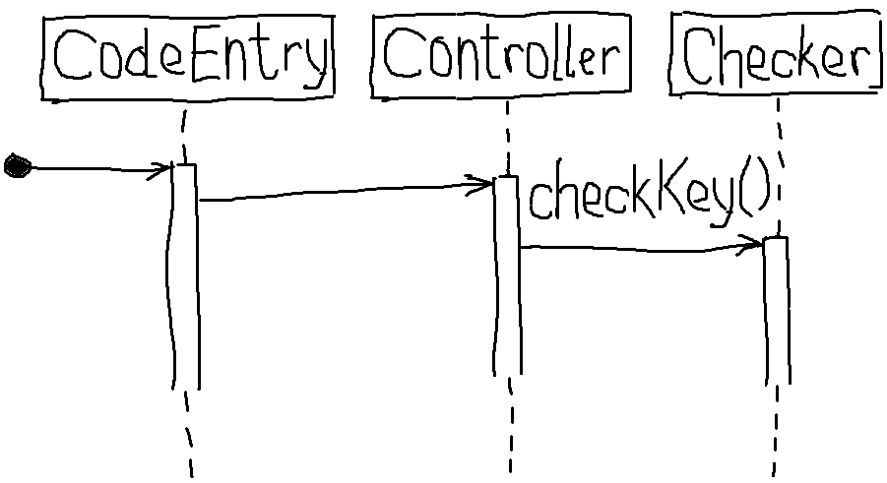
Gluing the Modules by Plan Walkthrough
Starting Points:
Domain Model from UC-1 (concept modules):
Use Case UC-1: Unlock (plan of action):
1. User enters the key code
2. System verifies that the key is valid
3. System signals the key validity
4. System controls:
(a) LockDevice to disarm the lock
(b) LightSwitch to turn the light on
Scenario Walkthrough:
for mapping a Use Case plan-of-action to the Domain Model
Q: who handles this data?
send message:
Interface objects and Controller
checkKey(k)
Q: who performs the verification? Based on what data?
return value
Key Checker, based on entered key-code and stored valid keys
Design Sequence Diagram

Slide 11
Mapping Actions to Modules
Starting Points:
Domain Model from UC-1 (concept modules):
Use Case UC-1: Unlock (plan of action):
1. User enters the key code
2. System verifies that the key is valid
3. System signals the key validity
4. System controls:
(a) LockDevice to disarm the lock
(b) LightSwitch to turn the light on
Scenario Walkthrough:
for mapping a Use Case plan-of-action to the Domain Model
Q: who handles this data?
Interface objects and Controller
message: checkKey(k)
Q: who performs the verification? Based on what data?
return value
Key Checker, based on entered key-code and stored valid keys
message: ???
Q: who signals? Based on what data?
Controller and Interface objects, based on key verification; because they are «boundary»
Q: who signals? Based on what data?
Controller or Key checker ???, based on key verification

Slide 12
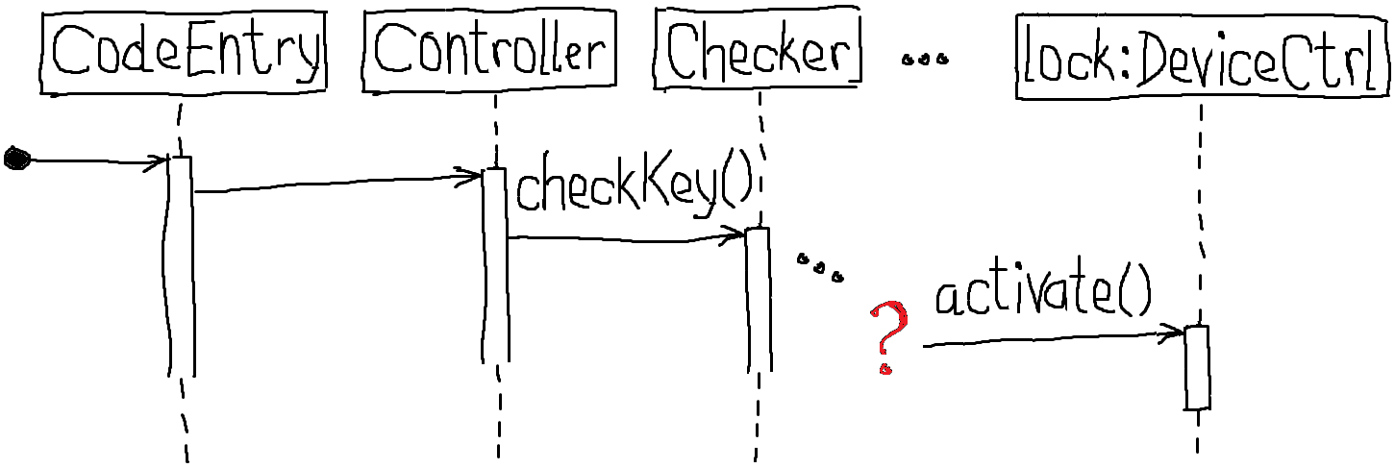
Sequence Diagram (in progress)
Q: who performs the verification? Based on what data?
return value
Key Checker, based on entered key-code and stored valid keys
message: ???
Q: who signals? Based on what data?
Controller and Interface objects, based on key verification; because they are «boundary»
Q: who signals? Based on what data?
Controller or Key checker ???, based on key verification

Slide 13
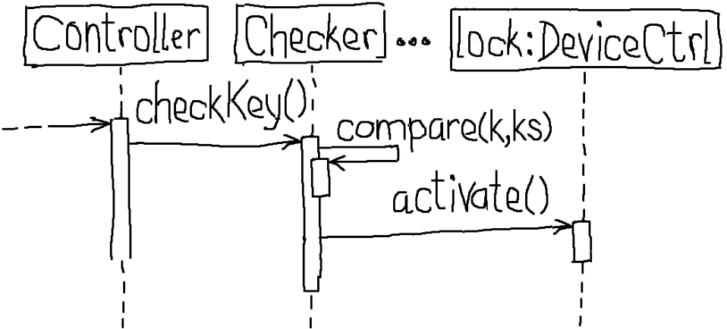
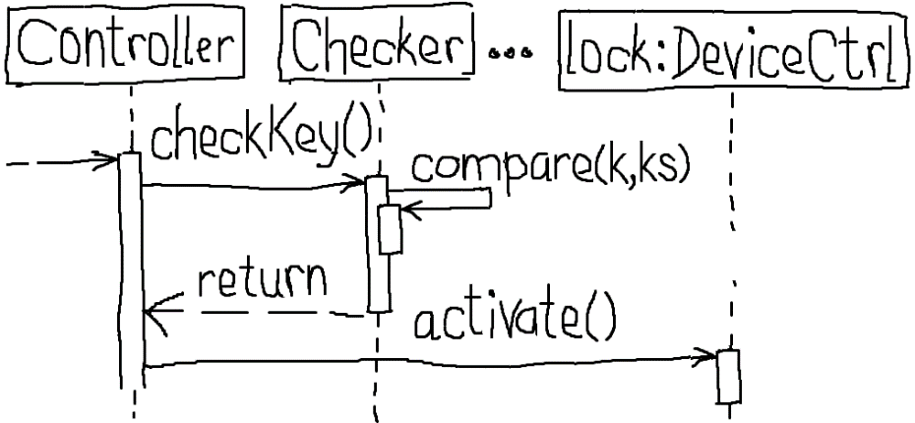
Alternative Designs:
versus
Which design is better?
How to evaluate the “goodness” of a design?

Slide 14
How Data Travels
Option A:
“expert” (Key Checker) passes the information (key validity) to another object (Controller)
which uses it to perform some work (activate the lock device)
key-code
key-code
is-valid
activation-params
Controller
Checker
Controller
LockCtrl
“expert” on key validity
Option B:
“expert” (Key Checker) directly uses the information (key validity)
to perform some work (activate the lock device)
Advantage:
Shorter communication chain
Drawback:
Extra responsibility for Checker
key-code
key-code
activation-params
Controller
Checker
LockCtrl
“expert” on key validity

Slide 15
Characteristics of Good Designs
Short communication chains between the objects
Balanced workload across the objects
divide-and-conquer during analysis should divide the system into manageable modules
Low degree of connectivity (associations) among the objects
A system with “hub” modules is more prone to failures
method_1()
method_1()
method_2()
…
method_N()

Slide 16
Some Design Principles
Expert Doer Principle: module that knows should communicate information to those that need it
How to recognize a violation: If a method call passes many arguments
High Cohesion Principle: module should not take on too many computation responsibilities
How to recognize a violation: If a class has many loosely or not-related attributes and methods
Single Responsibility Principle (next lecture)
Low Coupling Principle: module should not delegate responsibilities in many tiny parts
How to recognize a violation: many outgoing links
Better solution: Hierarchical delegation by limiting the number of dependencies for each delegate and letting the delegates further split the complex resopnsibilities
There are many more … (next slides)

Slide 17


Design Involves Compromises
Any nontrivial design is a compromise between the desired and the possible
Design principles may contradict each other:
Shortening the communication chain (expert doer) tends to concentrate responsibilities to fewer objects (low cohesion)
Minimizing the number of responsibilities per object (high cohesion) tends to increase the number of dependencies (strong coupling)
It is critical for others to know how the designer resolved each compromise/tradeoff, so others can evaluate the reasoning
document the reasons for choosing the particular tradeoffs and compromises
code alone cannot provide this information
code shows the product but not the process of reasoning

Slide 18
Design: Assigning Responsibilities
(a)
(b)
Although the Checker is the first to acquire the information about the key validity, we decide to assign the responsibility to activate the DeviceCtrl to the Controller
This is because the Controller would need to know key-validity information anyway—to inform the user about the outcome of the key validity checking
In this way, we maintain the Checker focused on its specialty (key validation) and avoid assigning unrelated responsibilities to it

Slide 19
Responsibility-Driven Design
Identify the responsibilities
start with a use case plan-of-action and the domain model
some may be missed at first and identified during implementation of the design
For each responsibility, identify candidate modules or objects to assign to
if the choice appears to be unique then move to the next responsibility
Consider the merits and tradeoffs of each alternative by applying the design principles
select what you consider the “optimal” choice
Document the reasoning process by which you arrived to each responsibility assignment
design involves tradeoffs—let others know how you resolved them
preserve not only the final chosen design but also all the alternatives you considered and their perceived merits (process, instead of product only!)

Slide 20
time to tidy up … Unlock Use Case
Time
Notes:
We built an undue complexity into the Controller while striving to preserve high degree of specialization for all other objects. [[ Note: GUI aspects are treated separately. ]]

Slide 21
Unlock Seq. Diag. Variation 1
To avoid an impression that the above design is the only one possible...
Sets a Boolean attribute of the Key object: ok = true/false;
Business logic (IF-THEN rule) relocated from Controller to LockCtrl
May be useful if Controller and LockCtrl are in different memory spaces and their communication could be intercepted, so the Key should be encrypted

Slide 22
Unlock Seq. Diag. Variation 2a
Instead of the original solution where the Controller, gets involved in the operation of different devices, the Controller only sends the message to one of a group of objects associated with a device
Controller contains high-level business logic/policies and should not get involved in device-control details
Checking whether it is dark and the light is needed should be a responsibility of LightCtrl
Similarly, if other devices require multi-step control, the Controller should not be involved
For example, MusicCtrl would find the appropriate playlist and activate the player
AlarmCtrl will determine the list of who needs to be notified and send text messages

Slide 23
Unlock Seq. Diag. Variation 2b
This solution need separate methods to:
- Turn light ON
- Turn light OFF
It may seem helpful that checkIfDaylightAndIfNotThenSetLit() is named informatively (reveals the intention) …
but the low-level knowledge of operating a particular device (lighting) is encoded in the name of the method …
which, in turn, means that low-level knowledge (“mechanism”) is imparted onto the caller (Controller) which should be concerned with high-level business policies
Mixing low-level knowledge with high-level knowledge results in rigid and non-reusable designs

Slide 24
Summary of Some Design Variations

Slide 25
Are We Done w/ UC-1: Unlock ?
Didn’t check that the user is at the right door
Missing: Managing access rights
Didn’t distinguish critical and non-critical functions
For example, what if logTransaction() call to Logger does not return, e.g., no access to database (network outage) or disk-space full ?
Missing: Independent execution of non-critical functions
Adding new household devices causes major design changes
Controller has several unrelated reasons for future changes:
Business policies are entangled with authentication mechanisms
Device management
Etc.
➔ this design will be revisited in future lectures!

Slide 26
Business Policies
policy:
IF key ∈ ValidKeys THEN disarm lock and turn lights on
ELSE
increment failed-attempts-counter
IF failed-attempts-counter equals maximum number allowed
THEN block further attempts and raise alarm
mechanism:
Should be moved into a separate object:
Make them explicit part of the model
Separate business policies from impl. Mechanism
See Dependency Inversion Principle (next lecture)

Slide 27
Class Diagram
Class diagram should be derived by looking-up the sequence diagrams
Class diagram corresponds to the static module structure from conceptual analysis, but detailed and refined based on plan-to-module mapping

Slide 28
Traceability Matrix (3)
Mapping: Domain model to Class diagram
For missing checks, explain whether the concept module was discarded or delayed until future iterations

Slide 29
Types of Object Communication
S₁
A
B
A
B
P
S₂
S_{N}
(a)
(b)
(c)

