Slide 1
TicTacToe
TicTacToe Game v 1.0 -- 无脑人机对弈
TicTacToe Game v 2.88 -- 无敌人机对弈
TicTacToe Game v 3.89 -- 智慧人机对弈
TicTacToe Derby v 3.89 -- 智慧Derby测试

Slide 2
TicTacToe Game v1.0
Tool.java
Move.java
Board.java
TicTacToe.java
TicTacToeGame.java

Slide 3
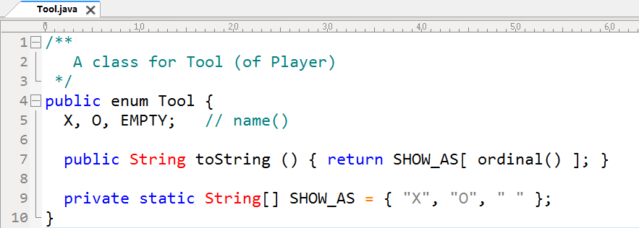

Slide 4
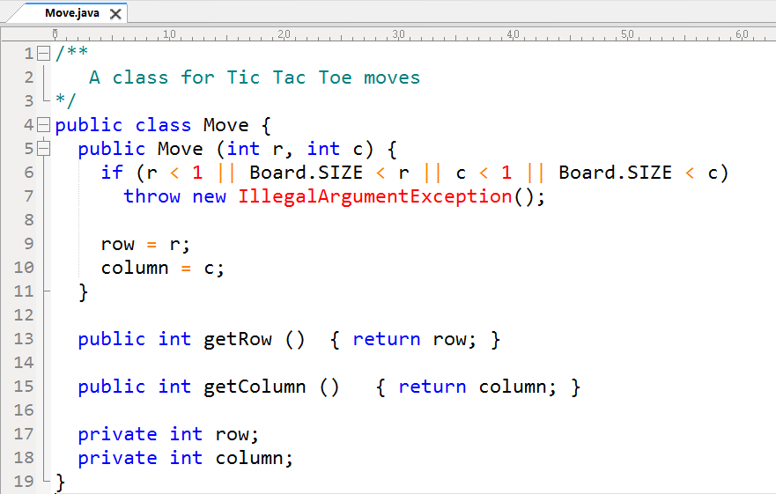

Slide 5
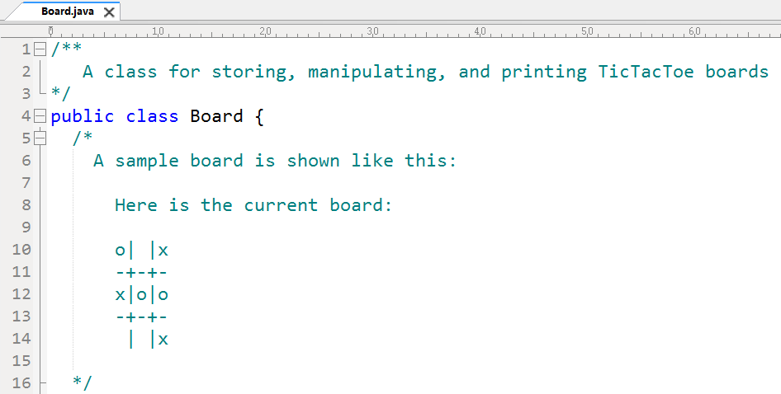

Slide 6
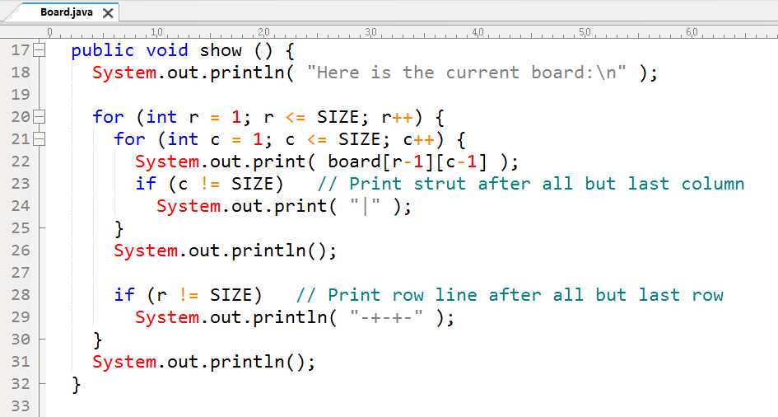

Slide 7
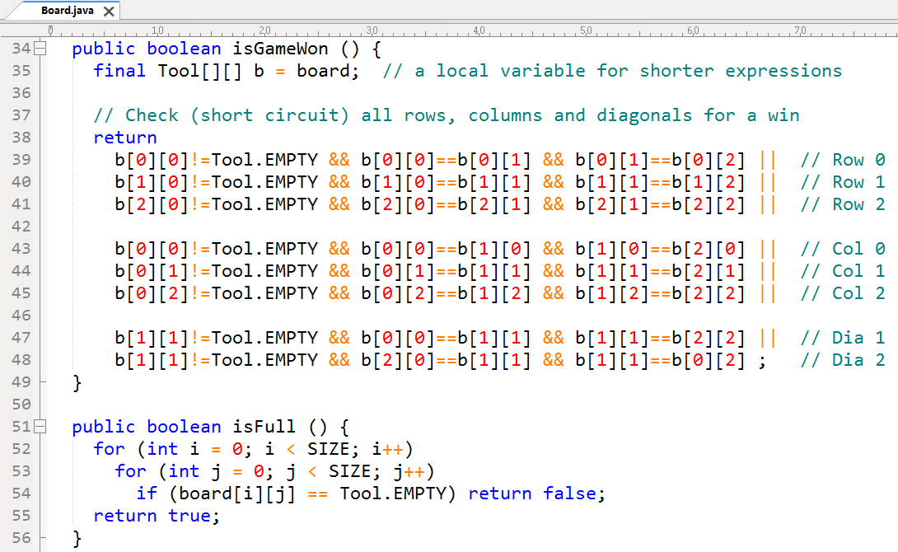

Slide 8
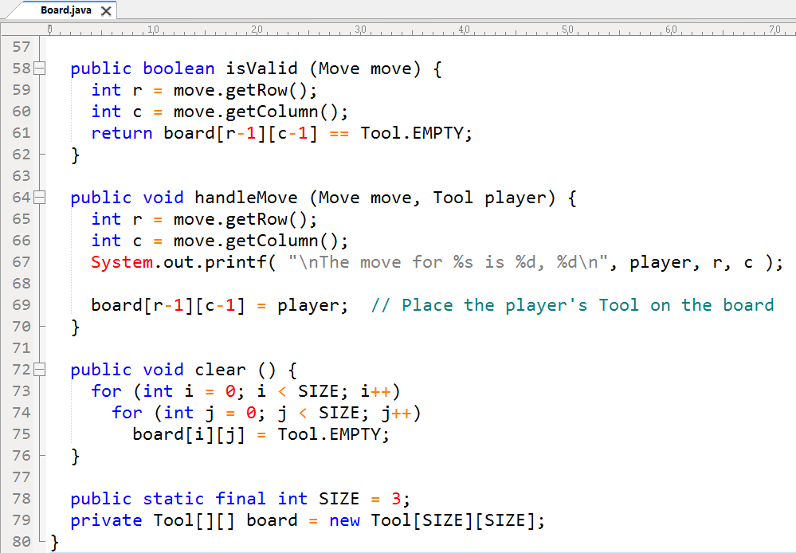

Slide 9
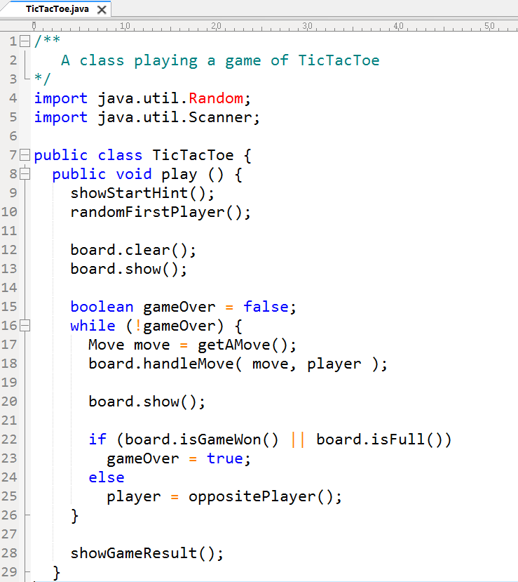

Slide 10
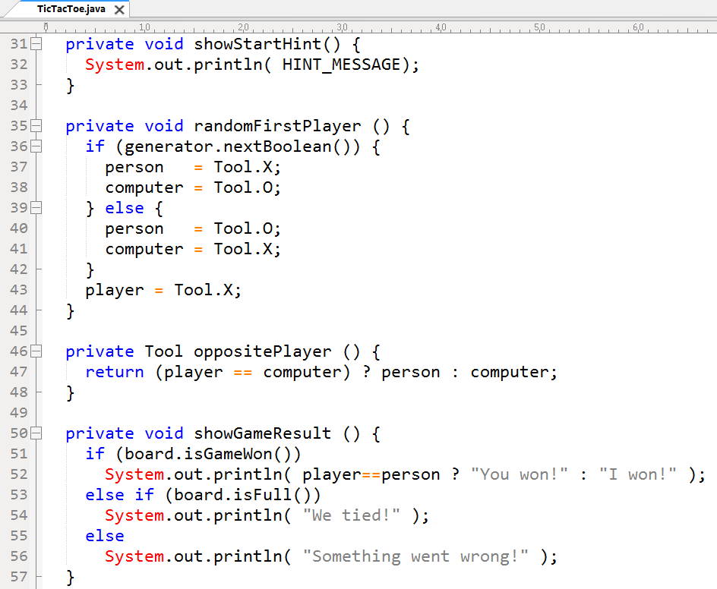

Slide 11
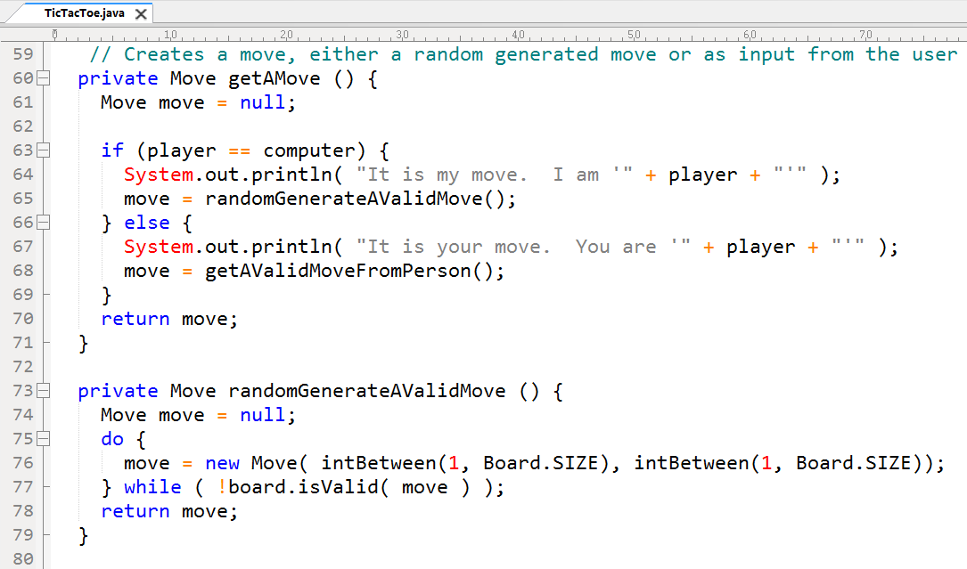

Slide 12
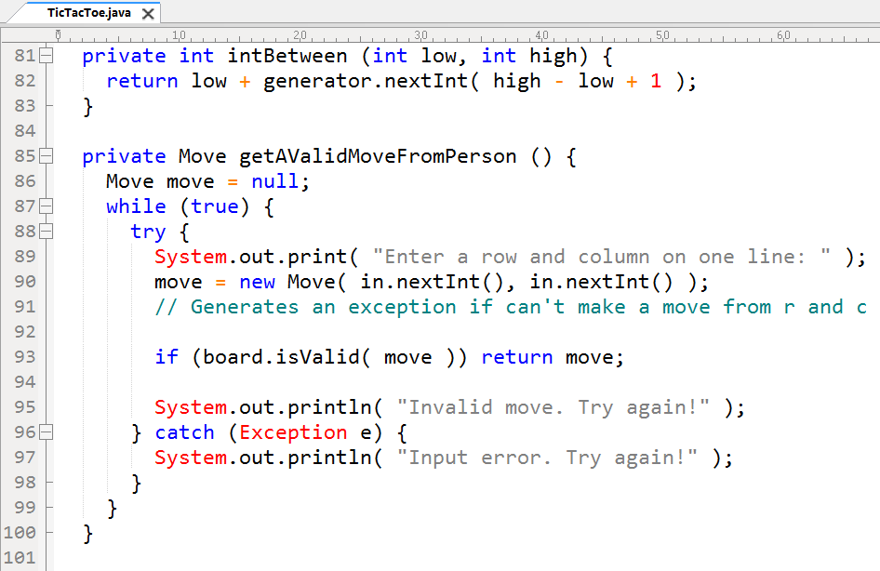

Slide 13
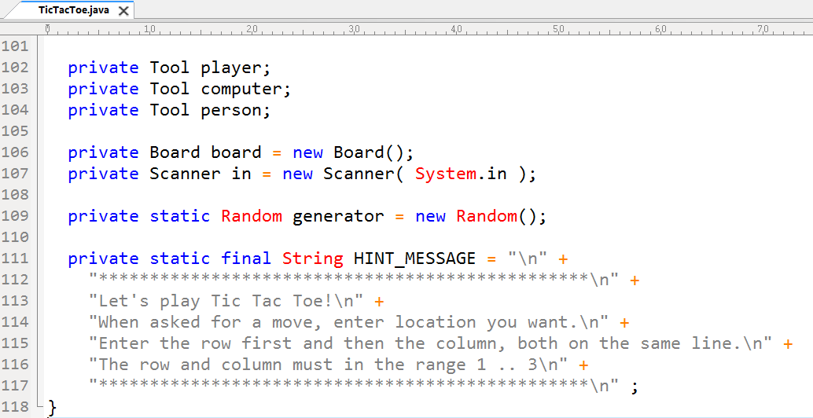

Slide 14
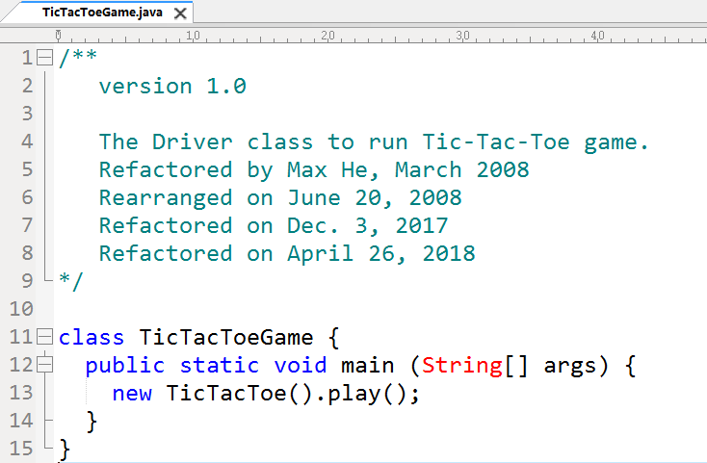

Slide 15
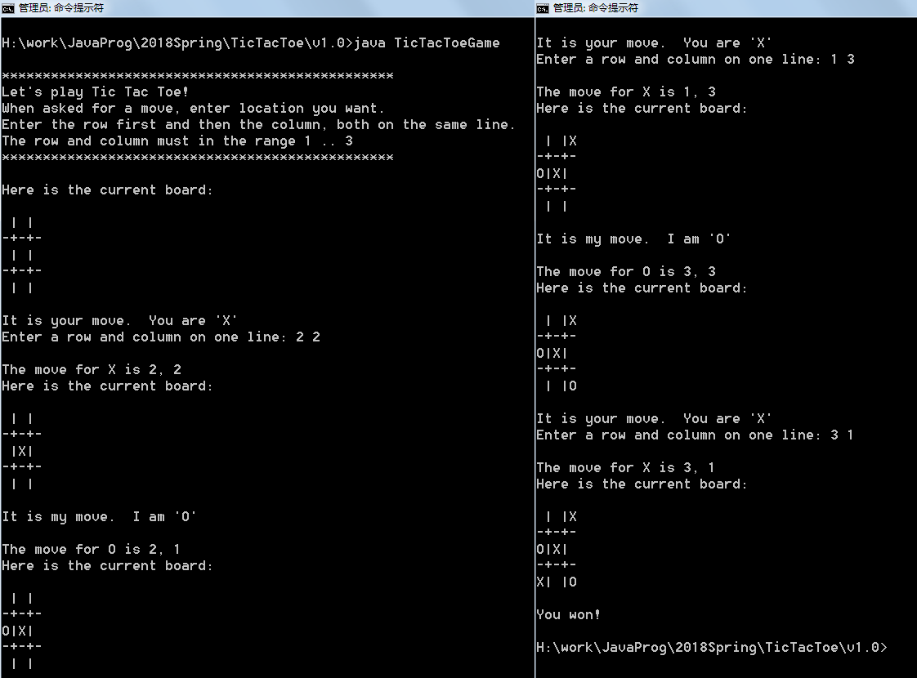

Slide 16
More in html
TicTacToe Game v 1.0 -- 无脑人机对弈
TicTacToe Game v 2.88 -- 无敌人机对弈 (html)
TicTacToe Game v 3.89 -- 智慧人机对弈 (html)
TicTacToe Derby v 3.89 -- 智慧Derby测试 (html)

