Slide 1
Architecture Design
何明昕 He Mingxin, Max
Email: c.max @ yeah.net (课程专用)
下载邮箱: c.program@ yeah.net

Slide 2
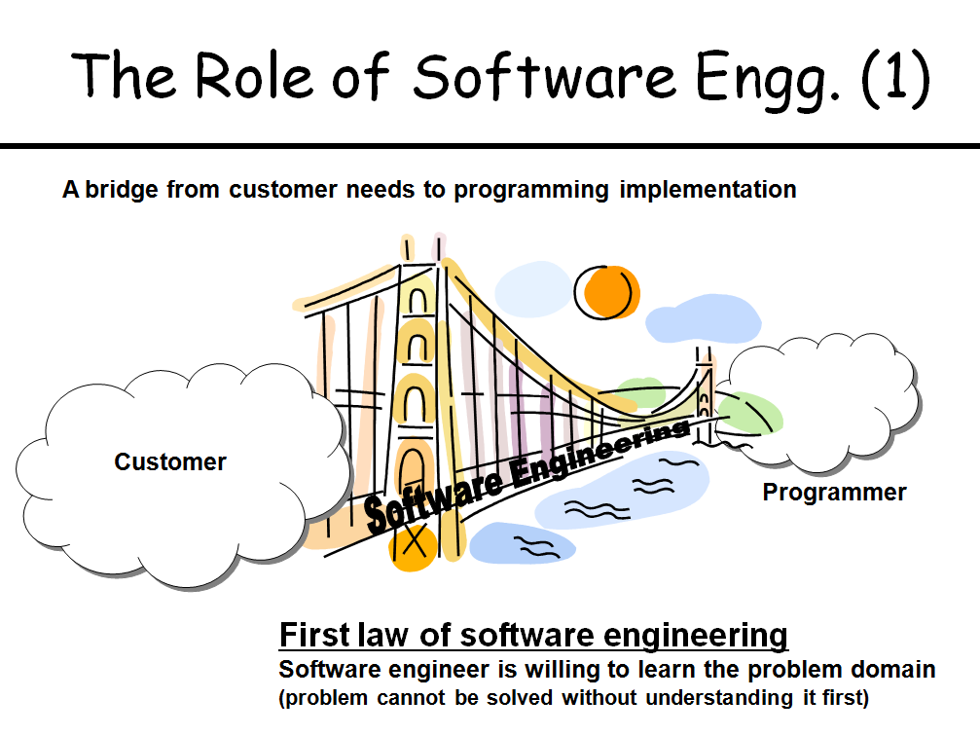

Slide 3
Software engineering
Software engineering is an engineering discipline that is concerned with all aspects of software production from the early stages of system specification through to maintaining the system after it has gone into use.
Engineering discipline
Using appropriate theories and methods to solve problems bearing in mind organizational and financial constraints.
All aspects of software production
Not just technical process of development. Also project management and the development of tools, methods etc. to support software production.

Slide 4
Software process activities
Software specification, where customers and engineers define the software that is to be produced and the constraints on its operation.
Software development, where the software is designed and programmed.
Software validation, where the software is checked to ensure that it is what the customer requires.
Software evolution, where the software is modified to reflect changing customer and market requirements.

Slide 5
Software is Complex
Complex (错综复杂的) ≠ complicated (复杂难懂的)
Complex = composed of many simple parts related to one another
Complicated = not well understood, or explained

Slide 6
Software Engineering is
Complex and Complicated
软件规模增长带来要素数量增长，熵增长必然导致混乱（热力学第三定律）
准确定义需求很难（用户通常不知道要什么，只知道不要什么），需求蔓延是软件项目失败的首要原因
不同的设计可以实现同样的功能(系统结构/行为/功能的关系），判断一个设计是否是好的设计很难（Conway’s law: 软件的结构倾向于与开发团队的组织架构具相似性)

Slide 7




Slide 8
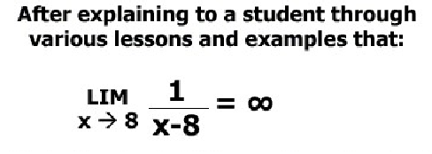
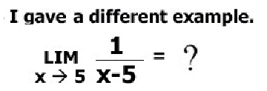
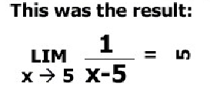

Slide 9
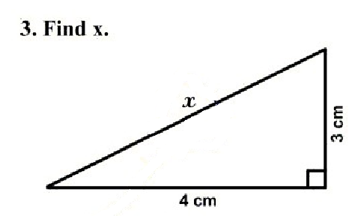
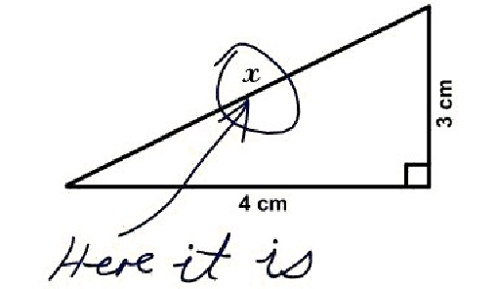

Slide 10

Critical Thinking
批判性思维
关键性思考
建设性思考
Critical Observing:
建设性观察
系统化认知问题 与
构建解决方案的能力

Slide 11
SEMAT http://semat.org
SEMAT (Software Engineering Method and Theory) drives a process to refound software engineering based on a solid theory, proven principles and best practices.

Slide 12
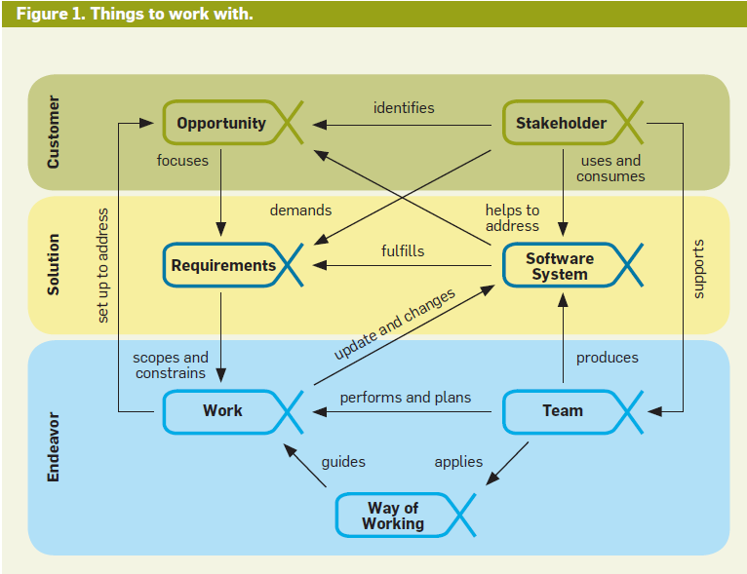
The Essence of Software Engineering:
The SEMAT Kernel By Ivar Jacobson

Slide 13
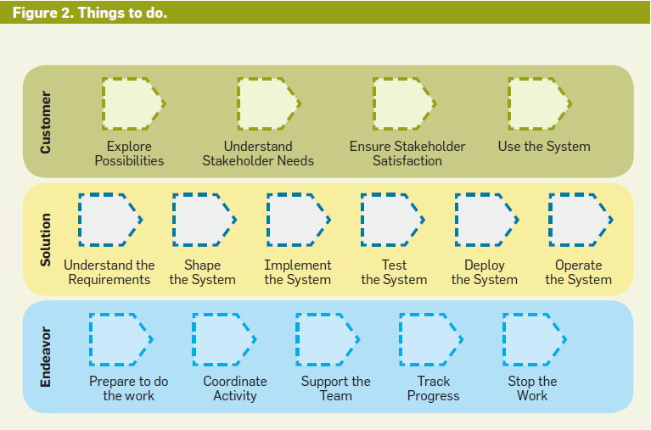
The SEMAT Kernel (cont.)

Slide 14
软件(程序)的三项职责(Robert Martin)
第一个职责是它要有效运行满足用户需要的功能。这也是该模块得以存在的原因。
第二个职责是它要应对变化。几乎所有的模块在它们的生命周期中都要变化，开发者有责任保证这种改变应该尽可能地简单。一个难以改变的模块，即使能够工作，也需要对它进行修正。
第三个职责是要和阅读它的人进行沟通。对该模块不熟悉的开发人员应该能够比较容易地阅读并理解它。一个无法进行沟通的模块也是拙劣的，同样需要对它进行修正。

Slide 15
好的软件(程序)的特征：
第一：能正确有效地运行；
第二：能容易地扩展和修改；
第三：能容易地与人沟通(便于交流)。

Slide 16
Essential attributes of good software
Product characteristic | Description
Maintainability | Software should be written in such a way so that it can evolve to meet the changing needs of customers. This is a critical attribute because software change is an inevitable requirement of a changing business environment.
Dependability and security | Software dependability includes a range of characteristics including reliability, security and safety. Dependable software should not cause physical or economic damage in the event of system failure. Malicious users should not be able to access or damage the system.
Efficiency | Software should not make wasteful use of system resources such as memory and processor cycles. Efficiency therefore includes responsiveness, processing time, memory utilisation, etc.
Acceptability | Software must be acceptable to the type of users for which it is designed. This means that it must be understandable, usable and compatible with other systems that they use.

Slide 17
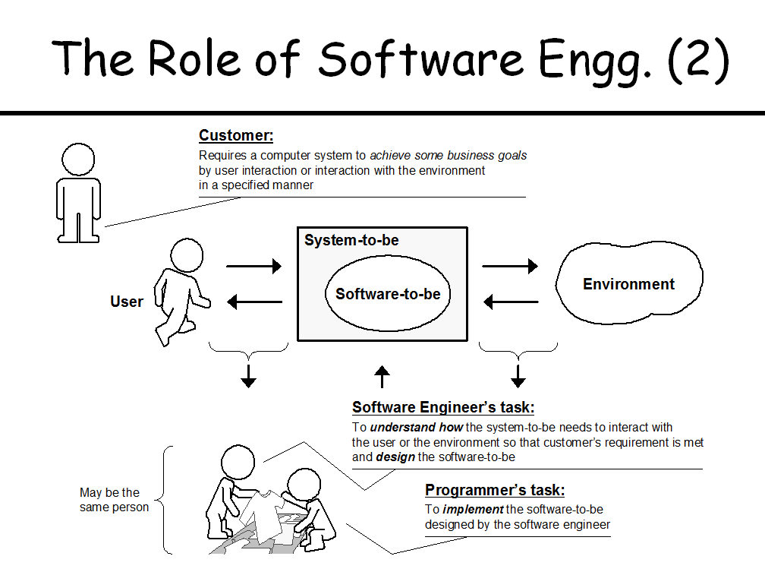

Slide 18
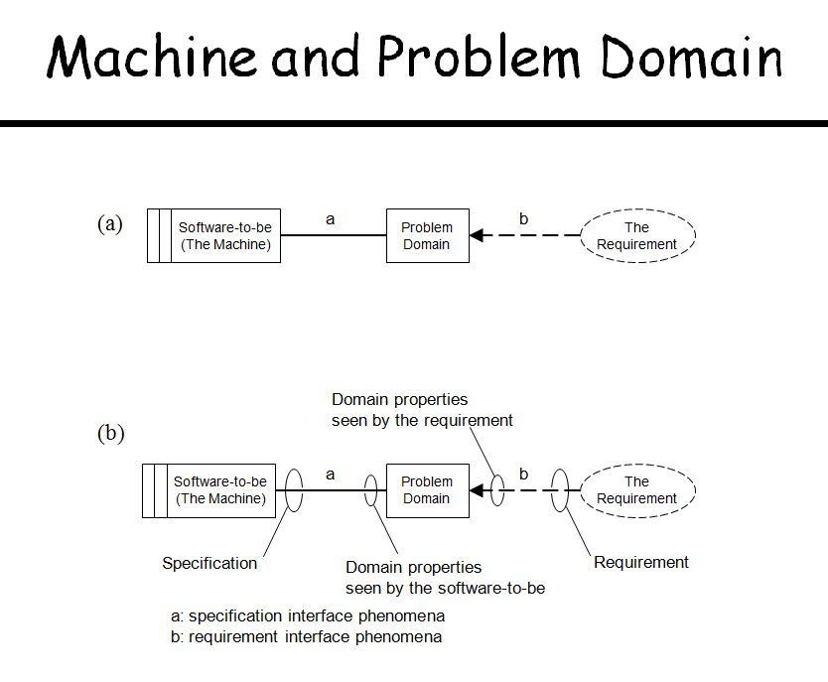

Slide 19
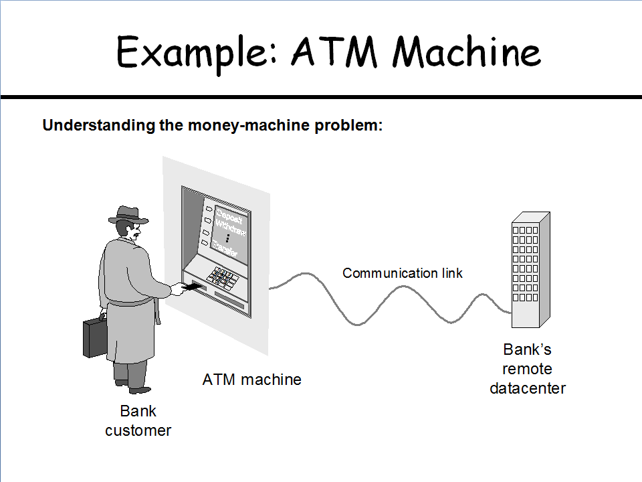

Slide 20
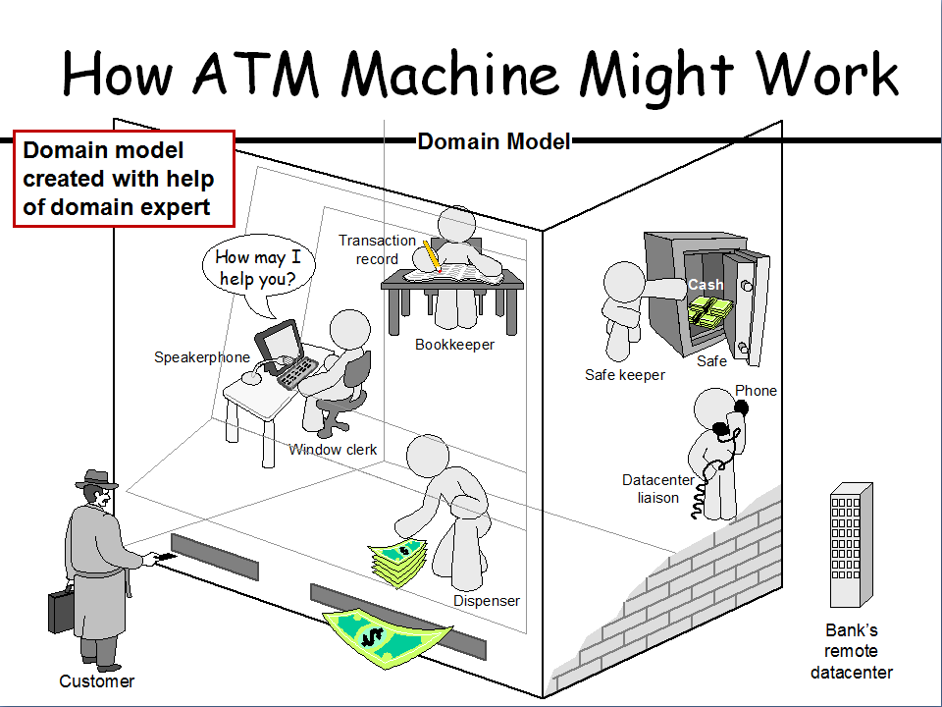

Slide 21
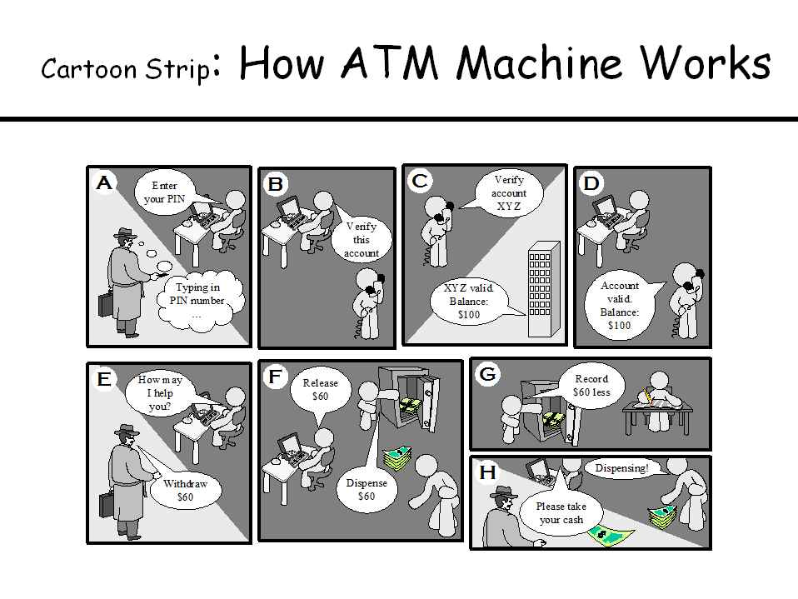

Slide 22
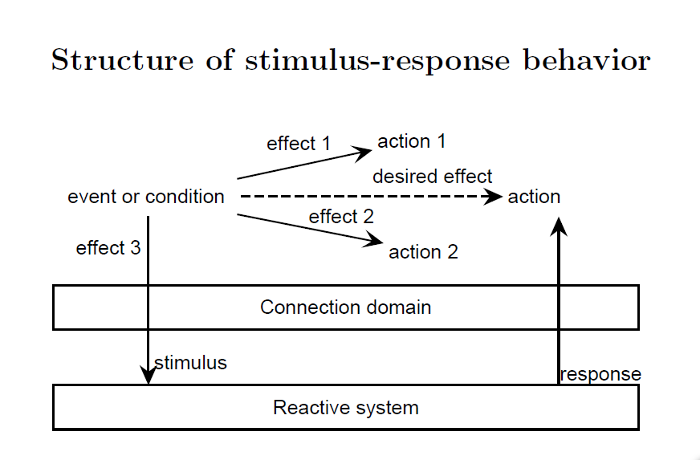

Slide 23
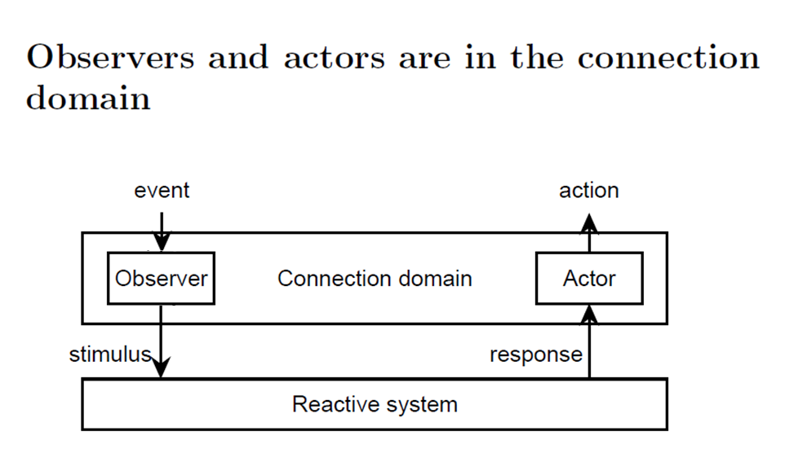

Slide 24
What is Analysis?
Analysis is a broad term. In Software development, we are primarily concerned with two forms of analysis.
Requirements Analysis is discovering the requirements that a system must meet in order to be successful.
Object Analysis is investigating the object in a domain to discover information important to meet the requirements.

Slide 25
What is Design?
Design emphasizes a conceptual solution that fulfills the requirements. A design is not an implementation, although a good design can be implemented when it is complete.
There are subsets of design, including architectural design, object design, and database design.

Slide 26
Analysis and Design
Focus on Make decisions (choices)
Analysis
do the right things
Design
Do the things right

Slide 27
软件设计的五个层面：
产品/服务市场架构设计(定位与设想)
系统(软件)架构设计
软件边界(界面或接口)设计
信息(数据)结构及存取设计
业务逻辑(处理/计算)设计

Slide 28
4+1商业模式
产品/服务的客户价值
组织与流程
关键资源
收入模式
+1）以IT为基础的基础设施

Slide 29
Applying UML and Patterns in OOA/OOD
What is a good object design?

Slide 30
Applying UML
UML is just a standard diagramming notation. It is just a tool, not a skill that is valuable in itself. Knowing UML helps you communicate with others in creating software, but the real work in this course is learning Object-Oriented Analysis and Design, not how to draw diagrams.

Slide 31
Assigning Responsibilities
The most important skill in Object-Oriented Analysis and Design is assigning responsibilities to objects. That determines how objects interact and what classes should perform what operations.

Slide 32
Design Patterns
Certain tried-and-true solutions to design problems have been expressed as principles of best practice, often in the form of Design Patterns.
A Design Pattern is a named problem solution formula that apply excellent design principles.

Slide 33
Requirements Analysis
All Software Analysis and Design is preceded by the analysis of requirements.
One of the basic principles of good design is to defer decisions as long as possible. The more you know before you make a design decision, the more likely it will be that the decision is a good one.
TFCL: Think First, Code Later!

Slide 34
Use Cases
Writing Use Cases is not a specifically Object Oriented practice. But it is a best practice for elaborating and understanding requirements. So we will study Use Cases.

Slide 35
Definition of Software Architecture
Software Architecture:There are various forms of it. But the common theme is that it has to do with large scale-the Big Ideas in the forces, organization, styles, patterns, responsibilities, collaborations, connections and motivations of a system and major subsystems.

Slide 36
软件架构
软件架构 = { 结构元 (Elements), 结构型(Forms), 结构理 (Rationale) }
即软件架构是由若干具特定结构形按结构理组合起来的结构元的集合。
结构元包括处理元、数据元和连接元

Slide 37
Definition variance
In software development, architecture is thought of as both noun and a verb.
As a noun, the architecture includes the organization and structure of the major elements of the system.
As a verb, architecture is part investigation and part design work.

Slide 38
Definition
Architectural investigation: involves functional and non-functional requirements that have impact on system design.
Some of these are: Market trends, performance, cost and points of evolution.
Architectural Design: is the resolution of these requirements in the design of software.

Slide 39
Architectural Dimension and Views in UP
The common dimensions are:
The logical architecture, describes the system in terms of its conceptual organization in layers, packages, classes, interfaces and subsystems.
The deployment architecture, describes the system in terms of the allocation of process to processing unit and network configurations.

Slide 40
Fig. 13.1 UP制品相互影响示例 (p146)

Slide 41
Package Diagrams
UML Package Diagrams are often used to show the contents of components, which are often packages in the Java sense.
Each package represents a namespace.
Packages, as components, can be nested inside other packages.

Slide 42
Package Diagram
UI
Domain
Swing
Web
Sales

Slide 43
What is a layer?
“A layer is a coarse grained grouping of classes packages or subsystems that has cohesive responsibility for a major aspect of the system.”
Higher layers call upon the services of lower layers.

Slide 44
Fig. 13.2 UML包图所表示的层 (p147)

Slide 45
Fig. 13.3 嵌套包的另一UML表示 (p148)

Slide 46
Architectural Patterns and Pattern Categories
Architectural patterns: Relates to large-scale design and typically applied during the early iterations(in elaboration phase).
Design patterns: Relates to small and medium-scale design of objects and frameworks.
Idioms: Relates to language or implementation-oriented low-level design solutions.

Slide 47
Architectural Pattern: Layers
Idea behind Layer patterns:
Organize the large-scale logical structure of a system into discrete layers of distinct, related responsibilities with a clean, cohesive separation of concerns such that the “lower” layers are low-level and general services, and the higher layers are more application specific.
Collaboration and coupling is from higher to lower layers.

Slide 48
Inter-Layer and Inter-Package Coupling
It is informative to include a diagram in the logical view that shows the coupling between the layers and packages.
Following figure shows the coupling.

Slide 49
Fig. 34.2 Partial coupling between Packages (p405)

Slide 50
Inter-Layer and Inter-Package Interaction
Emphasizes the dynamics of how objects across the layers connect and communicate.
The interaction diagram focuses on the logical view and on the collaborations between the layers and package boundaries.

Slide 51
Logical vs. Process and Deployment of Architecture
Architectural Layers are a logical view of the architecture
They are not a deployment view of elements to process.
Depending on platform, all layers could be deployed within the same process on same node.
Or across many computers.

Slide 52
Terminology:Tier, Layers, and Partitions
Tier relates to physical processing node or clusters of node, such as “client tier”.
Layers of an architecture represent the vertical slices
Partitions represents a horizontal division of relatively parallel subsystems of a layer.

Slide 53
Fig. 13.4 信息系统逻辑架构常见层 (p150)

Slide 54
Fig. 13.6 层和分区 (p153)

Slide 55
How do we design application logic with objects?
We could create one class and put all logic in it, but that violates the whole spirit of object orientation.
We create software objects with names drawn from the real world, and assign application logic responsibilities to them.
It takes a lot of skill and experience to do a good job of choosing objects and assigning responsibilities.

Slide 56
Domain Layer and Domain Model
These are not the same thing. Domain model shows the real world, while the Domain layer shows the software architecture.
But the Domain model inspires the Domain layer, and is the source of many of the concept, especially class names.
Do not confuse the problem with the solution.

Slide 57
Fig. 13.5 领域层和领域模型的关系 (p152)

Slide 58
Information Systems
In IS layered architecture was known as three-tier architecture.
A three-tier architecture has interface, Application logic and a storage.
The singular quality of 3-tier architecture is:
Separation of the application logic into distinct logical middle tier of software.
The interface tier is relatively free of application processing.

Slide 59
Information Systems(cont..)
The middle tier communicates with the back-end storage layer.
The following is an example of 3-tier architecture.

Slide 60
Fig. 34.11 三层架构经典视图 (p413)

Slide 61
Fig. 34.12 三层结构布署在两层/三层物理架构上 (p414)

Slide 62
Two-tier Design
In this design, the application logic is placed within window definitions, which read and writes directly to database.
There is no middle tier that separates out the application logic.

Slide 63
The Model-View Separation Principle
The principle states that model(domain) objects should not have direct knowledge of view(presentation) objects.
Furthermore, the domain classes should encapsulate the information and behavior related to application logic.

Slide 64
Need for Model-View separation
To support cohesive model definitions that focus on the domain process, rather than on interfaces.
To allow separate development of the model and user interface layers.
To minimize the impact of requirements changes in the interface upon the domain layer.
To allow new views to be easily connected to an existing domain layer, without affecting the domain layer.

Slide 65
Continue..
To allow multiple simultaneous views on the same model object.
To allow execution of the model layer independent of the user interface layer
To allow easy porting of the model layer to another user interface framework.

Slide 66
Fig. 13.8 SSD和层间系统操作 (p155)

