Slide 1
Reactive Systems I, ch 01~03
何明昕 HE Mingxin, Max
Send your email to c.max@yeah.net with
a subject like: SE345-Andy: On What …
Download from c.program@yeah.net
/文件中心/网盘/SoftwareEngineering26S

Slide 2

Slides for
Design Methods for Reactive Systems:
Yourdon, Statemate and the UML
Roel Wieringa
Department of Computer Science
University of Twente,
the Netherlands
roelw@cs.utwente.nl
www.cs.utwente.nl/∼roelw
1

Slide 3
List of Slides
3 Chapter 1. Reactive Systems
11 Chapter 2. The Environment
28 Chapter 3. Stimulus-Response Behavior
43 Chapter 4. Software Speciﬁcations
55 Chapters 5–7. Mission Statement, Function Reﬁnement
Tree, Service Description
77 Chapter 8. Entity-Relationship Diagrams
99 Chapter 9. ERD Modeling Guidelines
125 Chapter 10. The Dictionary
139 Part IV. Behavior Notations
154 Chapter 11. State Transition Lists and Tables
166 Chapter 12. State Transition Diagrams
2

Slide 4
188 Chapter 13. Behavioral Semantics
210 Chapter 14. Behavior Modeling and Design Guidelines
238 Part V. Communication Notations
246 Chapter 15. Data Flow Diagrams
265 Chapter 16. Communication Diagrams
276 Chapter 17. Communication Semantics
287 Chapter 18. Context Modeling Guidelines
300 Chapter 19. Requirements-Level Decomposition Guidelines
323 Chapter 20. Postmodern Structured Analysis (PSA)
332 Chapter 21. Statemate
351 Chapter 22. The Uniﬁed Modeling Language (UML)
381 Chapter 23. Not Yet Another Method
3

Slide 5
Chapter 1. Reactive Systems
• Partitioning of systems into information systems, control
systems and telecommunication systems is becoming obsolete.
• More informative partitioning: Transformational versus
reactive systems.
• Reactive systems respond to stimuli in order to bring about
desirable eﬀects in their environment.
• Reactive systems may do one or or of these things:
– Manipulate complex data,
– engage in complex behavior,
– communicate with many other systems.
4

Slide 6
Example 1
A training information system supports coordination of monthly
introductory training courses for new employees of large company.
• Nonterminating: When switched on, it should respond to
events such as queries, updates, arrival of downloads.
• Interactive: When switched on, it can engage in dialogs with its
users and with other software (personnel information system).
• State-dependent response: Its response depends upon the data
stored in it.
• Environment-oriented response: Responses deﬁned in terms of
courses, participants, teachers etc.
• Paral lel processing: May interact with several users and
programs simultaneously.
5

Slide 7
Example 2
An electronic ticket system supports buying and using rail tickets
by means of a smart card in combination with a PDA.
• Nonterminating: When switched on, it should respond to
events such as buy, show, use.
• Interactive: When switched on, it can engage in dialogs with
its users and with other software.
• State-dependent response: Its response depends upon the
tickets and the data about railroads stored in it.
• Environment-oriented response: Responses deﬁned in terms of
railroad routes and segments.
• Paral lel processing: It may consist of several pieces of software
running concurrently on smart card and PDA.
6

Slide 8
Example 3
A heating controller of heating tank in juice plant.
• Nonterminating: When switched on, it should respond to
events such as start heating, too hot, too cold.
• Interactive: When switched on, it can engage in dialogs with
its users and with devices.
• Interrupt-driven: It responds to time-outs and signals from
operator and devices as and when they occur.
• State-dependent response: Its response depends upon the data
that it stores, which is about the heating tank and its devices.
• Environment-oriented response: Responses are about heating
tank and its devices.
• Paral lel processing: Monitoring temperature, monitoring
pressure, listening to commands from operator.
• Rea l time: Responses would be incorrect if too late.
7

Slide 9
Deﬁnition of reactive system
A reactive system is a system that, when switched on, is
able to create desired eﬀects in its environment by enabling,
enforcing or preventing events in the environment.
Has most of the following characteristics:
• nonterminating
• interactive
• interrupt-driven
• state-dependent
• environment-oriented
• parallel
• real-time
8

Slide 10
Examples of reactive systems
• Information systems
• Workﬂow systems
• Groupware
• EDI systems
• Web market places
• Production control software
• Embedded software
9

Slide 11
Transformational systems
Contrast reactive systems with transformational systems, that
compute output from an input and then terminate.
• terminating
• sometimes interactive
• not interrupt-driven
• output not state-dependent
• output deﬁned in terms of input
• sequential
• usually not real-time
Compiler, assembler, loader, expert system, optimization
algorithm, search algorithm, linear programming algorithm, etc.
10

Slide 12
Design approach to reactive systems
To design reactive systems, environment models are important:
• Possible entities and behavior in environment (chapter 2).
• Communication of system with environment (chapter 3)
11

Slide 13
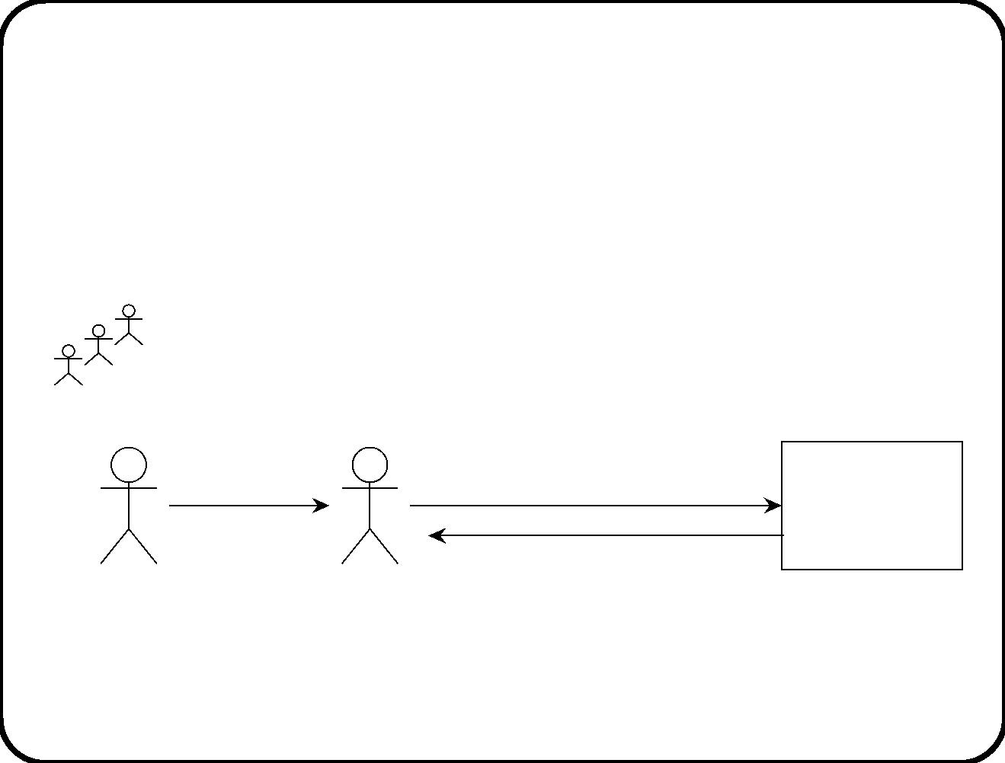
Chapter 2. The Environment
Example 1
Group 3
‘‘I want to
participate’’
‘‘XYZ wants to
participate’’
Training
Information
System
Joiner
(new employee)
Registration
desk
‘‘XYZ allocated to group 3’’
12

Slide 14
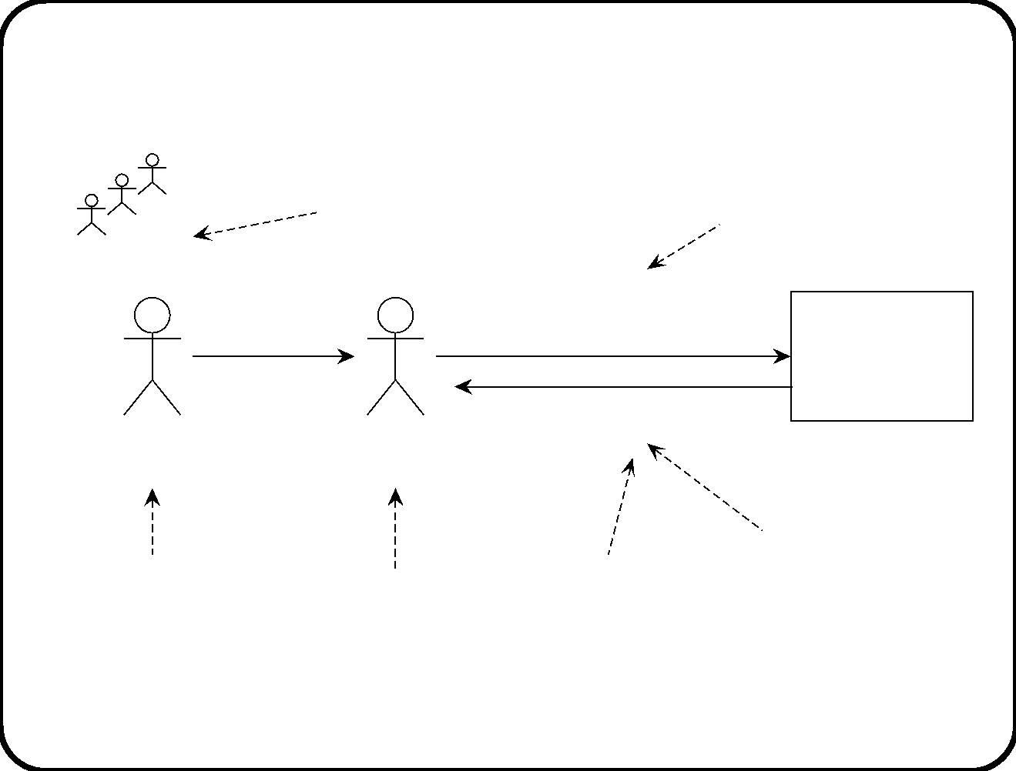
subject
Message about joiner
Group 3
Joiner
‘‘I want to
participate’’
‘‘XYZ wants to
Training
Information
System
participate’’
‘‘XYZ allocated to group 3’’
Registration
desk
(new employee)
Informative
subject
of both messages
connection
message about
joiner and group
function
of TIS
13

Slide 15
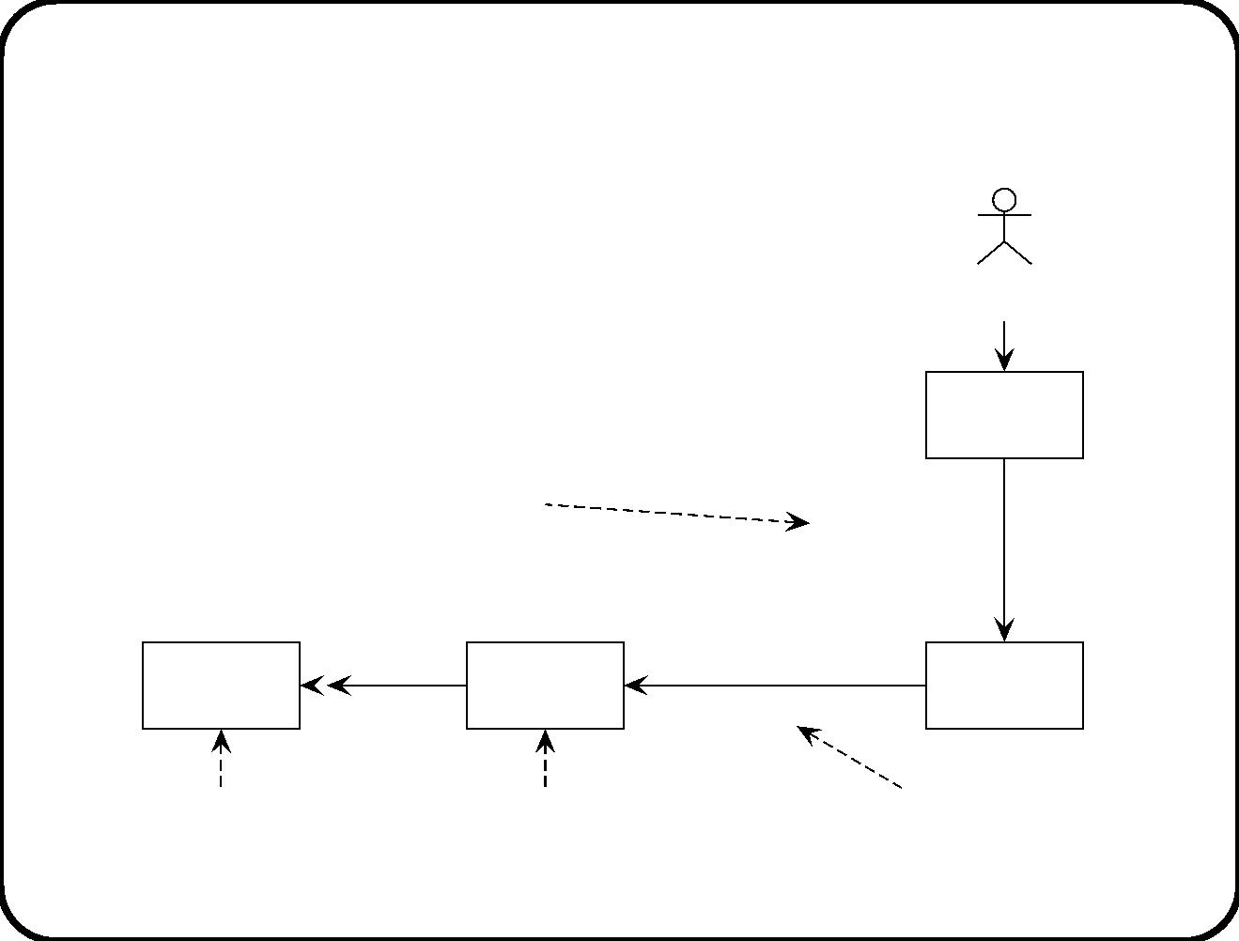
Example 2
Operator
Console
command about
heating tank
‘‘start
heating
1
the tank’’
Heating
tank
heat
‘‘switch on’’
2
Heating
controller
Heater
subject
of message 1
subject
of message 2
directive function
of controller
14

Slide 16
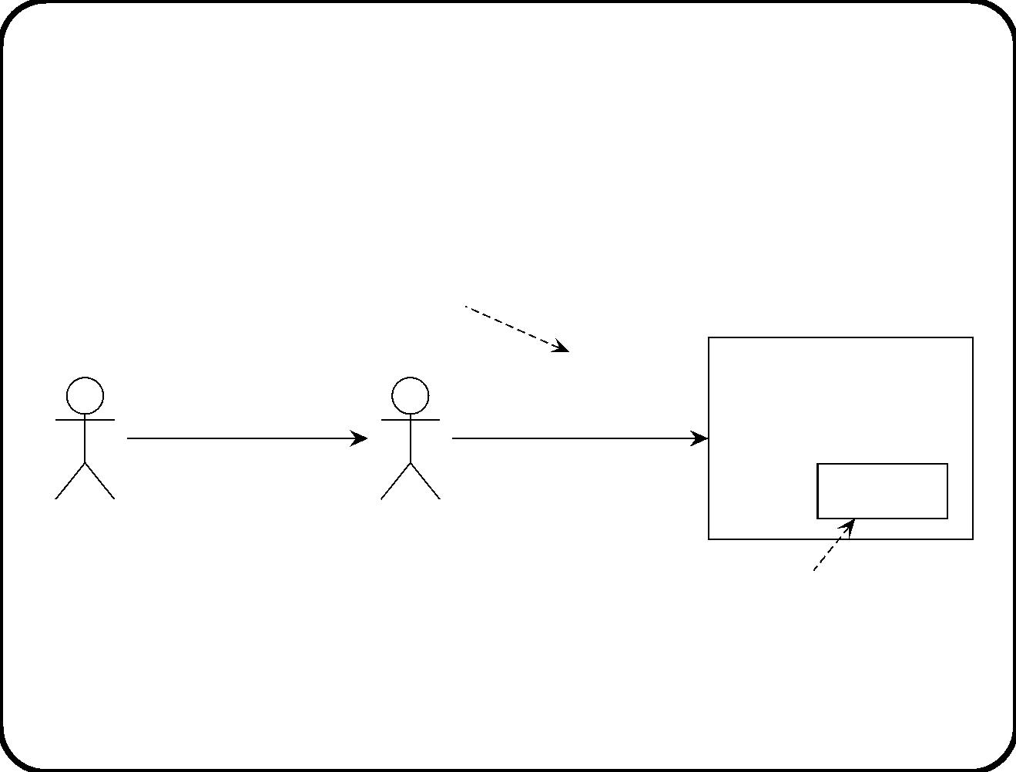
Example 3
Manipulative function
of Electronic Ticket System
enter traveller’s
smart card,
push usage button
‘‘Stamp ticket
for usage’’
Traveller’s
smart card
Ticket
Conductor
Conductor’s PDA
Subject
of message
15

Slide 17
Symbolic interactions
Reactive software systems communicate with their environ-
ment by means of linguistic messages.
• Not in object-oriented sense.
• Post-it notes exchanged with environment.
• Flow of symbols is more important than of ﬂow of energy or
matter.
• Physical connection is what makes symbol ﬂow possible.
• Eﬀect not determined by physical causality but by symbol ﬂow.
• We abstract from the physical realization of these messages.
16

Slide 18
Summary of examples
Messages entering and leaving a reactive software system are
characterized by three aspects:
• A subject
– What is the message about?
About people, devices, conceptual entities, lexical entities.
• A function
– What is the purpose of the message?
To inform or direct the environment, to manipulate lexical items
in the system.
• A connection
– Through which path does the message travel from sender to
receiver?
Messages can get delayed, distorted or lost along the way.
17

Slide 19
Deﬁnitions
• Subject domain of a reactive system: Set of all subjects of all
its input and output messages.
• Functions of a reactive system: All services provided by these
message exchanges.
• Connection domain of a reactive system: Channels through
which messages ﬂow to and from the system.
18

Slide 20
Sub ject domain
The part of the world talked about by the messages that cross
the system interface.
To ﬁnd it, ask what the messages entering and leaving the system
are about.
• Physical entities. Have a weight and a size. Make noise,
generate heat.
– People
– Devices
• Conceptual entities. Invisible and weightless. E.g. bank
accounts, obligations, permissions.
• Lexical items. Physical entities with a meaning. E.g. Tickets,
contracts, receipts.
19

Slide 21
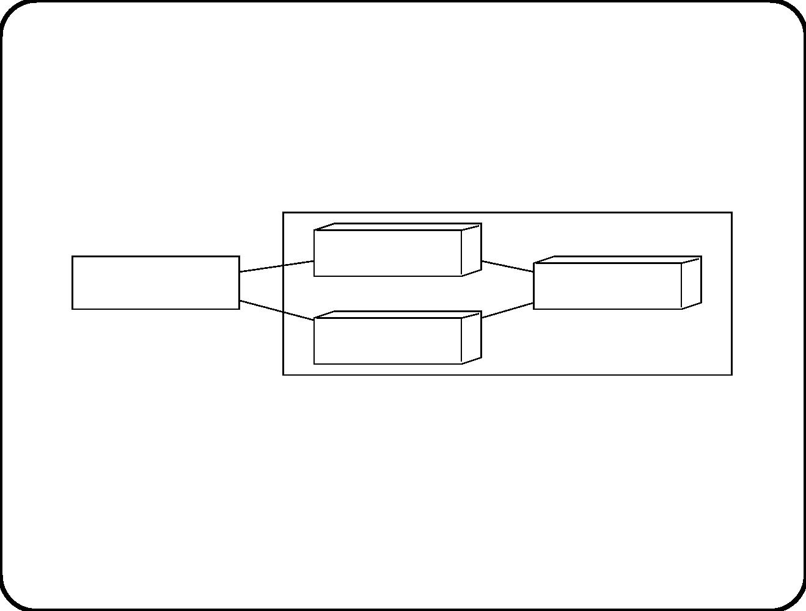
Example of a physical sub ject domain
Heater
Heating controller
Heating tank
Thermometer
Subject domain
A physical subject domain always exists outside the software
system.
20

Slide 22
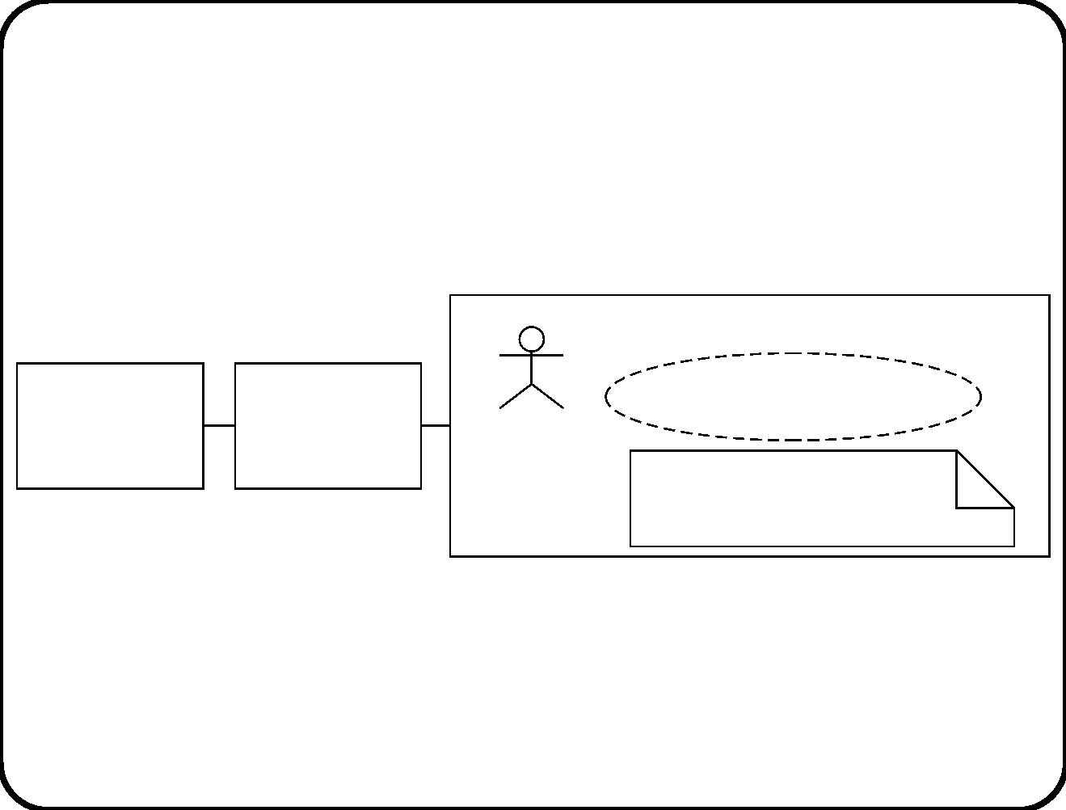
Example of conceptual, lexical, physical sub ject
domain entities
Subject domain
Personnel
information
system
Employee
department
personnel
Rights and obligations
Employment contract
Employee
Conceptual entities always exist outside the software system. They
exist because people agree to treat them as existing.
21

Slide 23
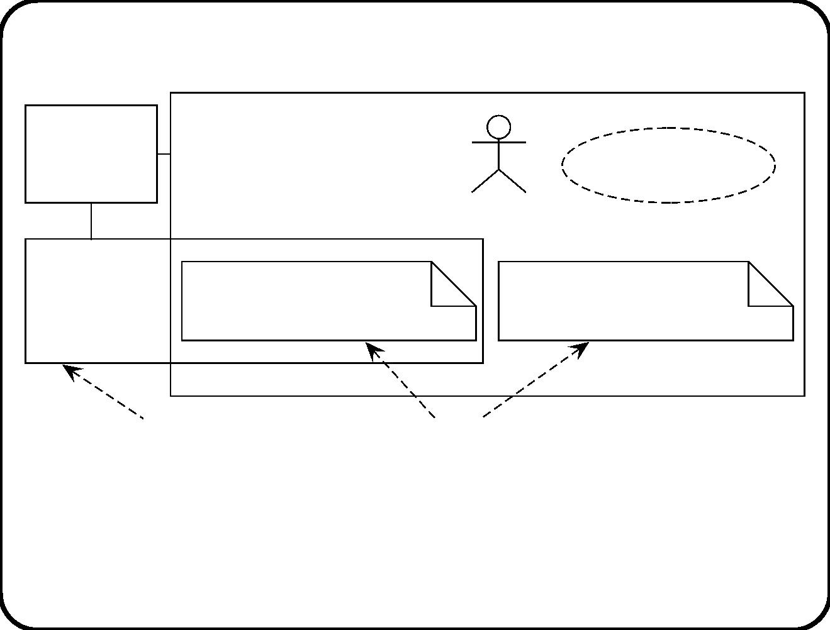
Lexical entities can be copied
Employee
Subject
department
domain
Rights and
obligations
personnel
Employee
Personnel
information
system
Employment contract
copy 1
Employment contract
copy 2
Software system
lexical entities
Lexical subject domain entities may exist in the software or in the
environment of the software. They may be copies of each other.
22

Slide 24
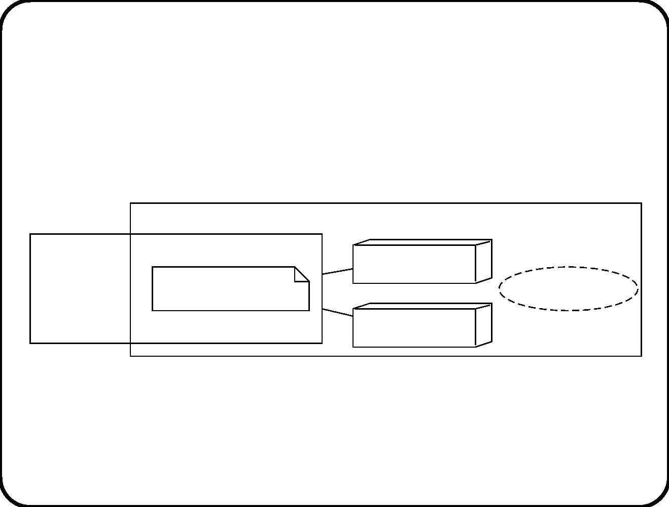
Physical and conceptual entities in a sub ject
domain
Subject dmain
Button
Elevator
Allocation record
Allocation
controller
Elevator cage
23

Slide 25
Functions of reactive systems
• Registration. System registers events in environment.
– TIS registers participation in course.
– Heating controller registers temperature.
• Direction. System inﬂuences events in environment.
– Controller switches heater on.
– Compact dynamic bus station controller: Tells driver at
which platform to park.
• Manipulation. System manipulates virtual entities; this has a
meaning in the social environment.
– ETS stamps ticket.
– TIS allocates joiner to group.
24

Slide 26
Connection domain
• Events of interest usually do not occur exactly at the interface
of the system.
• Actions caused by the system usually do not occur exactly at
the interface of the system.
Communication channel needed. If represented explicitly it is
called a connection domain. Is possible source of
• delay,
• loss, and
• distortion
of messages to/from the system.
25

Slide 27
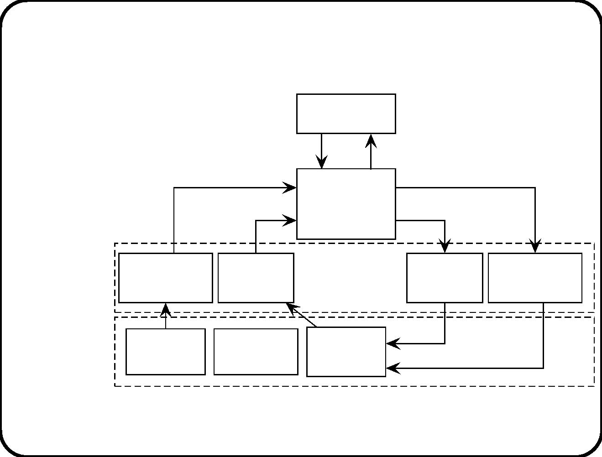
Sub ject domain and connection domain
SuD
Librarian
query
answer
acquisition info
remind request
Document
Circulation
System
reserve, borrow,
return
notification
Connection Acquisition Library
Library Circulation
domain
department
desk
desk
department
Subject
domain
Library
member
availability
reminder
Publisher Document
26

Slide 28
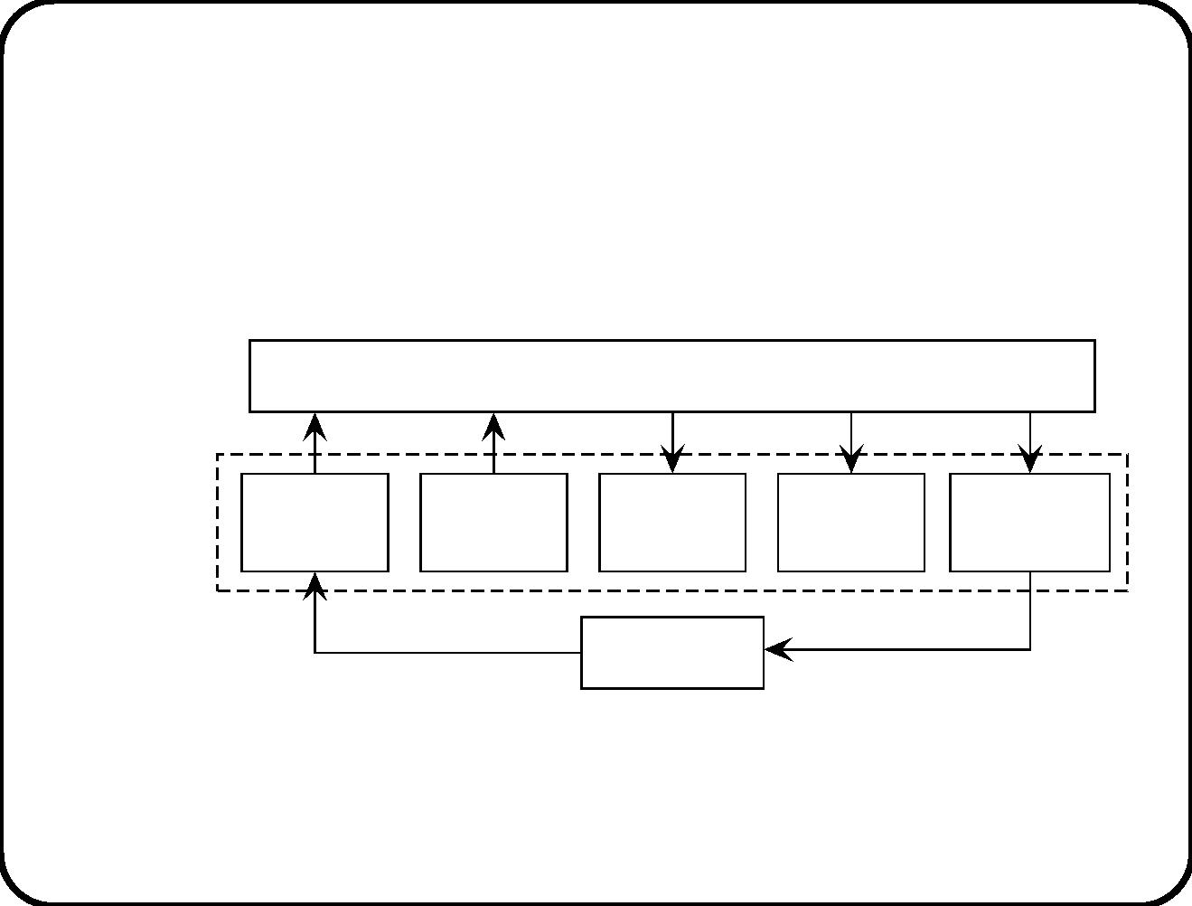
System directly connected to sub ject domain
SuD
Elevator controller
Subject
domain
Request
button
Arrival
sensor
Motor
Doors
Direction
indicator
Passenger
27

Slide 29
Main Points
Let SuD be a Software System under Design.
• Message that cross the interface of the SuD are about the
subject domain.
• Subject domain entities exist outside the SuD; except lexical
items, that may also exist inside the SuD.
• Messages that cross the interface have three kinds of functions:
Informative, Manipulative, Directive.
• Messages travel to and from the SuD through a connection
domain.
28

Slide 30
Chapter 3. Stimulus-Response Behavior
• A reactive system receives messages from sources in its
environment and it sends messages to destinations in its
environment.
• At the sources, events occur.
• At the destinations, actions occur.
• We now look at the chain of cause and eﬀect from event to
system stimulus, and from system response to action.
• We will see that to interpret stimuli and to motivate responses,
we need to make assumptions about the environment.
29

Slide 31
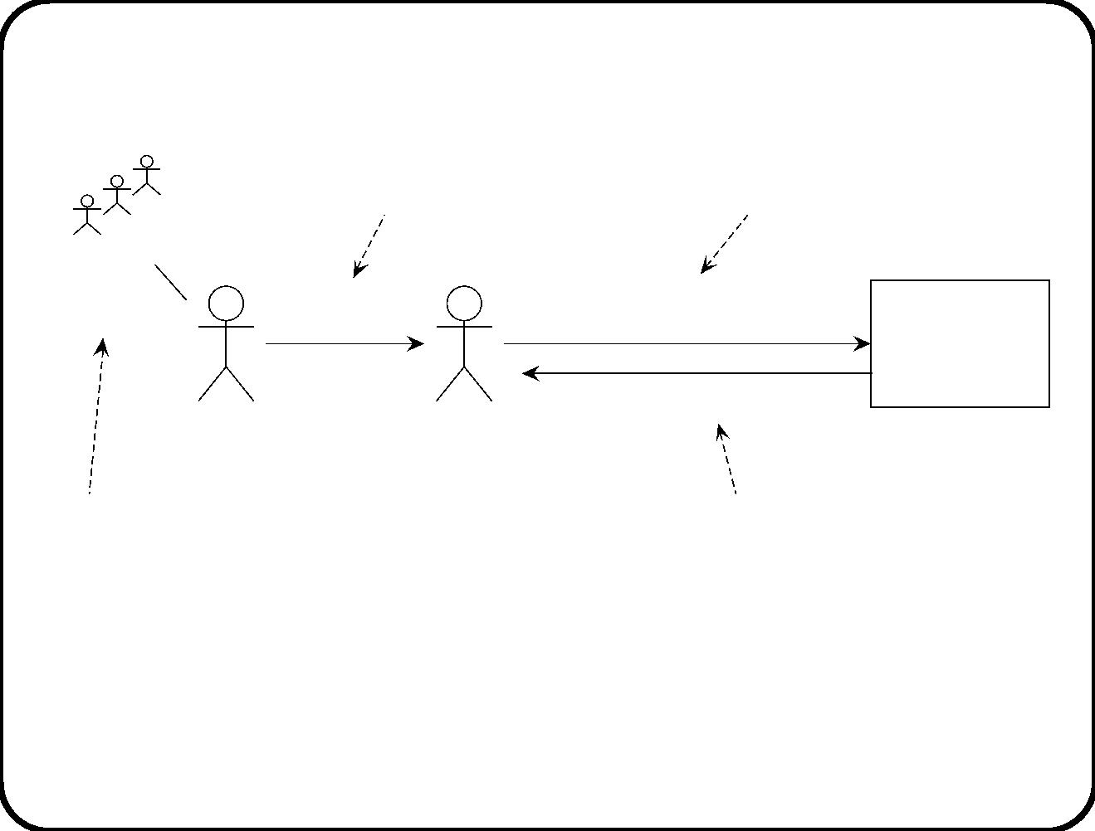
Example 1
event
stimulus
Group 3
allocation
created
‘‘I want to
participate’’
‘‘XYZ wants to
participate’’
Training
Information
System
‘‘XYZ allocated to group 3’’
Joiner
(new employee)
Registration
desk
action
response
Assumptions:
• Registration desk transmits message faithfully.
• The employee is indeed a joiner.
30

Slide 32
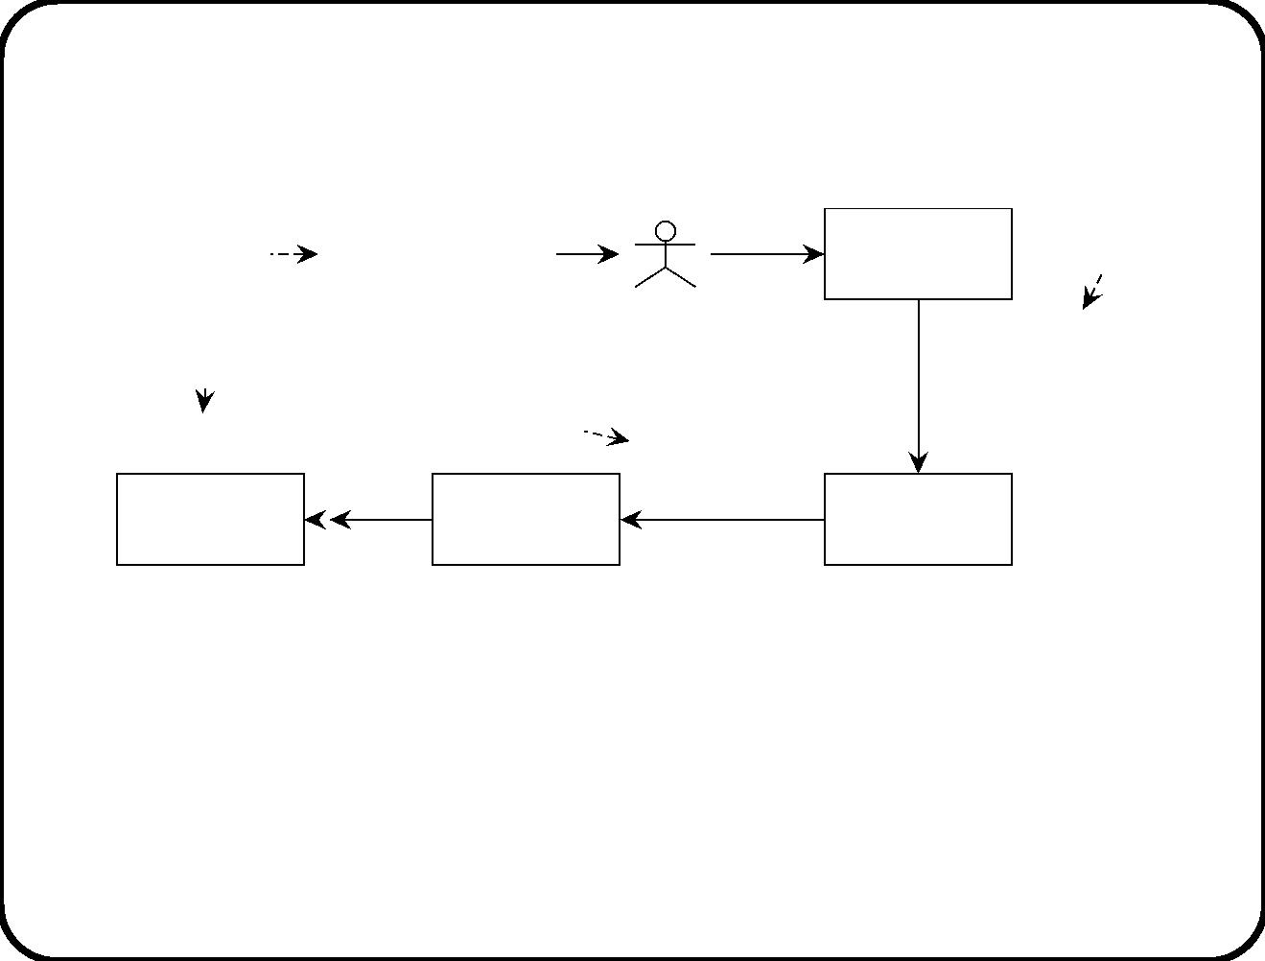
Example 2
temporal
event
Time to
stimulus
Console
start heating
Operator
‘‘start
action
response
heating
Heating started
Heating
‘‘switch
on’’
the tank’’
heat
Heating
controller
Heater
tank
Assumptions:
• The message is transmitted faithfully by the console.
• The translates “switch on” into heat production.
• The heater is connected to the heating tank.
31

Slide 33
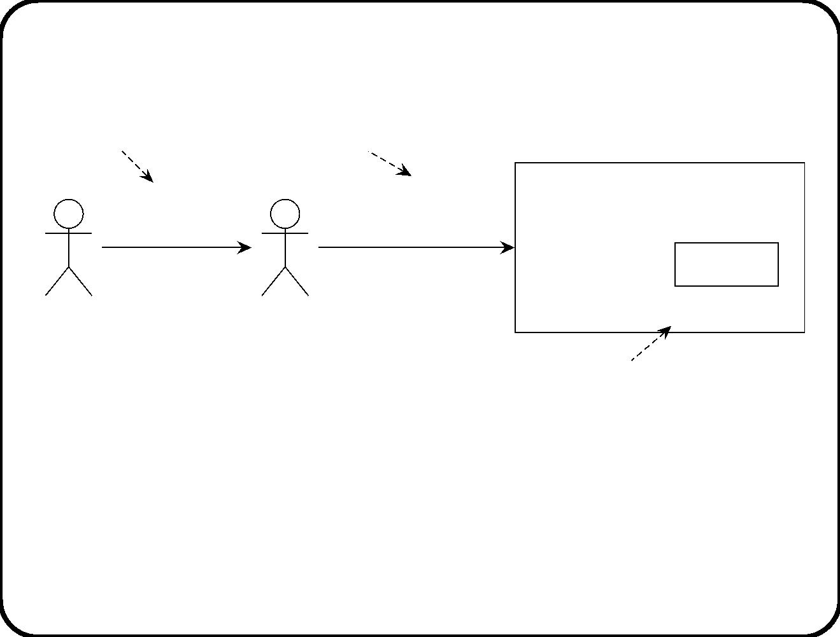
Example 3
event
stimulus
enter card
in PDA
‘‘Stamp ticket
for usage’’
Traveller’s smart card
Ticket
Conductor
Conductor’s PDA
stamp the ticket
response and action
Assumptions:
• The PDA is indeed the conductor’s PDA.
• The conductor requests to stamp the ticket while the ticket
owner is traveling on a segment for which the ticket is valid.
32

Slide 34
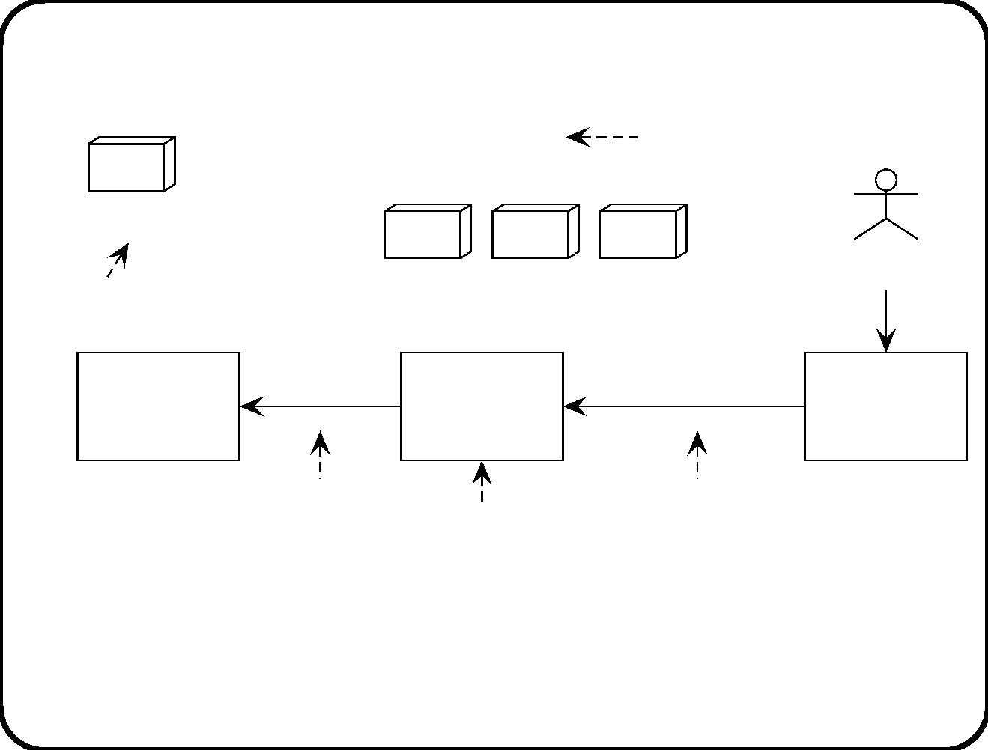
Example 4
Condition
change
event
A shelf becomes
empty
Receive 30 widgets
Customer
buy
Action
Goods on shelves in the supermarket
‘‘order 30
Supplier’s
information
system
Stock
information
system
‘‘stock too low’’
Point-of-
sale-
terminal
widgets’’
Response
Stimulus
SuD
SuD discovers the change event by testing the condition stock < 4.
Assumptions:
• Data in SIS accurately represent state of the shelves.
33

Slide 35
Summary of stimulus-response behavior
• Some named external event, condition change event or temporal
event occurs in the environment.
• Through some some communication channel, this causes an
SuD stimulus.
– May be modeled explicitly as connection domain.
• The SuD responds.
• Through some communication channel, this causes an action in
the environment.
– For virtual entities, response and action coincide.
34

Slide 36
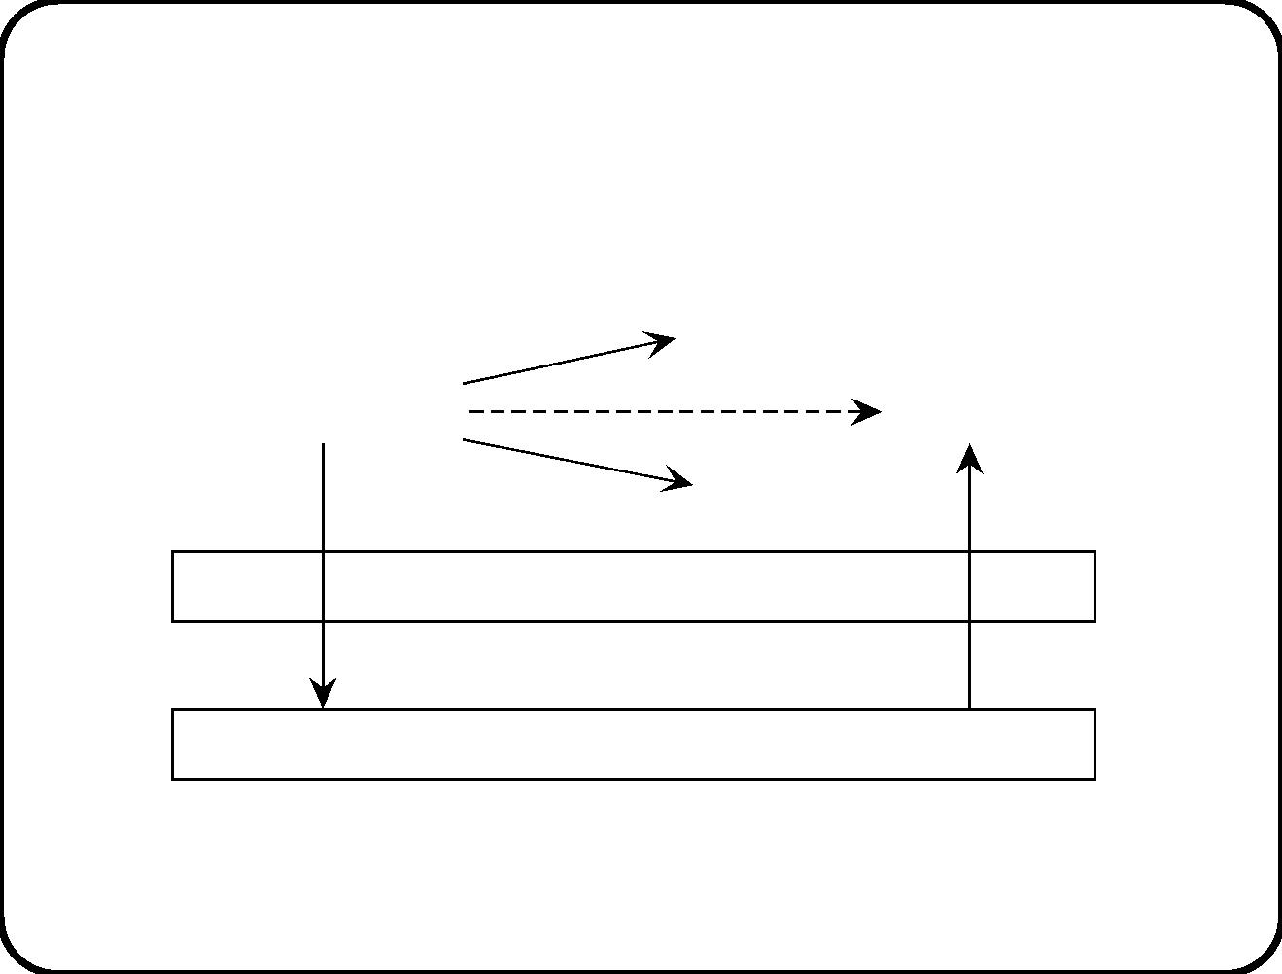
Structure of stimulus-response behavior
effect 1
action 1
desired effect
event or condition
effect 3
action
effect 2
action 2
Connection domain
Reactive system
stimulus
response
35

Slide 37
The role of assumptions
These are statements about the environment ...
• that must be true for the (stimulus, response) pair to be
desirable;
• but the SuD cannot guarantee them to be true.
• If assumption is false, (stimulus, response) pair may still be
desirable, or indiﬀerent, or even undesirable!
Typical assumptions concern laws of nature and properties of
devices (e.g. observers and actors) and people (e.g. users and
operators).
36

Slide 38
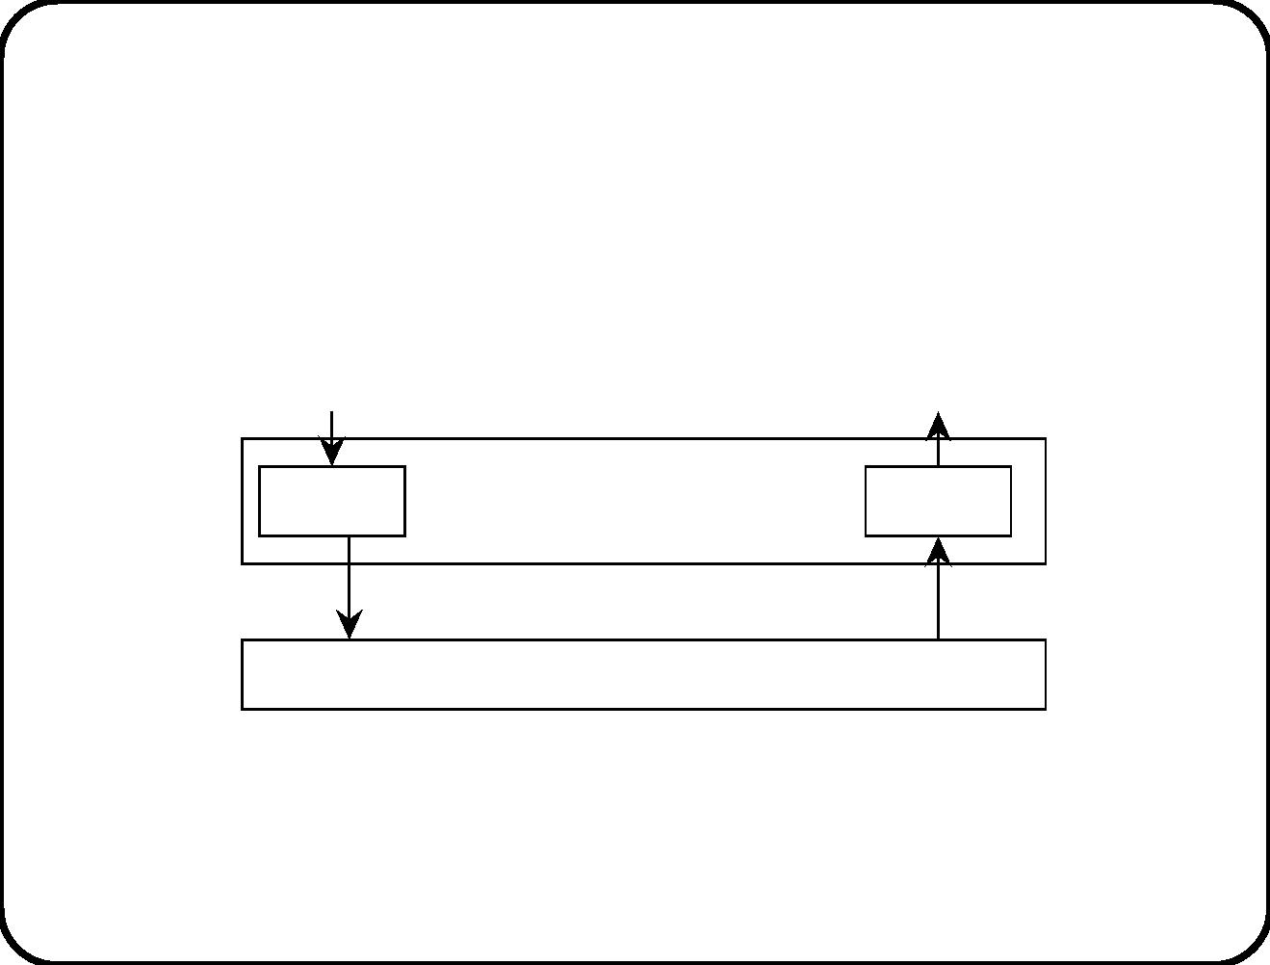
Observers and actors are in the connection
domain
event
action
Observer
Connection domain
Reactive system
Actor
stimulus
response
37

Slide 39
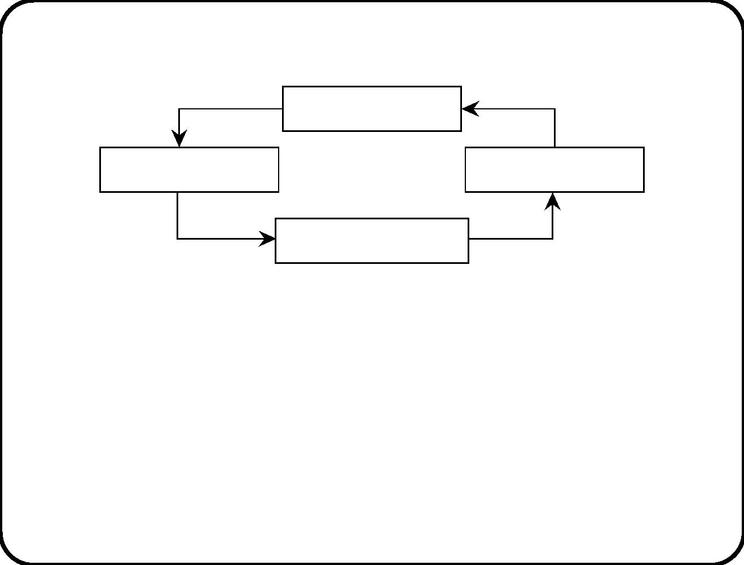
Assumptions about observers
close, open
Metal plate
cut
Photoelectric cell
Cutter
on, off
move
Plate cutting controller
• Events of interest: begin of plate arrives, end of plate arrives
• Available stimuli: on, oﬀ.
We need the following assumptions:
• The photo-electric cell is functioning prop erly.
• The cell is stimulated only by the arrival of the begin or end of a
metal plate.
38

Slide 40
Event recognition
System must respond to the event
• a point arrives where the sheet must be cut.
The system must infer the occurrence of this event. Event
recognition:
• Record the point in time at which plate arrives.
• Wait for time at which desired point is under the cutter.
Additional assumption needed:
• Speed of the plate is n meters / second.
39

Slide 41
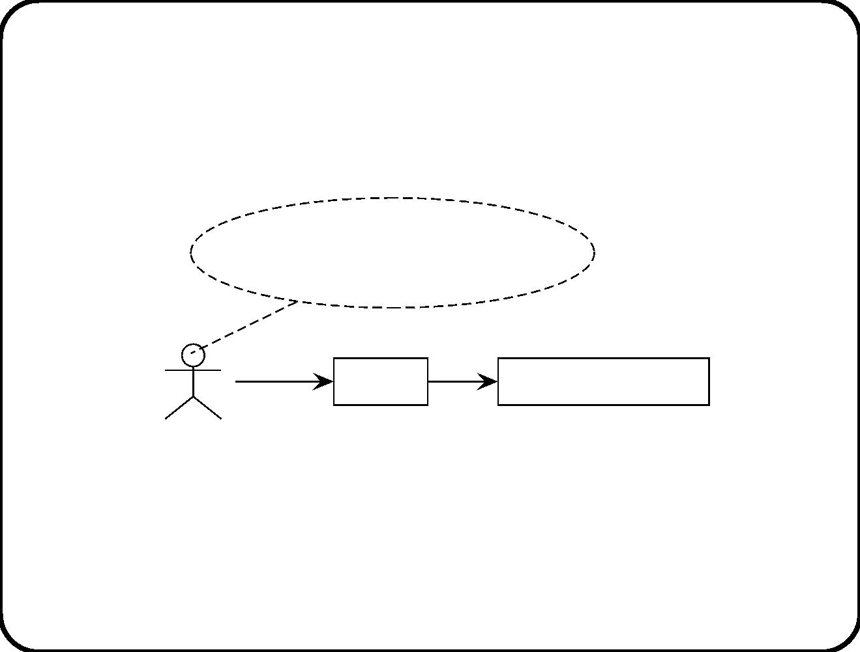
Observability of events
decide to take the elevator,
decide to take the stairs
push
close
Button
Elevator controller
What is the subject domain of the elevator controller?
40

Slide 42
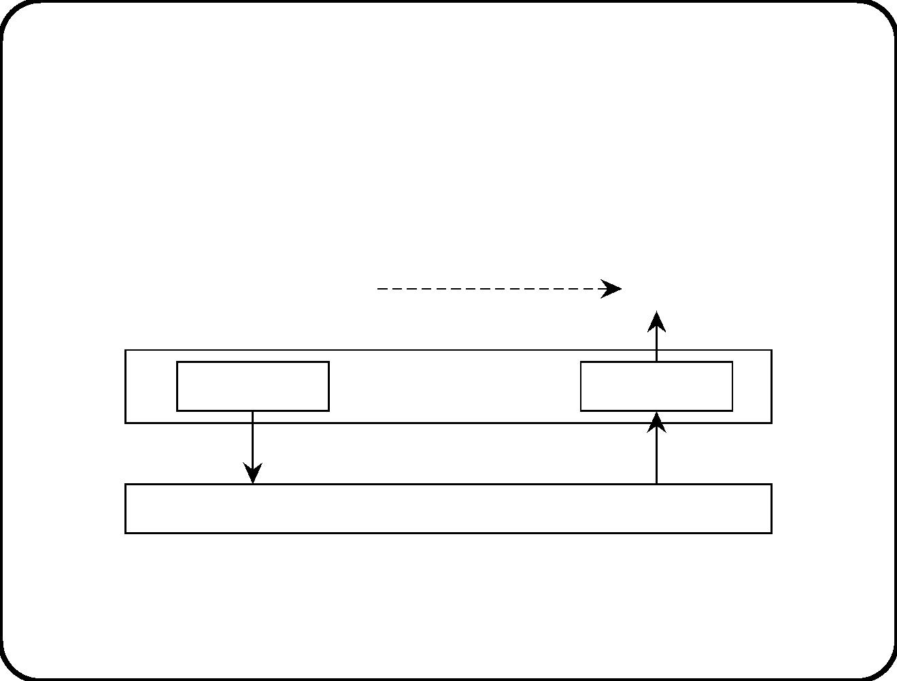
Observing temporal events
time to perform action
action
Actor
Timer
Connection domain
stimulus
response
Reactive system
41

Slide 43
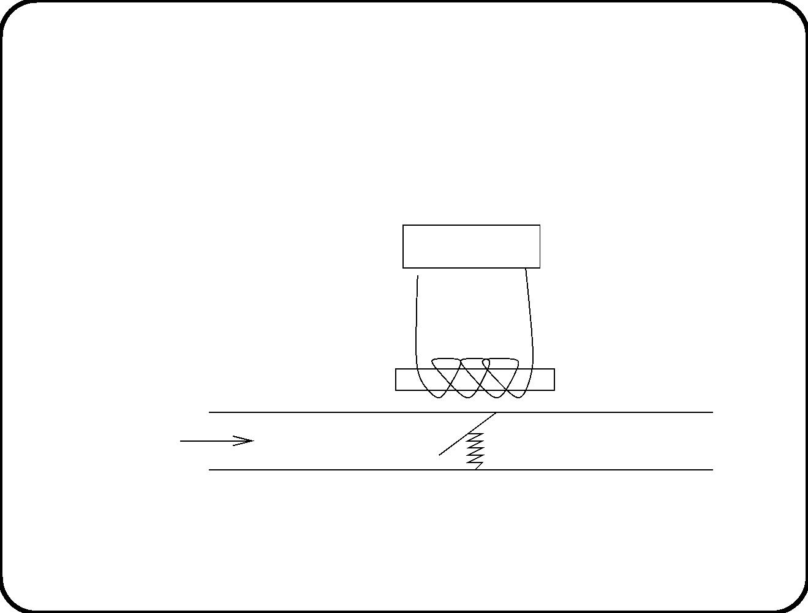
Realizability of actions
Controller
Solenoid
Tube
Coolant
Valve
Spring
42

Slide 44
Main points
• Reactive software system is connected to interesting events and
actions by a communication channel.
• Stimulus is event observation.
• Response is assumed to cause desired action.
• If assumptions about environment are true, (stimulus,
response) pairs are desirable; otherwise, they may be
undesirable or in diﬀerent.
• Assumptions cannot be guaranteed by the system.
43

