Slide 1
Reactive Systems I, ch 04~07
何明昕 HE Mingxin, Max
Send your email to c.max@yeah.net with
a subject like: SE345-Andy: On What …
Download from c.program@yeah.net
/文件中心/网盘/SoftwareEngineering26S

Slide 2

List of Slides
3 Chapter 1. Reactive Systems
11 Chapter 2. The Environment
28 Chapter 3. Stimulus-Response Behavior
43 Chapter 4. Software Speciﬁcations
55 Chapters 5–7. Mission Statement, Function Reﬁnement
Tree, Service Description
77 Chapter 8. Entity-Relationship Diagrams
99 Chapter 9. ERD Modeling Guidelines
125 Chapter 10. The Dictionary
139 Part IV. Behavior Notations
154 Chapter 11. State Transition Lists and Tables
166 Chapter 12. State Transition Diagrams
2

Slide 3
Chapter 4. Software Speciﬁcations
• We call any creative decision about a system a design decision.
• To design a system is to make a plan how it will be built.
• A speciﬁcation is a description of design decisions.
• A reactive system speciﬁcation must describe
– the place of the SuD in the system hierarchy,
– it must describe functions, behavior and communication of
the SuD, and
– it must describe its composition.
• The speciﬁcation must be used to motivate the design in a
systems engineering argument.
44

Slide 4
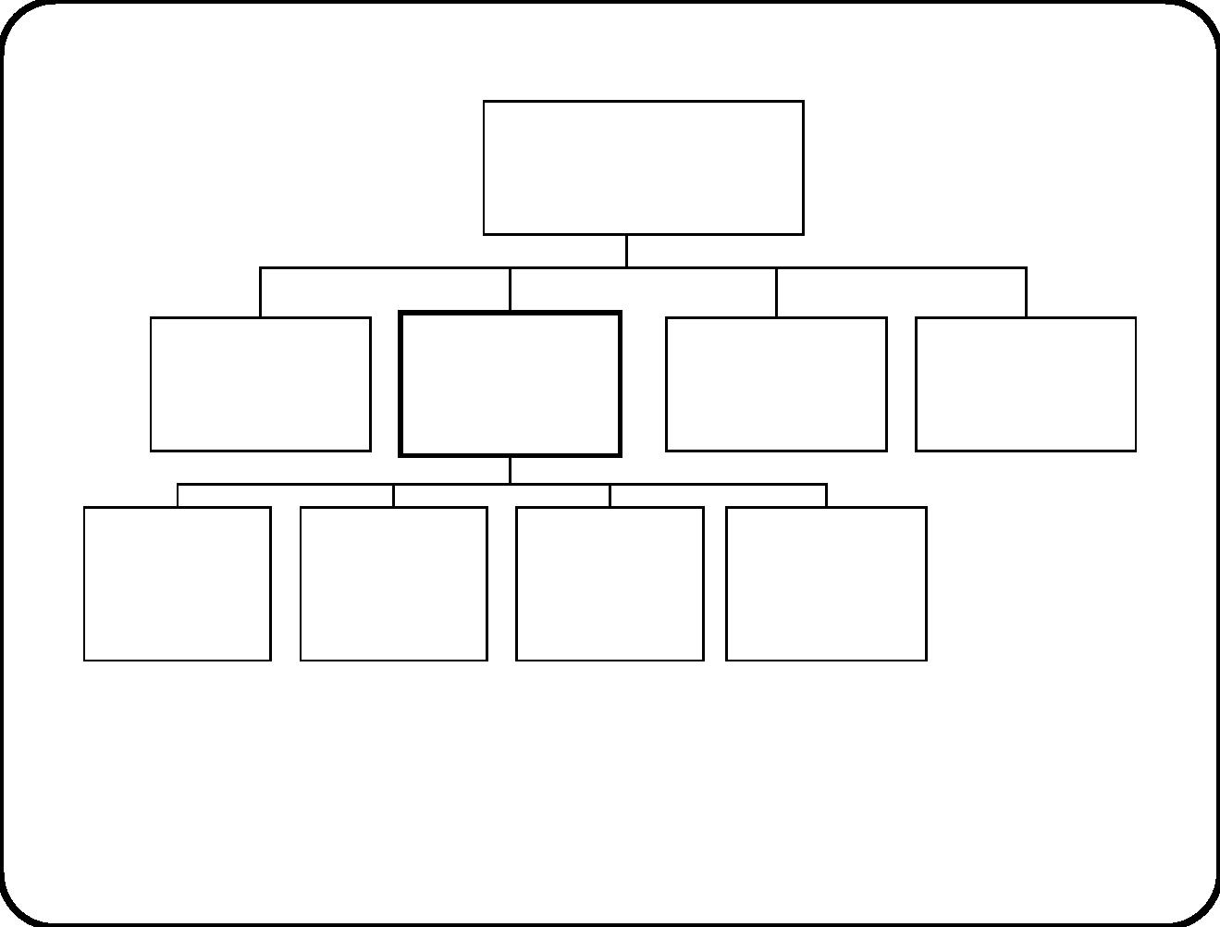
Systems engineering argument example 1
Training department
Training
Information
System
Course
coordinator
Secretary
Staff
Upload/
download
module
Allocation
Printing
Registration
• If TIS allows registration of unexpected participants
• and the department keeps extra staﬀ,
• then department is able to handle newcomers eﬃciently.
45

Slide 5
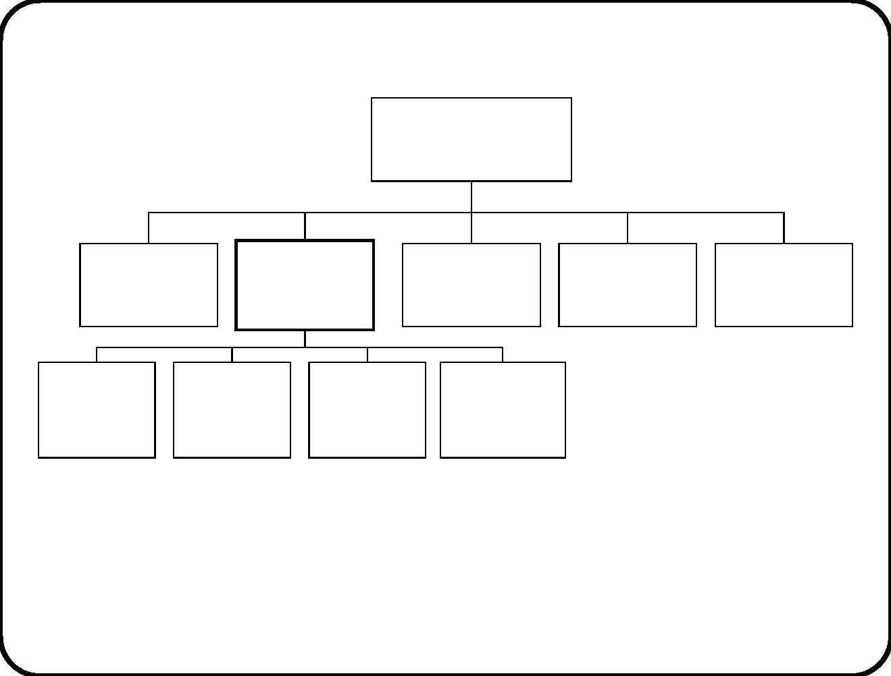
Systems engineering argument example 2
Juice pasteurization
unit
Operator
Heating
controller
Heater
Thermometer
Heating tank
Recipe
data
Device
data
Batch
control
Tank
control
• If controller controls heater according to batch recipe
• and thermometer is functioning,
• then pasteurization unit heats batch according to recipe.
46

Slide 6
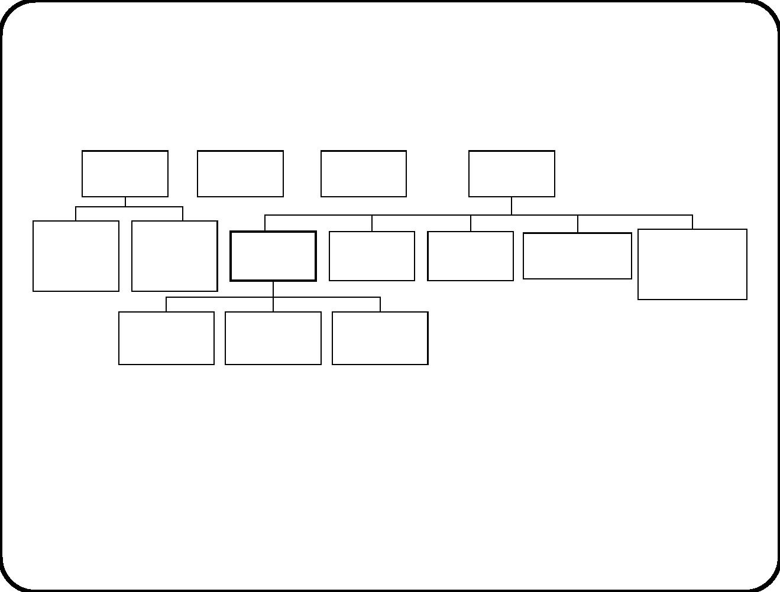
Systems engineering argument example 3
Traveler
Clearing
house
Bank
Railway
company
Traveler’s
PDA
Traveler’s
Rail
network
Conductor’s
PDA
Central
ticket selling
computer
smart
card
ETS
Conductor
Tickets and Rail network
stamps database
Bank
database
• If ETS allows travelers to buy tickets through their PDA
• and traveler’s PDA interfaces with ETS,
• then railway company reduces operating costs.
47

Slide 7
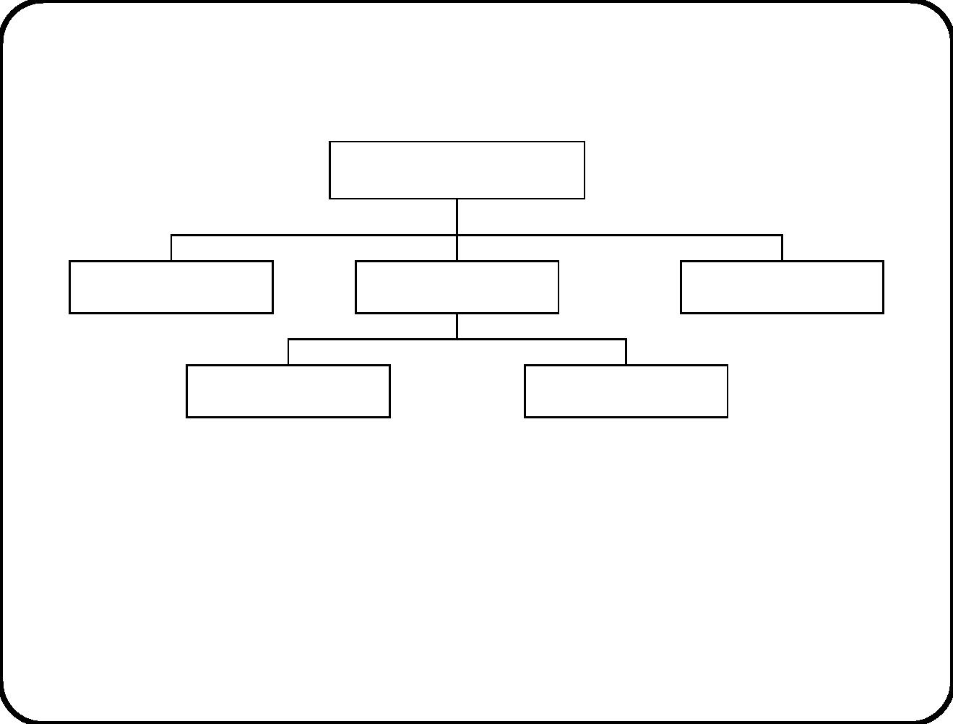
System engineering argument
Composite system
External entity
SuD
External entity
Subsystem 1
Subsystem n
• If SuD satisﬁes speciﬁcation S
• and environment satisﬁes assumptions A
• then composite system has emergent properties E.
Emergent properties arise by interaction of component systems.
They should satisfy goals of composite system.
48

Slide 8
The role of assumptions
• If assumptions are not satisﬁed by environment, the composite
system goal may not be reached.
• System cannot guarantee the assumptions.
Examples:
• Heat will rise when “switch on” sent to heater.
Assume laws of thermodynamics and assume that devices work.
• Ticket is stamped for segment of the current route.
Assume that the conductor, traveler and smart card are physically located
in the segment for which ticket is stamped.
49

Slide 9
Kinds of assumptions
• laws of nature
• speciﬁcations of devices
• rules for people (laws, procedures)
• deﬁnitions of conceptual structures (e.g. meaning of stamps
and tickets)
Only laws of nature are infallible ... we assume. Many assumptions
are about the subject domain and about the connection domain.
50

Slide 10
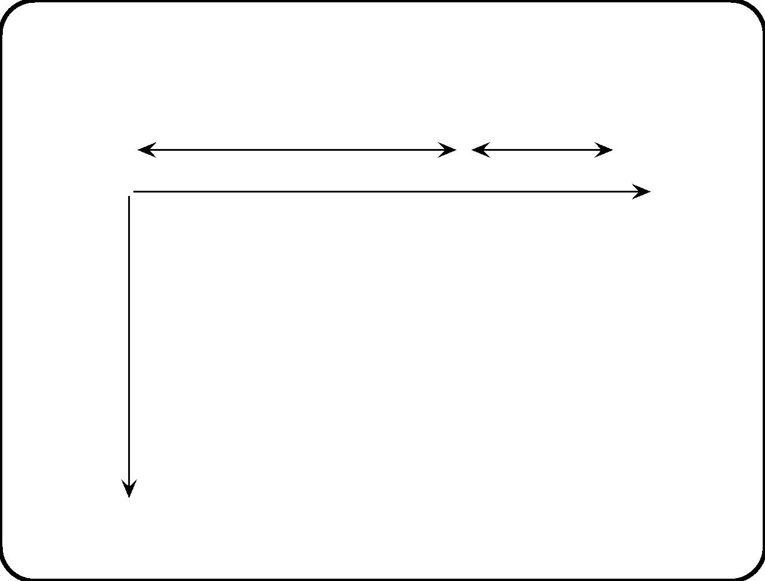
Kinds of properties
Quality
Functional properties
Services Behavior Communication
attributes
etc.
External
properties
Composite
system
Software
system
Software
subsystem
Software
component
Software
object
Decomposition
51

Slide 11
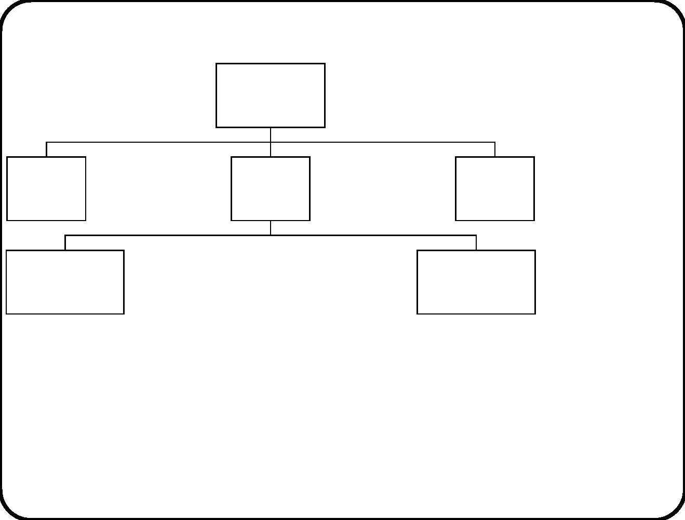
Properties occur at every level
Services
Composite
system
Behavior
Communication
External
entity
Services
Behavior
Communication
Services
SuD Behavior
Communication
External
entity
Services
Behavior
Communication
Services
Services
Subsystem 1 Behavior
Communication
......
Subsystem n Behavior
Communication
Functional properties appear at every level.
• Service = Interaction that delivers desired eﬀect.
• Behavior = Ordering of interactions over time.
• Communication = Symbol ﬂow between diﬀerent entities.
52

Slide 12
Terminology
With respect to the SuD, we talk about:
• Requirement = desired prop erty.
• Constraint = imposed prop erty.
• Aspect = group of properties.
53

Slide 13
Operational speciﬁcation
Speciﬁcation of set of reproducible operations to ﬁnd out whether a
property is present.
Important class of operational specs has the form
• If stimulus s occurs
• and system is in state C
• then produce response r.
Also called Event-Condition-Action (ECA) rule. Appears in state
transition table (see chapter 12).
54

Slide 14
Main points
• Systems have functional properties and quality properties.
• Functional properties are services, behavior, communication.
• These reappear at every level in aggregation hierarchy.
• (There are really three aggregation hierarchies.)
• SuD needs external entities to jointly produce desired emergent
properties of composite system. System engineering argument.
55

Slide 15
Chapters 5–7. Mission Statement, Function
Reﬁnement Tree, Service Description
• We describe the utility of the system for its environment by
describing its functions for the environment.
• But a function is not a component; it is not a program; it is
not a part of a program. It is the added value, or utility, of the
SuD for its environment.
– “The function of this coﬀee machine is to brew coﬀee.”
– “The added value of this coﬀee machine is to brew coﬀee.”
– “The utility of this coﬀee machine is to brew coﬀee.”
In this course, these three sentences mean the same thing.
56

Slide 16
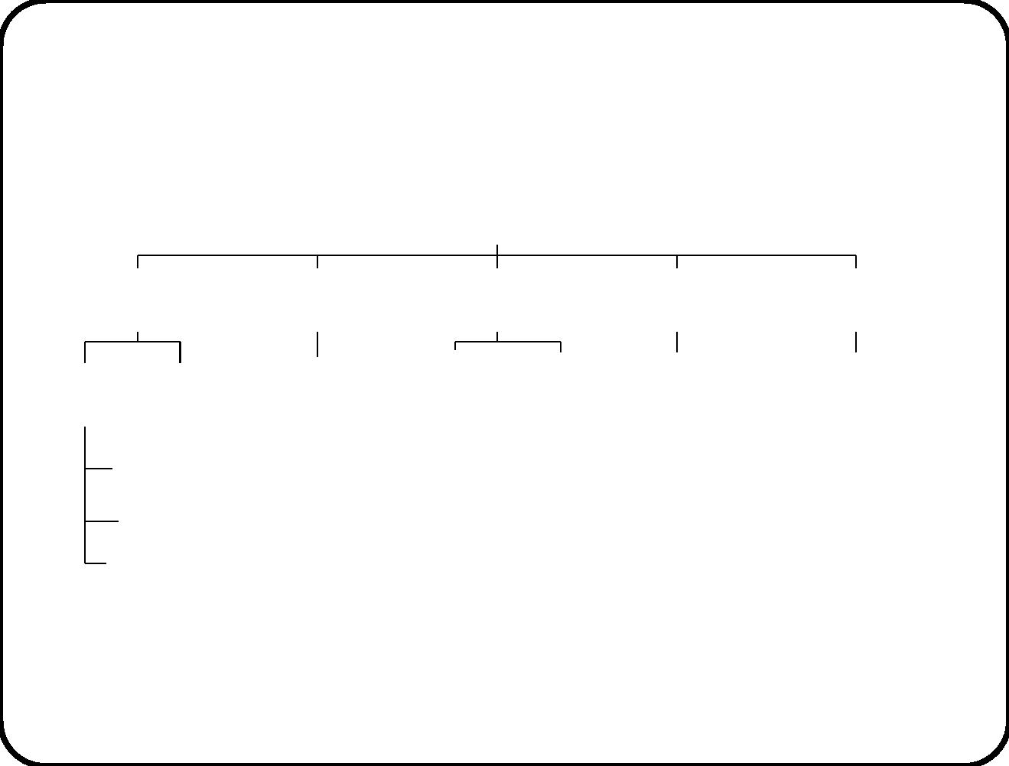
Example 1: Goal tree of the training department
More efficient and effective management of introductory courses
Faster handling of
Less unexpected
participants
Faster handling of Better information
Better information
expected participants
unexpected participants to speakers to personnel department
Prepare
Self−
Download
Ad−hoc
badge
On−line
Ad−hoc
Upload
material registration
latest information
from personnel
information system
registration list printing
participation data
printing
Allocate
participants
Print badges
Other activities
TIS should contribute to goals in italics.
57

Slide 17

Example 1: Mission of TIS
• Name: Training Information System
• Acronym: TIS
• Purpose: To support the management of monthly introduc-
tory training courses.
• Responsibilities:
– To support course preparation, including allocation of par-
ticipants to groups and printing badges
– To support course handling (unexpected, absentees)
– To support course wrap-up
• Exclusions:
– Data of unexpected participants is not checked.
– No support for allocation of speakers to groups.
– No support for allocation of groups to rooms.
58

Slide 18
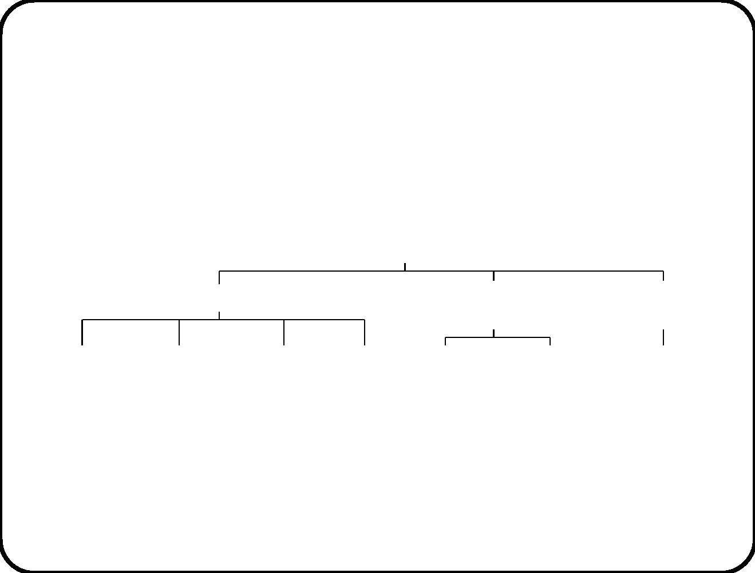
Example 1: Function reﬁnement tree of TIS
Support the coordination of introductory training courses
Course preparation support
Registration
support
Course wrap−up
support
Download list Allocate joiners Print list of
Print
Register
Register
Upload
of joiners
to groups
group members badges unexpected
participant
absentee
participation
record
59

Slide 19

Example 1: Description of a TIS service
Download joiners
– Triggering event: Coordinator requests to download list
of joiners from the personnel information system.
– Delivered service: Download the list of people from the
Personnel Information System who have joined the com-
pany since the previous training.
– Assumptions: The data in the Personnel Information
System reﬂects the situation accurately with a time lag
of not more than one working day.
60

Slide 20
Example 1: Description of another TIS service
Upload participant record
– Triggering event: Coordinator requests to upload list of
joiners to personnel information system.
– Delivered service: Upload the list of people who partici-
pated in the training to the Personnel Information System.
– Assumptions: The Personnel Information Systems is
able to deal with data about unexpected participants, in-
cluding any remaining errors in that data.
61

Slide 21
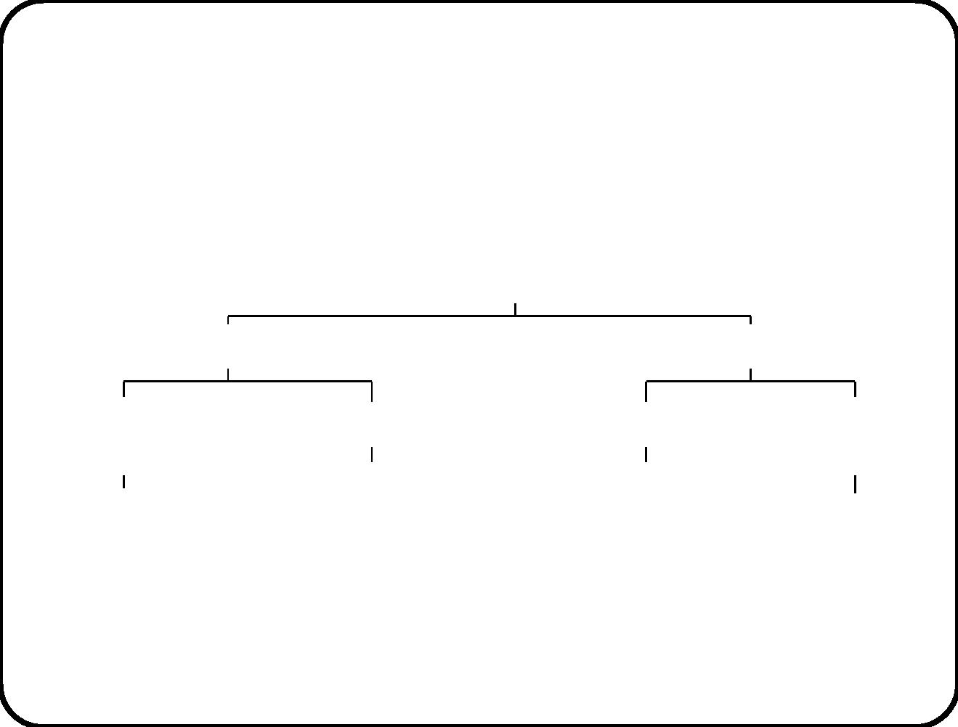
Example 2: Goal tree of juice pasteurization plant
Juice pasteurization
Efficiency
Effectiveness
Fast change
Short set-up time
Pasteurization
Improved
of recipes
traceability
Initialization of controller
by software
Heating a batch
according to recipe
Maintain recipe
database
Maintain log
62

Slide 22

Example 2: Mission of heating controller
• Name: Juice heating controller.
• Purpose: To control the heating process of fruit juices
in a heating tank.
• Responsibilities:
– To initialize itself with batch data and heat the batch
according to recipe.
– To report on the heating process.
– To maintain safe conditions in a tank.
• Exclusions:
– Filling the storage tanks with juice.
– Transferring pasteurized juice to the canning line.
63

Slide 23
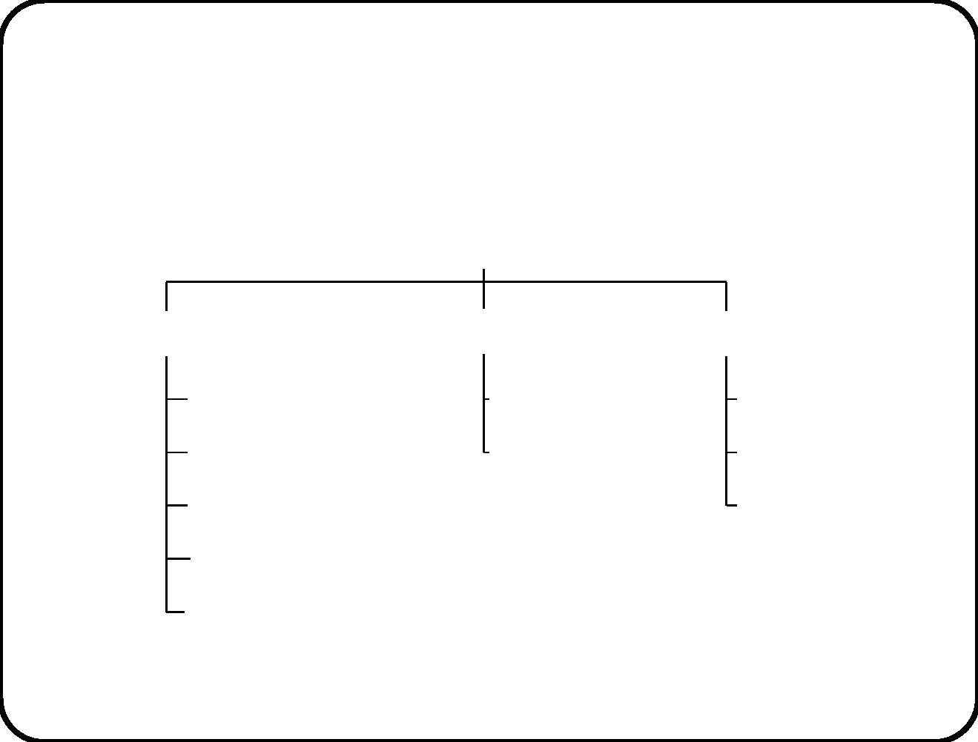
Example 2: Function reﬁnement of heating
controller
Control the heating process of fruit juice in a heating tank
Heating function
Reporting function
Safety function
Create batch data
Provide a report
Log temperature
Raise alarm
Shut down
Start heating
Switch on heater
Switch off heater
Finish heating
Stop heating
64

Slide 24
Example 2: A service description
• Name: P1. Heat batch according to recipe.
• Triggering event: Operator command “start heating batch b
according to recipe”.
• Delivered service: Upon reception of this command, the
controller ensures that a heating process takes place in the
heating tanks in which b is stored, according to the recipe of b.
• Assumptions: There is a batch in the heating tank.
65

Slide 25
Example 2: Another service description
• Name: Log temperature.
• Triggering event: When an execution of P1 starts, and then
every 10 seconds during this execution of P1.
• Delivered service: The controller records the measured
temperature in each tank in which b is stored.
66

Slide 26

Example 3: Mission statement of ETS
• Name of the system: Electronic Ticket System (ETS).
• Purpose: Provide capability to buy and use tickets of a rail-
way company using a PDA and a smart card.
• Composition: Software distributed over smart cart, PDA’s,
central computer.
• Responsibilities of the system:
– To support ticket buying
– To support ticket usage
– To support ticket refunding
• Exclusions:
– The system does not perform travel planning
– Only tickets for one person and one trip (single or return).
67

Slide 27
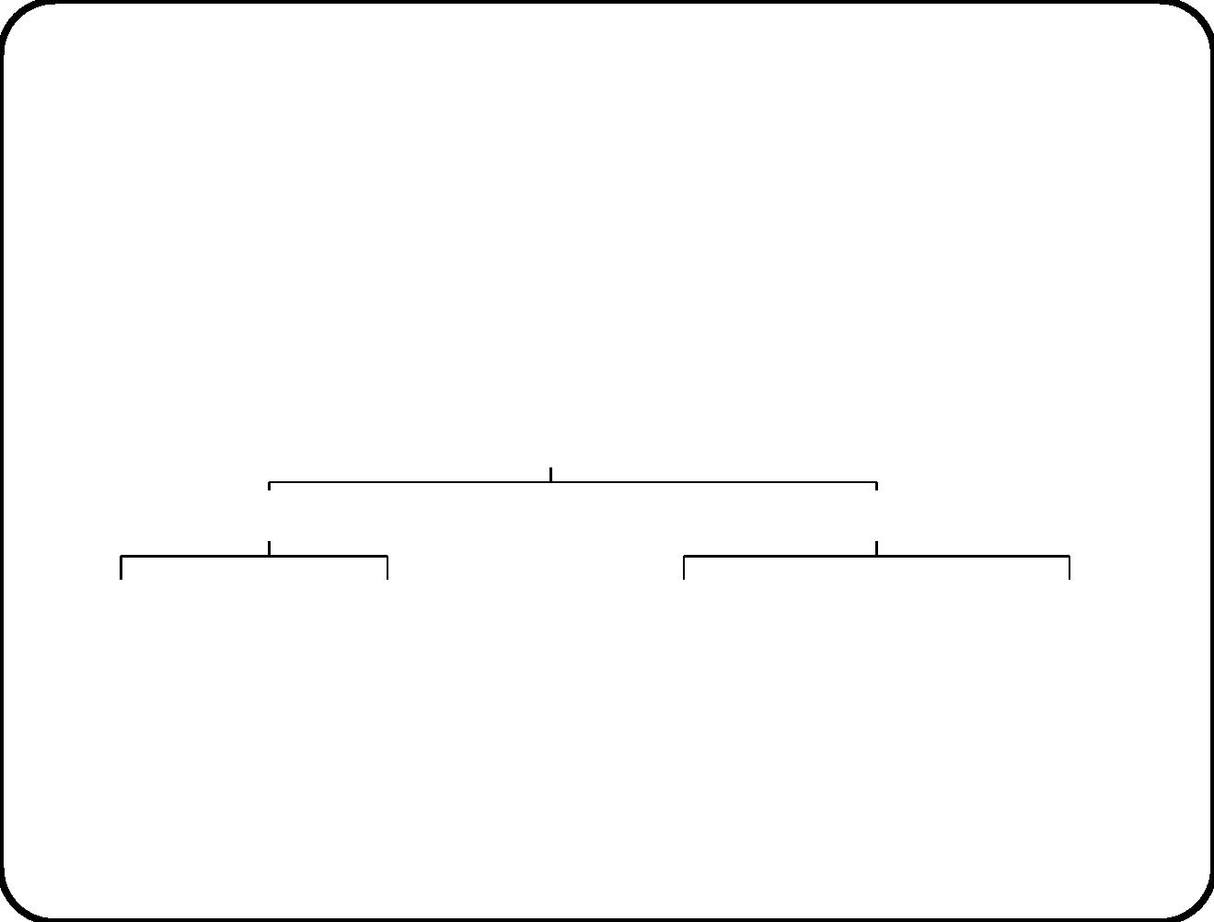
Example 3: Function reﬁnement of ETS
Provide capability to buy and use tickets
Traveler functions
Conductor functions
Sell a ticket
Show a ticket
Stamp a ticket for use
Refund a ticket
68

Slide 28
Two service descriptions of ETS
• Name: Sell a ticket.
• Triggering event: Traveler requests to buy a ticket.
• Delivered service: Allow a traveler to buy a ticket at
any time and place chosen by the traveler.
• Name: Show a ticket.
• Triggering event: Traveler requests to view a ticket.
• Delivered service: Display ticket attributes to the user.
69

Slide 29
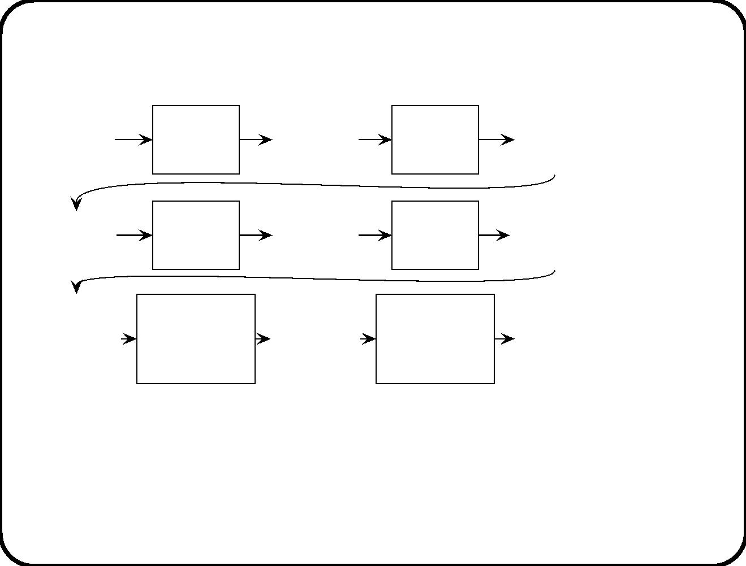
Levels of design
Business
Business
Business
problem
description
Business
design
process
Business
solution
specification
Decompo-
sition
problem
problem
analysis
Software
Software
Software
problem
description
Software
design
process
Software
requirements Refine-
specification
problem
problem
analysis
ment
Software
decompo-
sition
Software
decomposition
problem
Software
decompo-
sition
problem
description
Software
decomposition
design
Software
decompo-
sition
Decompo-
sition
problem
analysis
process
specification
• A business solutution speciﬁcation describe a decomposition of
the business that solves a business problem.
• A software speciﬁcation reﬁnes the software part of a business
solution.
70

Slide 30
Goal analysis
• First separate the design levels as on previous slides.
• Next identify business goals.
– In a goal tree, achievement of children goals is suﬃcient to
achieve parent goal.
– Leaves of a business goal tree usually are desirable business
activities.
• From the goals of the business solution, derive from the
software goals.
• This gives us statement of purpose and ma jor responsibilities
of the software.
71

Slide 31
Mission statement
Highest level software speciﬁcation. Talks about software solutions
instead of business solutions.
√
To ﬁnd software mission, analyze business goals.
√
To ﬁnd mission, ﬁnd desired emergent properties E of
composite system.
√
Justify mission and responsibilities by system engineering
argument: Mission statement + environment assumptions
entail business goals.
Mission statement is updated as our understanding improves
during the project.
72

Slide 32
Function reﬁnement tree.
Makes responsibilities more speciﬁc.
• Not a system structure: Just an indented shopping list.
• Organization of tree is subjective: Determined by discussion
with customer.
• The tree bounds functionality of the system.
• It is the most implementation-independent description of the
system.
• It justiﬁes the presence of services.
• It prevents the presence of unnecessary services.
73

Slide 33
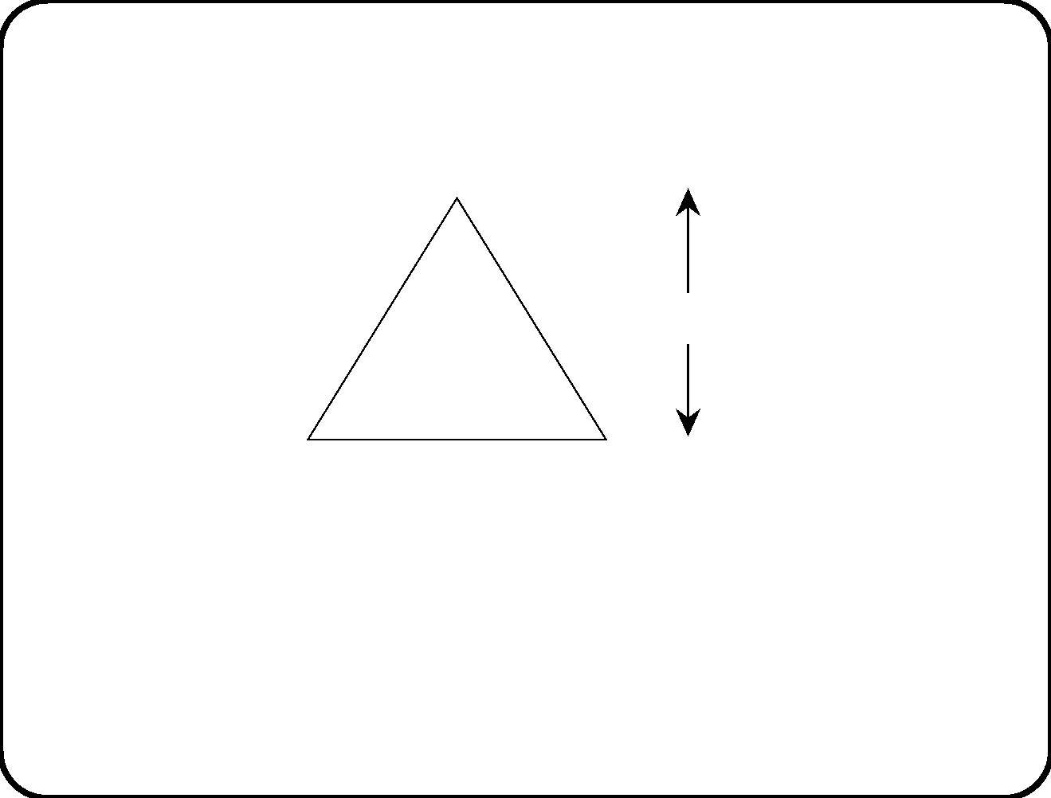
Terminology
Mission
Functions
Responsibilities
Services
Transactions
Function = ability to create desired eﬀect in the environment.
• Responsibility = Contribution to environment goal.
• Service = Useful interaction triggered by event.
• Transaction = Atomic interaction.
74

Slide 34
Service descriptions
• Each service is identiﬁed by a
(1) triggering event and a
(2) delivered value (beneﬁt).
• Each service may make assumptions about the environment.
• Do not give details about system behavior nor about
communication channels with the system.
• Just describe the valuable eﬀect that the system should have
on the environment.
• A service may have a simple or a complex behavior; describe
this later, using techniques from chapters 11 and 12.
75

Slide 35
Service descriptions are not system components
• For programmers, it is hard to see a piece of text not as a
software component.
• A service description is not a software component;
• it is a description of something useful done by the software.
76

Slide 36
Main points
• Mission relates system functions to business goals.
• Function reﬁnement tree relates services to mission.
• Services have a discrete beginning and deliver a value.
• Services may be non-atomic, consisting of many transactions.
77

