Slide 1
Reactive Systems III, ch 8~10, ERD
何明昕 HE Mingxin, Max
Send your email to c.max@yeah.net with
a subject like: SE345-Andy: On What …
Download from c.program@yeah.net
/文件中心/网盘/SoftwareEngineering26S

Slide 2

List of Slides
77 Chapter 8. Entity-Relationship Diagrams
99 Chapter 9. ERD Modeling Guidelines
125 Chapter 10. The Dictionary
2

Slide 3
Chapter 8. Entity-Relationship Diagrams
The subject domain of a software system is the part of
the world talked about by the messages that cross the system
interface.
To ﬁnd the subject domain of a system
• Look at the messages received and sent by the system, and
• Ask what these messages are about.
Document the meaning of these messages in a dictionary,
supplemented by an ERD of the subject domain.
78

Slide 4
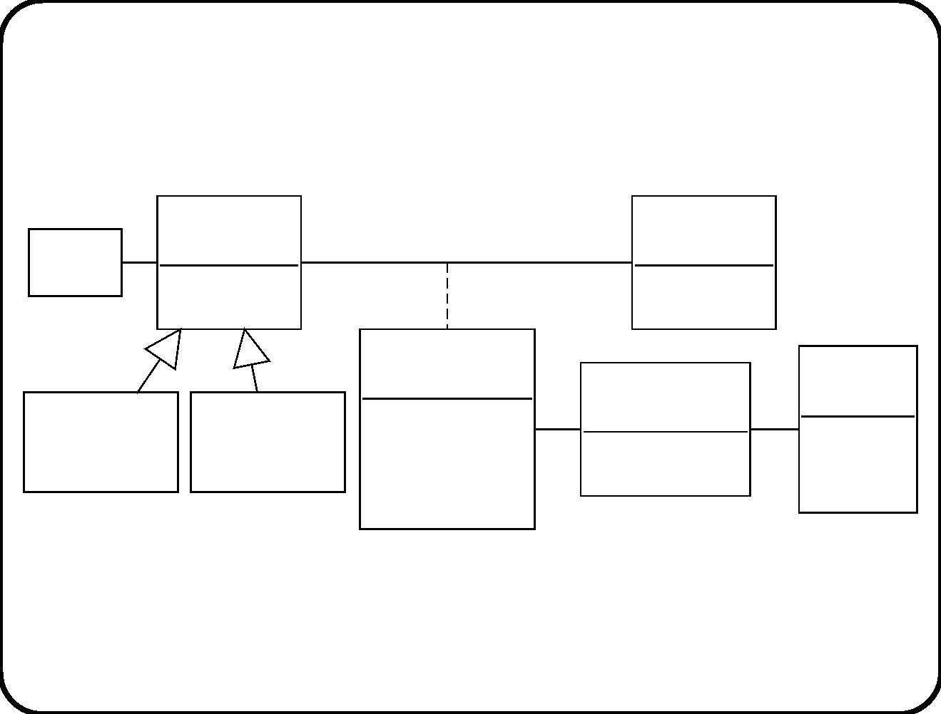
Example 1: Sub ject domain of TIS
Employee
Group
Branch
1 name
number
Participation
Coordi-
nator
Course
offering
Unexpected
participant
Joiner
absent : Bool
time
day : {1, 2}
1
name
identifier
starting date
1
These entities are the topic of interactions with TIS.
79

Slide 5
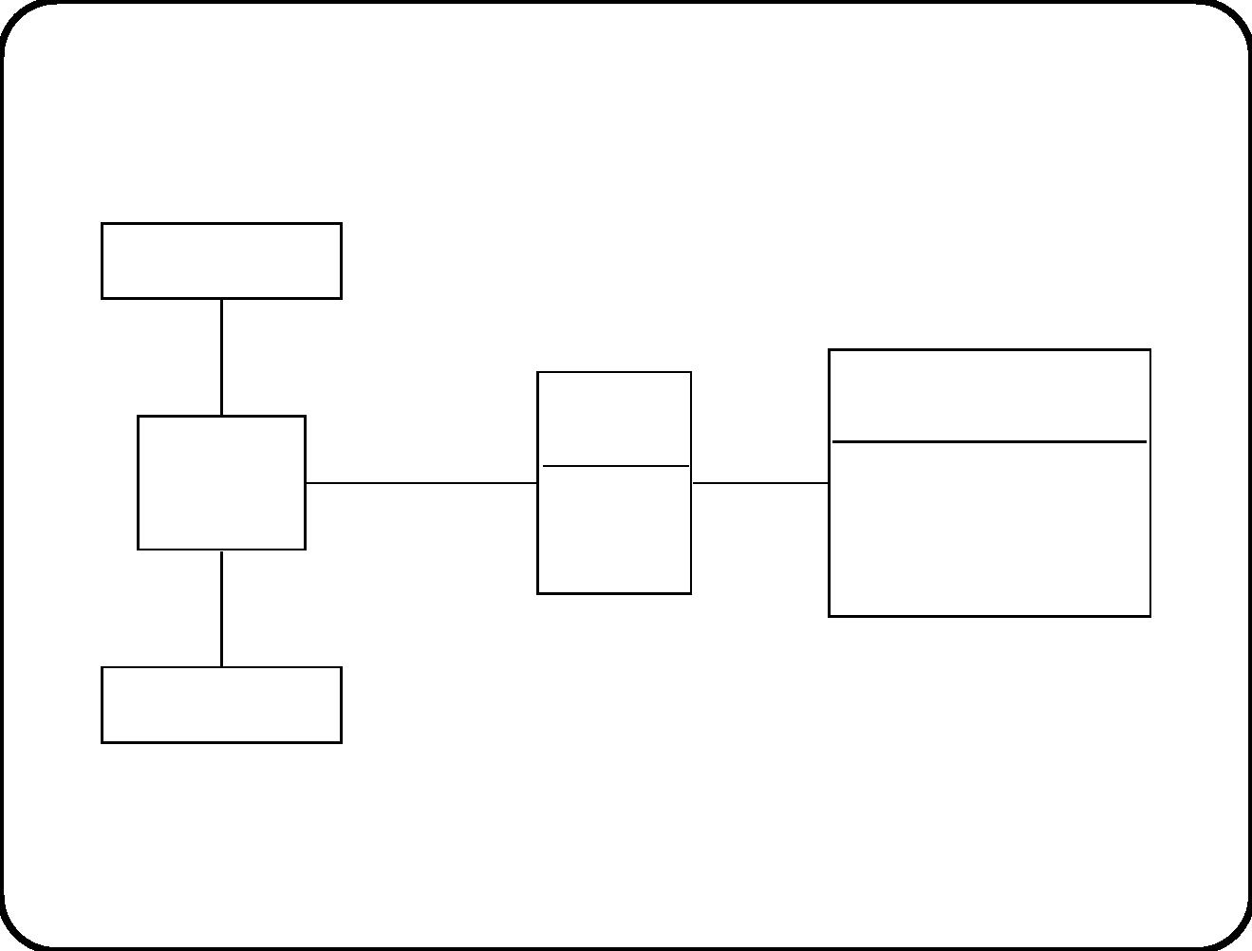
Example 2: Sub ject domain of heating controller
Thermometer
1
1
Recipe
Batch
Heating
tank
Allocation
1..2 0..1
name
batchID
amount
* 1 desired temperature
duration
1
1
Heater
These entities are the topic of interactions with the controller.
80

Slide 6
Example 3: Sub ject domain of ETS
See next slide.
• These entities are the topic of interactions with the ETS.
• Some of them are lexical entities to be stored in ETS.
81

Slide 7
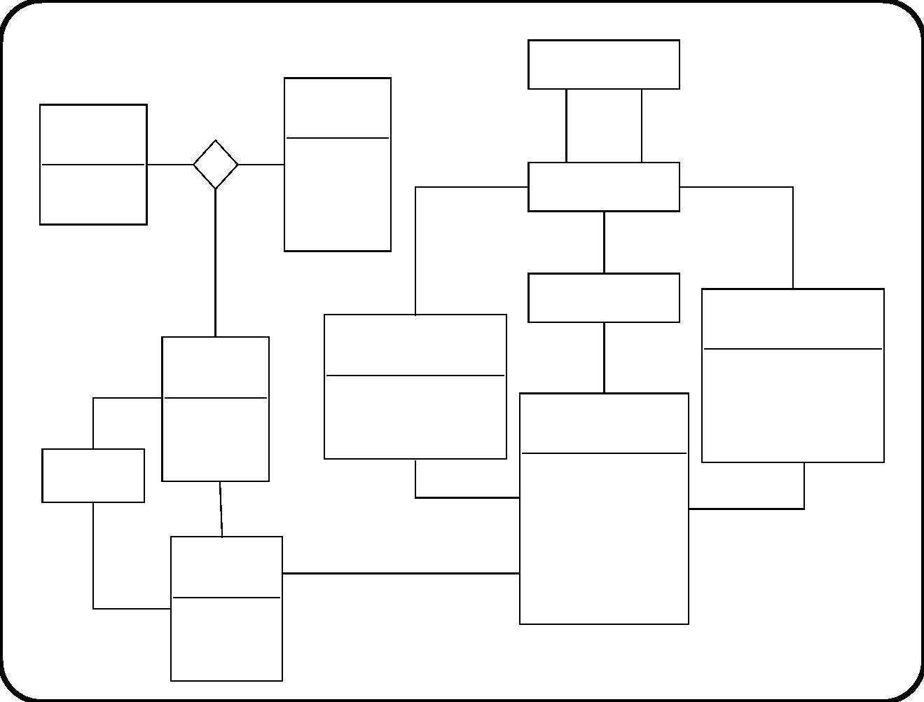
Railway station
Account
holder
Bank
name
to
f1rom
1
where
where
used
name
aborted
identifier
address
Rail segment
1..*
address
1
1
Route
1
Ticket usage stamp
Ticket refund stamp
from
Account
time
time
date
date
1
number
balance
Ticket
trip number
Refund
0..1
0..1
1
date of validity
class
1
price
1
Payment
train type
return or single
1
1
1
date
amount
82

Slide 8
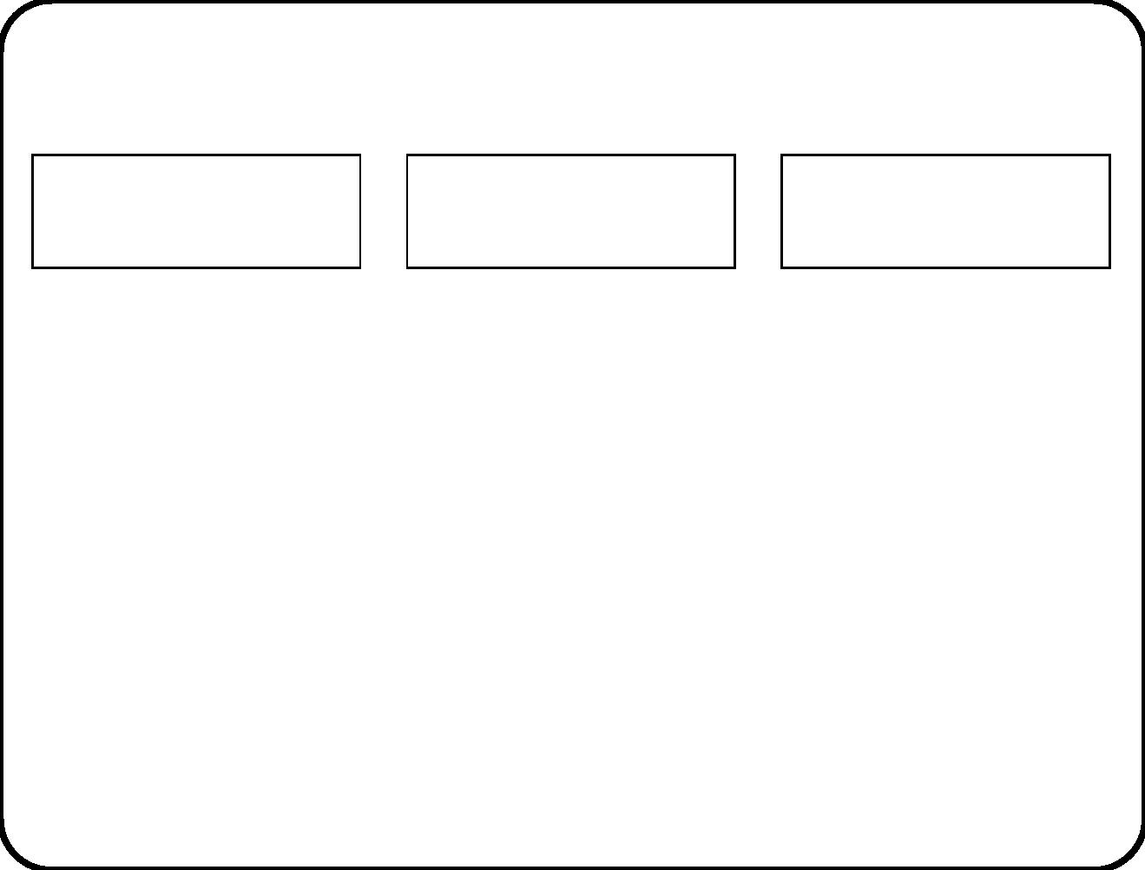
Syntax and semantics of ERDs
Bank
Railway station
Ticket
Entity typ e.
• Represented by a rectangle.
• Extension = All possible instances of entity type.
• Extent = All existing instances of entity type.
• Intension = All properties shared by all possible instances.
• Deﬁning intension = Properties used to deﬁne the entity
type. This is an abstraction (simpliﬁcation) of the full,
informal meaning.
83

Slide 9
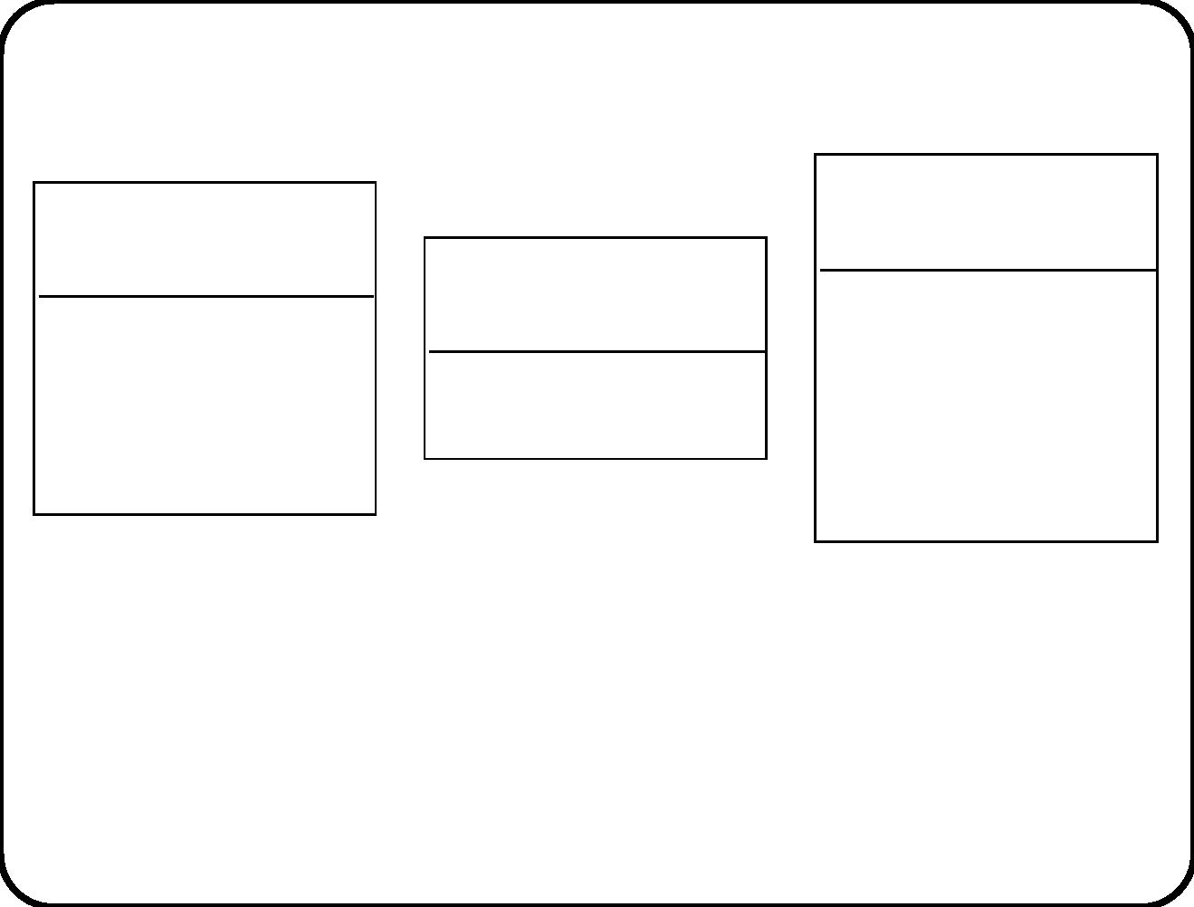
Attributes
Ticket
Bank
Railway station
name
date of validity
class
name
identifier
address
price
train type
• Properties of entities.
• Can be listed in a compartment directly below the typ e name
compartment.
Question: Which properties of a railway station did we describe in
this diagram?
84

Slide 10
Relationships
• A set of tuples of entities.
• Arity is the number of related entities. Binary, ternary, etc.
• Everything in the world is related to everything else!
• We only describe a relationship if we want to express relative
cardinality properties: How many entities of one typ e can exist
for each entity of another type.
85

Slide 11
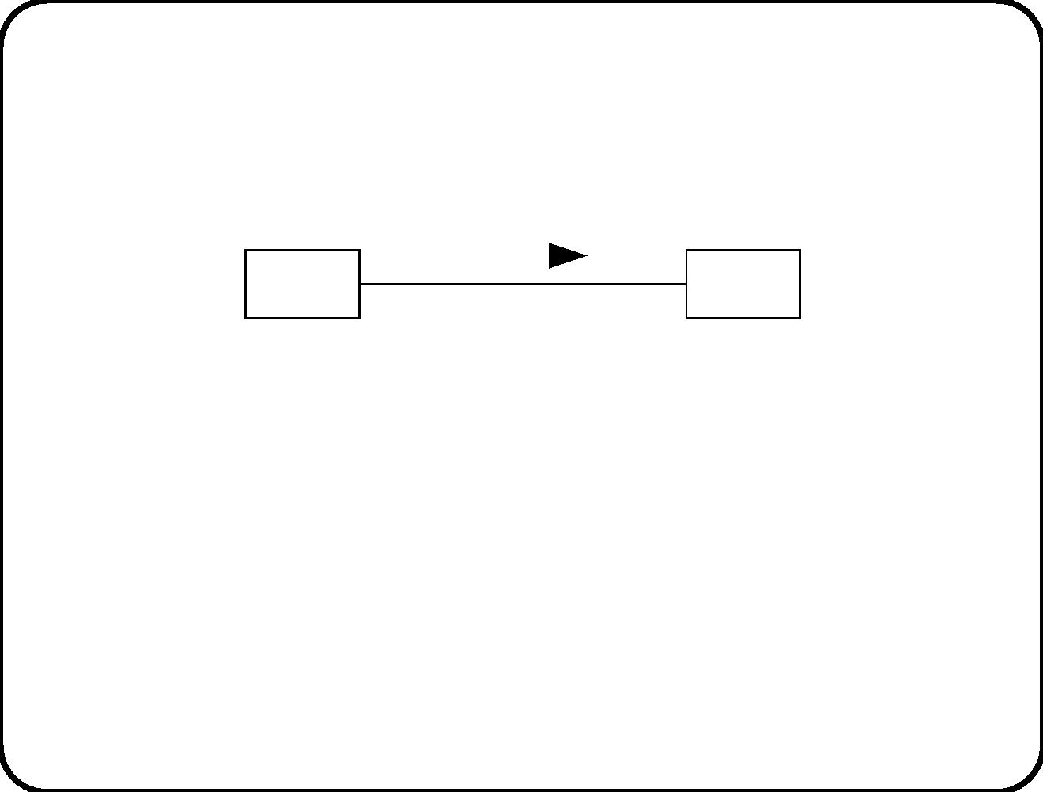
Binary relationships
role1
R
role2
c2
E1
c1
E2
• Binary relationship represented by a line.
• Relationship name can have a read direction.
• Role names indicate the role an entity plays in a relationship.
• Relationship name and role names can all be omitted if this
does not lead to ambiguity.
86

Slide 12
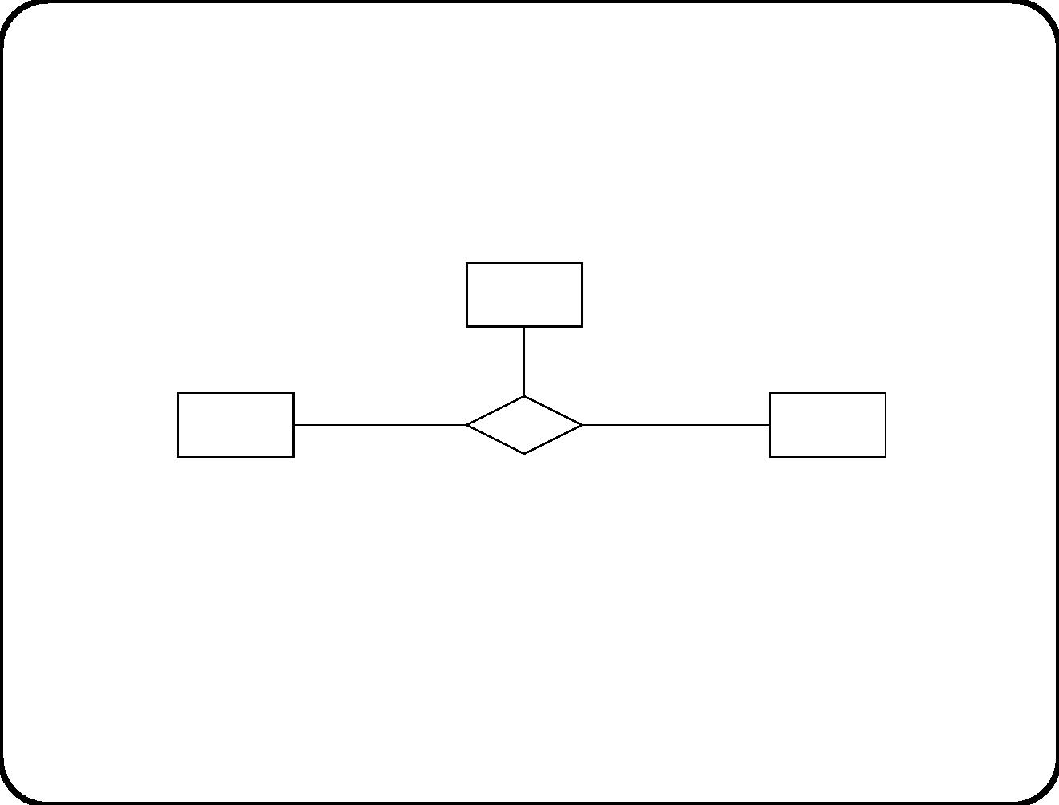
Relationships of higher arity
E1
role1 c1
role2
role3
c3
E2
c2
R
E3
• Relationships with arity ≥ 3 represented by a diamond.
• Name must be independent from direction of reading.
87

Slide 13
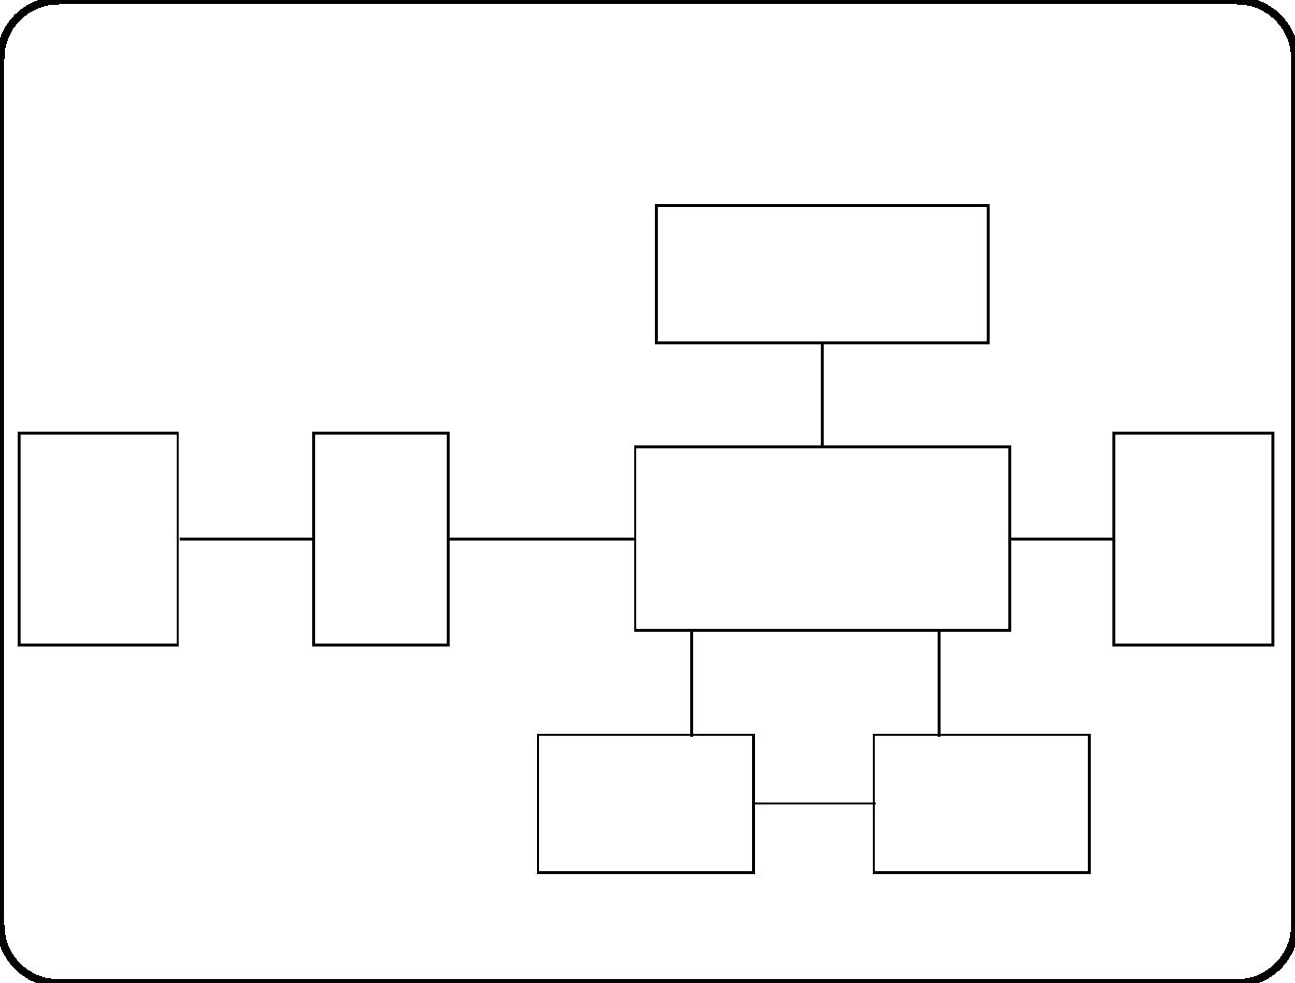
Cardinality properties: Elevator example
2
Location indicator
1
1
2
2
2
2
Entry
sensor
doors
1 1
Eleva- doors
cage
1
Elevator
cage
Motor
tor
1
1
1
door
cage
1
0..2
10
1
current floor
20
10
Destination
button
1
Floor
2
88

Slide 14
The meaning of cardinality properties
• A snapshot of the subject domain is the state of the subject
domain at one point in time.
• Cardinaility properties are snapshot properties.
• An absolute cardinality property says how many instances of
an entity can exist in a snapshot.
• A relative cardinality property says how many entities can
exist relative to some existing entity.
To ﬁnd a cardinality prop erty, imagine looking at an arbitrary state
of the domain and ask how many instances of some entity typ e can
exist in that state.
89

Slide 15
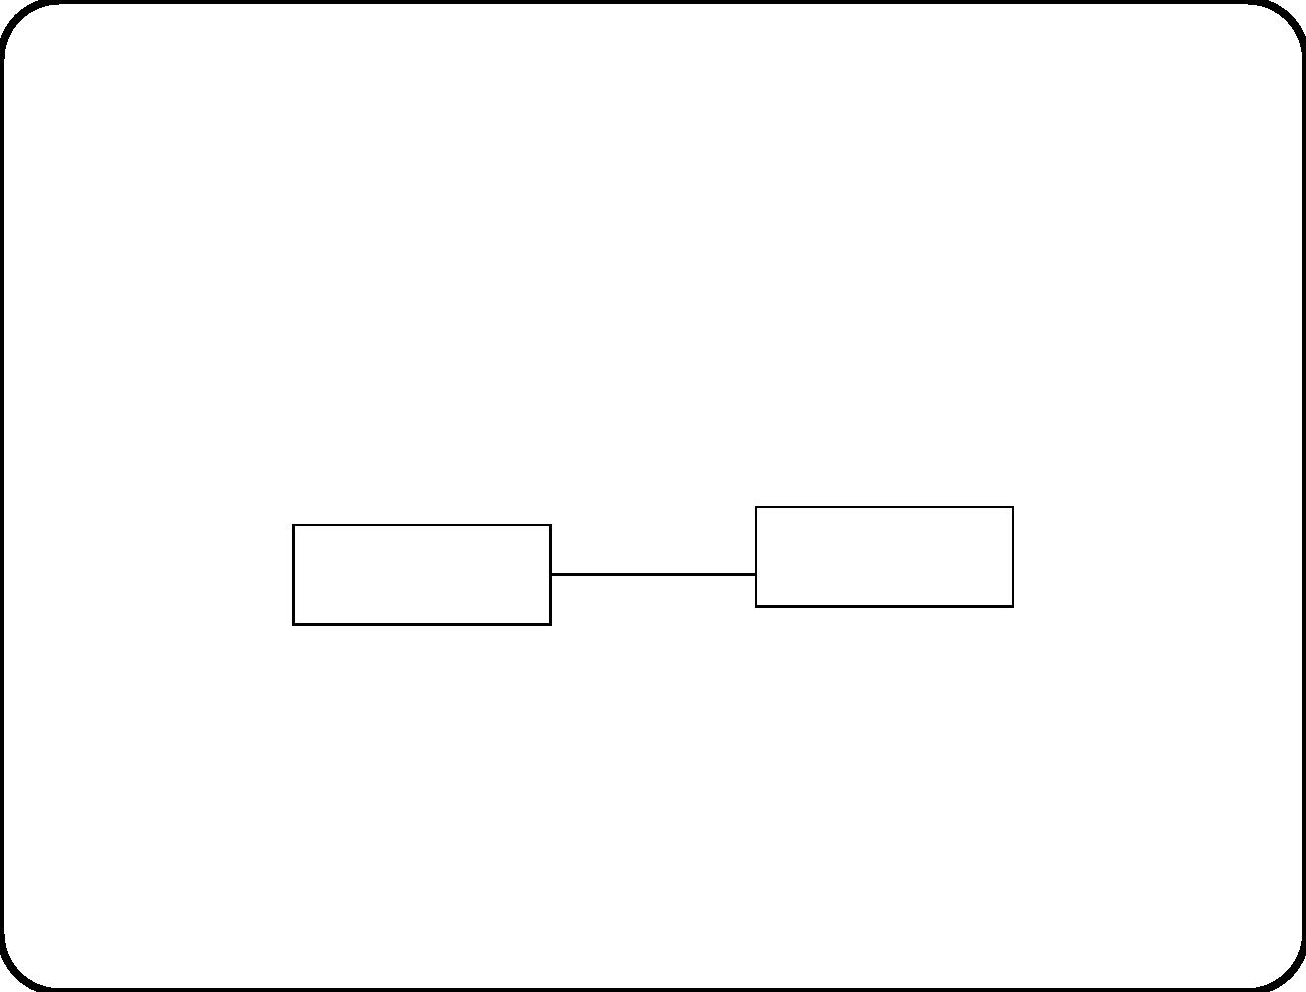
First example of inconsistent cardinality
properties
3
doors
1
2
Entry sensor
1
Elevator door
90

Slide 16
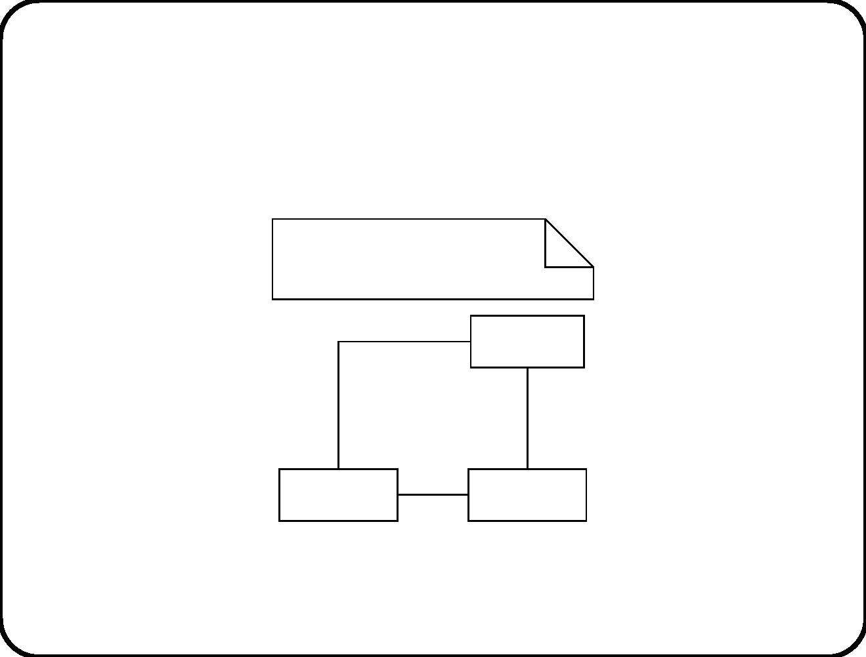
Second example of inconsistent cardinality
properties
For p: Payment,
p. from = p . refund. account
Payment
from
1
1
0..1
Refund
Account
2
91

Slide 17
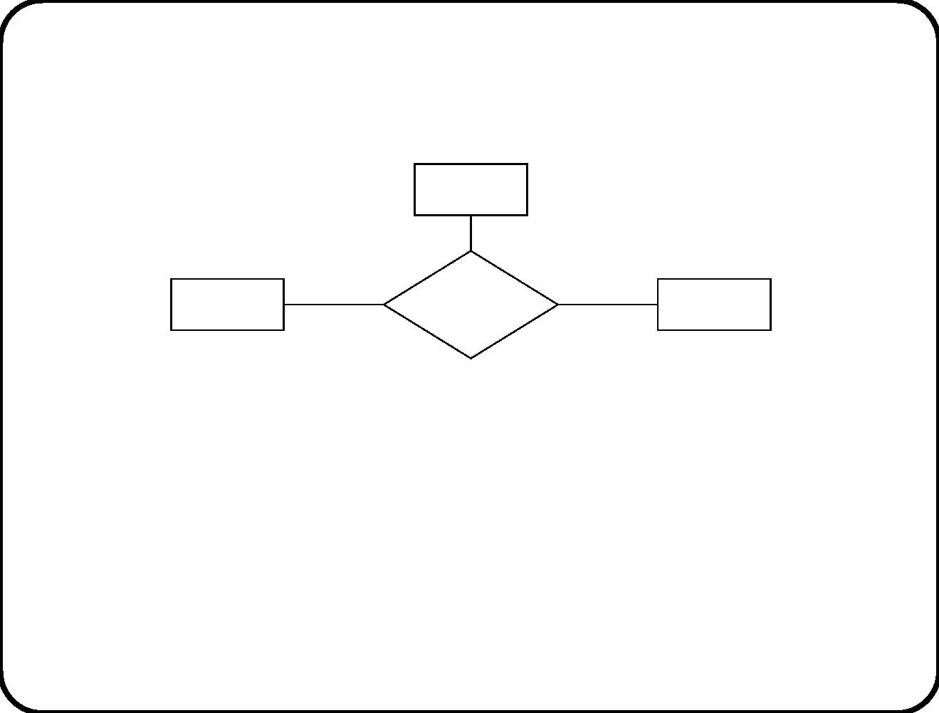
Ternary relationships
Course
Course
offering
Teacher
0..1
Room
1..*
Cardinality properties of relationships with arity /geq3 are hard to
understand.
Questions
1. Can a course have more than one teacher?
2. Can a teacher give several courses?
92

Slide 18
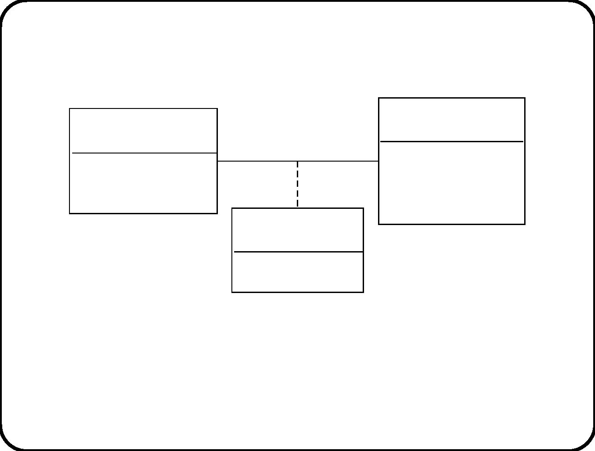
Association entities
Recipe
Juice specification
name
name
1..*
desired temperature
duration
percentage of solids
Mixture
percentage of juice
• An association entity is a relationship with attributes.
• Each instance is really a relationship. It is identiﬁed by a tuple
of component identiﬁers.
93

Slide 19
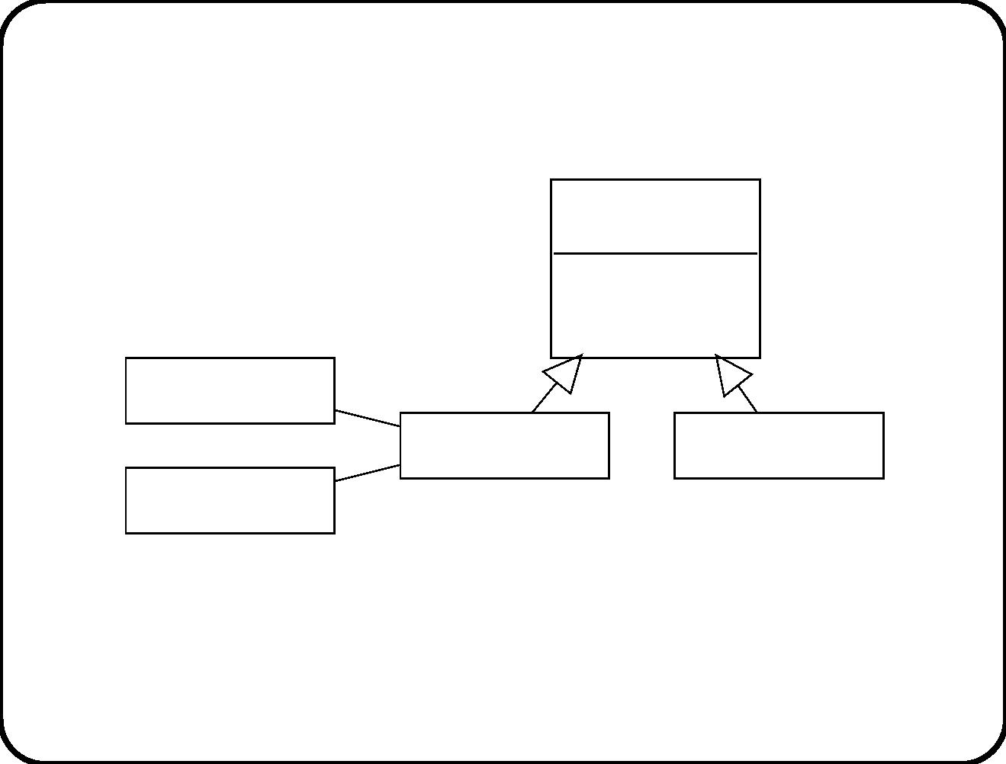
Generalization
Tank
tank ID
volume
Heater
Heating tank
Storage tank
Thermometer
Characteristic of specialization:
• Instance of a subtype is instance of a supertype.
94

Slide 20
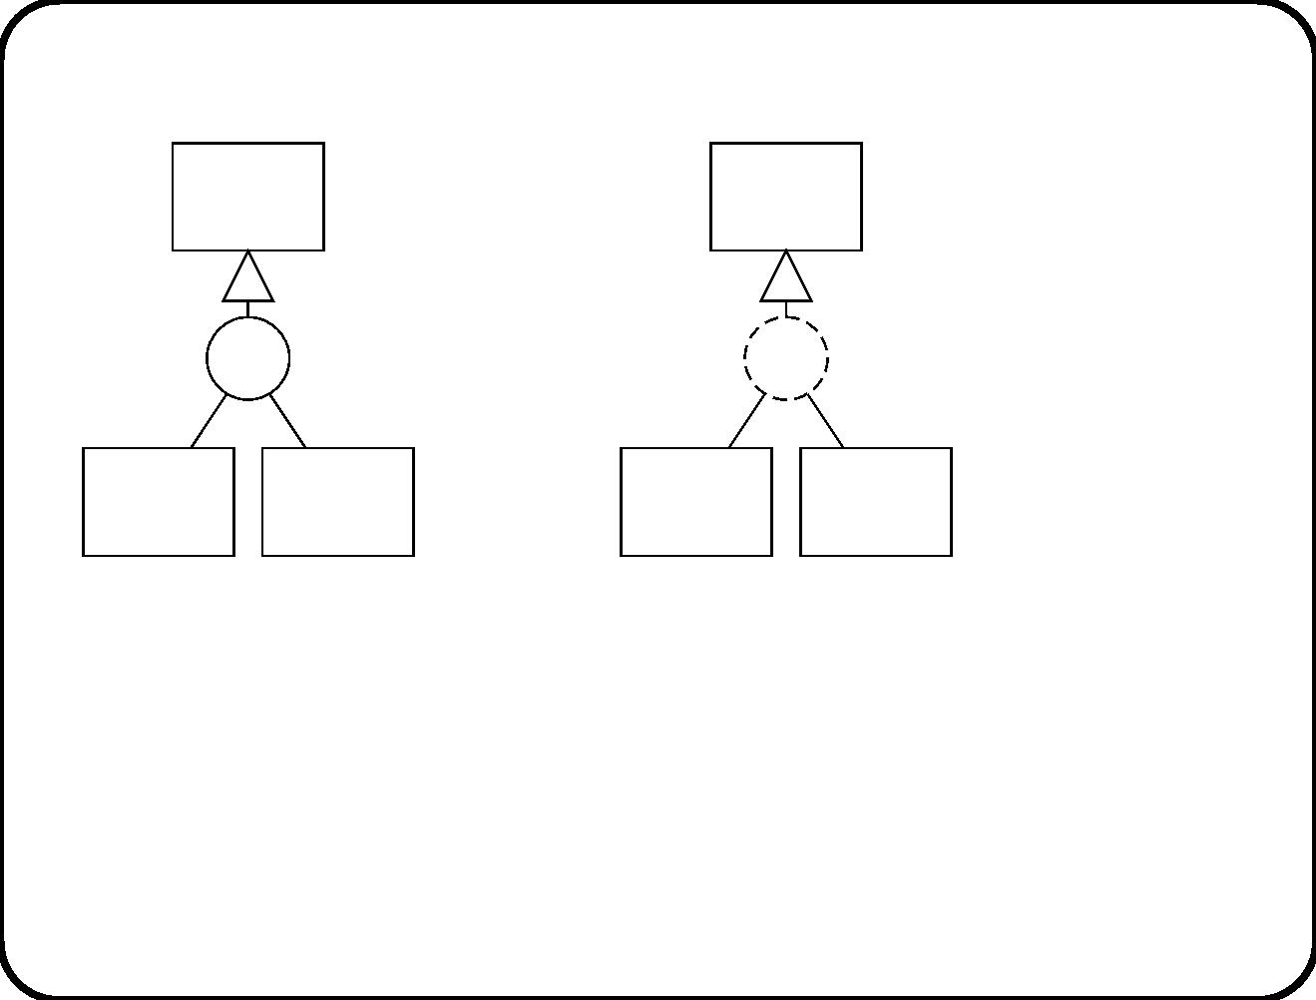
Dynamic versus static specialization
Tank
Tank
dc
dc
Heating Storage
Heating Storage
tank
tank
tank
tank
Static specialization:
Subtype extensions are
disjoint and cover
Dynamic
specialization: Subtype
extents are disjoint and
cover supertype extent.
supertype extension.
NB. If any heating tank can become a storage tank and vice versa,
then all three extensions are equal! Why?
95

Slide 21
Main points
• We make an ERD of the subject domain, not of databases.
Even virtual entities are interesting only because they are part of
the subject domain.
• ERD represents identiﬁcation and classiﬁcation of entities; and
cardinality properties.
Counting and classiﬁcation are closely related. Class (= type)
provides identiﬁcation criterion.
• Classiﬁcation can be static or dynamic.
96

Slide 22
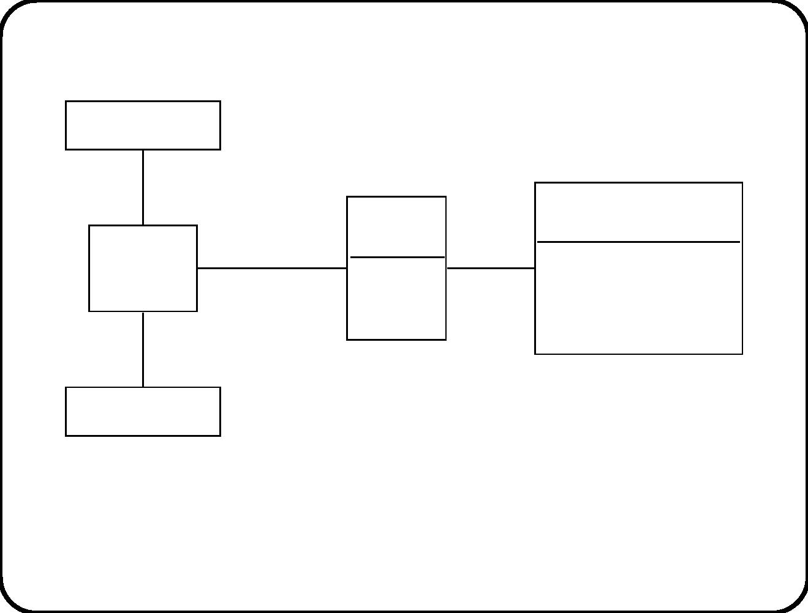
Questions
Thermometer
1
1
Recipe
Batch
Heating
tank
Allocation
1..2 0..1
name
batchID
amount
* 1 desired temperature
duration
1
1
Heater
• Suppose we interpret cardinalities historically: “the number of
instances related to in a lifetime”. Change the cardinalities to
historical ones.
97

Slide 23
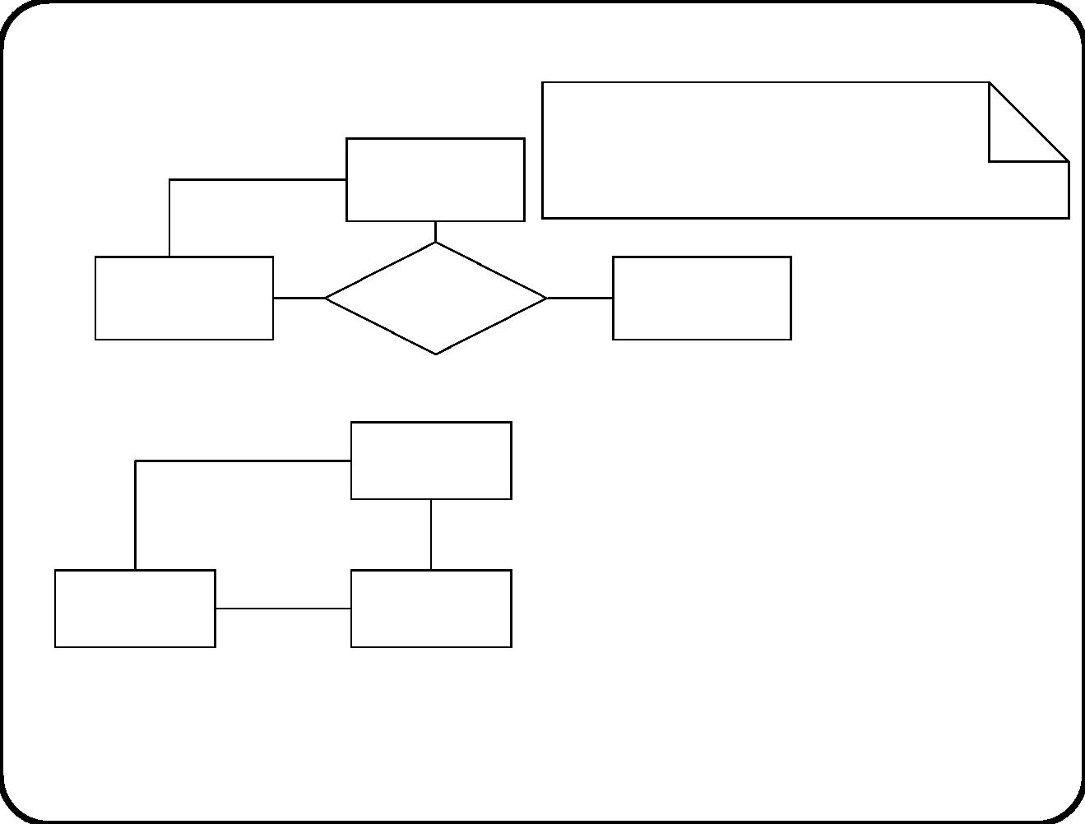
If w: Warehouse and g: Gadgets
are related by Delivery,
then w = g.Storage
Gadgets
Delivery
storage
Warehouse
Customer
Gadgets
storage
Warehouse
Order
Delivery
Customer
• Are these diagrams equivalent? Beware of the connection trap.
98

Slide 24
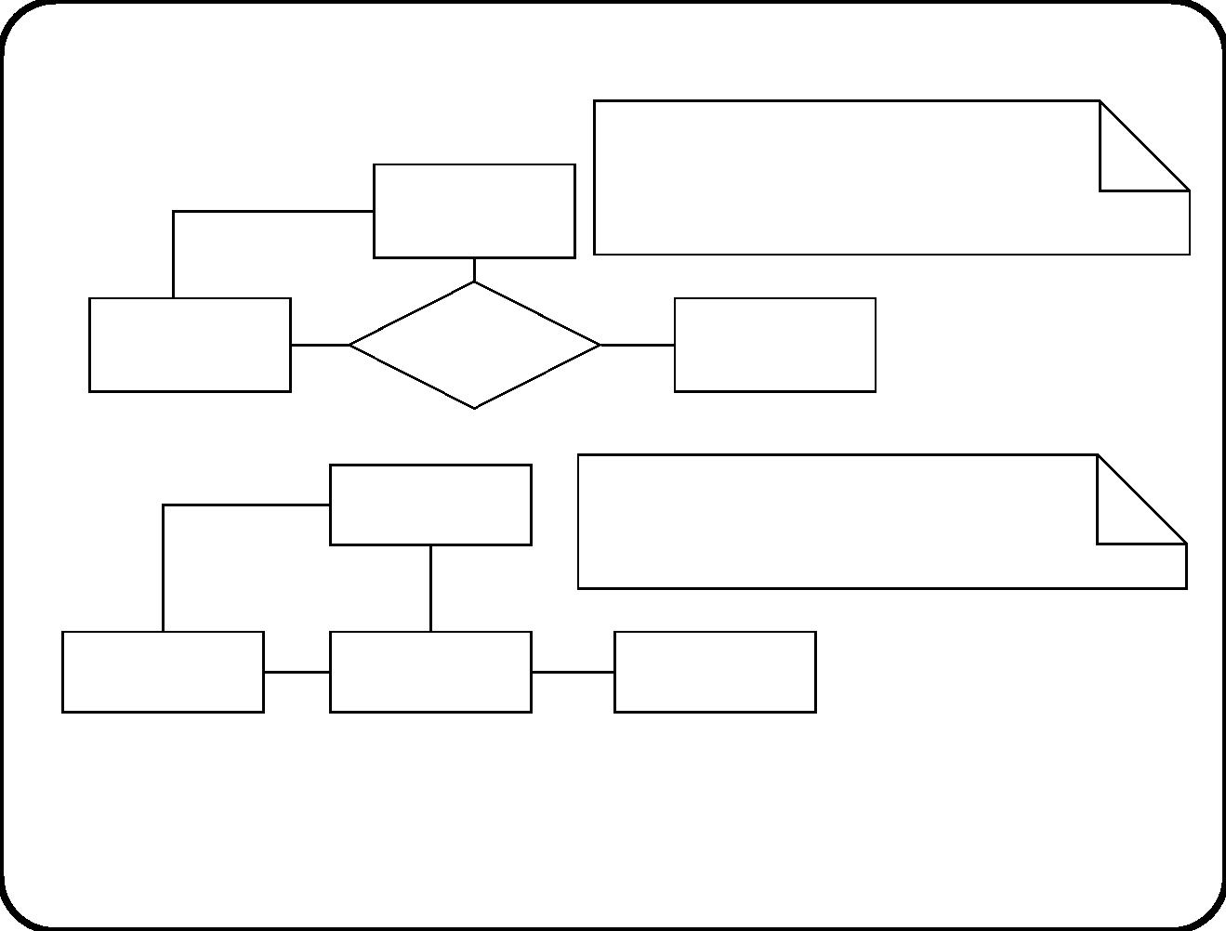
If w: Warehouse and g: Gadgets
are related by Delivery,
then w = g.Storage
Gadgets
Delivery
storage
Warehouse
Customer
Gadgets
If d: Delivery, then
1
d . gadgets . storage = d. warehouse
storage
Warehouse
1
Delivery
Customer
1
• Are these diagrams equivalent?
99

Slide 25
Chapter 9. ERD Modeling Guidelines
• ERDs can be used to declare any set of entity types and their
cardinality properties.
• In this course we use ERDs only to represent the structure of
the subject domain.
• Guidelines to determine the boundary of the subject domain
are relevant for this kind of use of ERDs only.
• All the other guidelines are relevant for all possible uses of
ERDs.
100

Slide 26
Sub ject domain boundary
The subject domain consists of entities and events. To ﬁnd the
boundary:
√
Roughly: What entities and events do the service descriptions
refer to?
√
More precisely: What are the messages entering and leaving
the system about?
√
Look for
— Physical bodies
— Devices
— (Parts of) organizations
— Conceptual entities
— Lexical items
and events in their life.
√
Entities and events should be identiﬁable by the SuD.
101

Slide 27
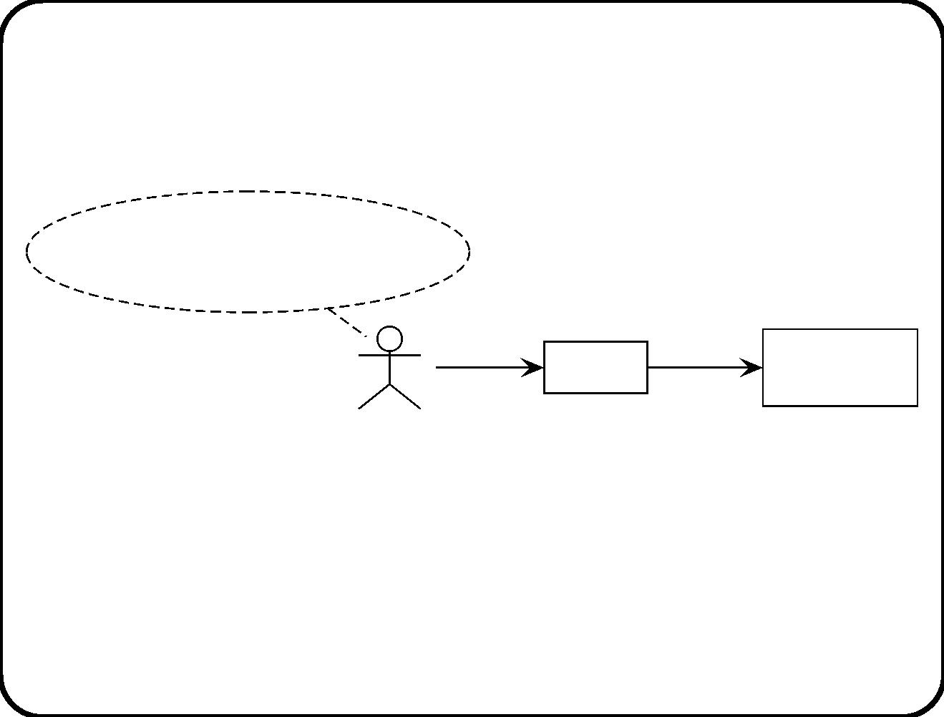
Unobservable events
decide to take the elevator,
decide to take the stairs
push
close
Elevator
controller
Button
Connection between events of interest (decisions by passenger) and
stimuli of controller are too weak to include passenger in subject
domain.
102

Slide 28
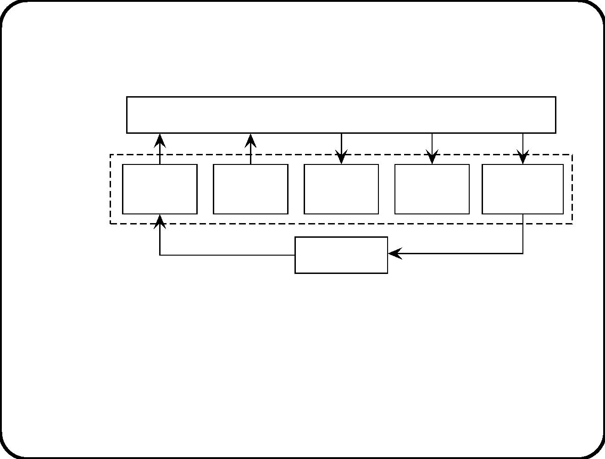
Including unobservable entities in a diagram of
external communications
SuD
Elevator controller
Subject
domain
Request
button
Arrival
sensor
Motor
Doors
Direction
indicator
Passenger
• The subject domain contains devices with whom and about
whom the elevator controller exchanges messages.
• However, we can include unobservable entities in a diagram
that shows external communication channels (the context
diagram).
103

Slide 29
Questions
• Which entities are in the subject domain of a railway travel
planner?
– Passenger, Station, Railway track, Trip segment, Route.
• Is a Passenger part of the subject domain of the Electronic
Ticket System? Why (not)?
The answers are determined by
(1) desired functionality of system and
(2) choices in connection technology.
104

Slide 30
Entities versus attributes
√
Entities are the things that the system talks about.
√
Attributes are the things said about entities.
• So if you want to store information about it, it is an entity.
If information about it can change, it is an entity.
√
105

Slide 31
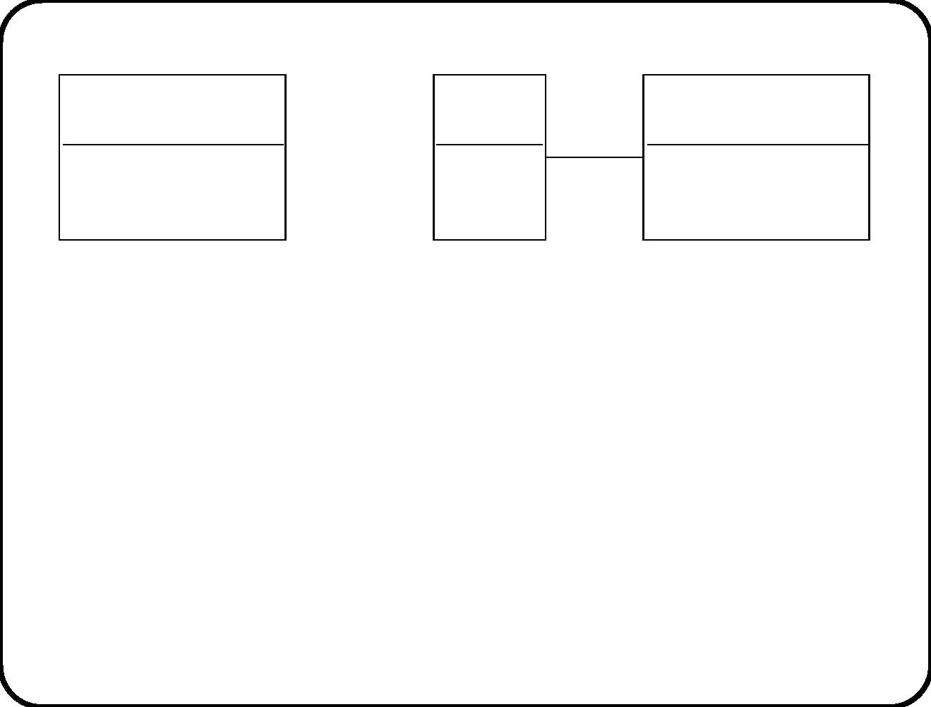
Example
Person
Person
name
Passport
name
passport number
0..1
date issued
number
1
• Counting persons is not the same as counting passports.
• Persons are not created at the same time as passports.
So they are diﬀerent entities. But which ERD is “correct”? That
depends:
• If the SuD must be able to talk about persons without
passports, or
• about persons with multiple passports (change cardinality
property for that),
• then we must include a separate passport entity type.
106

Slide 32
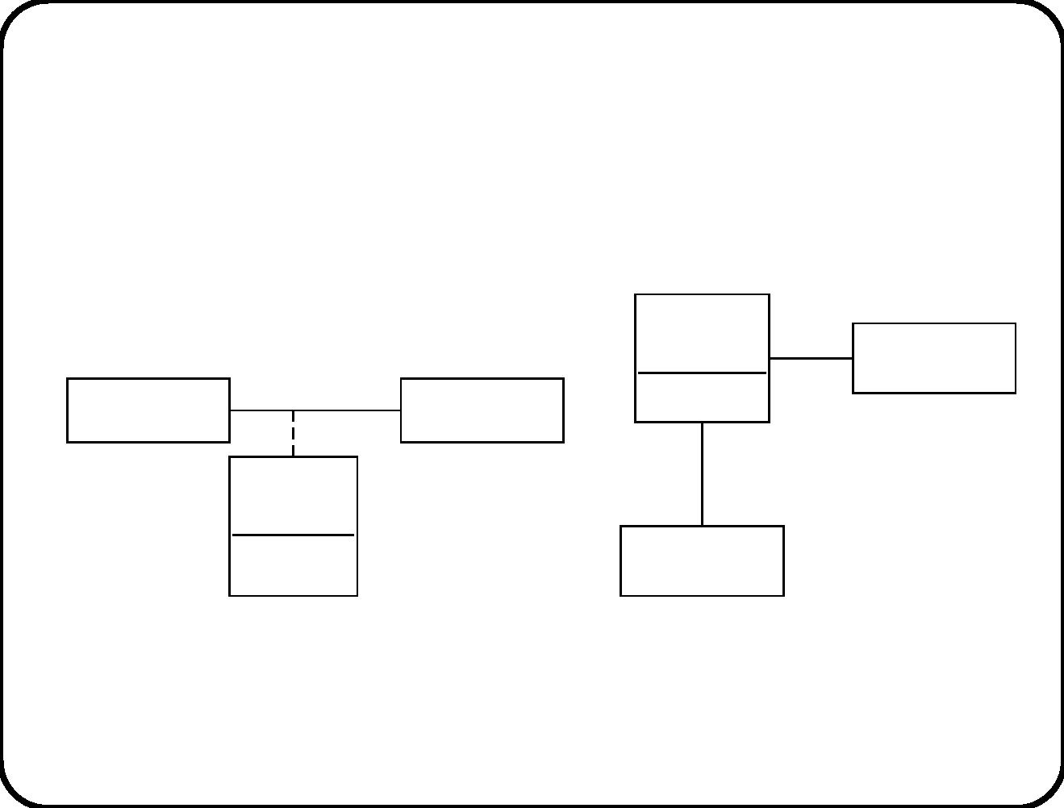
Entities versus relationships
√
Relationships are identiﬁed by their components.
So they are counted diﬀerently from the way entities are
counted.
Loan
1
Member
date
Document
0..1
Member
0..1
1
Loan
date
Document
Several loans may co-exist!
Not what we intend
107

Slide 33
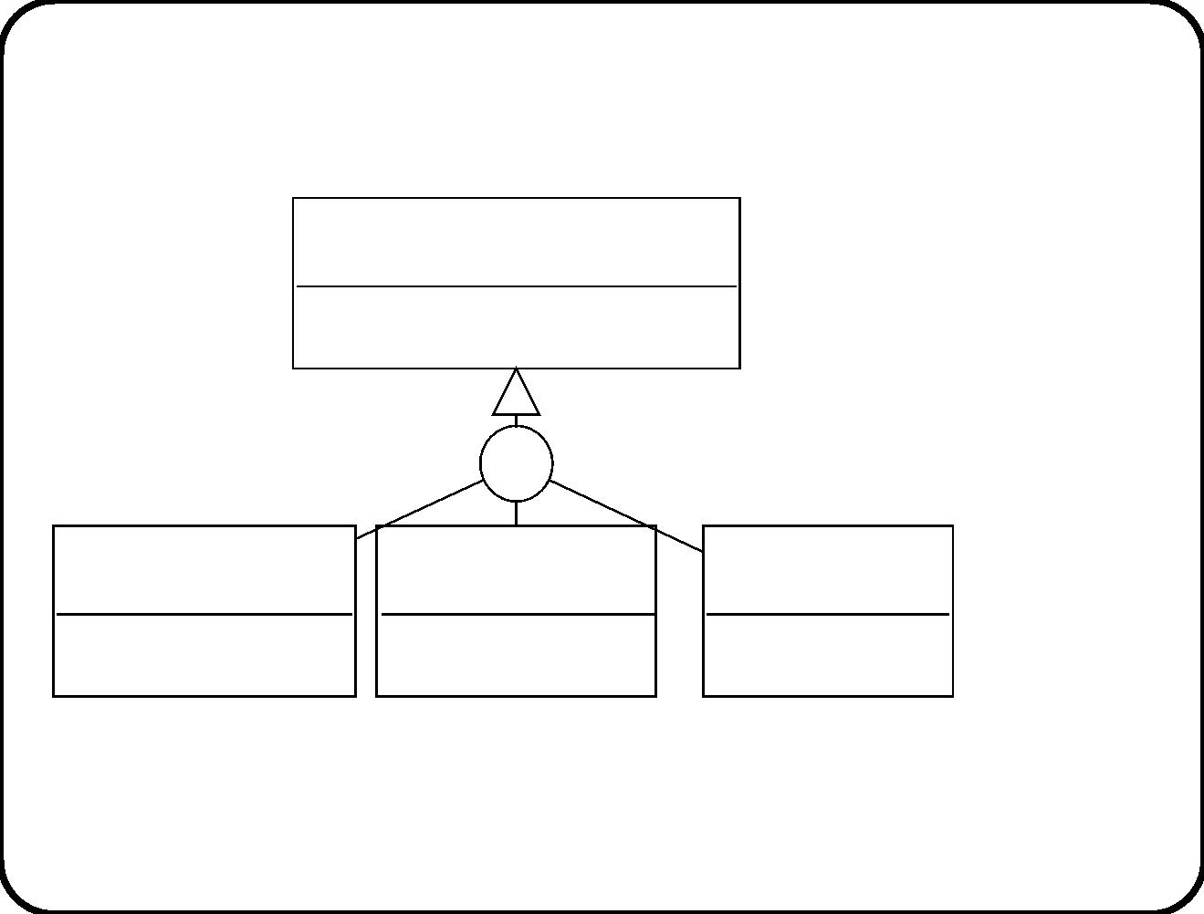
Taxonomic structures
√
Use a specialization attribute.
Vehicle
medium: {ground, air, water}
dc
Car
Boat
Aircraft
{medium = ground} {medium = water}
{medium = air}
Any subtypes missing?
Do we need these subtypes?
108

Slide 34
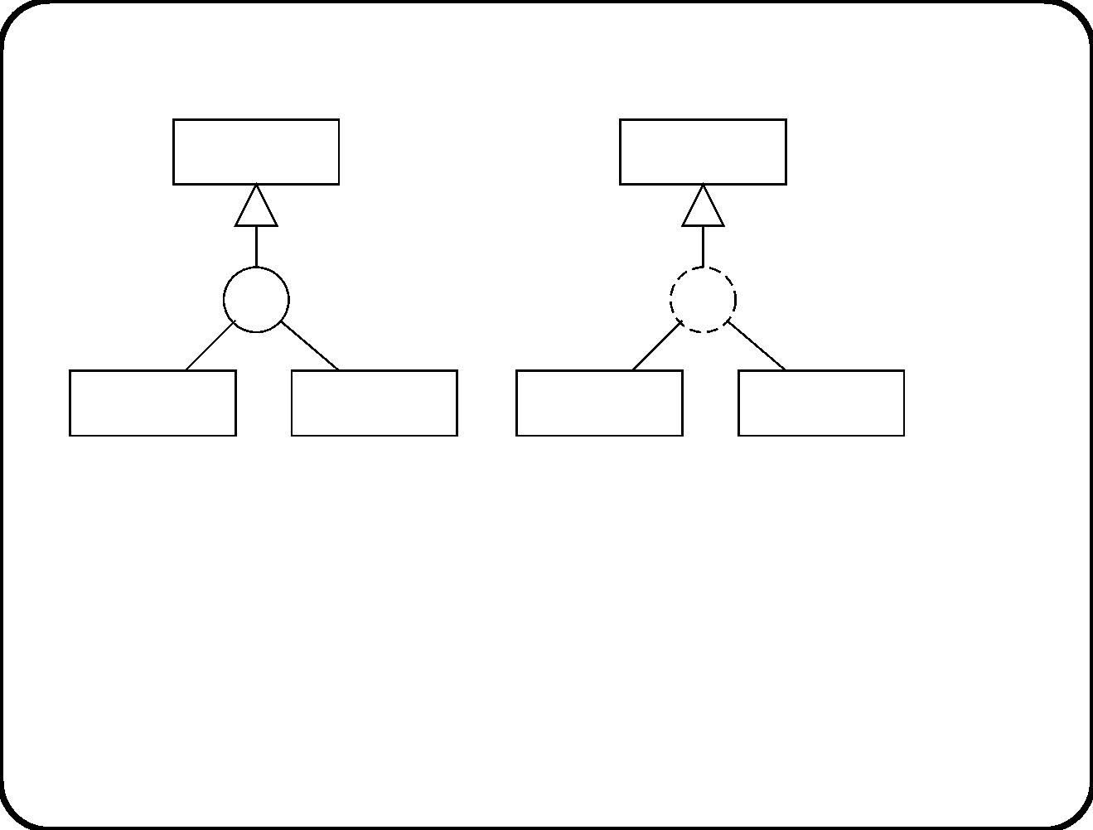
Static versus dynamic specialization
Vehicle
Tank
dc
dc
Car
Airplane
Heating tank
Storage tank
According to this ERD, if you are born as a car, you are always a
car. But heating tanks can become storage tanks and vice versa.
√
Creating a static subtype instance is creating a supertype
instance.
√
Creating a dynamic subtype instance may not involve creating
a supertype instance.
109

Slide 35
Classiﬁcation and identiﬁcation
√
A typ e deﬁnition should provide a recognition criterion and an
identiﬁcation criterion.
– The recognition criterion for Car gives us the answer to this
question “Is this a car?”
– The identiﬁcation criterion gives us the answer to the
question “How many cars do we have here?”
To ﬁnd the identiﬁcation criterion of typ e C, it is often useful
to look at the creation event of an instance of C.
110

Slide 36
Questions
Give recognition and identiﬁcation criteria for the following
concepts:
• Person
• Company
• Passenger
• Elevator button
• Your PC
• The chair you are sitting on.
If an instance of C is in the subject domain, then the SuD is able to
talk about a C, and so the SuD should be able to recognize and
identify C’s!
111

Slide 37
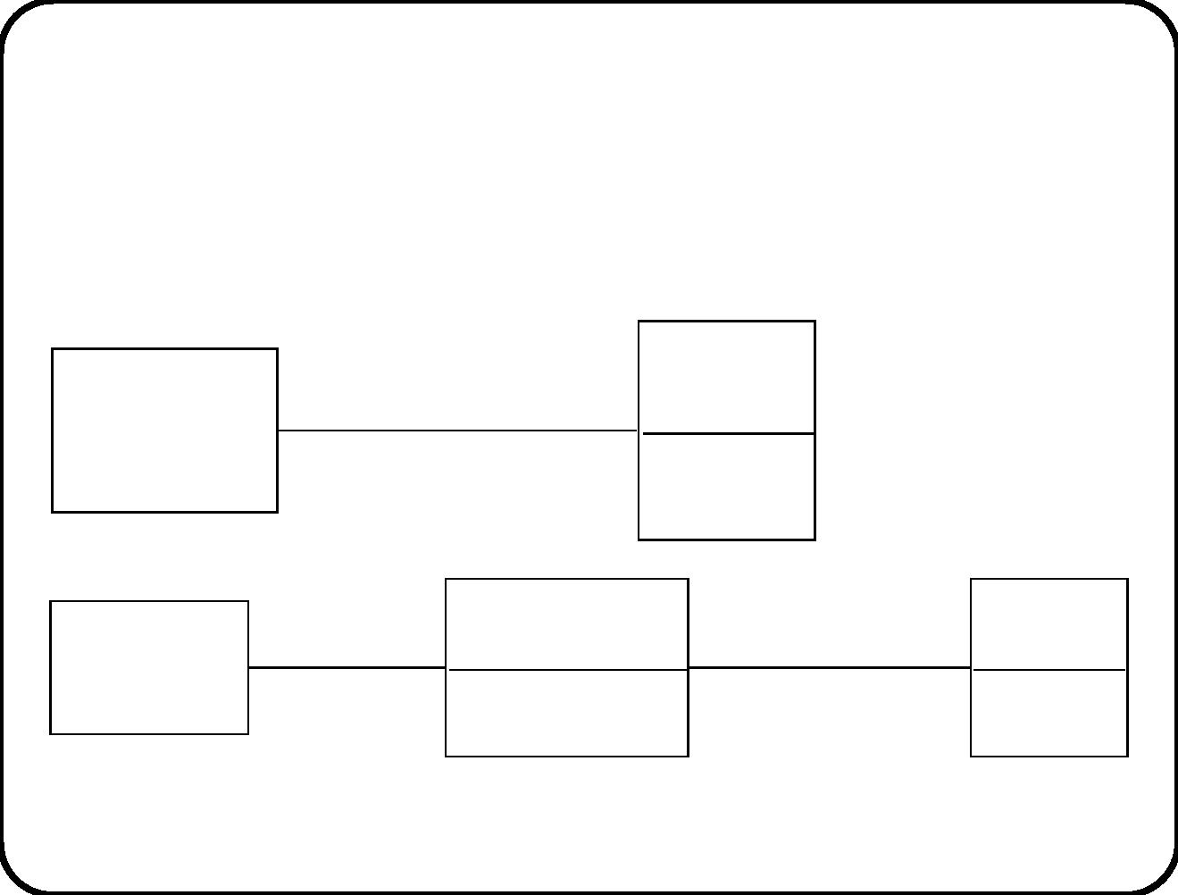
Subtypes versus roles
If an entity can play several roles of the same type, we can turn the
role into an entity type.
Person
employee
Company
name
Employee
role
player
1
Person
name
Company
1
employee nr
112

Slide 38
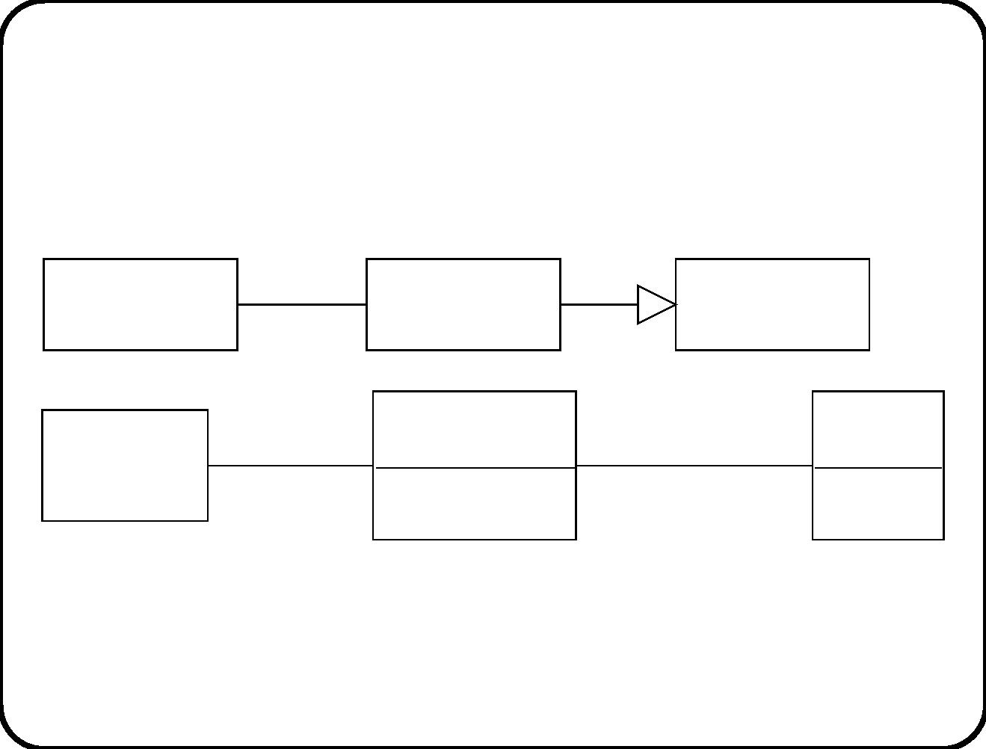
What is the diﬀerence between these two models?
Company
1
Employee
Person
Employee
role
player
1
Person
name
Company
1
employee nr
113

Slide 39
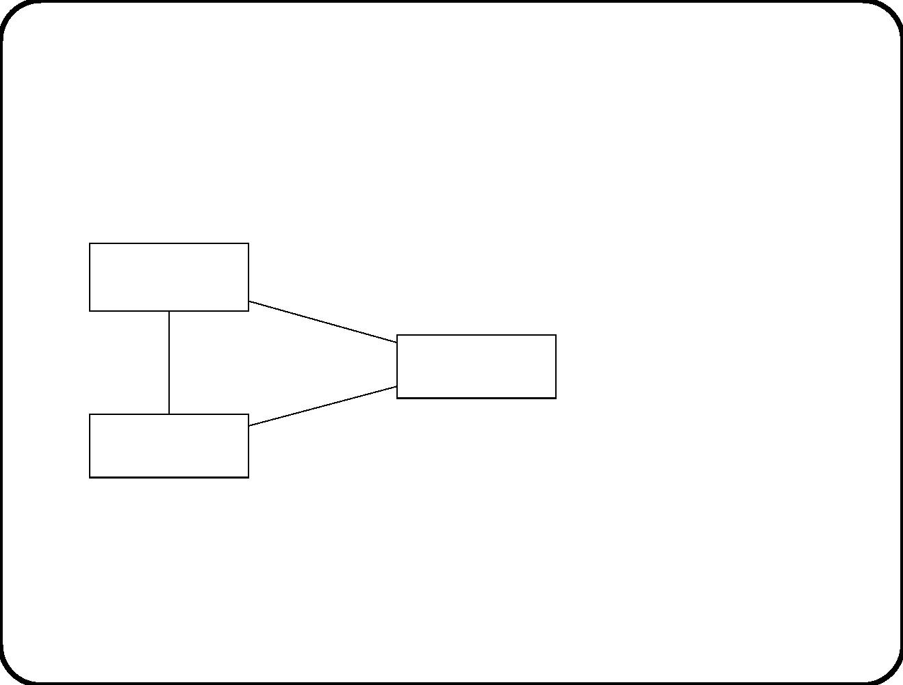
Validation of an ERD (1)
√
Check consistency of cardinality properties.
Elevator
2
cage
current
floor
1
2
1
Floor
10
Destination
button
2
1
If a diagram is not consistent, it cannot represent any subject
domain.
114

Slide 40
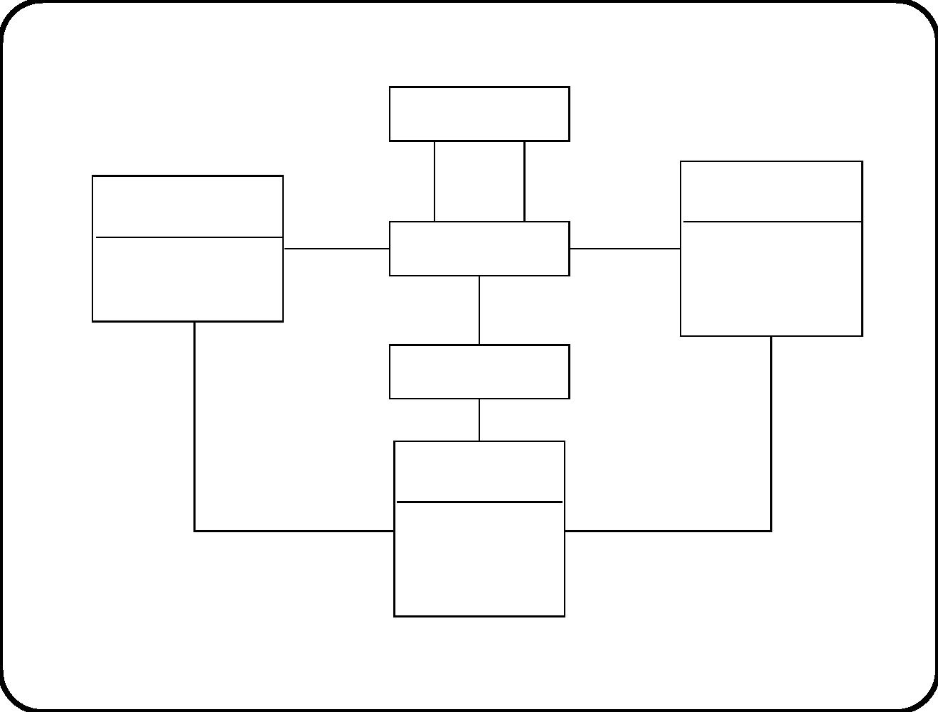
Validation of an ERD (2)
Railway station
to 1 from
1
Ticket refund stamp
where
used
Ticket usage stamp
where
aborted
time
time
date
1
Rail segment
1..*
1
date
trip number
0..1
Route
1
Ticket
date of validity
class
1
1
price
Are all loops commutative (any starting / destination node)?
115

Slide 41
Validation of an ERD (3)
√
Describe by elementary sentences and show to domain
specialist.
At each moment:
– A batch of juice has exactly one recipe.
– A recipe may be applicable to any number of batches.
– At any point in time, a heating tank has at most one batch
allocated to it.
– At any point in time, a batch is allocated to either 1 or 2 heating
tanks.
– Each heating tank has exactly one heater.
– etcetera.
116

Slide 42
Validation of an ERD (4)
√
Describe snapshot and show to domain specialist.
Segment
Usage
Refund
stamp
Ticket
Route
stamp
Return
Enschede-
Apeldoorn
(t1, April 2)
Enschede-
Apeldoorn
March 31
None
Return
(t1, April 2)
Enschede-
Apeldoorn
Apeldoorn-
Enschede
April 1
April 1
Flaws in the model:
– Ticket cannot be used before bought!
– No usage and refund for the same segment!
– Return must be on the same day!
These are subject domain properties.
117

Slide 43
Validation of an ERD (5)
√
Check against messages entering and leaving the system.
Or against service descriptions:
• Name: Sell a ticket.
• Triggering event: Traveler requests to buy a ticket.
• Delivered service: Allow a traveler to buy a ticket at any
time and place chosen by the traveler.
• Name: Show a ticket.
• Triggering event: Traveler requests to view a ticket.
• Delivered service: Display ticket attributes to the user.
Why is “Traveler” not an entity in the subject domain?
118

Slide 44
Main points
• Subject domain bounded by the topic of the conversation with
SuD.
• Entities have contingent properties, attributes do not.
• Relationships are identiﬁed by their components.
• Use specialization attribute.
• Static and dynamic specializations are distinguished by what
happens at creation time.
• Classiﬁcation and identiﬁcation closely connected.
• Roles can be reiﬁed to entity types.
• Validate your ERD: consistency, elementary sentences,
snapshots, check against interface of SuD.
119

Slide 45
Chapter appendix (slides only): describing
histories and events in an ERD
120

Slide 46
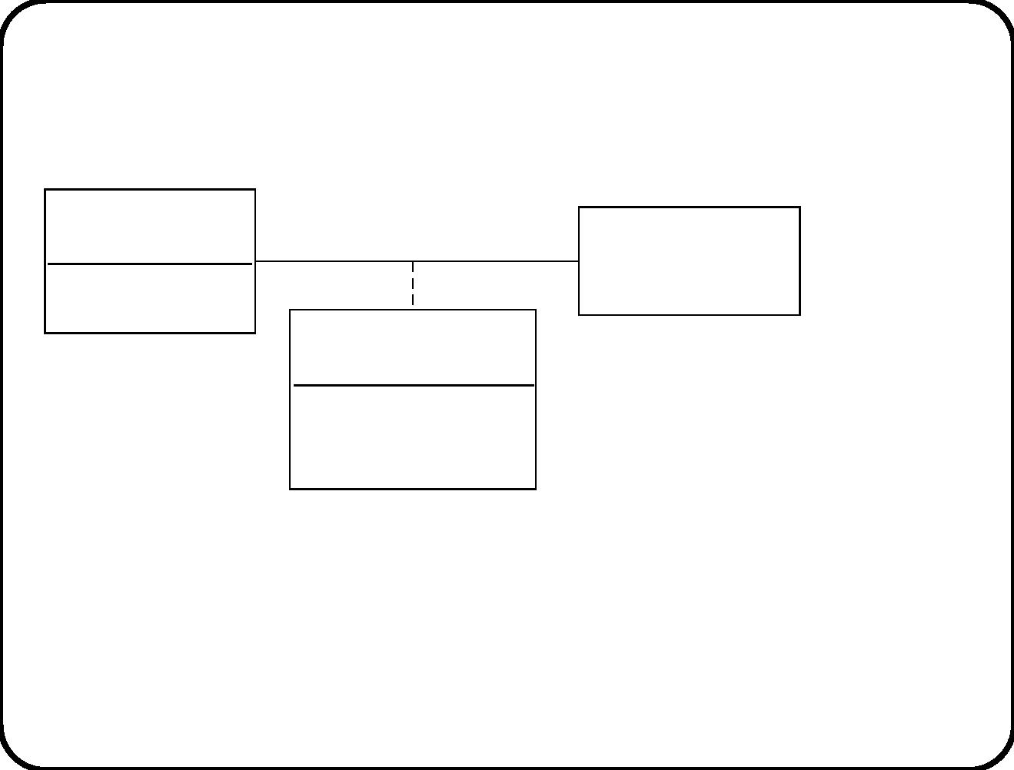
Histories
Person
Date
blood type
Person snapshot
name
weight
• Fixed attributes in the Person typ e b ox.
• Date-dependent attributes in an associative entity which
represents the person at a certain date.
121

Slide 47
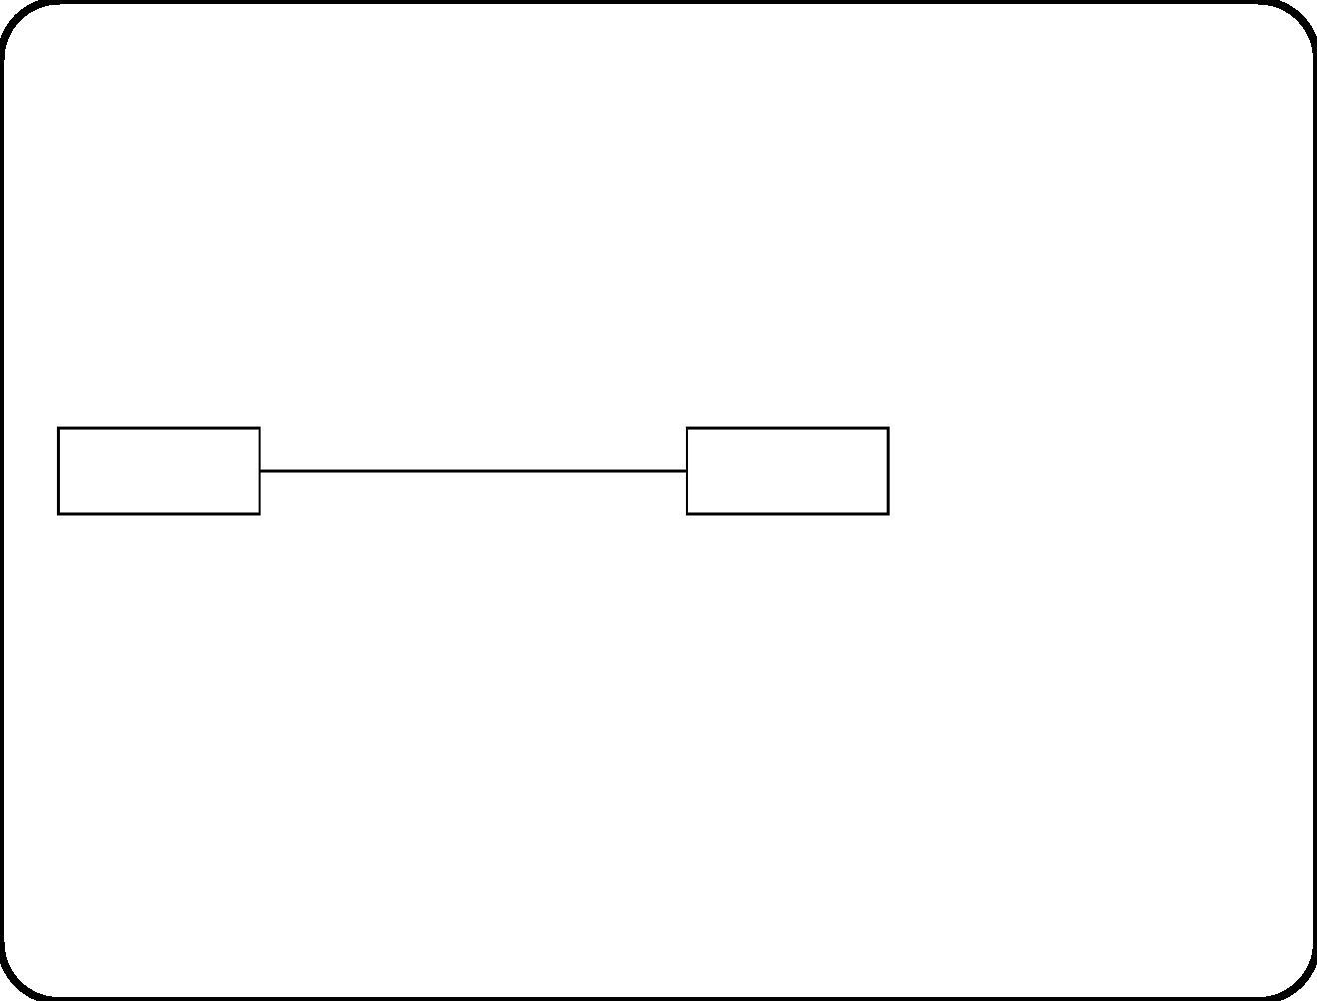
Events
Borrow
Person
Document
• Borrow is an event.
• An instance of Borrow exists for one moment only.
122

Slide 48
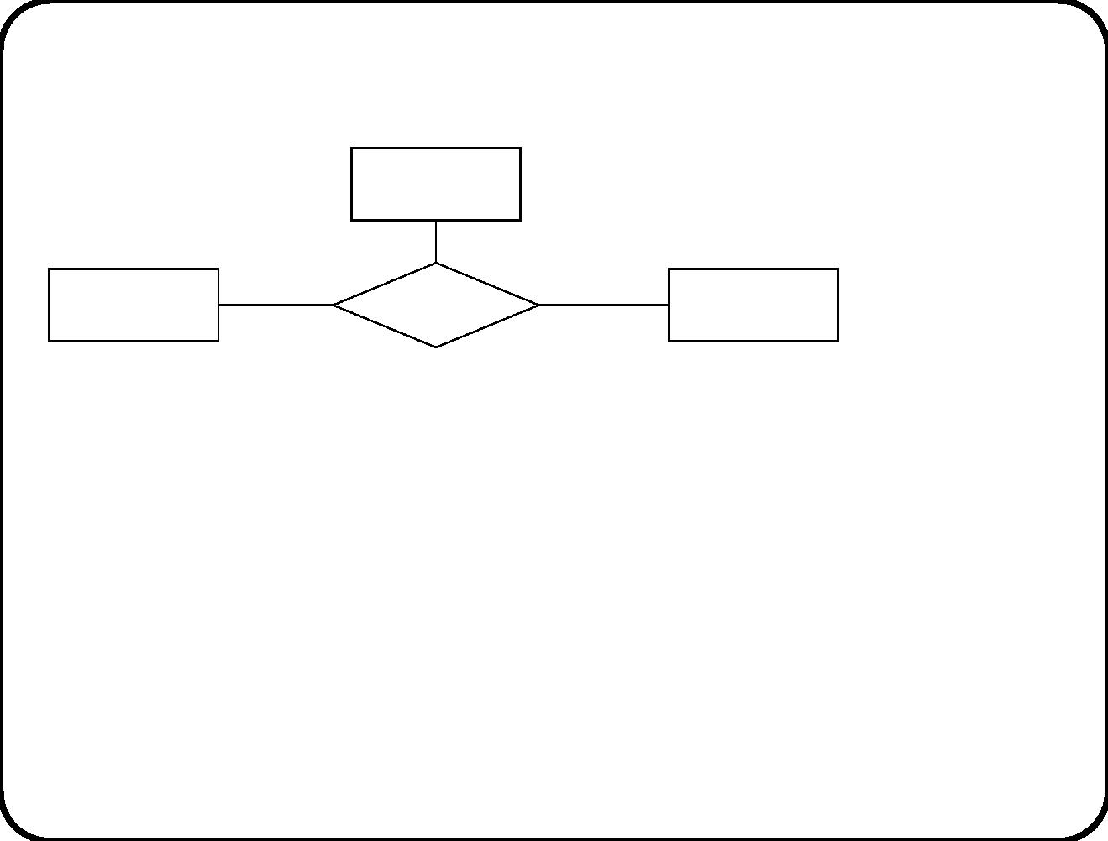
Date
Person
Borrow
Document
• Borrow is a dated event.
• An instance of Borrow represents the fact that at a certain
date, a person borrowed a certain document.
• An instance of Borrow has identiﬁer (p, dt, dc).
• We can include a time indication in the date too.
123

Slide 49
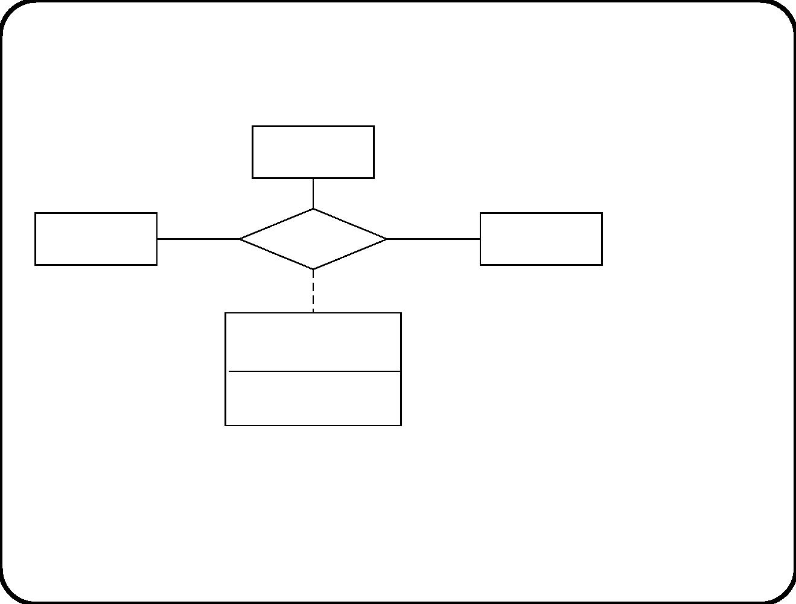
Date
Person
Document
Borrow
due date
• Now Borrow has an attribute.
124

Slide 50
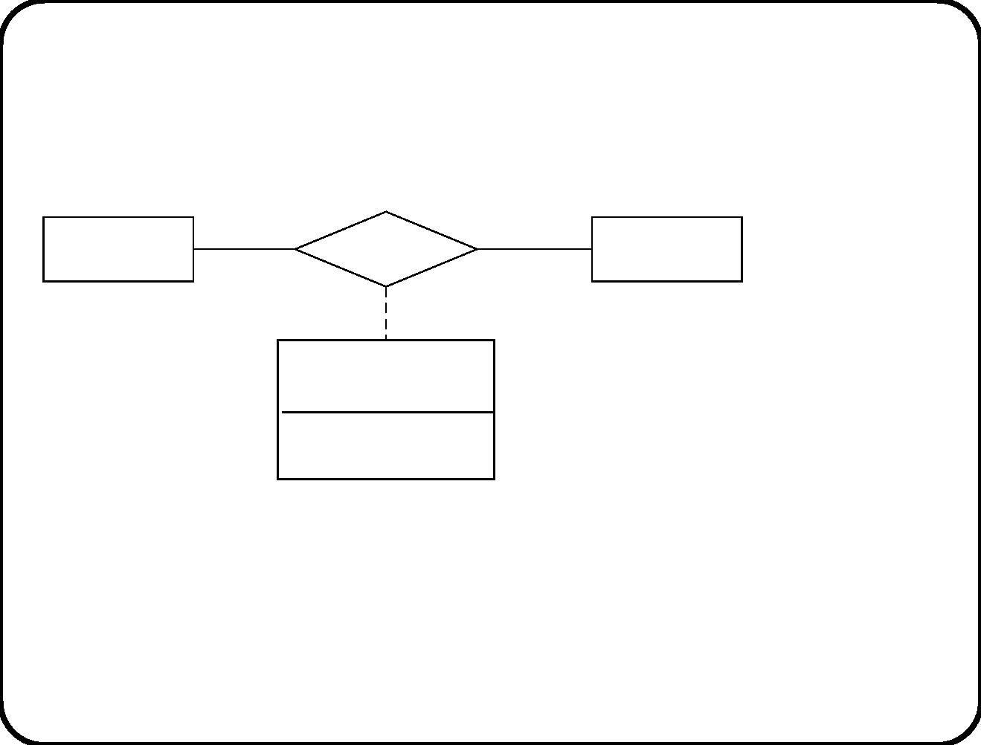
Person
date
Document
Borrow
due date
• Convention that abbreviates the diagram on the previous slide.
125

Slide 51
Chapter 10. The Dictionary
The dictionary documents the meaning of important terms:
• Words used in service descriptions
• Words used in messages that cross the external SuD interface
• Domain-speciﬁc jargon
• etc.
The subject domain ERD is a visual supplement to the dictionary,
that adds some precision to terms that refer to subject domain
entities.
In our dictionary, we use only a few syntactic categories of terms,
that are motivated by our domain ontology.
126

Slide 52
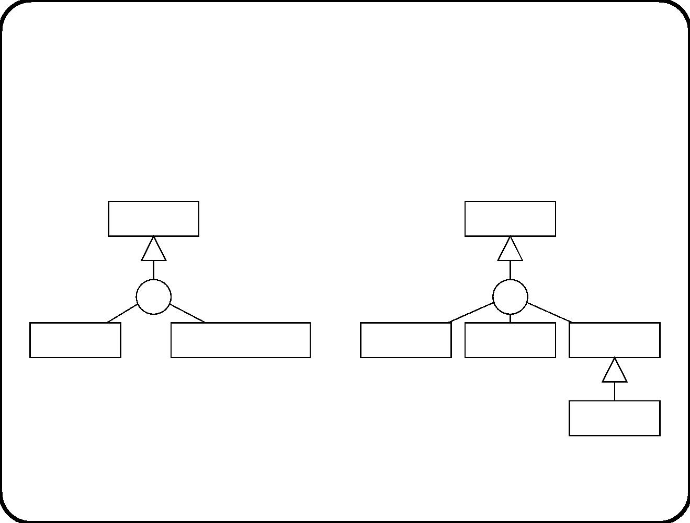
Domain ontology
• Domain is part of the world treated as a whole.
• Ontology is a metaclassiﬁcation.
Individual
Property
dc
d
Entity
Event occurrence
Entity type
Relationship
Attribute
State
127

Slide 53
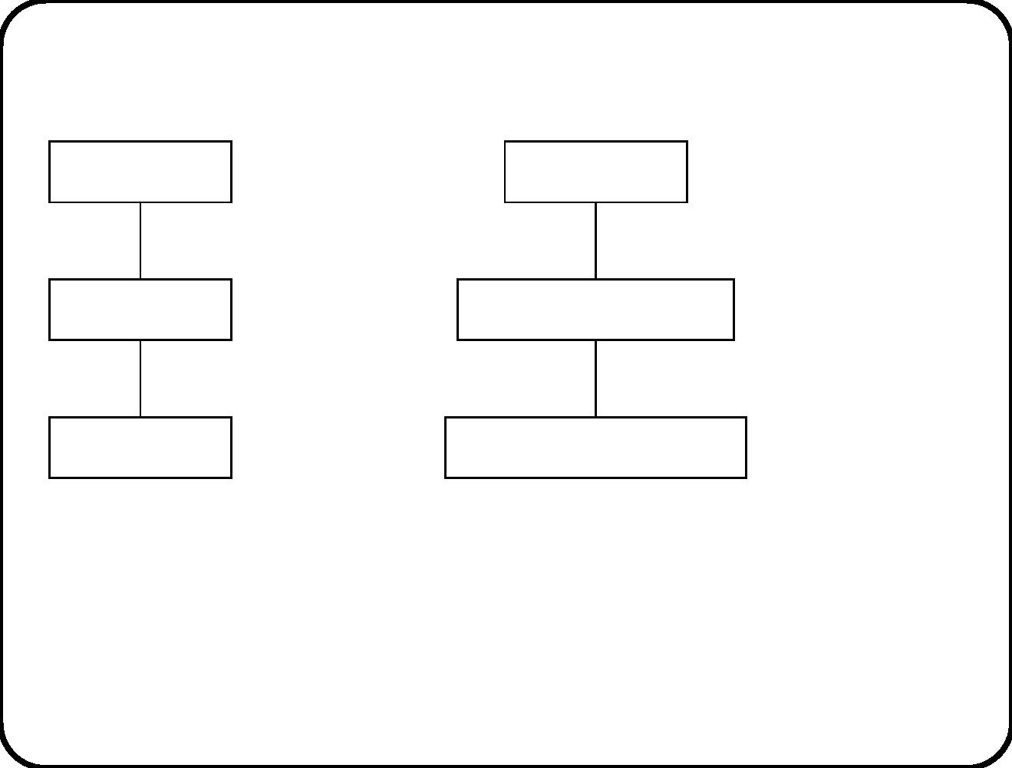
Individuals are entities and event occurrences
Entity type
1
Event
1
instance
occurrence in the life of entities
Entity
1
Event occurrence
1
occurrence at a particular time
Dated entity
Timed event occurrence
• No reincarnation of entities.
• Event occurrence can occur at many times.
sell(coﬀee, 0.2 l) is an occurrence of event sell and it can occur
at times 9:00, 9:02, etc.
128

Slide 54
Syntactic categories
• Identiﬁer. Unique proper name.
• Predicate name.
– Entity type name.
– Relationship name.
– State predicate name. Boolean prop erty.
• Attribute name.
• Event name.
129

Slide 55
Deﬁnitions from the ETS speciﬁcation
• Railway station. Entity type. Entity used to bound rail segments. May
consist of platforms where passengers can enter or leave a train. Can
also be a mathematical point used to bound a segment. Examples: The
point where the line of rail passes the Dutch-German border; one can
buy a ticket to that point. Can also be a collection of physical stations.
Example, a ticket to “Berlin U-Bahn” is a ticket to any subway station
in Berlin.
• Rail segment. Entity type. A shortest path between two Railway
stations. Segments are directed and are identiﬁed by the two stations
they connect. So all shortest paths through the rail network from A to
B are considered the same segment, called AB; and all shortest paths
from B to A are the same segment, called BA; and AB and BA are two
diﬀerent segments.
• Route. Entity type. A path through the rail network that consists of a
connected series of rail segments, where each segment occurs at most
once in the route.
130

Slide 56
Deﬁnitions from an elevator control speciﬁcation
• planned direction(c: Elevator cage). Attribute. The preferred
direction in which c will depart after closing its doors. If there are
requests to be served higher and lower than the current ﬂoor of the
elevator cage, then it will depart in the planned direction.
• Round trip time. The time in seconds for a single car trip around a
building from the time the cage doors open at the main terminal until
the doors reopen when the cage has returned to the main terminal ﬂoor
after its trip [Barney & dos Santos 1977].
• Atﬂoor(b: Request button, c: Elevator cage). Predicate. c
.
.
current ﬂoor = b ﬂoor.
• continue(c: Elevator cage). Action. Term is applicable only if c
planned direction = none.
– If c planned direction = up then start up(c
– If c planned direction = down then start down(c
.
6
.
.
.
motor).
.
motor).
The motor of c is started in the planned direction of c.
131

Slide 57
Path expressions
Deﬁnitions may use path expressions, that refer to paths through
the ERD.
See section 10.3 for syntax of path expressions.
132

Slide 58
Extensional and intensional deﬁnitions
• Extensional deﬁnitions list a few instances of the concept.
Easy to give. But do not deﬁne an intension.
• Intensional deﬁnition lists the deﬁning properties shared by
all instance of the concept.
Diﬃcult to ﬁnd.
Open-textured terms have no intensional deﬁnition.
√
Deﬁne these by giving a few examples, a sketch of the intent,
and indicating the procedure —if any— that determines
whether an instances falls under the concept.
Examples: Boat, title, document, vehicle, house, elevator, ...
133

Slide 59
When to deﬁne a term
√
To clarify a term.
√
To indicate that the term is open-textured.
√
To indicate that we attach little meaning to it.
√
The term is absolutely obvious to all stakeholders —but they
attach diﬀerent meanings to it.
When not to deﬁne a term
√
To raise a cloud of obscurity. (Bad idea, but frequent practice.)
√
Deﬁnitions can also be found in technical documentation of
devices. Don’t repeat these.
√
The term is absolutely obvious to all stakeholders —and they
understand the same by it.
134

Slide 60
Deﬁnition by genus and diﬀerence
Without genus
With genus
A compiler translates source code A compiler is a program that trans-
into object code.
lates source code into object code.
A catamaran is a boat with two
hulls.
A catamaran has two hulls.
A heating tank is a tank with a
heater and thermometer in which
juice can be heated.
A heating tank heats juice.
Joiners recently joined the com- A joiner is an employee that re-
pany.
cently has joined the company.
A ticket is a lexical item that repre-
sents the passenger’s right to make
a trip by train.
A ticket represents the passenger’s
right to make a trip by train.
135

Slide 61
√
√
The genus provides the identiﬁcation criterion of the entity
type.
The diﬀerence provides the recognition criterion of the entity
type.
136

Slide 62
Operational deﬁnitions
An operational deﬁnition of a term gives a procedure, that can be
followed by anyone, to determine whether or not the term is
correctly applied to a given case.
• Heating tank. Entity type. A tank with a heater and thermometer
attached. The heater can be recognized by red, blue and black wires
leading up to it, and the thermometer by its rectangular shape.
This is a operational deﬁnition by genus and diﬀerence.
• Round trip time. The time in seconds for a single car trip around a
building from the time the cage doors open at the main terminal until
the doors reopen when the cage has returned to the main terminal ﬂoor
after its trip.
Operational, but not as deﬁnition by genus and diﬀerence.
137

Slide 63
Abbreviations versus correspondence rules
• Abbreviation reduces the meaning of a word to the meaning
of other words deﬁned in the same dictionary.
To determine whether an individual is an instance of the
deﬁned concept, you do not n eed new observations but simply
look up words in the dictionary.
• Correspondence rules relate a word to reality. The words in
the deﬁnition are not deﬁned in the same dictionary.
To determine whether an individual is an instance of the
deﬁned concept, you must make observations.
Which deﬁnitions in the examples given are abbreviations, and
which are correspondence rules?
138

Slide 64
Main points
• The dictionary contains deﬁnitions of jargon, subject domain
terms, and other important tersm needed to understand the
design speciﬁcation.
• We can structure deﬁnitions as a taxonomic hierarchy:
deﬁnition by genus and diﬀerence.
• Tr y to give operational deﬁnitions.
• Distinguish abbreviations (no new phenomenon described)
from correspondence rules (link words to reality).
139

