Slide 1
Reactive Systems IV, ch 11~14
Behavior Notations
何明昕 HE Mingxin, Max
Send your email to c.max@yeah.net with
a subject like: SE345-Andy: On What …
Download from c.program@yeah.net
/文件中心/网盘/SoftwareEngineering26S

Slide 2

List of Slides
139 Part IV. Behavior Notations
154 Chapter 11. State Transition Lists and Tables
166 Chapter 12. State Transition Diagrams
188 Chapter 13. Behavioral Semantics
210 Chapter 14. Behavior Modeling and Design Guidelines
2

Slide 3
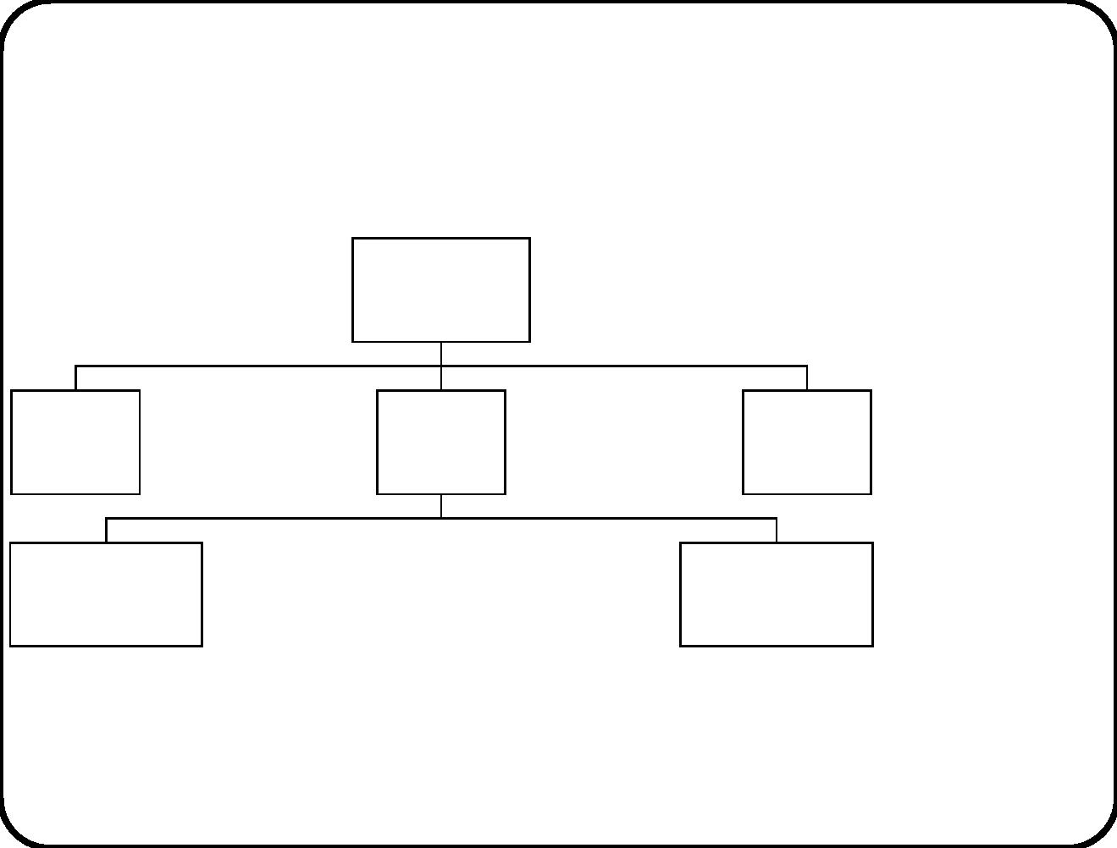
Part IV. Behavior Notations
Services
Composite
system
Behavior
Communication
External
entity
Services
Behavior
Communication
Services
External
Services
Behavior
Communication
SuD Behavior
Communication
entity
Services
Services
Subsystem 1 Behavior
Communication
......
Subsystem n Behavior
Communication
140

Slide 4
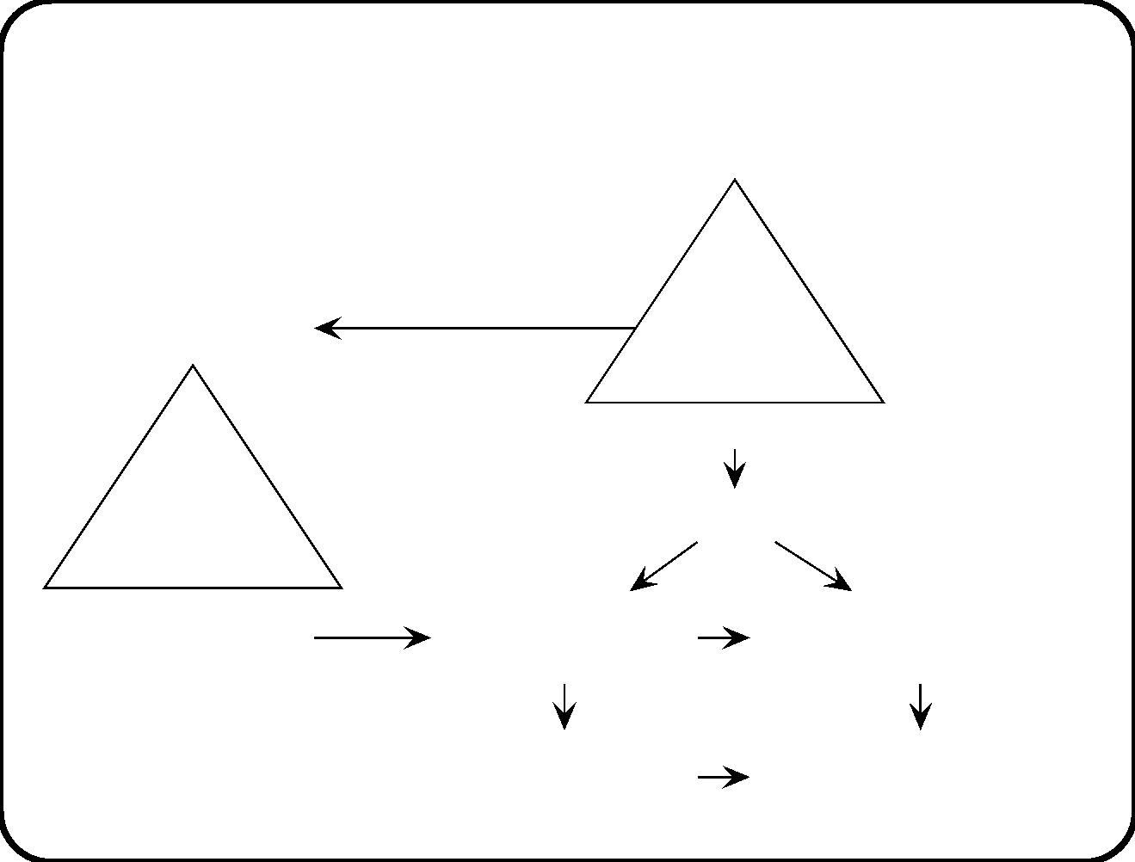
Road map of ways to ﬁnd behavior descriptions of
the SuD
Business goal
Goal
System purpose
tree
Solution goals
Activities to be supported by SuD
Function
refinement
tree
System services
Event-action list
(scenario)
Stimulus-response list
(scenario)
Event-action list
(transactional)
Stimulus-response list
(transactional)
141

Slide 5
Example 1: Training Information System
We take the route through service descriptions to desired
environment behavior.
Download Joiners service description
• Triggering event: Coordinator requests to download list of
joiners from the personnel information system.
• Delivered service: Download the list of people from the
Personnel Information System who have joined the company
since the previous training.
• Assumptions: The data in the Personnel Information Sys-
tem reﬂects the situation accurately with a time lag of not
more than one working d ay.
• Declarative service description! Not a scenario.
142

Slide 6
Example 1: Desired event-action pairs
Now we give behavioral details.
Environment event
Desired action
Personnel Information System
knows that list of joiners is
requested.
E1 Time to download list of
joiners
E2 Personnel Information System
Coordinator knows that list has
been downloaded.
sends list of joiners.
E3 System has been waiting for
Coordinator knows that list has
not been downloaded.
list of joiners too long.
• The SuD is not mentioned here.
• We describe desired behavior in the itshape environment.
143

Slide 7
Example 1: Required stimulus-response behavior
Current system
state
Response
Next system
state
Stimulus
send event
“send me a list
of joiners” to
personnel
Receive event
“download list
of joiners” from
coordinator.
System
System is
contains no list
of joiners.
waiting for list
of joiners.
information
system.
System is
System
Receive list of
joiners.
Conﬁrm to
waiting for list
of joiners.
contains list of
joiners.
coordinator.
System is
Inform
System
A timer times
out.
waiting for list
of joiners.
coordinator of
problem.
contains no list
of joiners.
144

Slide 8
Example 1: Which steps did we take?
• From desired system services we derived desired transactional
event-action pairs in environment.
– The service descriptions describe what is valuable to the
environment.
– The event-action pairs operationalize this as desired
behavior in environment.
• From event-action pairs we derive stimulus-response pairs at
the interface of the system.
– To make the SR pairs transactional, a system state is
introduced, which represents part of the environment state.
Compare our road map.
145

Slide 9

Example 2: Heating controller: Behavior to be
enforced.
We start from a model of desired environment behavior.
Event
Desired action
A heating process for the heating tanks of b is
started. If at the start of the process, tempera-
ture in a tank is too low, the heater of that tank
is switched on. When during the process, a tank
becomes 5 degrees Celsius warmer than the de-
sired temperature, its heater must be switched oﬀ.
When it becomes 5 degrees Celsius colder than the
desired temperature, its heater must be switched
on. When the heating process has lasted for the
duration of the recipe, heating must stop and the
operator must be notiﬁed of this fact.
Operator
gives com-
mand to start
heating batch
b.
146

Slide 10
Example 2: Same behavior in atomic transitions
Event
Subject domain
Desired action
state
E1 Operator gives com-
mand to start heating
batch b
Heaters of tanks of b that
are below recipe temper-
ature, are switched on.
E2 Temperature in tank
t rises 5 degrees above
recipe temperature
The juice in t is
being heated.
The heater of t is
switched oﬀ.
E3 Temperature in tank
t falls 5 degrees below
recipe temperature
The juice in
t is not being
heated.
The heater of t is
switched on.
E4 The heating duration
has passed, counted since
the start of heating of b.
• Heaters of b that are
b
is
being
on, are switched oﬀ.
heated.
• Operator is informed.
147

Slide 11
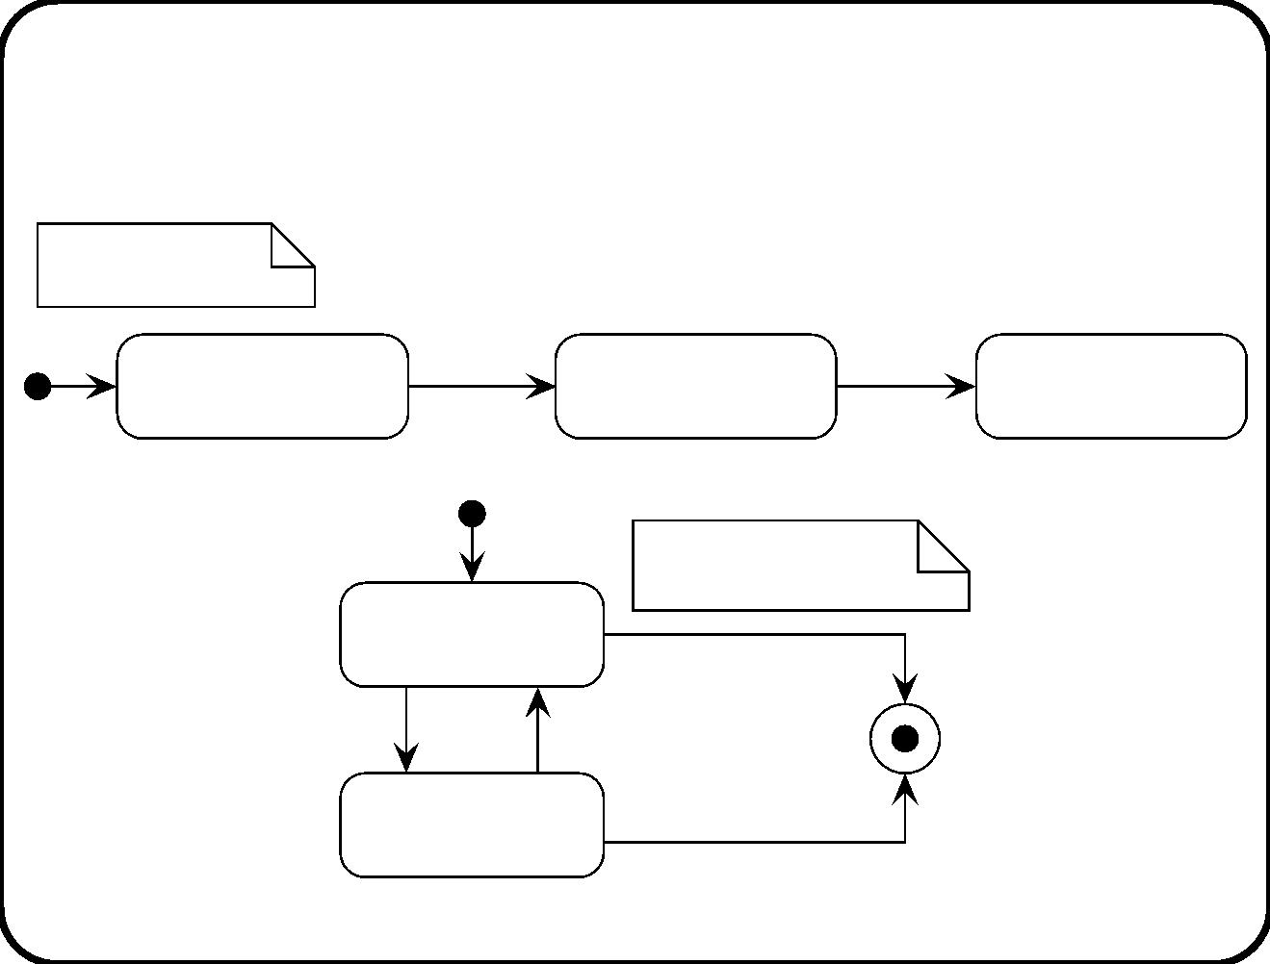
Example 2: Same behavior described by two
diagrams
after(b. duration) /
b: Batch
start heating(b) /
start tanks(b)
stop tanks(b),
inform operator
Not
pasteurized(b)
Pasteurizing(b)
Pasteurized(b)
t: Heating tank
Not heating(t)
stop(t)
too cold(t) /
too hot(t) /
switch on(t . heater)
switch off(t. heater)
stop(t) /
Heating(t)
switch off(t . heater)
148

Slide 12
Example 2: Deﬁnitions
• start tanks(b: Batch). For each tank t of b, signal “start(t)”.
• stop tanks(b: Batch). For each tank t of b, signal “stop(t)”.
These supplement the diagram.
149

Slide 13
Example 2: Stimulus-response behavior that
enforces environment behavior
Stimulus
Current
state
controller
Desired response
Next
state
S1 Operator gives
command to start
heating batch b
Switch on heaters of
tanks with low tem-
perature.
Not heating t and
not heating b.
Heating
t and b.
Heating t and mea-
S2 Every 60 seconds. sured temp > desired
Controller switches Heating
oﬀ the heater of t. t.
temp + 5
Heating t and mea-
sured temp < desired
temp − 5
Controller switches Heating
on heater of t.
t.
S4 Recipe time since
• Switch oﬀ heaters
Not
the start of heating Heating b.
of b has passed.
of b that are on.
heating
b.
• Inform operator.
150

Slide 14
Example 2: Questions
The behavior brought about by the SR pairs is not exactly the
same as the behavior that is desired.
• What are the diﬀerences?
• Why are these acceptable?
151

Slide 15
Example 2: Which steps did we take?
(Compare our roadmap)
• Desired environment behavior was modeled by means of
non-atomic event-action pair.
• This was decomposed into atomic event-action pairs.
• From this we derived desired system behavior as a set of
atomic stimulus-response pairs, that would approximately
bring about desired environment behavior.
152

Slide 16
Part IV: Main points
• Behavior occurs in the environment and at all levels in the
system.
• Find required system behavior by
– Analyzing required system services or
– modeling desired environment behavior.
• Behavior can be described in tabular format or by diagrams.
153

Slide 17
Structure of part IV
• State transition lists and tables
• State transition diagrams
• Execution semantics
• Modeling and design guidelines
154

Slide 18
Chapter 11. State Transition Lists and Tables
• Range from informal to formal
• Can be used at system level down to component or software
object level.
• Diﬀerent kinds of lists and tables:
– Event list
– Stimulus-response list
– State transition table
– Decision table
At system level, the lists are usually informal. At software object
level, they are usually formal.
155

Slide 19
The use of behavior descriptions
Behavior descriptions can be used to represent
• Assumed environment behavior
• Desired environment behavior
• Required system behavior
• Required component behavior
You cannot tell how a behavior description is used by reading it.
Each behavior description must be supplemented by an indi-
cation of its intended use.
156

Slide 20
Event lists
List of event descriptions and, for each event, a description of its
eﬀect.
Example: description of assumed device behavior.
• light on(b). If b is not already in state On(b), then it enters
state On(b). Otherwise, nothing changes.
• light oﬀ(b). If b is not already in state Oﬀ(b), then it enters
state Oﬀ(b). Otherwise, nothing changes.
157

Slide 21

Example event list: desired sub ject domain
behavior
Event
Desired action
A heating process for the heating tanks of b is
started. If at the start of the process, tempera-
ture in a tank is too low, the heater of that tank
is switched on. When during the process, a tank
becomes 5 degrees Celsius warmer than the de-
sired temperature, its heater must be switched oﬀ.
When it becomes 5 degrees Celsius colder than the
desired temperature, its heater must be switched
on. When the heating process has lasted for the
duration of the recipe, heating must stop and the
operator must be notiﬁed of this fact.
Operator
gives com-
mand to start
heating batch
b.
158

Slide 22
Example state transition table: Desired sub ject
domain behavior
Event
Subject domain
Desired action
state
E1 Operator gives com-
mand to start heating
batch b
Heaters of tanks of b that
are below recipe temper-
ature, are switched on.
E2 Temperature in tank
t rises 5 degrees above
recipe temperature
The juice in t is
being heated.
The heater of t is
switched oﬀ.
E3 Temperature in tank
t falls 5 degrees below
recipe temperature
The juice in t is
being heated.
The heater of t is
switched on.
E4 The heating duration
has passed, counted since
the start of heating of b.
• Heaters of b that are
b
is
being
on, are switched oﬀ.
heated.
• Operator is informed.
159

Slide 23
Eﬀect descriptions
• Transactional. Description of one state transition.
– Intermediate states abstracted away (i.e., atomic).
– Passage of time abstracted away (instantaneous).
• Scenario.
– Description of several state transitions, with intermediate
states (i.e. not atomic).
– Progress of time.
To transform a scenario description into a transactional list, we
need to introduce states.
160

Slide 24
State transition tables (STTs)
List of transactional entries of the form (event, current state,
actions, next state).
Variables are local to one entry. Bound in the left-hand side.
Current con-
troller state
Controller re-
sponse
Next
con-
Stimulus
troller state
Opened(c)
Opened(c)
pass doors(c)
Opened(c)
Closing(c)
open doors(c)
close doors(c)
10 seconds af-
ter the most re-
cent execution Opened(c)
of c state :=
Opened
Closing(c)
.
161

Slide 25
Adding an initial state and initialization action
Initially
close doors(c)
Closing(c)
Current con-
troller state
Controller re-
sponse
Next controller
state
Stimulus
pass doors(c)
Opened(c)
Closing(c)
Opened(c)
Opened(c)
open doors(c)
close doors(c)
10 seconds af-
ter the most re-
cent execution Opened(c)
of c state :=
Opened
Closing(c)
.
162

Slide 26
Transformation table: no state change
Event
Current state
Action
• stop motor(b, c)
• open doors(c)
• light oﬀ(b)
arrive(b, c)
Destination request(b, c)
and Atﬂoor(b, c)
• stop motor(b, c)
• open doors(c)
• light oﬀ(b)
Forward request(b, c)
and Atﬂoor(b, c)
• show direction(c)
• stop motor(b, c)
• open doors(c)
• light oﬀ(b)
Outermost
reverse
request(b, c) and At-
ﬂoor(b, c)
• reverse and show di-
rection(c)
163

Slide 27
Transformation table = Decision table
bd, bf, br: Request button
c: Elevator cage
Destination request(bd, c) and Atﬂoor(bd,
c)
T
F
F
F
T
-
T
T
-
F
F
T
T
F
Forward request(bf, c) and Atﬂoor(bf, c)
Outermost reverse request(br, c) and At-
ﬂoor(br, c)
T
stop motor(c)
X
X
X
X
X
X
X
X
X
X
X
X
X
open doors(c)
show direction(c)
reverse and show direction(c)
light oﬀ(bd)
X
X
X
X
X
X
X
light oﬀ(bf)
X
light oﬀ(br)
X
164

Slide 28
An STT with next states but without actions
Current
state
button
Event
Next button state
On(b)
light oﬀ(b)
light on(b)
light on(b)
light oﬀ(b)
Oﬀ(b)
On(b)
On(b)
Oﬀ(b)
Oﬀ(b)
165

Slide 29
Main points
• Tabular behavior descriptions range from informal (event list)
to formal (state transition table).
• Can be used for assumed or desired behavior of environment or
system.
• List entry can describe a transition or a scenario.
• Variables can be declared for a table; binding is local to one
entry.
• Stateless “transition” is really decision rule.
166

Slide 30
Chapter 12. State Transition Diagrams
• Good at showing the structure of behavior.
• Not good at showing unstructured behavior.
• Can only show a limite amount of information because
restricted to one sheet of paper.
• Tables and lists on the other hand can show unlimited amounts
of information, because they can continue on any number of
sheets.
167

Slide 31
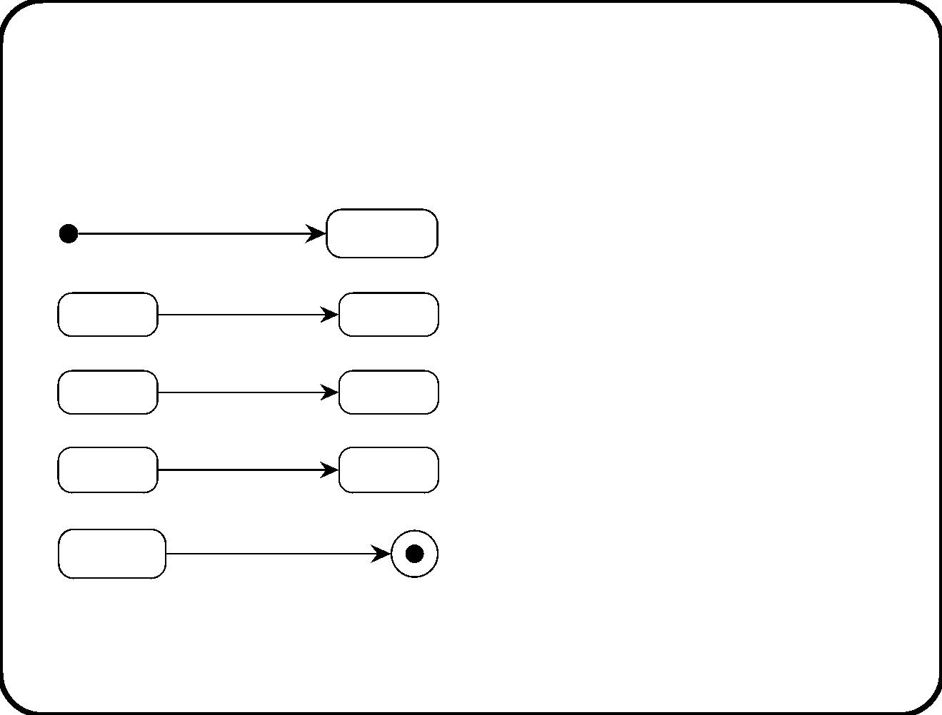
Mealy diagram constructs
Initialization actions a, initial
state .
/ a
S1
S3
S5
S7
S1
Trigger , guard , actions .
e [g] /a
[g] / a
/ a
e
g
a
S2
S4
S6
Ta ke transition when g be-
comes true, or immediately.
Ta ke transition immediately.
e [g] /a
Transition to ﬁnal state.
S8
168

Slide 32
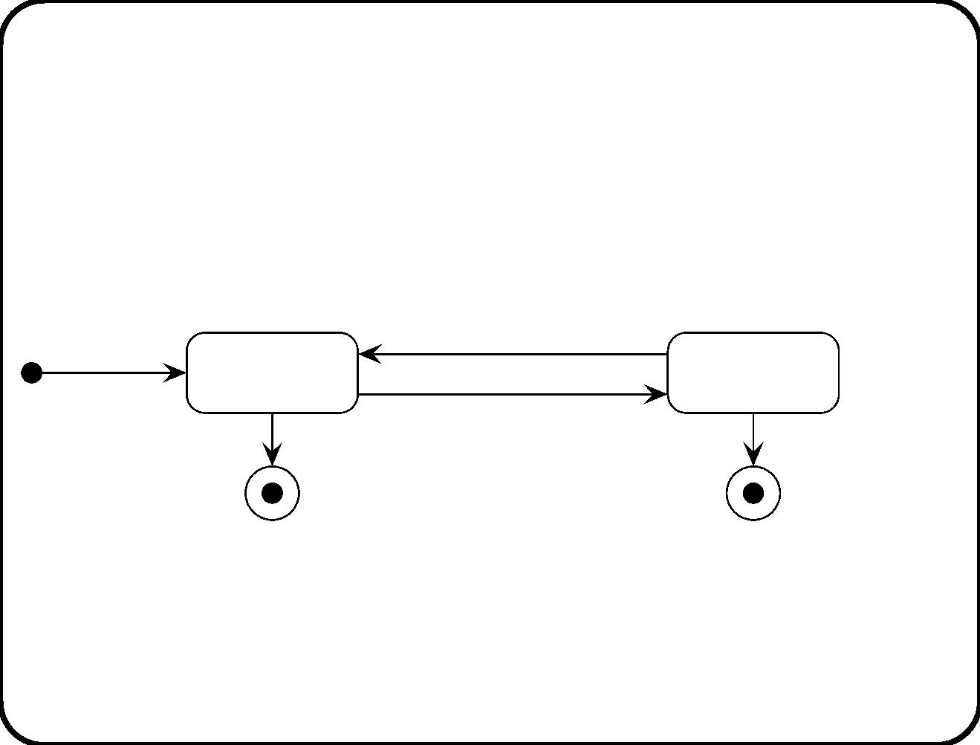
Example
check temp [Too low] /
switch on
/ switch on
Not
Heating
Heating
when(4 p.m.) /
switch off, finished
check temp [Too high] /
switch off
when(4 p.m.) /
finished
169

Slide 33
Events
An event is a discrete change in the condition of the world.
• Named events. We gave a name to it.
• Condition change event. A Boolean condition g becomes
true.
• Temp oral event. Signiﬁcant moment in time. Relative
temporal event: after(t), absolute temporal event: when(t).
170

Slide 34
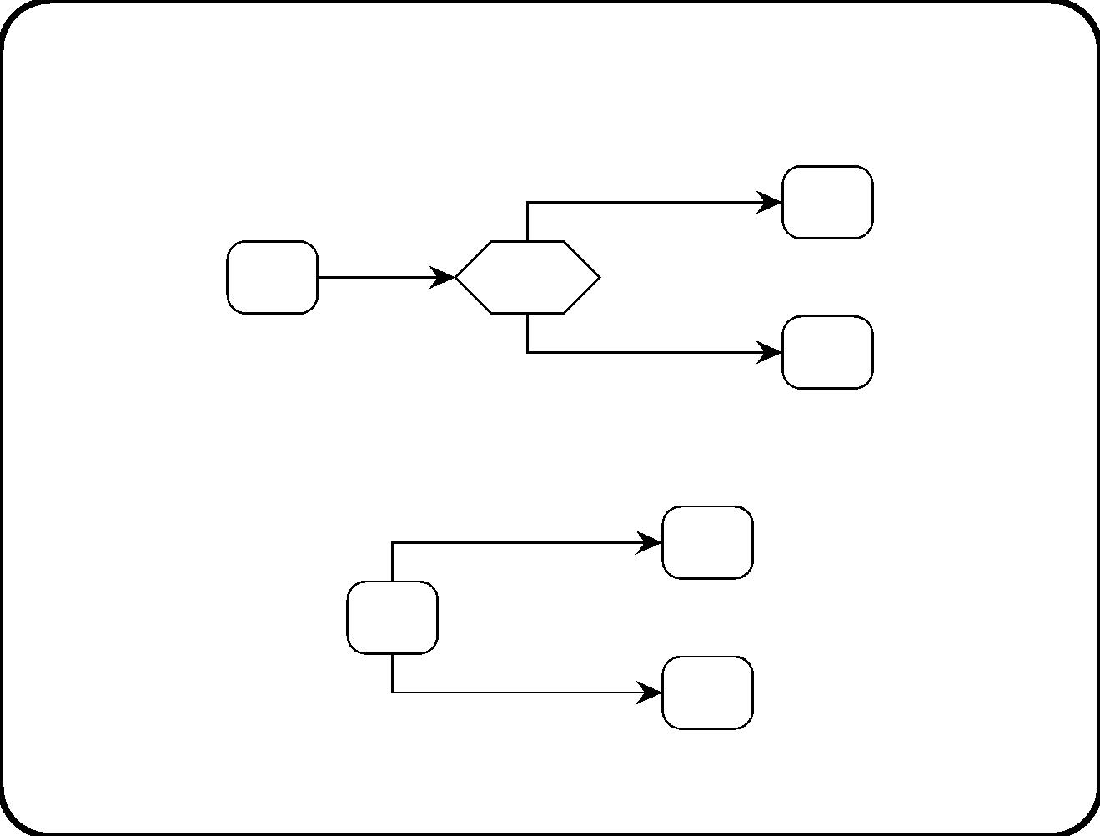
Decision states
[g] / b
S2
S3
e / a
S0
S1
[not g] / c
If g is not aﬀected by a, this can be replaced by:
e [g] / a; b
S2
S0
e [not g] / a; c
S3
171

Slide 35
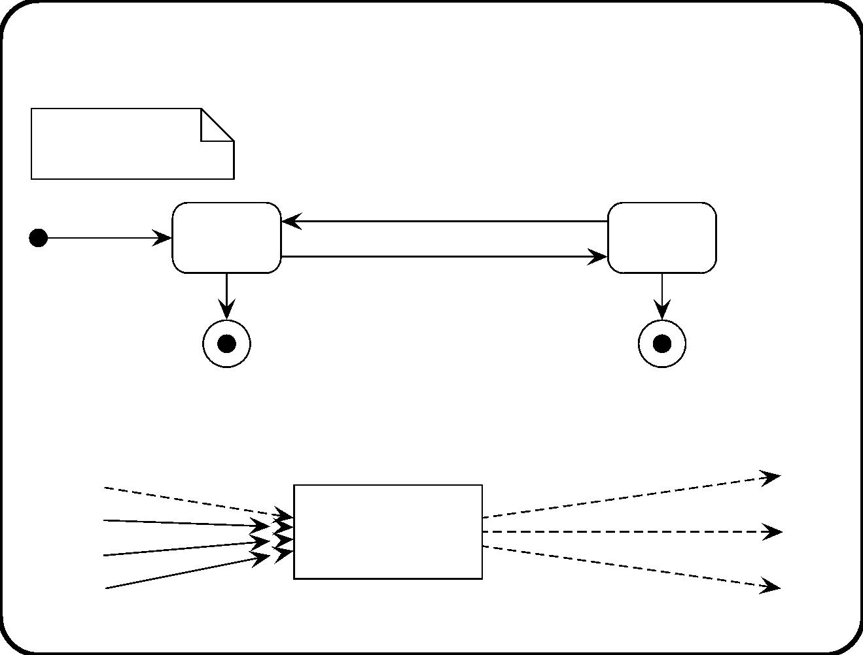
Variables
d, t: Rational
e: Time
receive temp(t) [t < d - 5] /
switch on
/ switch on
Not
Heating
Heating
when(e) /
switch off, finished
receive temp(t) [t > d + 5] /
switch off
when(e) / finished
Interface of this machine:
receive temp(t)
switch on
e
t
Heating
control
switch off
finished
d
172

Slide 36
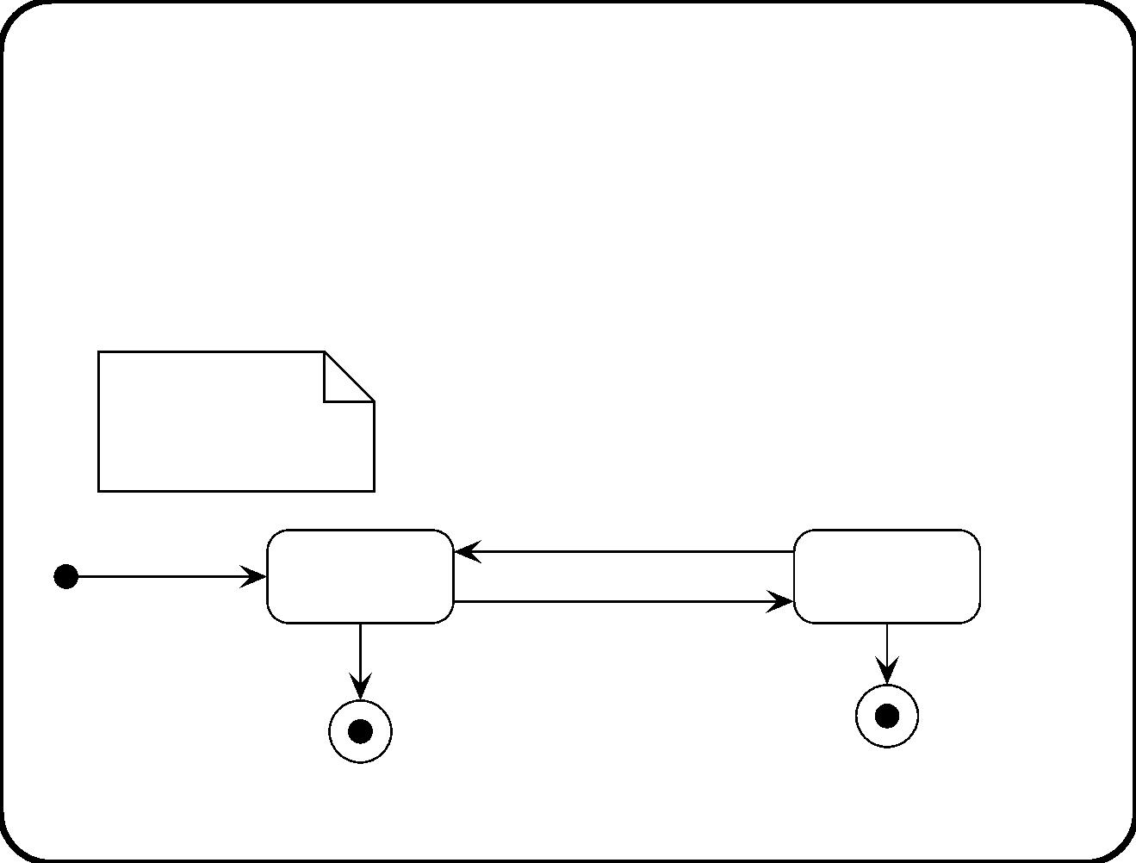
Locality
Variables are local to a transition, except the identiﬁer variable of a
diagram.
d, t: Rational
e: Time
h: Heater
receive temp(t) [t < d - 5] /
/ switch on(h)
switch on(h)
Not
Heating(h)
Heating(h)
when(e) /
switch off(h),
finished(h)
receive temp(t) [t > d + 5] /
switch off(h)
when(e) /
finished(h)
173

Slide 37
Statecharts
Mealy diagrams plus
• State reactions
• State hierarchy
• Parallelism
174

Slide 38
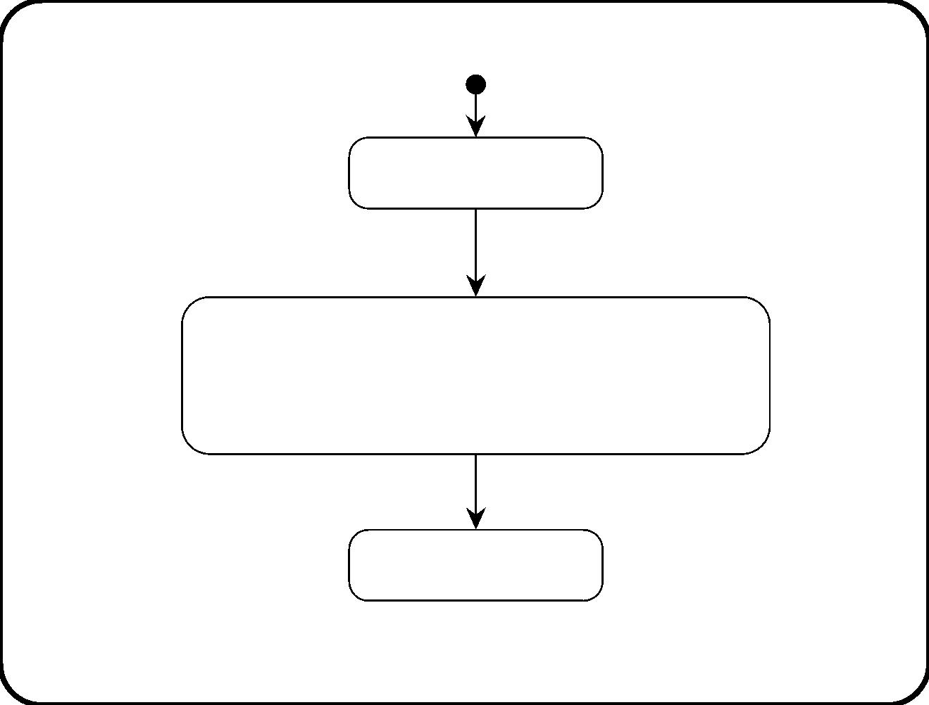
State reactions
Ready to sell
traveller requests to buy ticket /
ask for information
Acquiring route and ticket information
traveller selects route / set route
traveller selects ticket type / set ticket type
[route and ticket type set] /
offer to sell ticket
Ticket sale offered
Saves space in diagram.
175

Slide 39
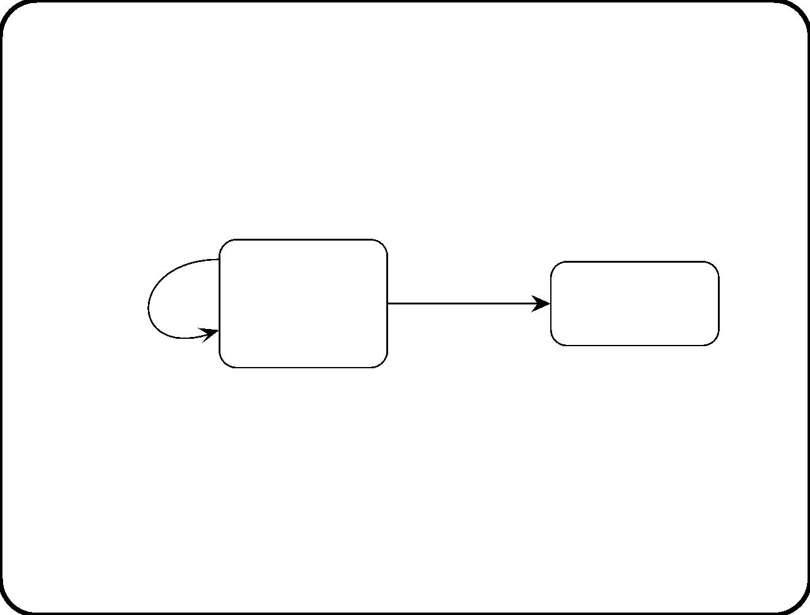
Example state reactions
S1
f /
entry / a
g / d
S2
e / b
exit / c
What happens when g occurs?
176

Slide 40
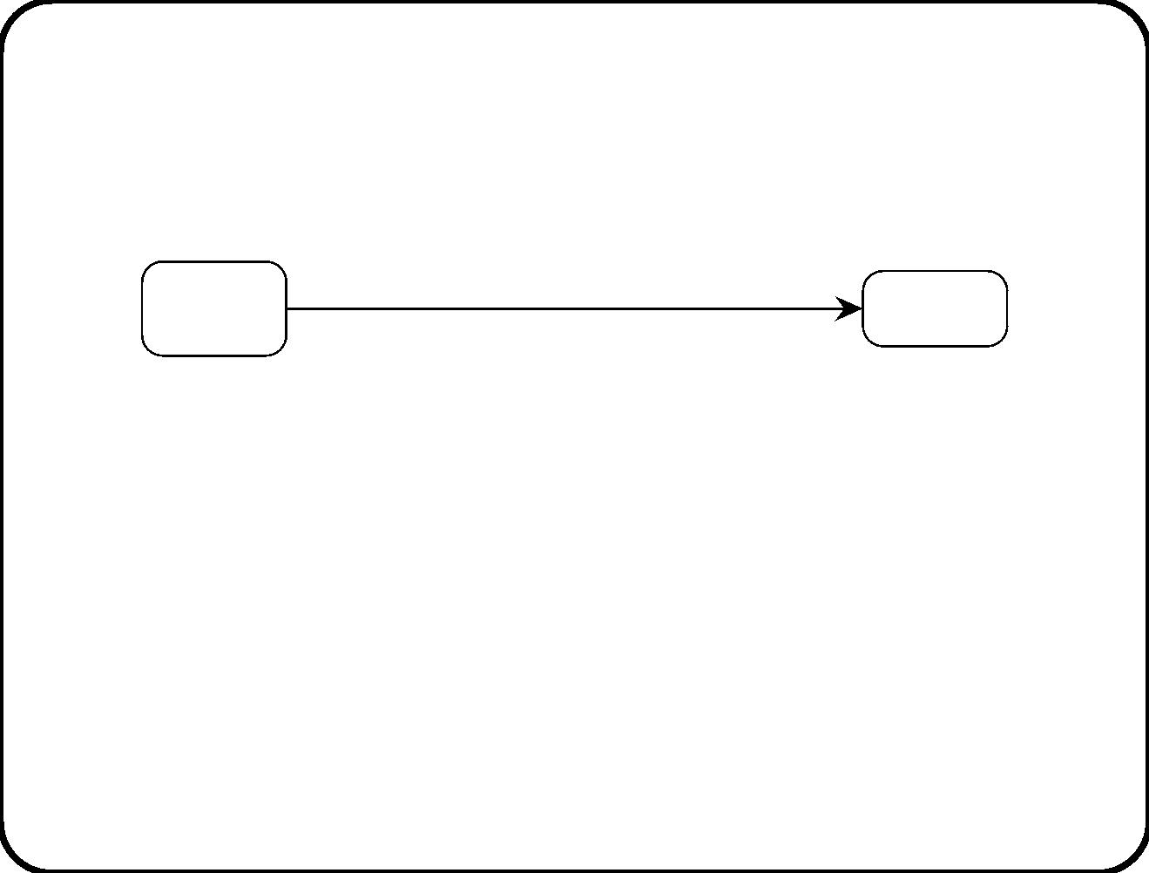
Conﬂict between state reaction and transition
S1
e [g] / b
S2
e / a
What happens when e occurs and g is true?
• Depends upon the semantics given to the notation by the
analyst.
• All readers and authors of the diagram should use the same
semantics!
177

Slide 41
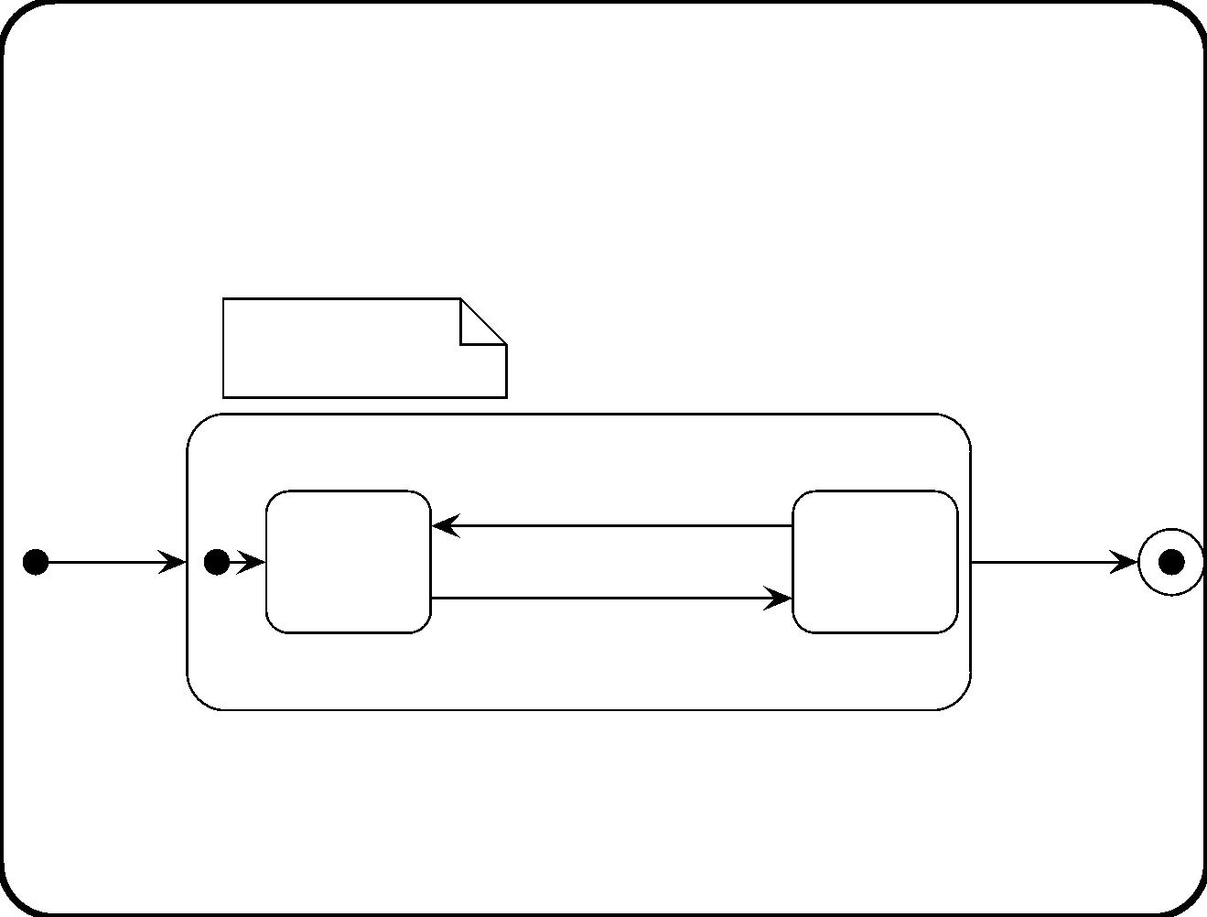
Hierarchy
d, t: Rational
e: Time
Monitoring
receive temp(t) [t < d - 5] /
switch on
when(e) /
finished
/ switch on
Heating
exit /
Not
Heating
switch off
receive temp(t)
[t > d + 5] /
178

Slide 42
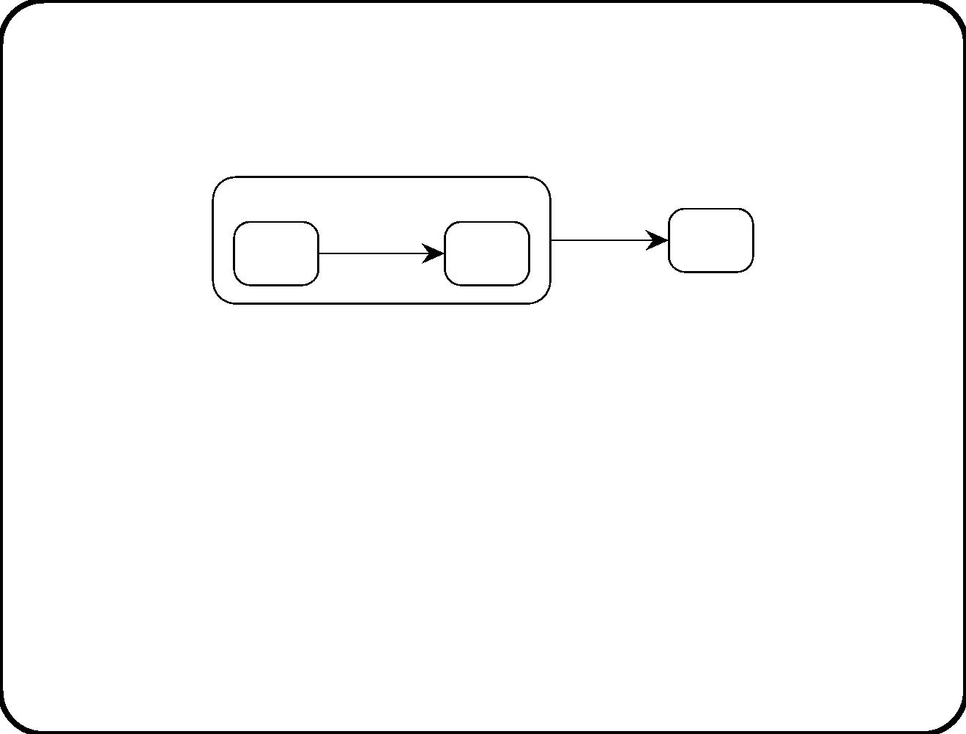
Conﬂicts between transitions at diﬀerent levels
S0
e / a
e / b
S3
S1
S2
What happens when e occurs?
• UML: The lower transition is taken.
• Statemate: The higher transition is taken.
UML views lower-level behavior as specialization. Statemate sees
higher-level behavior as more important, used e.g. to describe
interrupts and error-handling.
179

Slide 43
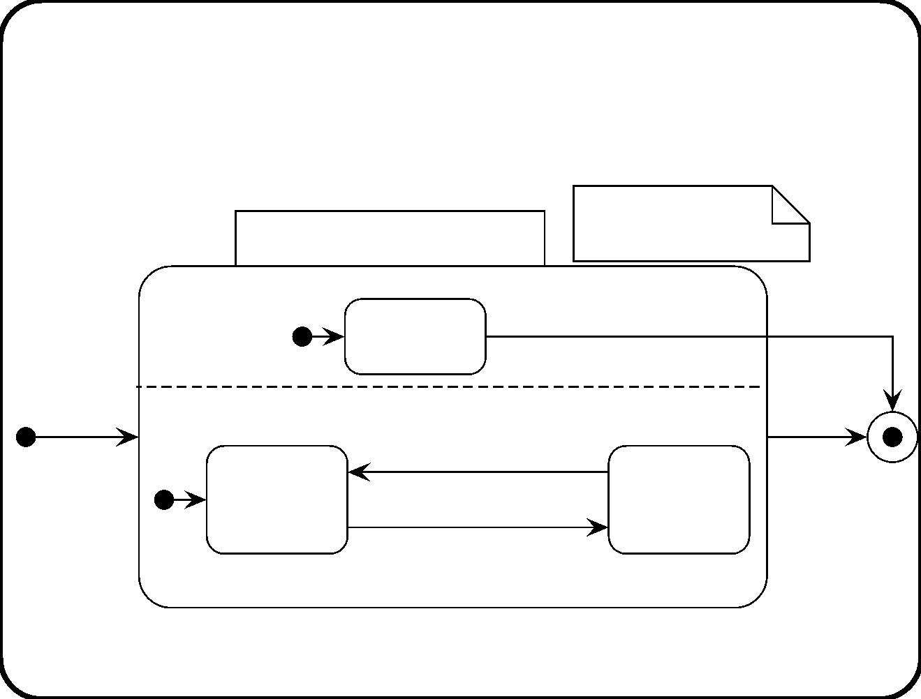
Parallelism
d: Rational
e: Time
Monitoring heating tank
Monitoring
pressure
[pressure > max] /
alarm
Watch
pressure
/ switch on
Monitoring heat
receive temp(t) [t < d - 5] /
Heating
exit /
switch off
switch on
Not
Heating
when(e) /
finished
receive temp(t)
[t > d + 5] /
180

Slide 44
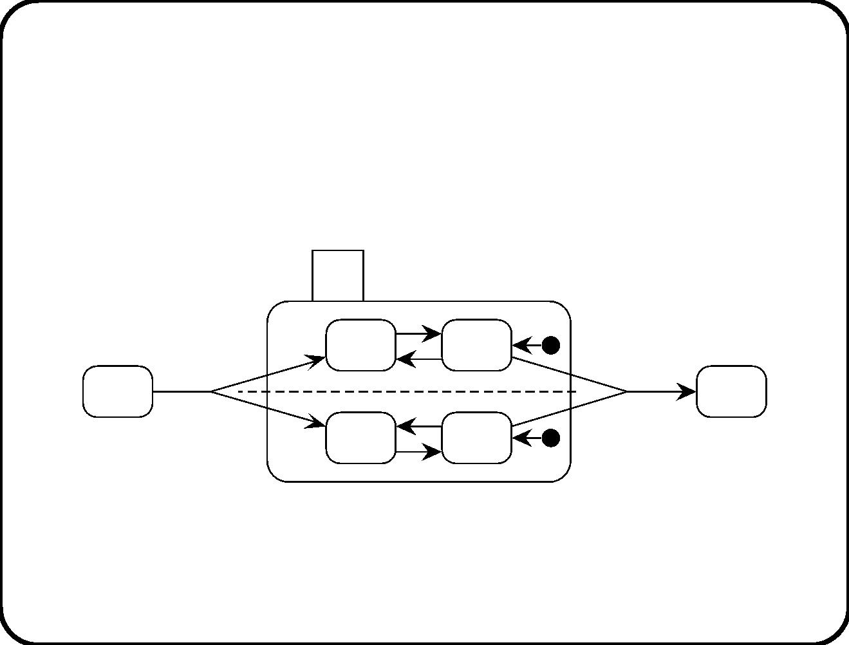
Hyperedges
B
B1
B11
B12
B22
f
e
A
C
B21
B2
181

Slide 45
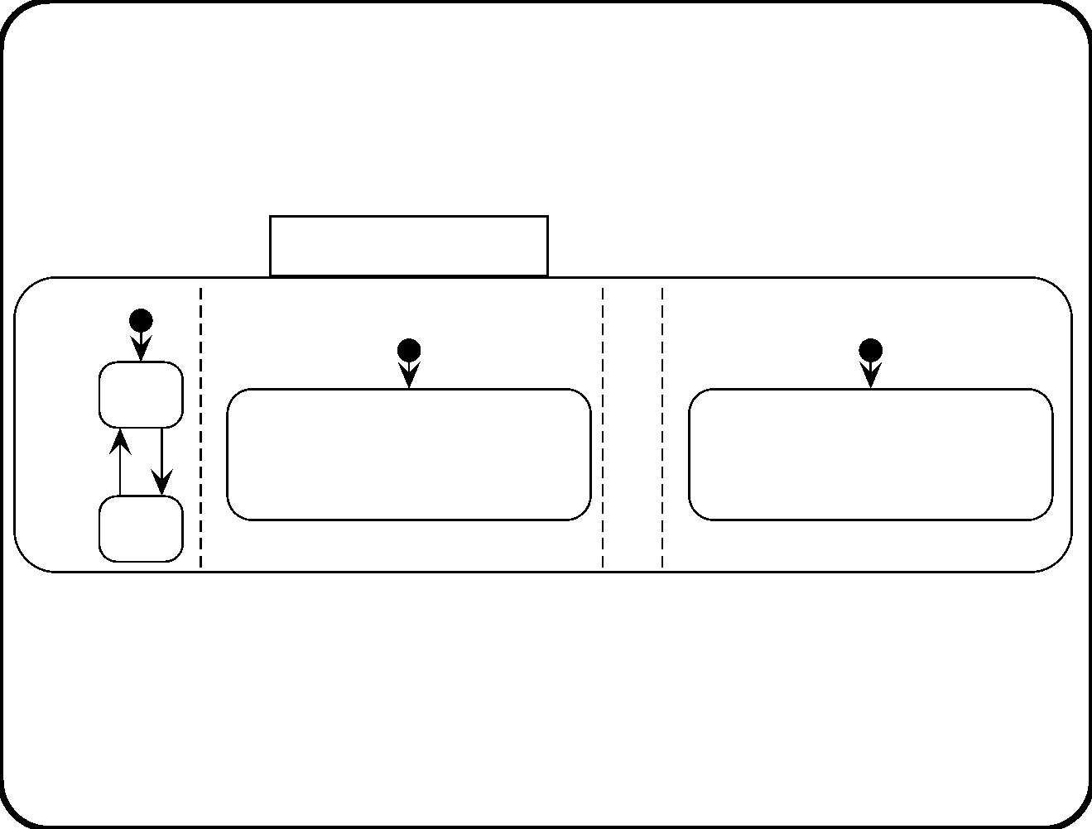
Breaking orthogonality by the in(State) predicate
Channel selection
Range
Button 1 selection
Button 6 selection
select
Lo
B1
B6
p p
Hi
push(1) [in(Hi)] / select 7
push(1) [in(Lo)] / select 1
...
push(6) [in(Hi)] / select 12
push(6) [in(Lo)] / select 6
Now the behavior in one state depends upon the state of some
parallel component.
182

Slide 46
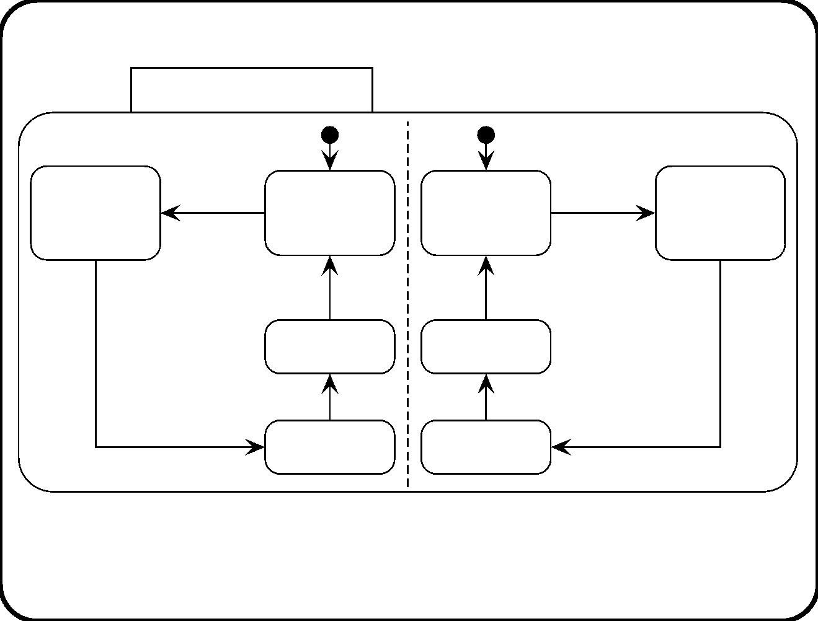
Breaking orthogonality by event broadcasting
Traffic light behavior
NS
EW
start
NS /
start
EW /
Red
entry /
Preparing
for green
Red
Preparing
for green
start EW
after(5 secs) /
start NS
after(5 secs) /
Yellow
after(30 secs) /
Green
Yellow
after(30secs) /
Green
after(5 secs) /
after(5 secs) /
Now the behavior of one state depends upon events generated in
some parallel component.
183

Slide 47
Main points
• STDs graphically represent reactive behavior, which consists of
a discrete state space and e [g] / a transitions.
• Events can be named, condition change, or temporal.
• Decision states are unstable.
• STDs can have local variables. Only the identiﬁer variable is
global to the diagram.
• Statecharts extend Mealy diagrams with state reactions, state
hierarchy, parallelism.
• The semantics of a diagram must be deﬁned explicitly (see
chapter 13).
184

Slide 48
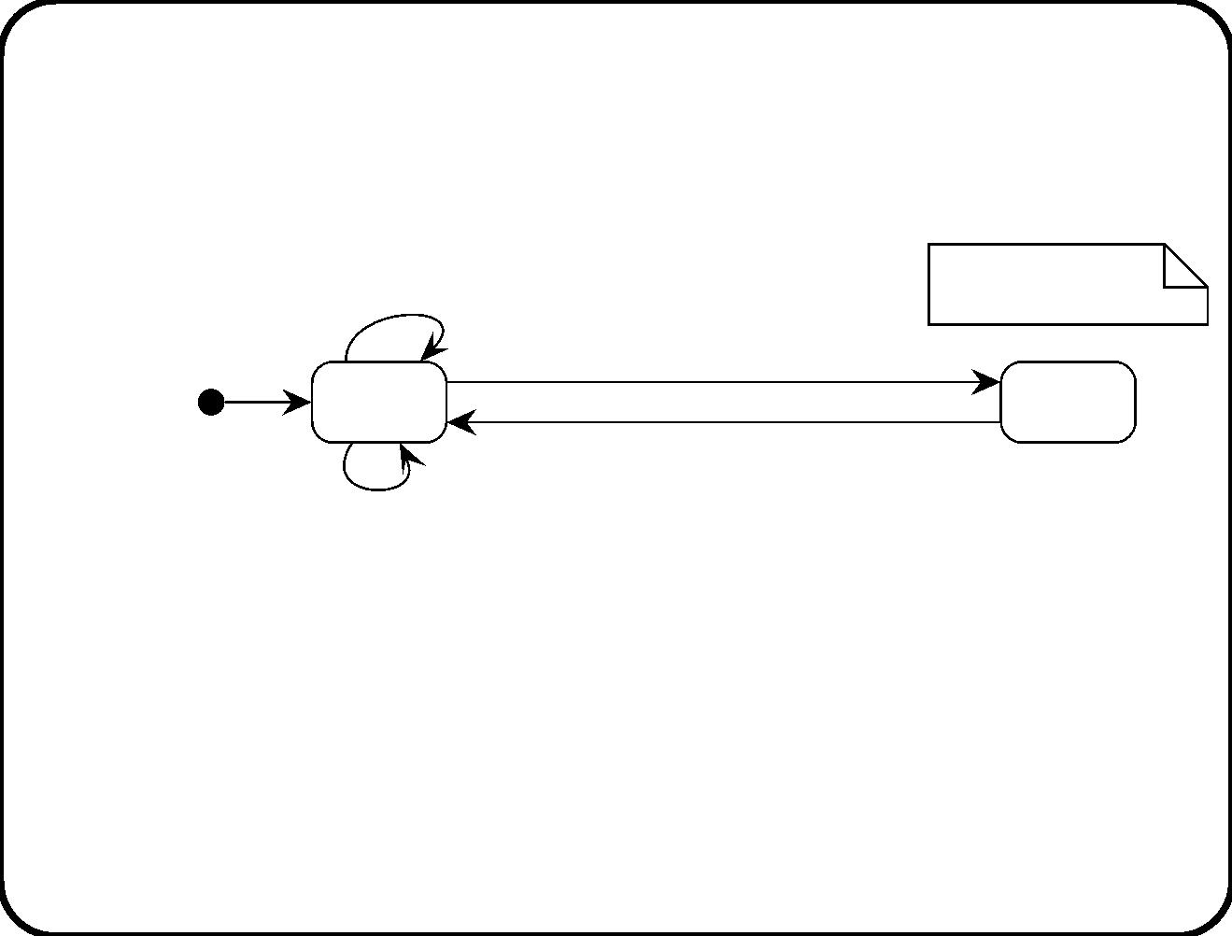
Questions
x: {hot, cold}
flipx [x = hot] / x := cold
flipy [x = hot] /
flipy [ x = hot]
Hi
Lo
flipx [x = cold] / x:= hot
• Eliminate the variables as follows: Deﬁne two parallel
components, one component for each variable.
• Is the resulting behavior equivalent to this one?
185

Slide 49
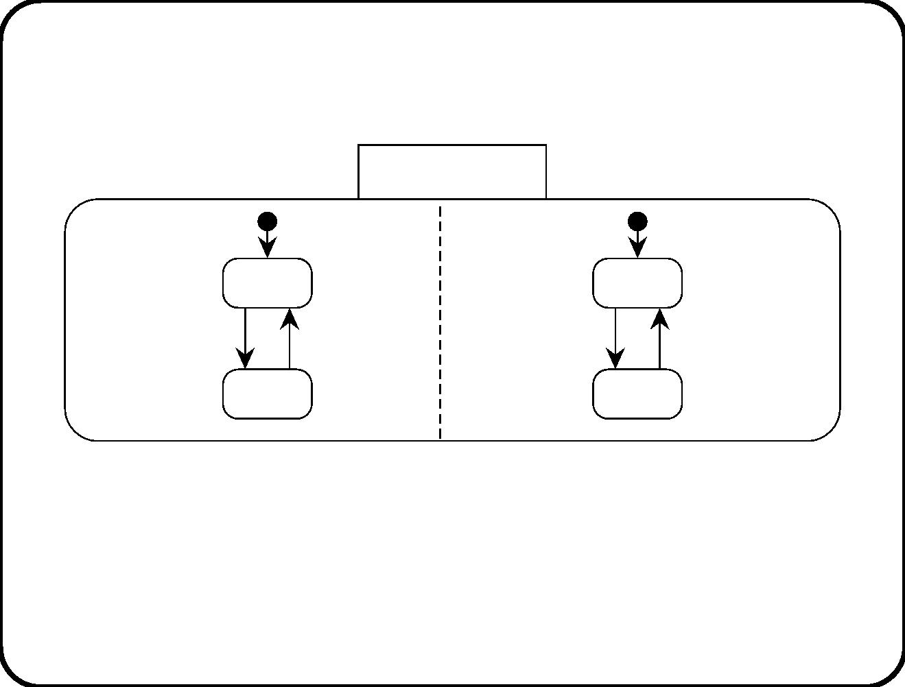
Solution
Two variables
X
Y
Hot
Hi
flipx(in(Hi)]
flipx(in(Hi)]
flipy [in(Hot)]
flipy [in(Hot)]
Cold
Lo
The important semantic diﬀerence between this statechart and the
Mealy diagram is that the statechart can respond to a ﬂipx and a
ﬂipy event at the same time.
186

Slide 50
Question
• Encode all state information in variables. The result should be
an STD with one state only.
• Is the result equivalent to the original STD?
187

Slide 51
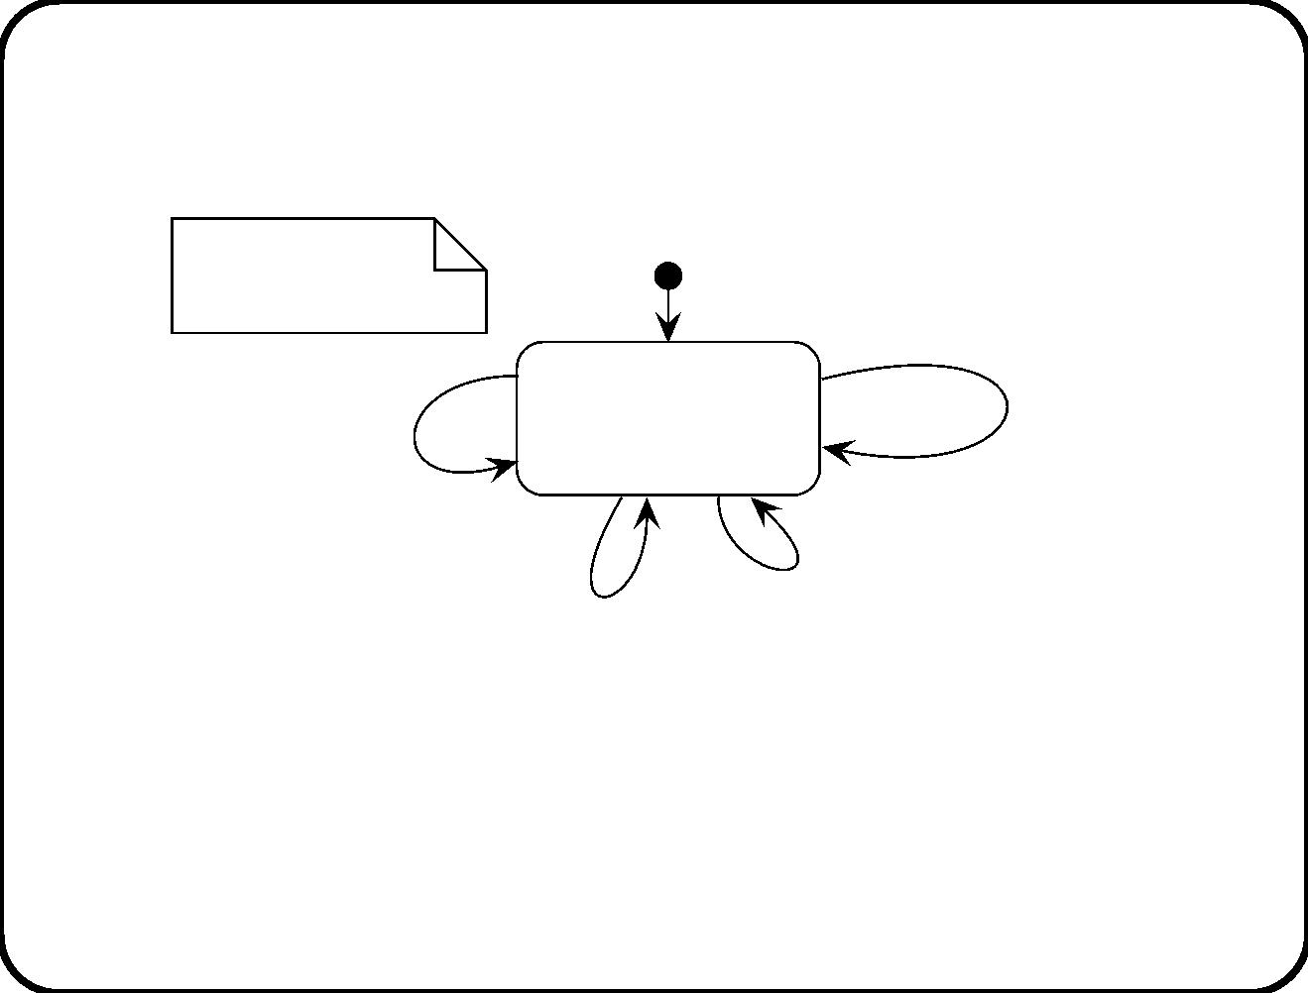
Solution
x: {hot, cold}
y: {Hi, Lo}
flipx [x=Cold and y=Hi] /
x:= hot
Ready
to
update
flipx [x=Hot and y=Hi] /
x:= cold
flipy [x=Hot and y=Lo] /
y:= Hi
flipy [x=Hot and y=Hi] /
y := Lo
This diagram does not indicate the initial value of the variables.
188

Slide 52
Chapter 13. Behavioral Semantics
• STTs and STDs are descriptions of behavior.
• But they can be interpreted in many ways! That is a problem:
– Designers, builders and users think they agree ...
– ... but nevertheless expect diﬀerent behavior to be
implemented.
– To execute a speciﬁcation, it must be unambiguous.
– To generate code, diﬀerent code generation tools must use
the same semantics.
In this chapter we review the relevant semantic choices.
189

Slide 53
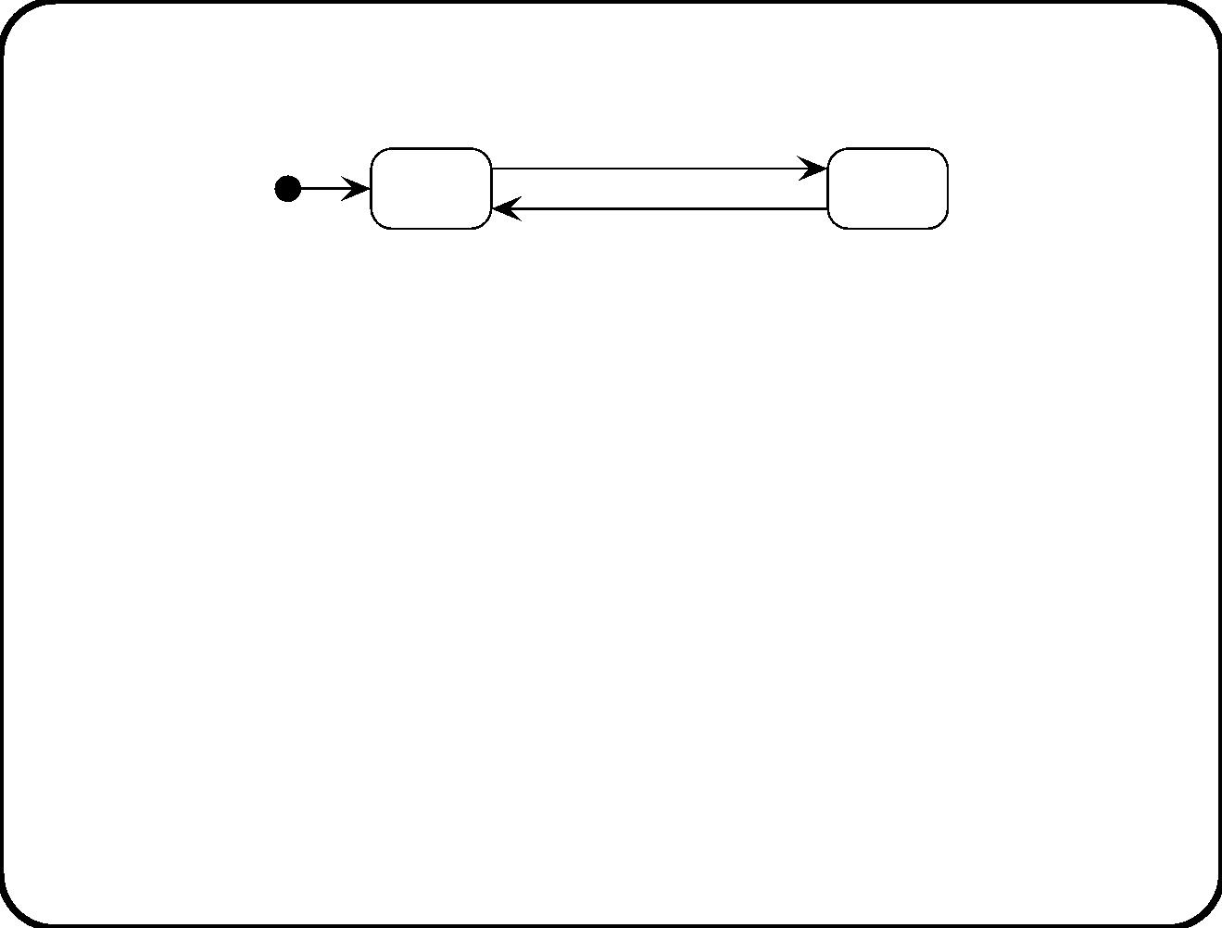
Discretization
switch on /
switch off /
Off
On
STDs and STTs are abstract, and therefore necessarily incomplete,
descriptions of continuous behavior.
• Atomicity. Ignore intermediate states of each transition.
• Possibility. There are no slightly diﬀerent events or states.
switch on is possible when Oﬀ etc.
• Isolation. Whatever else happens, switch on in state Oﬀ leads
to state On, etc.
• Durability. A state is stable until an event occurs that
triggers an outgoing transition.
190

Slide 54
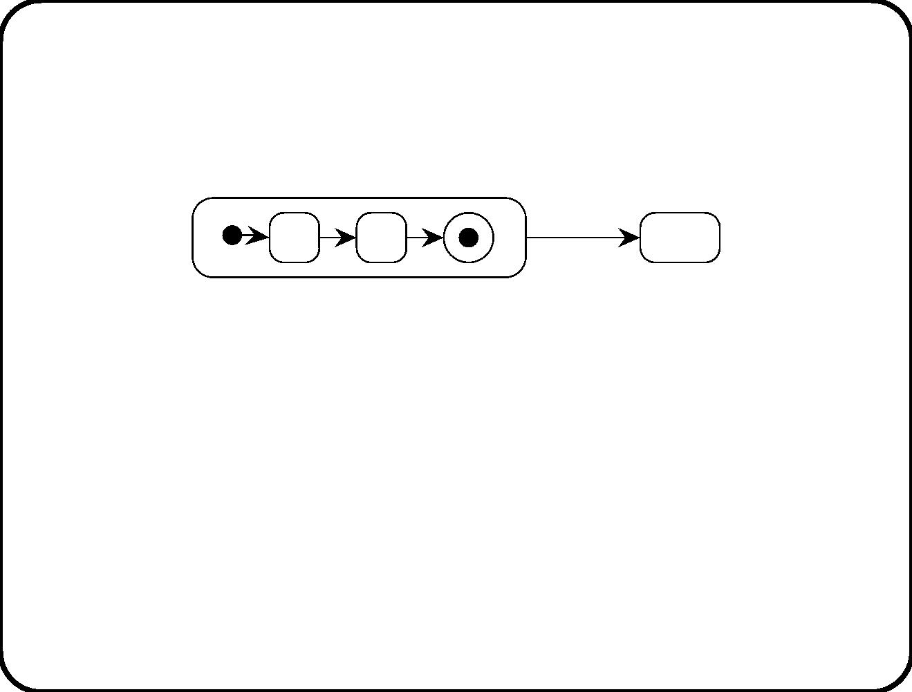
Wait States and Activity States: Semantic options
An activity state has internal activity, a wait state has not.
A
e/
e /
A1
A2
B
This creates the possibility for conﬂict: What happens when e
occurs? Options:
• Deferred response.
• Forced termination.
– Higher level has priority (Statemate).
– Lower level has priority (UML).
191

Slide 55
Final states: Semantic options
Activity states create ambiguity for ﬁnal state node. What
happens when ﬁnal state is reached?
• Global termination: bull’s eye indicates that overall process
terminates (Statemate).
• Local termination: Activity terminates; wait until e occurs
(UML).
192

Slide 56
Pre- and postconditions: Problems
Current state Event
P(x) e(x, y)
• Does P(x) become false?
• Should Q(x) be false in initial state?
Action
Next state
Q(x)
1
a(x, y)
• We will treat state descriptions in an STT as preconditions
and postconditions, that constrain the current and next
state. So:
– Q(x) can have any value in initial state.
– P(x) can have any value in next state.
If you don’t want this, write down truth value explicitly.
193

Slide 57
Pre– and postconditions: Possible solutions
Current state Event
Action
a(x, y)
Next state
Q(x)
1
2
P(x)
P(x)
e(x, y)
f(x, y)
a(x, y), b(y) R(x)
• What happens with R(x) in transition 1? Not speciﬁed.
• If we must write down truth values explicitly, table entries
become very large.
• Derivation rules. E.g. Q(x) → R(x). Part of domain
knowledge or SuD spec.
• Frame rule. If the transition rule and derivation rules do not
imply that P changes, then it does not change.
194

Slide 58
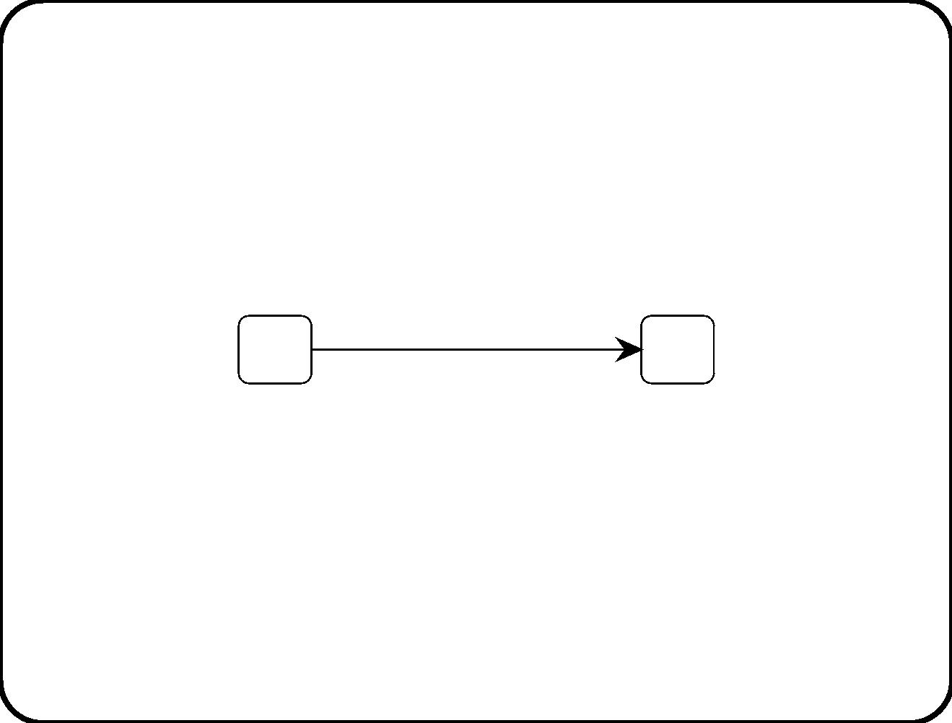
Pre– and postconditions in STTs and STDs
Current state Event
P(x) e(x, y)
Action
a(x, y)
Next state
Q(x)
1
e(x, y) / a(x, y)
P(x)
Q(x)
• Equivalent?
• No: STDs come with the interpretation rule that S ↔ ¬S for
i
j
i
= j.
6
• So P(x) ↔ ¬ Q(x) in the STD!
195

Slide 59
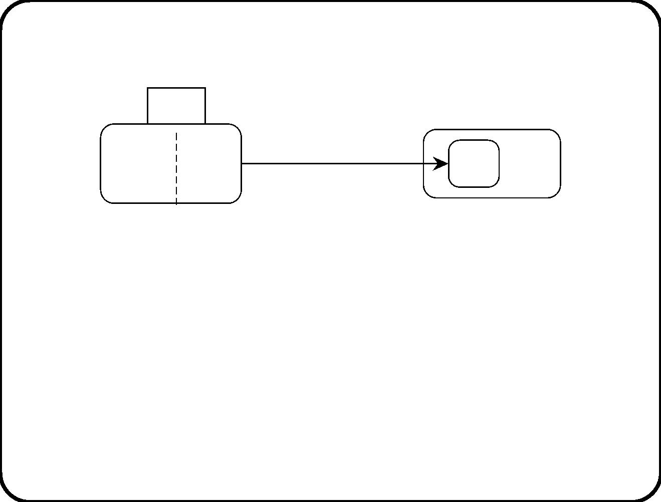
Interpretation rules for statecharts
P(x)
P1(x)
P2(x)
e(x, y) / a(x, y)
Q(x) S(x)
Use the following interpretation rules for statecharts:
• For all x, P(x) ↔ not S(x).
• For all x, Q(x) → S(x).
• For all x, P1(x) → P(x).
• For all x, P2(x) → P(x).
196

Slide 60
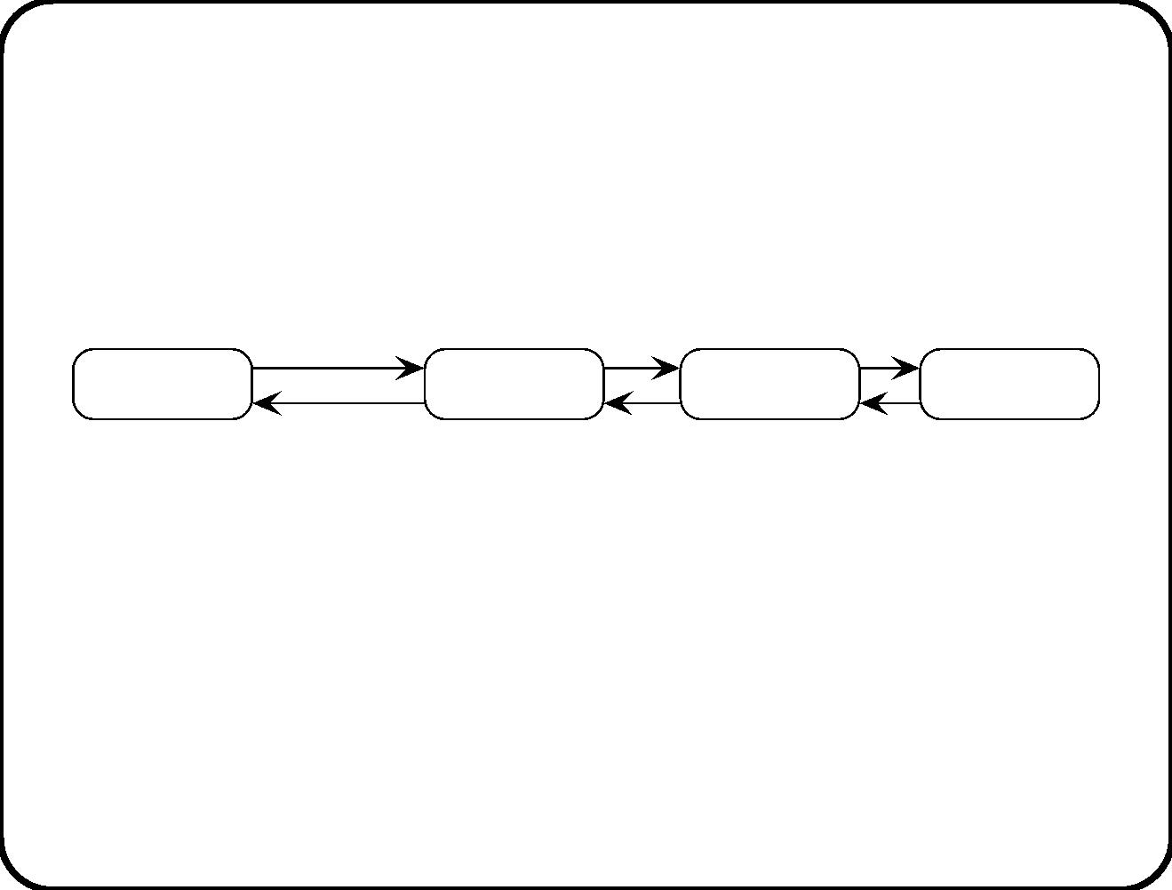
Triggering (1)
The ﬁrst problem with triggering is how we interpret what the
diagram does not s ay.
Freezing
Cool
Warm
Hot
start freezing
Can start freezing occur in state Hot?
• Physically impossible: Contradicts the laws of nature.
If this is what we mean, we should add this interpretation rule to
the diagram.
197

Slide 61
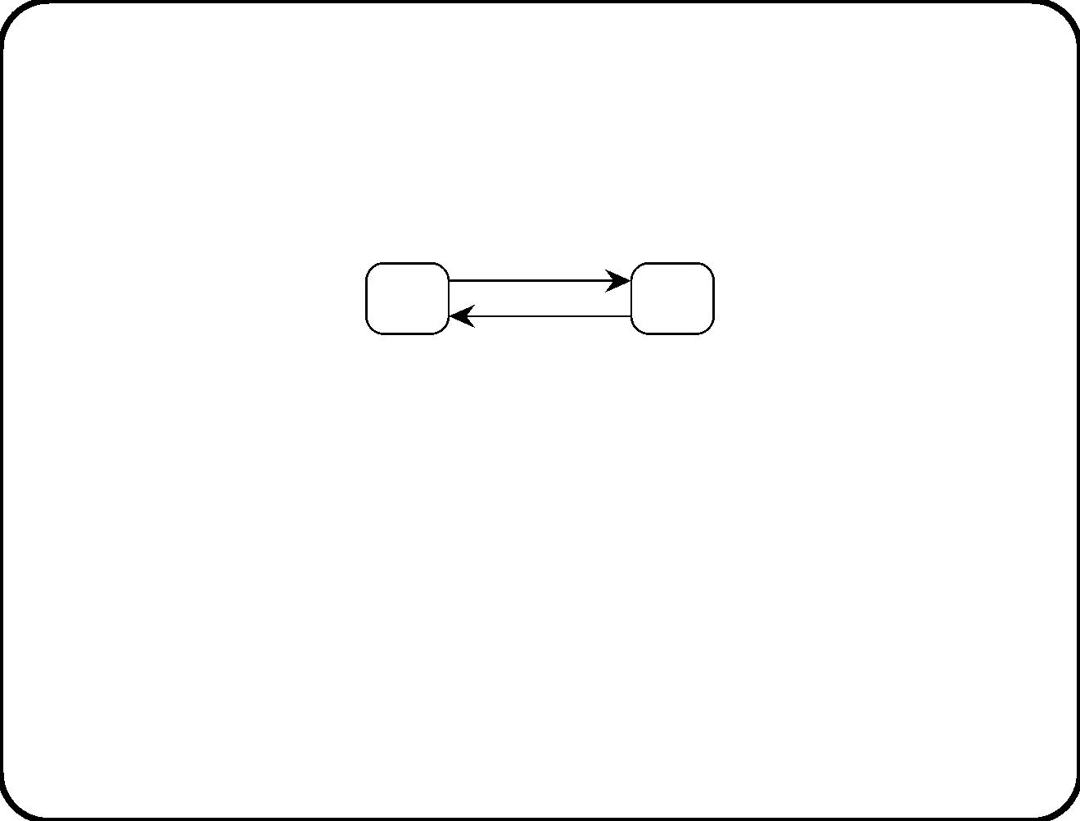
Triggering (2)
Deﬁnition:
• switch on is the event that leads the system from Oﬀ to On.
switch on /
Off
On
switch off /
What does this mean? Can switch on occur in state On?
• Logically impossible: Contradicts the deﬁnition in the
dictionary. Whatever happens in state On is not the switch on
event.
• Logically possible: switch on is a certain physical event that
can occur in many states. Update the dictionary with this.
Whatever we mean, add this to the diagram.
198

Slide 62
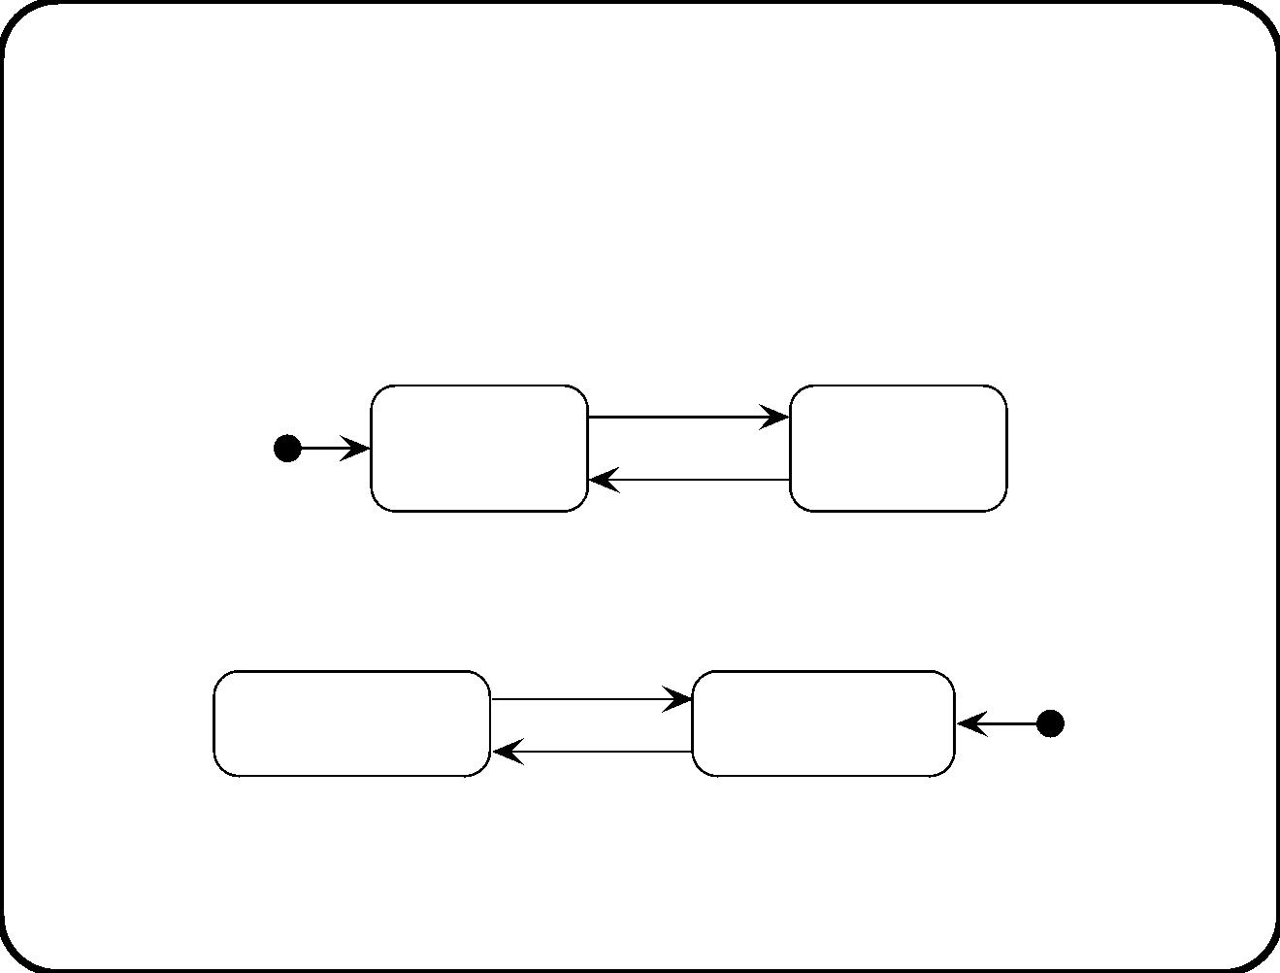
Triggering (3)
What happens if switch on does occur in state On?
• Ignore: Respond as if the event did not occur.
switch on
Off
switch off
On
switch off /
switch on /
• Inhibit: Make the event physically impossible.
after(10)
On
Off
push / <inhibit>
push
199

Slide 63
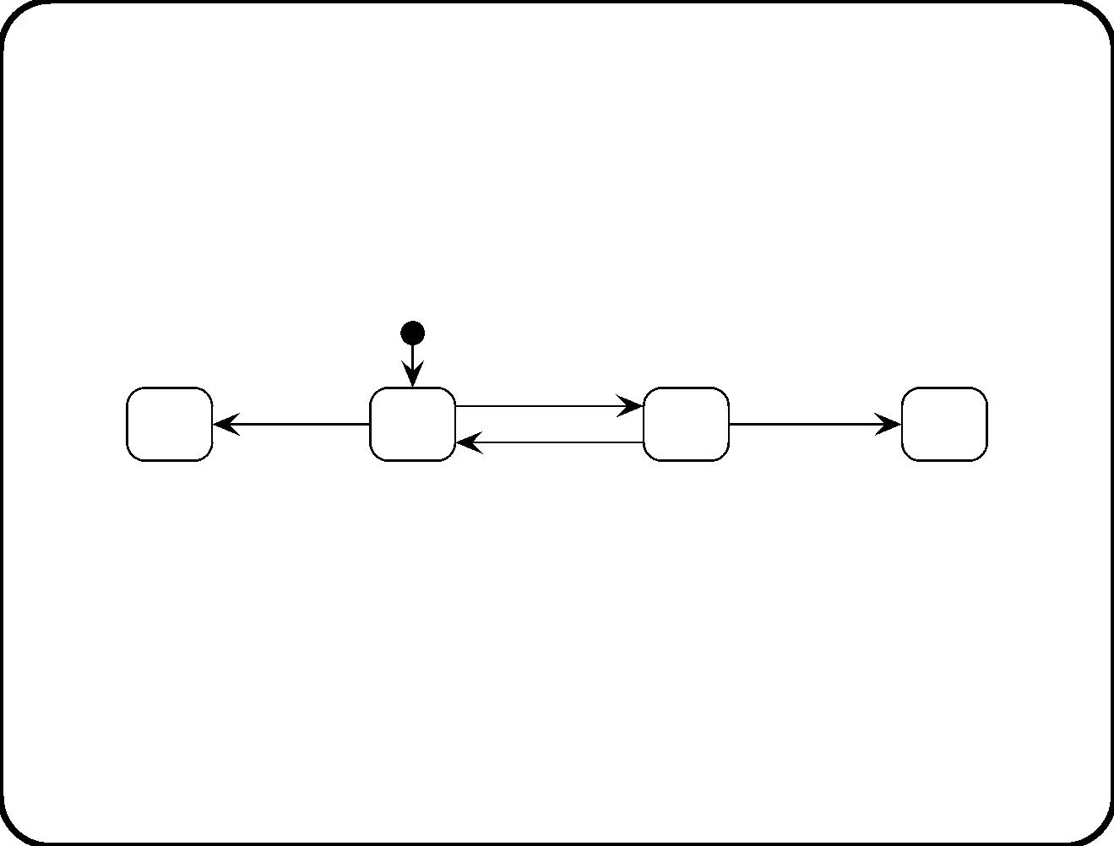
Triggering (4)
• Unknown eﬀect: The system breaks down. This is the fragile
semantics.
switch off
switch on
switch on
Off
On
switch off
Make clear whether you agree on the ignore, inhibit, or fragile
semantics as default interpretation for the STDs and STTs in a
speciﬁcation.
200

Slide 64
Triggering multiple transitions: The problem
Current state Event
Action
a(x, y)
b(y)
Next state
Q(x)
1
4
P(x)
R(y)
e(x, y)
e(y, z)
R(z)
P(x)and not
Q(x)
5
R(x)
e(x, y)
c(x)
Suppose e(2, 4) occurs. Entries are instantiated as:
t1
t4
P(2)
R(2)
e(2, 4)
e(2, 4)
a(2, 4)
b(4)
Q(2)
R(4)
R(2)
e(2, 4)
c(2)
P(2) and not
Q(2)
t5
Suppose P(2) and R(2) are true. What happens?
201

Slide 65
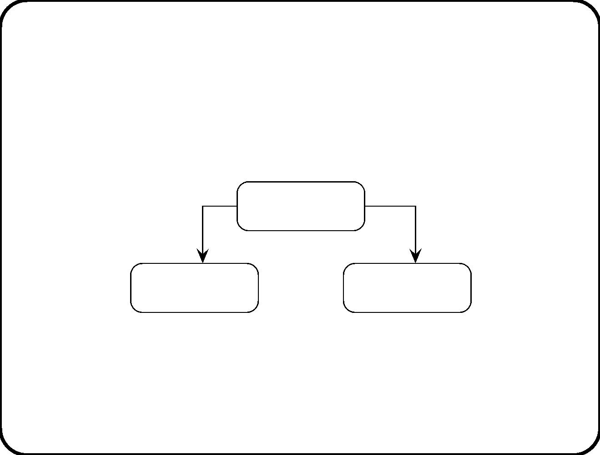
Triggering multiple transitions: Possible solutions
• Step semantics. Execute as many transitions as possible in
one step. (Statemate and UML multi-threaded semantics)
Two possible steps:
e(2, 4) / a(2, 4), c(2)
e(2, 4) / a(2, 4)
Step 1= {t1, t4}
P(2) and R(2)
Step 2 = {t4, t5}
P(2) and R(2)
not P(2) and
Q(2) and R(2)
• Single-transition semantics. Choose one transition
non-deterministically. Forget about the others. (UML
single-threaded semantics)
202

Slide 66

Responding to multiple events: The problem and
possible solutions
Suppose e(3, 4) and f(3, 4) occur at the same time. What happens?
t1
t2
P(3)
P(3)
e(3, 4)
f(3, 4)
a(3, 4)
a(3, 4)
Q(3)
R(3)
• Concurrent-event semantics. Respond to all events not yet
responded to. (Statemate)
• Sequential-event semantics. Respond to events in some
sequence. (UML)
203

Slide 67
Multistep semantics: The problem
One transition can trigger further transitions. E.g. suppose f(3, 4)
happens in state P(3):
t2
P(3)
f(3, 4)
a(3, 4), b(4)
R(3)
Action a(3, 4) in turn triggers an instance of entry 3:
P(3) and not
R(3)
t3
R(3)
a(3, 4)
b(3)
What happens?
204

Slide 68
Multistep semantics: Possible solutions
• Single step semantics. After each step, the behavior can
respond to external as well as internally generated events.
(Statemate option)
• Superstep semantics. The behavior ﬁrst performs the
complete multistep response before it is able to respond to
external events. (Statemate option)
• Delayed step semantics. The behavior responds to internal
and external events in some later step. (UML)
205

Slide 69
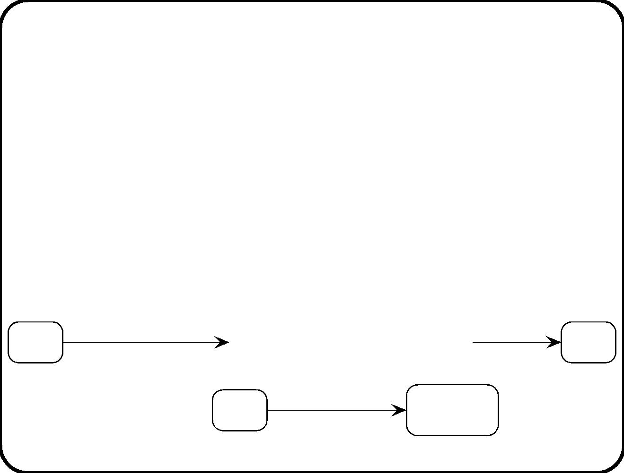
Action semantics
How is a complex action such as a, b, c executed?
• Concurrent action semantics. The actions in a complex
action s are all executed simultaneously. (Statemate)
• Sequential action semantics. The actions are executed in
some sequence. (UML)
What if a UML action is an operation call?
t2: f(3, 4) / a(3, 4)
t2: b(4)
P(3)
...
...
R(3)
t3: a(3, 4) / b(3)
P(3) and
not R(3)
R(3)
206

Slide 70
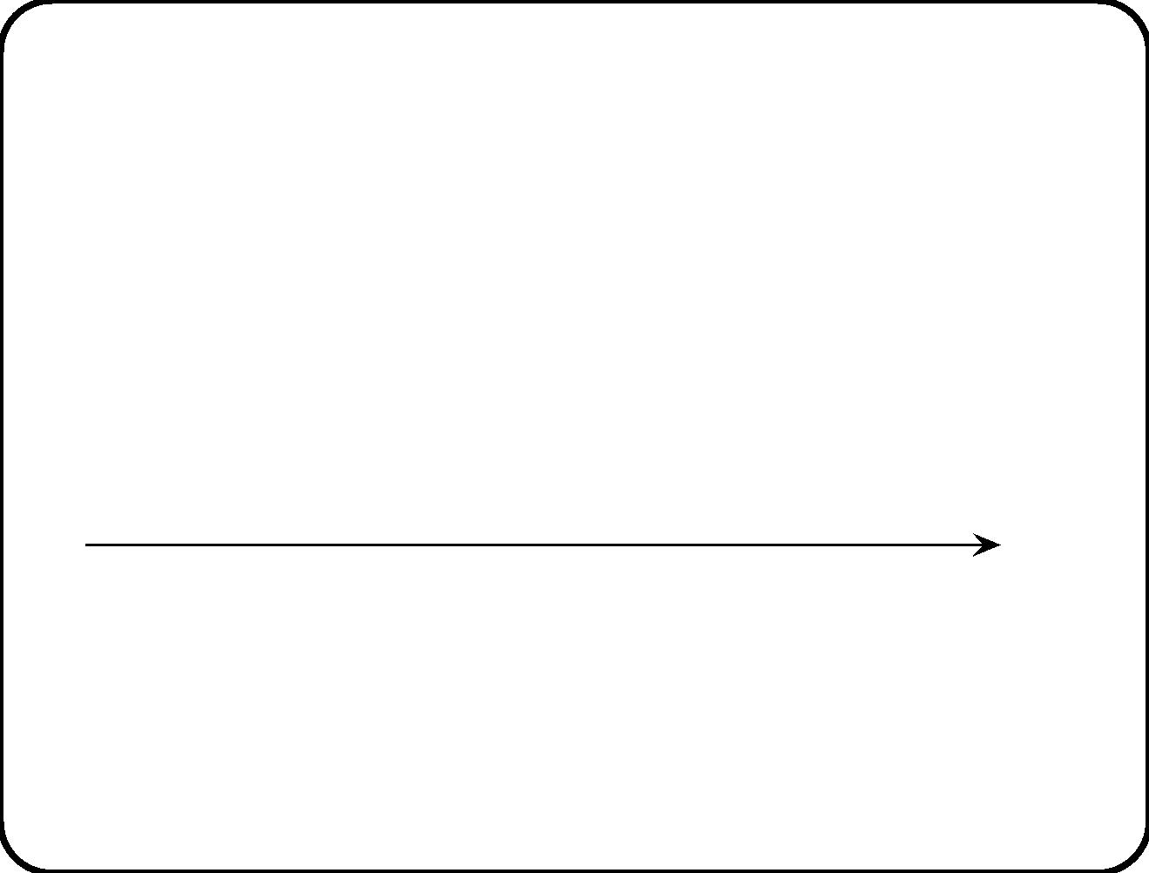
Time
A “time point” is a time interval whose length is not signiﬁcant
for the description.
Abstract time points
5:00 p.m.
5:01p.m.
[
) [
) Time
5:00 p.m. <= t < 5:01 p.m.
5:01 p.m. <= t < 5:02 p.m.
Real time
207

Slide 71
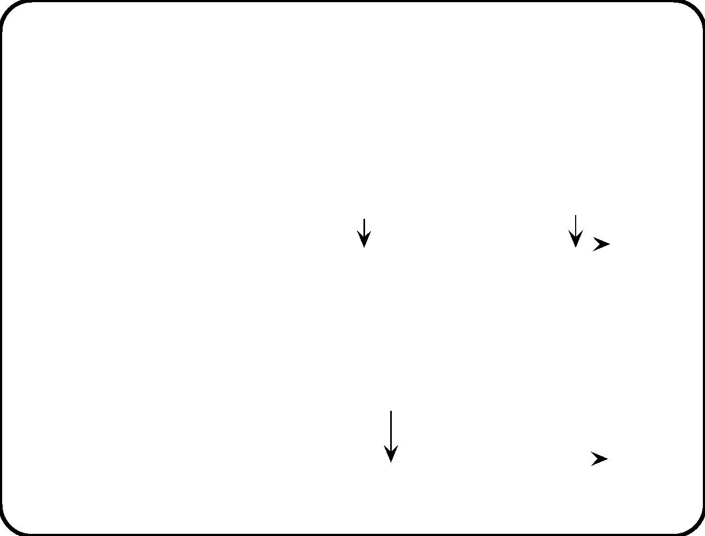
Events
Our events are abstractions: They are instantaneous.
• Clock-driven semantics (Statemate)
e occurs
at some point
in this interval
The response starts
at the next clock tick
[
) [
)
Time
5:00 p.m. <= t < 5:01 p.m.
5:01 p.m. <= t < 5:02 p.m.
• Event-driven semantics (Statemate and UML)
e occurs here
The response starts here and is immediately finished
[
) [
) Time
5:00 p.m. <= t < 5:01 p.m.
5:01 p.m. <= t < 5:02 p.m.
208

Slide 72
Perfect technology asssumption
No implementation restrictions. Inﬁnite speed, unlimited memory.
• Clock-asynchronous: Respond immediately to an event
occurrence.
• Perfect technology: Response takes no time to compute.
Together this implies a superstep semantics.
This agrees well with requirements-level models.
209

Slide 73
Main points
• STTs and STDs are describe discrete behavior that abstracts
from continuous behavior in the real world.
• Conﬂict between transitions inside and out of activity states
can be resolved diﬀerently.
• Final states can be global or local.
• Ambiguity in pre– and postconditions in STTs and STDs can
be reduced by means of derivation rules and frame rules.
• The absence of event triggers can be interpreted in diﬀerent
ways: impossible, ingnore, inhibit, unknown.
• Triggering multiple transitions: Steps versus single transitions.
• Derived transitions: Single steps, supersteps, delayed steps.
• Action semantics: Concurrent or sequential action execution.
• Time: Clock-driven or event-driven semantics. Perfect
technology assumption.
210

Slide 74
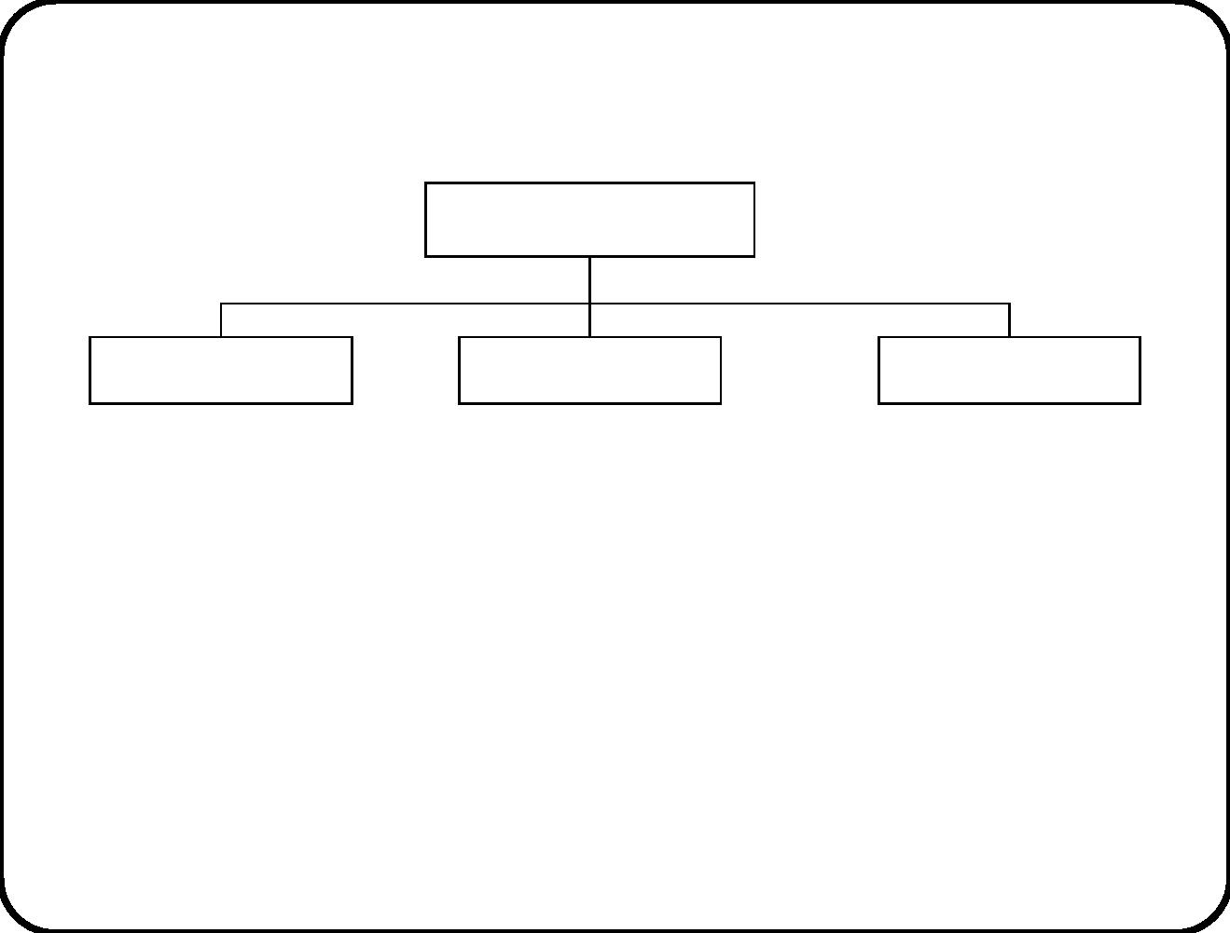
Chapter 14. Behavior Modeling and Design
Guidelines
Composite system
External entity
SuD
External entity
• Systems engineering argument: (System speciﬁcation) and
(Assumptions about environment) entail (Emergent properties
of composite system).
• To ﬁnd SuD speciﬁcation, (1) describe desired emergent
behavior, (2) derive system speciﬁcation, (3) accumulate
necessary assumptions when system behavior is not suﬃcient
to produce desired emergent behavior.
211

Slide 75
Road map
Business goal
System purpose
Goal
tree
Solution goals
Function
refinement
tree
Activities to be supported by SuD
System services
Event-action list
(scenario)
Stimulus-response list
(scenario)
Event-action list
(transactional)
Stimulus-response list
(transactional)
212

Slide 76
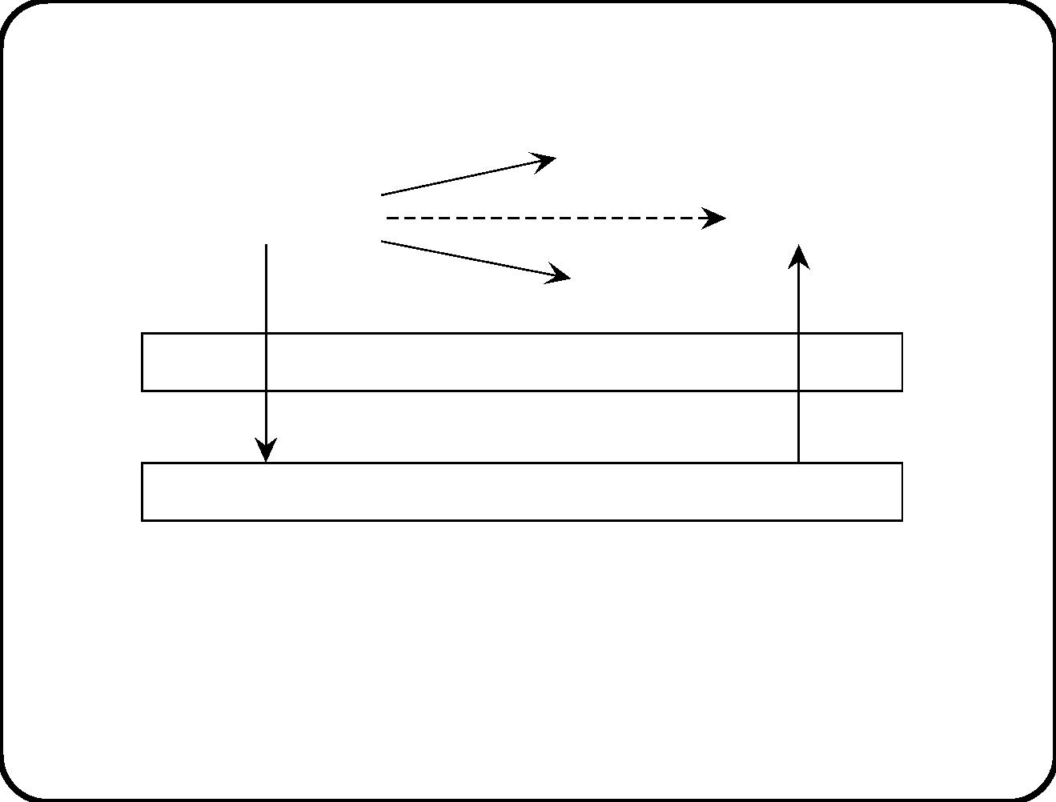
Bringing about desired emergent behavior
effect 1
action 1
desired effect
event or condition
effect 3
action
effect 2
action 2
Connection domain
Reactive system
stimulus
response
• The role of a reactive system is to bring about desired eﬀects in
the environment.
• Informative, directive, manipulative functions.
213

Slide 77
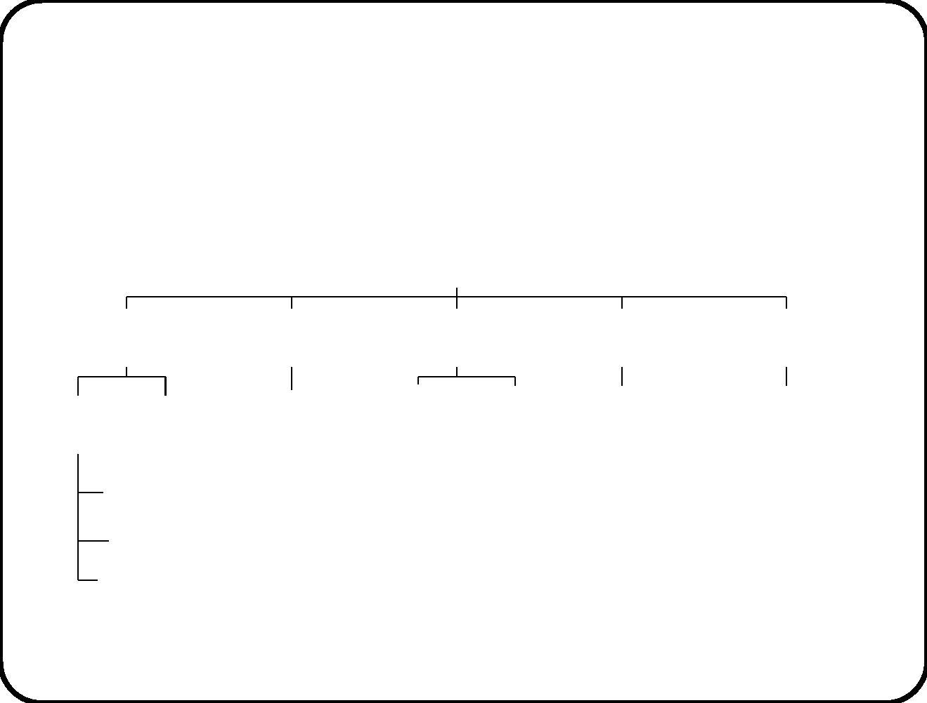
Example 1: Training department
Business goal tree of Training Department
More efficient and effective management of introductory courses
Faster handling of
Less unexpected
participants
Faster handling of Better information
Better information
expected participants
unexpected participants to speakers to personnel department
Prepare
Self−
Download
Ad−hoc
badge
On−line
Ad−hoc
Upload
material registration
latest information
from personnel
information system
registration list printing
participation data
printing
Allocate
participants
Print badges
Other activities
214

Slide 78
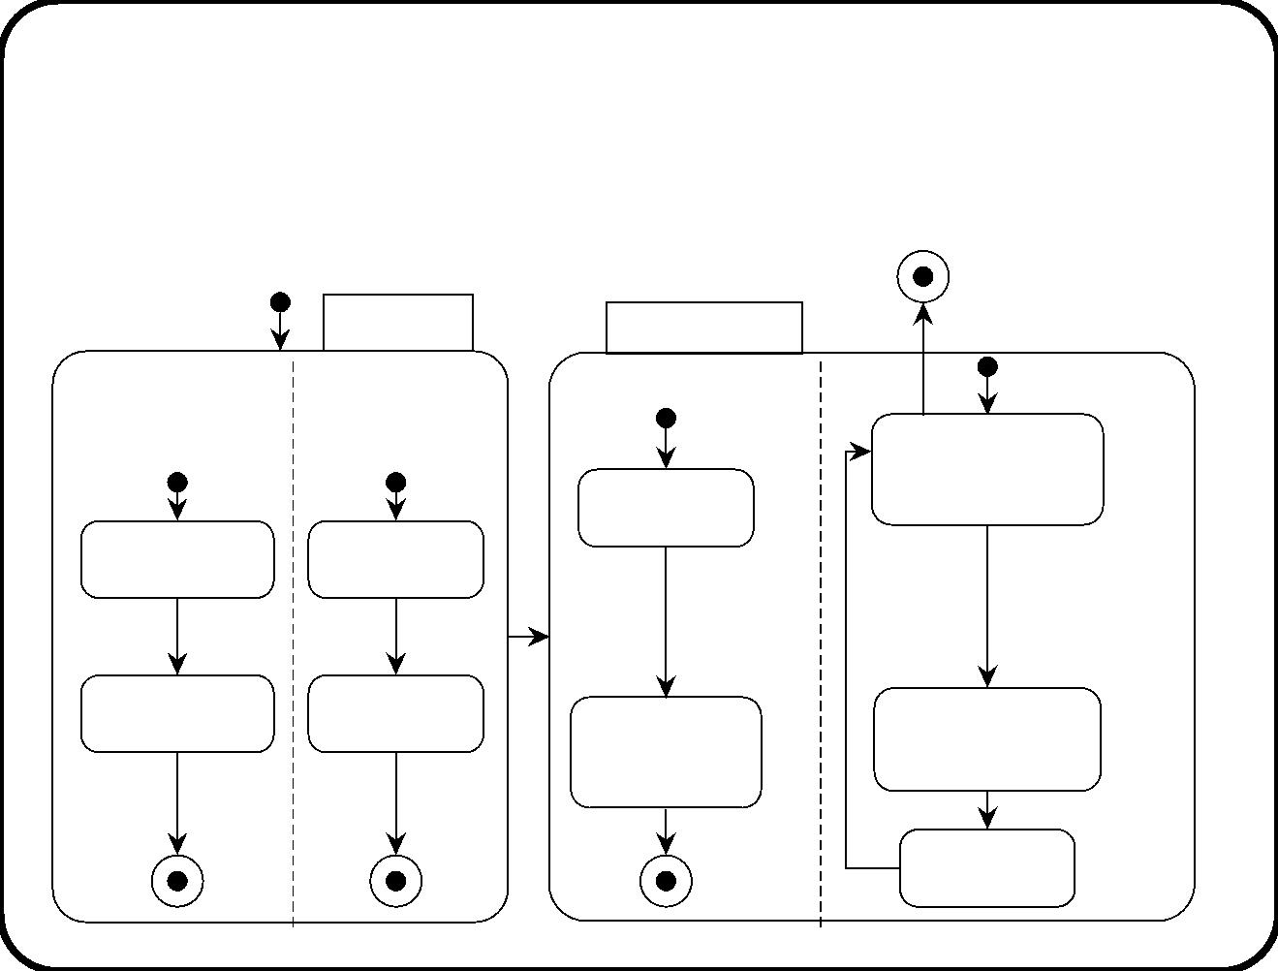
Example 1: Training department
Workﬂow at the registration desk
Preparation
Provisioning
[registration period closed]
Preparing tables
Collecting lists
Making
material
available
Registration
Ready to register
unexpected
participants
Wait a bit
Ready to
receive badges
receive
Ready to
E10: unexpected
receive lists
decide to put
badges and
material
participant arrives /
enter participation
request
receive
lists /
badges /
on table /
Receiving
badges
Receiving
lists
Putting badge
and material
on table
Registering
Exit / print badge
Giving course
material
215

Slide 79
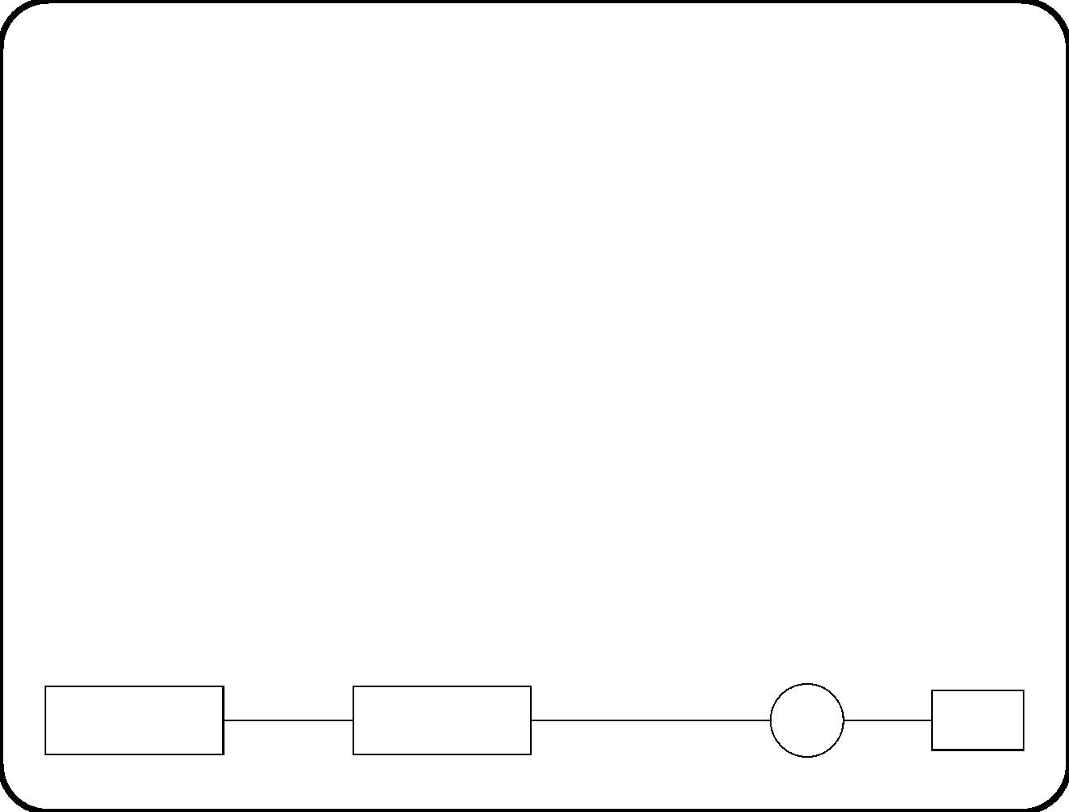
Example 1: Training department
Desired emergent behavior
Event
Desired action
If there is still room, the participant
should be registered and a badge should
be printed.
E10 Unexpected
participant arrives
Embedding the system in its environment
participation request,,
Unexpected
participant
confirm registration,
print
arrives
Registration desk
personnel
inform of impossibility
badge
Employee
TIS
Printer
216

Slide 80
Example 1: Training department
Desired stimulus-response behavior of system
Current
Stimulus
Response
Next state
state
Allocate partic-
ipant,
to registration
desk person-
According
inform
System
S10 Request to
register partici-
pant is entered.
to
the
contains
data of the
system,
there is still
room.
updated list
of partici-
pants.
nel, and send
badge printing
command
printer
to
According
Inform to reg- System con-
istration desk tains same
to the data
of the sys-
tem, there
is no room.
personnel
of list of par-
ticipants.
impossibility.
217

Slide 81
Example 1: Training department
Question
• Which assumptions did we make about the environment?
218

Slide 82
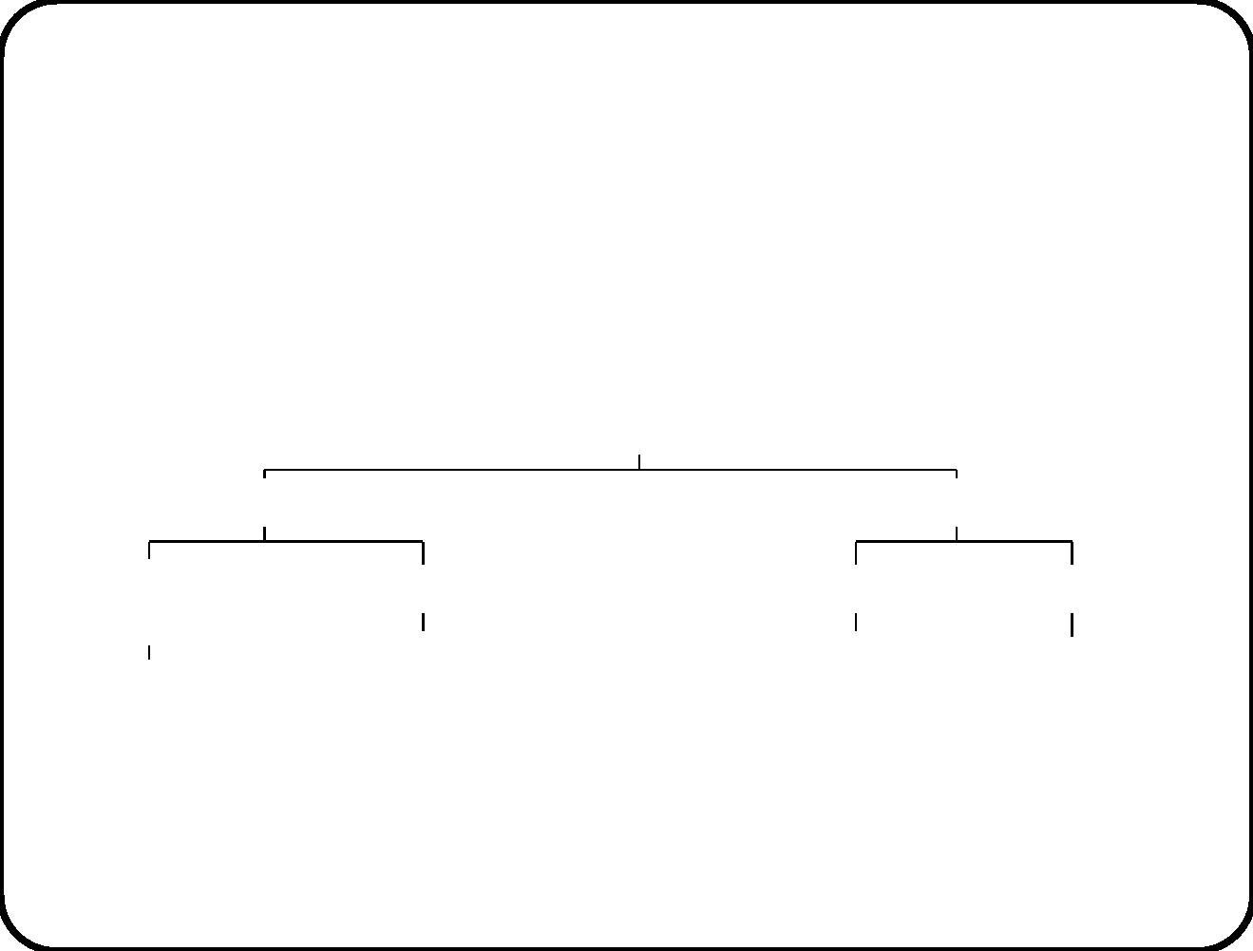
Example 2: Juice pasteurization
Business goal tree of pasteurization department
Juice pasteurization
Efficiency
Effectiveness
Fast change
Short set−up time
Pasteurization Improved traceability
of recipes
Initialization of controller
by software
Heating a batch
Maintain log
Maintain recipe
database
according to recipe
219

Slide 83
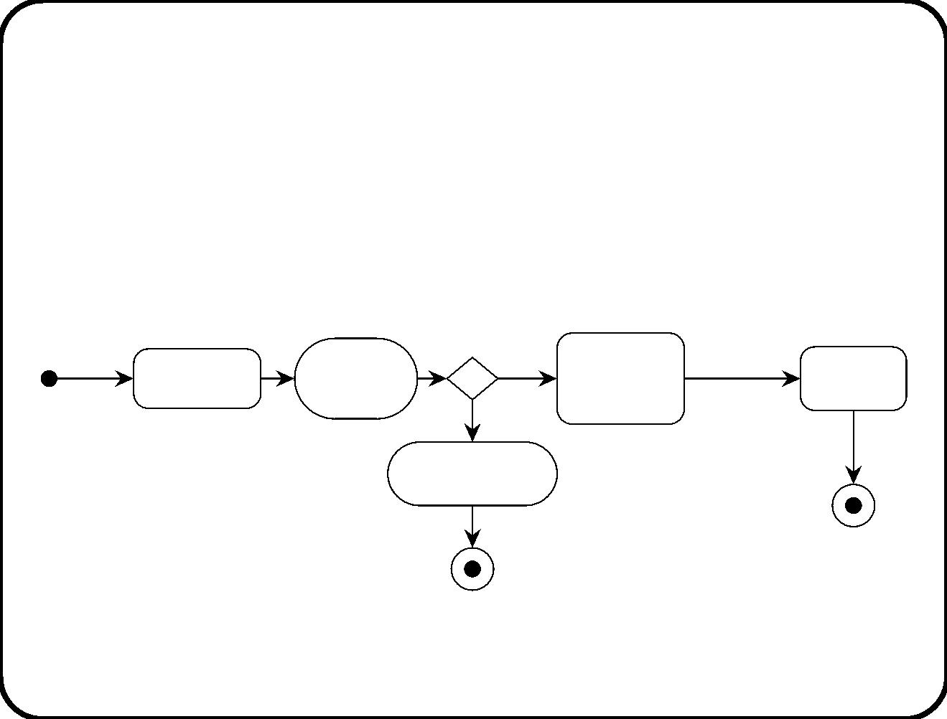
Example 2: Juice pasteurization
Operator workﬂow
/ create
batch
time to
start heating /
start heating
data
Batch data
created
Check
[OK]
Wait for
Heating
equipment
production
start
the batch
[KO]
Premature
termination
finished /
220

Slide 84
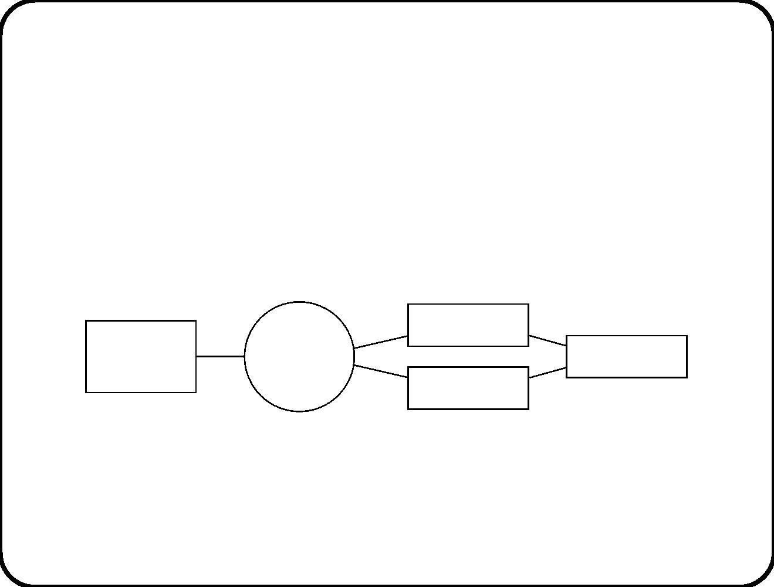
Example 2: Juice pasteurization
Embedding the controller in its context
Thermometer
Heating
Operator
Heating tank
controller
Heater
221

Slide 85
Example 2: Juice pasteurization
Desired emergent behavior
Event
Desired action
A heating process for the heating tanks of b is started.
If at the start of the process, temperature in a tank is
too low, the heater of that tank is switched on. When
during the process, a tank becomes 5 degrees Celsius
warmer than the desired temperature, its heater must
be switched oﬀ. When it becomes 5 degrees Celsius
colder than the desired temperature, its heater must
be switched on. When the heating process has lasted
for the duration of the recipe, heating must stop and
the operator must be notiﬁed of this fact.
Operator gives
command to
start heating
batch b.
222

Slide 86
Example 2: Juice pasteurization
Desired emergent behavior: Transactions
Event
Subject domain
Desired action
state
E1 Operator gives com-
mand to start heating
batch b
Heaters of tanks of b that
are below recipe temper-
ature, are switched on.
E2 Temperature in tank
t rises 5 degrees above
recipe temperature
The juice in t is
being heated.
The heater of t is
switched oﬀ.
E3 Temperature in tank
t falls 5 degrees below
recipe temperature
The juice in t is
being heated.
The heater of t is
switched on.
E4 The heating duration
has passed, counted since
the start of heating of b.
• Heaters of b that are
b
is
being
on, are switched oﬀ.
heated.
• Operator is informed.
223

Slide 87
Example 2: Juice pasteurization
Required controller behavior
Stimulus
Current
state
controller
Desired response
Next
state
S1 Operator gives
command to start
heating batch b
Switch on heaters of
tanks with low tem-
perature.
Not heating t and
not heating b.
Heating
t and b.
Heating t and mea-
S2 Every 60 seconds. sured temp > desired
Controller switches Heating
oﬀ the heater of t. t.
temp + 5
Heating t and mea-
sured temp < desired
temp − 5
Controller switches Heating
on heater of t.
t.
S4 Recipe time since
• Switch oﬀ heaters
Not
the start of heating Heating b.
of b has passed.
of b that are on.
heating
b.
• Inform operator.
224

Slide 88
Example 2: Juice pasteurization
Assumptions about environment
• The operator works according to the operator workﬂow.
• The operator only gives the start command when the batch is
in its heating tanks.
• The heater of a tank never breaks.
• The controller is connected to the heaters of the tanks.
• The thermometer of a tank never breaks.
• The controller is connected to the thermometers of the tanks.
225

Slide 89
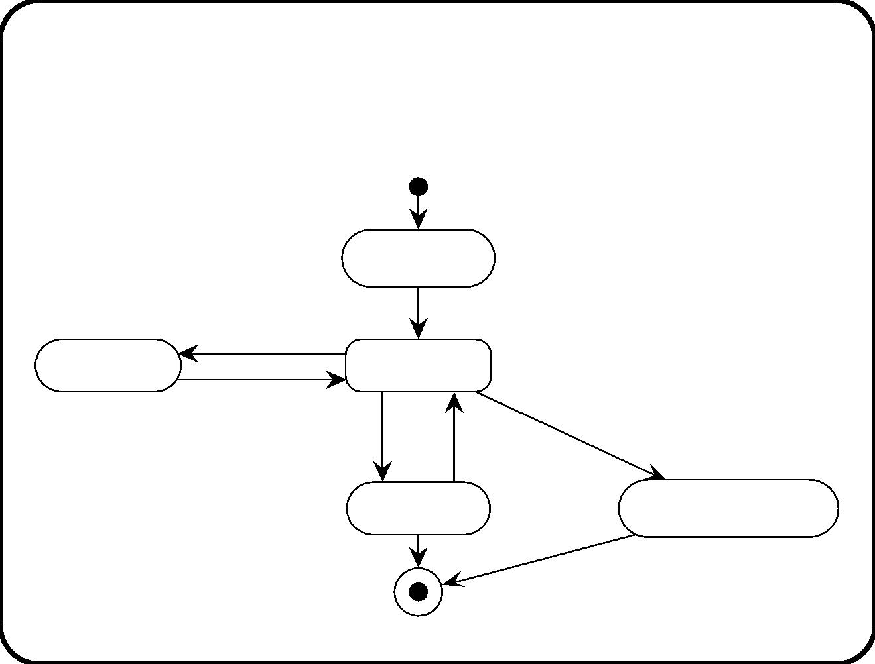
Example 3: Electronic Ticket System
“Workﬂow” of a ticket
Buying ticket
Traveler requests
to see ticket
Viewing ticket
Keeping ticket
Conductor requests refund
Getting ticket refund
Conductor wants
to stamp ticket
Using ticket
226

Slide 90
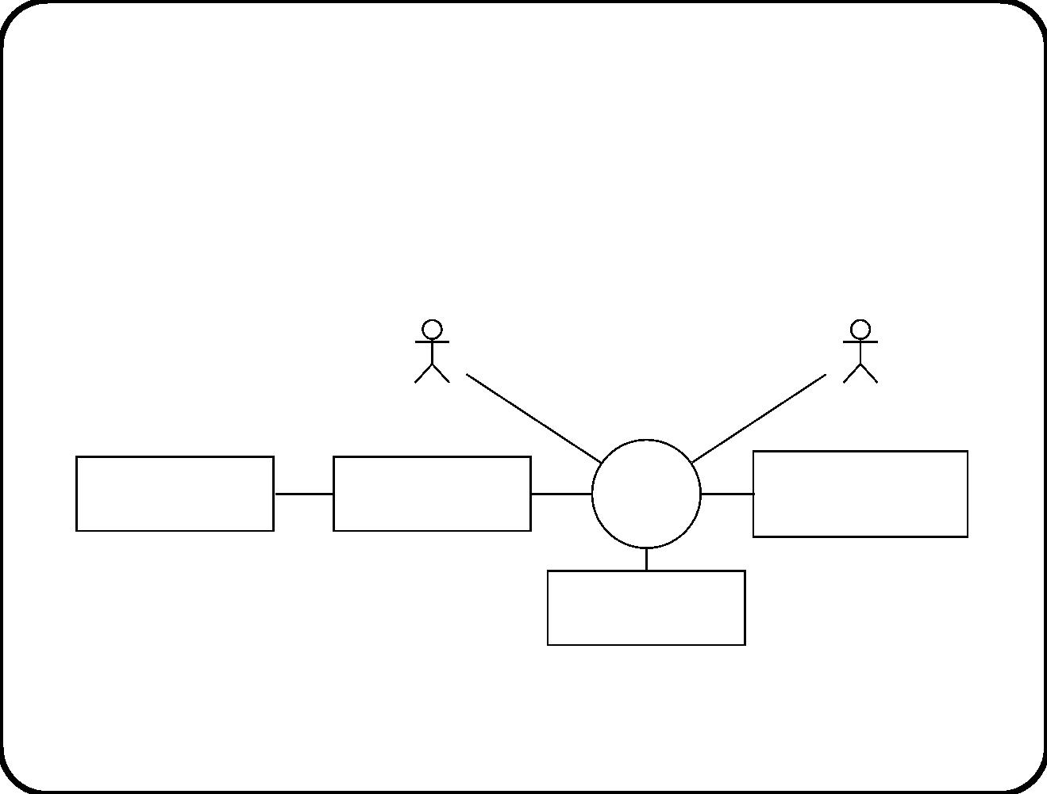
Example 3: Electronic Ticket System
The ETS in its logical context
Traveler
Conductor
Bank
Clearing house
ETS
Railway company
computer
>
Rail network
227

Slide 91
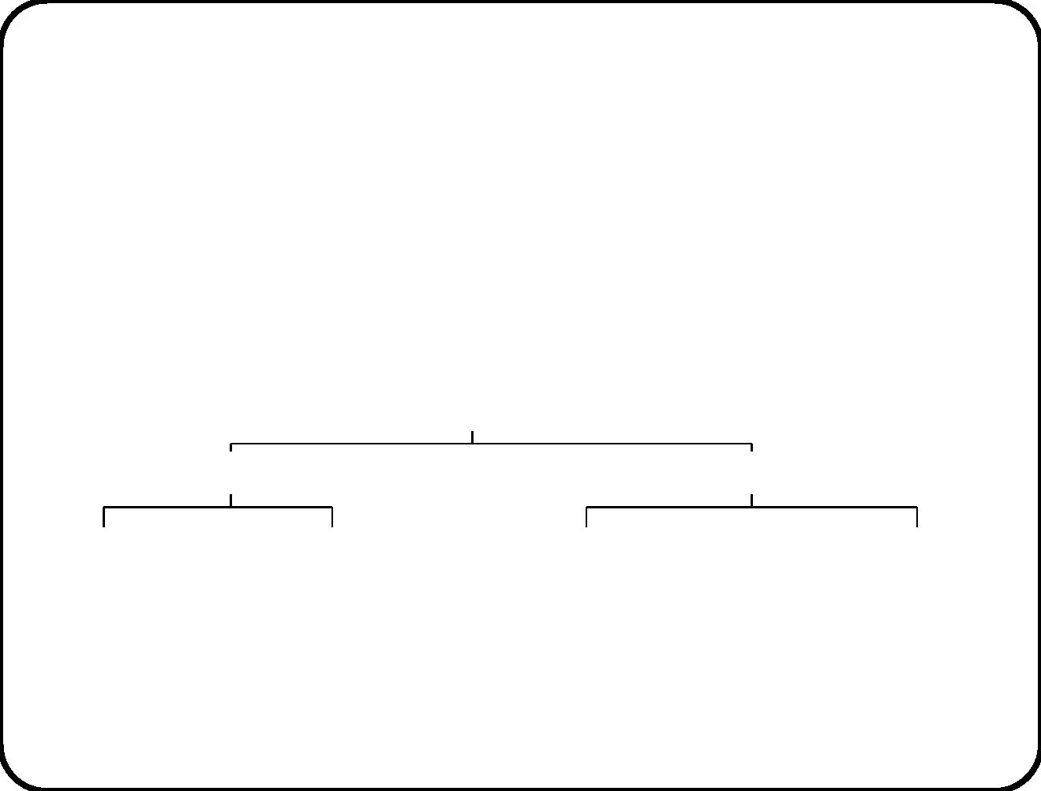
Example 3: Electronic Ticket System
Required ETS functions
Provide capability to buy and use tickets
Traveler functions
Conductor functions
Sell a ticket
Show a ticket
Stamp a ticket for use
Refund a ticket
228

Slide 92
Example 3: Electronic Ticket System
Required ETS services
• Name: Sell a ticket.
• Triggering event: Traveler requests to buy a ticket.
• Delivered service: Allow a traveler to buy a ticket.
• Name: Show a ticket.
• Triggering event: Traveler requests to view a ticket.
• Delivered service: Display ticket attributes to the user.
• Name: Stamp a ticket for use.
• Triggering event: Request to stamp an unused ticket part.
• Delivered service: Mark the requested part of the ticket as used.
• Name: Refund a ticket.
• Triggering event: Request to refund an unused ticket part.
• Delivered service: Cause a refund and make invalid.
229

Slide 93
Example 3: Electronic Ticket System
Other desired properties
• A traveler cannot get a ticket without paying for it.
• The price of a ticket is withdrawn from the bank account
associated with the smart card.
• A traveler who has paid for a ticket gets it.
• A refunded ticket cannot be used any more.
• A fully used ticket cannot be refunded.
• It is not possible to use a ticket twice.
230

Slide 94
Example 3: Electronic Ticket System
Desired emergent behavior
Event
Current domain
Desired action
Next
state
domain
state
Request to buy
ticket
Any
Ticket
created
Ticket and pay-
ment exist
and paid for
Request to see
tickets
Any
All tickets are dis-
played
Unchanged
Ticket
exists
Request to use Ticket exists and Create
ticket
and ticket usage
stamp exists for
this rail segment
and ticket
ticket for a rail is valid for that stamp for that
segment
rail segment
rail segment
Ticket exists and
Create
stamp
refund
Ticket refunded
and ticket is not
longer valid
Request to refund
ticket
not
completely
used
231

Slide 95
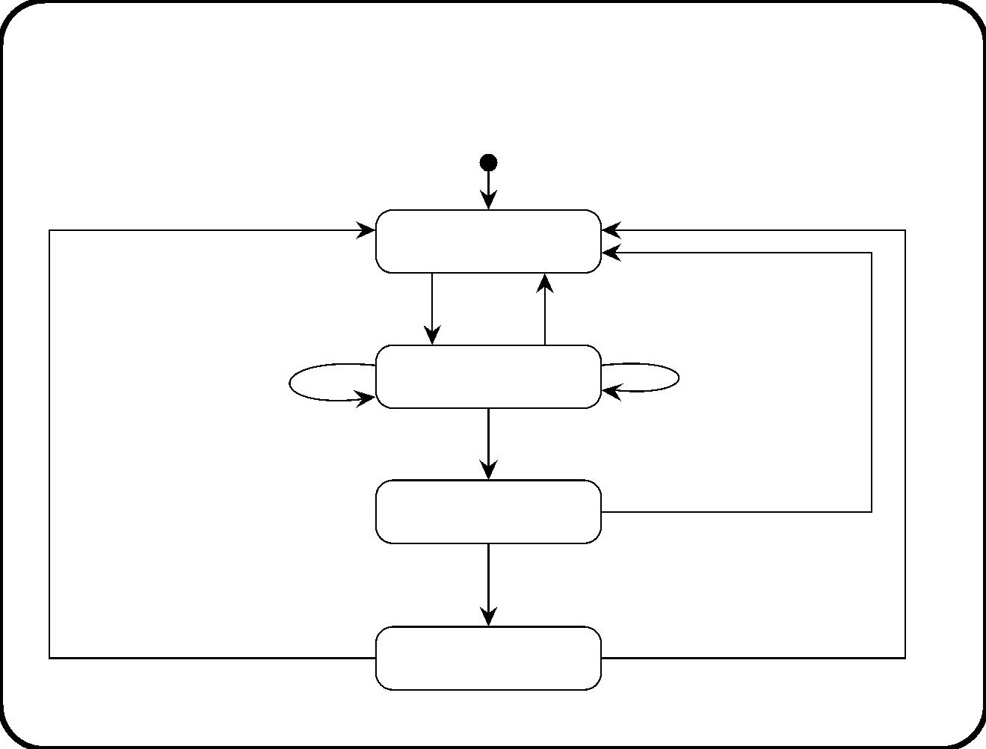
Example 3: Electronic Ticket System
Selling scenario
payment accepted /
payment refused or no response /
show abort message
create ticket, show success message
Ready to sell
traveler requests to buy a ticket /
ask for route and ticket information
traveler aborts /
traveler selects route /
Route and ticket
information requested
traveler selects ticket type /
[traveler has given all information] /
offer to sell ticket
Ticket sale offered
traveler declines offer /
show abort message
traveler accepts offer /
request payment from clearing house
Payment requested
232

Slide 96
Example 3: Electronic Ticket System
What is so special about this example?
• Some subject domain entities are virtual.
• They are implemented by the system
• So some required system behavior is desired subject domain
behavior (rather than causing it indirectly).
233

Slide 97
Summary of guidelines (1)
Finding states:
√
Look for states in which the behavior is waiting for something
to occur.
√
Look for modes of behavior (e.g. normal-standby-emergency
etc.)
Finding events:
√
Look for signals, condition changes, temporal events to which
the system must respond.
√
Look for desired eﬀects of the system. What triggers the
system to produce such an eﬀect?
234

Slide 98
Summary of guidelines (2)
Dealing with parallellism:
√
If you cannot show with absolute certainty that two events
occur in sequence, then assume they occur in parallel.
Introducing hierarchy:
√
Introduce hierarchy to express commonality in behavior.
√
Introduce hierarchy to introduce common response to some
event (e.g. alarm, suspend, mode change, etc.)
235

Slide 99
Summary of guidelines (3)
Finding system behavior:
√
Follow several paths through our road map and check whether
they lead to the same behavior speciﬁcation.
√
Through desired causality to system transactions.
• Identify business solution goals.
• Identify solution activities in subject domain, user workﬂow.
• Identify desired event-action in the environment.
• Map to stimulus-response pairs of SuD; introduce
connection domain if necessary.
• Reﬁne to transactions by introducing SuD states.
236

Slide 100
Summary of guidelines (4)
√
Through desired system services to system transactions.
• Identify business solution goals.
• Derive desired system services: triggers and added value,
assumptions.
• Include connection domain.
• Reﬁne to stimulus-response pairs; Introduce system states
237

Slide 101
Behavior Modeling and Design Guidelines: Main Points
• To ﬁnd required system behavior, look for desired emergent
composite system behavior.
• Reduce this to desired system behavior.
• Accumulate any assumptions about environment needed to
show that desired system behavior is suﬃcient to create desired
emergent behavior.
238

